Slide 1
Sensitivity of Oregon's Watersheds to Streamflow Changes due to Climate Warming: A Geohydrological Approach
Mohammad Safeeq
Department of Geosciences, Oregon State University
Gordon E. Grant
USDA Forest Service
PNW Research Station
Sarah Lewis
Department of Geosciences, Oregon State University
Cristina Tague
Bren School, University of California, Santa Barbara

Slide 2
Today’s menu
Develop a theoretical model of streamflow sensitivity to warming
Apply this model to long-term data from basins across western US; examine empirical trends in streamflow
Explore sensitivity to warming across basins across Oregon
Compare with downscaled models

Slide 3
Key questions
Part A:
Can we characterize the summer streamflow sensitivity to climate change using key watershed controls of drainage efficiency and snowmelt timing?
Part B:
How does the sensitivity analysis derived from empirical data correspond with that derived from regional scale hydrologic modeling?

Slide 4
Streamflow Sensitivity to Climate Change: Approach
1) “Top-down“ Approach :
GCM with greenhouse forcing
Downscalling/regionalization
Hydrologic Model
Future Projection

Slide 5
Streamflow Sensitivity to Climate Change: Approach
1) “Top-down“ Approach :
2) “Bottom-up” Approach:
GCM with greenhouse forcing
Downscalling/regionalization
Hydrologic Model
Future Projection
Future Projection
Hydro-climatic models
Regionalization of Controls
Identify “Key” Controls
Sensitivity derived from empirical data
Future Projection
Hydro-climatic models
Regionalization of Controls
Identify “Key” Controls
Sensitivity derived from empirical data

Slide 6
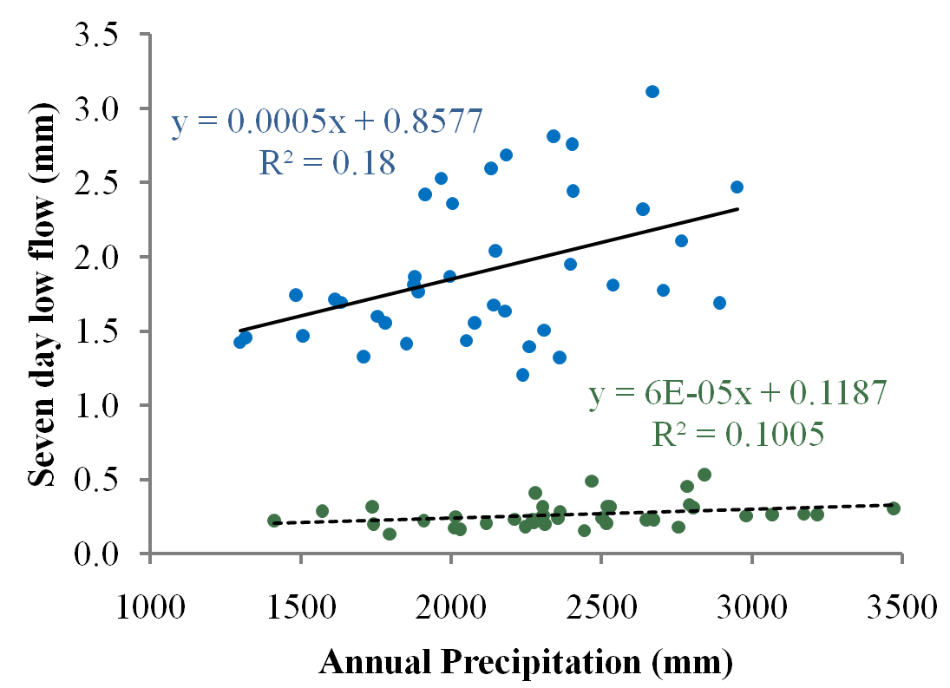
Definition of low-flow sensitivity
High Aquifer Permeability (McKenzie at Clear Lake)
Sensitivity
Low Aquifer Permeability (South Santiam Quartzville)
Sensitivity

Slide 7
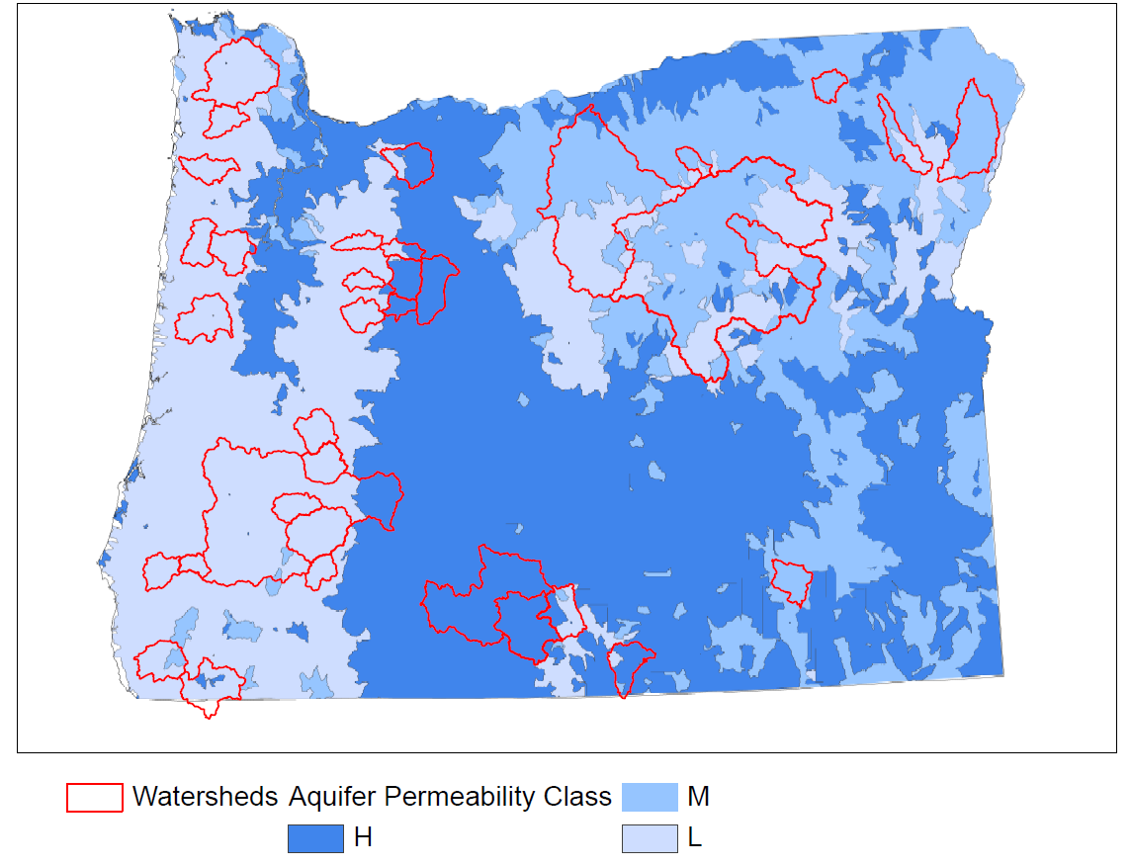
Aquifer permeability of selected watersheds
Notes:
36 unregulated watersheds with longer streamflow record (1971-2009) selected from initial pool of 58

Slide 8
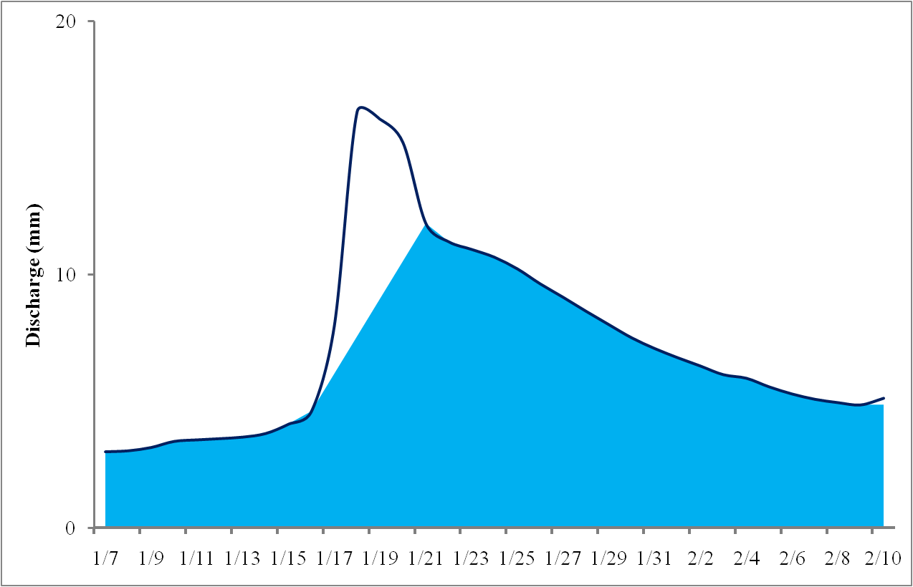
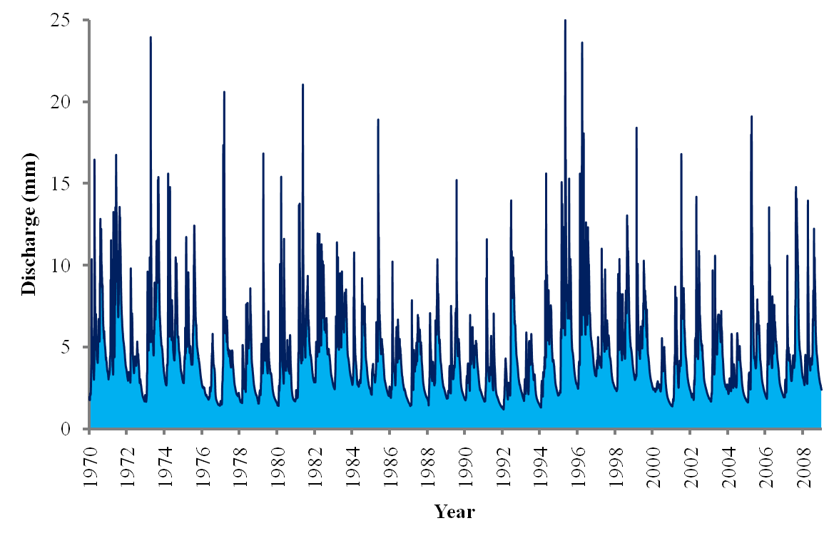
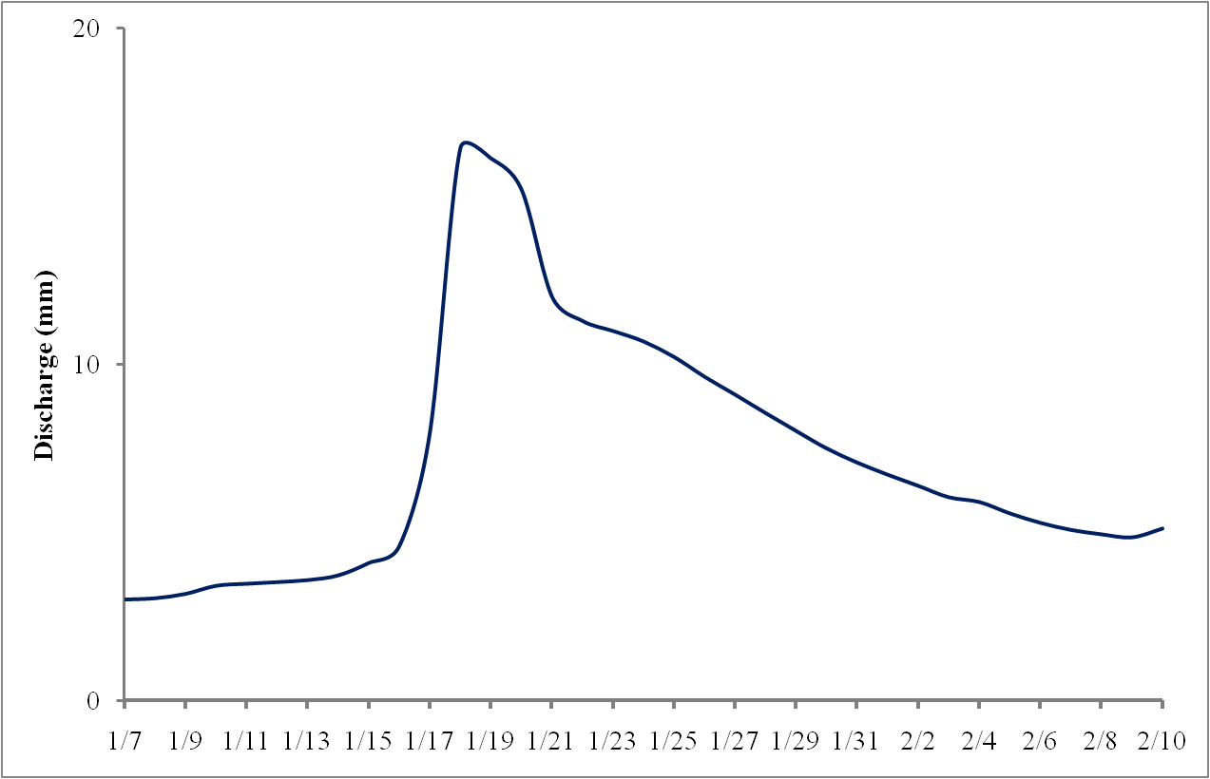
Extracting metrics from hydrograph
Baseflow separated using USGS method by Wahl & Wahl (1988)
BFI = area under light blue / Area under dark blue line
recession constant = k= Δ discharge/time

Slide 9
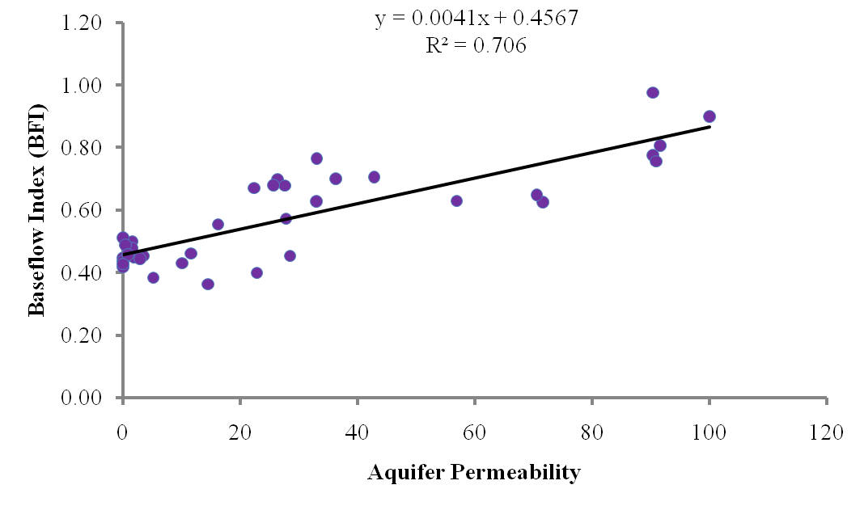
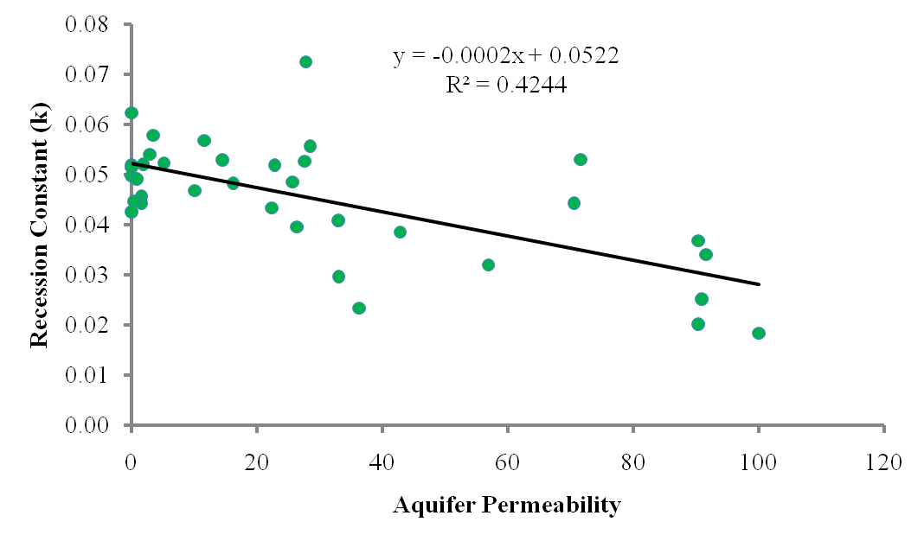
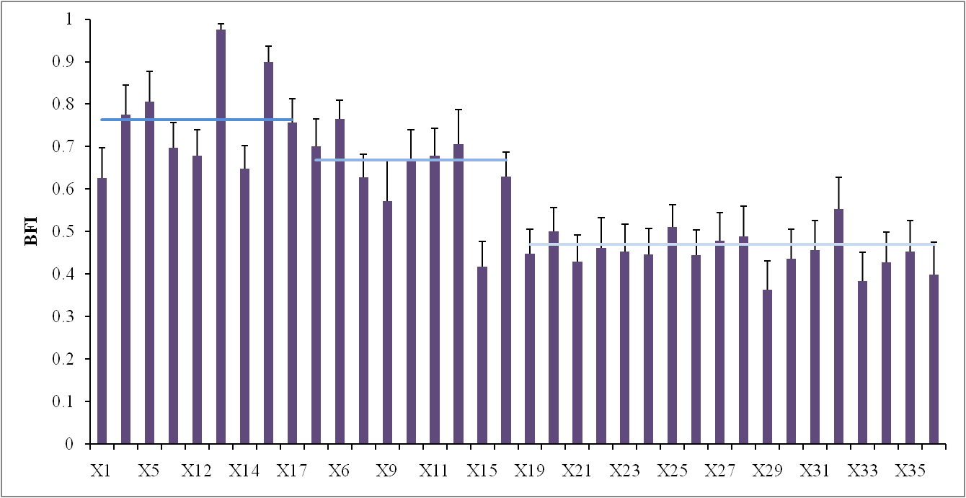
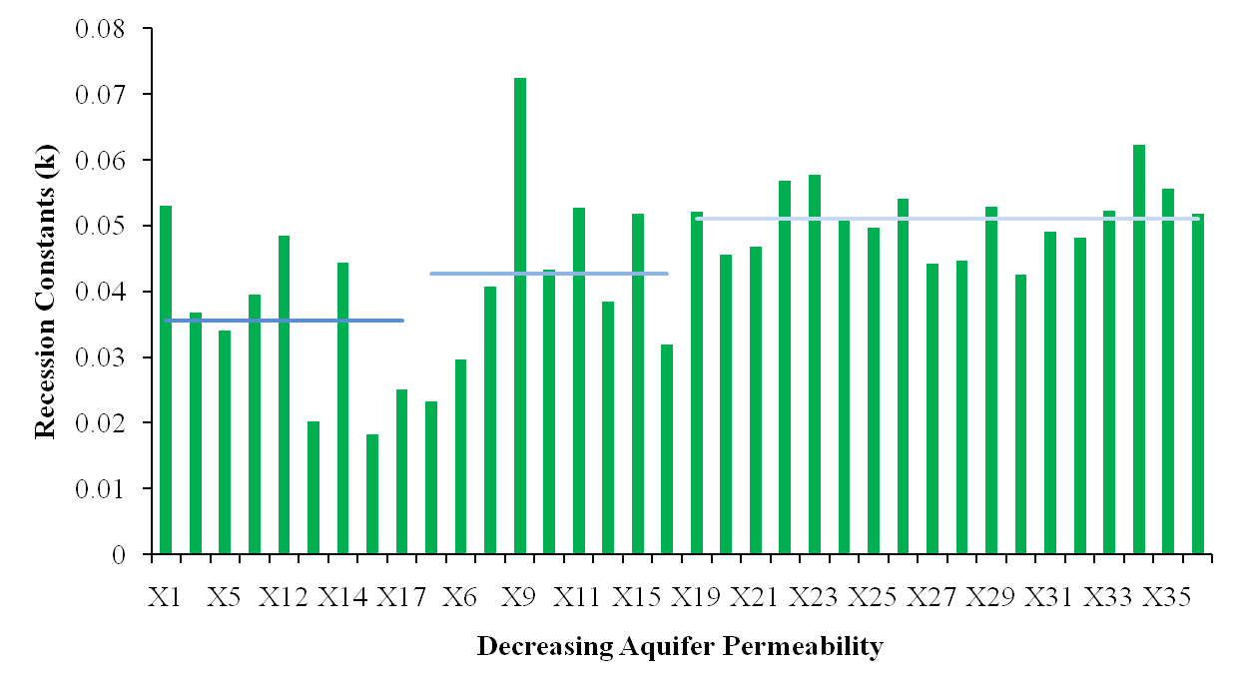
Recession constant and BFI explains the variability in aquifer permeability
Slow/Deep groundwater
Fast/Shallow groundwater
Slow/Deep groundwater
Fast/Shallow groundwater

Slide 10
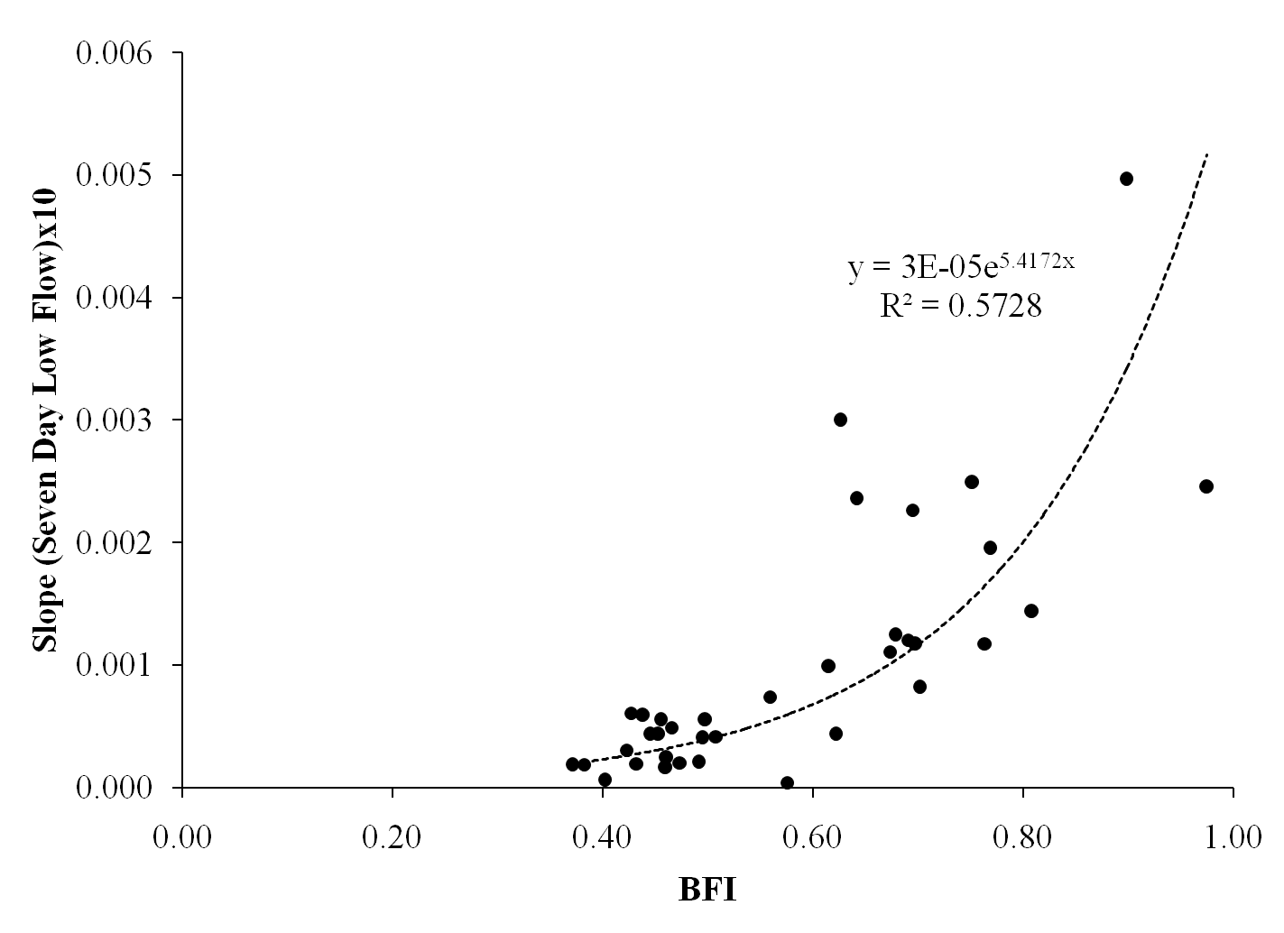
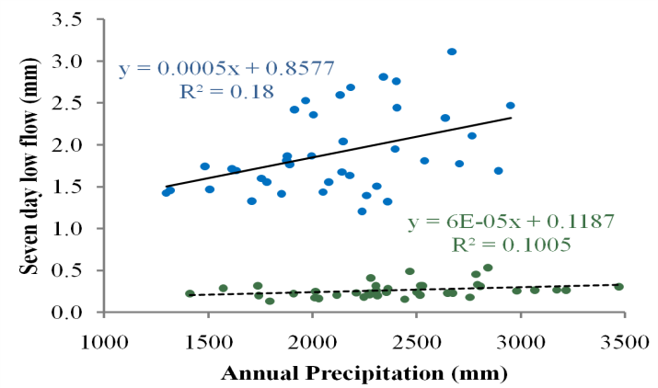
Basins with high BFI show greater sensitivity
Sensitivity
Sensitivity
Fast/Shallow groundwater
Slow/Deep groundwater

Slide 11
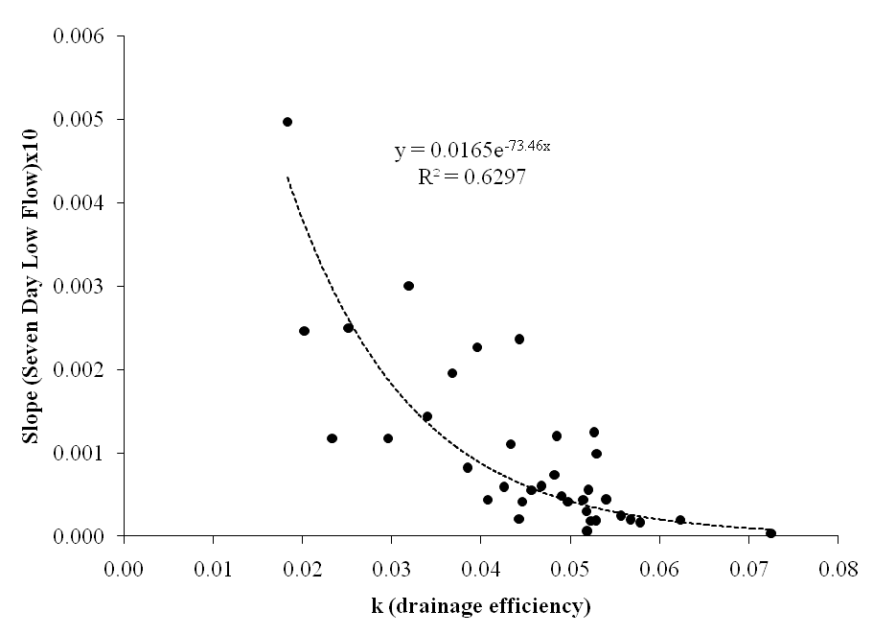
Basins with low k show greater sensitivity
Slow/Deep groundwater
Fast/Shallow groundwater

Slide 12
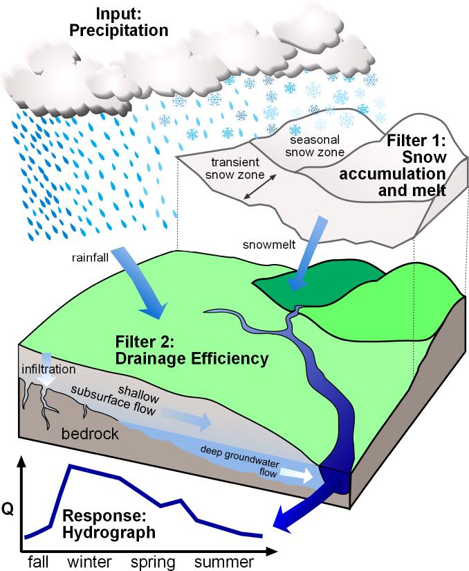
Filter 1:Timing and Magnitude of Recharge
Filter 2: Drainage Efficiency
Tague & Grant, 2009

Slide 13
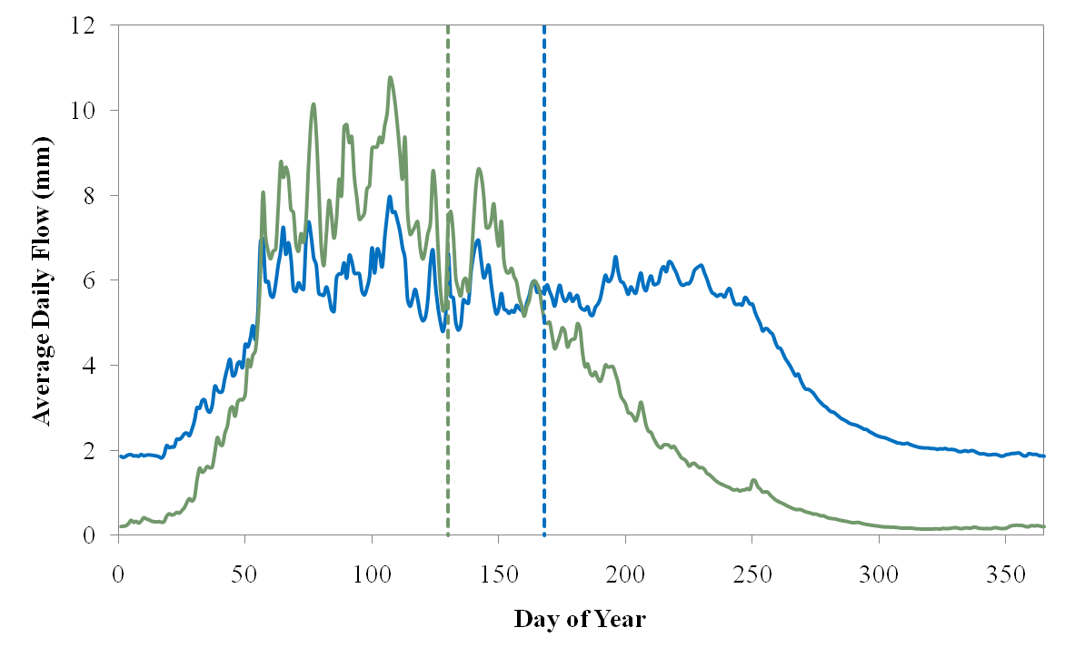
Implications of CT for summer low flows
February 7
March 17
Luckiamute River near Suver (Rain dominated)
North Santiam River below Boulder Cr (Snowmelt dominated)
?

Slide 14
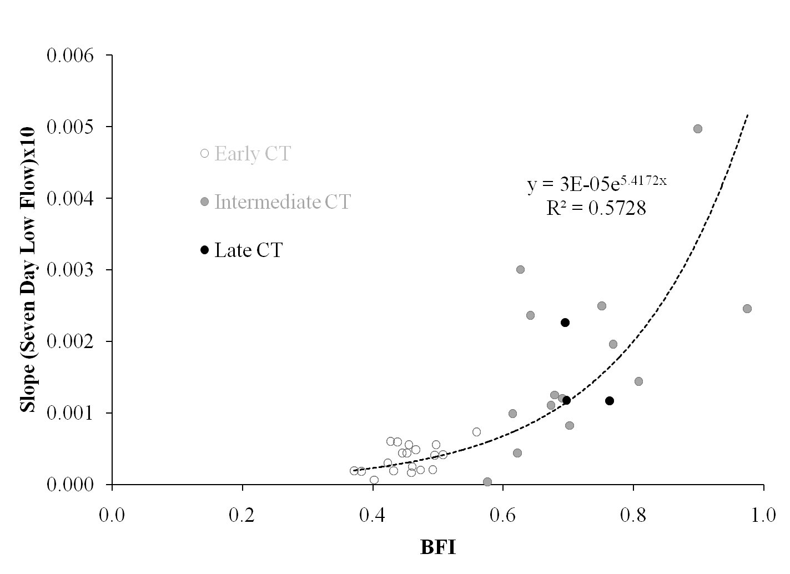
Basins with intermediate CT show greater sensitivity with respect to BFI
<150 days
>200 days
Fast/Shallow groundwater
Slow/Deep groundwater

Slide 15
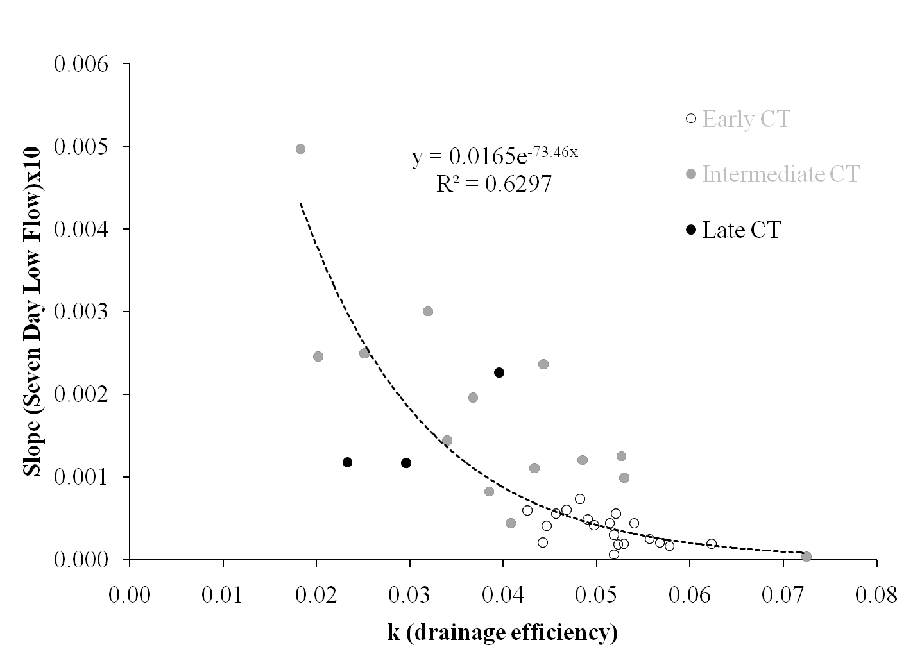
Basins with intermediate CT show greater sensitivity with respect to k
Slow/Deep groundwater
Fast/Shallow groundwater

Slide 16
Conclusions
Empirical data supports the theory developed in Tague and Grant, 2009
Late season streamflow sensitivity driven both by precipitation regime (rain vs snow) and drainage efficiency
Relationship between drainage efficiency and low flow sensitivity is strongest for intermediate CT basins with significant variability.

Slide 17
Key questions
Part A:
Can we characterize the summer streamflow sensitivity to climate change using key watershed controls of drainage efficiency and snowmelt timing?
Part B:
How does the sensitivity analysis derived from empirical data correspond with that derived from regional scale hydrologic modeling?

Slide 18
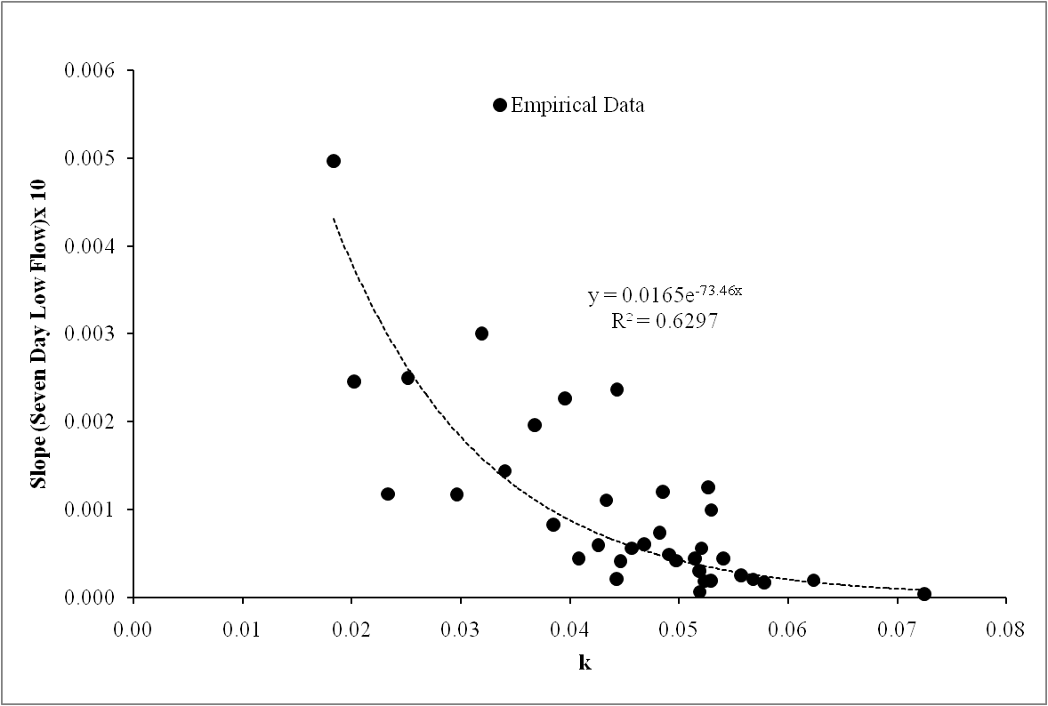
Comparing sensitivities derived from empirical and VIC simulated streamflow data
Slow/Deep groundwater
Fast/Shallow groundwater

Slide 19
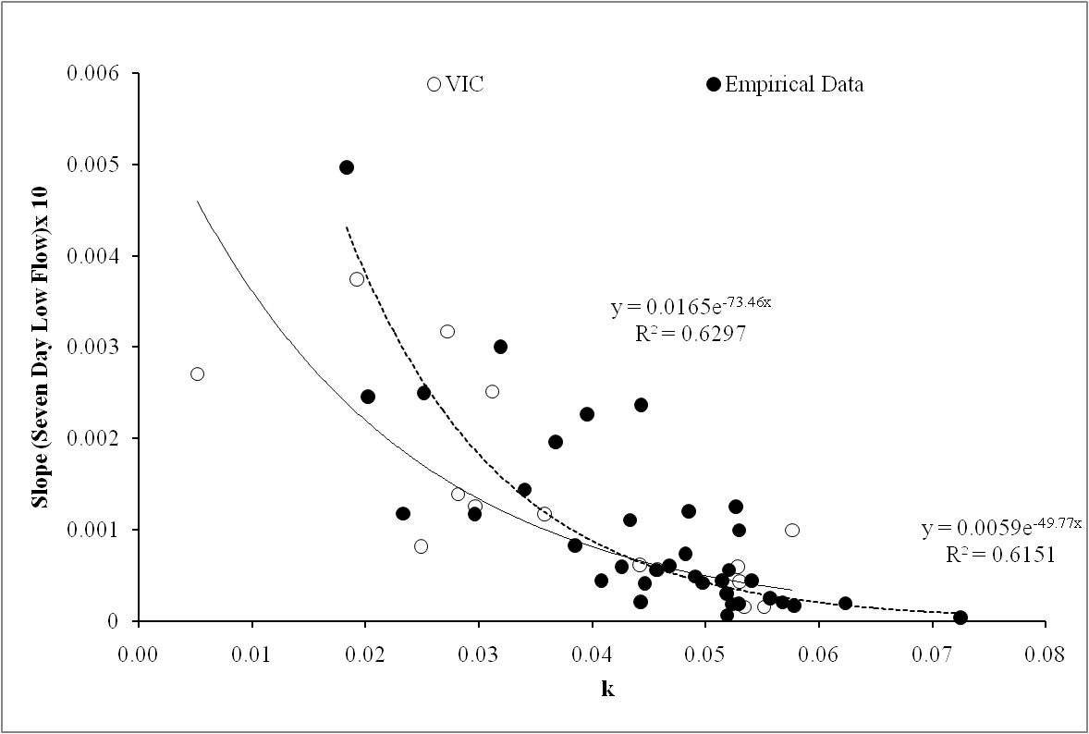
Comparing sensitivities derived from empirical and VIC simulated streamflow data
Calibrated basins
Slow/Deep groundwater
Fast/Shallow groundwater

Slide 20
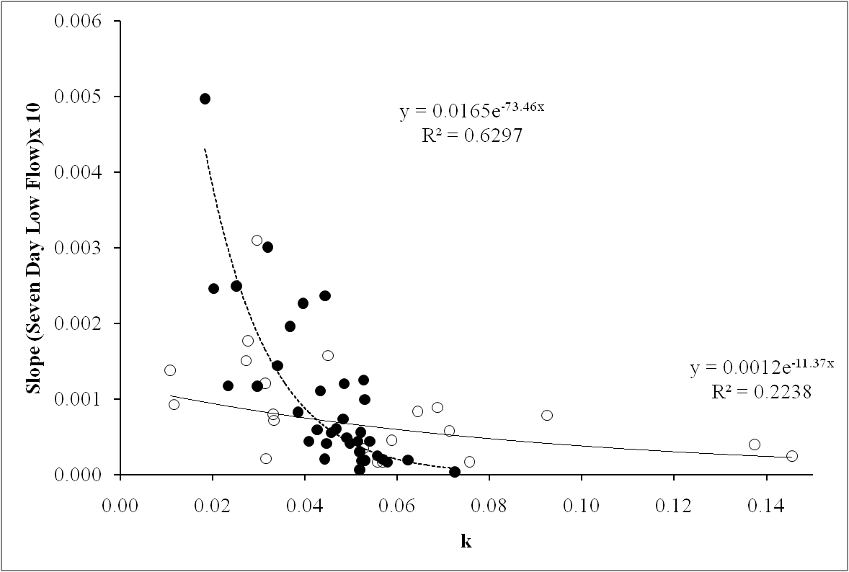
Comparing sensitivities derived from empirical and VIC simulated streamflow data
Un-calibrated basins
Slow/Deep groundwater
Fast/Shallow groundwater

Slide 21
Conclusions
VIC does not capture the distinction in behaviors of basins with low and high drainage efficiency
In un-calibrated basins VIC under predicts the sensitivity in low k and over predicts in high k basins

Slide 22
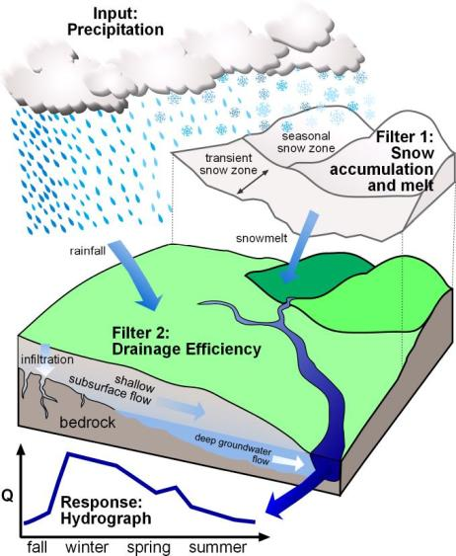
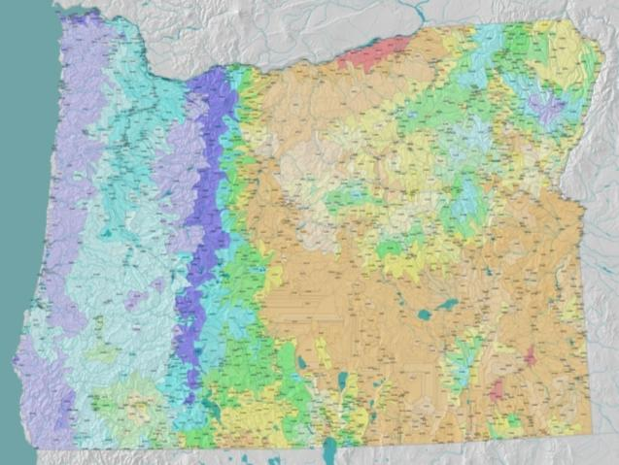
Oregon Hydrologic Landscape Classification
Oregon Hydrologic Landscape Classification
Oregon Hydrologic Landscapes Map from EPA, Wigington in review

Slide 23
Centroid of timing
Recession constant, k

Slide 24
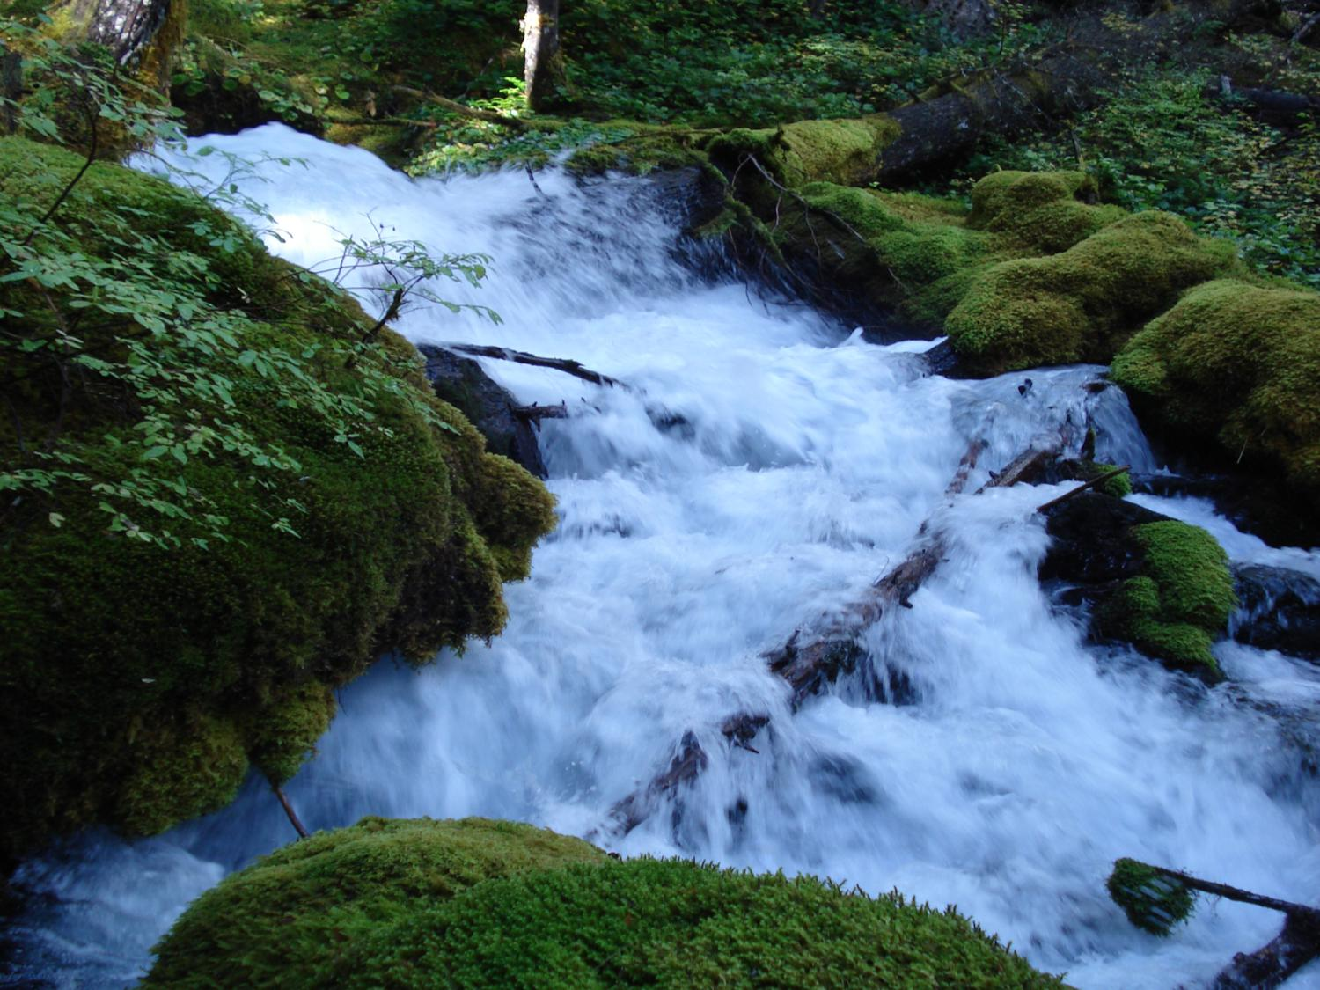
Extra Slides
www.fsl.orst.edu/wpg

Slide 25
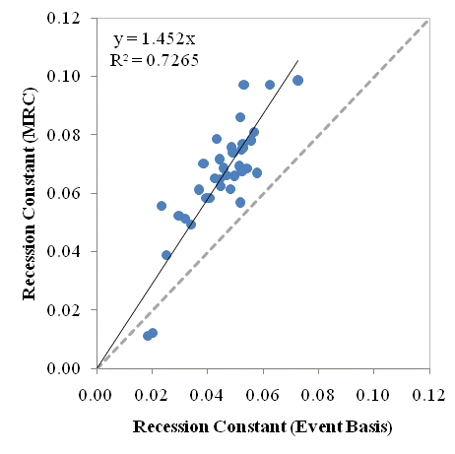
Comparison of Recession constants calculated using events>15 days vs. using MRC analysis

Slide 26
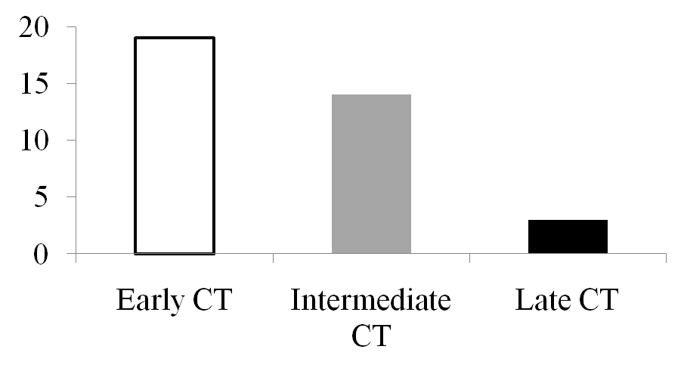
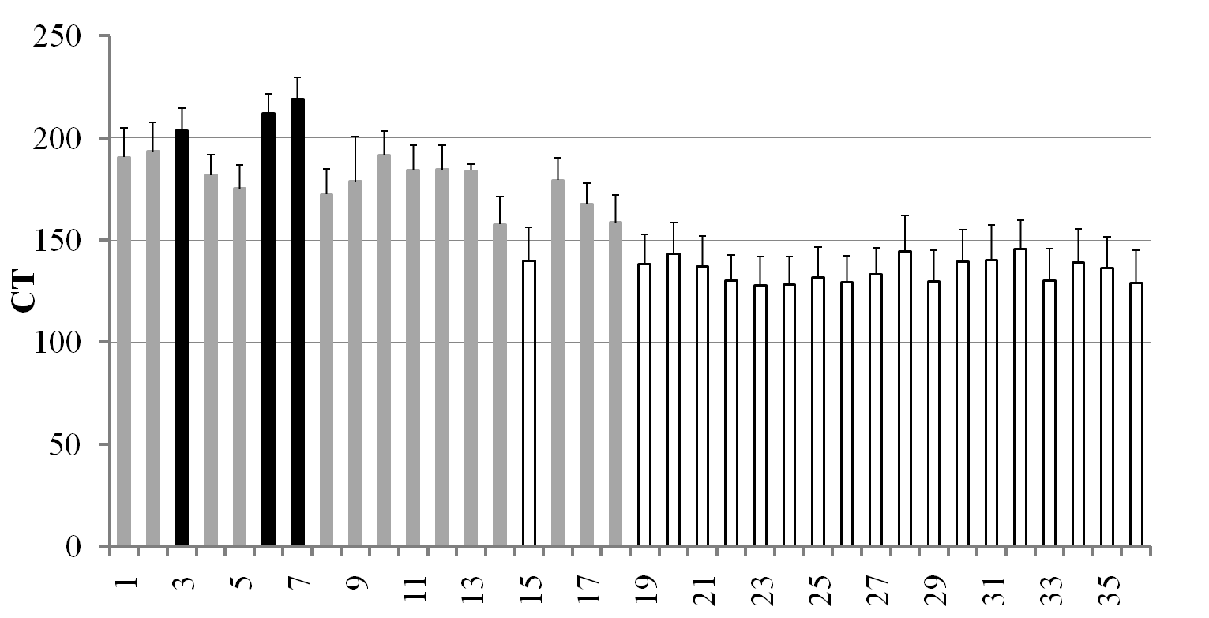
Distribution of basins based on CT
19
14
Frequency
3
Slow/Deep groundwater
Fast/Shallow groundwater

