Slide 1
Understanding Regulatory DNA Through Molecular Cloning and Transient Transformation
Cesar Juarez*, Zuzana Vejlupkova, John Fowler,
Department of Botany and Plant Pathology, Oregon State University, Corvallis 97331, OR, USA

Slide 2
Fowler Lab
Focus: Molecular mechanisms that control cellular morphogenesis and plant development.
Arabidopsis
Maize
Christensen 2012

Slide 3
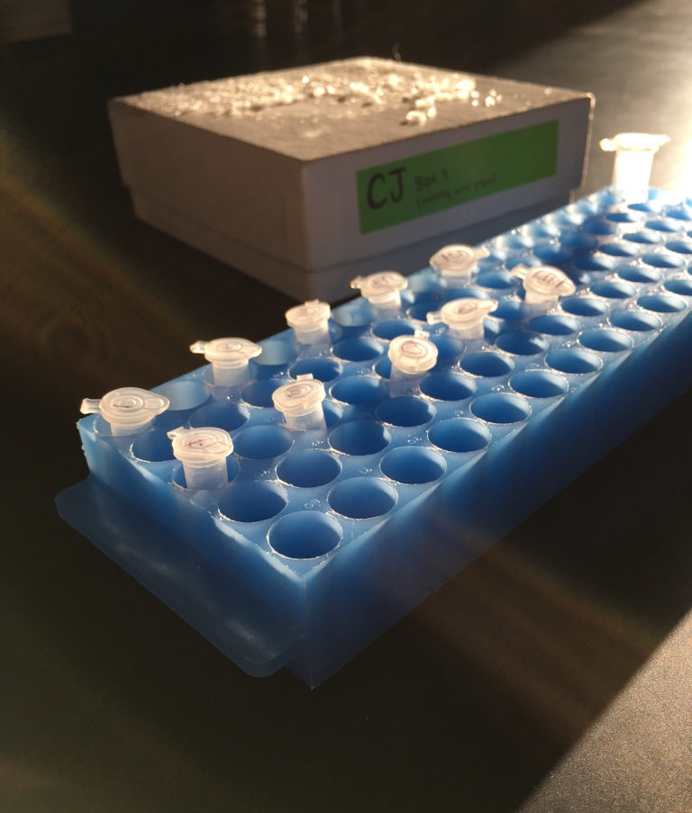
Topics Covered
Biology background
Molecular cloning
Golden Gate Cloning
Cis-Regulatory Modules
Biolistic Transformation

Slide 4
Central Dogma of Molecular Biology
DNA
RNA
Protein
Transcription
Translation

Slide 5
Central Dogma of Molecular Biology
DNA
RNA
Protein
Transcription
Translation
How is gene expression controlled?

Slide 6
Cis-Regulatory Modules (CRMs)
DNA sequences that dictate the expression of genes by influencing transcription.
Cis = on the same DNA strand as the influenced gene
Gene
Notes:
Helps define location to START transcription

Slide 7
Cis-Regulatory Modules (CRMs)
DNA sequences that dictate the expression of genes by influencing transcription.
Cis = on the same DNA strand as the influenced gene
EXAMPLES
Promoters
Enhancers
Silencers
Gene
Notes:
Helps define location to START transcription

Slide 8
Cis-Regulatory Modules (CRMs)
DNA sequences that dictate the expression of genes by influencing transcription.
Cis = on the same DNA strand as the influenced gene
EXAMPLES
Promoters
Enhancers
Silencers
Promoter
Gene
Notes:
Helps define location to START transcription - required

Slide 9
Cis-Regulatory Modules (CRMs)
DNA sequences that dictate the expression of genes by influencing transcription.
Cis = on the same DNA strand as the influenced gene
EXAMPLES
Promoters
Enhancers
Silencers
+ + +
Enhancer
Promoter
Gene
Notes:
Enhancer – increases transcription, usually under specific conditions – eg, under heat stress, only in leaves, etc.

Slide 10
Cis-Regulatory Modules (CRMs)
DNA sequences that dictate the expression of genes by influencing transcription.
Cis = on the same DNA strand as the influenced gene
EXAMPLES
Promoters
Enhancers
Silencers
- - -
Silencer
Promoter
Gene
Notes:
Silencer is the opposite of an enhancer, will decrease transcription under certain conditions

Slide 11
CRMs work as combinations of Transcription Factor (TF) binding sites
+ + +
Promoter
Gene
Enhancer
Notes:
Can be very complex – multiple TF binding sites

Slide 12
CRMs work as combinations of Transcription Factor (TF) binding sites
+ + +
Promoter
Gene
Enhancer

Slide 13
In plants, CRMs are not well understood
Promoter
Gene
Enhancer
? ? ?
Notes:
Can be very complex – multiple TF binding sites

Slide 14
In plants, CRMs are not well understood
Huge variety of CRMs
Difficult to predict from DNA sequence alone
Effects on gene expression are unclear
Promoter
Gene
Enhancer
? ? ?
Notes:
Can be very complex – multiple TF binding sites

Slide 15
My project was to help characterize CRMs in plants
Molecular cloning to test candidate CRMs
Collaborators in the lab of Mike Freeling, UC Berkeley
Establish semi-in vivo method of measuring transcriptional activity of a CRM in a reporter plasmid
Promoter
REPORTER
Candidate CRM
? ? ?
Notes:
Can be very complex – multiple TF binding sites

Slide 16
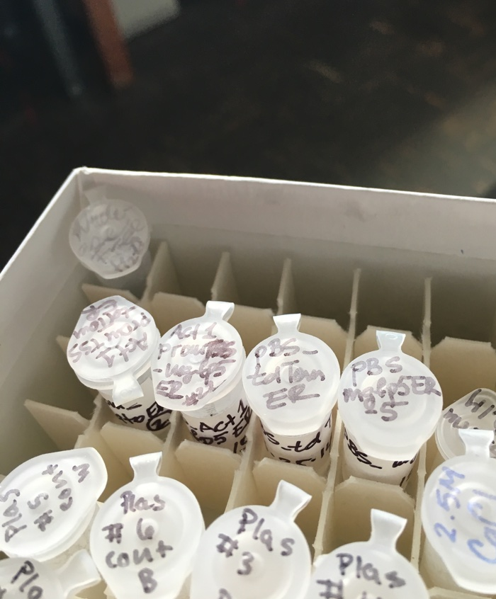
I. Molecular Cloning
Plasmid
Restriction Digest
Ligation

Slide 17
Plasmid
Restriction Digest
Ligation

Slide 18
Golden Gate Cloning
Type IIs restriction enzymes
Cut just outside of the recognition site
Eliminate the recognition site
Allows for simultaneous restriction digest and ligation
Final product is formed in one step
Vector
PCR product
= Golden Gate Cloning site

Slide 19
My goal: Golden Gate Cloning site in Reporter plasmid
REPORTER
Ease insertion of Candidate CRMs
Candidate CRM

Slide 20
Results
Golden Gate Cloning Construct
pBSSK
pBSKS
Initial attempts worked, but…
Map of plasmid was incorrect
New scheme was devised

Slide 21
Results
First Step:
LacZ fragment with Golden Gate sites cloned

Slide 22
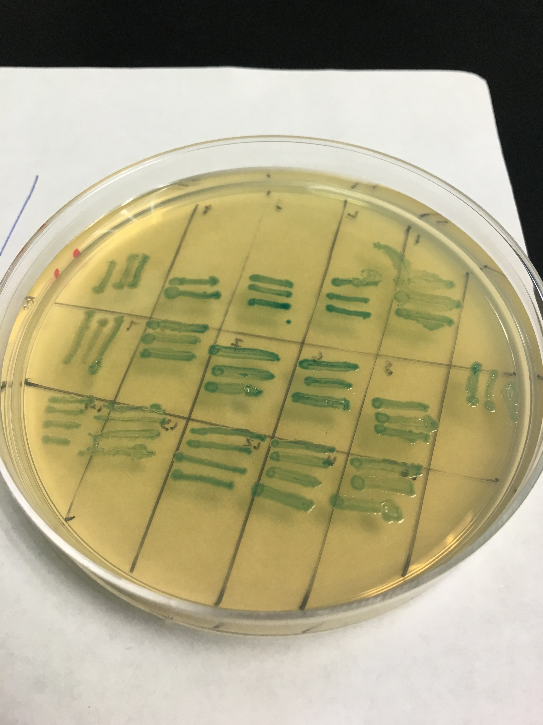
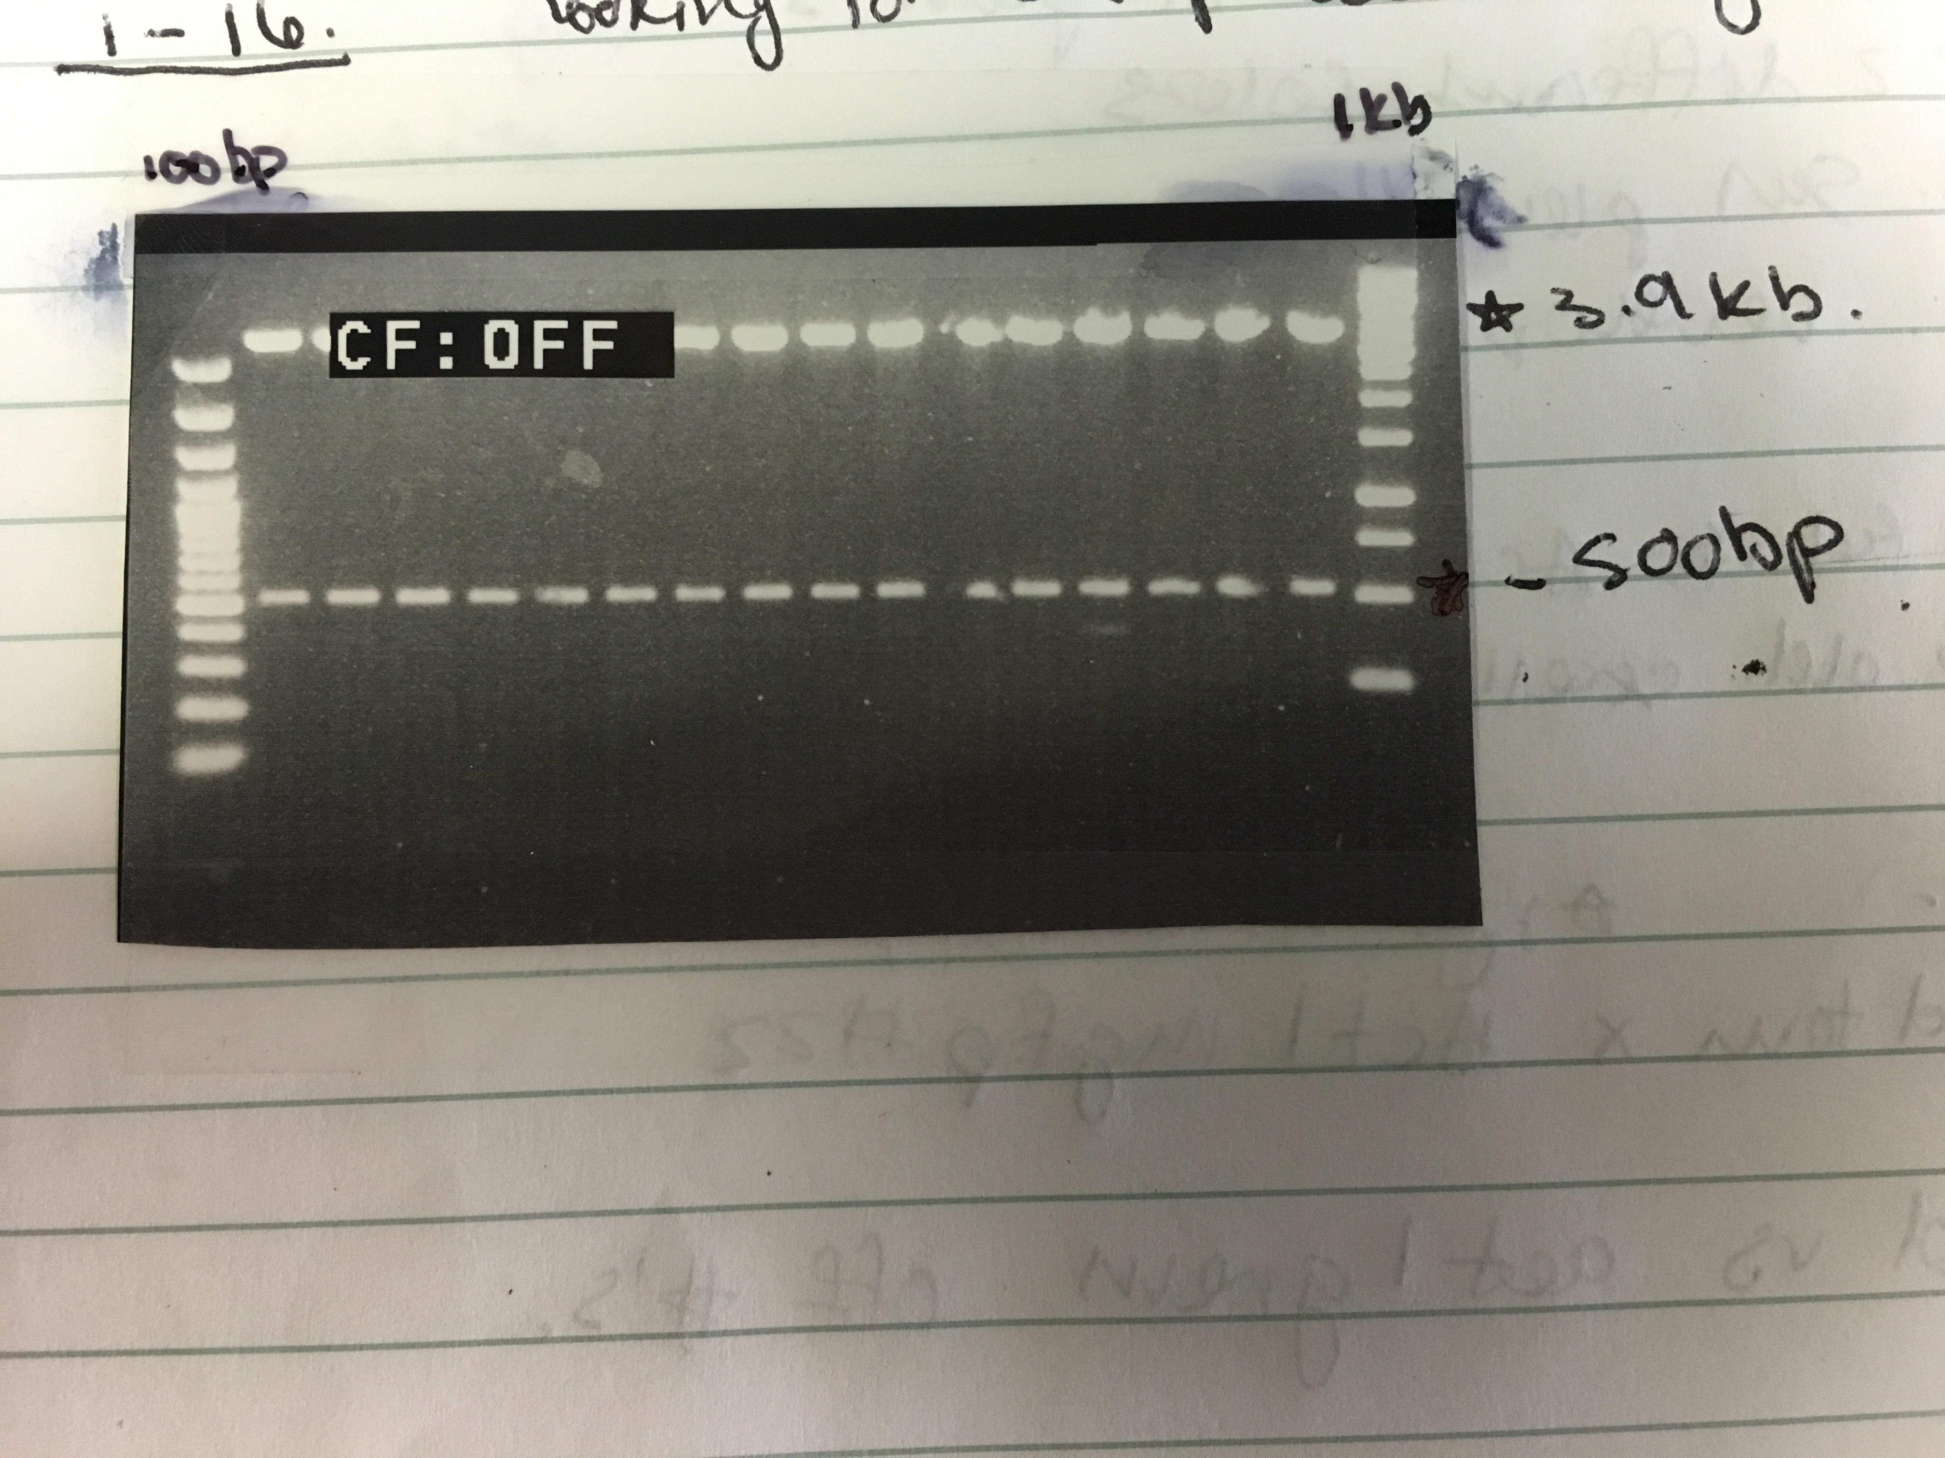
Results
Golden Gate Cloning Construct
LacZ Fragment
Successfully cloned into TA cloning vector.
Next step is to clone into pGG_Min_Red1

Slide 23
Results
Final Golden Gate Cloning Construct
LacZ Fragment

Slide 24
Results
II. Biolistic Transformation with fluorescent reporter genes
2x35S promoter
Act1TSS promoter

Slide 25
Biolistic transformation
Immature leaves (~1 month old)
Tungsten particles
Co-bombardment
Fluorescent microscope

Slide 26
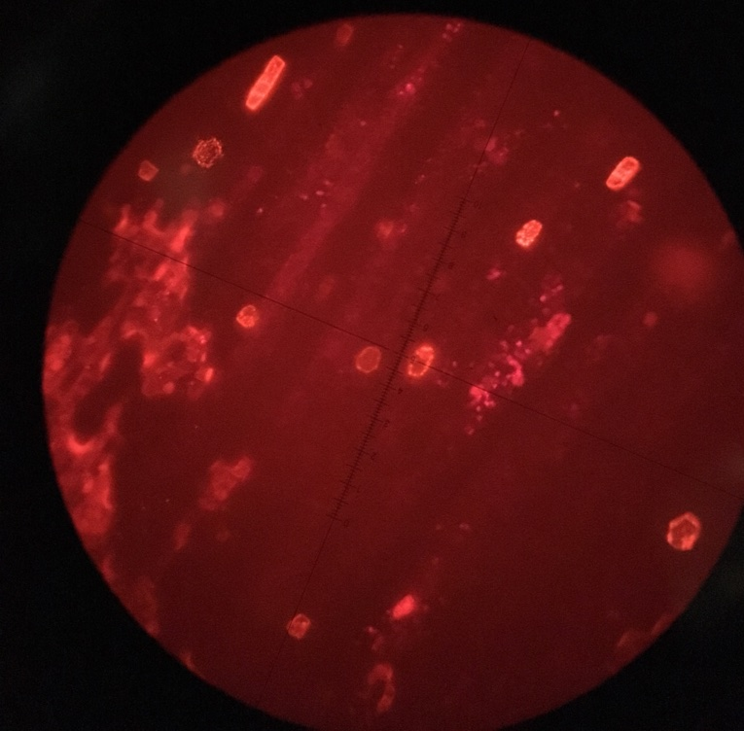
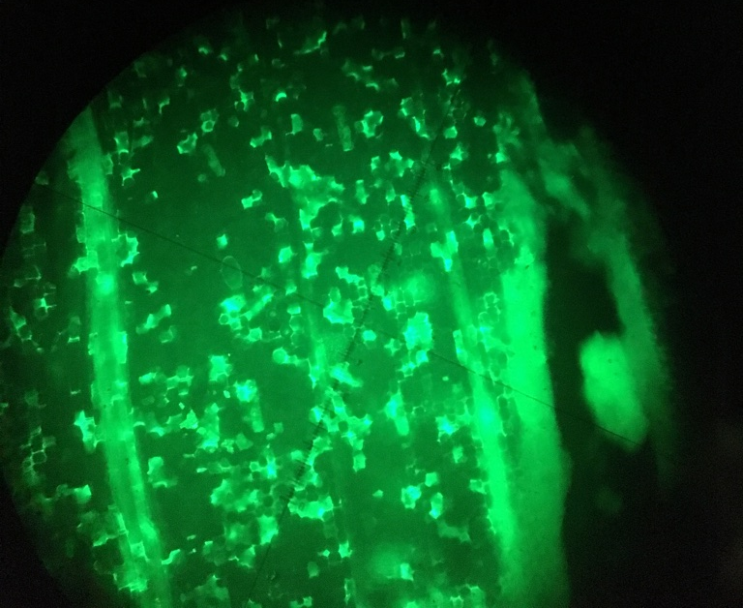
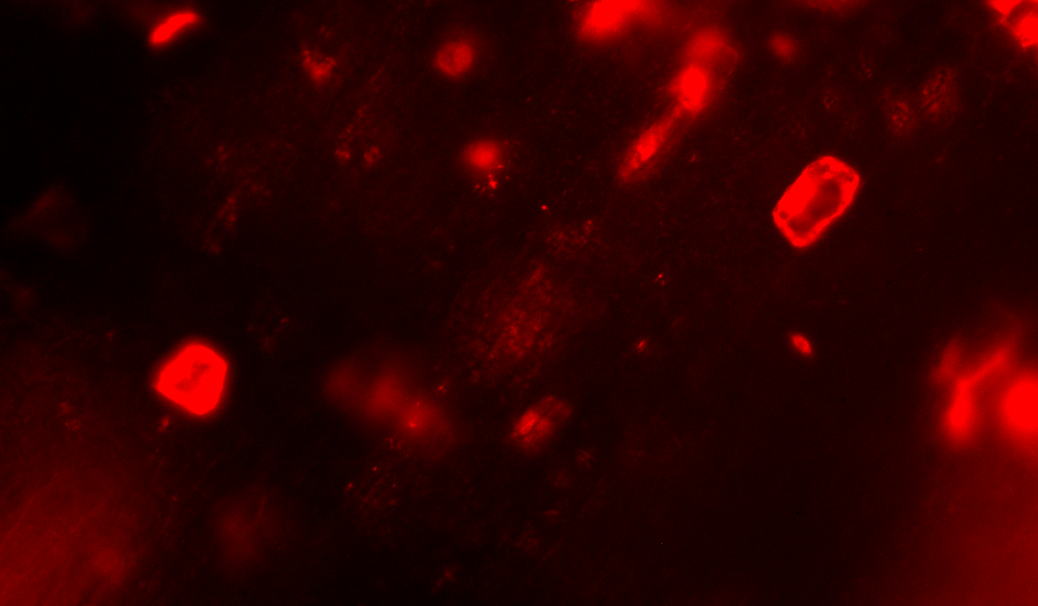
Fluorescing Cells
mgfpER
tdTomatoER
ER = targeted to endoplasmic reticulum

Slide 27
Results
Biolistic Transformation
Co-bombardment assay with two different set of plasmids
Green fluorescent reporter
Red fluorescent reporter
Measure by ratio (red/green)

Slide 28
Negative Control Experiment
Zuzana Vejlupkova
Same day, side-by-side co-bombardments
Notes:
The 2x35S-null construct has no tdTomato-ER, just the 2x35S promoter. This shows that the bombardment alone does not induce red fluorescence.

Slide 29
Negative Control Experiment
Zuzana Vejlupkova
Conclusion:
Without a reporter the bombardment does not induce red fluorescence
Same day, side-by-side co-bombardments
Notes:
The 2x35S-null construct has no tdTomato-ER, just the 2x35S promoter. This shows that the bombardment alone does not induce red fluorescence.

Slide 30
Results
Biolistic Transformation – Experiment 1

Slide 31
Results
Biolistic Transformation – Experiment 1
Conclusion:
Unexpected difference between the two promoter transcription levels
P=0.006

Slide 32
Results
Biolistic Transformation – Experiment 2

Slide 33
Results
Biolistic Transformation – Experiment 2
Conclusion:
While differences are present in ratios a p-value of 0.076 does not indicate a significant difference.

Slide 34
Results
Biolistic Transformation – Comparison Expts 1 & 2

Slide 35
Results
Biolistic Transformation – Comparison Expts 1 & 2
Conclusion:
Different days can produce different results.
p= 0.014

Slide 36
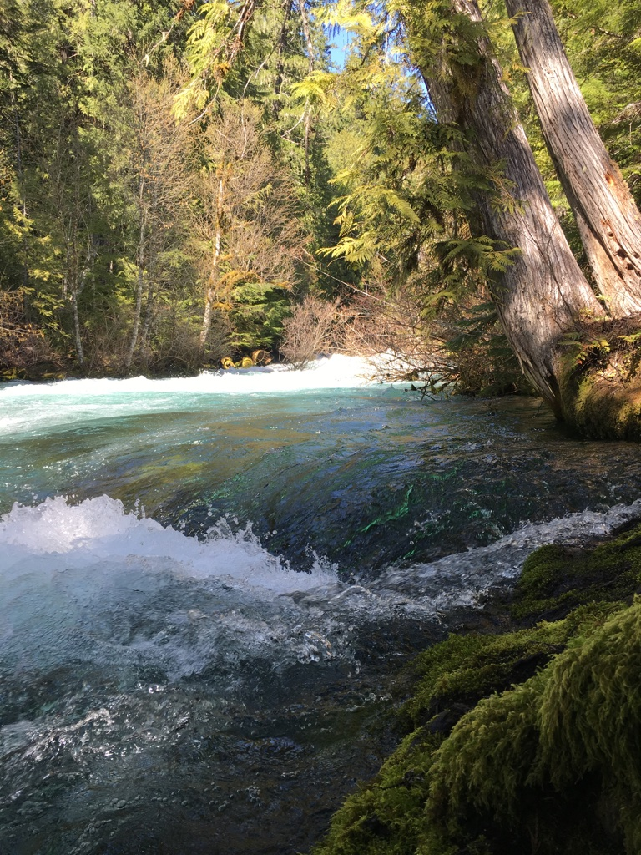
Future
Construct Golden Gate Cloning vector
Improve biolistic transformation method in Fowler lab
Characterize various CRMs

Slide 37
Acknowledgements
Fowler lab
BRR program
Bioenergy minor program
Funding from: Agriculture and Food Research Initiative Grant no 2014-67013-21661 from the USDA National Institute of Food and Agriculture (Fowler lab support)
Botany & Plant Pathology - Ernest and Pauline Jaworski Fund for Summer Research Experiences
Bioenergy Education Project Internship and Research

