Slide 1
Buy Request:
Just in Time v. Just in Case at OSU Libraries
Uta Hussong-Christian
Kerri Goergen-Doll
Timberline 2010
Notes:
[Kerri] Buy Request is the moniker for the year-long pilot of purchase on demand we conducted at OSU.
Today, Uta and I will briefly go over the start up process of the pilot, share the results of our data, discuss what’s next, and address your questions. You also have been given a handout with some of the details that are in our presentation.
Who here has heard of purchase on demand or just in time acquisitions? (Define briefly if no one has)

Slide 2
About OSU
Located in Corvallis, OR
Land, Sea, Sun, & Space grant university
~$250M in funded research
OSUL=Valley, Guin, Cascades
~1.4M volumes in all subject areas
  14,000 serials
  500,000 maps & gov’t documents
18,067 undergrads / 3,902 grads
3, 481 faculty
Notes:
[Kerri]

Slide 3
A
Long
Time
Ago…
Notes:
[Kerri] Way back in 2008, I attended an ALA preconference called “Throw off your policies and expose your resources”. I came back from that with a lot of enthusiasm to expose our library’s resources. We extended our ILL loan period to 8 weeks with a renewal and increased the types of formats we’d send out. A task force was charged to come up with a pilot plan for purchasing from ILL loan requests. You may ask how purchasing would expose our resources. Well, instead of borrowing items with loan periods of 3-8 weeks, we could buy the material and have it available to check out to faculty for 6 months with 1 renewal and the item would then be available for others.

Slide 4
Criteria
Notes:
[Kerri] Our first step in setting up the pilot was to review the literature. We are not the first, nor the last, to consider this service. We also were able to get feedback from some of our peer institutions. From this, we were able to create a set of criteria by which items would be considered for purchase. The subject librarians gave a final review.

Slide 5

faculty/grad requests
Notes:
[Kerri]
Faculty and Graduate requests for “new” books (2004+)

Slide 6
$150 cap
faculty/grad requests
Notes:
[Kerri]
$150 price limit – so science books can be purchased

Slide 7
$150 cap
faculty/grad requests
amazon
Notes:
[Kerri]
Amazon prime – 2 day shipping on in stock items for $79/year
- Items not owned by OSU Libraries and held by only 1 Summit library (adding to our consortium holdings) in which the library lists the item as "local use only" or checked out will be candidates based on the following criteria:
English language
$150 max cost
Faculty and graduate requests
Published within the last 5 years
Available to ship within 2 days
Monographs
scholarly material
monograph series acceptable
no textbooks
no e-books
no standards or conferences
no award winning fiction
no microform/film
no dissertations
no A/V
paperback acceptable
high quality used acceptable

Slide 8
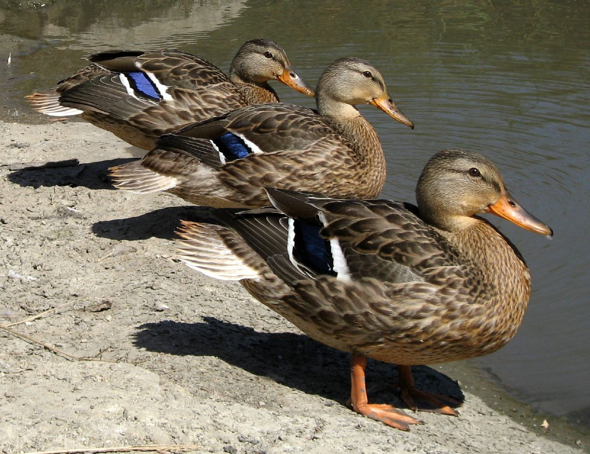
Notes:
[Kerri] Now we needed to get our ducks in a row. The funding came from an unrestricted gift fund. Based on the previous years ILL requests, we asked for an initial $10,000 for the pilot. We needed to ask for another $3,000 so that we could finish out the year. We piggy backed on existing procedures established for “Rush” acquisitions and made some slight modification to ILLiad to enable efficient communication. We also set up criteria for evaluating the success of the program which will be discussed shortly.

Slide 9
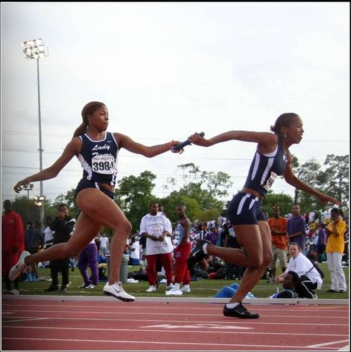
Notes:
[Kerri] One of the important elements of this service had to be quick turn around. I didn’t want my customers waiting for a purchase we could’ve borrowed faster. This meant having seamless handoffs and trusting different units to “run” with the request to meet our 5 day turn around time. We couldn’t have done this without collaboration among the different library units.

Slide 10
Patron
ILL Request
Acquisitions
Cataloging
Circulation
Collection Maintenance
Patron
Notes:
[Kerri] This represents the basic workflow of our pilot and the units that were impacted. ILL staff used the criteria to determine which requests were to be purchased. Acquisitions checked to make sure the title wasn’t already ordered. Once the item was received by cataloging, they processed it within 24 hours and delivered it to circulation. Circ staff placed the holds on the items for the patrons and our ILS sent out the hold email notices. The circ staff would check the items out using our established loan periods for faculty and graduates. Once the item was returned, collection management staff would shelve it in our stacks.

Slide 11
The Numbers, Please
Notes:
[Uta] So in order to say whether or not this pilot was meeting some of the overarching goals we had for it such as meeting researchers’ point of need requests and enhancing the current and future value of the collection, we needed data. One of the first things we looked at was circulation statistics taking the view that if the items were circulating, it meant they were meeting research needs and thus of value to the collection. We knew from our lit review that the Buy Request items, those purchased just in time so to speak, tended to circulate at a higher rate than those purchased in traditional ways, the just in case model. We were not disappointed. The numbers please…

Slide 12
1.6
Notes:
[Uta] At the one year mark in mid-February (the pilot was conducted from mid-February 2009 to mid-February 2010), just in time purchases had, on average, 1.6 circulations per item. A total of 190 items were purchased over the year, and these generated a total of 305 circulations. Circulation counts at the one year mark ranged from 0 (we did have some patrons who never picked up their items) to a high of 6. While 1.6 circs may not seem like an impressive number…

Slide 13
0.5
Notes:
[Uta] Compare it to 0.5, the average circulations per item for just in case purchases, those items added to the collection through traditional collection development channels. This is based on analysis of the approximately 6800 items added to the collection during the same time period as the pilot (actually about 85% of those records, since 15% of the records were quite a mess).

Slide 14
Average Circulation per Item
Notes:
[Uta] Giving some visual context to these numbers, we have a substantial increase in borrowing of the just in time items over the just in case items. Increase of 215% or 3.15 times more circulation. This is consistent with what is being reported in the literature. Just a note…while I don’t have the vertical axis shown on this graph, the proportions are correct.

Slide 15
Notes:
[Uta] We wanted a little better idea of what was going on with circulation counts, so we looked at circulation frequency and found some interesting things. Not surprisingly in both categories of purchasing, 0-1 circulations per item dominates, though it is much higher with the just in case items than with just in time items. What really stands out is that just in time purchases do have a much higher percentage of multiple circulations. We did consider the possibility that some of that activity was driven by renewals, especially in the category of 3 or more circulations. But it turns out that 89% of the circulations in this category are unique circulations. This is indicating to us that these items are of value to patrons beyond the patron who originated the request, once again showing us that these items are of value to the collection. In just a moment I’ll present some patron behavior that has impact here.

Slide 16
Talk to Us
Notes:
[Uta] In addition to looking at circulation statistics, we wanted to get direct feedback from patrons receiving material through this pilot program. If they were satisfied, what contributed to that satisfaction? And beyond mere satisfaction ratings, how important were the items to these individual researchers. So we asked Buy Request patrons to complete an online survey about the pilot. 62 patrons responded to the survey. This is around a 30% response rate given that we purchased 190 items and there were a few patrons for whom we purchased multiple requests. There is no shortage of programs describing various aspects of purchase on demand programs, but very little of that literature address patron response besides the summary “it was well-received” comment. So this is where our project will contribute to the literature.

Slide 17
Notes:
[Uta] We asked two questions about borrowing that help us understand the circulation number we looked at previously and which provide some indication of the importance of these items to individual researchers. First we asked if they would borrow the item again. We are asking this after they have received the item and have had time with it. Only 10% of our patrons indicated that they would not borrow the item again. So…the item was of significant interest that they requested it in the first place and now they are telling us that it is important enough that they will check it out again (keep in mind that graduate students have loan periods from 90 days and our faculty have loan periods of 120 days…not insignificant periods). This behavior may explain one piece of the increased multiple circulations for just in time purchases, though remember that only 11% are driven by renewals thus far…this will likely increase as time passes.

Slide 18
Notes:
[Uta] The second piece that helps explain the increased multiple circulations and maybe gets at some of what’s behind the high number of unique circulations is the response to the question about whether they would recommend the title to colleagues or students or add it to a course reading list? Once again, only a small percentage of our buy request patrons indicated that they would not do this…the majority would. So not only is the purchased item important to that researcher, but now they are indicting that it is will be useful to others as well. How’s that for adding items of value to the collection? They told us what they needed, we bought it, they AND others are using it….AND we have data to back that up. Good value for our collection dollars.

Slide 19
Notes:
[Uta] The four questions that we asked related to patron satisfaction first of all showed us that patrons were highly satisfied with the pilot project. Are you beginning to see a trend here? On a scale of 1 being very unsatisfied and 5 being very satisfied, patrons gave us an overall rating of 4.74. The fact that we were able to deliver the items quickly was obviously very important, but all of these aspects contribute to the overall satisfaction and should be kept in mind when piloting any new service. It’s not just quick service that counts. Trying new things is important and enhancing services, or in this case, collections, is also important to our patrons. So with that said, were there any issues? Yes, as a matter of fact there were.

Slide 20
Feedback
36 comments
Notes:
[Uta] We rounded out the survey by asking patrons to provide any other feedback they wished us to have. 36 patrons responded with comments. Content analysis revealed that the majority of the comments were unequivocally positive. The next largest category of comment was what we identified as qualified. In other words, the patron expressed support for the program, but also expressed some measure of concern. Very few of the comments were negative (in fact, we received only one negative comment) and a few patrons noted technical issues with the survey (and we did get the underlying issues sorted out).

Slide 21
“This is a dream come true: something is needed but is not available ... and then you make it available. Please go on, if at all possible!”
“I think this is a great idea! Balancing (expected repeated) shipping costs against acquisition cost is a smart way of optimizing the library budget, which I think will pay off in the medium and long run.”
“This ha[s] facilitate[d] my dissertation writing because this book is key to my investigation. Other colleagues are plan[n]ing to use it and I will definitely use it for a graduate course.”
Notes:
[Uta] Let’s start with the positive comments, as a colleague of ours is fond of saying…the warm and fuzzy feedback. It’s fun to read and heartwarming to know we’ve made a difference in the lives of our graduate students and faculty. But the content of the feedback is also informative about the ways in which programs like this support our faculty and grads. And it does provide evidence that they understand the financial implications of making these items a permanent part of our collection and supports the data we have that these items will get future use.

Slide 22
“I don't think 'a buy on demand program' is good way to purchase library items. You end up purchasing books without knowing if it was requested with teaching, research, or some other reason entirely. The library has gaping holes in its collection in all areas that are of interest to me. Filling these areas seems more important to me than randomly purchasing books.”
Notes:
[Uta] But what about that negative comment. Before I talk about this one, take a moment to read it.

Slide 23
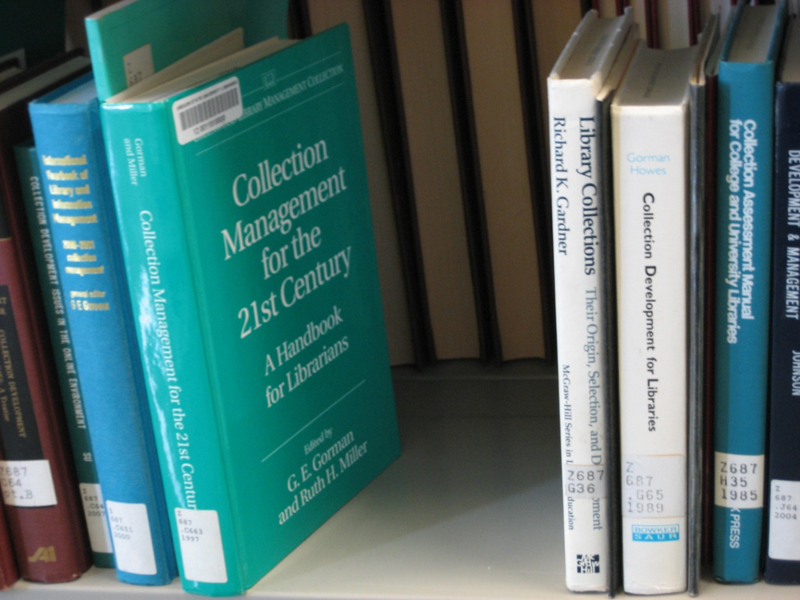
Notes:
[Uta] I have to take issue with this lone negative comment. The patron noted “The Library has gaping holes (POINT OUT HOLE IN PHOTO) in its collection…” which I don’t dispute…well maybe a little…GAPING is a strong word. But I would suggest that it is programs like Buy Request or just in time purchasing that helps fill some of those holes, at least in the short term. In the longer term, collection development decisions can and should be guided by the trends we see in this kind of requesting…we should build up collections in areas where a lot of requesting is taking place. But back to the comment…the criteria we used screened for scholarly material, so we know this material is being used for research and thus of value to our collection. I wish I knew who left this comment in order to have the chance to discuss the program with him or her. I would say that the purchasing of materials in this way is very focused on those areas of direct and immediate interest to our patrons and that these purchases are the very opposite of random. By the way, I must confess that this photo was staged, but opportunity to highlight this issue was too good to pass up.

Slide 24
Biggest suggestion I have is to ASK the borrower of a book if they would like it to be purchased. While I appreciate getting the book, I really just wanted to take a look at it for some basic information and to see if it was worth buying in the first place. It probably did not need to be purchased and will likely not be used again.
“I think this is a great idea! Balancing (expected repeated) shipping costs against acquisition cost is a smart way of optimizing the library budget, which I think will pay off in the medium and long run.”
“This is a dream come true: something is needed but is not available ... and then you make it available. Please go on, if at all possible!”
“How do you decide which items to buy? I cannot be sure this system is useful unless I know your criteria.”
“This ha[s] facilitate[d] my dissertation writing because this book is key to my investigation. Other colleagues are plan[n]ing to use it and I will definitely use it for a graduate course.”
Notes:
[Uta] The qualified comments were, to us, some of the more interesting one and the ones that lead us to consider what kind of changes we can implement to effect positive change in the future. These are the comments in orange. One patron asked about the criteria we used when converting the request to a purchase. A valid question and one that came up in various forms several times. We did not share this information with our patrons, partly so that requesting habits would not change and we could obtain “clean” data but also because we did not want the system “gamed”. The other type of qualified comment that was most predominant was one where patrons indicated that the program was useful but that they wanted a say in what was converted to purchase. Getting our patron’s input on whether or not to purchase an ILL request is certainly an option and actually makes a lot of sense. Given that beneficiaries of just in time purchasing at this point is faculty and grad student researchers, they have subject expertise that we can tap into for making these purchase decisions. Katina referred to this yesterday morning in her keynote and it plays an important role here. And in fact, there are tools being developed right now that allow us to gather just that type of information to make more informed purchasing vs. loan decisions. So Kerri will take back over and bring us up to speed on Future Moves.

Slide 25
Future Moves
Notes:
[Kerri] Our pilot will be made a permanent service beginning July 1, 2010, but we are already looking at ways to move beyond our model and incorporate some of what we heard from the survey responses.

Slide 26
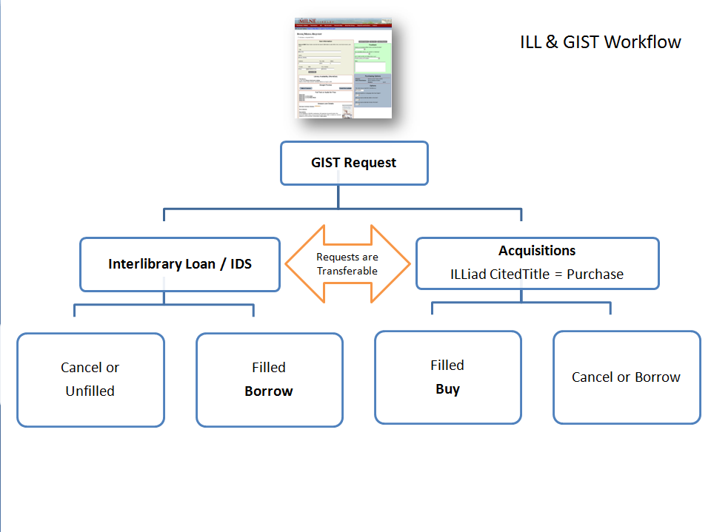
Getting It System Toolkit
Notes:
[Kerri] GIST (Getting It System Took Kit) was developed by the Information Delivery Services (IDS) Project in New York to capitalize on the established workflow of Acquisitions and ILL to assist with buy vs borrow. (http://toolkit.idsproject.org/doku.php?id=wiki:gist)
This is free, customizable, and works with ILLiad 8.0.

Slide 27
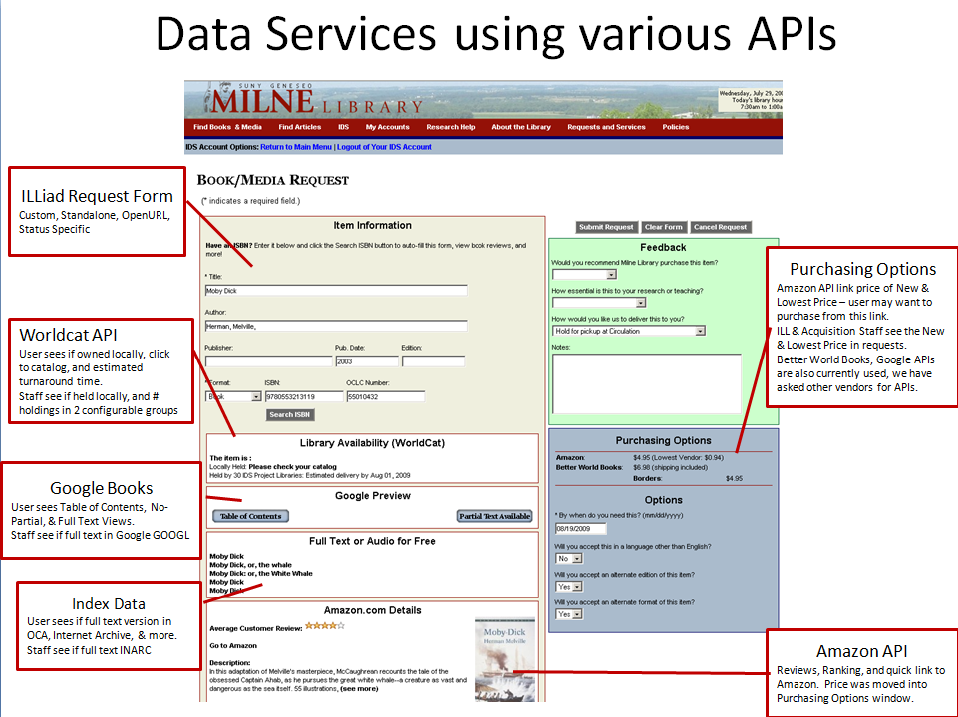
Notes:
[Kerri] One stop requesting removes the uncertainty from the user, and allows acquisition and ILL staff to work together to get the material to the user in the best interest of the library’s collection.
As our institutions move to have one-stop discovery, we need to think about initiating one-stop requesting. The patron wants something and regardless of where it is held (our catalog, consortium, ILL), there is only one place to submit the request. We then let the system of staff mediate getting the information to our patron.

Slide 28
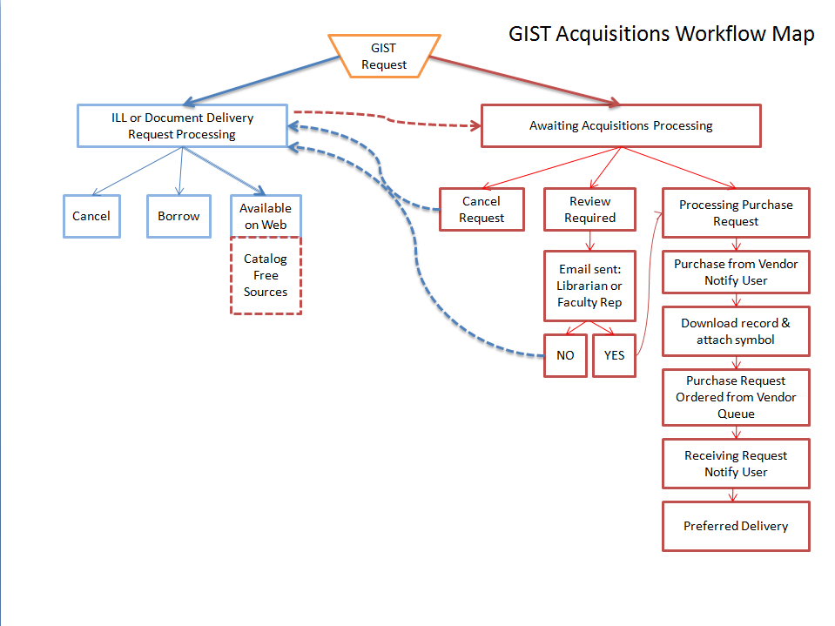
Notes:
[KERRI] Collaboration made easy!
Free, customizable, flexible, and brings together the best of purchase on demand while addressing concerns for patron input into purchasing decisions.
At this point, it requires the use of ILLiad 8.0. For those who don’t use ILLiad, it provides a model for incorporating ILL requests into acquisitions to enhance collections.

Slide 29


“Print Streaming”
Notes:
[Kerri] Ginny Sylvester and Marcia Anderson at ASU are working with Coutts to load bibliographic records for approval plan type books into their catalog. When a patron discovers the record in the catalog, clicks through to request it (authenticates), the book is purchased. If Coutts does the technical processing, the book arrives in about 2 weeks. If the library opts to do the processing, the item is delivered sooner. They are still working out the bugs to get this started, so no data exists to recommend this model, but libraries experiences with patron driven acquisition of ebooks and purchase on demand would make this a potential gold star procedure.

Slide 30
Questions for us?

Slide 31
It’s (Almost) All Good!
Notes:
[Uta] No program is perfect and we’re continually working to improve the value and relevance of the collection for our users. Just in time purchasing through programs like Buy Request is one way to do this. So let me leave you with a positive message from Oregon State University faculty and graduate student patrons. They are clearly satisfied and tell us that…

Slide 32

Notes:
[UTA] Buy Request is a “great book purchase program.”

Slide 33
Photo Credits
Check Chk
  http://www.flickr.com/photos/mattcarman/1573507091/
  Flickr user Matt Carman, Some rights reserved
‘Ducks in a Row’
  http://www.flickr.com/photos/malingering/227816239/
  Flickr user Malingering, Some rights reserved
56th Annual TSU Relays, Texas Southern University, Houston, Texas 2007.03.24
  http://www.flickr.com/photos/fossilmike/438214403
  Flickr user fossilmike, Some rights reserved
Collection Development Gaps
  Uta Hussong-Christian, Some rights reserved
Getting It System Toolkit
  http://idsproject.org/Tools/GIST.aspx
  http://toolkit.idsproject.org/lib/exe/fetch.php?cache=&media=gist:implementation:install:image01.png
  http://toolkit.idsproject.org/doku.php?id=gist:workflow:map
ASU Logo
  http://commguide.asu.edu/downloads/logos
Coutts logo
  http://www.couttsinfo.com/

Slide 34
uta.hussong-christian@oregonstate.edu
kerri.goergen-doll@oregonstate.edu

