Slide 1
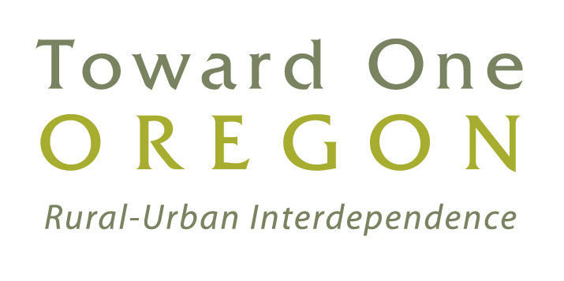

Slide 2
From Urban Frontier to Metropolitan Region: Oregon’s Cities from 1870 to 2008
Carl Abbott
Portland State University
abbottc@pdx.edu

Slide 3
Three Eras of Oregon Cities
Portland ascendant: 1870-1920
Oregon in balance: 1920-1970
The long arm of the metropolis: 1970-2008

Slide 4
Who’s on first?
Portland has been Oregon’s largest city through the entire era of statehood.
Three cities have occupied second place: Salem, Astoria, and Eugene.
Ten additional cities have traded off among the top five. In chronological order they are: Oregon City, Jacksonville, The Dalles, Albany, Baker City, Pendleton, Medford, Klamath Falls, Corvallis, and Bend.

Slide 7
Portland: Gateway to the Northwest

Slide 8
Transportation Center

Slide 9
Transportation Center

Slide 10
Manufacturing Powerhouse

Slide 11
Financial Center
Banks across the U.S. voted in 1913 for their preferred city for branch bank of the new Federal Reserve Baking System. 191 banks in Oregon and Washington submitted their first choice.
75 picked Portland
40 picked Seattle
32 picked San Francisco
26 picked Spokane
18 picked other cities

Slide 12
Oregon Cities in 1920:
Rank Size Model and Actual Populations
Figure 1

Slide 16
Oregon’s Largest Cities: 1940 and 1960
Portland 305,294
Salem 30,908
Eugene 20,838
Klamath Falls 16,497
Medford 11,281
Portland 728,088
Eugene 162,890
Salem 48,142
Medford 24.425
Corvallis 20,669
Portland and Eugene 1960 are metropolitan area populations

Slide 17
The Common Culture of Natural Resources: Estacada 1949 and Portland 1959

Slide 18
The New Economy of Leisure: The Columbia River Scenic Highway

Slide 19
Oregon’s Metropolitan Areas, 1980 and 2007
Portland 1,050,750
Eugene 275,226
Salem 249,895
Medford 132,456
Portland 1,734,000
Salem 378,520
Eugene 343,140
Medford 202,310
Bend 160,810
Corvallis 78.153

Slide 20
Metropolitan Counties

Slide 21
Oregon catches up in the 20th century
In 1920, Portland was twice as large as the next twenty cities combined.
In 1960, Portland was twice as large as the next twelve cities.
In 2007, the Portland metro area was twice as large as the next two metro areas

Slide 22
Portland of the Future: 1920s Style
Skyscrapers for finance and professional services
Intermodal transportation hub
Global connections and the promise of the Pacific Rim.

Slide 23
Two Conclusions
What’s stayed the same?
Portland’s fundamental services for Oregon were the same in the 1870s, the 1920s, and today.
What’s changed?
Oregon’s system of cities is far more equally balanced than it was a century ago.

