Slide 1
THESES AND DISSERTATIONS LIVE:
Oregon State University Library’s
ETD Metadata Workflow
Sue Kunda
Open Repositories
May 20, 2009
Notes:
Like many academic libraries we became interested in capturing our student research as soon as students began using word processors to produce their theses and dissertations. In the late 1990s, inspired by Virginia Tech, we began some very tentative conversations with our graduate school, but nothing really got off the ground. In, 2004, however, we were investigating institutional repositories and felt like theses and dissertations were a natural fit for the IR.

Slide 2
T/Ds Natural Fit for IR
T/Ds Represent OSU Research
Graduate School/Library Shared Philosophy
Guaranteed Content Growth
Notes:
Hi, I’m Sue Kunda, and I’m the Digital Production Librarian at Oregon State University. When I sent in my abstract for this presentation I think I might have been a little ambitious and even though my parents have always said I talk too fast, I don’t think even I could talk fast enough to get everything in. So what I decided to do was talk, in general terms, about some of the things we’re doing at OSU with our ETD collection and leave time at the end for any specific questions you may have about our processes and procedures.
Like many academic libraries we became interested in capturing our student research in the late 1990s. Inspired by Virginia Tech we began some very tentative conversations with our graduate school just before the turn of the century, but nothing got off the ground until around 2004. At that time we were investigating institutional repositories and felt like theses and dissertations were a natural fit for the IR.

Slide 3
Notes:
We started with one interested department on campus, in 2005 – appropriately enough, the school of Electrical Engineering and Computer Science. There were so few problems with the workflow and process that all departments on campus agreed to require both P.h.D. and Master’s students, beginning in July 2006 and January 2007 respectively, to submit their research to ScholarsArchive@OSU.

Slide 4
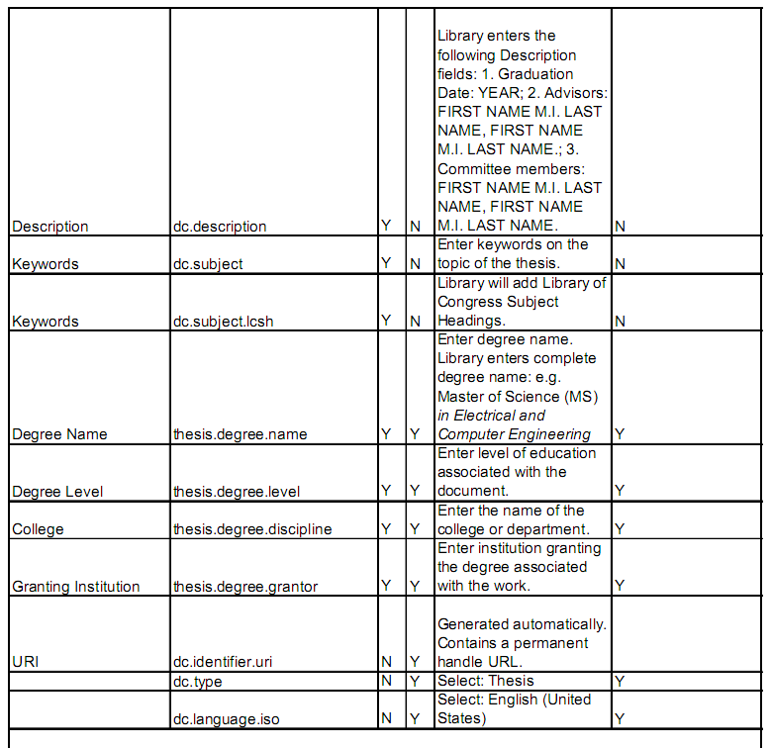
ETD Data Dictionary
Notes:
One of the first things we had to do when creating our ETD workflow was change the DSpace form. We created a data dictionary based on the Networked Digital Library of Theses and Disssertations ETD metadata standards, but also created elements that seemed to make sense for this particular collection (degree.name, degree.level, degree.discipline, and degree.level) We then modified the submission form to include these changes to the standard DSpace Dublin Core. We also revised the instructions on the submission form based on usability studies conducted by our head of Technical Services, and co-developed an online instruction guide with the Graduate School. We feel both measures cut down on the amount of time we have to spend troubleshooting student difficulties.

Slide 5
Notes:
Our workflow begins with the student logging in to SA, which automatically registers him/her with the ETD collection. An LDAP modification which profiles users and then automatically places them into the appropriate DSpace communities was developed at OSU and is currently being used by other academic institutions using DSpace. The student enters the appropriate metadata into the submission form and attaches the file of his/her work.

Slide 6
ScholarsArchive Licenses
Graduate School License
Creative Commons License
Notes:
Students also have the option of attaching a Creative Commons license and they agree to the graduate school’s license, which is different from the standard license in DSpace. This license, of course, gives OSU various non-exclusive rights, such as translating, reproducing, distributing, and archiving the item. The student then submits the record and file to SA.
The graduate school’s thesis editor then checks the submission against the paper copy, making sure the pretext pages are identical in both copies and paging is correct. She approves (or rejects) the document and the library takes over from there. Just a note here: Even though students submit their theses or dissertation electronically, we still require a print version for archival purposes

Slide 7
Notes:
One of two library technicians pulls the thesis or dissertation from the work file, reviews the student-created metadata, adds Library of Congress Subject Headings, and does a final upload of the record into ScholarsArchive. DSpace automatically generates structural and administrative metadata, and an email is automatically sent to the student and the graduate school with the url of the item.

Slide 8
Notes:
Approximately once a week, depending on the number of t/ds being submitted, a library technician uses a modified version of MarcEdit, a cataloging utility developed at OSU, to map the DSpace Dublin Core metadata to MARC. She enters the appropriate information, which includes the server address (with the oai request), the set name (which is the handle for our ETD Collection), the metadata type (Dublin Core), and the Crosswalk Path. She enters the dates she wants to search on (bringing up anything that’s been edited in this collection during that time period) and

Slide 9
MarcEdit Translation
MARC Record
Dublin Core Record
Notes:
MarcEditor then translates the DC to MARC.

Slide 10
Batch Import into WorldCat
Notes:
The library technician batch imports the records into WorldCat where she finishes creating and editing the metadata. Although the process works fairly smoothly and saves us a lot of time there are still some corrections and additions that need to be made. We make some changes to the punctuation, add pagination, illustration, and bibliographic information and add a local subject heading with the department name. After uploading the records in WorldCat and attaching our holdings, the library technician then downloads the records into our local catalog.

Slide 11
Tickler Created in Order Record
Notes:
Although we don’t actively encourage it, students can restrict access to their thesis for a specified time period, most often one year. The student has to have their request approved by the Graduate School, after which, the library technician edits the Read Policy in DSpace and creates a tickler to remind us to remove the restriction after the specified time period is over, using an order record attached to the bibliographic record in our ILS.

Slide 12
Print vs. Electronic Workflow
Notes:
Moving from a print workflow to a (mostly) electronic workflow (remember, we still require students to submit one print copy for archival purposes) has saved the OSUL more than $2000 per year, a reduction of more than 20 percent. The majority of these savings are a result of graduate students providing metadata and no longer sending out t/ds for binding – the one print copy we require is placed in a storage envelope rather than being bound.

Slide 13
Should We Discontinue These Practices?
Assigning LCSH
Requiring Print Copies
Notes:
We continue to evaluate our workflow, however, looking for other ways to economize the process. Discontinuing subject analysis and no longer requiring a print copy are two options we discuss on a regular basis, but at this time, we’re not willing to let go of either one.

Slide 14
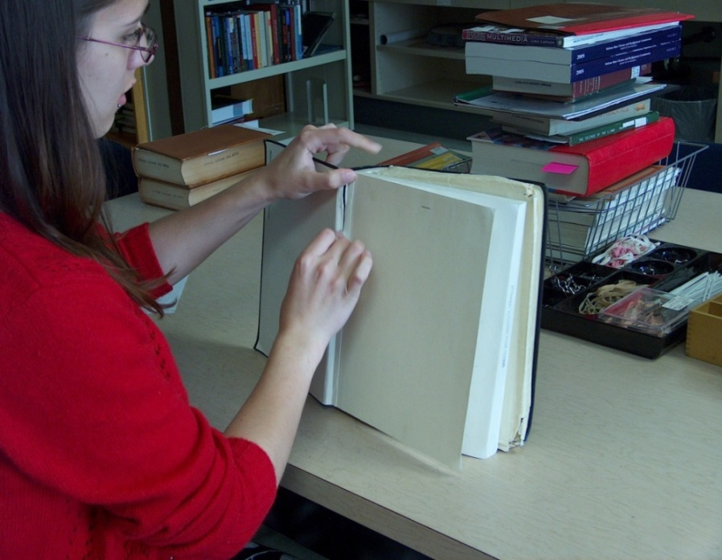
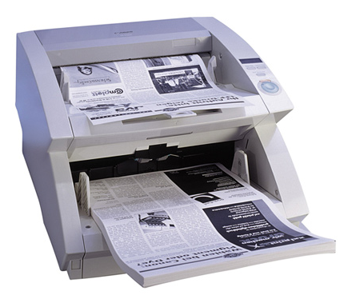
On-Demand Theses/Dissertation Digitization
Notes:
Earlier this year we added another procedure to our ETD workflow when we began digitizing theses and dissertations as they’re requested through ILL. These are older t/ds created before the electronic submission process was required. An ILL Specialist forwards any email request for a t/d to the Digital Production Unit where it’s printed out and passed on to a student scanner. The student retrieves the circulating copy from the stacks, debinds it, and scans it. After ocring and compressing the file the student scanner submits the item to the ETD Collection using the same method our P.h.D. and Master’s students do.

Slide 15
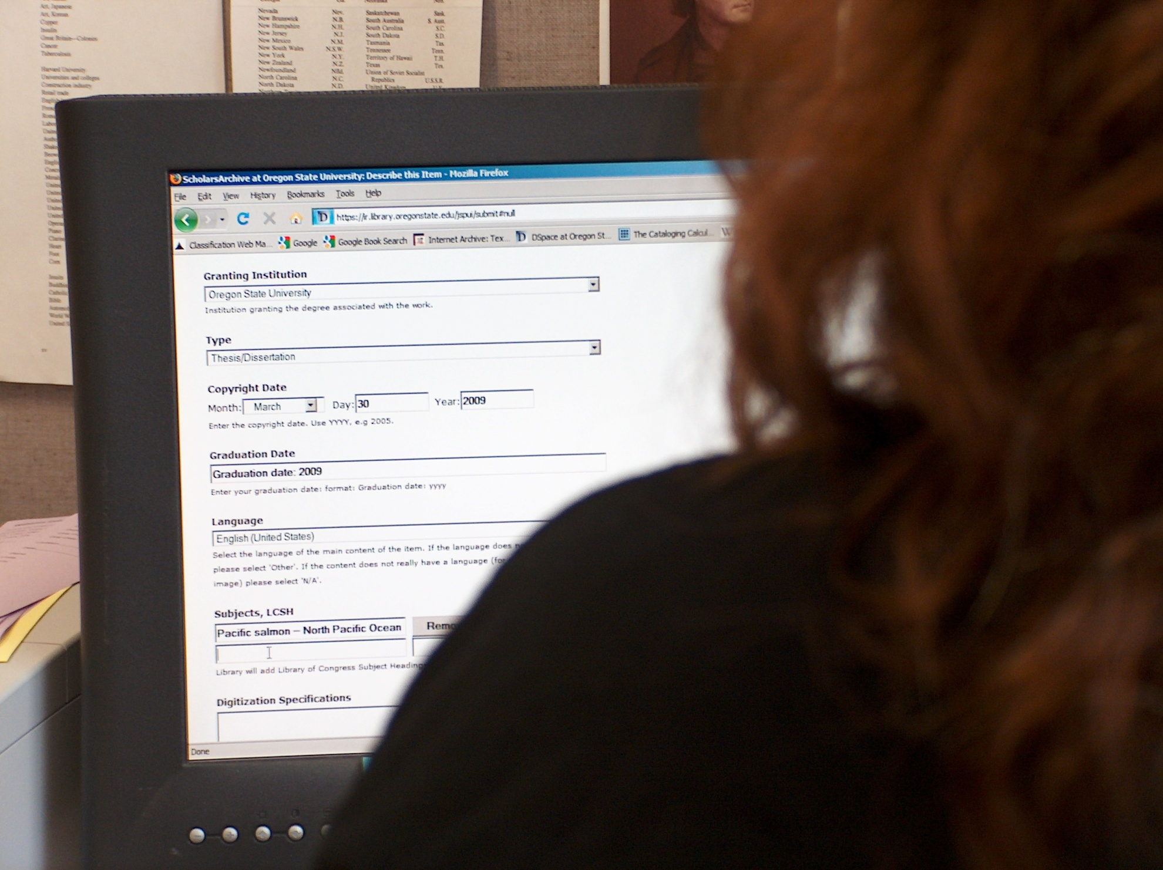
Reviews Metadata
Uploads T/D to ScholarsArchive
Adds Handle to Catalog Record
Sends Handle to ILL
Notes:
After the student scanner enters the correct metadata, attaches the pdf created during digitization, and submits it all to SA, a library technician again takes over (the graduate school doesn’t play a part in this process). The library technician reviews the student-created metadata and uploads the item to SA. Because these are older theses and dissertations, they’ve already been added to our catalog and WorldCat, and the library technician doesn’t need to add anything more to the records other than the handle. She also sends the handle to the ILL Specialist who passes it on to the patron who requested the item. Consortial lending agreements require us to deliver requested items within three days, but we’ve been able to get the vast majority of our t/d requests out within 24 hours, if not faster.
We also use this same procedure for theses and dissertations requested through other sources: OSU staff and faculty, OSU alumni, and national and international researchers. The only difference is we email the url directly to the patron making the request. This service of digitizing theses and dissertations on-demand has been a huge hit with our ILL staff, patrons, and OSU alumni. ILL staff figure we’re saving them thousands of dollars in postage alone, patrons are thrilled to receive their request in such a timely manner, and past students are now emailing us, asking if we’ll digitize their work – we even had a student offer to send us a pdf of his thesis so we didn’t have to do the scanning.
We’ve also had family members request we digitize their parent’s or grandparent’s research and they’ve been some of the most appreciative patrons we’ve had. While this is kind of a stretch from our original intention for providing this service, we think it goes a long way in promoting goodwill with people who may not otherwise have any reason to notice or care about the OSU Library.

Slide 16
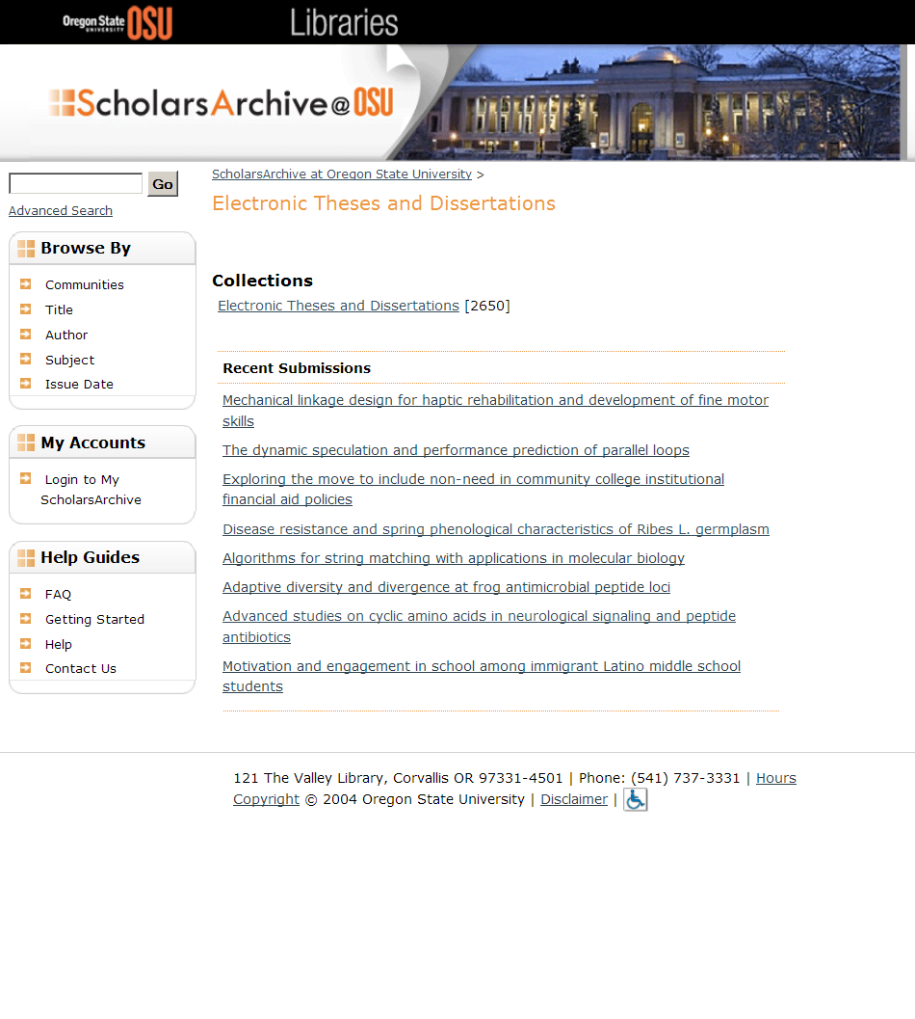
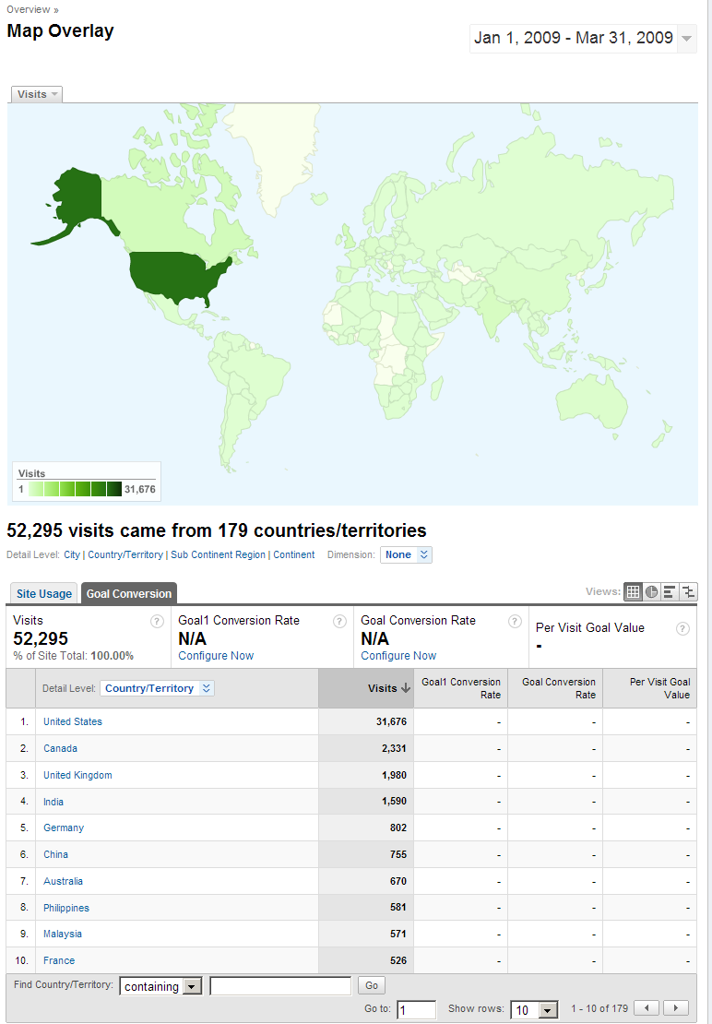
ETD Collection is Large and Popular
Notes:
Our ETD Collection is our largest and, probably, most popular collection. We currently have over 2600 items in the collection, which is just under 25% of the total number of items in ScholarsArchive@OSU. We spent a good amount of time this past year digitizing ~1000 Forestry t/ds that had been sitting around in filing cabinets and storerooms and are working on digitizing any t/ds we don’t have in SA so we’ll eventually have the entire t/d collection online.
As you can see, from the Goggle Analytics screen, we get visitors from around the world, many of whom are downloading our t/ds. I’ve personally fielded requests from scientists in Brazil, Belgrade, Italy, and India looking for information contained in our t/ds. We digitized a research paper for a researcher who had been looking for specific information for more than ten years. This is one of the most satisfying aspects of my job.
While we’re pleased with our successes, as I stated before, we’re continually looking for ways to improve and economize our workflows. In addition to possibly discontinuing subject analysis and requiring an additional print copy we’re still playing around with the order of fields in the submission process (placing the items the library’s responsible for last) and editing the instructions. We’re especially interested in reusing and mapping the MARC data from our catalog into DSpace, but haven’t yet figured out how to do it so if anyone out there knows how to do this we’d love to hear from you.

Slide 17
References
Boock, M. & Kunda, S. (2009). Electronic thesis and dissertation metadata workflow at Oregon State Libraries, Cataloging and Classification Quarterly, 47 (3-4), 297-308. http://hdl.handle.net/1957/11396
ScholarsArchive@OSU. https://ir.library.oregonstate.edu/jspui/
MarcEdit. http://oregonstate.edu/~reeset/marcedit/html/index.php

