Slide 1
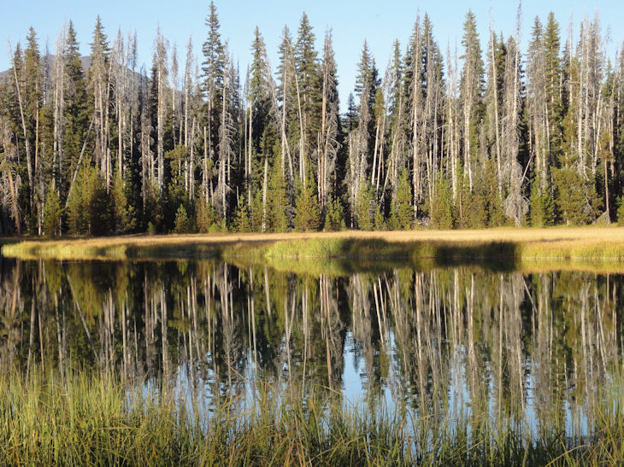
groundwater
&
ecosystems
allison aldous
joseph gurrieri
roger congdon
trish carroll
leslie bach
upper deschutes: a aldous

Slide 2
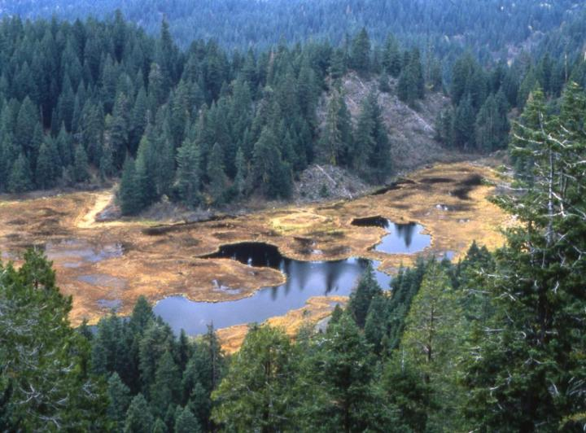
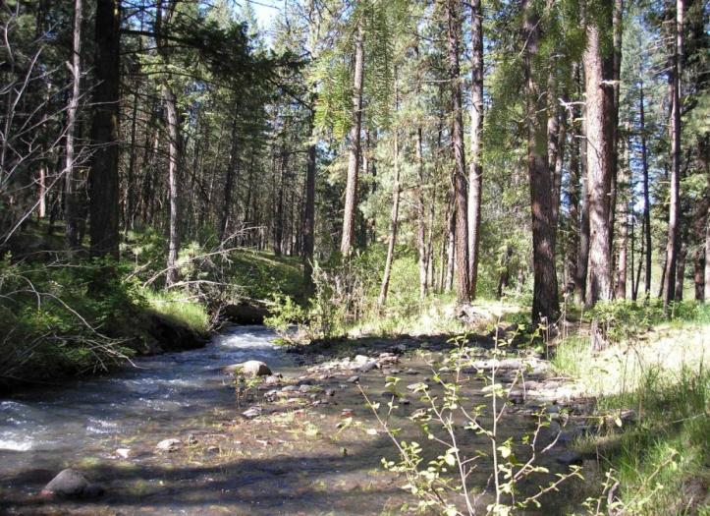
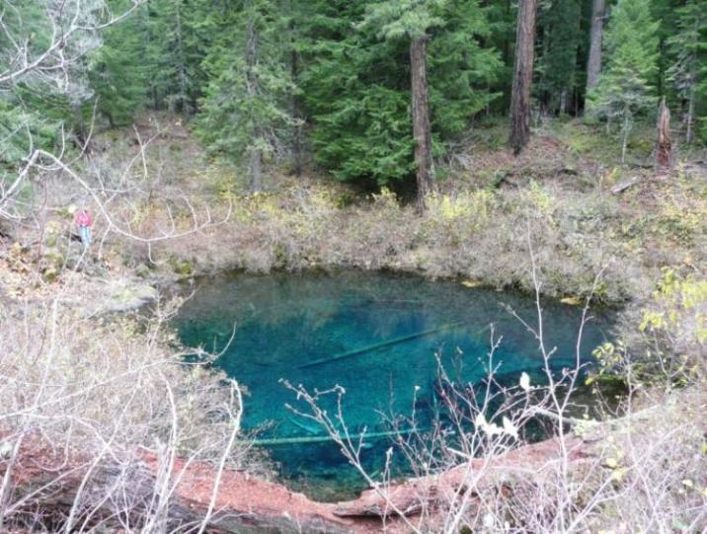
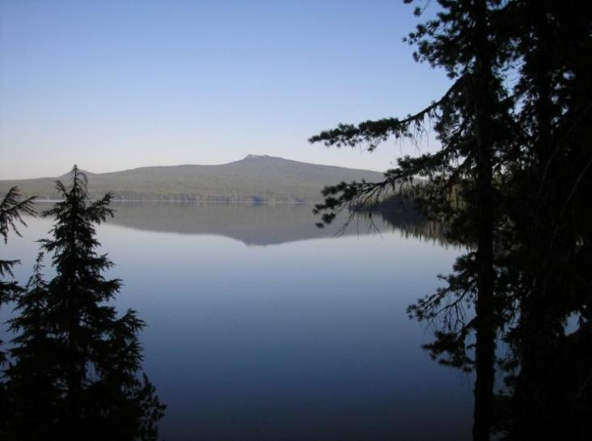
wetlands
rivers
sharon’s fen: l olson
mckenzie river: l bach
springs
lakes
mckenzie spring: d gusey
wallowa lake: l bach

Slide 3
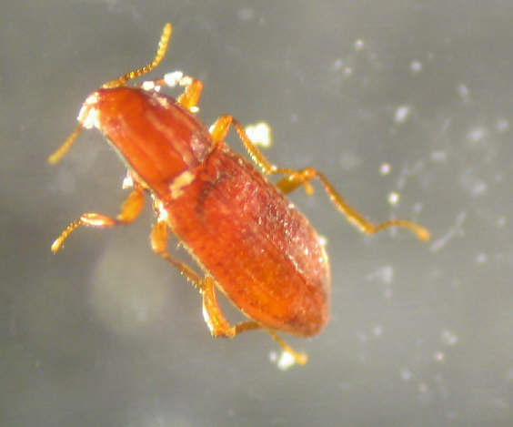
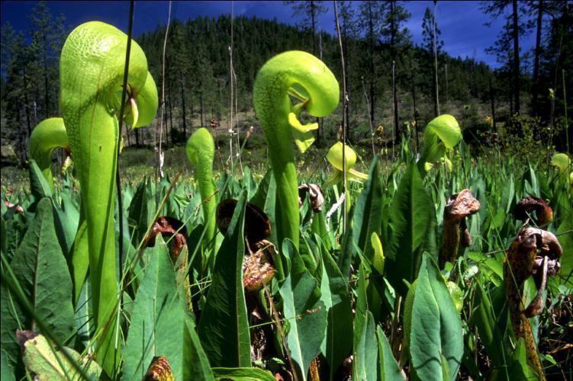
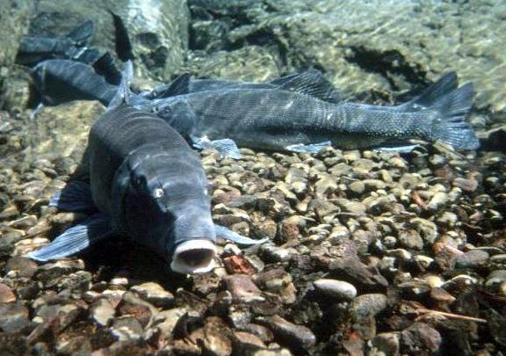
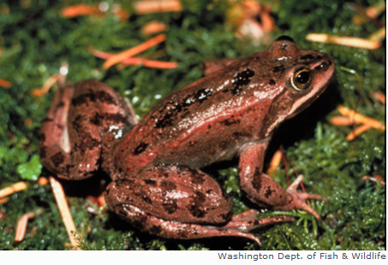
blind elmid: m tomlinson
darlingtonia: a hesterman
blind elmid: m tomlinson
lr sucker: t blake
or spotted frog

Slide 4
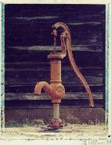
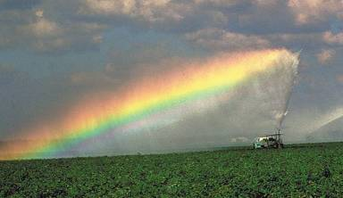
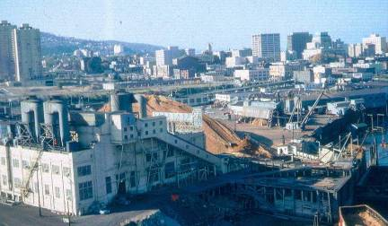
groundwater pumping
irrigation
municipal
supply
industry

Slide 5
Statewide assessment of
GDEs and threats
Methods Guide for
including groundwater in conservation plans

Slide 6
Ecological Water Requirements (EWRs)
“Intrinsic water requirements of ecological attributes of groundwater-dependent ecosystems”
quantity (timing, volume)
late season baseflow in streams
perennial water supply in wetlands
quality
oligotrophic water supply
cool water

Slide 7
TNC/USFS partnership
Develop and implement ecological water requirements (EWRs)
Pilot study in groundwater-dependent wetlands (fens) in the Fremont-Winema National Forest

Slide 8
Ecological Water Requirements
(EWRs) for fens
Sustained groundwater discharge
Water table close to land surface
Plant & animal communities adapted to:
prolonged saturation
organic peat soils
frequent anoxic conditions
low nutrient availability
Frequent sustained anoxia
Peat accretion or maintenance
Notes:
make note that this is an example for a GDE wetland

Slide 9
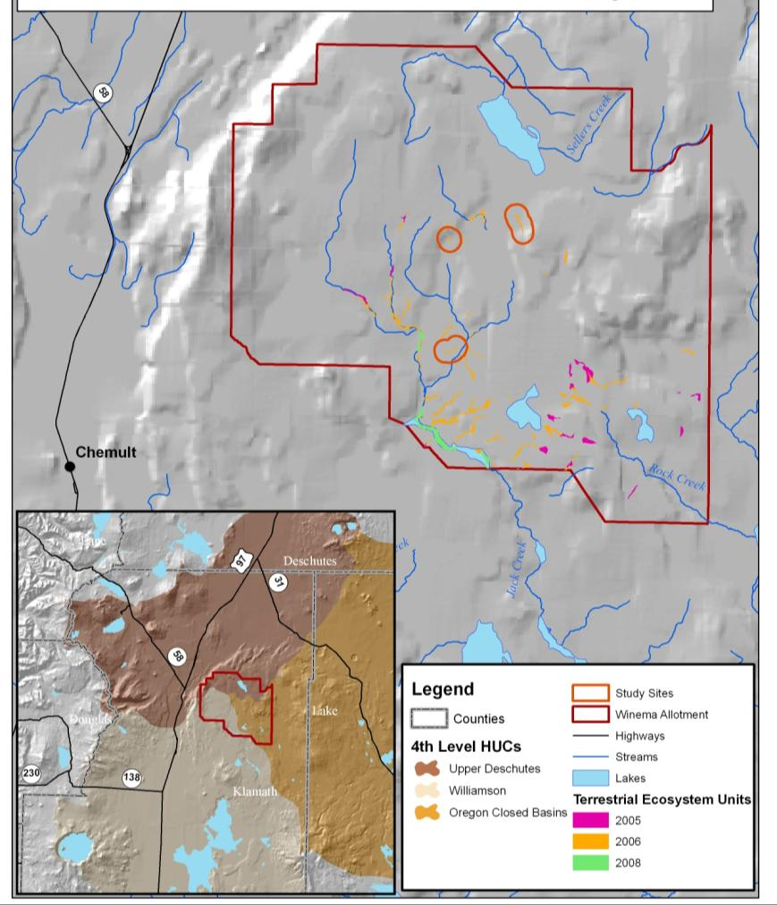
Fens of the Fremont-Winema National Forest

Slide 10
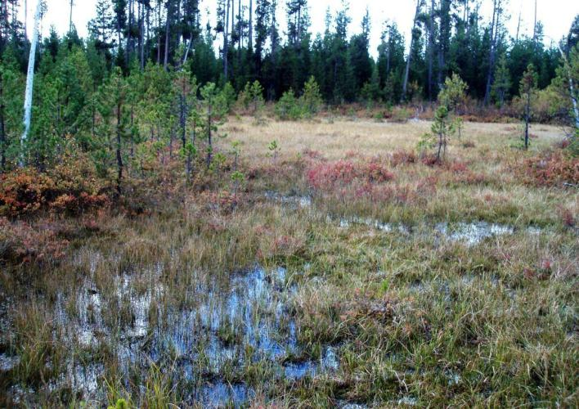
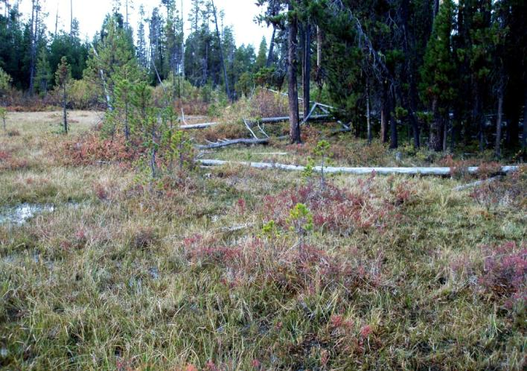
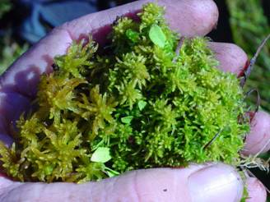
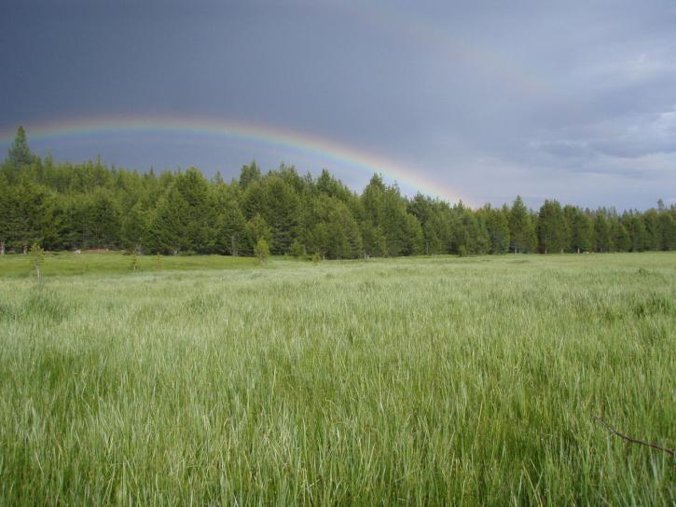
Fens of the Fremont-Winema

Slide 11
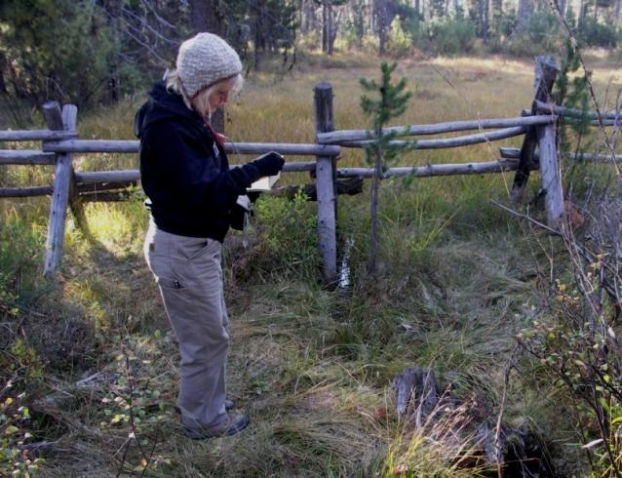
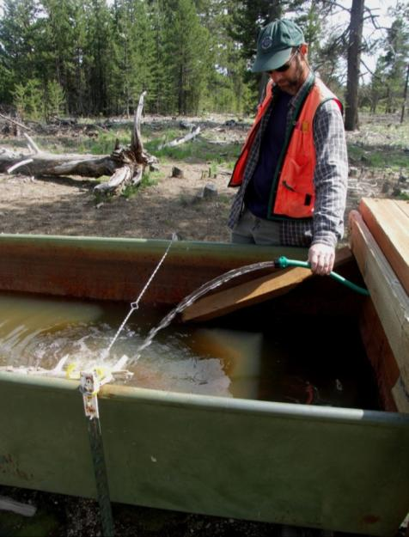
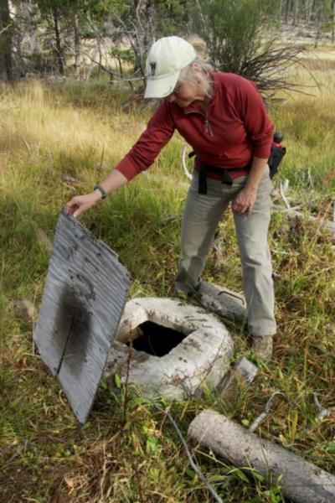
Management context

Slide 12
Ecological Water Requirements: Approach
Premise: fen species and ecosystem processes
respond most closely to the hydroperiod
Measure plant & soil water table thresholds
Maximum pumping rate that does not exceed water table threshold
Model groundwater flow into the wetlands
vary the pumping rate
determine water table drawdown

Slide 13
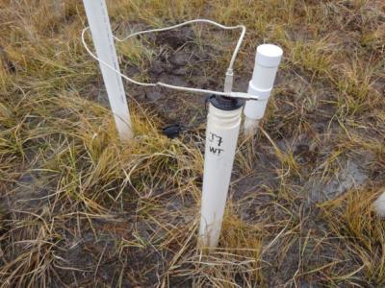
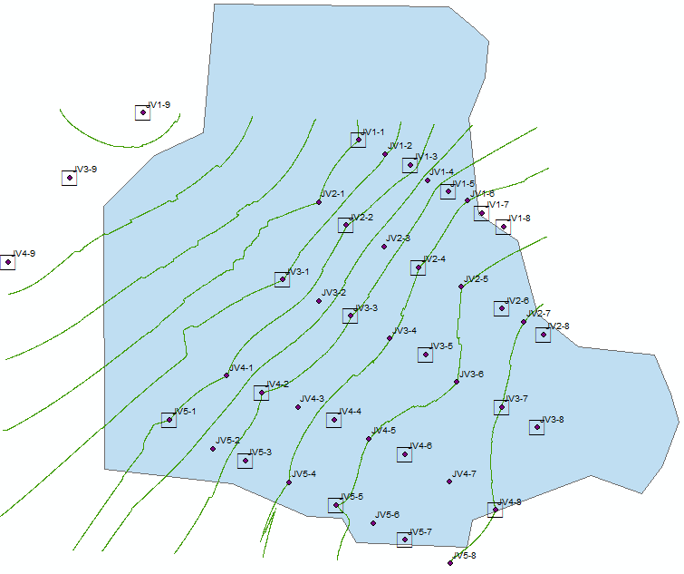
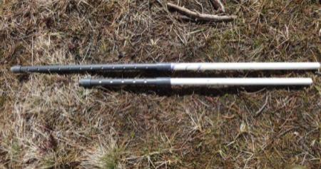
Johnson site set up
measure along each transect:
depth to water table
head at 1m, 1.5m
plant species composition
peat depth

Slide 14
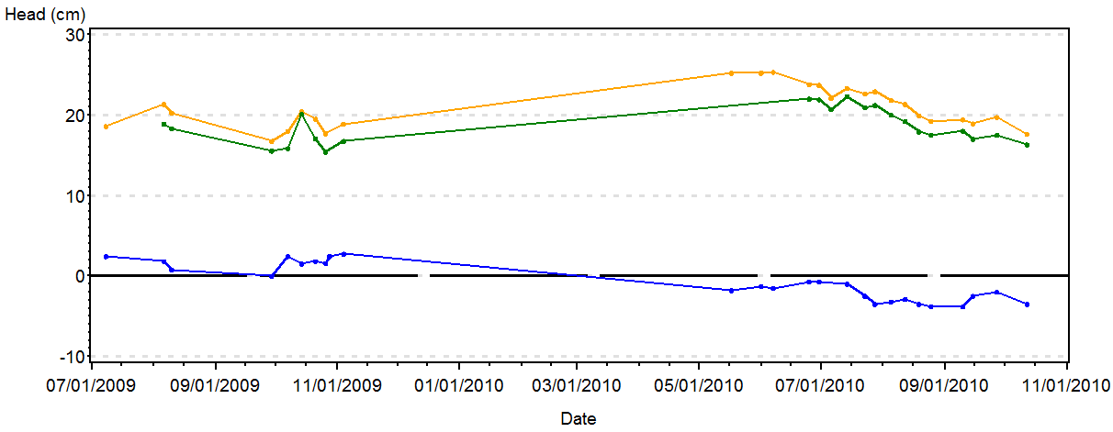
Shallow hydrology, Johnson Fen, 2009-2010
water table
piezometer at 1m
piezometer at 1.5m

Slide 15
Water table thresholds for indicator species
Obligate wetland plant
Widely distributed: found at all sites
Common: occurs in >10 plots/site

Slide 16
Ecological Water Requirements: Approach
Premise: wetland plants respond most closely to the
hydroperiod (position of the water table)
Measure plant & soil water table thresholds
Maximum pumping rate that does not exceed water table threshold
Model groundwater flow into the wetlands
vary the pumping rate
determine water table drawdown

Slide 17
peat
drawdown (20cm max)
affected radius
pumice
water piped to trough
Notes:
a superposition model was used. No recharge was applied

Slide 18
NW
Drilled well
groundwater dates 28-42 years likely recharge ~10km
SE
Pumice
Peat
Bedrock
Notes:
Discharge from the bedrock from preferential flow paths in the horizontal unconformities at the contact between capping basalt units and lower permeability non-flow units

Slide 19
Hydrogeologic model
numerical superposition model (Modflow)
3 layers (peat, clay, pumice)
75 day pumping during dry season
no recharge or ET applied
boundary 1.5km from pumping well
outside edge is no-flow

Slide 20
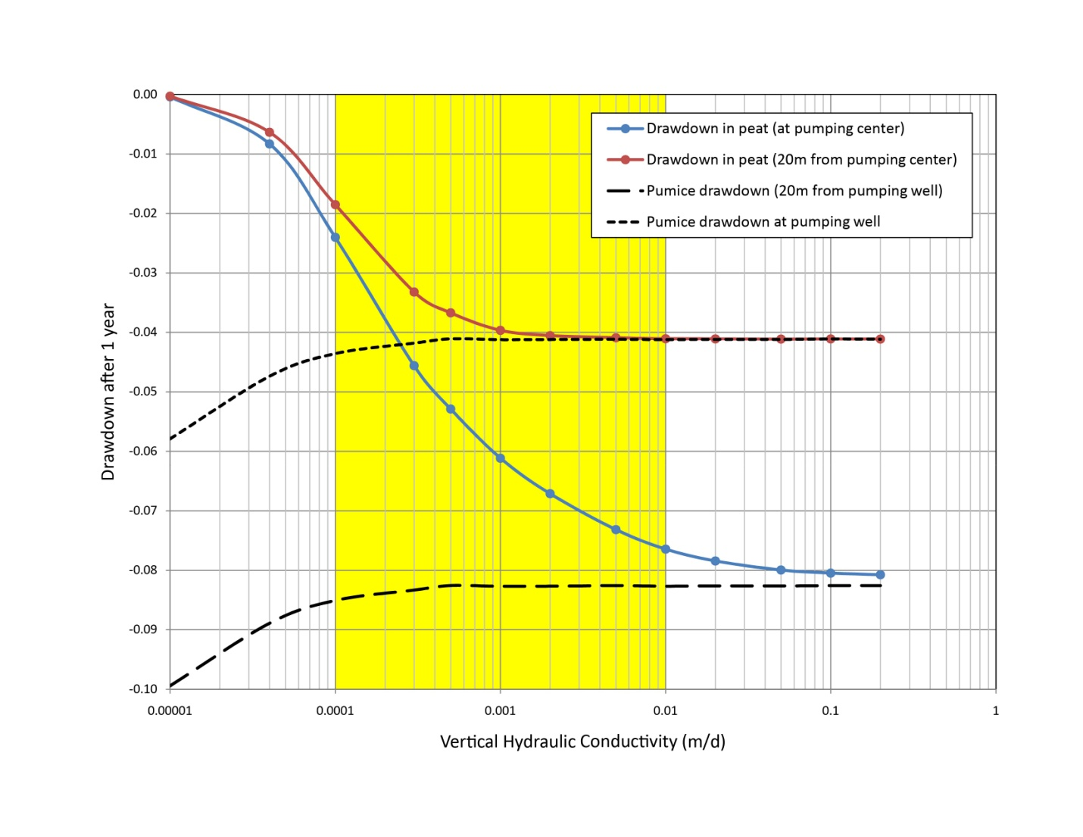

Slide 21
Conclusions
Plant WT threshold 15-20cm
methods to set thresholds for peat accretion?
Pumping has no or limited effect on drawdown
Ecological Water Requirements – next steps
more complex scenarios
thresholds have potential to be exceeded
field test in more sites
methods for peat depths

Slide 22
