Slide 1
Real Time Flood Forecasting for the Willamette Basin using HEC-CWMS / ResSim Modeling By: Shali Bogavelli and Dan Christensen sbogavelli@westconsultants.com May 25, 2010 Corvallis, OR

Slide 2
Presentation Overview
Summary of HEC CWMS & ResSim
Overview of Willamette Basin
ResSim Model Inputs
Physical Data
Reservoir Operation Rules
State Variables / Scripts
Model Results

Slide 3
HEC CWMS Summary
Corps Watershed Management System
An integrated system of hardware, software, and communication resources supporting the Corps’ real time water control mission
Major components:
data acquisition (observations)
database
modeling (forecasts)
Notes:
CWMS stands for the Corps Watershed Management System. Real time decision support for water management.
The Army Corps of Engineers is responsible for round-the-clock monitoring and operation of more than 700 CE reservoir, lock and dam and other water control projects, and during flood operations this responsibility expands to include an additional 120+ Section 7 projects.
Water control management provides critical information and hydrologic decision making that are fundamental to achievement of the full range of benefits from all our projects.
It’s more than just a modeling program like HMS or RAS—it is a comprehensive, an integrated system of hardware, software, and communication resources for real time water decision support.
The major components are database, data acquisition (observations), and modeling (which produce the forecasts).
CWMS has been around for awhile, and version 2.0 is currently being deployed by HEC.
WEST was involved in the deployment of the LA, Omaha, Portland, and Mobile District CWMS models.
Data Acquisition (Observations)
Collects real-time data from data streams
Decodes, validates, and transforms the raw data
Database – ResSim model gets data from the NWRFC
Stores hydromet data in Oracle DBMS
Manages retrieval and display of same
Modeling (Forecasts)
Manages model configurations for watersheds
Runs models for operational forecasts

Slide 4
HEC CWMS Summary
Models used in CWMS
HEC-HMS - Hydrology
HEC-ResSim – Reservoir Simulation
HEC-RAS - Hydraulics
HEC-FIA - Flood Impact Analysis
Notes:
These are the modeling possibilities in CWMS…
HEC-HMS – The purpose of HMS is to simulate a precipitation event using observed or forecasted precipitation data in order to compute the runoff from that event. Computes runoff from observed and forecasted precipitation data.
Computes forecasted flows.
HEC-ResSim – main purpose of ResSim is to simulate the operation of a reservoir or system of reservoirs.
Simulates reservoir operations and downstream flows from HMS input.
HEC-RAS – Analyzes river hydraulics to compute water depth, velocity, and inundation boundaries.
Computes stages and inundation areas from the ResSim input.
HEC-FIA – Economic/Impact Analysis. Computes damages and benefits for different scenarios.
Computes damages and impacts from RAS stages or ResSim flows.

Slide 5
Integrated Watershed Modeling Shared Features
User Interface
Map Background
Stream Alignment
Modeling Layers
Projects
Computation Points
Notes:
Only the HEC-ResSim component was developed for the Willamette Basin, but the watershed was setup so that in the future HMS, RAS, and FIA could be added. Purpose of watershed setup is to provide a common framework for watershed creation and definition.
User Interface: CAVI = Control and Visualization Interface
Executes and controls various models
Can choose what models to use
Can set model parameters
Visualize results
Can generate and compare alternatives.

Slide 6
WHAT is HEC ResSim?
HEC’s model to simulate reservoir operations (releases)
It can simulate the operation of a reservoir or reservoir system for an observed, synthetic, or predicted flow event using a defined operation scheme.

Slide 7
ResSim Overview
Watershed Setup
Reservoir Network
Simulation
Notes:
For reservoirs you need to define the physical characteristics of the pool, set up a hierarchical outlet structure, and also set up the operational plans.
Junctions and control points will have inflow, observed, and stage lookup data.
Routing Reaches are defined with Muskingham-Cunge and provide connectivity and hydrologic routing.
A Guide Curve is a seasonal or variable target pool elevation. The basic guide curve operation is that within physical limits, the model wants to get the reservoir pool elevation to the guide curve as fast as possible.
The Zones divide the storage pool into operational zones. A prioritized set of rules within each zone limits or over-rides basic guide curve operation.
In general, rules involve:
Complex Local and Downstream Flow Objectives
Release or Pool elevation Rates of Change
Emergency Gate Regulation and Induced Surcharge
Local and System Hydropower requirements
Parallel and Tandem Reservoir Systems
User-Scripted release objectives
If-Blocks, include additional constraints of the use of one or more rules
ResSim Alternatives – for the reservoir network, select one operation plan per reservoir, define the initial conditions by setting the lookback period, and connect the time series of flows to the inflow locations.
A Simulation or Forecast can be set up by selecting a specified Time Window and select alternative to be consider.

Slide 8
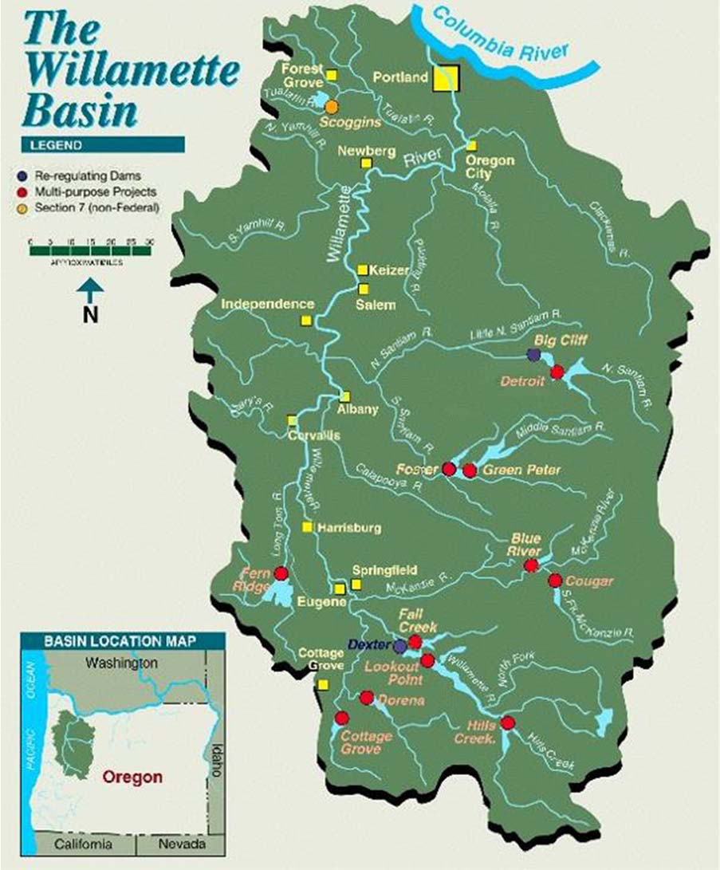
Willamette Basin Overview
Area: 11,500 mi²; 13th largest river in lower 48 states.
13 Army Corps Dam : 2 are re-regulating dams
Dam operation objectives
Flood control
Hydropower
Water Quality
Fisheries
Irrigation
Summer flow augmentation (summer recreation)
Notes:
70 percent of Oregon resident’s live in the Willamette Basin. Central part of State’s ecomomy.
Objectives for Reservoir operation and water allocation are…… Recently, there has been a shift in the objective priority. Flood Control is still #1, but hydropower is being superseded by fisheries.
Currently, Portland District had a daily time step model used for seasonal planning. Wanted to have a model with hourly time –step to link to NWRFC forecast data for real-time operations
Army Corps wants their own forecast model. Currently the Corps works closely with the NWRFC (their forecasting model)

Slide 9
Willamette Biological Opinion
2008 Willamette Biological Opinion (BiOp)
National Marine Fisheries Service
Adopted mainstem Willamette River flow targets at Salem for April through June
Minimum flow rules
Ramping Rates
Notes:
Concerns about fish population have led to 2008 Willamette Basin Biological Opinion
The National Marine Fisheries Services (NMFS) completed a consultation with the US Army Corps of Engineers and other agencies on the impact of the Willamette River Basin Project on species listed for protection under the Endangered Species Act.
Flow recommendations are based on correlations between flow and water temperature during the juvenile steelhead out-migration and subsequent adult returns
In addition to the normal operation of the Willamette Project for flood
control, hydropower, in-stream water rights, irrigation, and summer flow augmentation, the
Willamette Project will be operated to maintain spring mainstem flows based on the Oregon
Department of Fish and Wildlife (ODFW) minimum flow objectives for juvenile winter
steelhead, as requested and submitted to the Corps of Engineers (Corps) by National Marine
Fisheries Service (NMFS) in the 2008 Willamette Biological Opinion.
d. In the past few years, the Corps has adopted mainstem Willamette River flow targets at
Salem from April through June based on recommendations from NMFS and ODFW (through
OWRD). The flow recommendations are based on correlations between flow and water
temperature during the juvenile steelhead out-migration and subsequent adult returns. Upper
Willamette River (UWR) winter steelhead is listed as "threatened" under the ESA.

Slide 10
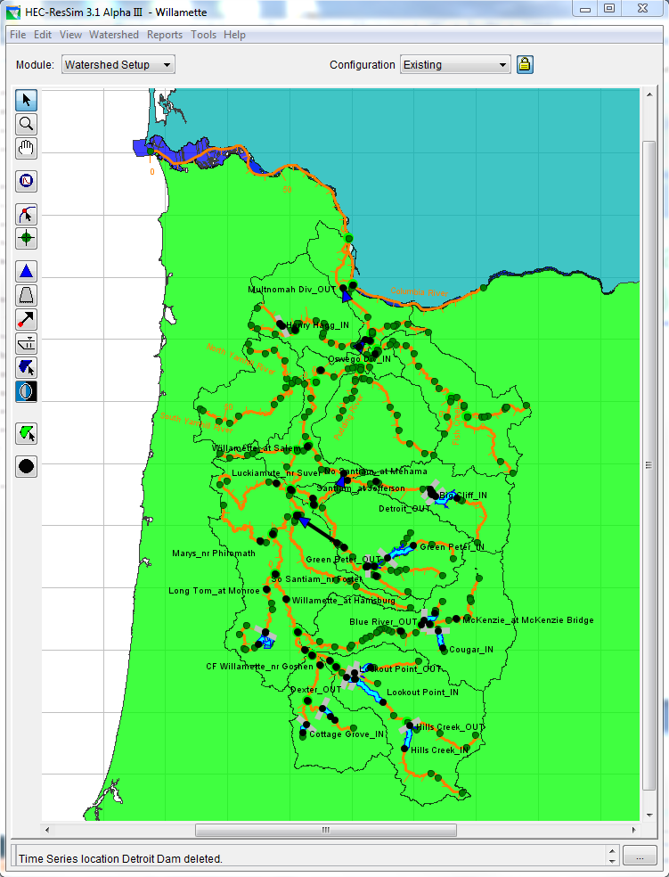
ResSim Watershed Setup
Where you define…
Background images (shapefiles)
Stream Alignment: reach elements, nodes, and junctions
Project Elements: reservoirs, diversions, levees, storage areas
Computation points: points of interest (gages, confluences)
Configurations:
Physical arrangement of elements that will be used to make a ResSim Network (ResSim model).
Notes:
Local inflows for junction points

Slide 11
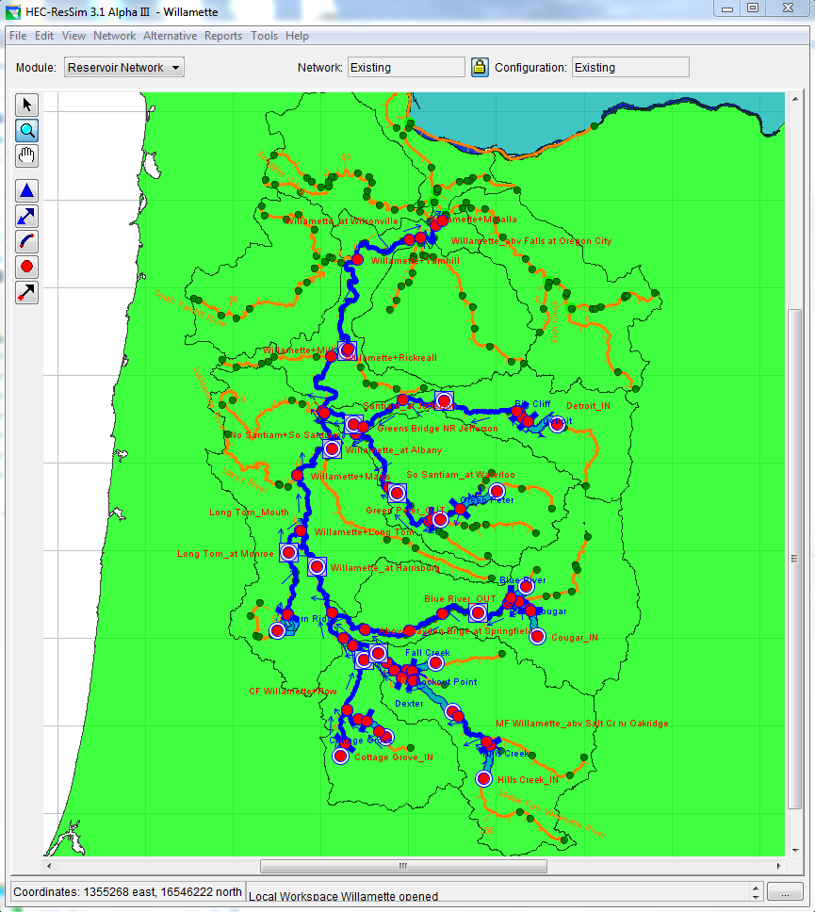
ResSim Network
Create the ResSim model elements
Automatically from configuration and manually
Define Routing Reaches
Assign parameters
Physical parameters (outlets, storage curves, routing)
Reservoir rule operations
Define Alternatives
Assign a set of reservoir rule operations
Assign computation timestep
Assign input data (lookback, initial conditions, & observed)
Notes:
Set up of zones.

Slide 12
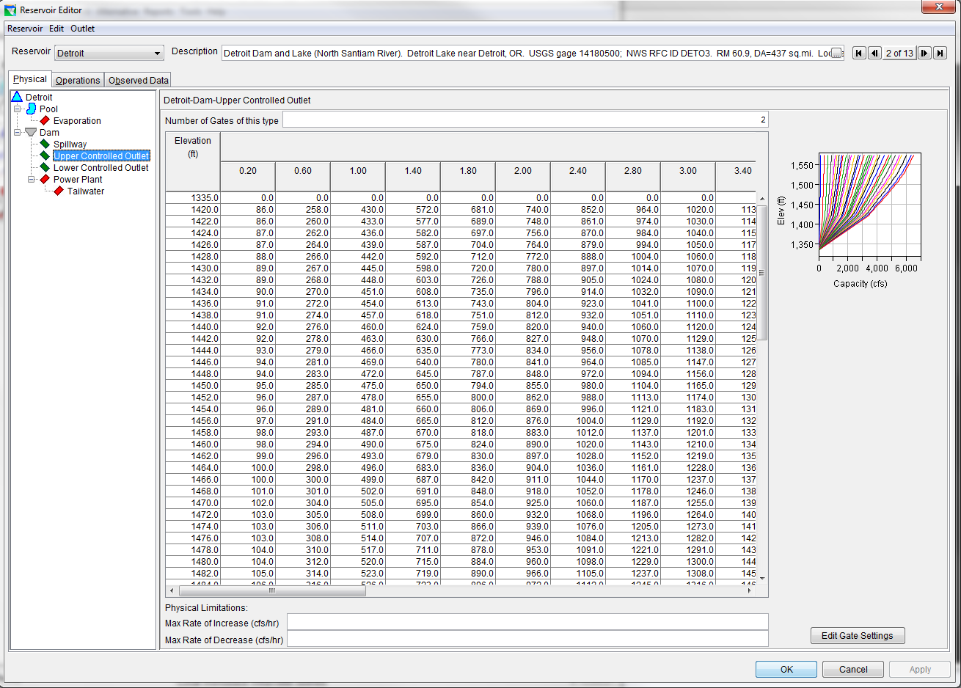
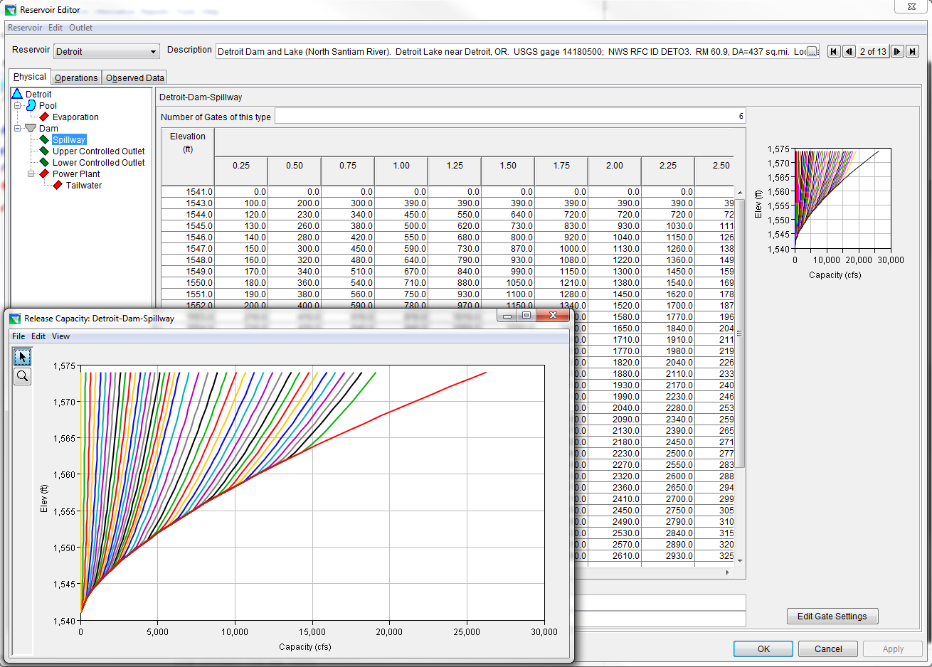
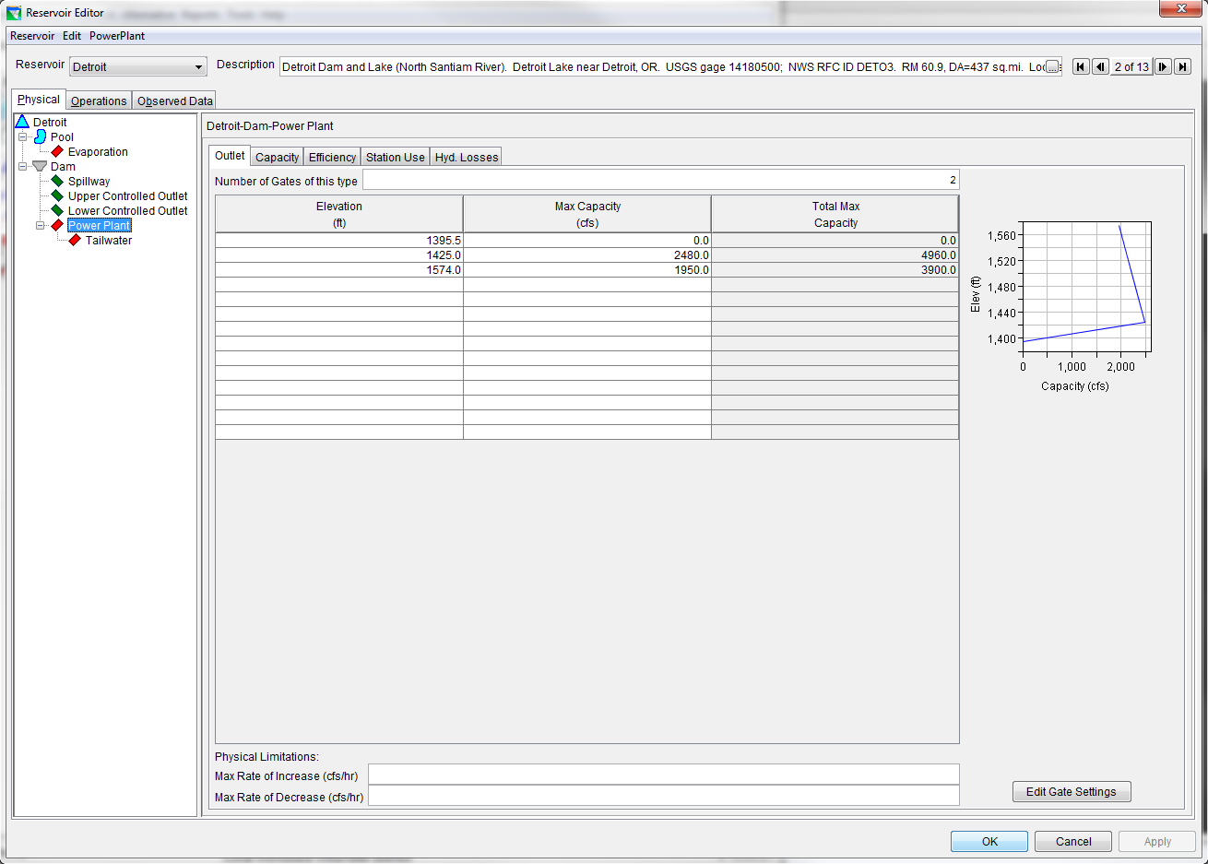
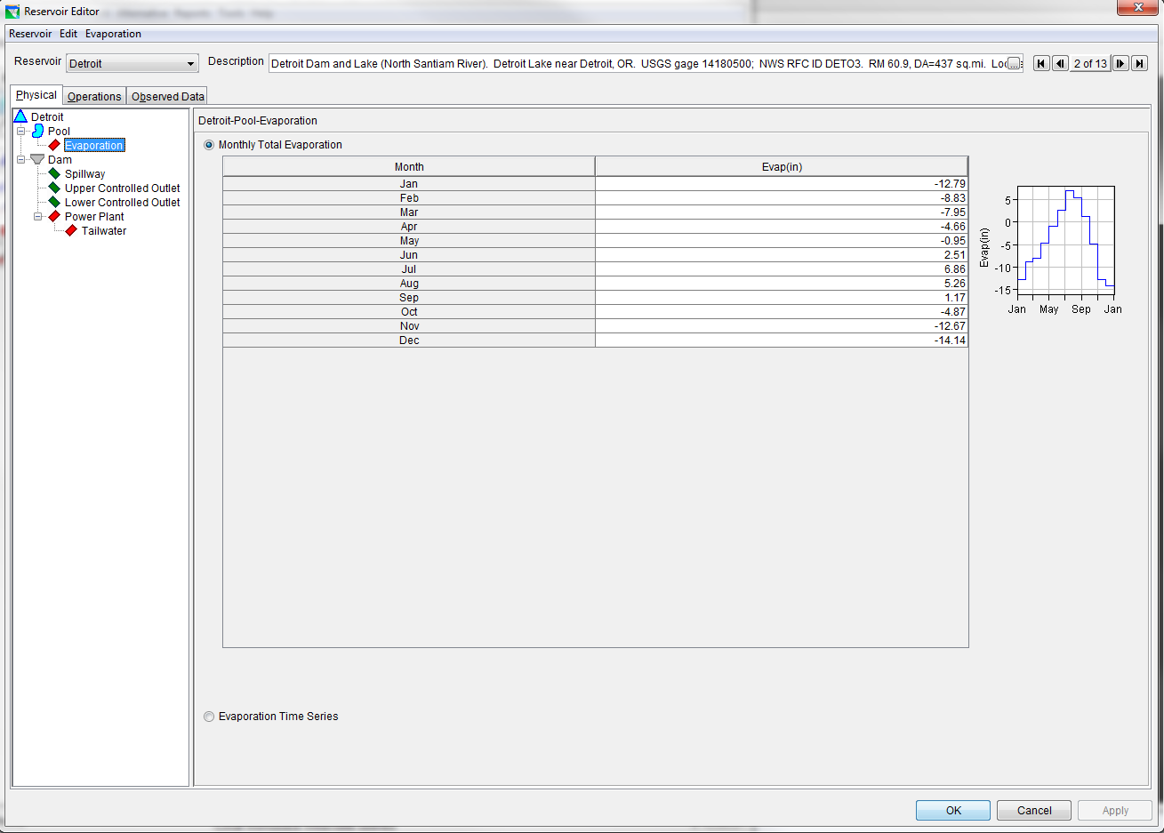
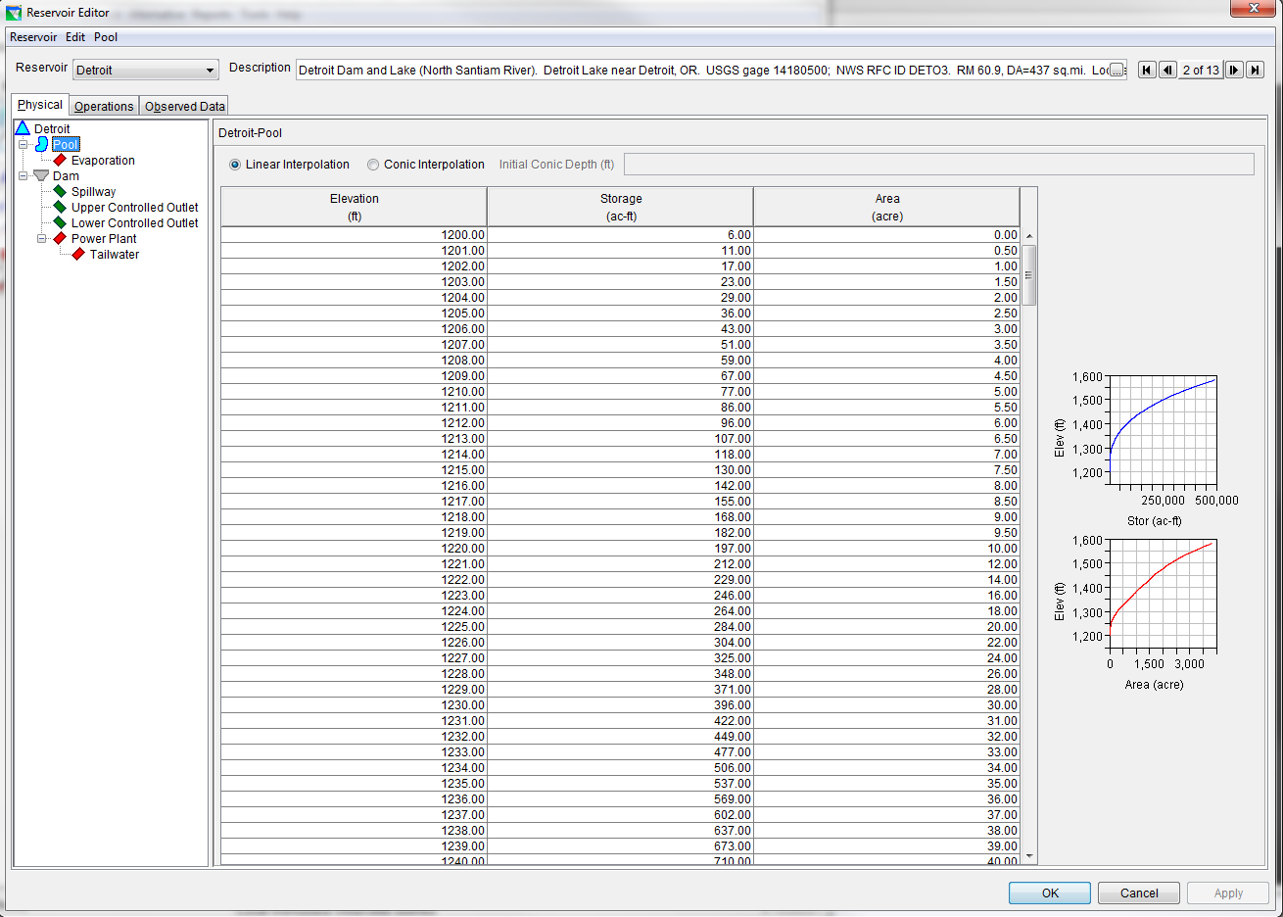
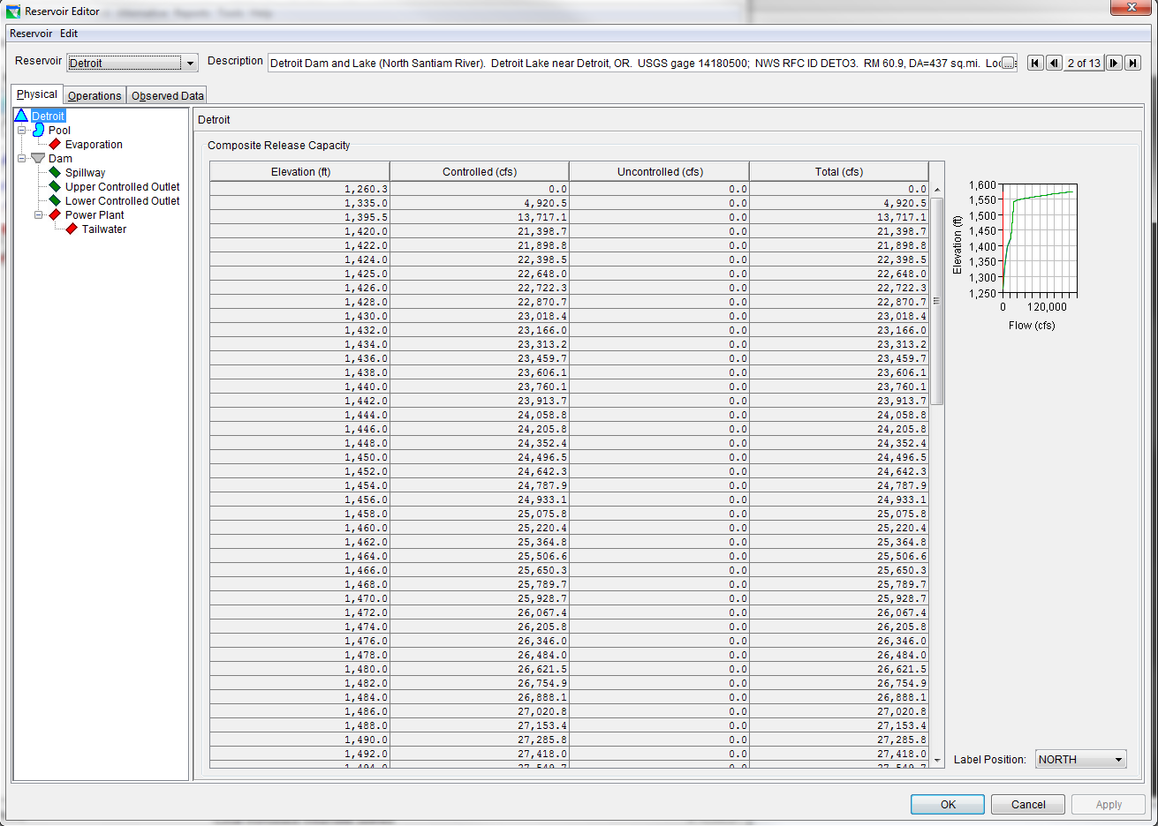
Physical Data

Slide 13
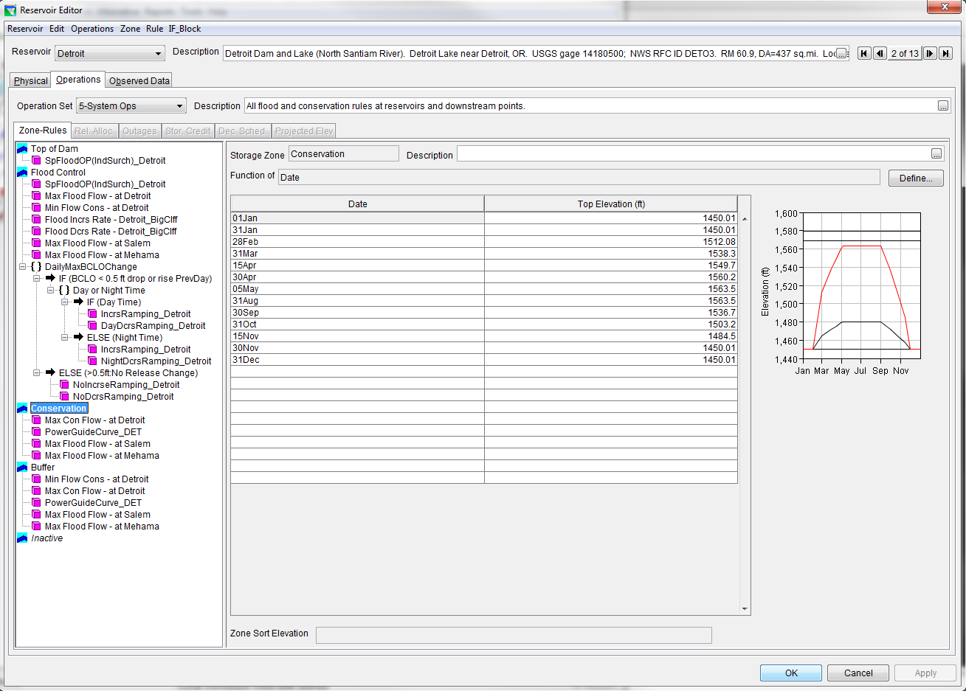
Reservoir Operation
Notes:
Operational rules are hierarchical
Pool divided into zones

Slide 14
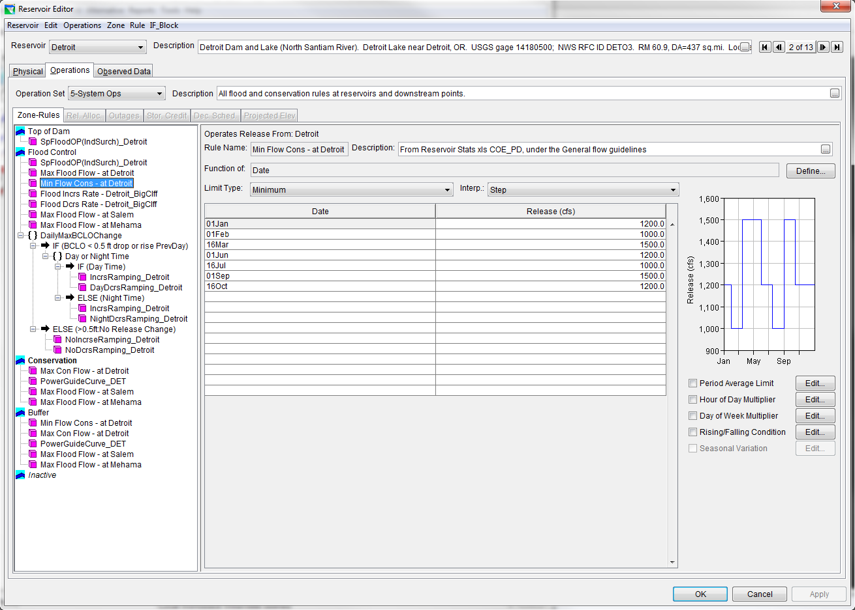
Min and Max Flow Rules

Slide 15
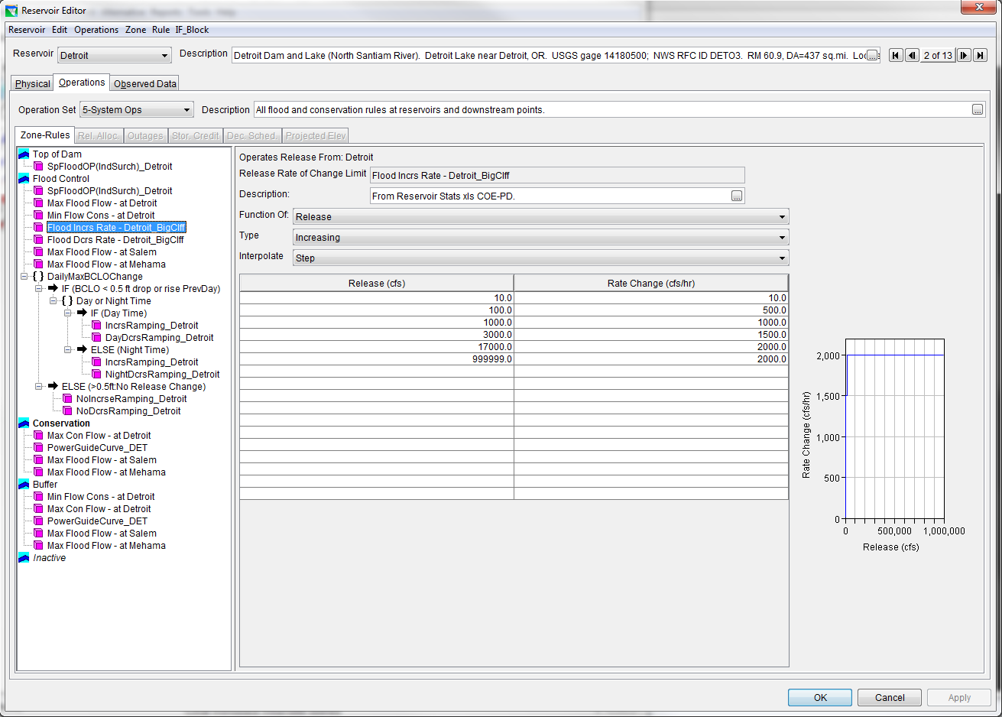
Flow Rate of Change Rules

Slide 16
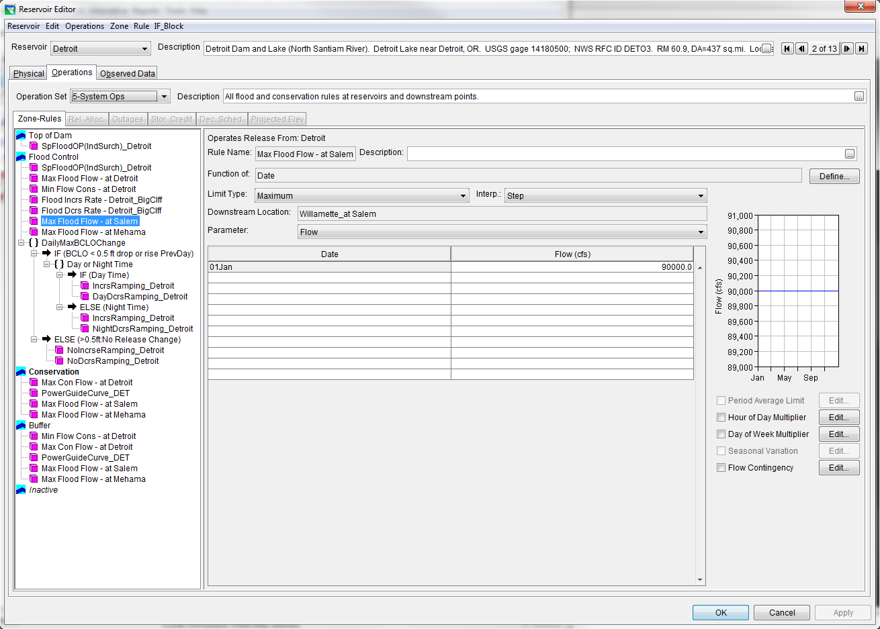
Downstream Rules

Slide 17
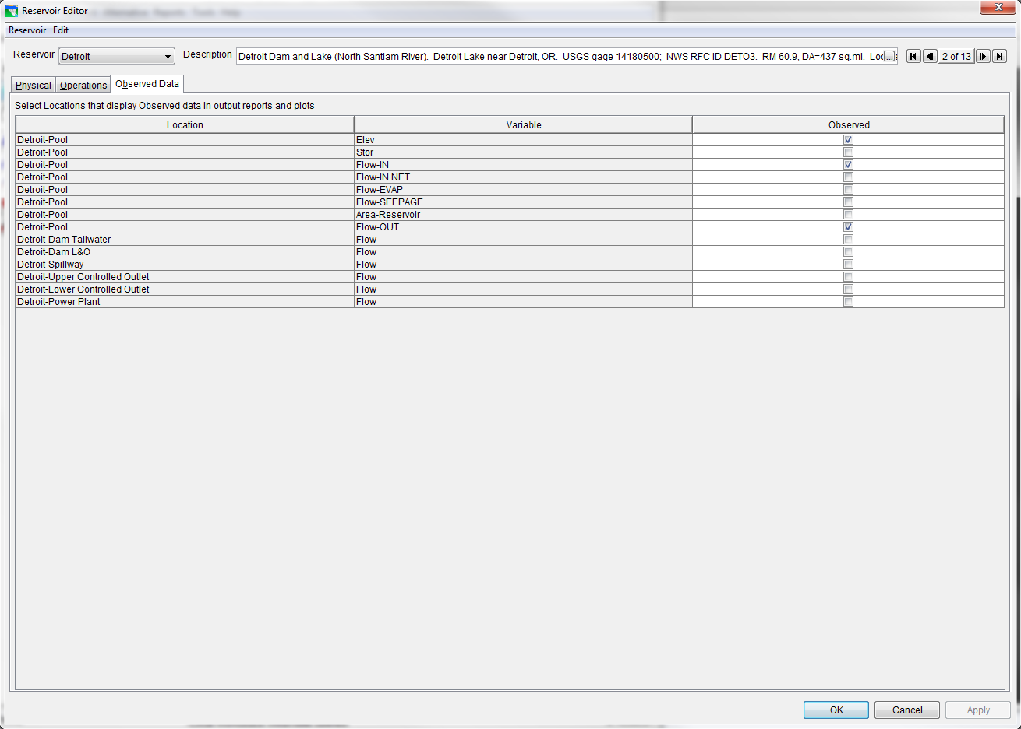
Observed Data

Slide 18
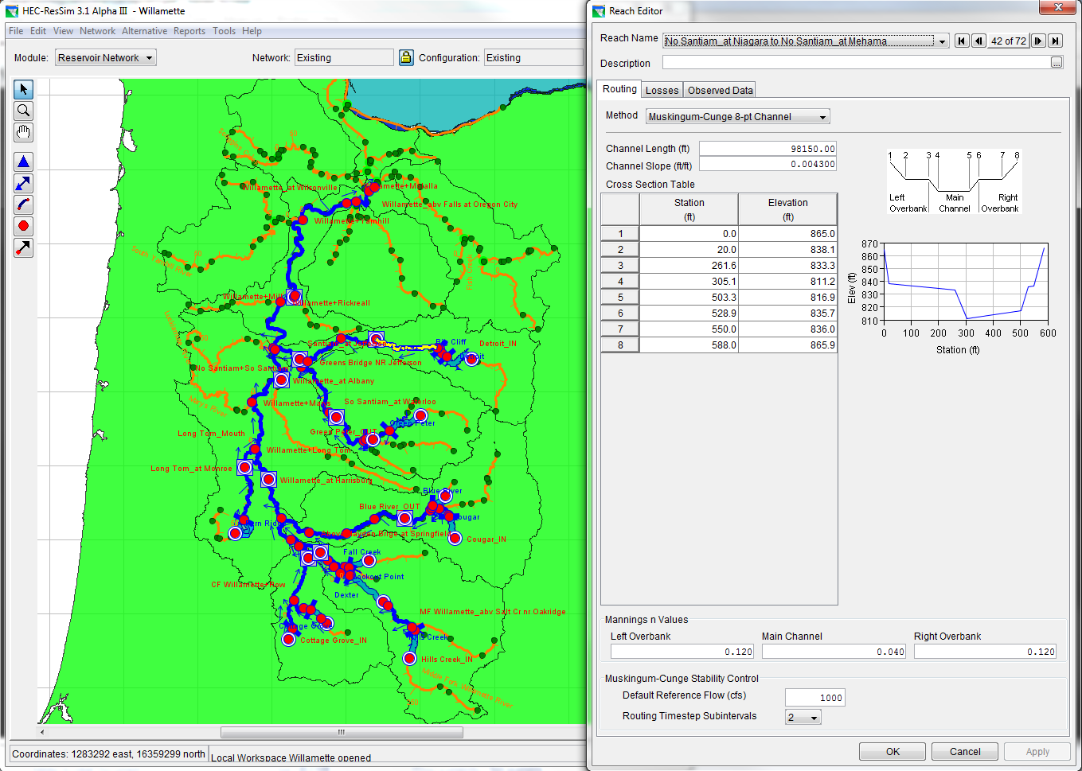
Routing Reaches

Slide 19
State Variables / Scripts
State Variables are user-defined (scripted) model variables for each time step.
SV can be a function of internally computed ResSim model variables or from external variables (dss files)
Examples:
BiOp flows: rate of change rules as a function of downstream river stage conditions
Releases based on reservoir pool temperature
Notes:
State variable can represent complex or abstract concepts that effect the model release decisions.
We will show you an example of how we used it in our Willamette Basin model. (BIOP Ramping Rates)

Slide 20
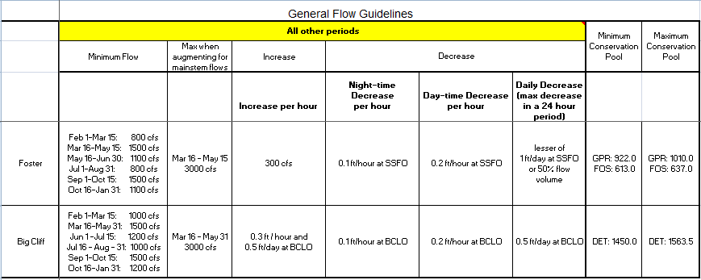
State Variable BiOp Rates

Slide 21
Simulation Results
Notes:
In the Simulation Window, you select the time window of the forecast and the alternative you want to run.
A forecast has 3 parts: the lookback time, the forecast time, and the end time
For the 2006 event:
The forecast time was a ten day period from Dec 25 at 12:00 to Jan 5 at 1:00pm
The lookback time began on Dec. 18th

Slide 22
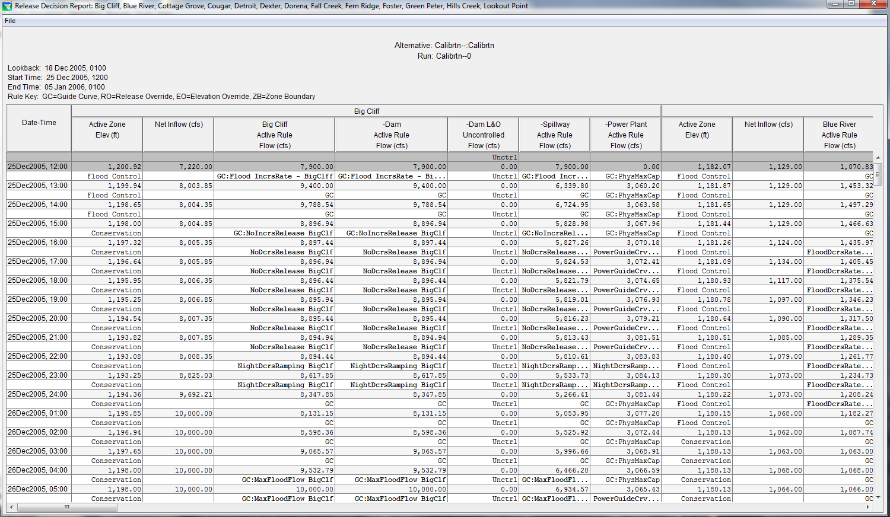
Decision Report
Notes:
A decision report is produced for each simulation run. The table lists what rule is being used at each time step, but not always the easiest thing to read.

Slide 23
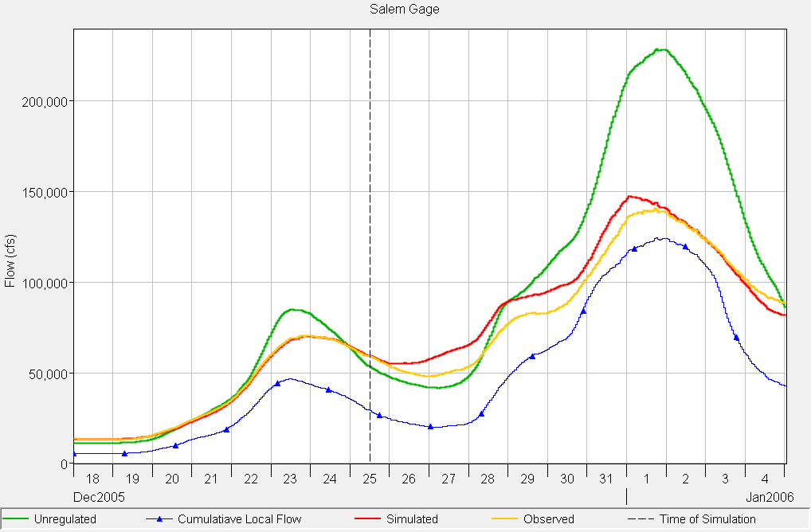
Simulation Results (Salem)
90Kcfs Downstream Rule
Notes:
Salem and Harrisburg are the 2 main gages that control the releases from the dams.
Lookback, Start of Simulation, Simulation
Downstream Rule
Colors of Graph

Slide 24
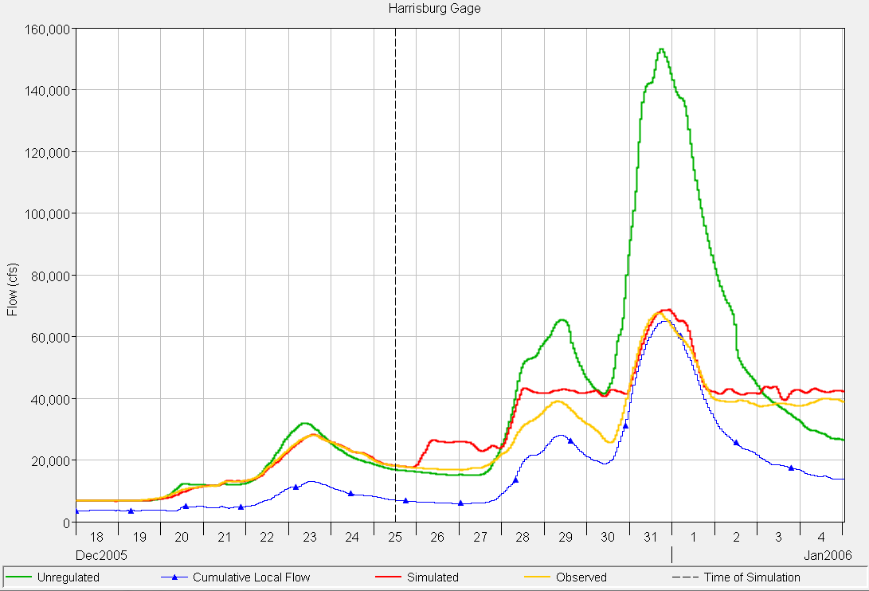
Simulation Results (Harrisburg)
42.5 Kcfs Downstream Rule

Slide 25
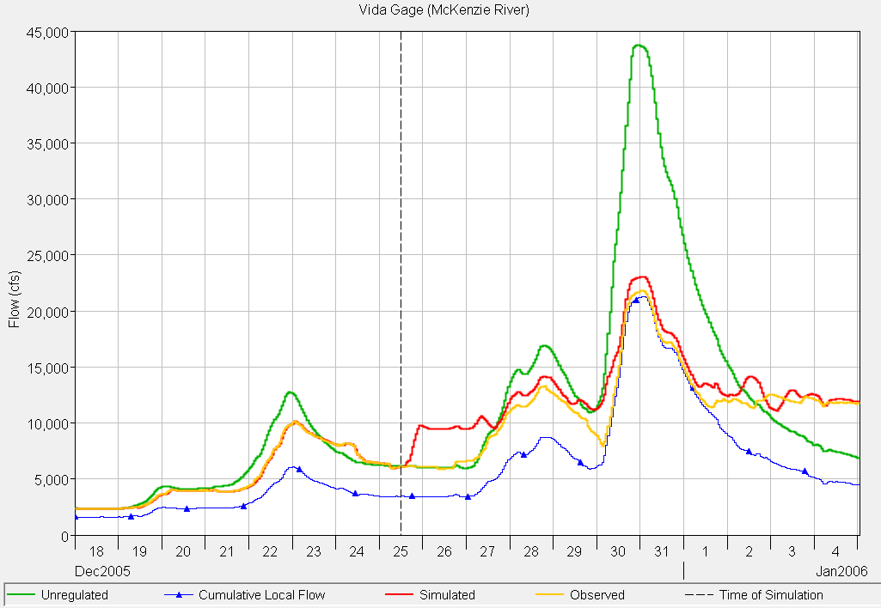
Simulation Results (Vida)
14.5 Kcfs Downstream Rule

Slide 26
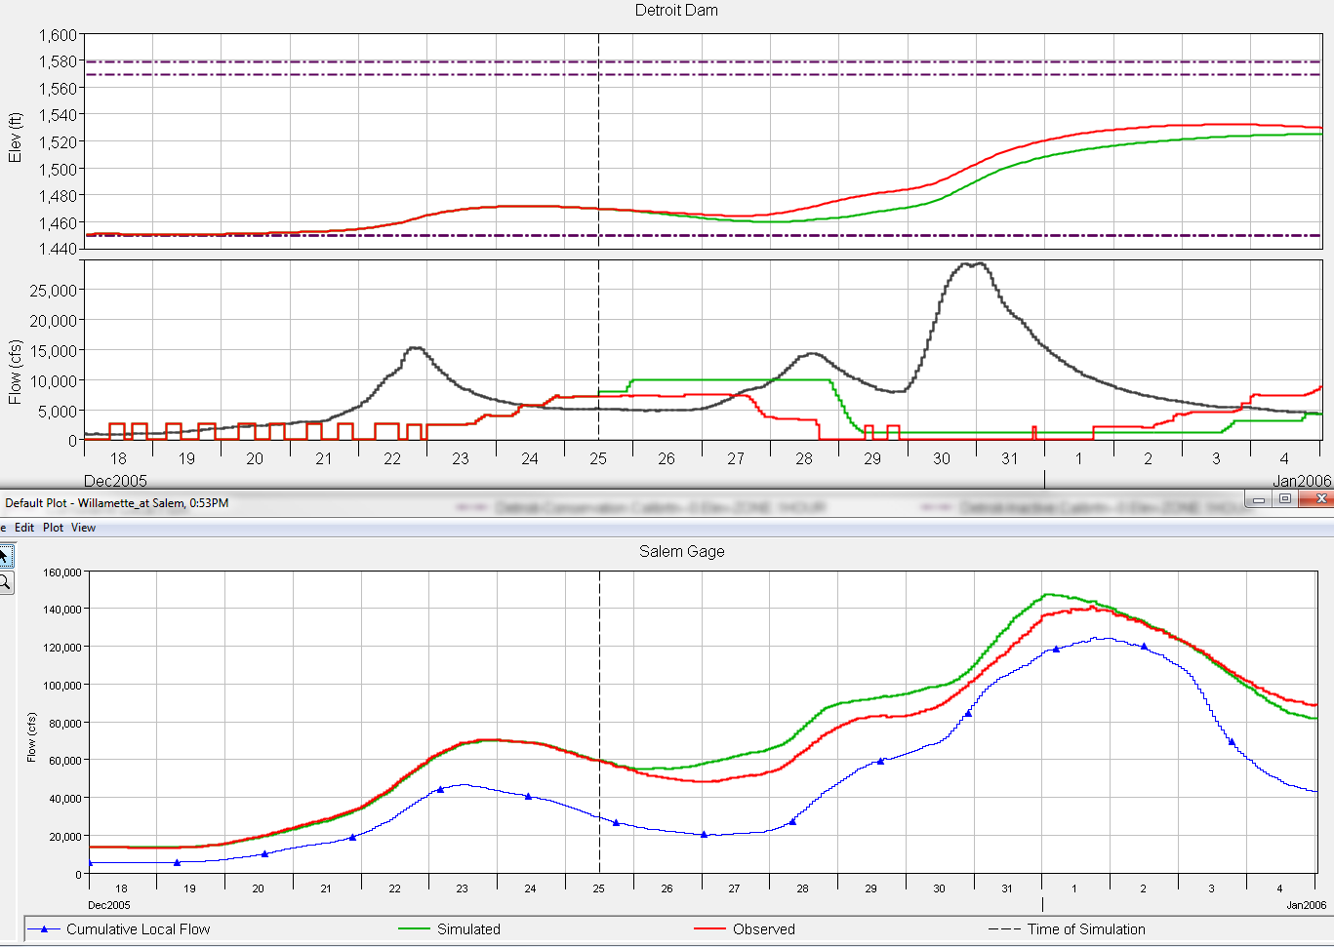
Detroit Dam and Salem Gage

Slide 27
Detroit Dam and Salem Gage
Increase Rate of Change Allowed (BiOp rules)
Salem Downstream: Min
No Rate of Change Allowed (BiOp rules)
Max Flood Flow
No Rate of Change
Increase Rate
90Kcfs Downstream Rule
Notes:
Rule Decision Example - Detroit:
Figure 6 of Detroit releases also shows the rules that are triggered during different times in the simulation. The first 12 hours of simulation show how the BIOP ramping rates function. During the “No Decrease Ramping”, no flow change is allowed because during the previous 24 hours the downstream river stage has risen more than 0.5 feet, which can be seen in the BCLOmaxDailyRamping variable. At about 8 hours into the simulation, the downstream 24 hour river stage change becomes less than 0.5 feet and therefore allows the release to increase, which triggers the Increase rate of change rule until it reaches the 10,000 cfs max flow. At the start of the 29th December the Salem downstream rule is triggered and it drops the release down to the minimum flow of 1,000 cfs. The Salem downstream rule stays triggered until the 3rd January at midday and then goes through the BIOP ramping rate rules of increase ramping when the previous 24 hour downstream river stage change is less than 0.5 feet and the no rate of change rule if the 24 hour river stage change is greater than 1 foot.

Slide 28
Summary
Willamette Basin HEC-ResSim model developed for use with real time forecast data
ResSim is a powerful tool for simulating reservoir release operations
Hierarchal rules : many rules for different types of releases
State Variables and Scripts : flexibility; user defined model variables
Notes:
Developed Willamette Basin HEC-ResSim model on CWMS platform, so can use real-time data, and can have multiple users
ResSim is a powerful tool

Slide 29
Questions? sbogavelli@westconsultants.com dchristensen@westconsultants.com
29
Notes:
29

