Slide 1
Managing for Ecosystem Services Through Governance Networks: An Analysis of Oregon Senate Bill 513
Harmony Paulsen, Oregon State University

Slide 2
Overview
Research Question
Challenges in Natural Resources Management
Network Governance
Policy Tools
Oregon Senate Bill 513
Democratic Accountability
Implications for Water Management

Slide 3
Research Question
Does implementation of the Oregon Senate Bill 513 policies improve the democratic accountability of natural resource managers and professionals in Oregon?

Slide 4
Challenges in Natural Resources Management
Non-point source pollution
Private property rights protection
Waning political popularity for authority tools
Institutional and regulatory “silos”
Endangered Species Act Example
Species specific approach
US FWS within the Department of Interior oversees protection of terrestrial species and freshwater fish
NMFS within the Department of Commerce oversees protection of marine species and anadromous fish
Source: http://basiceating.blogspot.com

Slide 5
Challenges in Natural Resources Management
“The environmental problems that remain are largely beyond [the earlier regulatory paradigm’s] ability to address efficiently, effectively, equitably, and accountably.”
(Durant 2004, 644)
Source: http://pdsgroup.wordpress.com/tag/top-down/

Slide 6
Network Governance
Governance networks
Governance vs. government
Multi-actor structures
Public, private and civil actors
Reorientation of the State
Cross-scale linkages
Exchange of resources
Policy development and implementation
Full range of policy tools
Source: http://www.ctsearch.com
Source: https://www.usa-serve.com/Services
Notes:
Process vs. institution.
The idea is that, in order to cope with the complexity of natural resource systems, institutional arrangements and related management systems should incorporate different actors from different areas of society – including private and civil actors as well as public actors. Maximizing the management and exchange of resources between actors, including information, human resources, fiscal resources.
The State is just one of many actors involved in the governance processes.
Necessity of working at multiple scales depending on the problem at hand – federal, state, regional, local – also recognizing the regulatory and economic constraints at each level.
Recognizing the need for these linkages in the development and interpretation of the policies as well as implementation.
Fully utilizing all available policy tools – see next slide.

Slide 7
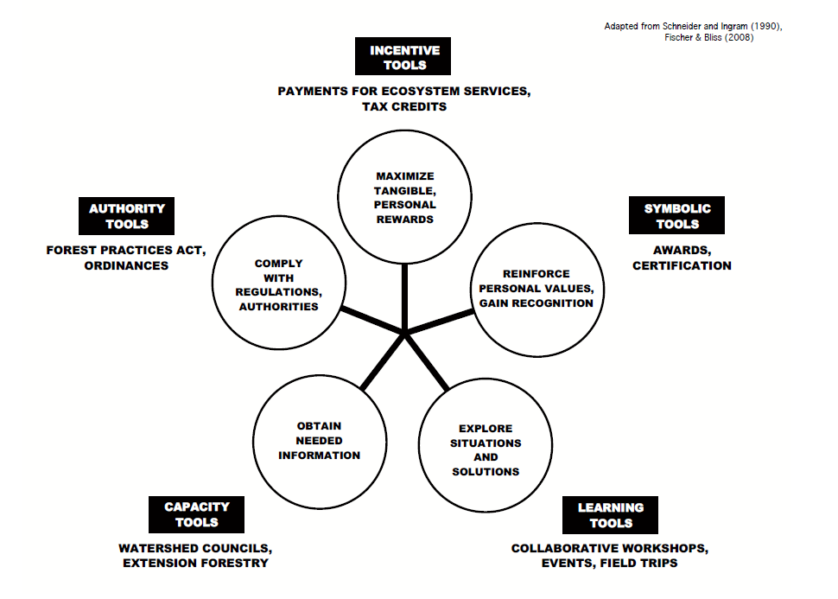
Potential Policy Tools
Adapted from Schneider and Ingram (1990)

Slide 8
Oregon Senate Bill (SB) 513
Passed by the 75th Oregon Legislative Assembly in 2009
Emphasizes ecosystem-based approach to natural resource management
Managing for ecosystem services
Encourages development of ecosystem service markets
Promotes adaptive management
Notes:
SB 513 explicitly recognizes ecosystem management as a priority of the state and acknowledges the role that the private sector must play in furthering the state’s conservation and restoration goals. This represents a fundamental shift from traditional natural resource management, which presented government agencies as the “ultimate promoters, providers, and guarantors of essential goods, services and opportunities to their citizens” (Durant, 177). SB 513 also explicitly acknowledges the role that adaptive management must play in natural resource management decision. Adaptive management is defined in the Bill as “the processes of implementing programs in a scientifically based, systematically structured approach that tests and monitors assumptions and predictions in management activities and then uses the resulting information to improve programs and management activities” (1).

Slide 9
Oregon Senate Bill (SB) 513
Natural resources management and economic development “efforts are generally fragmented, uncoordinated and often work at cross-purposes.”
“New or improved regulatory schemes and increased public awareness will make additional natural resources available to protect and enhance ecosystem services.”
(SB 513 2009, 1)

Slide 10
Oregon Senate Bill (SB) 513
Ecosystem Services Markets Working Group
Notes:
SB 513 advocates for broad participation in achieving natural resource management objectives. The ecosystem-based approach requires synergy between existing natural resource policies, government agencies, private entities and citizens in order to be successful. Furthermore, SB 513 advocates for public-private partnerships to develop new incentive-based market mechanisms that will achieve shared conservation and restoration objectives. SB 513 blurs the line between policymaking and implementation and involves a plurality of actors in both processes. The complex arrangement proposed through SB 513 policies lays the groundwork for network governance in state-wide natural resource management activities.
So does SB 513 have the potential to improve democratic accountability?

Slide 11
Democratic Accountability
Political Responsiveness
Political decisions correspond with public demands
Administrative Performance
Promises connect with outcomes
Efficiency and effectiveness in achieving outcomes
Normative Considerations
Equitable allocation of goods and services
(Weber 1999)
Notes:
Democratic accountability is a central concern of public administration theorists since it links the policies and actions of government to the political will of the citizens.
Emergence of complex governance networks has posed a challenge to traditional theories of democratic accountability, which were based on clearly defined institutions and chains of command. “The design and implementation of public policy […] no longer resides with a single governmental unit acting alone, […] but has been supplanted by often quite complex governance networks comprised of a plurality of actors”
Edward Weber proposes these three measures of democratic accountability that I use to assess SB 513.
EXTRA FLUFF!
Public administration theorists such as Woodrow Wilson, Herbert Simon and Luther Gulick, asserted that a professional public administration constructed on principles of efficiency, centralized authority, hierarchy of command, divisions of labor and scientific management would increase accountability and promote effective delivery of public services and goods so long as it was sufficiently isolated from political influence. This theory was predicated upon the strict separation of politics and administration where public agencies obediently carried out the will of the state that was expressed by elected officials. “Democracy, if it were to survive, could not afford to ignore the lessons of centralization, hierarchy and discipline” (Frederickson et al. 46)
The new public administration theorists contended that bureaucrats need to practice equitable distribution of goods and services as opposed to equal distribution, since equal does not always translate into fair. Social equity could be enhanced by increasing public participation development and implementation of policies, making bureaucratic agencies more representatives of the communities they seek to serve, or by improving the ethical decision-making ability of bureaucrats at all levels of governance. The new public administration made accountability more bi-directional, with the public agencies serving as the intermediary between politicians and the citizenry.
Proponents of the new public management sought to reinvent government so that it would “work better and cost less” (Denhardt, 141) by promoting market solutions to public problems. New public management is predicated on the following core issues: productivity, marketization, service orientation, decentralization, policy and accountability (Frederickson, 215). Accountability is achieved by better connecting government with citizens to “improve customer satisfaction with public services” and through decentralization measures which sought to place policy making processes and policy implementation closer to the affected citizens (Frederickson et.al., 215). “The “closeness” translates into government more responsive to citizen demands and better able to provide solutions suited to the geographical, social, or economic particularities of a [region]” (Weber, 470).
According to the new public theorists, the issue of accountability in public administration is increasingly complex; “it involves the balancing of competing norms and responsibilities within a complicated web of external controls, professional standards, citizen preferences, moral issues, public law, and ultimately the public interest” (191).

Slide 12
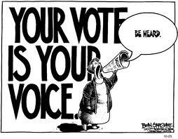
Political Responsiveness
How can we measure political responsiveness?
State Legislature
Legislative approval
Reports to the Legislature
Representative bureaucracies
Public review and comment
Involvement of public, private and civil stakeholders
Source: Ben Sargent, www.statesman.com
Notes:
How can we measure political responsiveness?
Are all interests represented?
What is the structure of the network? Do some organizations have a disproportionate amount of power and influence?
Social network analysis
One of the challenges in network governance is that you need a certain amount of cohesion in terms of shared values and norms, but too much “group think” can stifle innovation

Slide 13
Administrative Performance
How can we measure administrative performance?
Shared conservation goals and priorities
More strategic investment of resources
Emphasis on outcomes vs. compliance
Use of incentive-based policy tools
Pilot projects
Measurement/monitoring parameters
Source: http://www.110 pounds.com/?p=12504
Notes:
Compliance with a regulation may not always achieve the intended results, especially when dealing with complex and dynamic natural resource issues. For instance, mandated forest management practices that were meant to protect the spotted owl under the Endangered Species Act have resulted in “habitat so crowded with undergrowth [that] it is unsuitable for the owl” (459). In addition, wetland mitigation required under the Clean Water Act rarely results in creation of high functioning wetlands because there is a focus on acreage, which is easy to measure, rather than wetland functions.
The most significant potential impediments to administrative performance are the present lack of an institutionally recognized lead entity and limited funding.
How can we measure administrative performance?

Slide 14
Normative Considerations
How can we measure issues of equity?
Benefits to land-owners, rural communities, public agencies, private companies and the general public
For every $1 million dollars spent on restoration projects, over twice that amount of money, plus numerous jobs will be returned to the community (OSB 2010, 8)
Significant cost-savings
Ecosystem improvements
Proper government oversight
Sufficient public involvement
Source: http://ssatdirect.com/Equity.aspx
Notes:
The normative dimension of accountability is concerned primarily with the question of who benefits from implementation of policies. According to the SB 513 policy recommendations, restoration and conservation projects should result in benefits to the participating individual, the local economy, public agencies, and society at large. The report to the State Legislature recognizes that “maintaining sustainable rural landscapes is important to Oregonians, and that landowners need assistance to maintain ecological values on the land” (OSB 2010, 10).
The SB 513 working group recommends that a group of diverse stakeholders develop standard operating procedures so that if public funds are used to develop or invest in ecosystem service markets, the public will “be able to see the benefit of the purchase” (16).
SB 513 has the potential to benefit public agencies and private entities through cost-savings measures, individual landowners through income diversification, rural economies through economic development and job growth, as well as the greater citizenry through improved ecosystem services. The SB 513 working group does not do an adequate assessment of potential tradeoffs that could occur; rather it focuses on the benefits that could be received by all parties. Potential social inequities may develop, however, if mitigation efforts and consequent economic benefits are not applied in the community most negatively impacted by public or private actions. If the benefits are transferred outside of the impacted community, then the impacted community will experience a disproportionate amount of the negative externalities associated with development. Communities that are situated in the least ecologically desirable locations may also experience undue development pressures. The SB 513 working group advocates for proper government oversight of any ecosystem services market rather than a “free-market” approach to ensure equitable distribution of financial incentives and ecosystem services. Social inequities may also be prevented if impacted communities are involved in decision-making and program development from the onset.

Slide 15
Implications for Water Management
Focus on managing for ecosystem services
Market-based mechanisms
Increased inter-agency coordination
Greater involvement from other private and civil actors in policy development and implementation
Source: http://anwish.wordpress.com
Notes:
I conclude that successful implementation of the SB 513 policies has the ability to improve democratic accountability of natural resource managers and professionals by advancing the principles embodied in network governance, ecosystem-management and adaptive management.

Slide 16
Path Forward
Continue to foster networks
Identify shared objectives and priorities
Measure democratic accountability
Qualitative and quantitative measures
Temporal considerations
Fully utilize all available policy tools
Source: http://eagereyes.org/blog/

Slide 17
References
Denhardt, R. (2008). Theories of Public Organization. Boston, MA: Wadsworth.
Durant, R., C. Young-Pyoung, K. Byungseob, and L. Seongjong. (2004). Toward a New Governance Paradigm for Environmental and Natural Resources Management in the 21st Century? Administration and Society. 35 (6): 643-682.
Frederickson, G. and K. Smith. (2003). The Public Administration Theory Primer. Boulder, CO: Westview Press.
Klijn, E., J. Edelenbos and B. Steijn. (2010). Trust in Governance Networks: Its Impacts on Outcomes. Administration & Society. 42 (2): 193-221.
Oregon Sustainability Board (OSB). (2010). Senate Bill 513 Ecosystem Services and Markets: DRAFT Report from the Oregon Sustainability Board to the 2011 Legislative Assembly.
Weber, E. (1999). The Question of Accountability in Historical Perspective: From Jackson to Contemporary Grassroots Ecosystem Management. Administration & Society. 31 (4): 451-494.
Schneider, A. and H. Ingram (1990. Behavioral assumptions of policy tools. Journal of Politics 52(2): 510-529.
Senate Bill (SB) 513. 75th Oregon Legislative Assembly. (2009).

Slide 18
Thank you!
Questions?
Harmony Paulsen
paulsenh@geo.oregonstate.edu

