Slide 1


Improved Global Health through Printing & Paper-based Disease Diagnostics
Bill Bedell | Meghan Keck
Travis Heinze | Spencer Saunders
Notes:
Needs more HP logo, maybe a more direct title

Slide 2


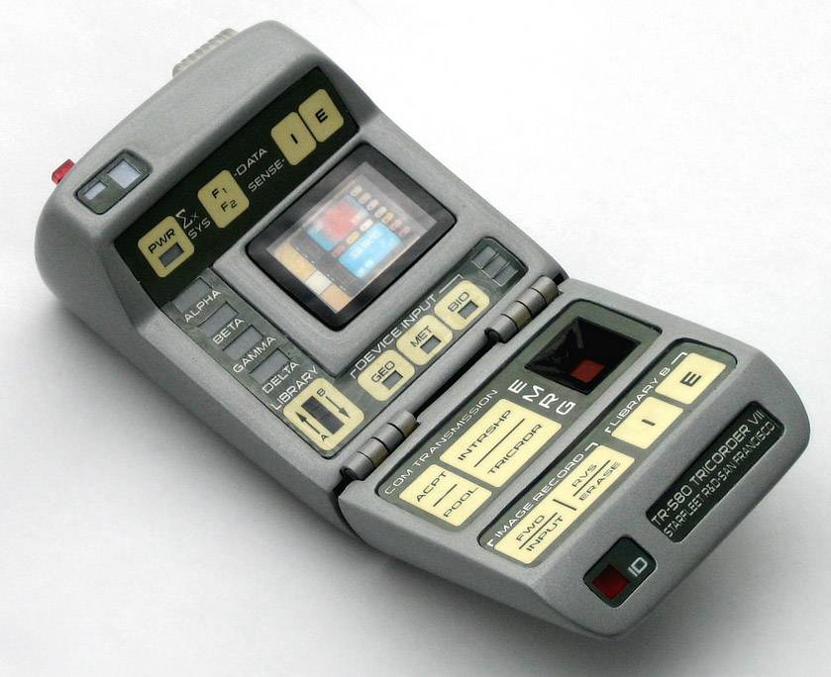
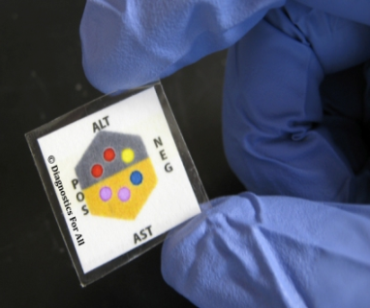



Notes:
Presenter: Bill

Slide 3
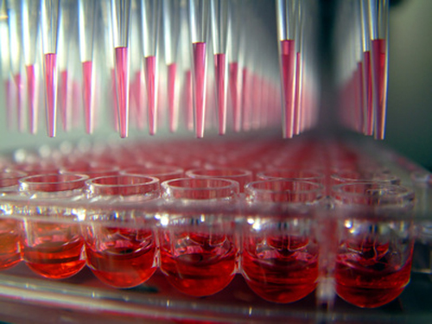
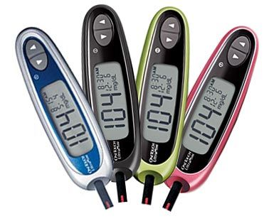
In-Vitro Diagnostics (IVD)
Biological fluids are tested for medical information
‘Point-of-care’ diagnostics are currently 30% of the industry and growing fast
Several key opportunities
  Infectious disease diagnostics
  Chronic health monitoring
Notes:
Presenter: Bill

Slide 4
Customer needs
Ease of use
Minimal training
Few steps
Portability
Handheld
Little external equipment
High Throughput
Short procedure time
Inherently scalable
?
Low consumables cost
Small scale
Easy disposal
Digital
Automatic preparation
Robust analysis
Clinical informatics
Notes:
Presenter: Bill

Slide 5
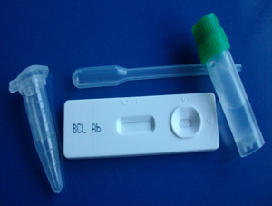
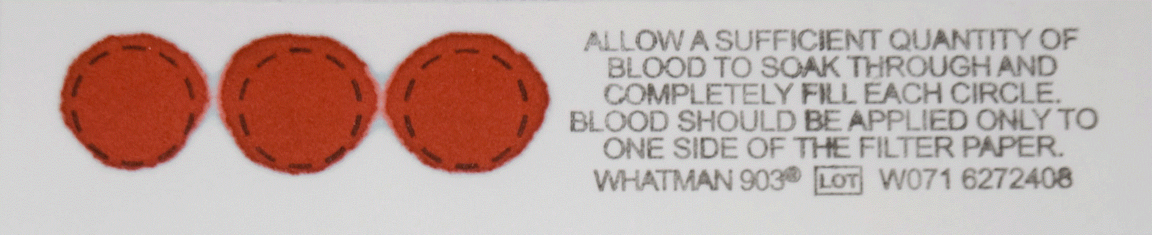
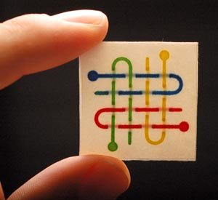
Current Market
Veterinary Rapid Test Kits ($5-$20)
  Robust and easy to use, but non-quantitative with required centrifugation
Dried blood tests ($5.00)
  Connects remote areas with central labs; accurate, but notoriously slow
Diagnostics For All ® (~$0.50)
  Inexpensive and versatile, but non-quantitative and in limited circulation
http://www.wired.com/images_blogs/wiredscience/images/2008/12/08/paperdevice.jpg
Notes:
Presenter: Bill

Slide 6
The Hewlett-Packard solution
Notes:
Presenter: Bill

Slide 7
The value of a diagnostic support system by HP
Inkjet technology for in-field reagent printing
  Smaller volumes mean lower costs
  Easily multiplex assays for personalized diagnoses
Automatic image analysis for immediate feedback
  Formerly ‘yes-or-no’ rapid tests can produce quantitative data
  Images can be locally cataloged or used in…
Remote data management for clinical informatics
  Diagnostic tool connects to a smartphone or laptop
  Easily store patient data on the HP Cloud
Notes:
Presenter: Bill

Slide 8
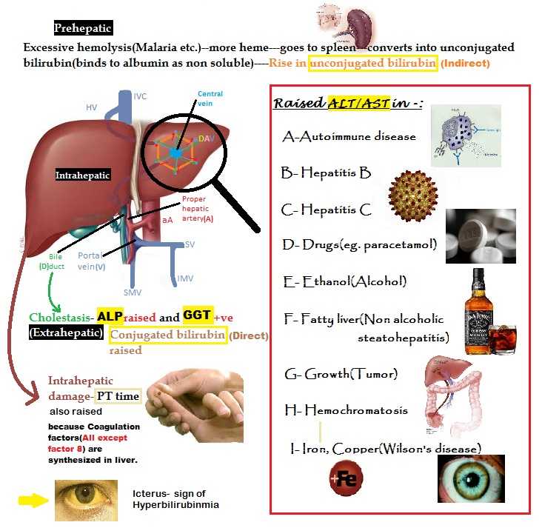
In Vitro Assay Selection – Liver Health Assays
Bilirubin Assay
Alanine Transaminase (ALT) Assay
Alkaline Phosphatase (ALP) Assay
Notes:
Presenter: Meghan

Slide 9
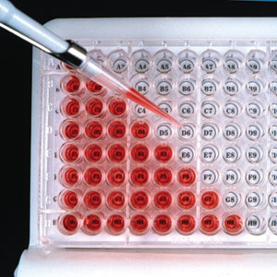


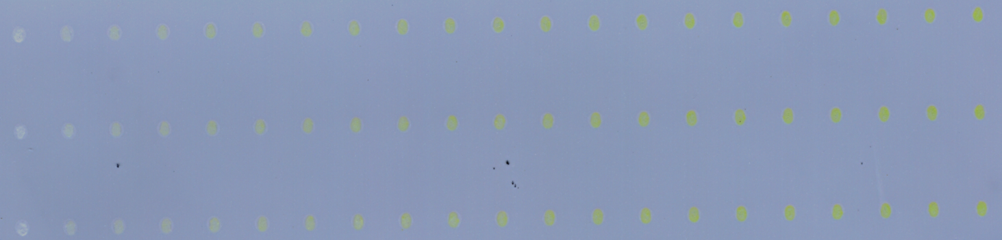
Adapting assays
Printer used to dispense assay – reducing volumes by two orders of magnitude
Paper vs. well plate
Standard curve development
Detection limits
Bilirubin Assay: 0 – 18 mg/dL bilirubin concentration in sample
ALT Assay: 0 – 9 M pyruvate
Drop Sizes: 200 – 480 nL
ALP Assay: 0 – 0.125 M substrate, 20 nL enzyme
Notes:
Presenter: Meghan

Slide 10
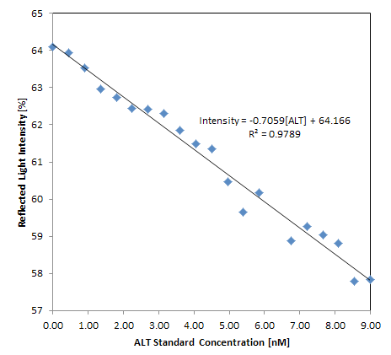
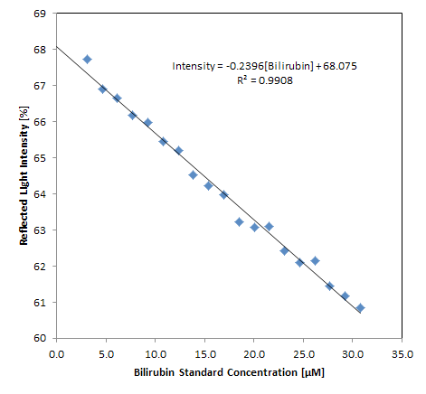
Standard Curves

Slide 11
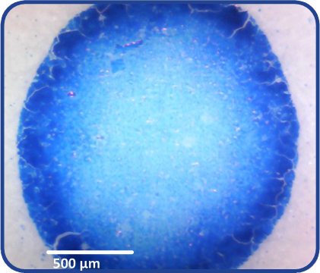


Assay Findings
Surfactant smoothed printing of aqueous reagents
Optimal print order: Reagent, then buffer/sample
Known drying time vs. drop volume controls reaction time
Pre-mixed reagents have short storage lives
Colorimetric response degrades over time
Most results show signs of a “coffee ring” effect
Reagent –paper reactions cause false results
Drop Sizes: 200 - 400 nL
Notes:
Presenter: Meghan

Slide 12
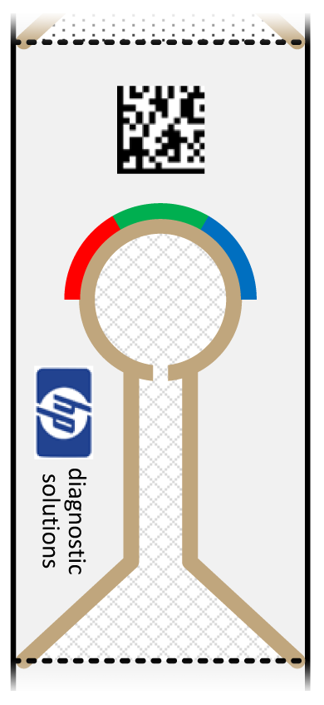
Potential Test Strip Design
Wicking and agglutination for serum separation
Quantifiable colorimetric response
Standardized form for accurate reagent printing
Unique ID for data handling
Notes:
Presenter: Meghan

Slide 13
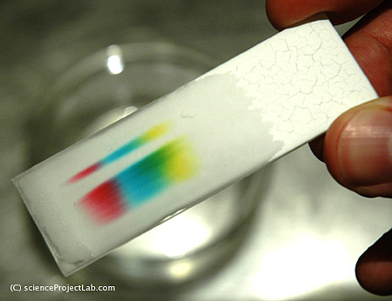
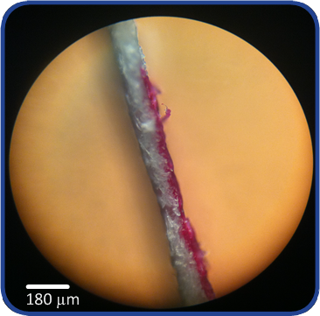

Microfluidics
Chromatography paper is an effective media, providing fast wicking & adequate colorimetric response
Hydrophobic ink provides barriers that completely permeate through paper media to prevent leaks and guide sample flow
Controlled wicking distributes equal sample volumes for multiple assays
Notes:
Presenter: Meghan

Slide 14
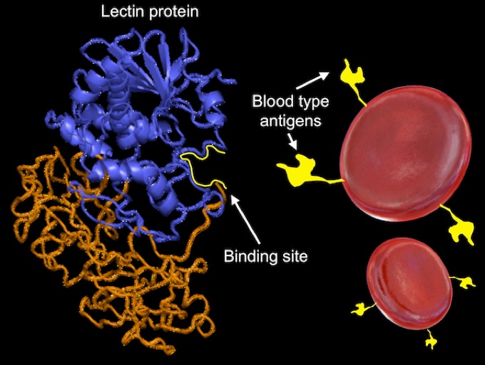
Blood Separation
Red Blood Cells (RBC) interfere with colorimetric response
Agglutination may be an effective method for blood separation
Wheat-Germ-Agglutinin (WGA) is a viable choice
  Agglutinates mammalian RBCs without lysing cells
  Relatively heat and pH stable
Notes:
Presenter: Meghan

Slide 15
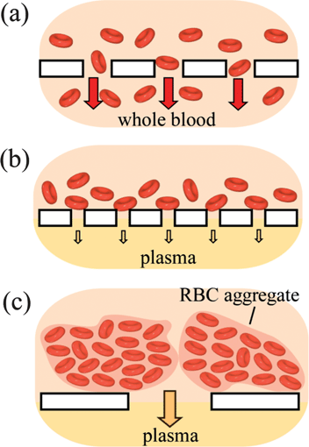
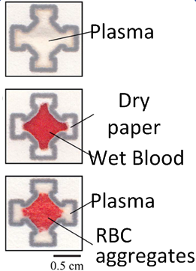
Blood Agglutination
  WGA binds to N-acetylneuraminic acid on RBC, allowing plasma to wick to the reagent site
  Viable for a variety of mammalian RBC agglutination, expanding use to veterinary field
Notes:
Presenter: Meghan

Slide 16
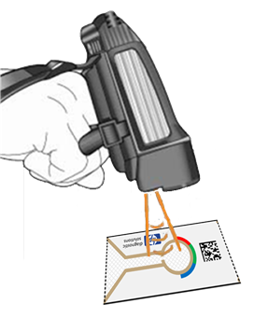
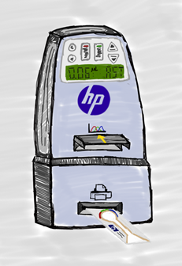
Handheld Printing
Current device:
  Printer with replaceable cartridges
  Barcode scanner used to identify products
  Camera capable of imaging while printing
Future tool might incorporate:
  Screen for basic user interface
  Barcode scanners for data handling
  Colorimetric scanner/imager in the device
  Wireless connectivity
  Reagent printer with interchangeable reservoirs
Notes:
Presenter: Travis
Handheld Printer presentation goes here

Slide 17
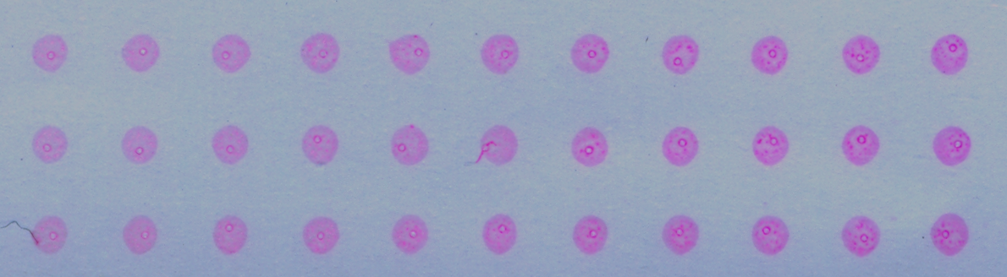
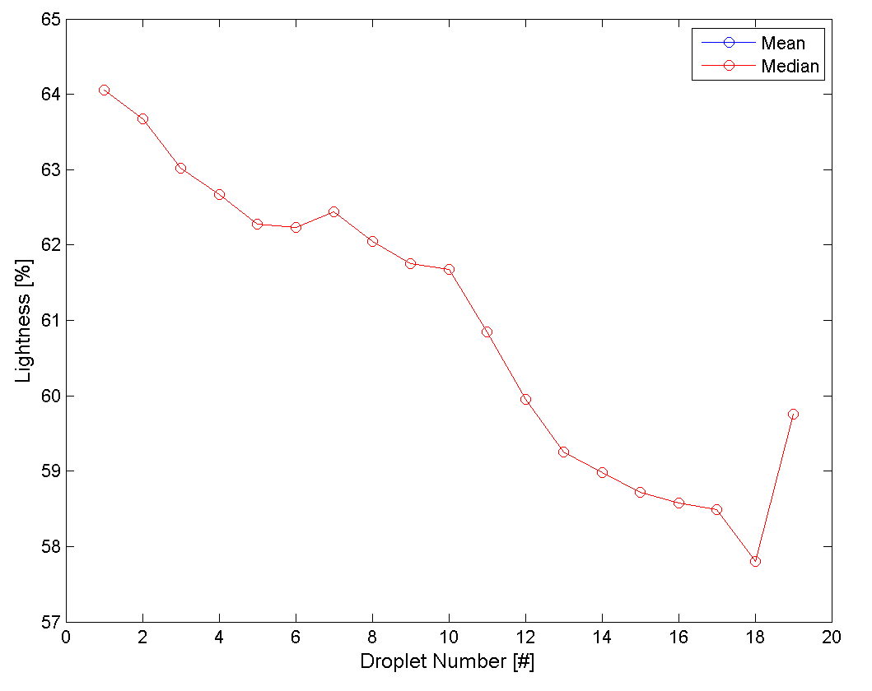
Colorimetric Analysis
Notes:
Presenter: Spencer

Slide 18
Colorimetric Analysis
Assay Scan
Greyscale
Avg. Color
Cleaned B/W
Outlines + Original Img
Filled Drops
Object Outlines
Notes:
Presenter: Spencer

Slide 19
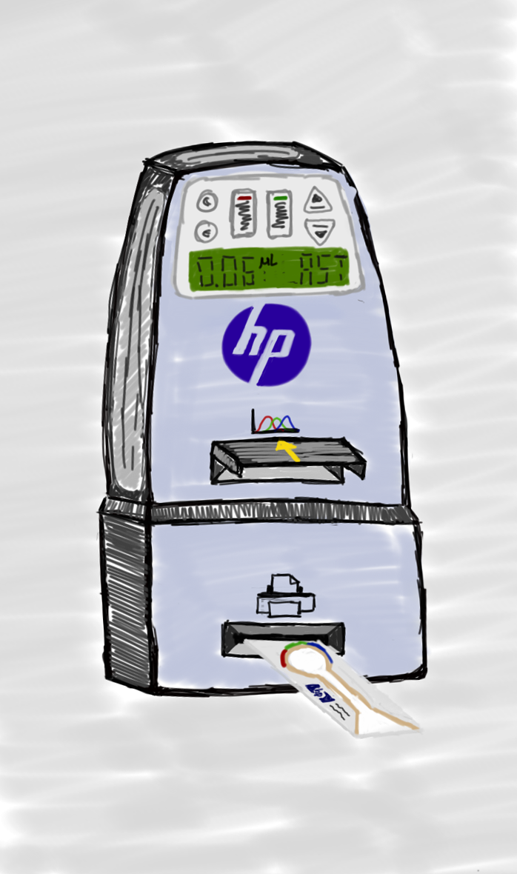
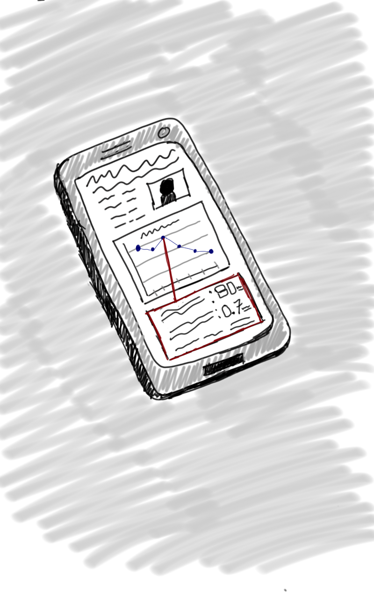

The Data Ecosystem
Data Sources
Data Interaction
Assay Device
User’s Smart Phone
(or Laptop/Tablet)
Local Wireless
Internet Connection
Information Repository
GOAL: Seamless, secure data handling
Notes:
Presenter: Spencer

Slide 20
HP Diagnostic Tool
Prints reagent/buffer
Analyzes color response
Reads data code (unique ID #)
  Assigns:
    Assay type
    Response
    Patient ID
Notes:
Presenter: Spencer

Slide 21

HP Cloud
Secure Information repository
Stores/Organizes health information
  Historical Data
    Patient history
    Previous test results
  Demographic Data
    Disease incidence rate
    Analyte reference ranges
Notes:
Presenter: Spencer

Slide 22
User’s Smart Phone
Portal to data sources
  Input device for patient information (name, etc.)
Displays
  Test results
  Cloud Diagnostic Engine
    previous results
    related patient history information
    relevant demographic data
      disease incidence
      reference analyte ranges
Bottom Line
Pertinent information, enabling an
informed diagnosis at point-of-care
Notes:
Cloud Diagnostic Engine”
Context-aware medical reports
Information pertinent to assay/diagnostic goal

Slide 23
Informatics with the Cloud
Centralized repository with a wealth of
aggregate non-identifying health information
could be used for:
  Epidemiological studies
    Mapping the spread of diseases
    Incidence/prevalence rates
    Average analyte levels
  Planning NGO medical campaigns
  Assessing pharmacological priorities
Notes:
Still in work; each application needs to ‘pop’
Presenter: Spencer

Slide 24
Platform Technology
  Printer/µPAD/Cloud: a versatile dispensing and data handling system
    Platform for field diagnostics (POCT) development
Some possibilities:
Rapid disease testing
Frequent monitoring of chronic conditions
Preventative medicine
Toxin testing
Non-medical assays
µPAD design flexible to best suit application
Multiplexed disease screen →
Notes:
Presenter: Spencer

Slide 25
Challenges/risks
Reagent degradation/shelf life
Some assays still rely on external equipment
  Microfluidic RBC separation yet undemonstrated in our lab
Envisioned device not fully developed
  Though handheld printer demonstrated
Notes:
Outline

Slide 26

Opportunities for Collaboration
Looking for:
End-user input
    Customer needs
Expert advice on biological assays
Help standardizing assay adaptation
Work will continue this summer…
Notes:
Working slide

Slide 27
Acknowledgements
We’d like to thank:
Dr. Manish Giri – Sponsor, Hewlett-Packard
Jim Stasiak – Sponsor, Hewlett-Packard
Dr. Sue Tornquist – OSU College of Veterinary Medicine
Dr. Jean Hall – OSU College of Veterinary Medicine
Dr. Phil Harding – Mentor, OSU

