Slide 1
The Ecology of Disease and Anthropogenic Stressors in Amphibians
By Kellie French
Mentor: Dr. Andrew Blaustein
Department: Zoology
Notes:
http://www.lifesci.ucsb.edu/eemb/labs/kuris/pubs/lafferty2012howtopres.pdf

Slide 2
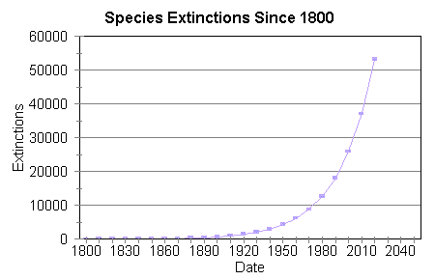
Sixth Mass Extinction?
Notes:
“Some people think we’re in the midst of the 6th mass extinction…”
Mass extinction is defined as over 75% of species going extinct.
The last great extinction occurred 65 million years ago, when the dinosaurs were wiped out.

Slide 3
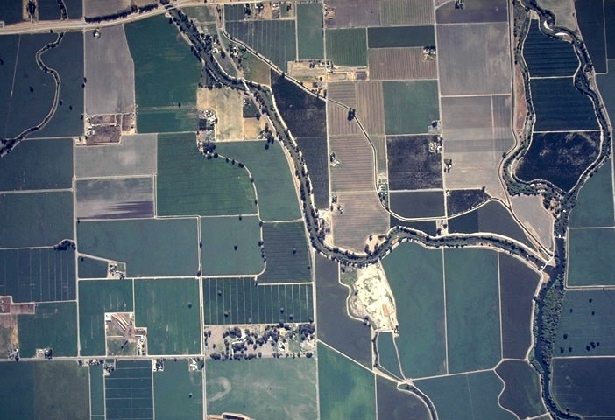

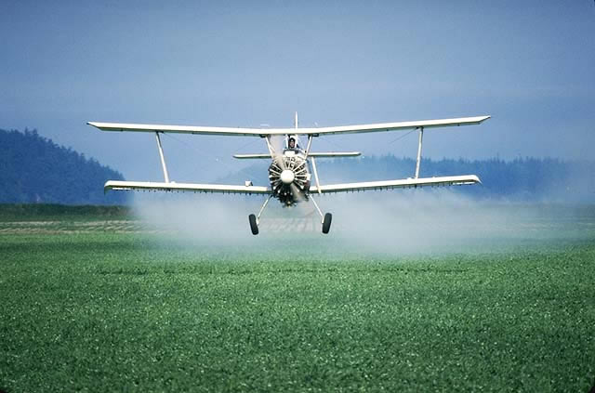
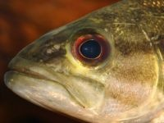
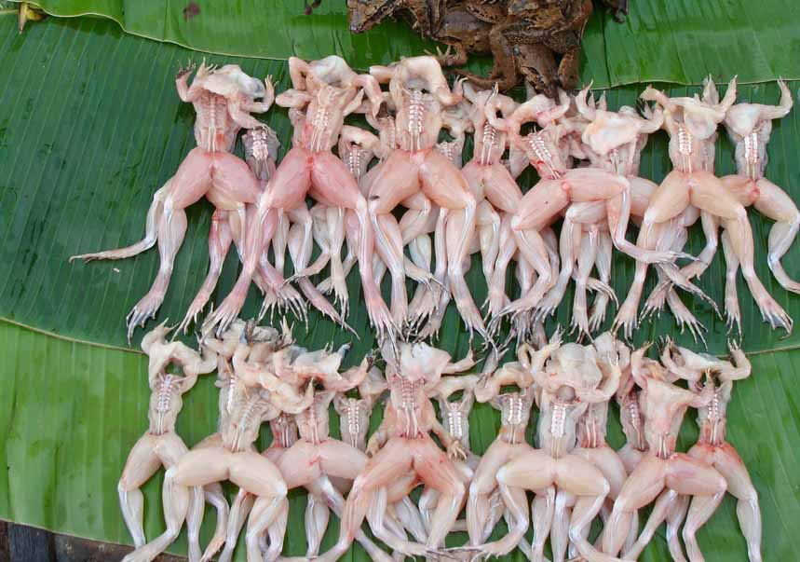
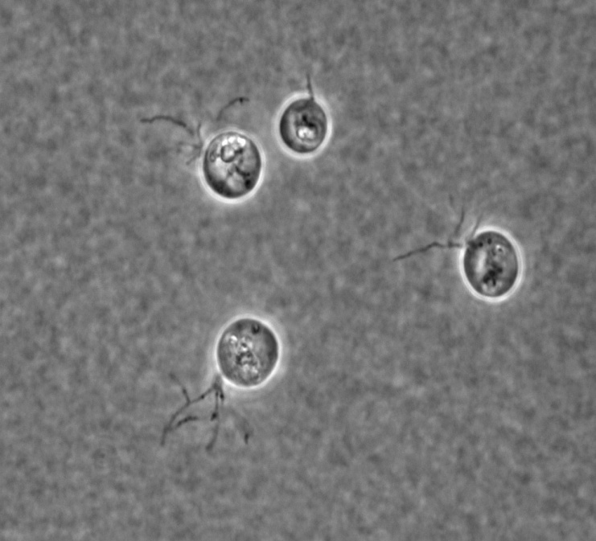
Can interactions between these factors modify their effects?
Joyce Longcore
Notes:
Factors can act in isolation, but INTERACTIONS are what we’re examining with this project
Several possible causes of amphibian population declines have been proposed: Habitat loss/fragmentation, large-scale atmospheric changes, contaminants, invasive species, overharvest, and parasites and pathogens.
However, we are just beginning to understand how interactions with other species may modify these stressors.

Slide 4
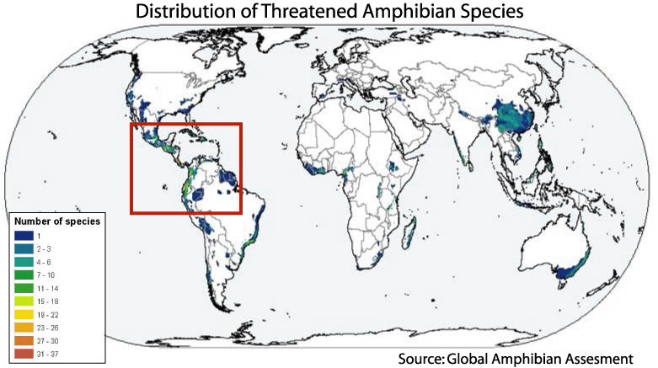
Amphibian Population Declines
Notes:
Nearly one-third (32%) of the world’s amphibian species are threatened, representing 1,856 species. Amphibians have existed on earth for over 300 million years, yet in just the last two decades there have been an alarming number of extinctions, nearly 168 species are believed to have gone extinct and at least 2,469 (43%) more have populations that are declining.

Slide 5
Global amphibian population declines
Group
Threatened
Endangered
Mammals
23% (1130)
3.8% (184)
Birds
12% (1211)
1.8% (179)
Amphibians
33% (1856)
7.4% (427)
Stuart et al. 2004. Science
Notes:
A recent study has shown that relative to mammals and birds, amphibians are proportionally more threatened/endangered.

Slide 6
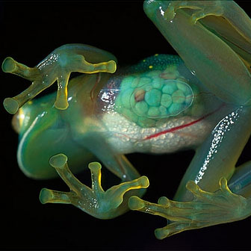
Why study amphibians?
Offer an ideal system for studying the interaction of contaminants (e.g., pesticides) and pathogens
  Live in and out of water
    More susceptible to terrestrial and water-borne stressors
  Permeable skin and unshelled eggs
Notes:
For us,
-Amphibians offer an ideal system for studying the interaction of contaminants (e.g., pesticides) and pathogens.
-Live in and out of water and are therefore more susceptible to terrestrial and water-borne stressors.
-Have permeable skin and unshelled eggs which make them hypersensitive to the environment.

Slide 7

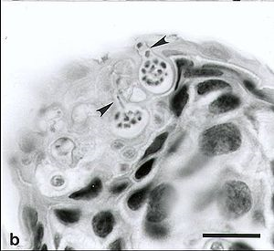
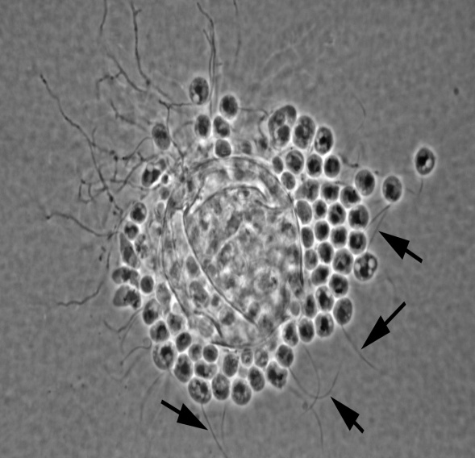
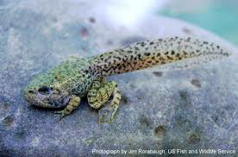
Batrachochytrium dendrobatidis (Bd)
Joyce Longcore
Joyce Longcore
Implicated in population declines globally
Fungal pathogen of amphibians
Causes chytridiomycosis
Infects keratinized tissue
Notes:
The pathogen we are STUDYING is batrachochytrium dendrobatidis (Otherwise known as Bd)
The sporangia of Bd release their zoospores once they come in contact with water.
Once the zoospore reaches its host, it forms a cyst underneath the surface of the skin, and initiates the reproductive portion of its life cycle.
These zoospores disrupt the osmotic balance of amphibians and cause cardiac arrest.
Batrachochytrium dendrobatidis (Bd) has received considerable attention as one of the causes of declining amphibian populations.
However, there are amphibian populations with the presence of these pathogens without amphibians showing symptoms of disease or experiencing population declines. Therefore, co-factors such as pesticides and pathogens may be involved.
It is a fungal pathogen of amphibians
Causes the disease chytridiomycosis
Infects the keratinized tissue of the adult frogs’ skin and the mouth part of tadpoles.
Most information on mortality comes from studies on post-metamorphic stages, but chytridiomycosis can have numerous sublethal effects on tadpoles, such as delayed metamorphosis and reduced growth rate, and tadpoles can also serve as important reservoirs of the pathogen.

Slide 8
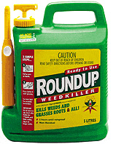
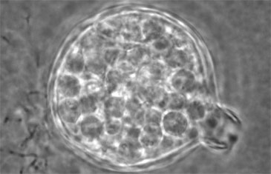
Our Goal
To examine the separate and combined impacts of pathogens and pesticides on five species of amphibians.
+
Notes:
Pesticides and pathogens have been studied separately, but never together. We chose to study these stressors interactions together because environmental contaminants alter properties of skin, organ systems, and their the immune system- which may make them more susceptible to pathogens.

Slide 9
Hypothesis
Ecologically relevant concentrations of pesticide mixtures will increase susceptibility of metamorphic amphibians to a pathogen (Bd).
Specifically, exposure to the contaminants in the larval and metamorphic stages will
increase mortality
increase pathogen load
decrease growth

Slide 10
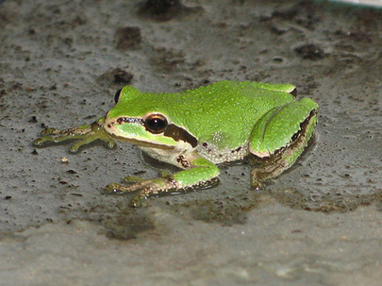
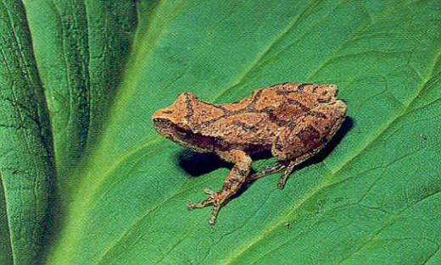
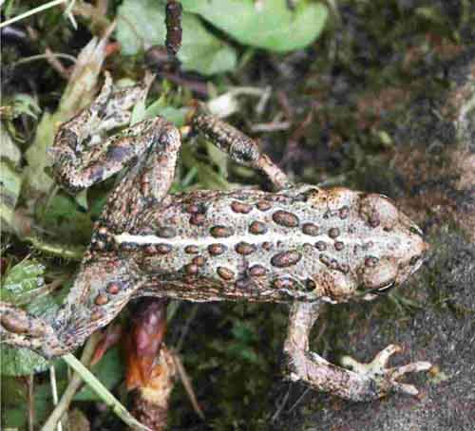
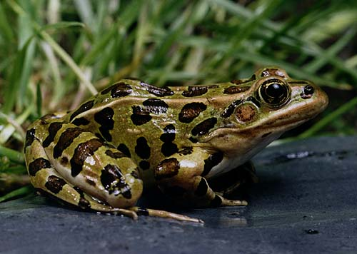
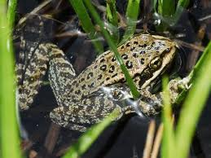
Our Amphibians
Spring peepers
Pseudacris crucifer
Pacific Tree Frogs
Pseudacris regilla
Western Toads
Anaxyrus boreas
Leopard frogs
Rana pipens
Cascades Frogs
Rana cascadae
Notes:
2 Tree Frogs, 1 Toad Species, 2 True Frogs

Slide 11
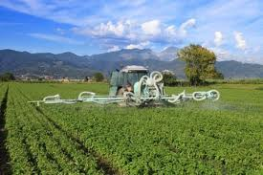
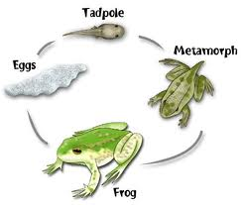
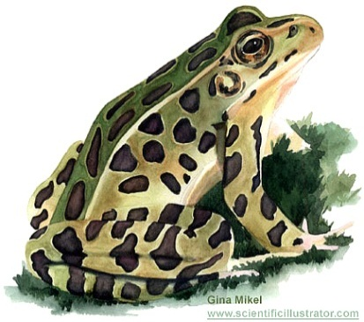

Experimental design:
5 x 5 x 2 x 2 factorial
X
X
X
5 Species of Frogs
Spring Peepers
Pacific Tree Frogs
Western Toads
Leopard Frogs
Cascades Frogs
5 Pesticide Treatments
High Herbicide
Low Herbicide
High Insecticide
Low Insecticide
Control
2 Exposure Stages
Tadpole Exposed
Metamorph
Exposed
2 Bd Treatments
Present
Absent
Notes:
Exposure group refers to when they are exposed to pesticides, NOT Bd
5sp X 5 pest X 2Bd x 2 exposures = 100treatments.
25 reps/each = 2500 animals
2015 = actual number

Slide 12
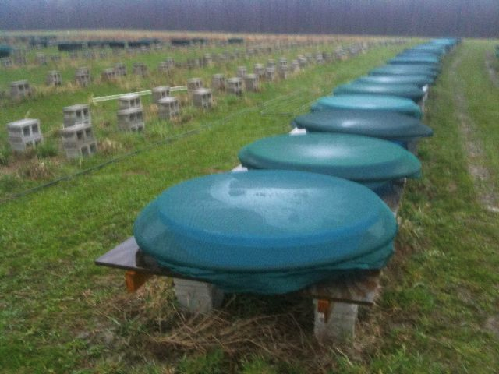

Slide 13
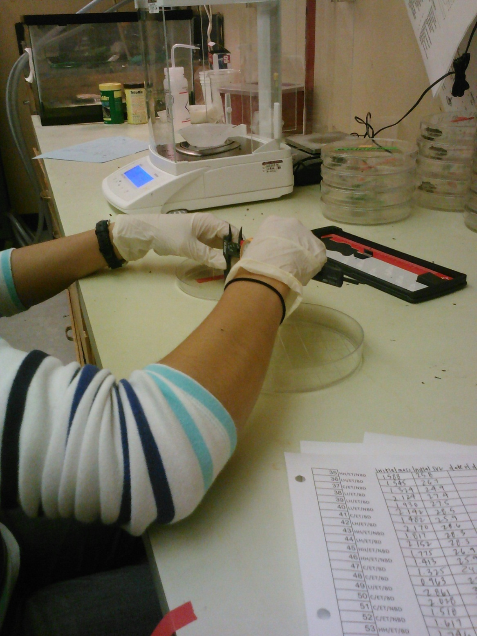
Notes:
Initial weight and SVL
Source of animals = Pittsburgh

Slide 14
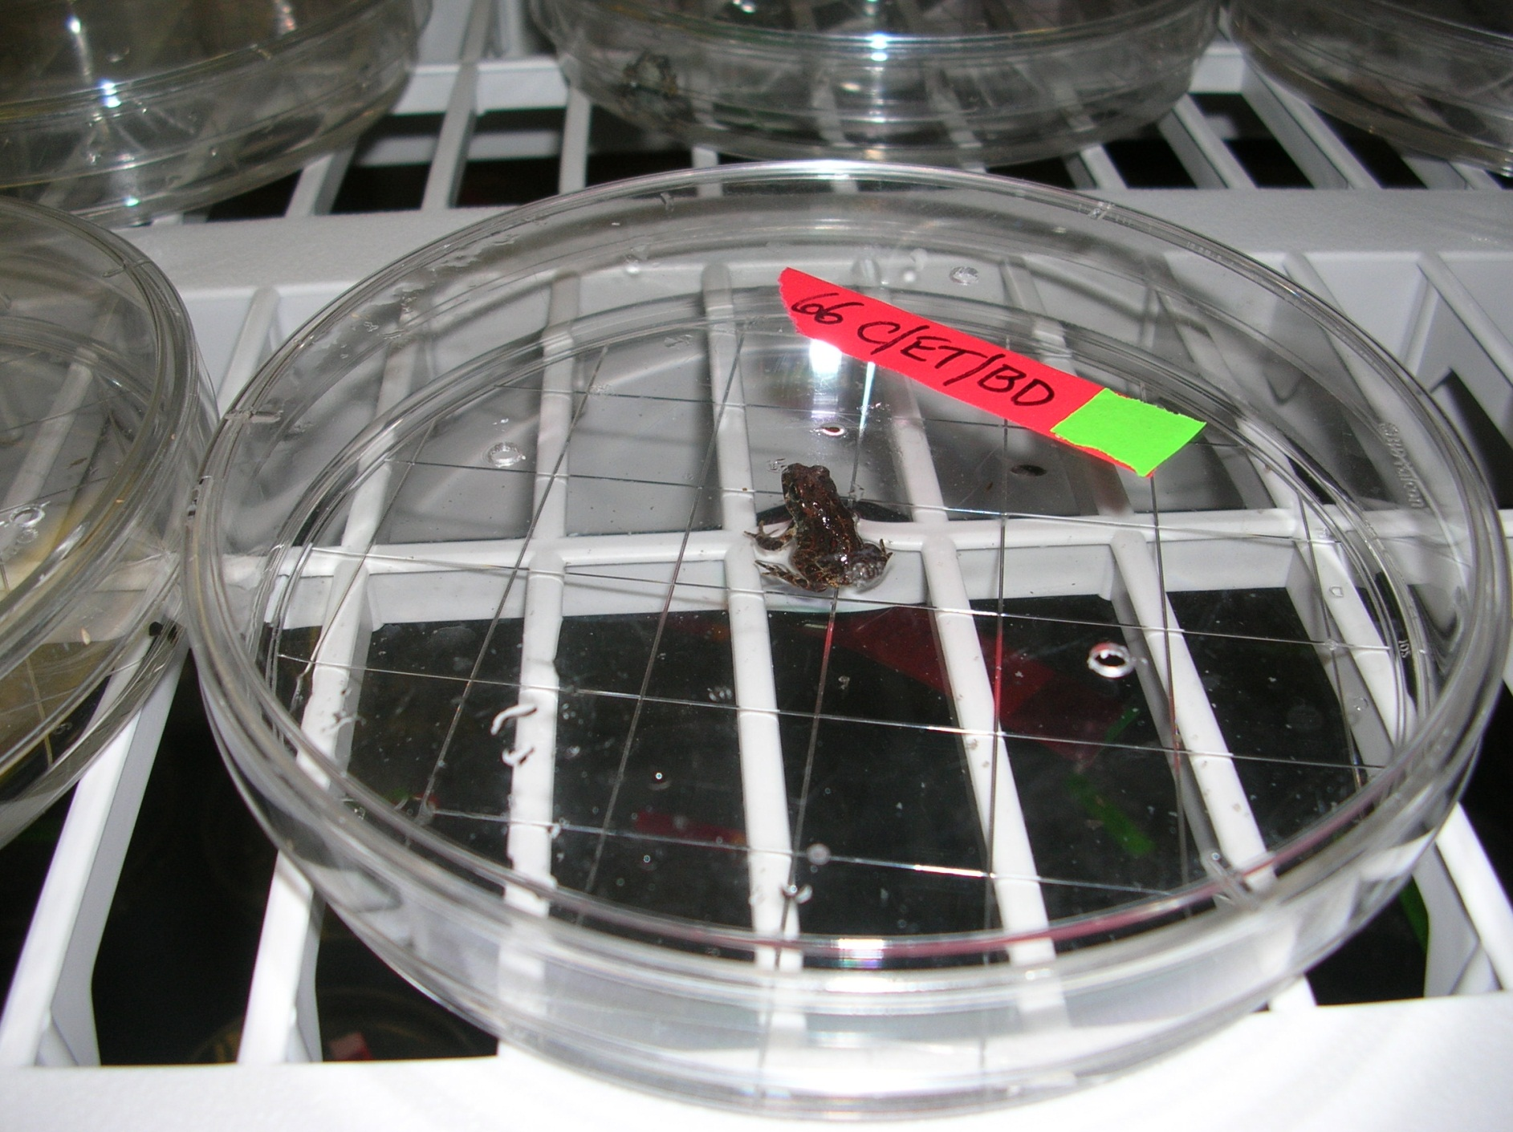
Notes:
Plate with 15mL water and 10mL inoculate…
Each plate is marked with their pesticide treatment group, exposure group, and if they’ve been exposed to Bd (chytrid fungus) or not
Daily monitoring protocol, feeding, water changes, etc.
Each animal is kept in the lab for 2 weeks

Slide 15
Results
Spring Peepers, tadpole exposure (showing pesticide controls only)
Survival Rate
Bd dashed
No Bd solid
Time (days)
Notes:
Just explain pesticide controls… Bd vs. No Bd

Slide 16
Spring Peepers (tadpole exposure)
Survival Rate
Control
High herbicide
Low herbicide
Low insecticide
Bd dashed
No Bd solid
Bd effect: p< 0.01
HR: 38.84
Time (days)
Notes:
Pesticide groups added in…
Stepwise pattern of mortality
P-value= Bd exposed animals were shown to have a statistically significant difference in survival rate than animals not exposed to Bd (<0.05)
HR (Hazard ratio)= Compares the slopes of the lines over time (Bd vs. No Bd) and finds a RATE of mortality, not just an overall mortality at the end. The animals exposed to Bd are 38.84 times more at risk than those that were not exposed.

Slide 17
Pseudacris crucifer, metamorph exposure
Spring Peepers (metamorph exposure)
Survival Rate
Control
High herbicide
High insecticide
Low herbicide
Low insecticide
Bd dashed
No Bd solid
Bd effect: p< 0.01
HR: 18.737
Time (days)

Slide 18
Pseudacris regilla, tadpole exposure
Pacific Tree Frogs (tadpole exposure)
Survival Rate
Control
High herbicide
Low herbicide
Low insecticide
Bd dashed
No Bd solid
Bd effect: p< 0.01
HR: 38.105
Time (days)

Slide 19
Pseudacris regilla, metamorph exposure
Pacific Tree Frogs (metamorph exposure)
Survival Rate
Control
High herbicide
High insecticide
Low herbicide
Low insecticide
Bd dashed
No Bd solid
Bd effect: p< 0.01
HR: 58.415
Time (days)

Slide 20
Anaxyrus boreas, tadpole exposure
Western Toads (tadpole exposure)
Bd effect: p<0.01
HR = 279.9
Survival Rate
Control
High herbicide
Low herbicide
Low insecticide
Bd dashed
No Bd solid
Time (days)

Slide 21
Anaxyrus boreas, metamorph exposure
Western Toads (metamorph exposure)
Bd effect: p<0.01
HR = 27.97
Survival Rate
Control
High herbicide
High insecticide
Low herbicide
Low insecticide
Bd dashed
No Bd solid
Time (days)

Slide 22
Rana pipiens, tadpole exposure
Leopard Frogs (tadpole exposure)
Survival Rate
Control
High herbicide
Low herbicide
Low insecticide
Bd dashed
No Bd solid
Time (days)

Slide 23
Rana pipiens, metamorph exposure
Leopard Frogs (metamorph exposure)
Survival Rate
Control
High herbicide
High insecticide
Low herbicide
Low insecticide
Bd dashed
No Bd solid
Time (days)

Slide 24
Rana cascadae, tadpole exposure
Cascades Frogs (tadpole exposure)
Survival Rate
Control
High herbicide
High insecticide
Low herbicide
Low insecticide
Bd dashed
No Bd solid
Time (days)

Slide 25
Rana cascadae, metamorph exposure
Cascades Frogs (metamorph exposure)
Survival Rate
Control
High herbicide
High insecticide
Low herbicide
Low insecticide
Bd dashed
No Bd solid
Time (days)

Slide 26
Summary of Results
3 of 5 species showed significant mortality
Similarities between tree frogs
    Showed Bd effect with significant p-value
Toads showed increased susceptibility (High HR)
True frogs had no significant effects
    Very little mortality
Notes:
Tree frogs= spring peepers and pacific tree frogs
Toads=Western Toads
True frogs= leopard frogs, cascades frogs
We don't know why toads are more susceptible. It could have something to do with amount of keratin in the skin, or how they regulate water uptake. Keep in mind that Bd infection disrupts osmotic balance of amphibians, causing cardiac arrest (check out Voyles 2009 for more on that). Lots of people have looked at western toads and Bd (mostly fieldwork) and found them to be very susceptible.
The multispecies project showed the some species within the genus Rana (true frogs) are less susceptible to Bd than species within other genera. But there were species of true frogs that showed higher susceptibility too, like Rana pipiens in that experiment. It's certainly possible that size has a lot to do with susceptibility, and the Rana are usually bigger.

Slide 27
Summary of Results
Other interesting effects:
  Pesticide effect in metamorph exposed Pacific Tree Frogs
    High insecticide: p=0.0023, HR=0.239
  SVL effect in metamorph exposed Leopard Frogs
    p=0.000048, HR = 0.44
Notes:
A publication that studied Bd independent of a host stated that they found results that suggested that pesticides can inhibit Bd zoospore production. It’s possible that our metamorph exposed pacific tree frogs still had remnants of the pesticides on their skin and it could have gotten into the water in the petri dish and killed the Bd.
BUT other metamorph exposed frogs did not show this result, so it is up for speculation.
Snout vent length affect

Slide 28
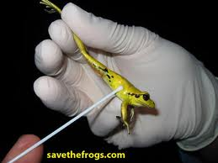

What’s next?
Mass & SVL after death
qPCR
Notes:
Mass, SVL
qPCR (Quantitative PCR) to measure pathogen load

Slide 29
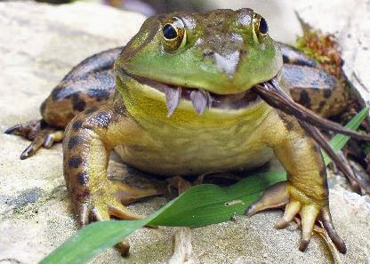
Benefits to Society
Disappearing amphibians may affect whole ecosystems
The potential to offer new insights into the spread of infectious disease
  All organisms, including humans are exposed to pesticides and pathogens.
Notes:
Why should we care??
Chytridiomycosis is an EID
-The potential to offer new insights into the spread of infectious disease.
-All organisms, including humans are exposed to pesticides and pathogens. What we learn about amphibians can tell us generally about how simultaneous exposure to both pathogens and pesticides may affect organisms, including humans.
-Amphibians are animals that are integral parts of ecosystems. Disappearing amphibians may affect whole ecosystems because they are food for a variety of animals and they consume plants and other animals, including many insect pests.

Slide 30


Acknowledgements
Howard Hughes Medical Institute
Undergraduate Research, Innovation, Scholarship & Creativity (URISC): Start Program
Oregon State University Honors College
Dr. Andrew Blaustein’s Research Lab
Dr. Rick Relyea’s lab at University of Pittsburgh
Dr. Kevin Ahern

