Slide 1
Looking for LOV: Location of LOV1 function in Nicotiana benthamiana cells
By:
Patrick Rutledge¹
Dr. Jennifer Lorang^{2,3}, Dr. Marc Curtis^{2,3}, Dr. Thomas Wolpert^{2,3}
BioResource Research¹, Botany and Plant Pathology², Center for Genome Research and Biocomputing³, Oregon State University, Corvallis, Oregon 97331

Slide 2
Introduction
Plants able to recognize and confer resistance to pathogens in two ways
1) Recognition of pathogen associated molecular patterns (PAMPs)
Successful pathogens must suppress immunity in host
Inhibit pathways or molecules involved in defense response by using effectors
2) Recognition of effectors by resistance proteins
Plants have evolved to produce resistance proteins that “guard” molecules targeted by pathogen effectors
Notes:
Basics of plant immunity
components of Pathogen that are hard to change, cell wall, flagellum, secreted enzymes
Successful pathogen must suppress this immunity to infect the plant

Slide 3
Virulence Effectors
Secreted by both biotrophic and necrotrophic pathogens
Biotrophs- Can only live and replicate on living hosts
Necrotrophs- Kills living cells of host and feeds on dead tissue
Virulence effector, victorin, secreted by Cochliobolus victoriae
Notes:
In the case of biotrophs, they are called biotrophs because they can only live on living host tissue, if host cell dies, this prevents their infection, because they need living cells to interact with to get nutrients.
-One of the common defense responses mediated by these resistance proteins is to cause cell death of the host cell, this confers resistance
Necrotrophs on the other hand love dead tissue so they try to kill their host tissue, if a resistance protein causes cell death this can be beneficial to a necrotroph.
The effector we’re working on was originally described in a necrotroph called C. victoriae which makes this effector precisely because it causes cell death and is able to take advantage of it.
That’s the system we’re working on
Coke-li-ob-olous victoriae

Slide 4
Pieterse et al 2009
Notes:
Let me review this with…
Pattern Recognition Receptors (PRR)
Bacterial Lipopolysaccharide, an endotoxin found on the cell membrane of a bacterium
B) These effectors can either block the signal or block the output of the signal
Anti-microbial compounds
Programmed cell death
Phytoalexins
C) What I’ve been working on for my project is how ONE of these R-proteins work, and how it recognizes the effector, victorin.
We call that R-protein LOV1

Slide 5
Isolated LOV1
Locus Orchestrating Victorin Effects 1
Encodes for resistance (R) protein that “guards” thioredoxin 5 (TRX-h5)
Arabidopsis thaliana
Notes:
LOV1 gene identified and isolated in Arabidopsis thaliana, LOV1 stands for ********, and encodes for a resistance protein that guards TRX-h5, and becomes activated when victorin binds to TRX-H5

Slide 6
Leaf Cell
NPR1
NPR1
NPR1
NPR1
CYTOPLASM
S
S
H
S
S
S
H
H
S
H
H
H
H
S
S
H
H
H
S
H
S
S
S
H
S
S
H
H
NPR1
NPR1
NPR1
HS-
TRX-h5
HS-
RESISTANCE!
TF
HS-
NPR1
Defense genes
TRX-h5
HS-
TRX-h5
Salicylic Acid
NUCLEUS
Design credit: Thomas Wolpert
Notes:
Let me walk you through how this works very briefly

Slide 7
Leaf Cell + Victorin
NPR1
NPR1
NPR1
NPR1
CYTOPLASM
S
H
S
S
S
S
S
S
S
H
S
S
S
S
S
S
NPR1
NPR1
NPR1
Inhibition of TRX-h5!
V
HS-
V
TRX-h5
HS-
V
V
HS-
Defense genes
TRX-h5
HS-
TRX-h5
Salicylic Acid
Plant is SUSCEPTIBLE, immune response is compromised
NUCLEUS
Design credit: Thomas Wolpert

Slide 8
Leaf Cell + LOV1 + Victorin
NPR1
NPR1
NPR1
NPR1
CYTOPLASM
S
H
S
S
S
S
S
S
S
H
S
S
S
S
S
S
NPR1
NPR1
NPR1
V
V
Hypersensitive Response (HR)
CC domain
CC domain
Defense genes
HS-
ATP
TRX-h5
ADP
HS-
Successfully kills off biotrophs, but necrotrophs able to take advantage of cell death
TRX-h5
LRR domain
LRR domain
Salicylic Acid
NUCLEUS
Design credit: Thomas Wolpert

Slide 9
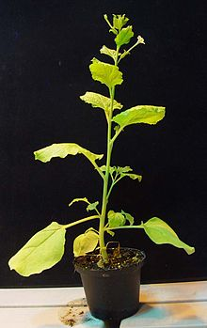
Nicotiana benthamiana
Close relative to tobacco
Not for smoking!
Model organism used to study plant disease
Able to transiently express proteins
Very susceptible to Agrobacterium
Allows for study of protein localization and interactions
Study of plant immunity and defense
en.wikikpedia.org
Notes:
While this work was conducted in Arabidopsis, we also thought we could do transient expression in N. benthi which is the system I used.

Slide 10
Nicotiana benthamiana leaves
Phenotypic cell death response exhibited only when LOV1 + TRX-h5 expressed together
Notes:
-This whole system is shown to work with transient expression of LOV1 and TRX-h5 together
-N. Benthi leaves expressing these two proteins together causes sensitivity to victorin
Cauliflower moasic virus 35s promoter

Slide 11
Research Objectives
Overall Objective: Understanding where LOV1 protein exerts its effects to regulate cell death
R proteins present in all plants, and even humans!
Some R proteins translocate to the nucleus, study attempts to show LOV1 can function solely in the plasma membrane.
Specific Objectives:
Quantifying a specific victorin concentration to run effective time courses of cell death
Clarifying where LOV1 protein is activated in N. benthamiana cells
Understanding where LOV1 localizes and functions after activation of cell death

Slide 12
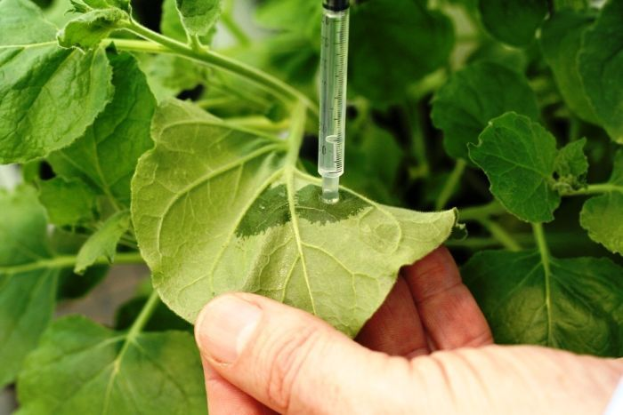
Methods
Various genetic tags engineered onto LOV1
Nuclear Export Signal (NES) and mutant NES (nes)
CBL & mCBL
Electrolyte leakage assays (ELAs) of tobacco using various concentrations of victorin solution
Direct phenotype response
Fluorescent microscopy on light and confocal microscopes
Notes:
Genetic constructs were made to study if these constructs affected the ability of LOV1 to carry out programmed cell death function
These constructs were studied by use of electrolyte leakage assay to quantitatively assess their ability to carry out programmed cell death
And further examined using a phenotypic response to provide a qualitative assessment
To observe how these constructs were localizing in the cells, fluorescent microscopy was used.

Slide 13
Genetic Constructs of LOV1
NES & nes tags fused to C-terminal
NES-LOV1 prevents localization to nucleus
nes-LOV1 as control
CBL & mCBL tags fused to N-terminal of LOV1
CBL-LOV1 irreversibly tethers LOV1 to plasma membrane
mCBL-LOV1 as control
NES | 5'-atggacgagctgtacaagaacgagcttgctcttaagttggctggacttgatattaacaag-3'
nes | 5'-atggacgagctgtacaagaacgagcttgctcttaaggcagctggagcagatgctaacaag-3’
CBL | 5’-atgggctgcttccactcaaaggcagcaaaagaattt-3’
mCBL | 5’-atggccagcttccactcaaaggcagcaaaagaattt-3’
Notes:
1st tag: NES tag- prevent accumulation of LOV1 in Nucleus
nes as control
2nd tag: CBL tag- Anchor LOV1 irreversibly to plasma membrane
mCBL as control

Slide 14
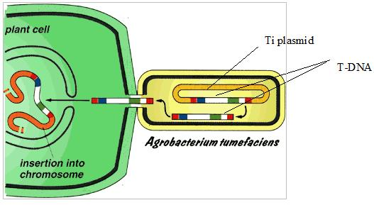
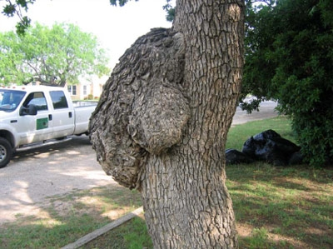
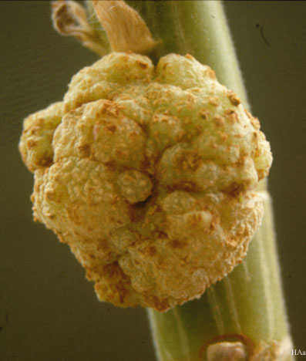
Mechanism of A. tumefaciens infection
Nature’s
“genetic engineer”
www.nepadbiosafety.net
Tumors produced by A. tumefaciens infection
www.lifesciencesfoundation.org
microbewiki.kenyon.edu
Notes:
tumefaciens has ability to insert own genes into host chromosome and have it produce those genes.
Researchers have found a way to insert their own genes
Can transiently express proteins in N. benthi

Slide 15
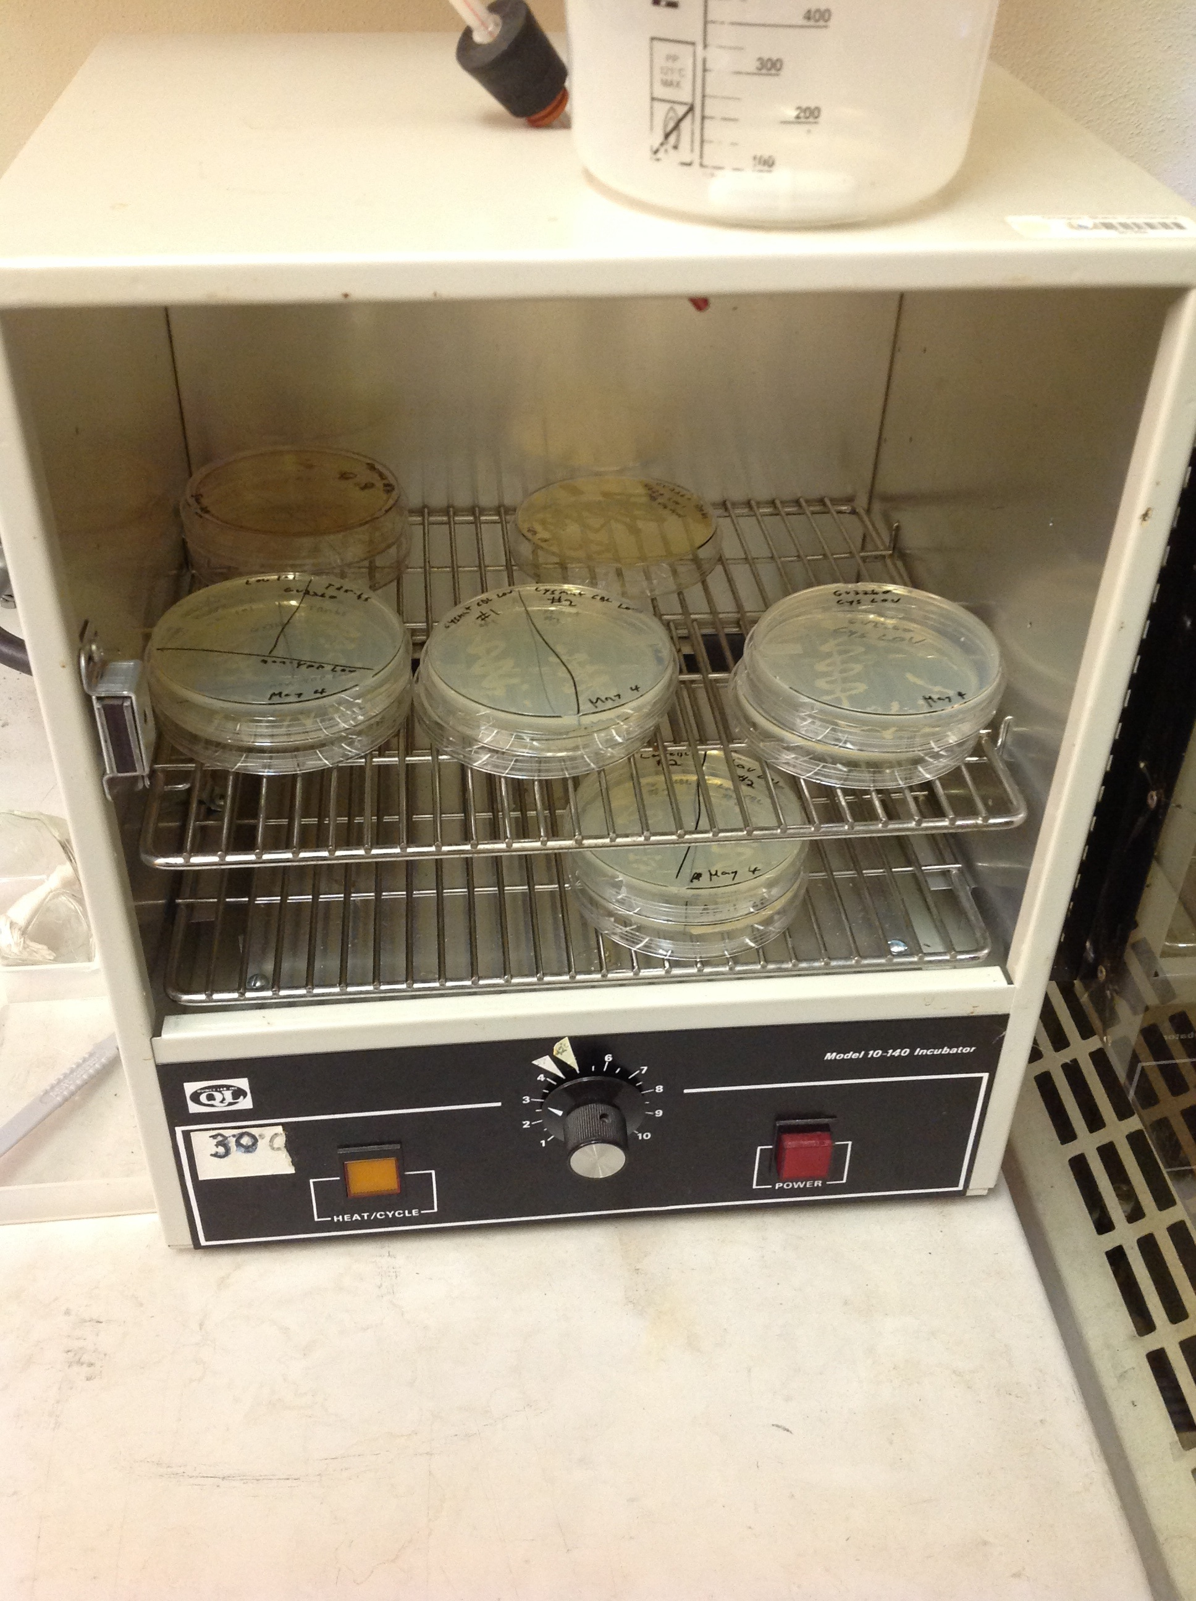
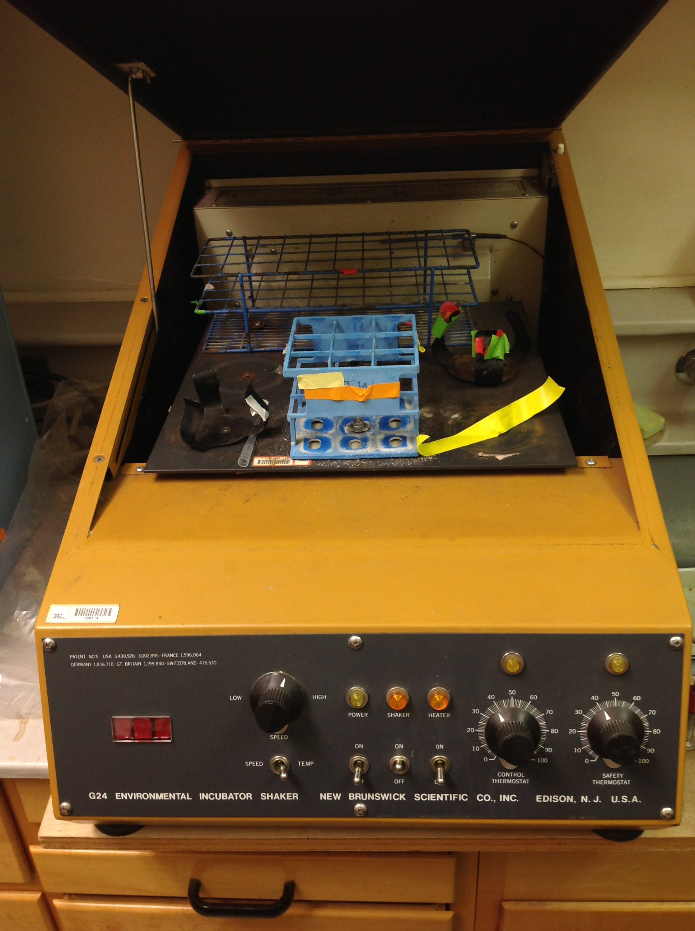
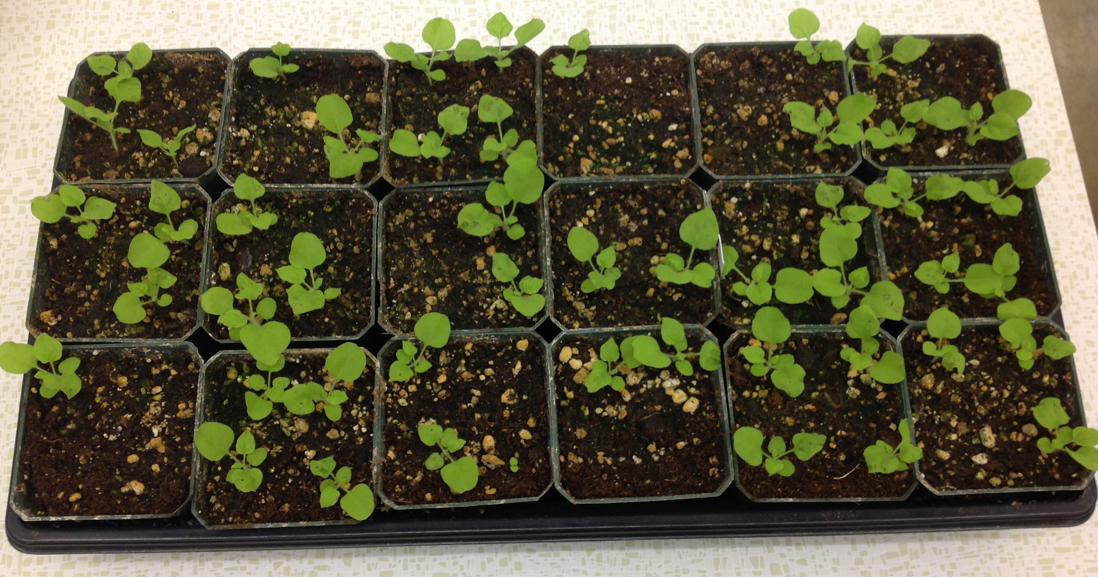
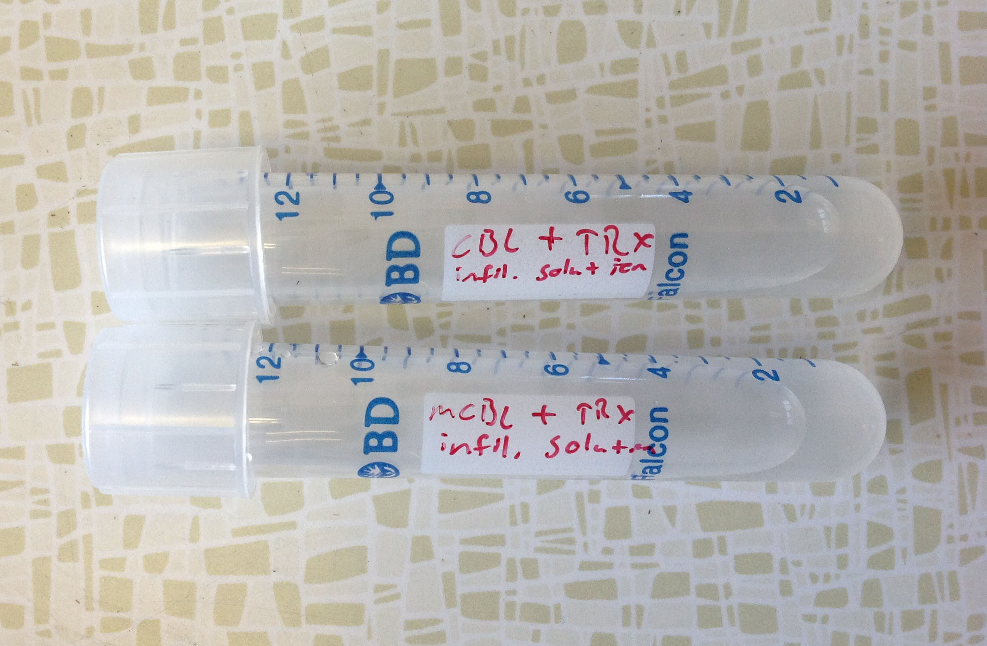
Genetic variations of LOV1
TRX-h5
Incubated 3 days
(30 °C)
Grown overnight
Injection
3 week old tobacco plants
Infiltration Solution
Notes:
We electroporated this vector into Agrobacterium, then selected for transformants using kanamycin, picked singles colonies and grew them up, activated virulence using acetosyingone, and injected them into three week old leaves of tobacco.

Slide 16
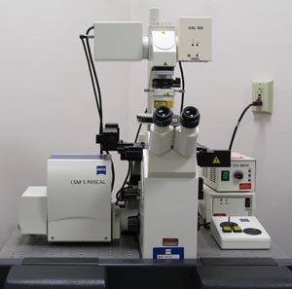
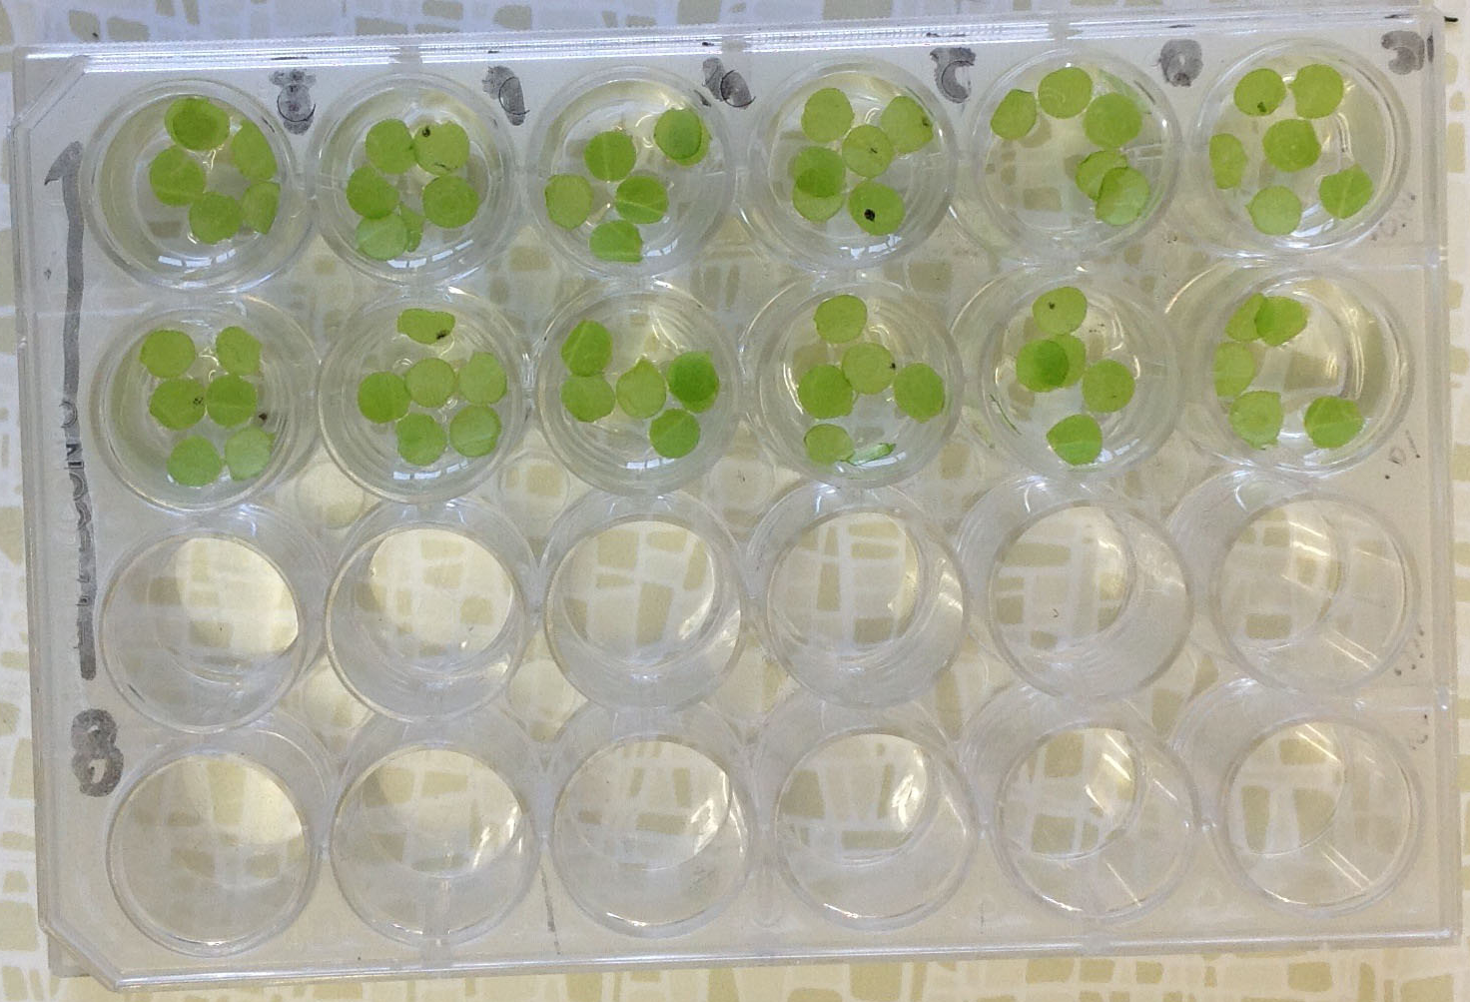
Infiltrated tobacco leaves
Confocal Microscopy
Electrolyte Leakage Assay
Phenotypic Response
http://www.vmrf.org/researchcenters/confocal/instrumentation.html

Slide 17
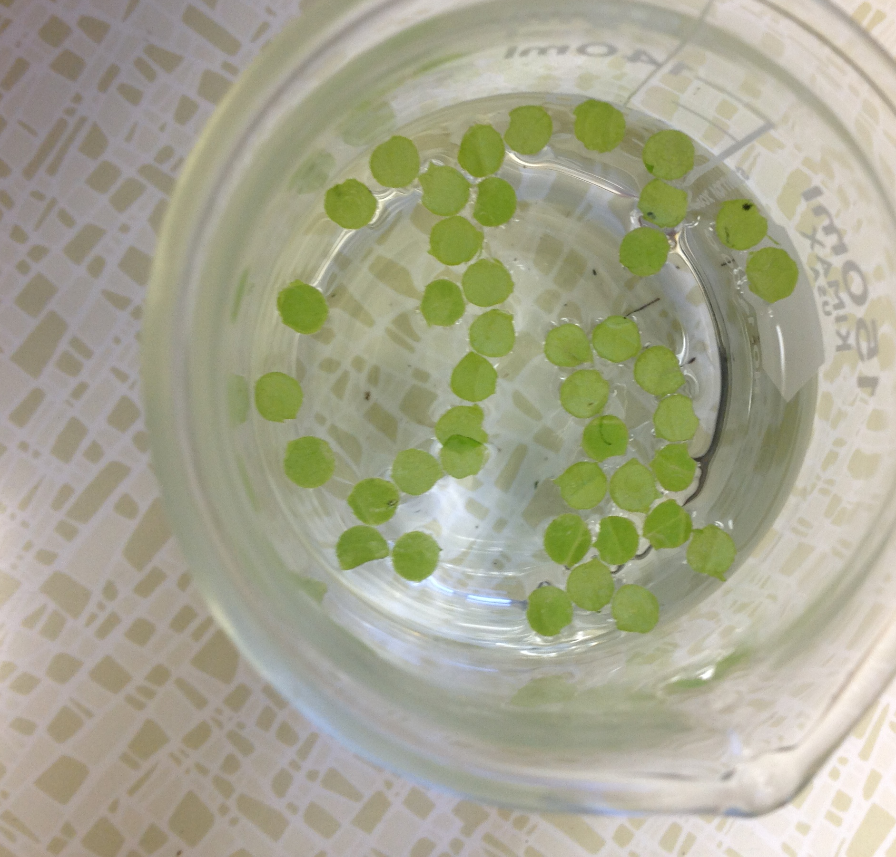
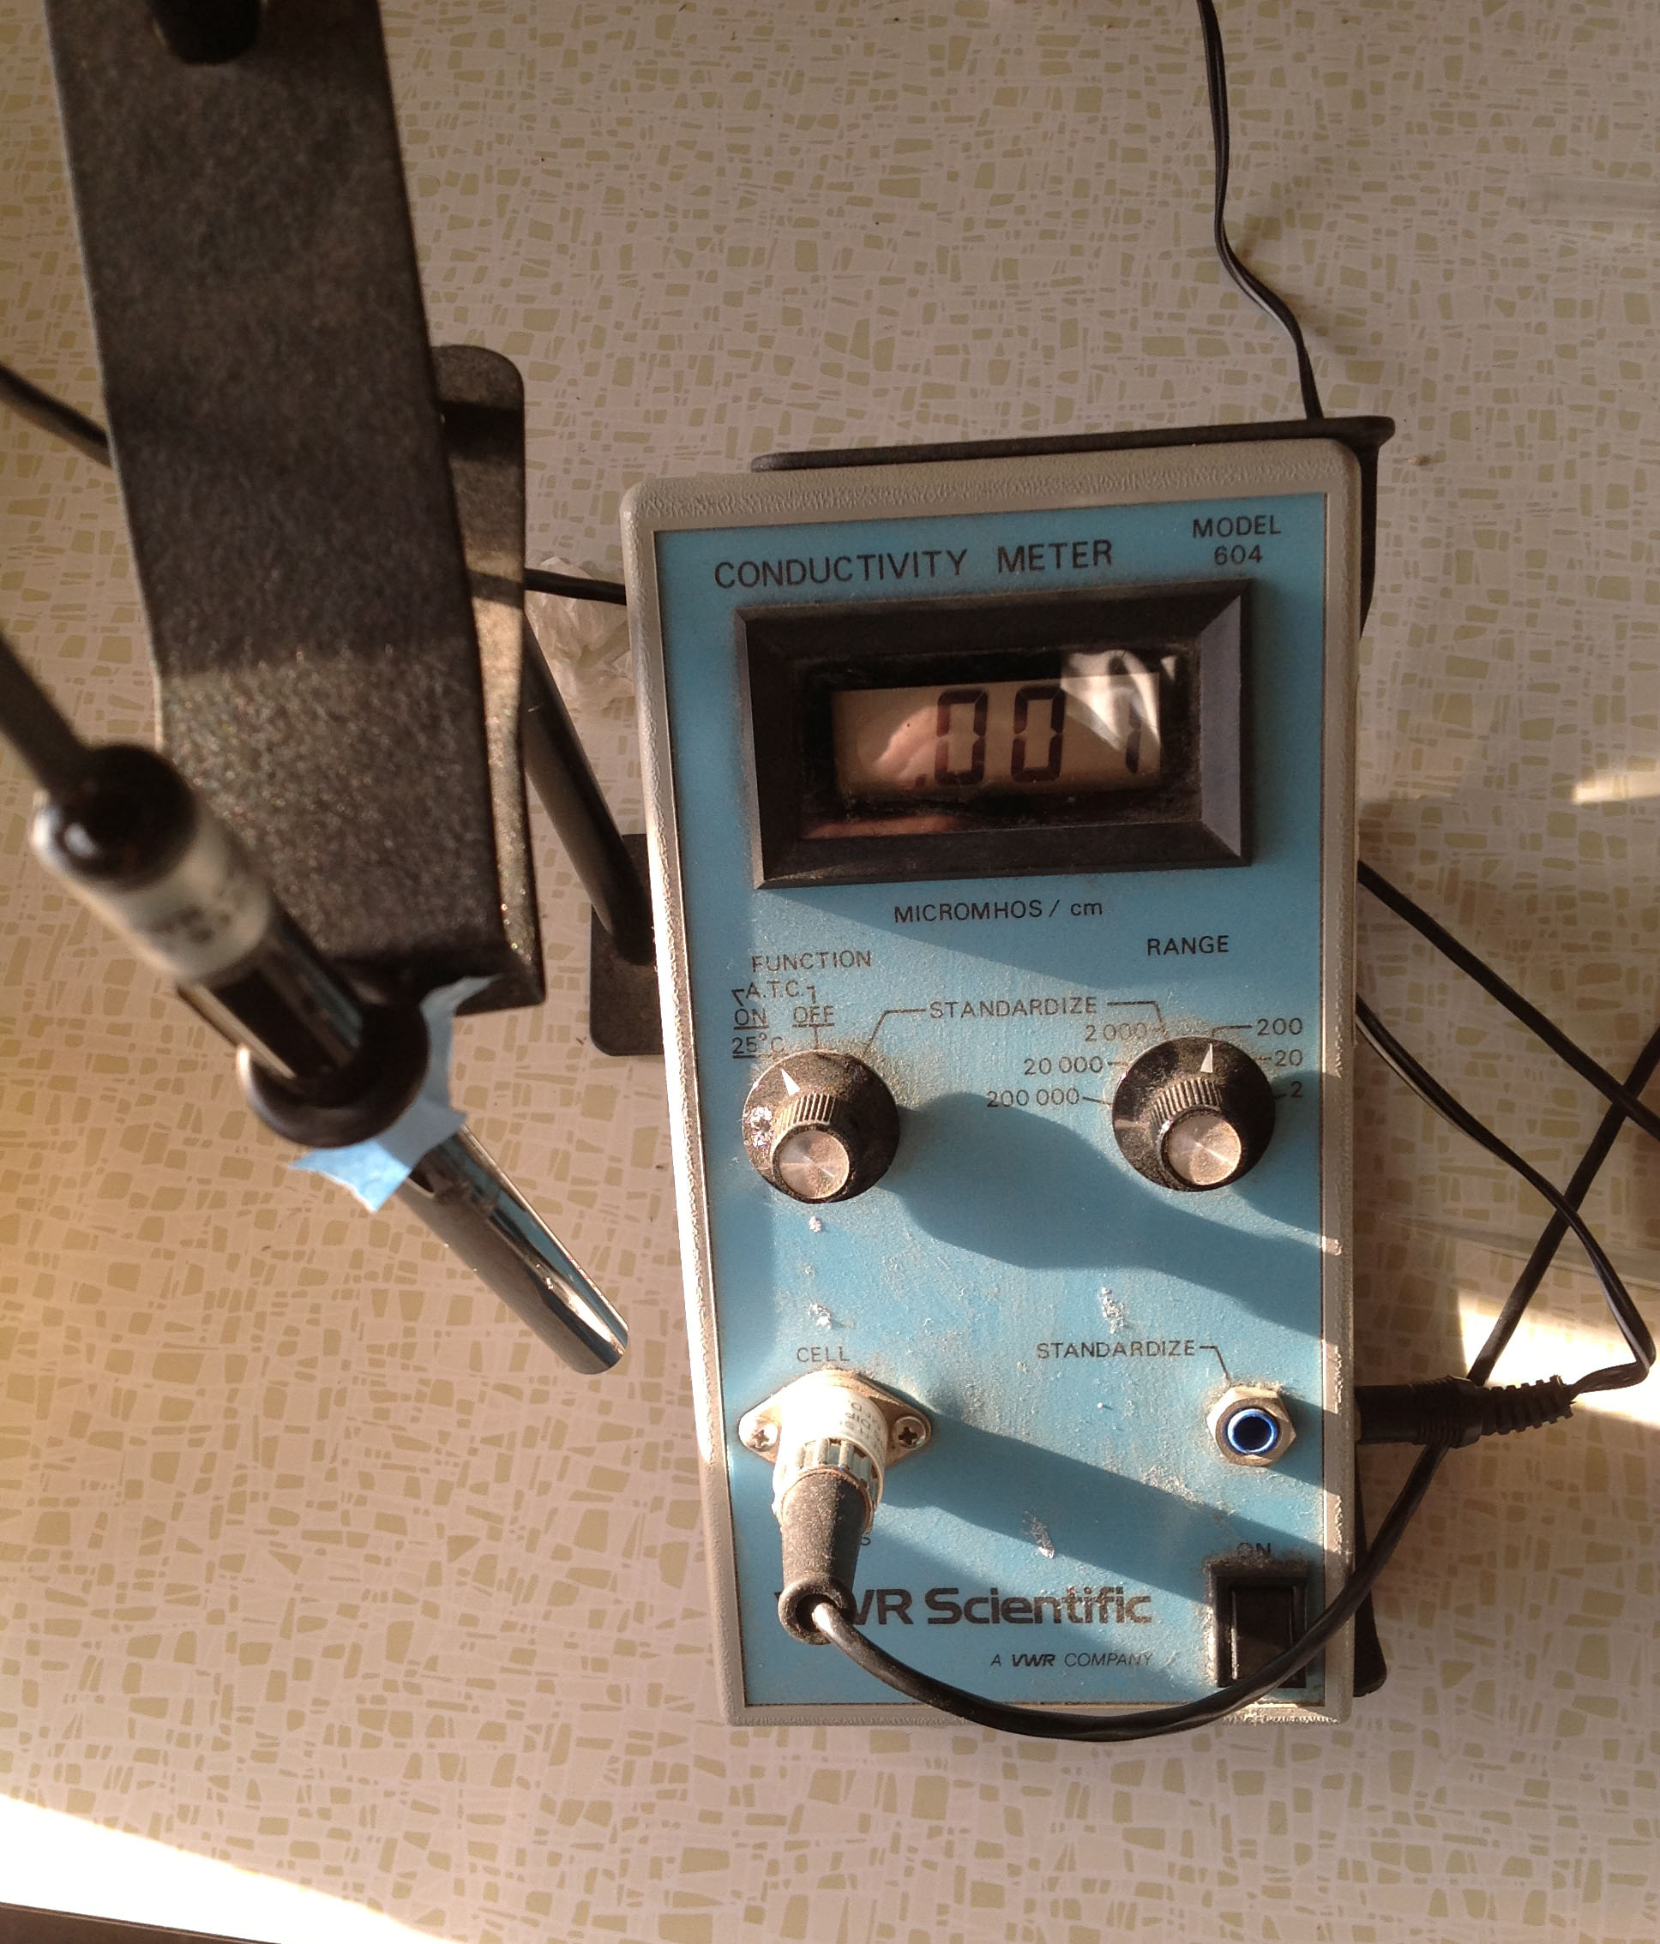
Electrolyte Leakage Assay
Method of quantifying cell death
Wells contain water and victorin
6 leaf discs per well
Replicates of 3-5 wells
Repeatable using different genetic constructs
Useful comparison of protein’s functionality
Leaf discs randomized
Discs put into separate wells
Conductivity meter used to measure ion leakage

Slide 18
Results
Graph 1: Victorin mediated cell death in N. benthamiana transiently expressing LOV1. The amount of cell death induced by victorin is directly correlated with the amount of electrolyte leakage.

Slide 19
Graph 2: A nuclear exclusion signal (NES) was fused to LOV1. As a control, a mutant NES (nes) was also fused to LOV1. Treatment with 384 ng/ml victorin concentration shows no significant difference in cell death.

Slide 20
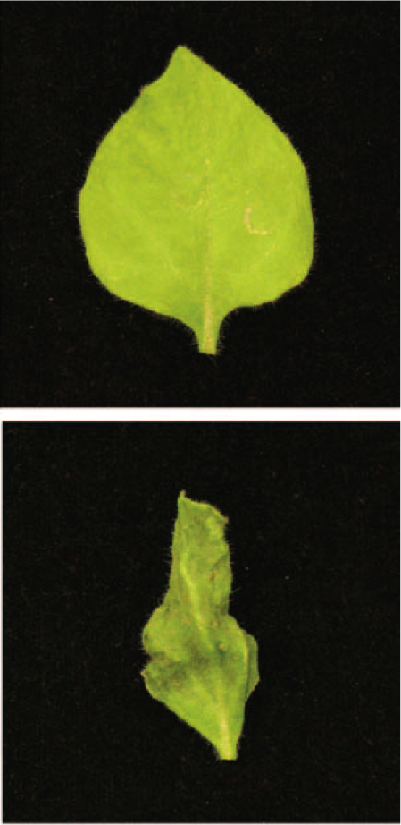
H₂O
Victorin
Phenotype response to victorin. An example of victorin induced cell death in N. benthamiana transiently expressing NES LOV1 + TRX-h5. 2 hours post-infiltration
Notes:
A direct phenotypic response experiment was run to observe if nuclear export of LOV1 exhibited as much sensitivity to victorin as WT-LOV1. This image shows that although LOV1 was not allowed into the nucleus, it was still able to recognize victorin and carry out its programmed cell death function.

Slide 21
Graph 3: Transcriptional inhibitor Cordycepin used to determine further transcription of downstream defense genes needed for hypersensitive-response function. Treatment with 384 ng/ml victorin concentration shows no significant difference in cell death.
Notes:
An independent approach was used to determine if gene reprogramming is required for LOV1 function of cell death, we used the transcriptional inhibitor Cordycepin
Transcriptional reprogramming not required for LOV1 to exert its function
Because both of these data show the same results, this reinforces the idea that LOV1 is not required

Slide 22
Confocal Microscopy
To operate, need to take classes
Microscopes cost over $300,000!
Yellow Fluorescence Protein (YFP) fused onto C-terminal of LOV1
Allows for detection and tracking by use of UV-irradiation
Can be used to observe localization of genetic constructs of LOV1
Notes:
To observe these proteins while they were exerting their effects, we used confocal microscopy. YFP tag was fused to protein to allow observation of where this fluorescence occurs.

Slide 23
LOV1 localizes to the plasma membrane. Confocal microscopy of yellow fluorescence protein (YFP) tagged LOV1 shows protein localizing to the plasma membrane of N. benthamiana cells
Notes:
This image shows LOV1 localizing in the plasma membrane of N. benthamiana cells. Red dots represent the autofluoresence of choloplasts
To test if LOV1 could function solely from the plasma membrane, a phenotype response was conducted to observe if CBL-LOV1 was sensitive to victorin, and able to carry out programmed cell death.

Slide 24
CBL
mCBL
WT
Phenotype response to victorin. CBL construct designed to irreversibly tether LOV1 to plasma membrane. mCBL acts as control for testing protein functionality. 30 hours post-infilitration.

Slide 25
Discussion/Conclusion
LOV1 tagged with a functional NES is as sensitive to victorin as LOV1 tagged with a nonfunctional NES (nes).
Implies LOV1 does not need to translocate to the nucleus to confer sensitivity to victorin.
Transcription of other defense genes after programmed cell death begins is not required.
YFP tagged LOV1 localizes to the plasma membrane.
LOV1 tethered to plasma membrane still functional throughout a victorin-induced cell-death time course.
Notes:
From these results, we conclude
LOV1 excluded from the nucleus is as sensitive to LOV1 being allowed to translocate to nucleus
-Implies LOV1 does not require nuclear localization to exert its effects
Our data working with the cordycepin inhibitor showed that there was no change in cell death when transcription was inhibited, compared to the control.
-LOV1 does not induce transcriptional reprogramming to exert its effects
Using confocal microscopy, we established LOV1 resides in the plasma membrane before its activation, so that may be where it becomes activated.
CBL-LOV1 data shows that LOV1 can be irreversibly tethered to the membrane and still able to exert its function.
Our overall conclusion from this study is that LOV1 is activated and functions solely from the plasma membrane

Slide 26
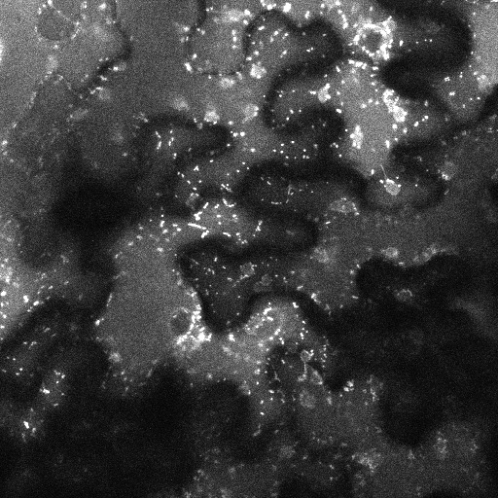
Future Experiments
Mitochondrial dye experiments
More accurate cell death indication
Electrolyte Leakage Assays using CBL & mCBL
Fluorescent tagging of mitochondria using Tetramethyl Rhodamine (TMRM) dye
Notes:
One thing we didn’t get a handle on was where LOV1 was during the cell death process. Couldn’t visualize it for a bunch of technical problems, so we’ve been trying to assess cell death by mitochondrial movement. Just recently we had a good result showing that once the mitochondria stopped moving, LOV1 was still observed in the plasma membrane, but due to clarity of video and photos, I decided not to show you today.
Mitochondria stop functioning and moving Is the first step in cell death.

Slide 27
Acknowledgements
Many thanks to:
Dr. Thomas Wolpert, Dr. Jennifer Lorang, Dr. Marc Curtis
BRR advisor Wanda Crannell
BRR director Kate Field
E.R. Jackman Internship Support Group
Audience!
Notes:
Coke-li-ob-olous victoriae
Spores of C. victoriae have so much victorin in them, we have to wash them before we put them on sensitive plant
Produces a lot of victorin
Enough to kill and then invade, repeat
Purify victorin through 3 different columns, HPLC, Gravity flow column, High resolution HPLC
Grow for 3 weeks, Purify, blah blah

Slide 28
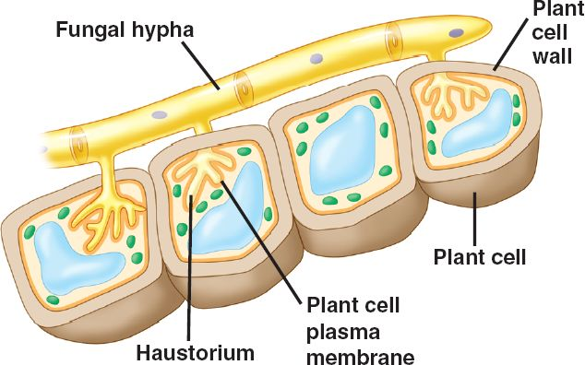
biologyarticle.blogspot.com

