Slide 1


Nuanced and Timely:
Capturing Collections Feedback at Point of Use
Jane Nichols, OSUL&P
Rick Stoddart, OSUL&P
Terry Reese, OSU
33rd Annual Charleston Conference
Notes:
Thank you for coming; in right place; I’ll be talking about a project the 3 of us have been working on to test a point of use survey tool. Rick is joining us via video and Terry was not able to come. So what I hope to do is present for about 20 minutes and then leave the rest of the time for questions and discussions. We’ll kick it off with Rick’s short introductory remarks.

Slide 2

Hello!
Rick Stoddart
Assessment Librarian
at
Oregon State University
Libraries and Press
Nuanced and Timely: Capturing Collections Feedback at Point of Use
– Charleston Conference 2013
Notes:
Hello, my name is Rick Stoddart and I am the assessment librarian at Oregon State University Libraries & Press. My apologies for not being there in person but I wanted to be able to share with you my role in this project with Jane and Terry. It is great to collaborate on this project as we all have different interests from creating technology to deploy the survey, uncovering patron feedback that can inform collection development and management, and to my interest as an assessment library to articulating library and collection value to our stakeholders in areas such as student learning & success and faculty productivity. Of course we all have the ultimate goal in this project to make a more effective and better library.

Slide 3

Retrieved from OSU Ecampus
Notes:
CD annually reviews serials and databases to make obvious cuts primarily based on cost per use…in the past few years this data has been rounded out by metrics suggested by Wilson and Li at California Digital Library. We took up their concepts of Utility which includes (usage and citations), Quality (Impact Factor;1 SNIP 2) and Cost Effectiveness (cost per use; cost per SNIP). In addition to the annual serial and database review we our collections are assess when program and degree reviews come up.
What was missing was qualitative data linking student success to CD efforts. Do our collections contribute to their success? How? Could we establish a link between library collections and student success similar to the University of Huddersfield’s just released article reporting on their finding of “a statistically significant relationship between student attainment and…e-resources use and book borrowing statistics” while Huddersfield hasen’t yet proven a causal relationship between student success and library use; at OSU libraries we hoped our experiment with a in-house created point of use survey would make an in-road into this area.
Stone, Graham and Ramsden, Bryony (2013) Library Impact Data Project: looking for the link between library usage and student attainment. College and Research Libraries, 74 (6). pp. 546-559. Web. http://crl.acrl.org/content/early/2012/11/08/crl12-406.full.pdf.
Wilson, Jacqueline and Li, Chan (2012) Calculating Scholarly Journal Value Through Objective Metrics. CDLINFO News, February 13, 2012. Web. http://www.cdlib.org/cdlinfo/2012/02/13/calculating-scholarly-journal-value-through-objective-metrics/.
Impact Factor is a measure of the frequency with which the “average article” in a journal has been cited in a particular year or period.
Thomson Reuters (2013) The Thomson Reuters Impact Factor. Web of Knowledge. Web. http://wokinfo.com/essays/impact-factor/.
SNIP: Source Normalized Impact per Paper (SNIP) measures contextual citation impact by weighting citations based on the total number of citations in a subject field.
Elsevier B.V. (2013) About SNIP. Journal M3trics. October 18, 2012. Web. http://www.journalmetrics.com/snip.php.

Slide 4

Retrieved from MINES for Libraries®
Notes:
OSUL&P had experience with point of use surveys from it’s experience with MINES—which was used to learn about research funded and non-funded use of our e-resources. This helped the library develop a cost-recovery model for funded research. To conduct MINES the library needed to develop the technical infrastructure—so in our case that meant using our proxy server to run the survey. Since our programmer, Terry Reese, had implemented the infrastructure for MINES, it became apparent that he could develop a similar survey application for other library purposes.

Slide 5
Fall 2012
Spring 2013
Fall 2013
Test with JSTOR
Code
created
Test with Elsevier
Notes:
Last year Terry created the code, and the following spring we ran our first test with our Elsevier UTL unique title list and this Fall after revisions to the software, the survey and the survey design we tested it again.

Slide 6
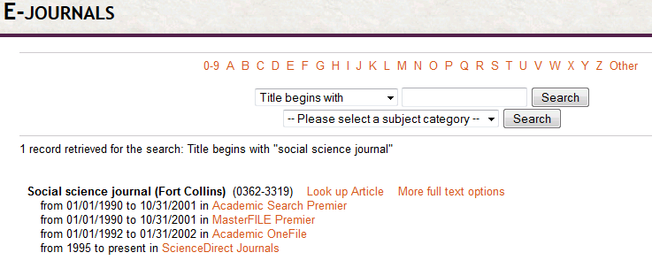
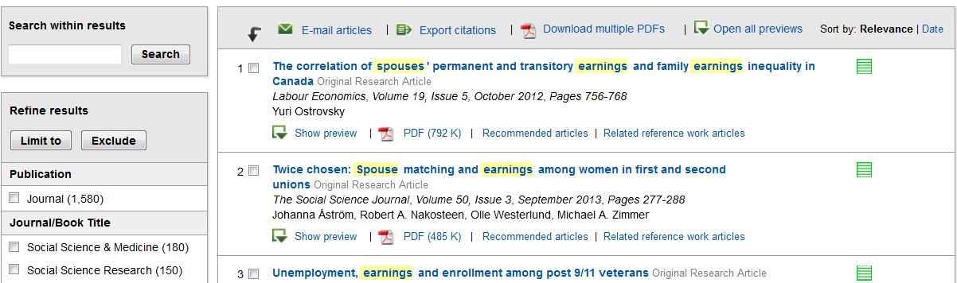
Notes:
For each iteration of the survey, users encountered it if they went through our e-journal list or through a database or discovery tool. Once the user selected a targeted resource, a journal we selected to target, then the…

Slide 7
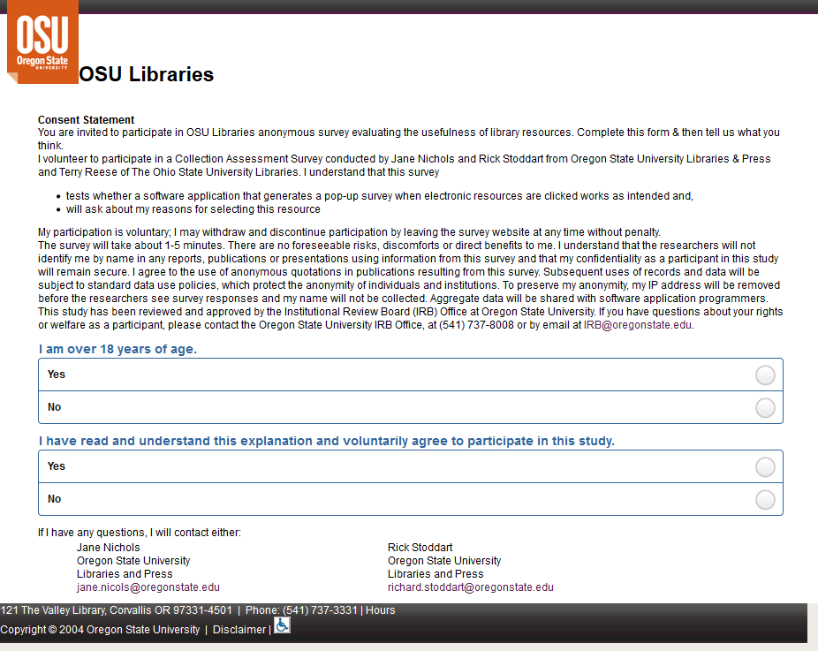
Notes:
IRB and survey displayed. Once they completed the survey…

Slide 8
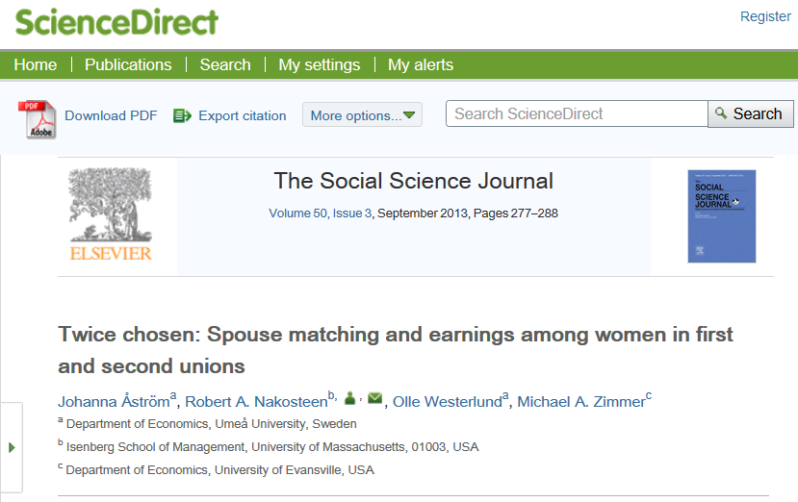
Retrieved from © 2013 Elsevier B.V. The Social Science Journal
Notes:
the user was directed to their intended article. For anyone who didn’t want to respond to the survey they were able to choose to not respond and they were also immediately presented with their intended article.

Slide 9
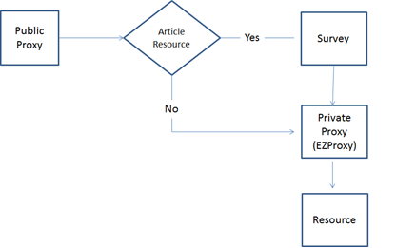
(Apache)
Terry Reese. "Improving Evaluation of Resources through Injected Feedback Surveys". July 2013, Ariadne Issue 71 http://www.ariadne.ac.uk/issue71/reese
Notes:
As I mentioned earlier we used our proxy server, in our case, EZProxy, to implement MINES. So for this survey infrastructure another proxy was deployed, a public proxy server on Apache. I’ll explain this diagram and the workflow superficially and recommend Terry’s article published in Ariadne for further details and obviously he can be contacted directly. We’re all familiar with using a proxy server from off-campus where you log in prior to getting to your article; that’s what is meant in our case by public proxy. In this workflow; an Apache proxy is added which encompasses the private proxy; this becomes the public proxy and plays the key job of a decision engine. Based on the context, the public proxy recognizes the users request for an article; determines if the person should be displayed a survey; displays the survey when appropriate and when not; sends the person to their article. For the most part this works well and as I share survey results some of the tweaks that needed to be made will become apparent.

Slide 10

Survey Round 1
1 month- all hours
8 questions
170 responses
70+ journals
Retrieved from © 2013 Elsevier B.V.
Notes:
What did we learn? In our test run with Elsevier journals last year we focused on our UTL list under the thinking that since these are our must have journals we hoped to capture from users why these journals are so key to their teaching and research.
The survey was posted for one month and just over 70 titles were targeted. We received 170 unique responses and 186 unique articles were accessed.
We asked demographic questions such as status, department affiliation and qualitative questions about impact such as what impact does having access to this resource have and what does access to this resource enable you to do. We also asked respondents to place a monetary value on the item they wanted.
In this round we got great feedback that I think contributes to the larger question of collections and impact. Comments such as “electronic access to library resources helps a lot. I need to complete a term paper” and “they have been critical in the construction of my graduate thesis. When access to certain documents is denied it has a material impact on the quality of the writing and causes significant frustration” clearly show that users see value in the resources.
This is pretty fantastic, right? We’re able to get real-time sentiment at the article level about its importance. Unfortunately there was just one hitch with this round—because we had it on at all times, as you might have guessed, some respondents encountered the survey several times…and we all know this is definitely not ideal. This led to a little frustration and several duplicates.

Slide 11
Survey Round 2
Changes
Kept
Information Commons:
once every 60 minutes
Other IP addresses:
once every 24 hours
JSTOR
1 month
Some questions
Notes:
Enter round 2
For this round we focused our efforts on reducing duplication. This was handled through a combination of survey design changes and if-then statements that Terry added to the code about which IP addresses would see the survey and when. Instead of being displayed at every journal selection; in the info commons it was displayed once every 60 minutes and for other IP addresses once every 24 hours.
We stuck with the 1 month duration and several of the same questions. We changed journals which I’ll go into in a moment.

Slide 12
$ Value-Elsevier
$1 $10 $20 $30 $40 $50 $60 $70
Notes:
One of the questions we changed was “If you had to pay for this article out of your own funds, how much would you be willing to pay for immediate access?”
For the first round we tried using a scale where the respondent could move it to make their selection. However, the vast majority left it at $0, the default, so most didn’t actively respond to the question or maybe they did and they wouldn’t pay for it. The next highest dollar amount was $5. Of course we think that’s interesting because we know how much those Elsevier journals cost.
Wide ranging responses with most at $0 the default; then $5 (19); $1 (10); $15 (7) and $70 (4)

Slide 13
$ Value-JSTOR
$0-$1
$1-$5
$2-$6
$6-$10
$11-$15
More than $15
Notes:
For round 2 we focused on JSTOR articles and as a point of comparison.

Slide 14

Some rights reserved by
Flickr user rychlepozicky.com
Notes:
83% of all of our respondents regardless of which campus the person identifies with indicated they valued the journal article at just $1 despite the response choices being lower than in the previous round. It could be that the majority in this round also left the response at the default. Obviously, this is a question we’ll have to continue to play with…I think there are too many other factors at play to feel comfortable with how to interpret the responses.

Slide 15

Retrieved from OSU Ecampus
Notes:
For the second round the library focused on JSTOR journals because we were able to acquire 3 collections due to a generous gift from OSU’s Ecampus department. Like other institutions, Ecampus has seen significant growth, they now offer over 30 degrees and students receive the same diploma as on-campus students. Also on-campus students can take Ecampus courses alongside their in-person courses. So…e-resources are obviously very beneficial to students. When Ecampus gifted the library they asked us to share information about the impact of their gift.

Slide 16




77 responses
48 out of 663 journals
Retrieved from Qualtrics OSU Valley Library instance
Notes:
With the ecampus gift we added JSTOR Arts & Sciences III, V & VI this fall. By October we had the survey up and running. In response to our 9 questions we got 77 good responses. So let me say something about the response rate. While 77 responses out of the 55,000+ responses is quite paltry and obviously not statistically significant the intent was to first test the software and second to go through intentional survey design iterations…to get closer to linking student success to collection development efforts. In other words we intend to repeat this survey over the course of the next year and beyond. As we run the survey over time responses will be added to this set of 77; and with that accumulation we’ll be able to better see across time what our users say about library e-resources.
/ 55,694 transactions 14,177 unique IPs
If you are familiar with JSTOR’s collections—you’ll recognize these as the major areas of content for Arts & Sciences 3,5 and 6. I thought it was interesting that other most accessed journals were 7=Journal of Anthropological Research and 5= Journal of Applied Ecology.

Slide 17
Ecampus
Status
Type of use
Notes:
We had a discrete goal of demonstrating to Ecampus the value of their investment; in 1 month their investment, which was substantial, is already seeing returns.
17 of the respondents were using the resource for an Ecampus course; so that’s just 22%.
2 were unsure and 3 left this field blank
What else did we learn?

Slide 18
 | Undergrad | Other Student | Faculty/ Instructor
Course assignment | 10 | 2
Course assignment/Curriculum development/My research | 1
Course assignment/My research | 2
Curriculum development | 1 |  | 1
My research |  |  | 1
Total | 13 | 2 | 2
Notes:
We learned that of the Ecampus usage…the majority of respondents students and the majority is for their assignment/homework. I think this gets us towards the impact that Ecampus would want to see—they invested in library resources and students used them for their assignment.

Slide 19


Notes:
All Ecampus respondents said that the article at hand was core to their purpose, be it their assignment or homework, their research or teaching. So this gives one lens to see how our users value our collections. And while numbers are great to see; most of us also really love to see comments like these:

Slide 20
Provide important readings for my students
~faculty
Complete my assignments in the way expected using well sourced journals.
~student
My homework assignment
~student
Write my research paper for the end of the term ~student
Complete class assignments
~student
Learn
~student
Notes:
Comments like this round out the numbers and add a human element that we can easily relate to and understand. We can visualize faculty and students at work and maybe it’s this image that helps administrator’s understand the impact/ the value that library collections bring to our institutions.

Slide 21
Lessons Learned
Survey design
  Fewer questions
  Alternate questions
  Explore if capturing data from proxy server would could work
  See if we can get usage data that is meaningful
  Consider working more closely with Ecampus on questions
Notes:
Going forward we have a few changes we’d like to make to the survey….

Slide 22
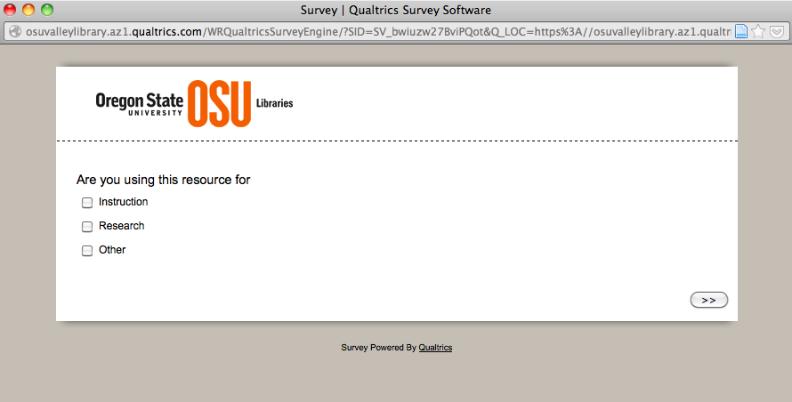

Retrieved from Qualtrics OSU Valley Library instance
Notes:
For institutions that have Qualtrics, you may already know that it includes a pop-up distribution option that looks very nice. Can paste code into your web site; Includes animation and of course the full backend of Qualtrics. However where this differs is what causes the survey to pop-up; with Qualtrics you would have to figure out how to launch the survey at the journal level.

Slide 23
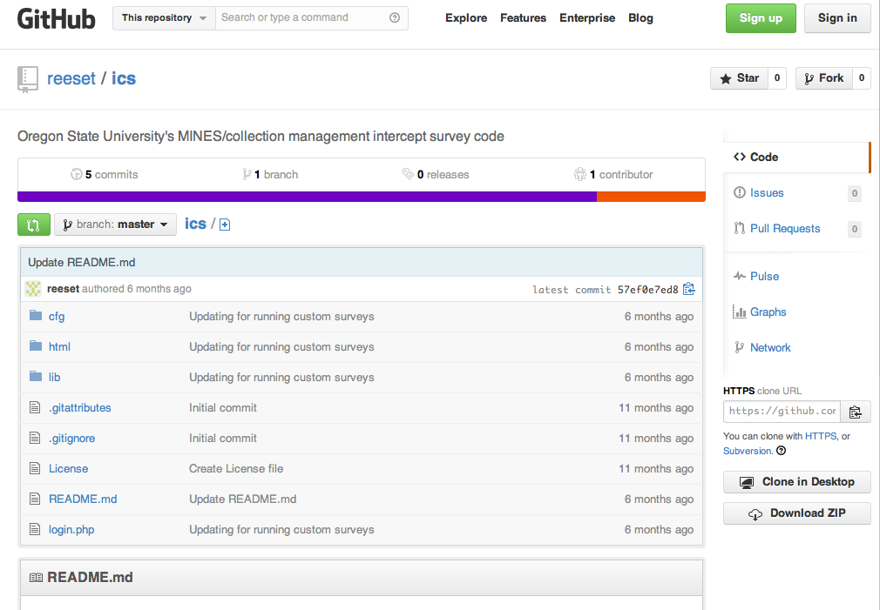
Code: https://github.com/reeset/ics
Retrieved from GitHub, reeset/ics
Notes:
Here’s where the initial code release is stored: https://github.com/reeset/ics

Slide 24
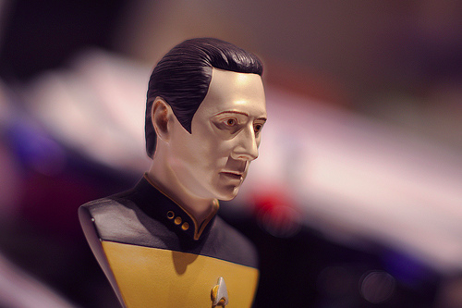
Some rights reserved by
Flickr user puntxote
Notes:
Test survey at your institution? Interested in data aggregation.

Slide 25

Some rights reserved by
Flickr user Oberazzi
Notes:
Discussion

Slide 26
Jane Nichols
Collection Development Librarian
jane.nichols@oregonstate.edu
Terry Reese
Head, Digital Initiatives
reese.2179@osu.edu
Rick Stoddart
Assessment Librarian
richard.stoddart@oregonstate.edu

