Slide 1
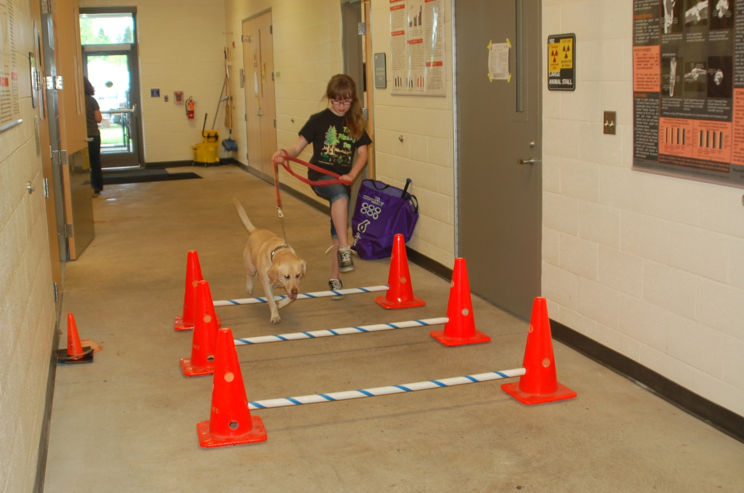
COLLEGE OF PUBLIC HEALTH AND HUMAN SCIENCES
Effect of Physical Activity with Family Dog on Gross Motor Skills of Children with Cerebral Palsy (CP)
Haylee Winden, Amanda Tepfer, Wendy Baltzer, DVM, PhD, DACVS and Megan MacDonald, PhD
Introduction
Cerebral palsy is a permanent neurodevelopmental disorder that affects physical activity level as well as perception and cognition and is often accompanied by secondary disorders (Rosenbaum, 2006). In order to gain the most health benefits, research shows that meeting the physical activity requirements of strength and cardiorespiratory training should be combined with a focus on decreasing sedentary activity as well (Verschuren et al., 2014). As alternative therapies such as swimming and horseback riding can provide additional incentive for a child to follow a repetitive therapy routine, it is thought that therapy with a family dog could provide similar motivation (Bertoti, 1988). Since a child’s ability to perform normal activity affects their ability to socialize, a lifestyle with regular physical activity may increase overall quality of life for children with cerebral palsy (Neves dos Santos, 2013).
The purpose of this exploratory study was to examine the effect of an exercise-based physical activity program with a family dog on gross motor skills of children with cerebral palsy.
Study Design
Children ages 5-15 years old completed the TGMD-2 assessment before and after an eight week intervention treatment. Three participants had a Gross Motor Function Measure (GMFM) of level 1, one at level 2, and one at level 3. One participant left the study before completing the intervention.
Procedures:
The following descriptive assessments were completed.
Demographic Questionnaire
Self-reported and parent-reported quality of life surveys
The Test of Gross Motor Development (TGMD-2) was used to assess gross motor skills at baseline.
Procedures cont’d…
3. An 8 week intervention at OSU included exercises that the child performed with the family dog:
Sit-to-stand
Tossing a ball
Walking
Brushing
Families were also asked to complete an activity log at home that recorded the time spent with the dog and the number of times the child completed their exercises each week.
4. A post-intervention TGMD-2 test was completed.
The TGMD-2 scores were analyzed and compared between time points to test for improvement.
Results cont’d…
Conclusion
No relationship was found between the amount of time the child spent with the dog and improvement of gross motor skill scores. Also, the amount of time spent with the dog each week does not directly indicate that the child was completing their exercises during that time.
Results show that all TGMD-2 measurements increased between pre-intervention and post-intervention assessments; however, the increase was not statistically significant.
These findings are important for understanding how to adjust procedures in order to support more representative results.
References
Rosenbaum, P. (2006). A report: the definition and classification of cerebral palsy Developmental Medicine and Child Neurology 49(109), 8-14. Web. 15 Apr. 2014.
Verschuren, O, et al. (2014). Health-enhancing physical activity in children with cerebral palsy: More of the same is not enough. Physical Therapy, 94(2), 297-305. Web. 15 Apr. 2014.
Bertoti, D.B. (1988). Effect of therapeutic horseback riding on posture in children with cerebral palsy. Physical Therapy , 68(10), 1505-1512. Web. 15 Apr. 2014.
Neves dos Santos, A. (2013). Sit-to-stand movement in children with hemiplegic cerebral palsy: Relationship with knee extensor torque and social participation. Elsevier 34(6), 2023-2032.
Ulrich, D.A. (2000). Test of Gross Motor Development . 2nd ed. 2000. Print.
Acknowledgements
A special thanks to the following:
Undergraduate Research, Scholarship, and the Arts (URSA ENGAGE)
Oregon State University Division of Health Sciences
Amanda Tepfer
Dr. Wendy Baltzer, DVM, PhD, DACVS (PI) and Megan MacDonald, PhD. (Co-PI)
Figure 1
A bar graph of three TGMD-2 measurements for each of the five participants.
Results
*Participant 5 used a manual wheelchair and did not complete locomotor portion of assessment
Figure 2
Table 1
 | N | Minimum | Maximum | Mean | Std. Deviation
Age (years) | 5 | 5.50 | 14.91 | 10.9640 | 3.91749
Locomotor Total | 4 | 5.0 | 42.0 | 24.750 | 15.7136
Object Control Total | 5 | 13.0 | 48.0 | 27.600 | 14.7411
Total Motor Skills Score | 5 | 18.0 | 90.0 | 47.400 | 31.5959
Pre-intervention descriptive statistics.
A bar graph of three TGMD-2 measurements for each participant after the 8-week exercise intervention.
Table 2
Figure 3
 | N | Minimum | Maximum | Mean | Std. Deviation
Age (yr) | 4 | 9.58 | 15.25 | 12.6275 | 2.88625
Locomotor Total | 3 | 14.0 | 47.0 | 32.333 | 16.8028
Object Control Total | 4 | 13.0 | 40.0 | 28.750 | 12.3390
Total Motor Skills Score | 4 | 13.0 | 87.0 | 53.000 | 33.4265
Physical Activity Total | 4 | 7.0 | 54.0 | 34.000 | 20.5426
Figure 4
5
Post-intervention descriptive statistics. Physical activity is measured as the number of times the child completed their exercises over the 8 week intervention.
A bar graph detailing physical activity totals during the intervention period according to the number of days that each participant reported completion of exercises.
A participant demonstrates her exercises as part of the intervention.
Notes:
PA Data:

