Slide 1
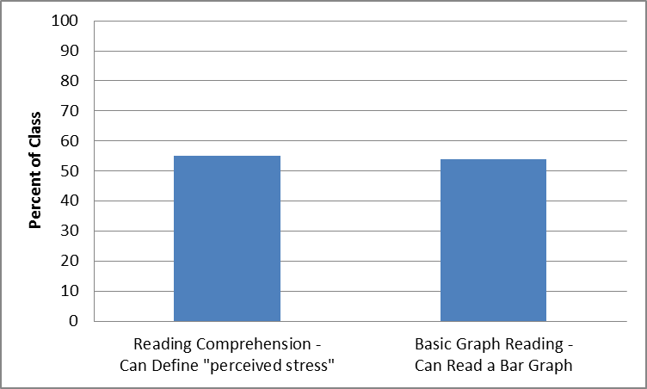
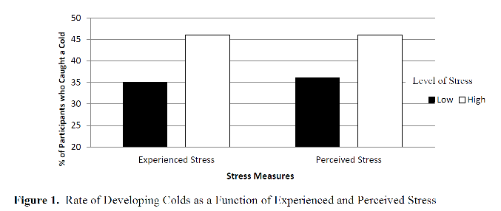
Multiple-Choice Testing to Teach Scientific Reasoning and Prepare Psychology Students for MCAT2015
Kathryn Becker-Blease¹, Courtney Stevens², Melissa Witkow², Keiko Bostwick¹
¹ Oregon State University ² Willamette University
SCIENTIFIC LITERACY IN INTRO PSYCHOLOGY
In 2015, the MCAT will for the first time include a section covering Introductory Psychology content and scientific literacy. How can we teach high level scientific literacy skills in large lectures? Well-designed multiple choice questions can be used not only for assessment, but to teach material through retrieval practice and elaboration (Carpenter, 2012; Glass & Sinha, 2013; Little, Bjork, Bjork, & Angello, 2012). In this pilot study, we address a basic question: Is it feasible to teach higher level research design and data-based reasoning in large sections of Introductory Psychology?
METHOD
212 Introductory Psychology students participated . On the first day, students took a pre-test without feedback. They then took 3 practice midterms and 3 real midterms in the class. Each midterm included a MCAT-style passage describing a research study with related questions. The same MCAT-style question was on the pre-test and 3rd midterm. Additional questions were added to this study to diagnose basic difficulty with reading comprehension and graph reading. The instructor explained each answer verbally immediately after the practice test. An answer key was posted electronically immediately after each real midterm.
IMPLICATIONS
This pilot study indicates that it is feasible to teach and assess high level research design and data reasoning in Introductory Psychology using multiple choice tests.
Preliminary results suggest that about half the class would benefit from remedial instruction in basic reading comprehension and graph reading, and this should be a target of more intensive interventions for selected students. All students will likely require more instruction and/or explicit feedback, and should be one target of a more intensive intervention for all students.
Additional research is needed to identify students’ areas of difficulty and to develop teaching methods that target those areas.
FUTURE RESEARCH
REFERENCES
Carpenter, S. K. (2012). Testing Enhances the Transfer of Learning. Current Directions in Psychological Science, 21(5), 279-283. doi: 10.1177/0963721412452728
Glass, A. L., & Sinha, N. (2013). Multiple-Choice Questioning Is an Efficient Instructional Methodology That May Be Widely Implemented in Academic Courses to Improve Exam Performance. Current Directions in Psychological Science, 22(6), 471-477.
Little, J. L., Bjork, E. L., Bjork, R. A., & Angello, G. (2012). Multiple-Choice Tests Exonerated, at Least of Some Charges: Fostering Test-Induced Learning and Avoiding Test-Induced Forgetting. Psychological Science. doi: 10.1177/0956797612443370
ACKNOWLEDGMENT
This research was funded by a Faculty Release Time grant through the OSU Research Office.
CONTACT INFORMATION
Kathryn.blease@oregonstate.edu
MCAT-STYLE QUESTIONS
RESEARCH DESIGN: Which of the following changes to the study would make it possible to investigate whether there is a causal link between stress, coping styles, and immune susceptibility?
Randomly assigning participants to conditions in which they learn different coping styles prior to exposing them to a stressor.
ADD NEW CONCEPT: Which of the following results would you predict if this study were extended to examine learned helplessness? People who develop learned helplessness: have higher levels of cortisol.
GRAPH INTERPRETATION: Which of the following conclusions is NOT supported by Figure 1? Perceived stress levels are negatively associated with immune functioning
DIAGNOSTIC QUESTIONS
ADDED TO THE MIDTERM FOR THIS STUDY
READING COMPREHENSION: In this study, "experienced stress" was measured by
the number of stressful life events the participant experienced in the past year.
BASIC GRAPH READING: What percent of those who reported a low level of experienced stress remained healthy (that is, did not catch a cold)? 65%
Could your Introductory Psychology Student Answer This MCAT2015-style Question?
Read this passage and answer the following questions.
…In a study designed to examine the impact of psychological stress on the immune system, participants completed two self-report measures in order to assess experienced stress versus perceived stress. One measure obtained the number of stressful life events the participant had experienced over the last year. The second measure assessed the extent to which the participant perceived life events as stressful. After the participants gave their informed consent and the stress-related information was collected, participants were quarantined and exposed to the common cold virus and their symptoms were monitored. ….
RESULTS
More Students Answered the MCAT-style Questions Correctly on the Midterm Compared to Pre-Test
Half of Students Lacked Basic Graph and Reading Comprehension Skills

