Slide 1
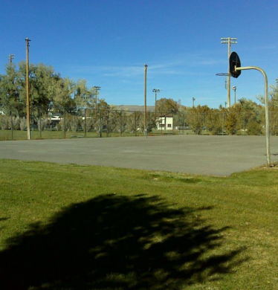
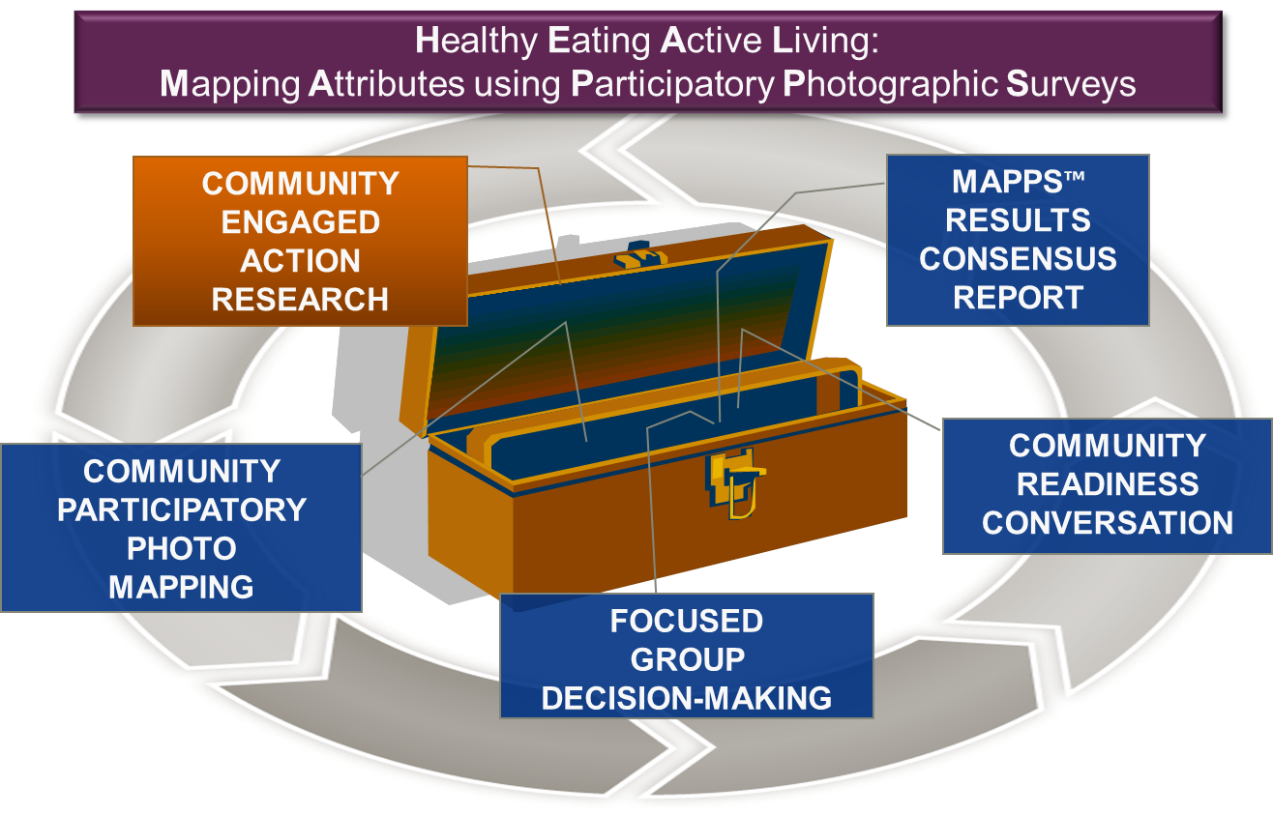
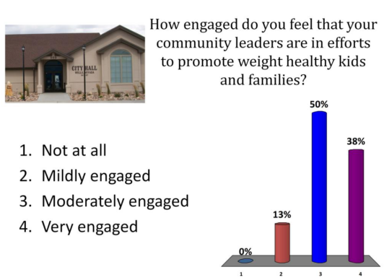
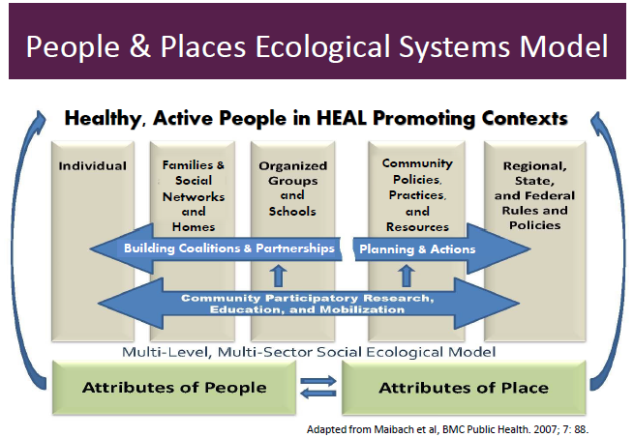
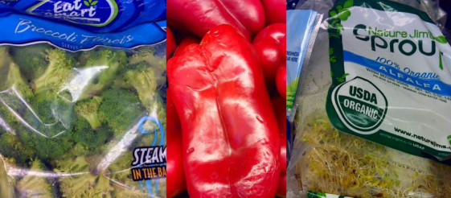
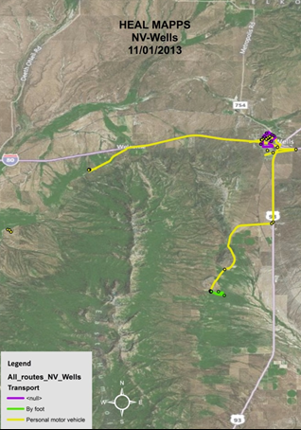
COLLEGE OF PUBLIC HEALTH AND HUMAN SCIENCES
Exploring Rural People’s Perceptions of Weight-Healthy Attributes of Community Place
Bridget Jamieson
Background
Generating Rural Options for Weight (GROW) Healthy Kids and Communities aims to prevent overweight and obesity in rural children and communities. Many characteristics of rural communities are associated with overweight and obesity in children, including environmental attributes that make it difficult for children to access and consume healthy foods and participate in physical activity to maintain a balanced energy equation.
Obesity Prevention Study Framework
Objectives
Asses features of the community environment that are viewed as obesity promoting and preventing
Assess perceptions of the community’s readiness to support resources and implement obesity prevention efforts.
Target Community:
Wells, Nevada
Population of approximately 2,000 people:
27.6% of the residents are under the age of 18 years
37% of students are receiving free or reduced lunch
29.6% of children in Nevada that are entering kindergarten are overweight or obese.
My personal objectives were to better understand how people’s perceptions play a role in understanding and participating in health interventions. I also wanted to gain experience working with qualitative data and applying it to health research.
Methods
GROW:HKC encourages community health action through resident engagement in research that uses various activities to identify supports/barriers to healthy eating and physical activity. HEAL MAPPS™ is the tool developed by GROW HKC researchers to help collect the qualitative data with and from communities.
My role as an research apprentice was to code results from the Wells, NV community conversation into nodes that represented the six dimensions of the Community Readiness Model (CRM). NVivo 10, qualitative research software, was used to manage the project.
Community Readiness Model
CRM assess community readiness to implement effective programs. CRM is composed of six dimensions:
Community knowledge about the issue, Community efforts, Community knowledge of efforts, Local Leadership, Community climate, Resources related to the issue
The results, stage of community readiness and emerging themes, were provided back to the community in a written report.
Results
After evaluating the community conversation, I gave Wells, NV a score of 3 on the CRM, showing that the community is only vaguely aware of how the environment affects population health.
Identified supports to Physical
Activity & Healthy Eating include:
Year-round youth sports
School recreation programs
Outdoor trails and parks
School’s Food assistance program
and hot lunches
Identified barriers to Physical
Activity & Healthy Eating include:
Unmaintained or nonexistent
sidewalks throughout Wells Routes of Wells,NV
Safety concerns at public parks enerated by HEAL MAPPS
Lack of local food production
Limited access and high cost of HEAL MAPPS routes fresh fruits and vegetables generated in Wells, NV
Evaluation of Outcomes
Personal Observations
I noticed that participants consistently polled higher than the community conversation data suggested.
Poll of CRM dimension: local leadership
Poling results conflicted with remarks stating local leadership was a barrier to a healthy lifestyle. Community perceptions indicate that residents are unaware of how the local environment affects individual health, and that Wells, NV would currently be unable to support effective health interventions.
Personal Development
Through my apprentice position with GROW:HKC I developed a better understanding of:
How personal/community perceptions reflect awareness of an issue
How different aspects of the built environment affect the health and habits of a community
How health models are applied to research and how they are applied in health interventions
The beginning stages of planning a health intervention and how research leads to program funding
Different mediums of qualitative data used to interpret themes and characteristics of communities
How to use the qualitative research program, NVIVO
This experience has given me the opportunity to relate concepts from class to real word public health situations, and apply the skills I’ve learned to future endeavors.
A special thanks to Dr. Deborah John and Alinna Ghavami for mentoring and coaching me through the project.
“Basketball court (really an old tennis court). There used to be a net. It’s in bad shape and not utilized.”
“Bountiful Baskets can’t do anything within the city. Since they are a coop they can’t get a business license so they can’t distribute. So we have people that want to help but the city is limiting us.”
“The produce is lousy. It’s really expensive. Trying to get fresh vegetables and fruit is a challenge”
Secondary logo if necessary

