Slide 1
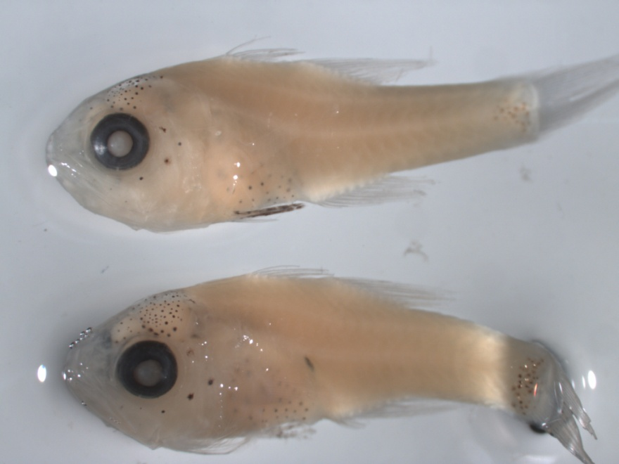
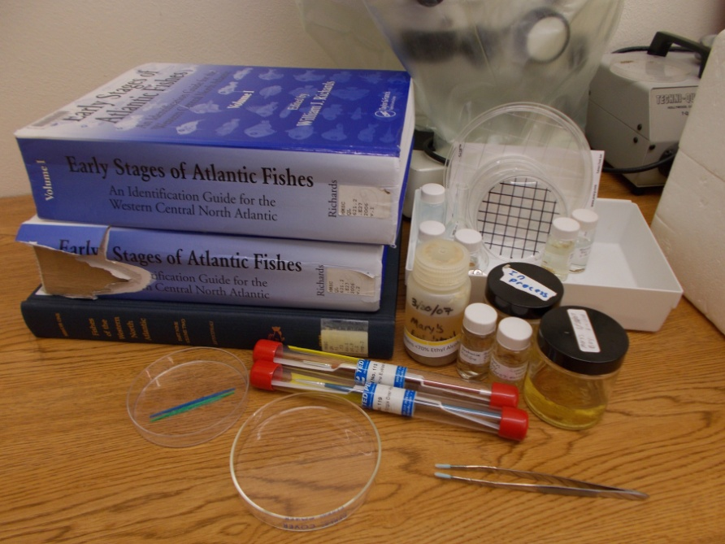
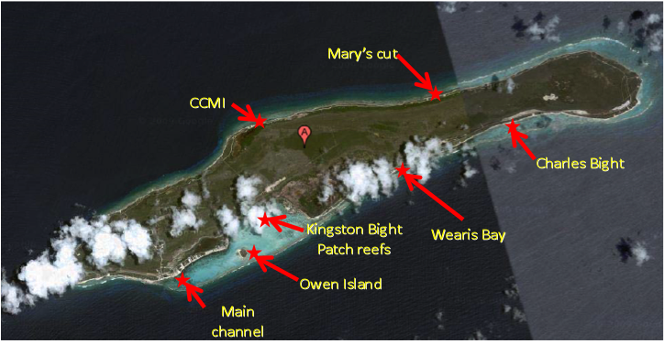
Larval Fish Diversity at Little Cayman Island, Caribbean Sea
Eric Post, undergraduate research, Heppell lab, 2013-2014

Slide 2
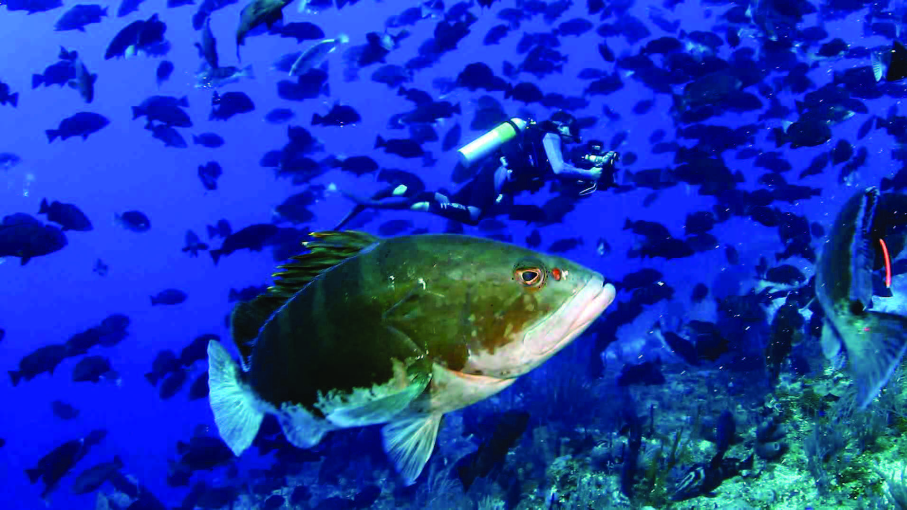
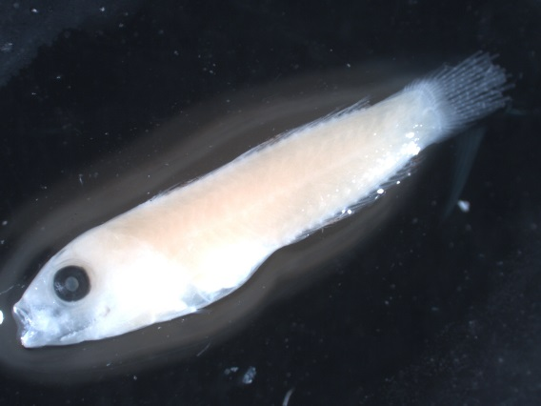
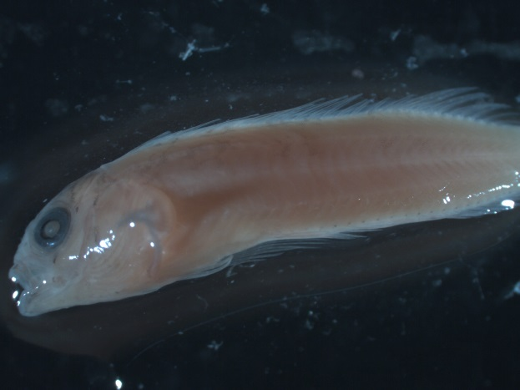
Background
Nassau grouper (Epinephelus striatus) study
  Spawning aggregations vulnerable to overfishing
  IUCN listed—endangered
  Interested in recruitment of grouper larvae
    Deployment of light traps around Little Cayman
    Result: no grouper larvae found
      *Many other species collected!*

Slide 3
New questions
How diverse is the larval fish community around Little Cayman Island?
Which fishes might be using areas around Little Cayman Island as nursery habitats?
Does larval fish diversity vary around Little Cayman Island, and if so, how?

Slide 4
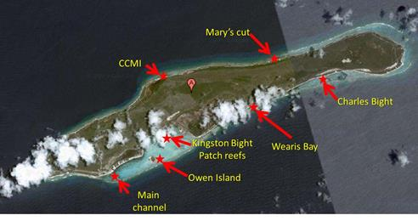
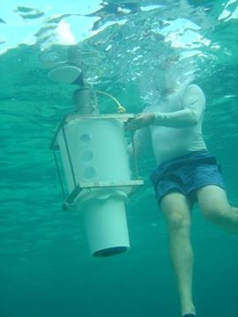
Methods
Light traps
  Larvae collected 32-45 days after peak grouper spawning 2007, 2008, 2009
  Larvae preserved in 70% ETOH
Jones (2006)

Slide 5

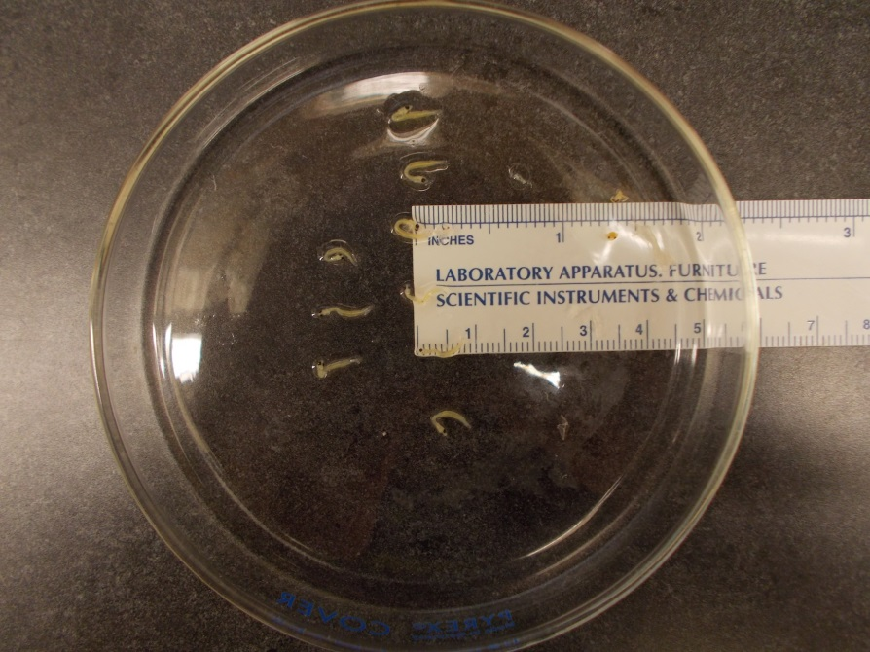
Methods: Larvae identification
Initial sorting—body form
Stereomicroscope
  Meristics and morphometrics
  Ultra-fine tools!
  I.D. guides: Richards et al (2006); Smith et al. (1989); coralreeffish.com (Victor 2014); fishbase.com
  Digital photography

Slide 6
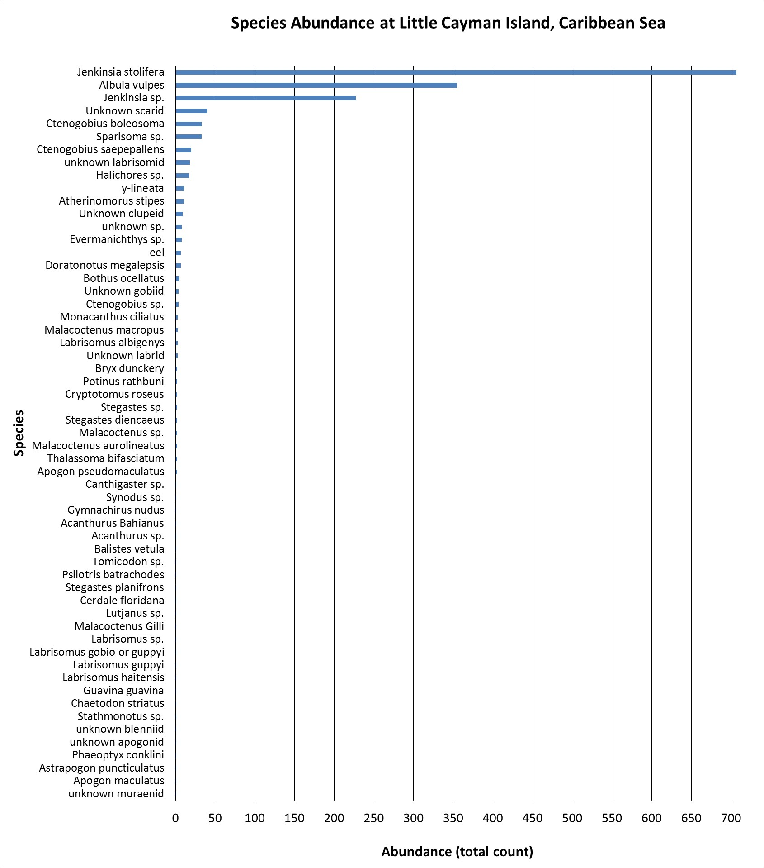
Results
All species
Charles Bay, Mary’s Bay, Kingston Bight (2007)
Traps 1-6 (2009)

Slide 7
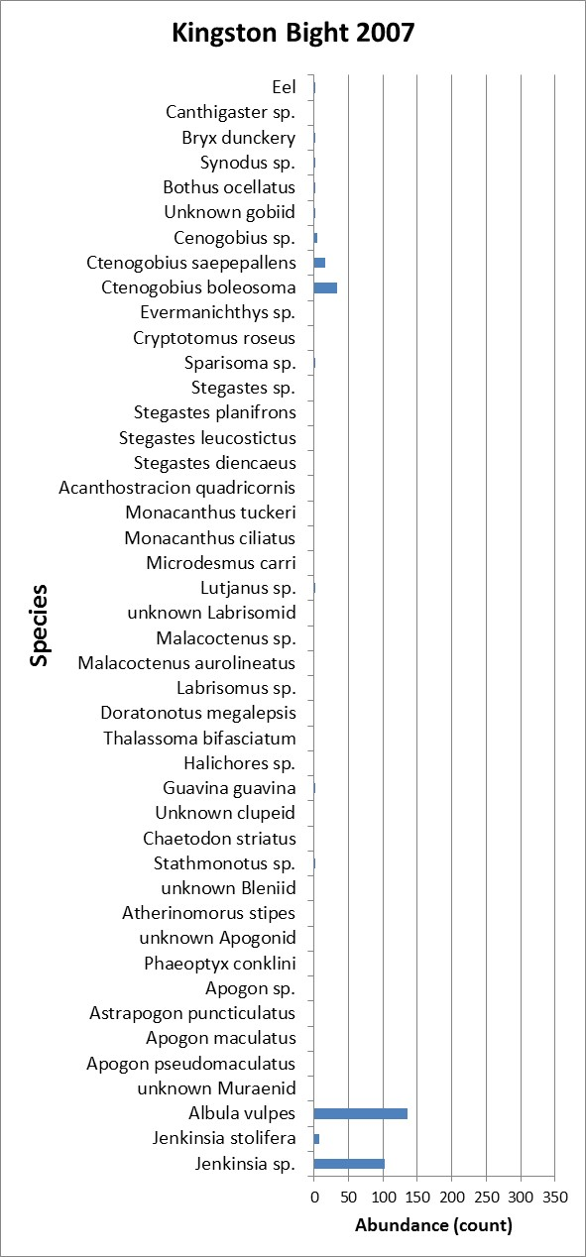
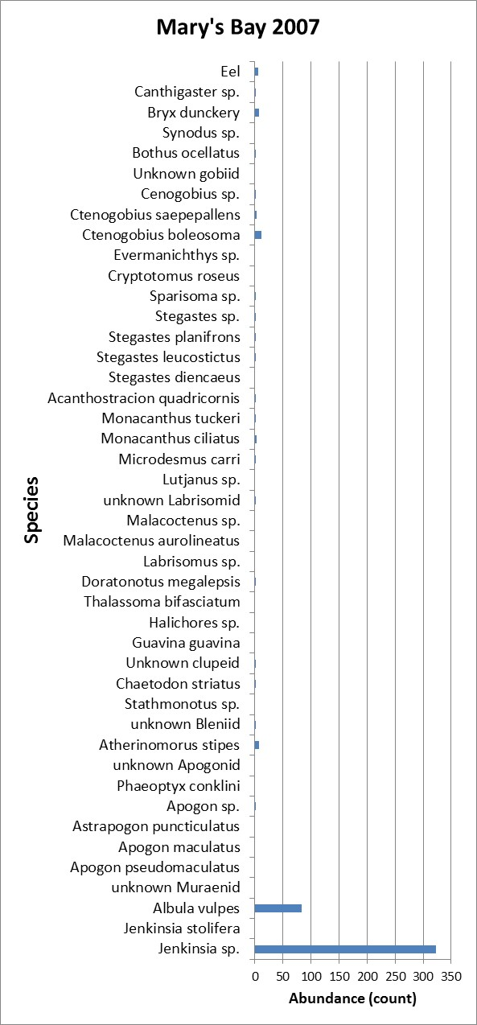
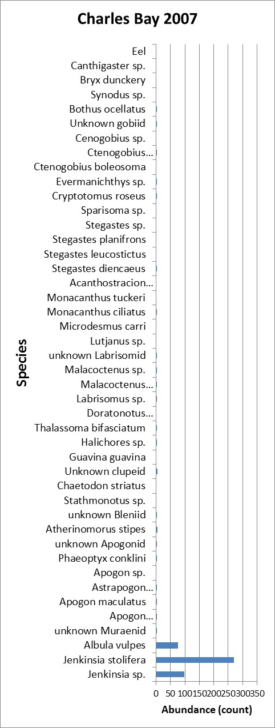

Slide 8
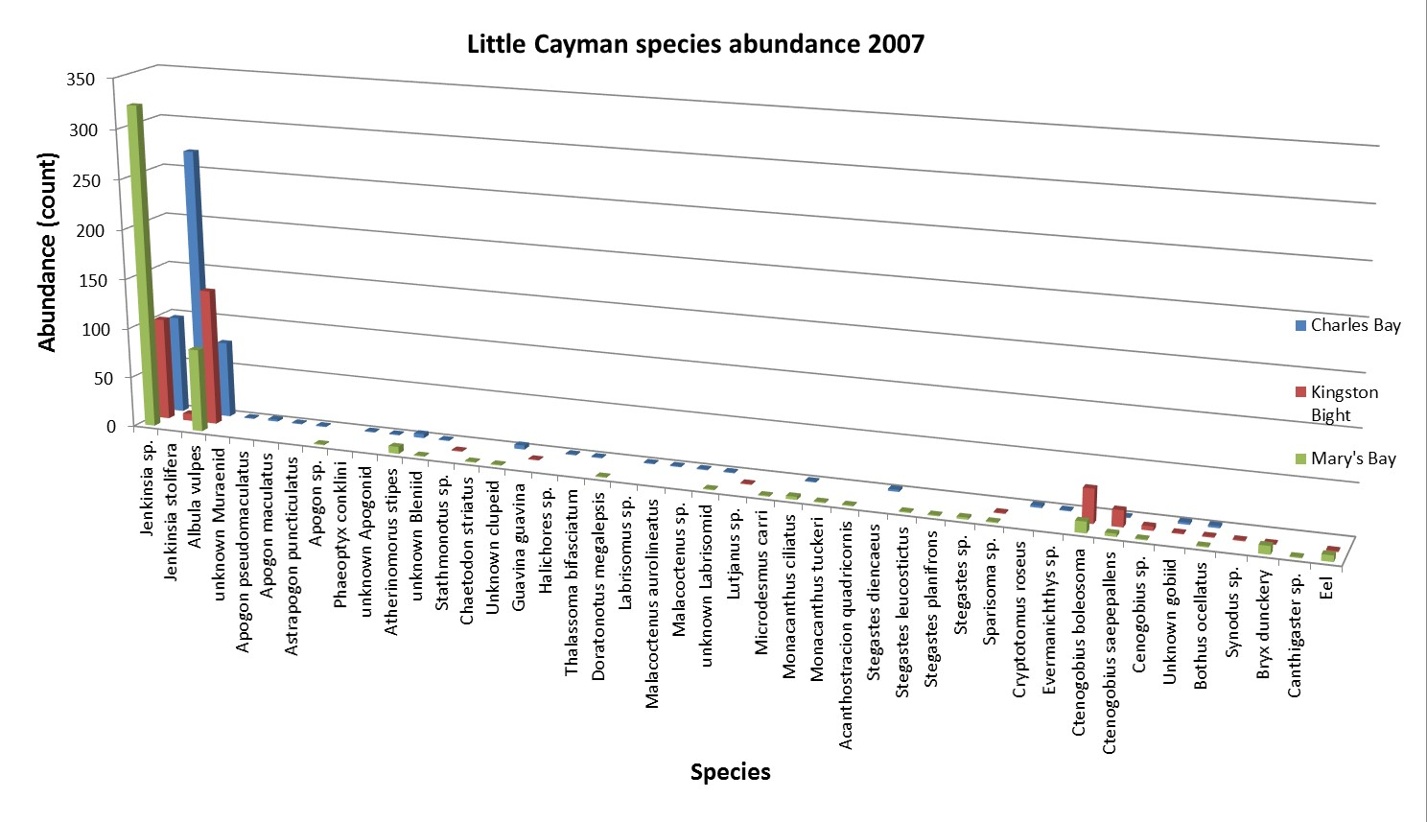
Results (continued)…

Slide 9
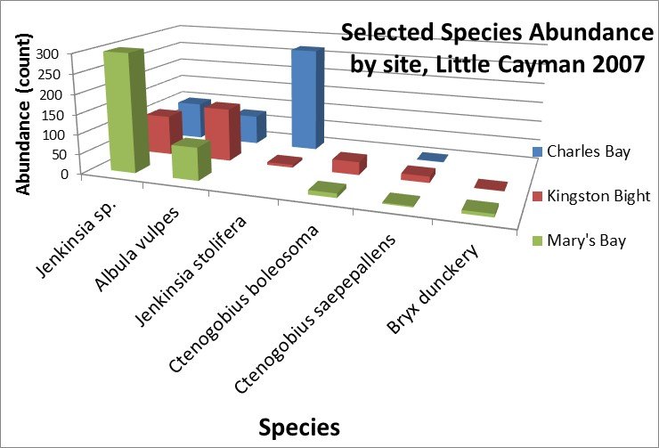
Results (continued)…

Slide 10
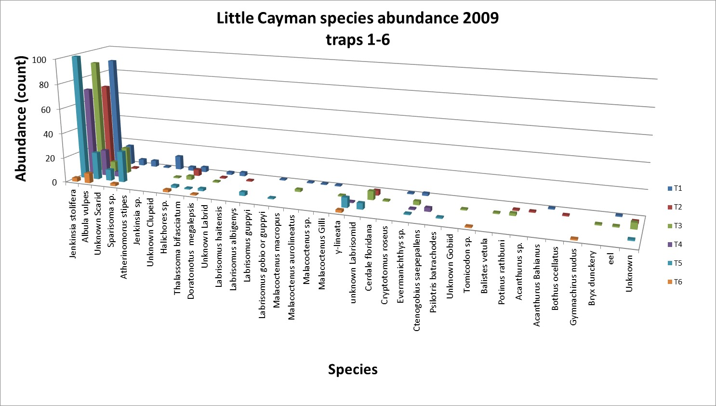
Results (continued)…
T= trap

Slide 11
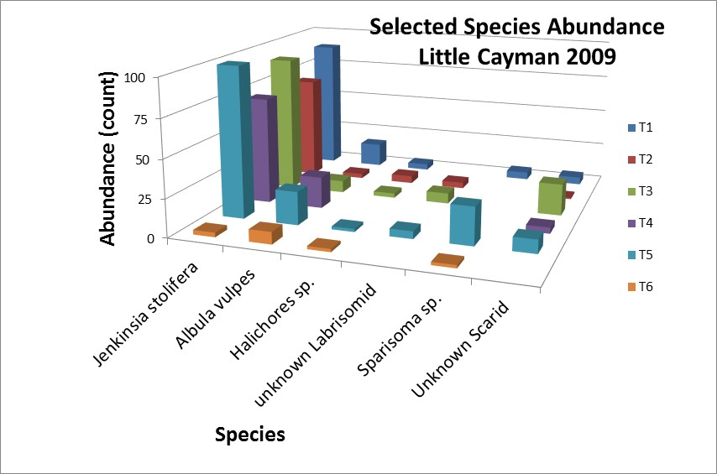
Results (continued)…
T= trap

Slide 12
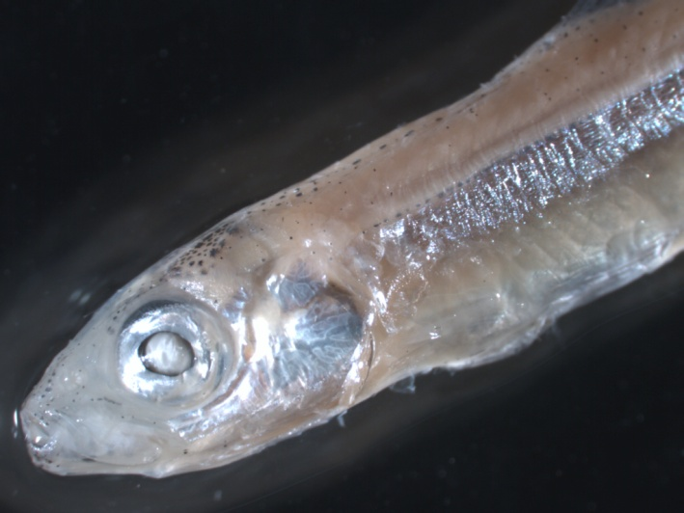
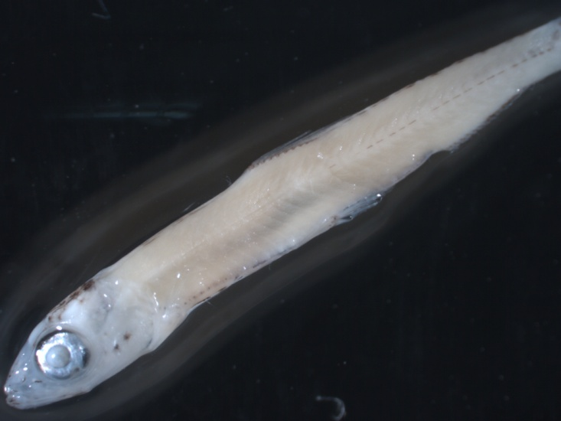
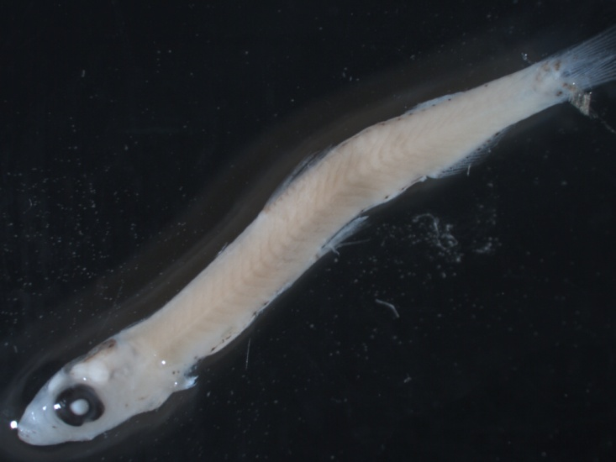
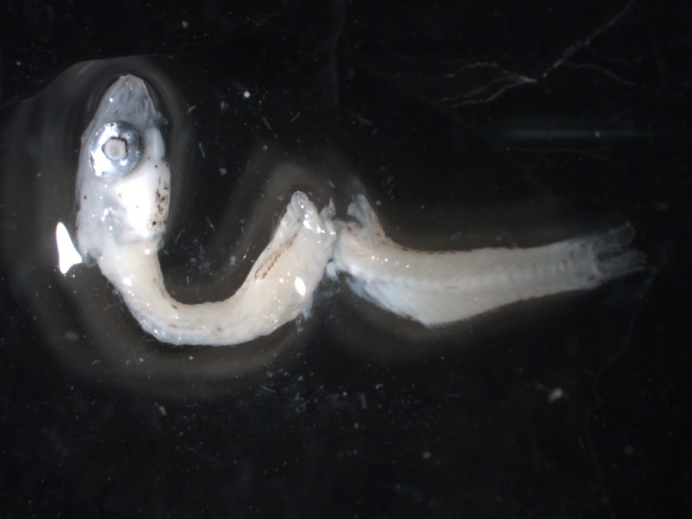
Jenkinsia sp. (stolifera? parvula?)
Jenkinsia stolifera

Slide 13
Meristics for Jenkinsia parvula & stolifera
Species | Vertebrae | Dorsal rays | Anal rays | Pectoral rays | Pelvic rays
Jenkinsia parvula | 38-39 | 10-13 | 12-16 | 11-12 | 8
Jenkinsia stolifera | 38-39 | 9-12 | 13-16 | 11-12 | 8
Richards (2006)

Slide 14
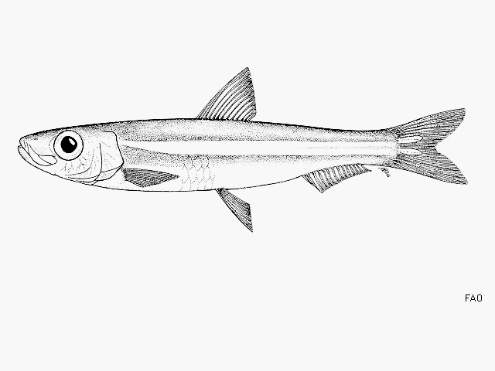
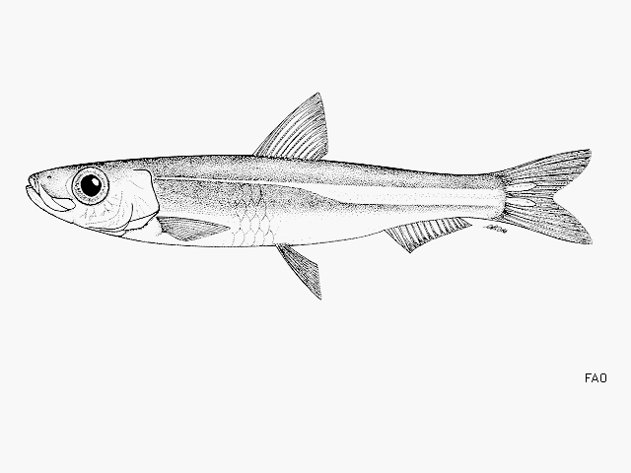
Jenkinsia stolifera
Jenkinsia parvula
“Florida round herring”
Florida, Belize, Venezuela
IUCN: not evaluated
“Short-striped round herring”
Venezuela
IUCN: Threatened, 1996 (needs updating)
fishbase.org

Slide 15
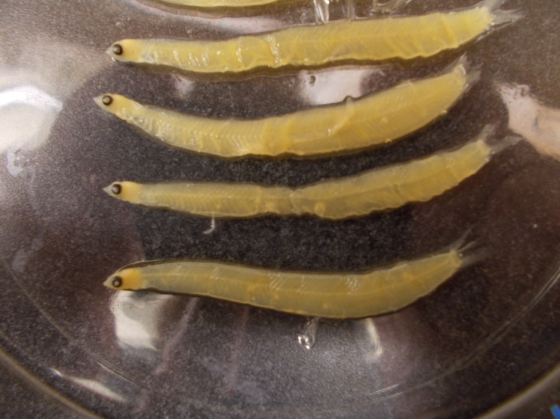
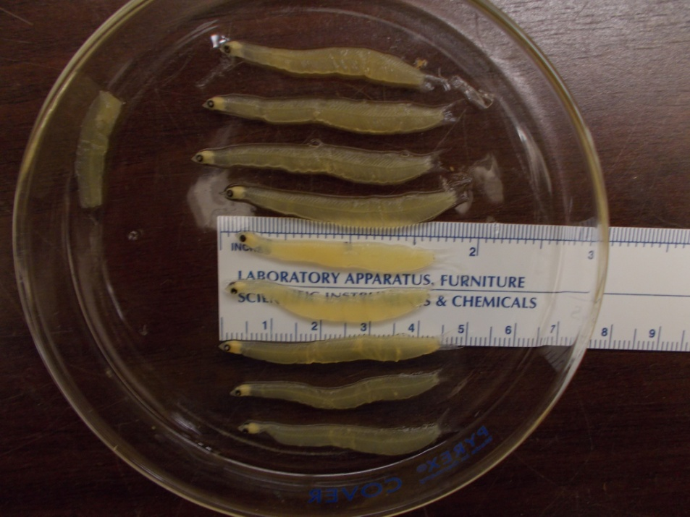
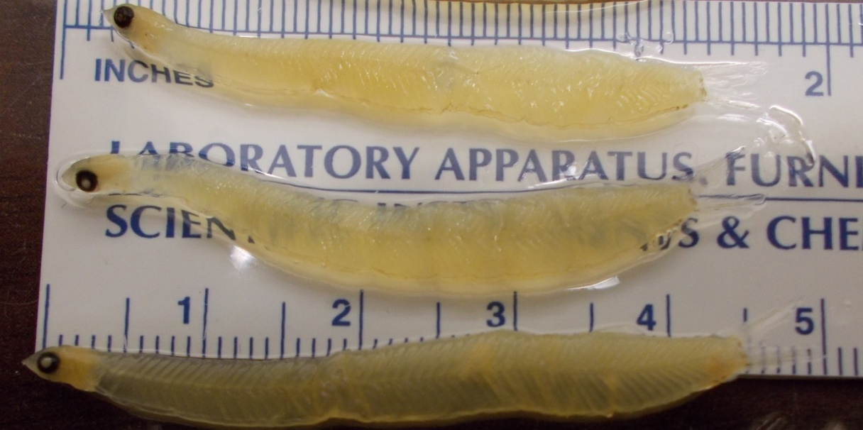
Albula vulpes leptocephali

Slide 16
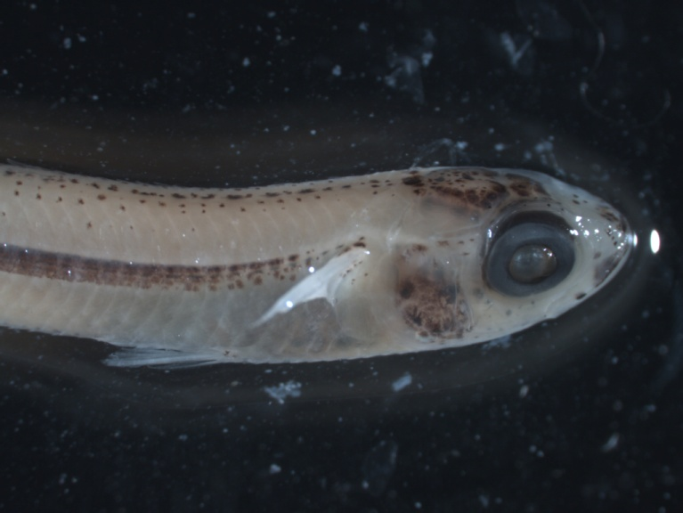
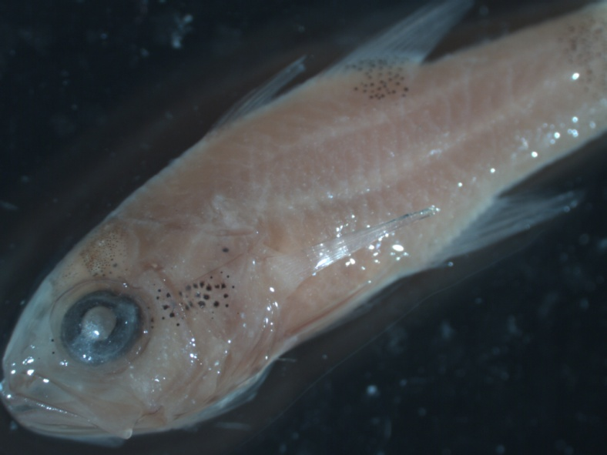
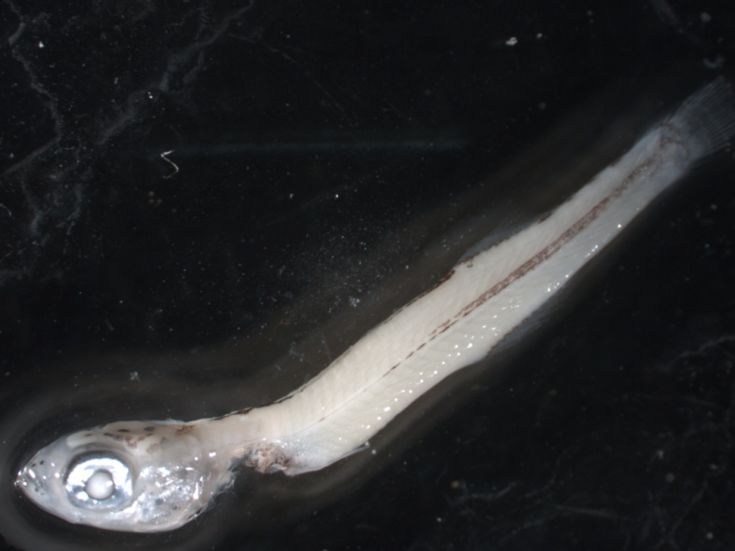
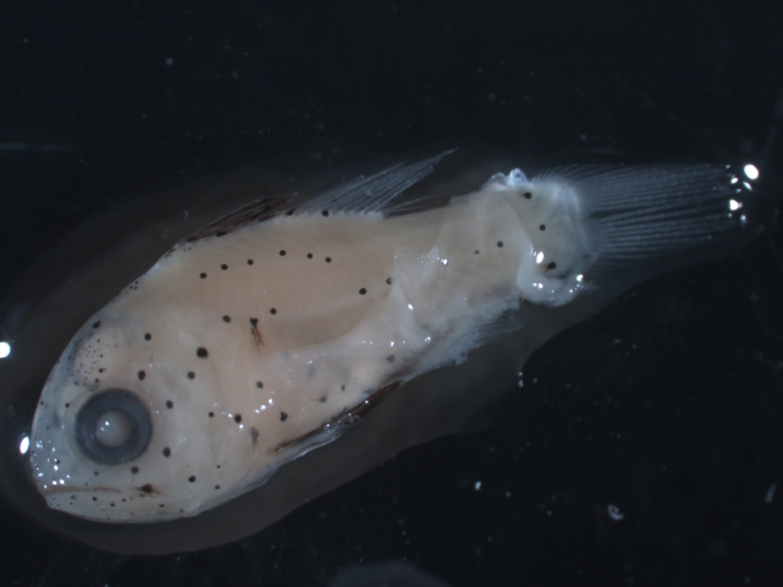
Atherinomorus stipes
Apogon maculatus
Astrapogon puncticulatus

Slide 17
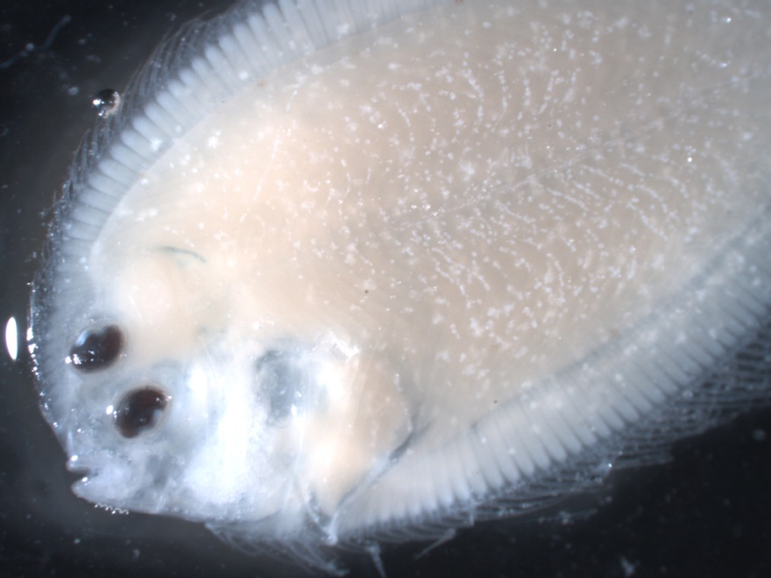
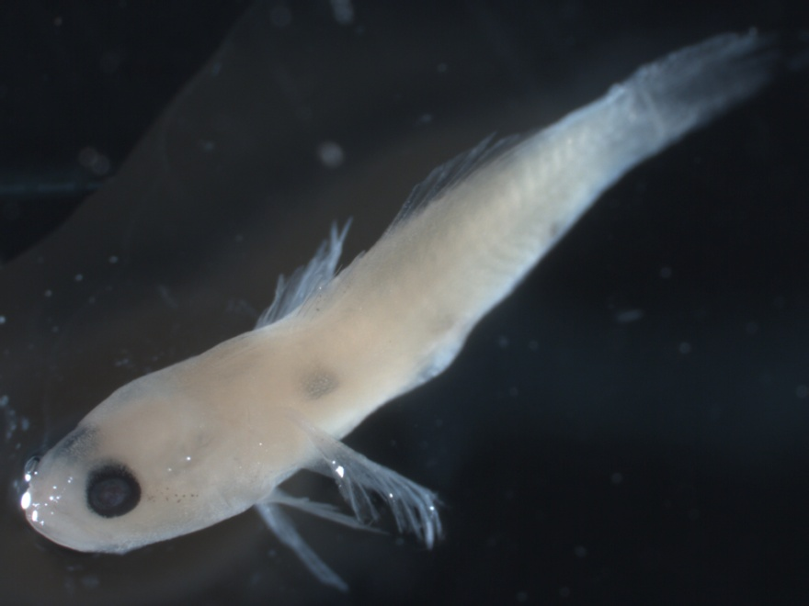
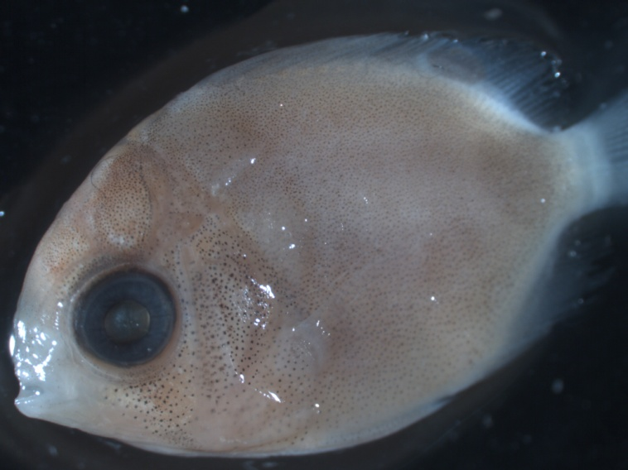
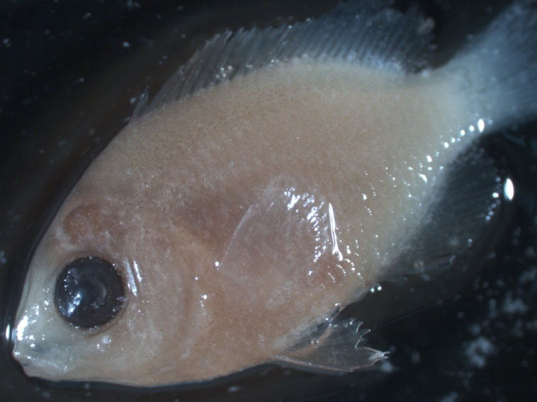
Bothus ocellatus
Family: Gobiidae
Chaetodon striatus
Stegastes sp.

Slide 18
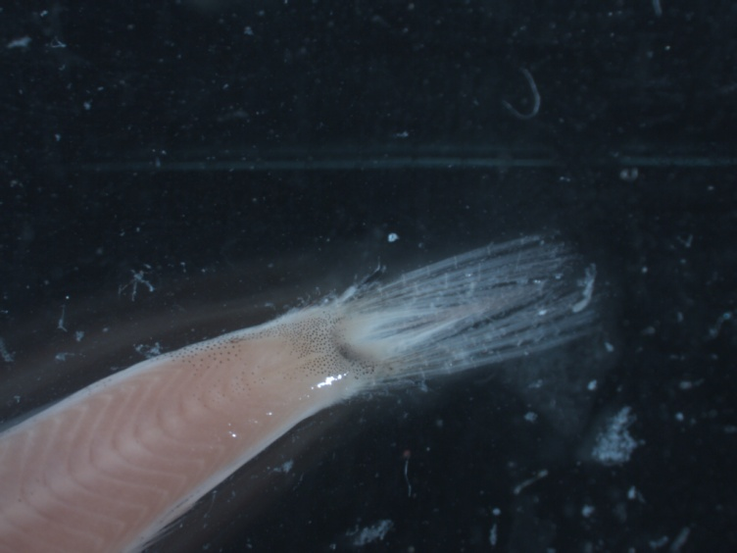
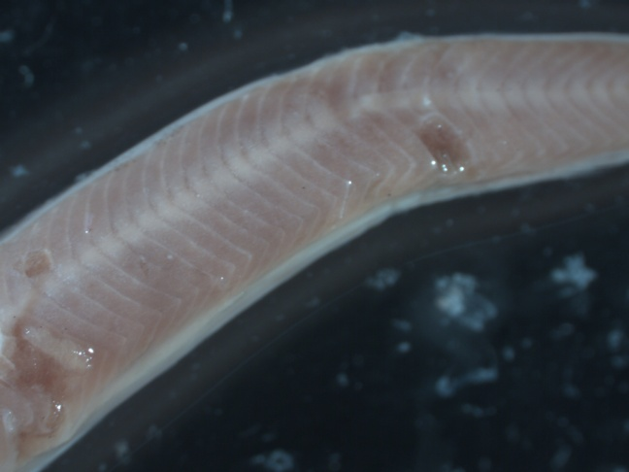
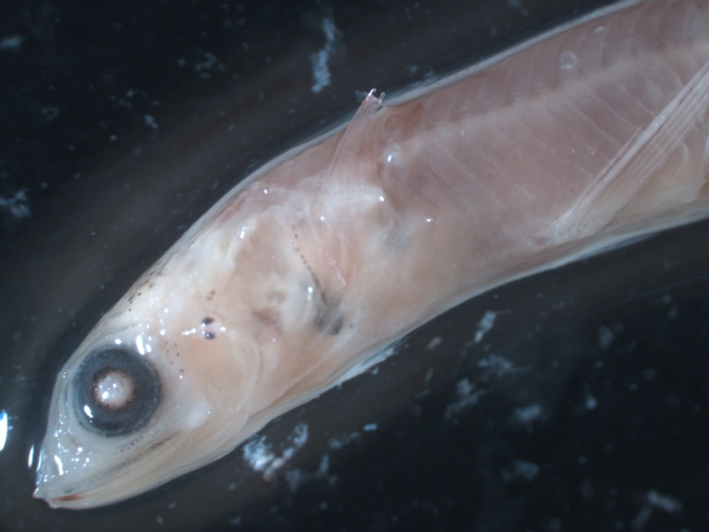
Synodus sp.

Slide 19
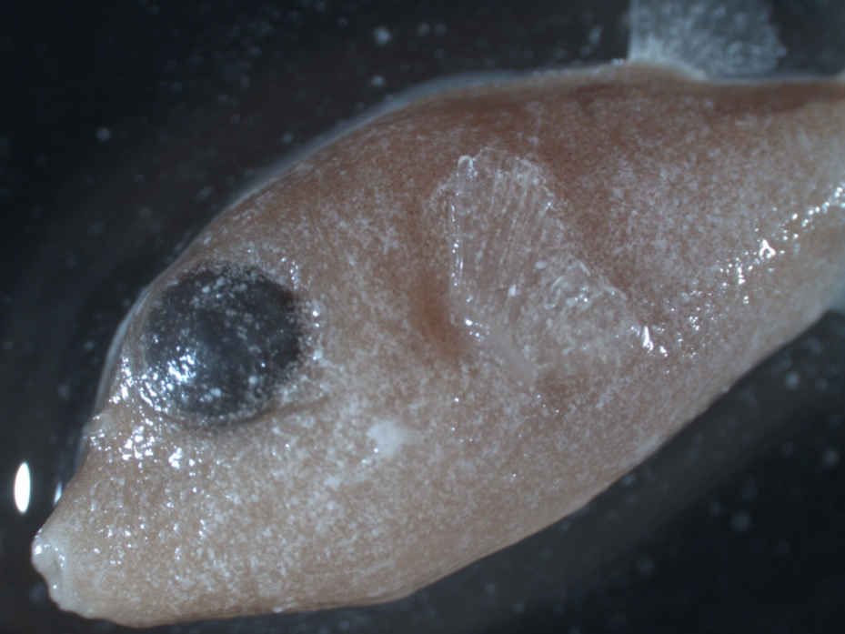
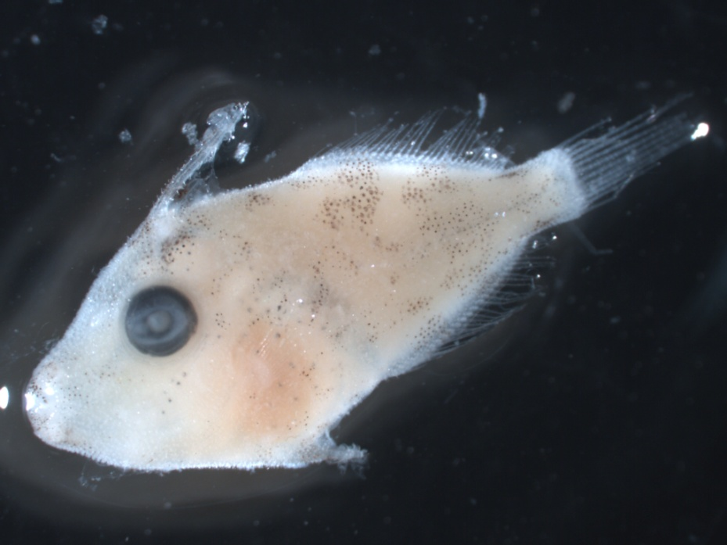
Canthigaster sp.
Monacanthus ciliatus

Slide 20
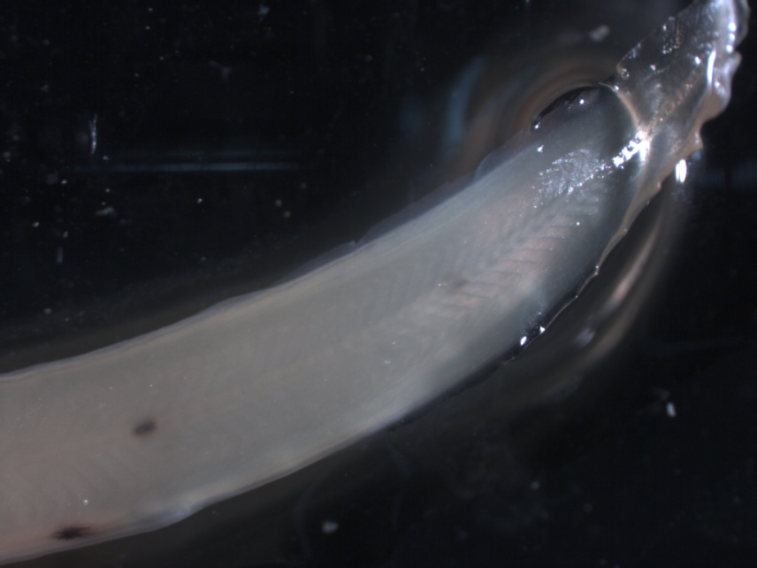
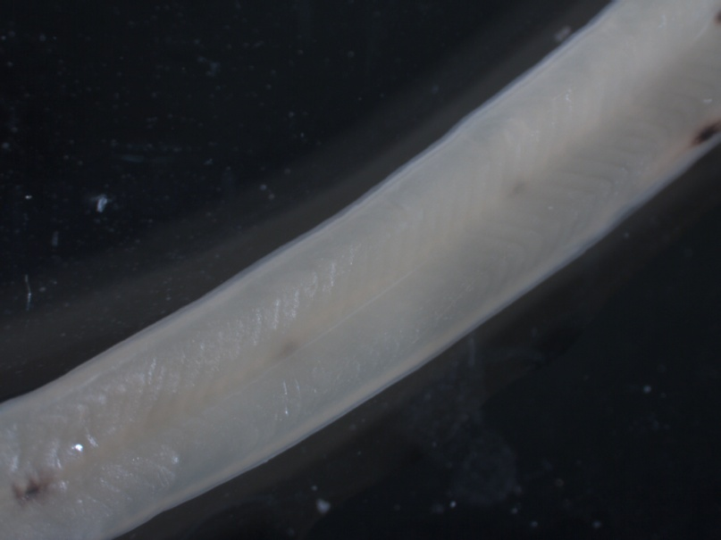
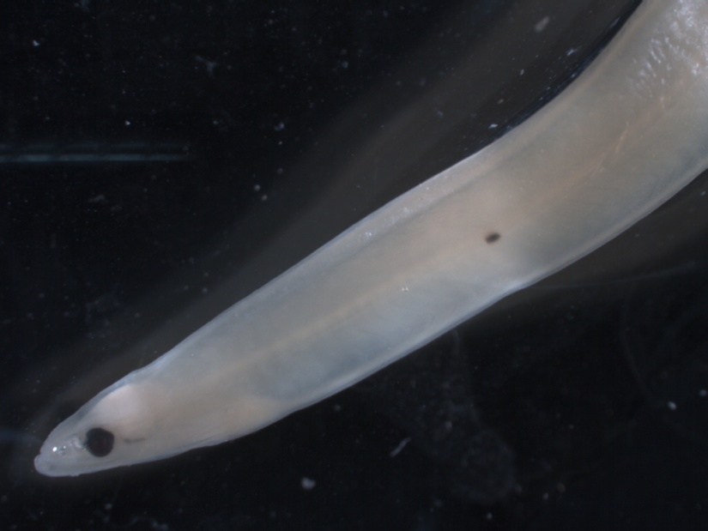
Un-ID Eel

Slide 21
Gymnothorax moringa
Gymnothorax moringa
ventral melanophore pattern

Slide 22
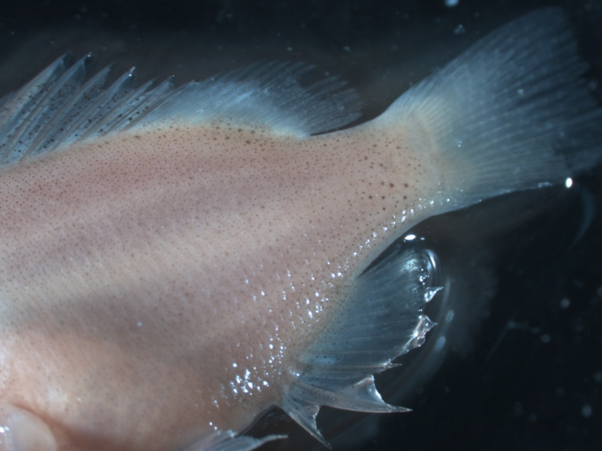
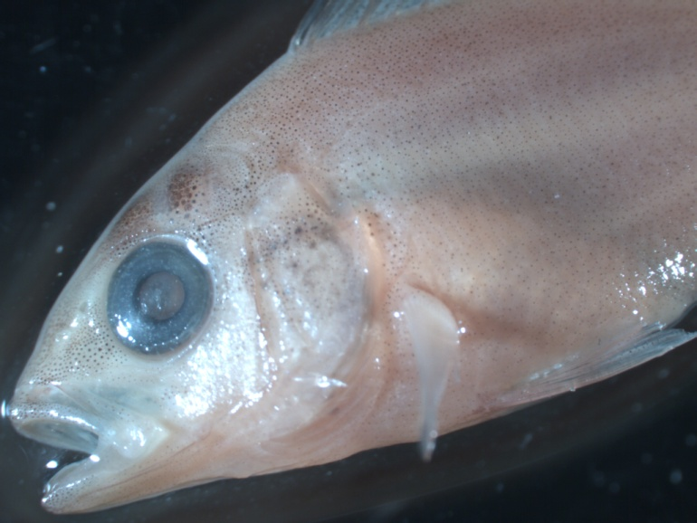
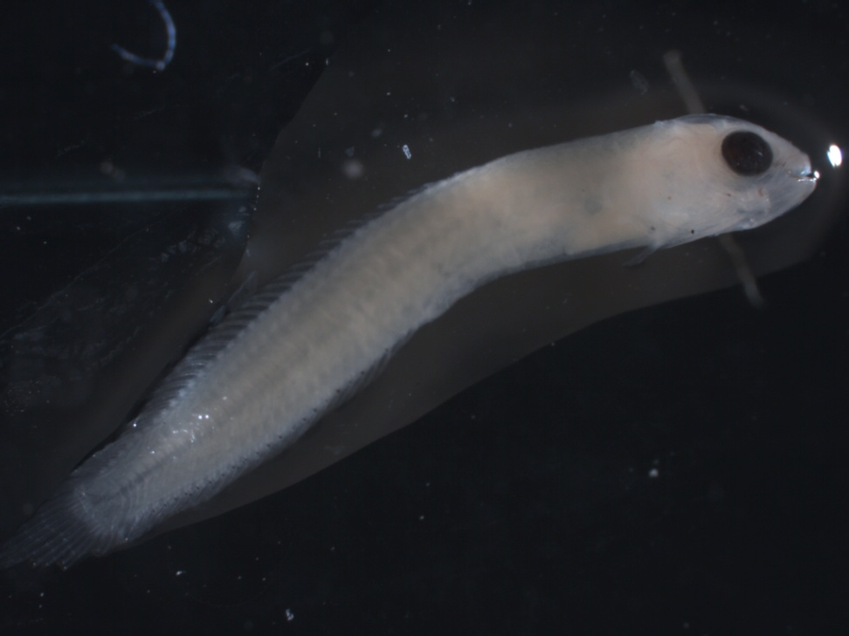
Lutjanus sp.
Stathmonotus sp.

Slide 23
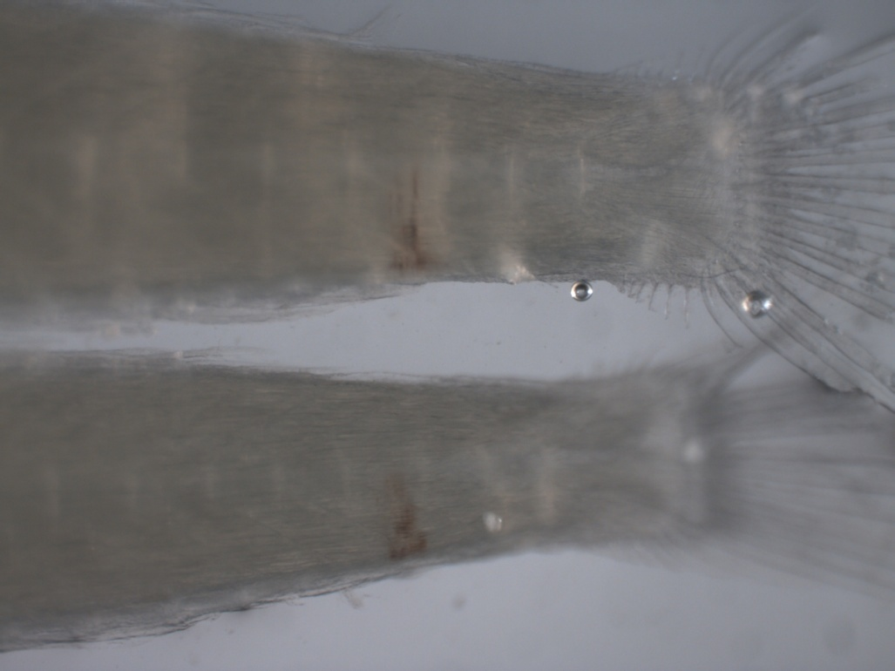
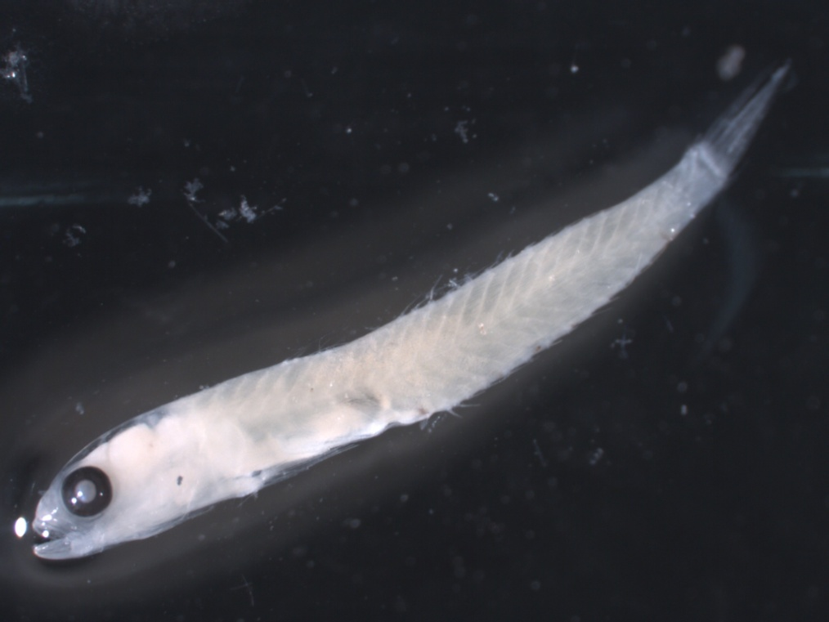
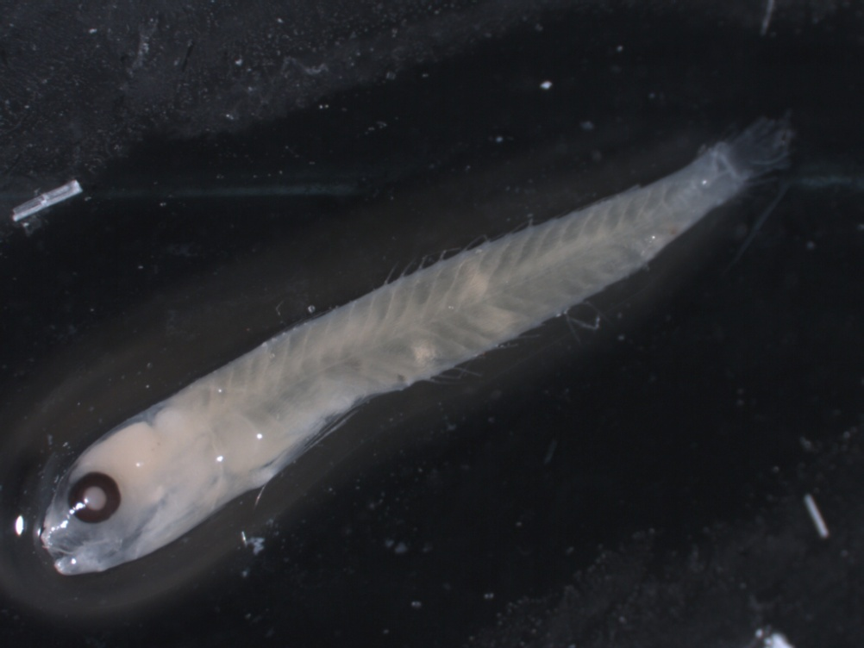
Melanophores
Ctenogobius boleosoma
or C. saepepallens

Slide 24
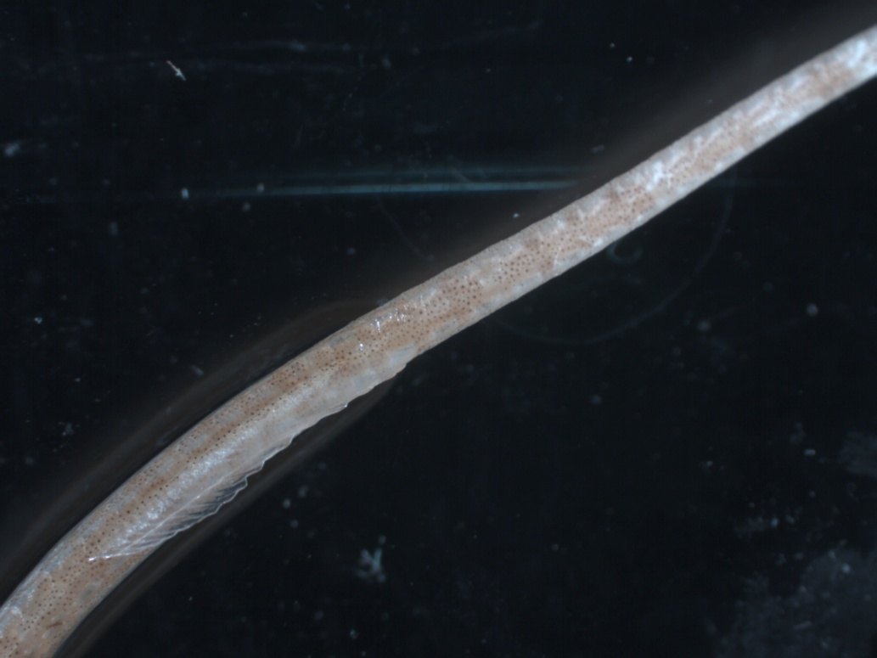
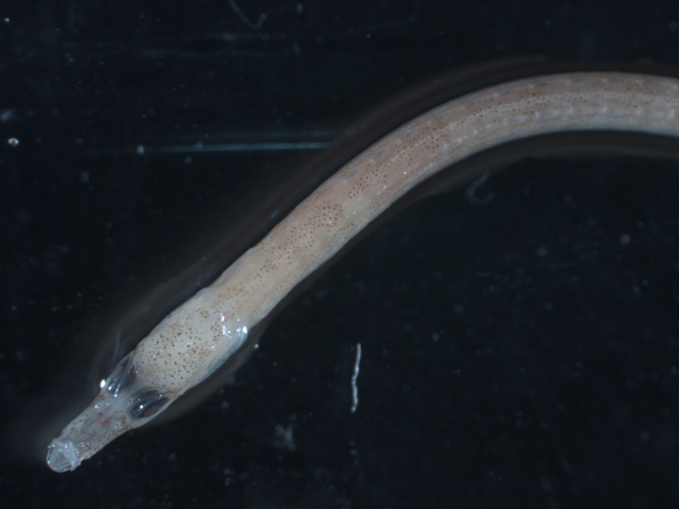
Bryx dunckeri

Slide 25


Microdesmus carri
Acanthostracion
quadricornis

Slide 26


← Un-ID juvenile eels
Gymnothorax
moringa →

Slide 27


Time consumers
bent specimens
invert-dense sample

Slide 28
Discussion
Major portion of larval fish diversity at Little Cayman
  Herrings (genus Jenkinsia)
  Bonefish (Albula vulpes)
  Other contributing taxa
    Parrotfishes (family Scaridae)
    Gobies (genus Ctenogobius)
    Future research possibilities
      Shannon’s biodiversity index
      Species distribution around Little Cayman
      Investigate nursery habitats

Slide 29
Photo file name format
Genus_species_SiteName_date(mmddyyyy, no slashes)

Slide 30
References
Froese R, Pauly D. Eds. 2014. FishBase. World Wide Web electronic publication. www.fishbase.org, version (04/2014), accessed August, 2013-June, 2014.
Jones DL. 2006. Design, construction, and use of a new light trap for sampling larval coral reef fishes. NOAA Technical Memorandum NMFS-SEFSC-544, 30 p.
Richards WJ. 2006. Early stages of Atlantic fishes: an identification guide for the Western Central North Atlantic. Vols. 1,2. CRC Press, Boca Raton, 2672 p.
Smith DG. 1989. Family Muraenidae: leptocephali. In: Bohlke EB (ed.) Fishes of the Western North Atlantic. Mem Sears Found Mar Res 2(9):900-916.
Victor B. 2014. A photographic guide to the larvae of coral reef fishes. www.coralreeffish.com, accessed August, 2013-June, 2014
Whitehead PJP. 1985. FAO Species Catalogue. Vol. 7. Clupeoid fishes of the world (suborder Clupeioidei). An annotated and illustrated catalogue of the herrings, sardines, pilchards, sprats, shads, anchovies, and wolf herrings. FAO Fish. Synop. 125(7/1):1-303. Rome: FAO.

