Slide 1
Digital Humanities and the
History of Science
Retrofitting Old Collections for New Purpose
Anne Bahde
RBMS 2014 Las Vegas
Notes:
Earlier this year, the Special Collections and Archives Research Center at Oregon State University Libraries began an experiment involving one of our most intriguing history of science archival collections. We hold one portion of the records of the Emergency Committee of Atomic Scientists,

Slide 2
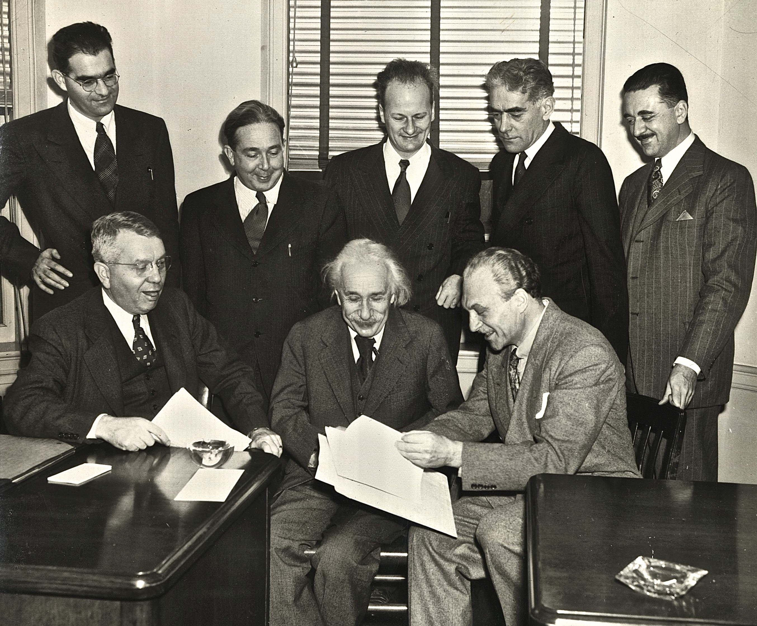
Emergency Committee of Atomic Scientists, 1946
Notes:
a group founded by Albert Einstein in 1946 to educate the American public about the dangers of atomic warfare and the need for world peace. The Committee, made up of nine scientists (including OSU’s own Linus Pauling),

Slide 3
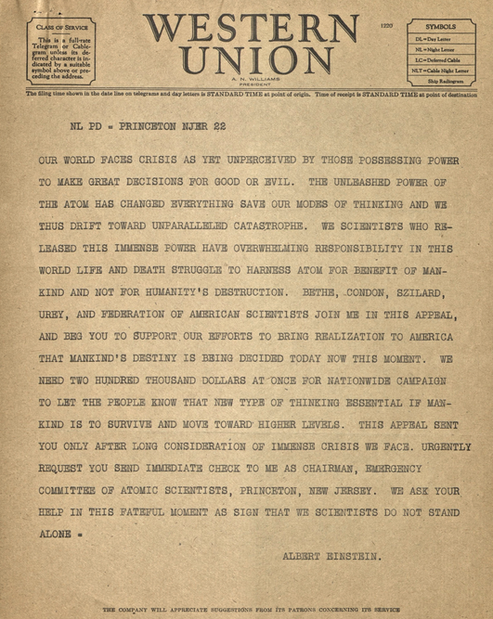
First fundraising telegram sent to donors, May 22, 1946
Notes:
sent out appeals across the nation for funds from American citizens to support this urgent mission.

Slide 4
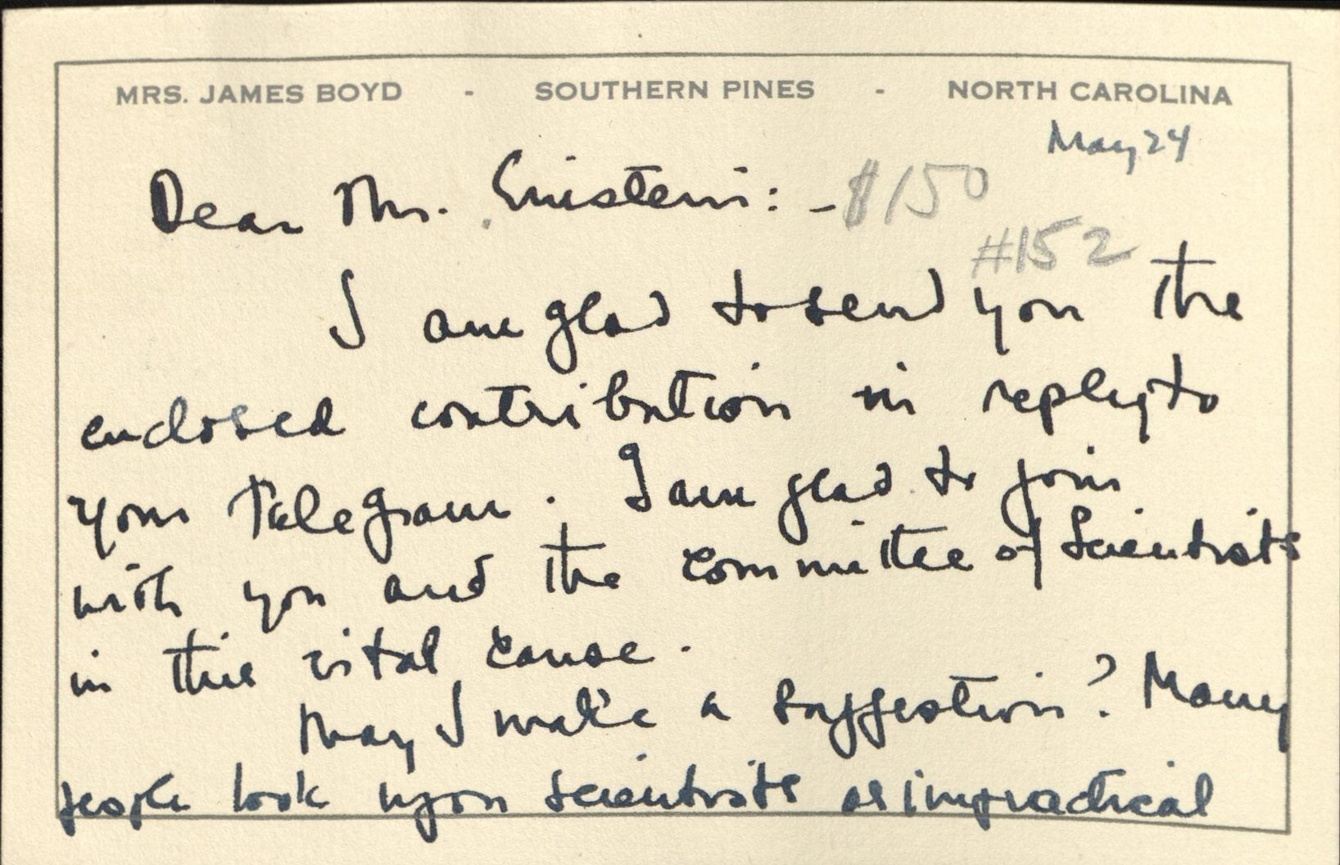
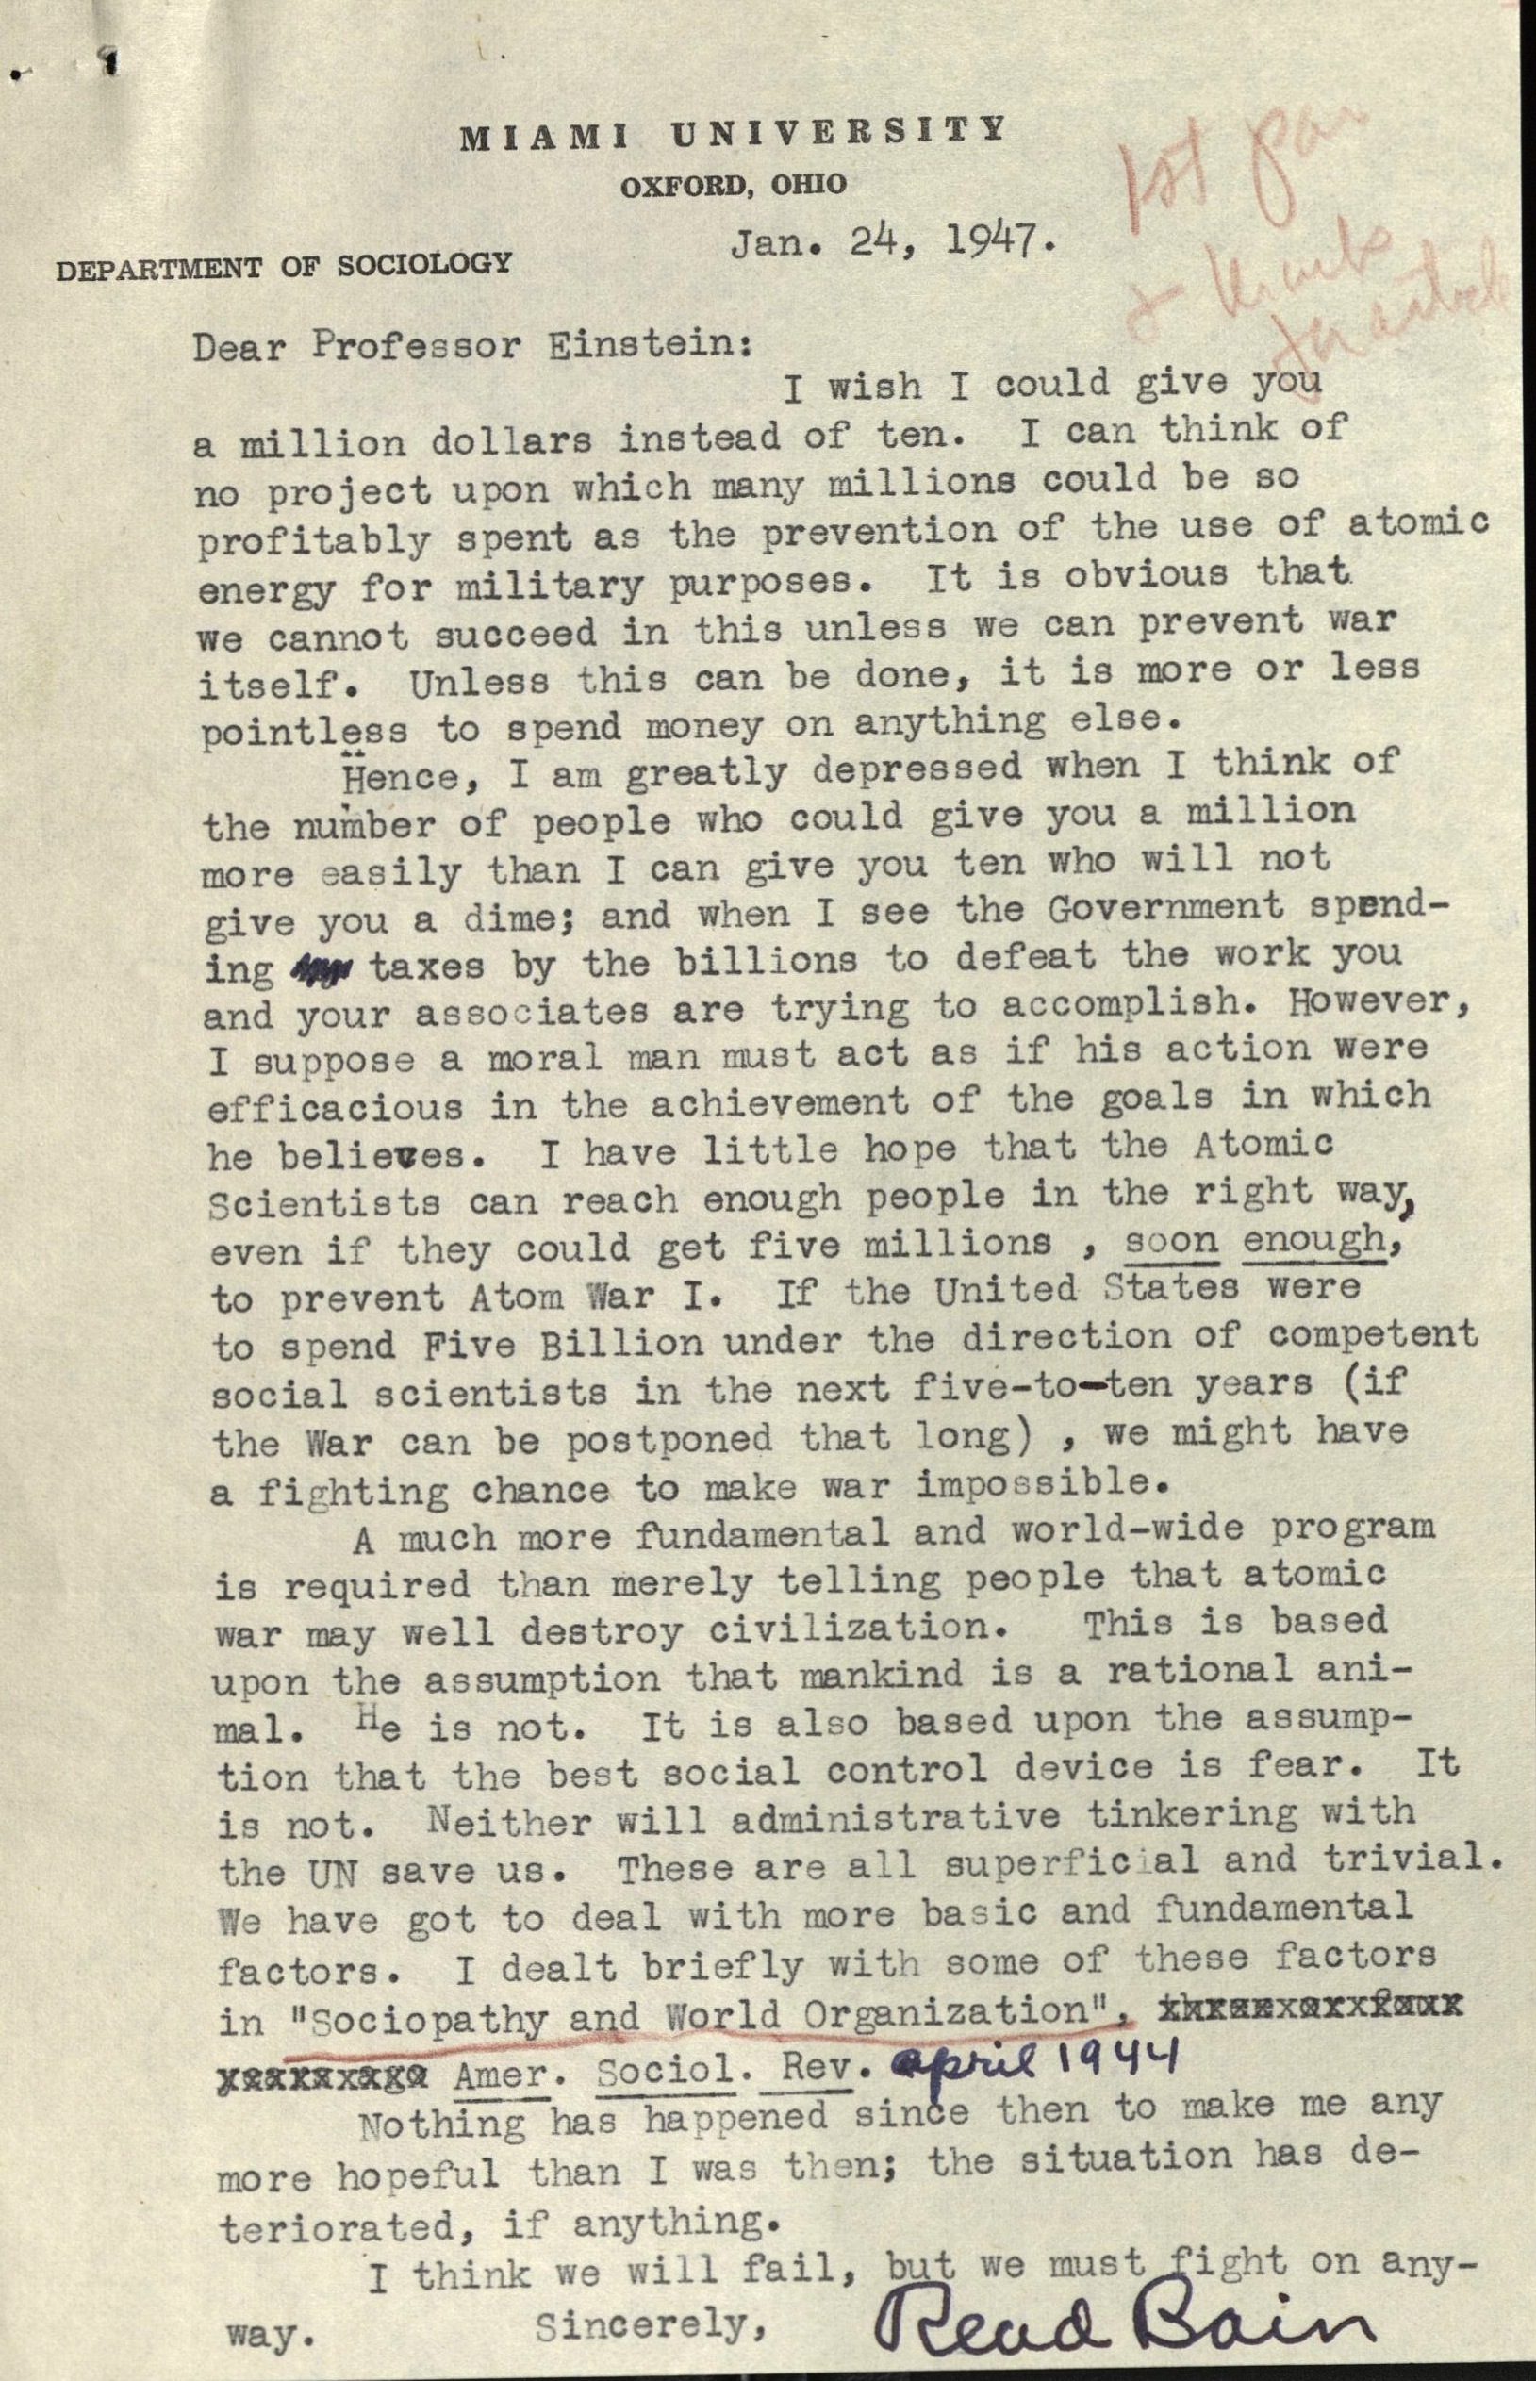
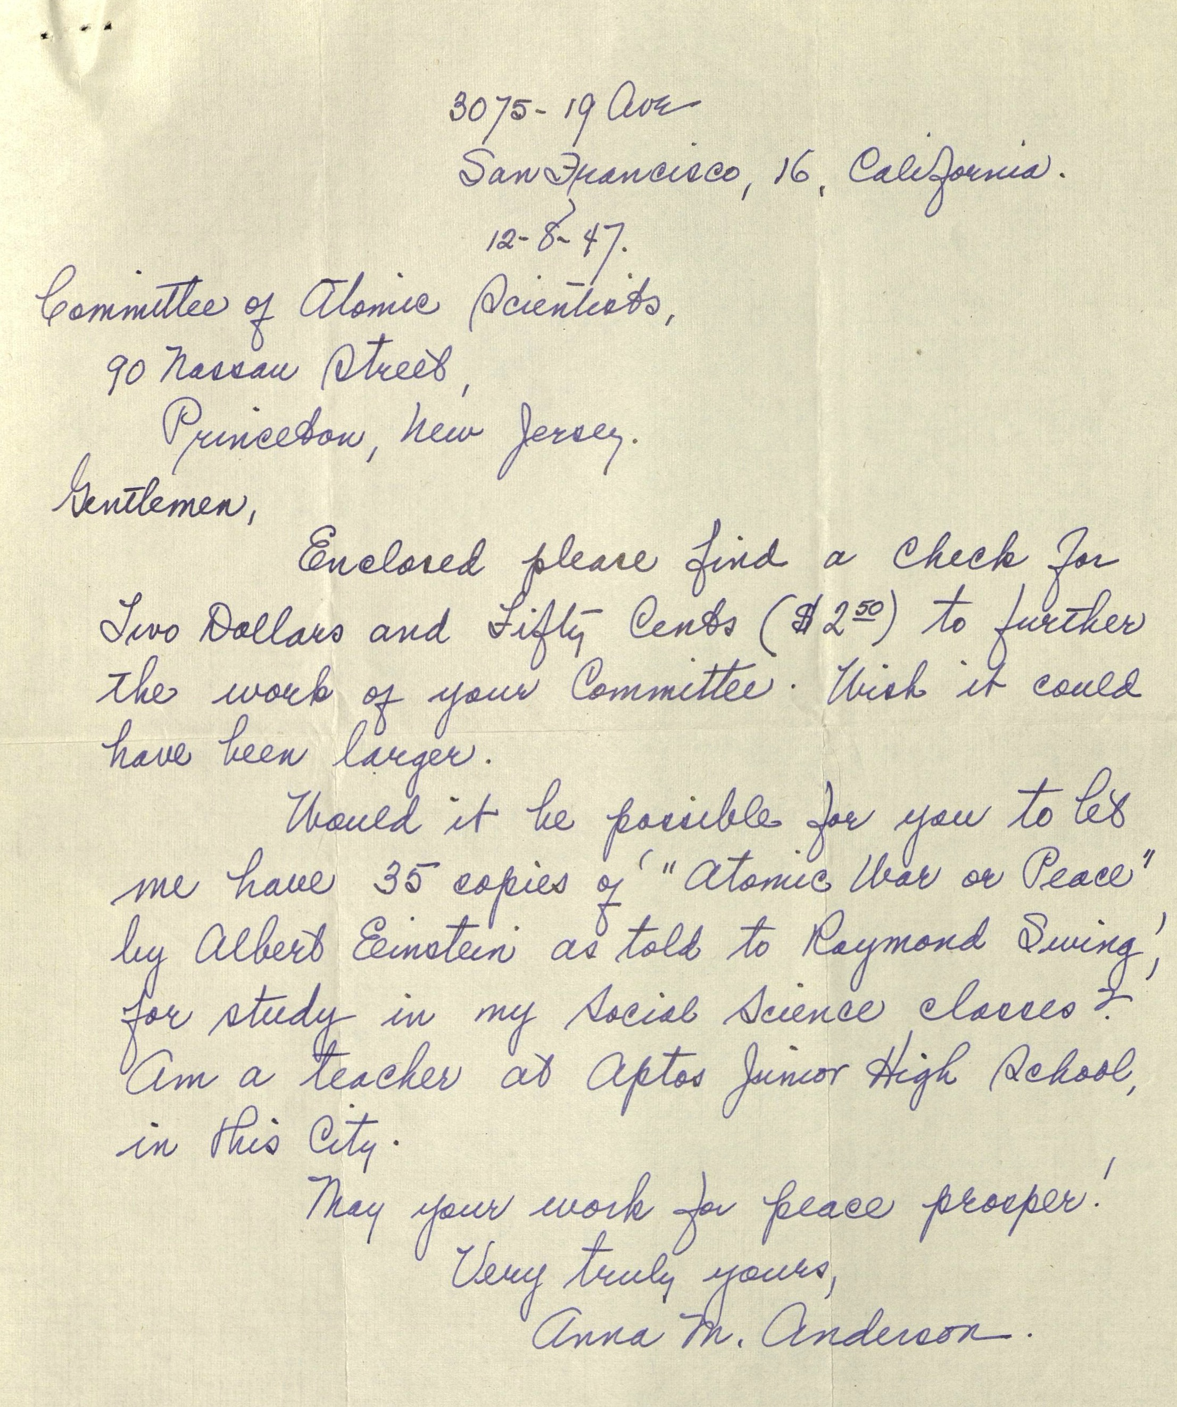
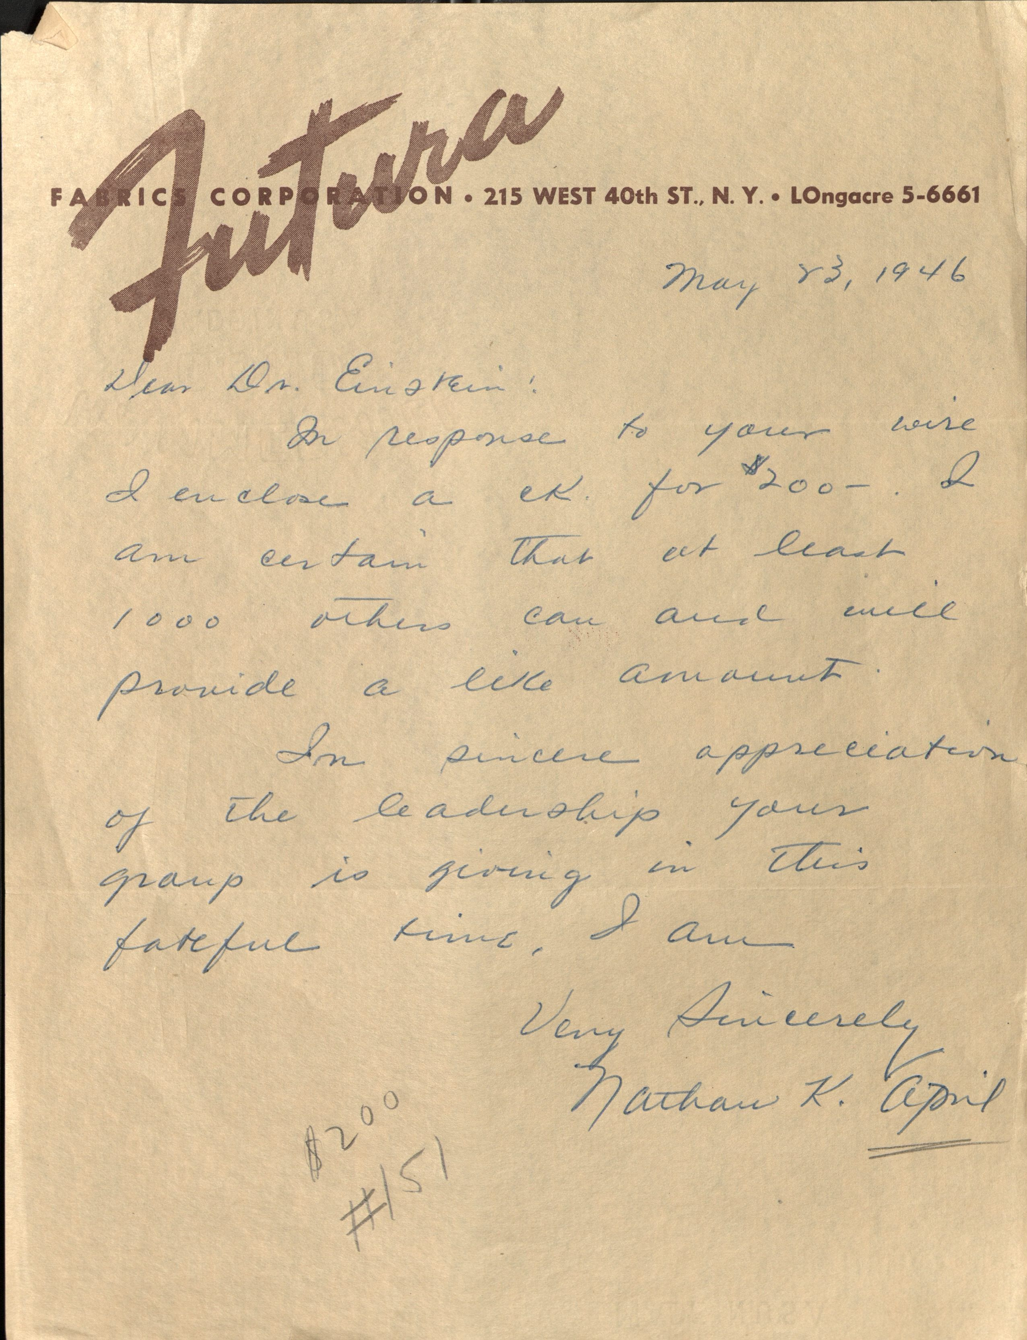
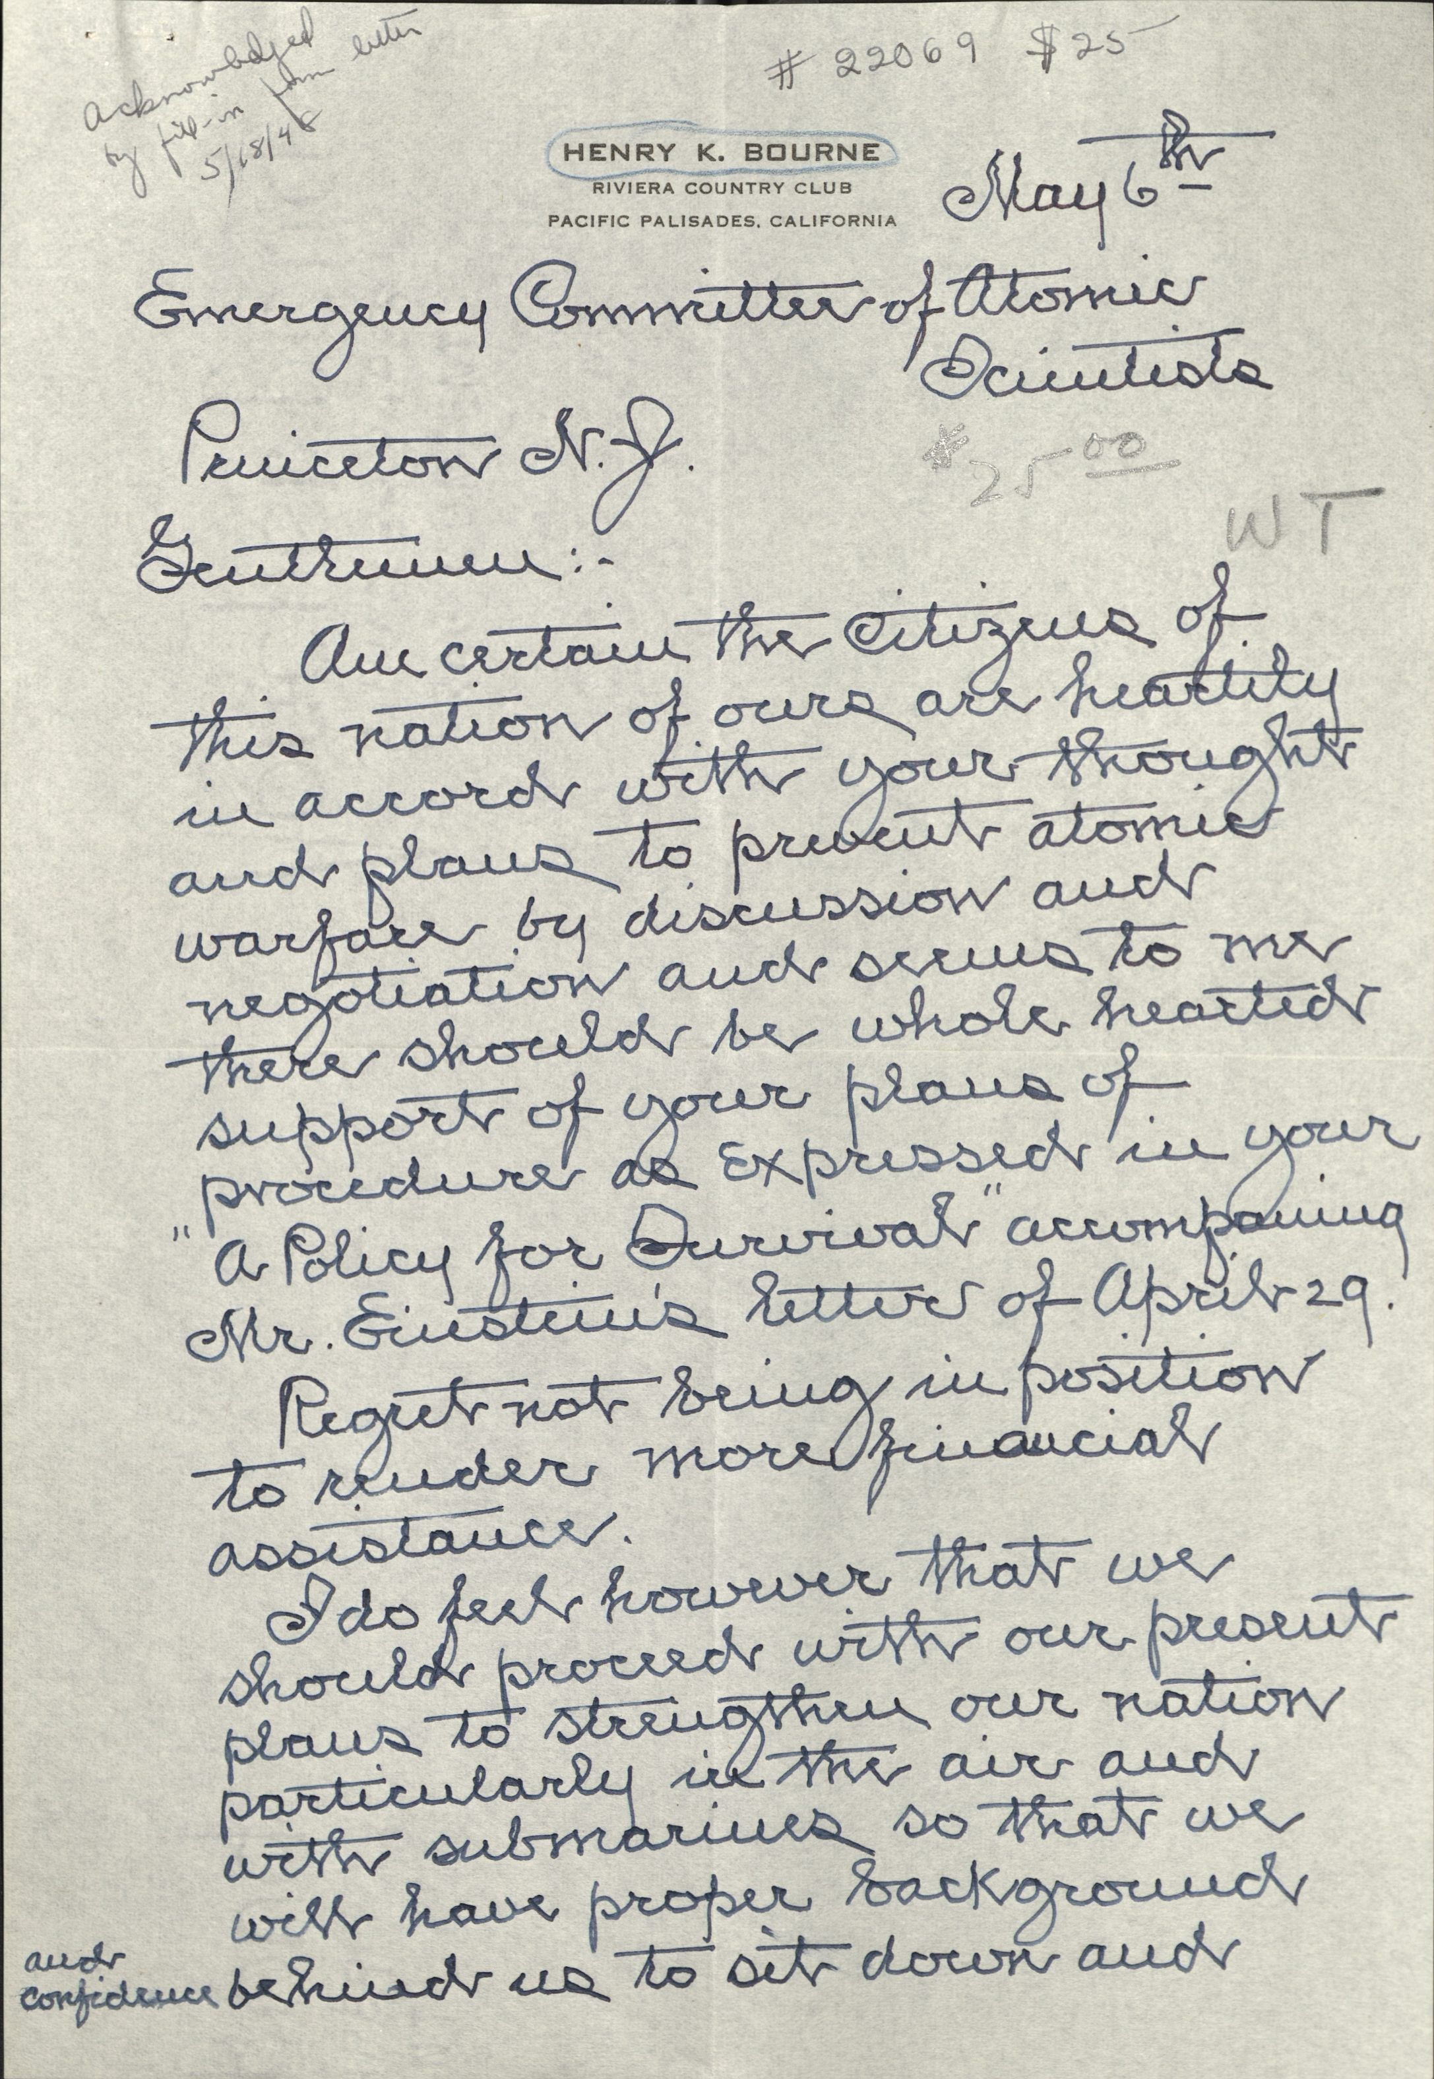
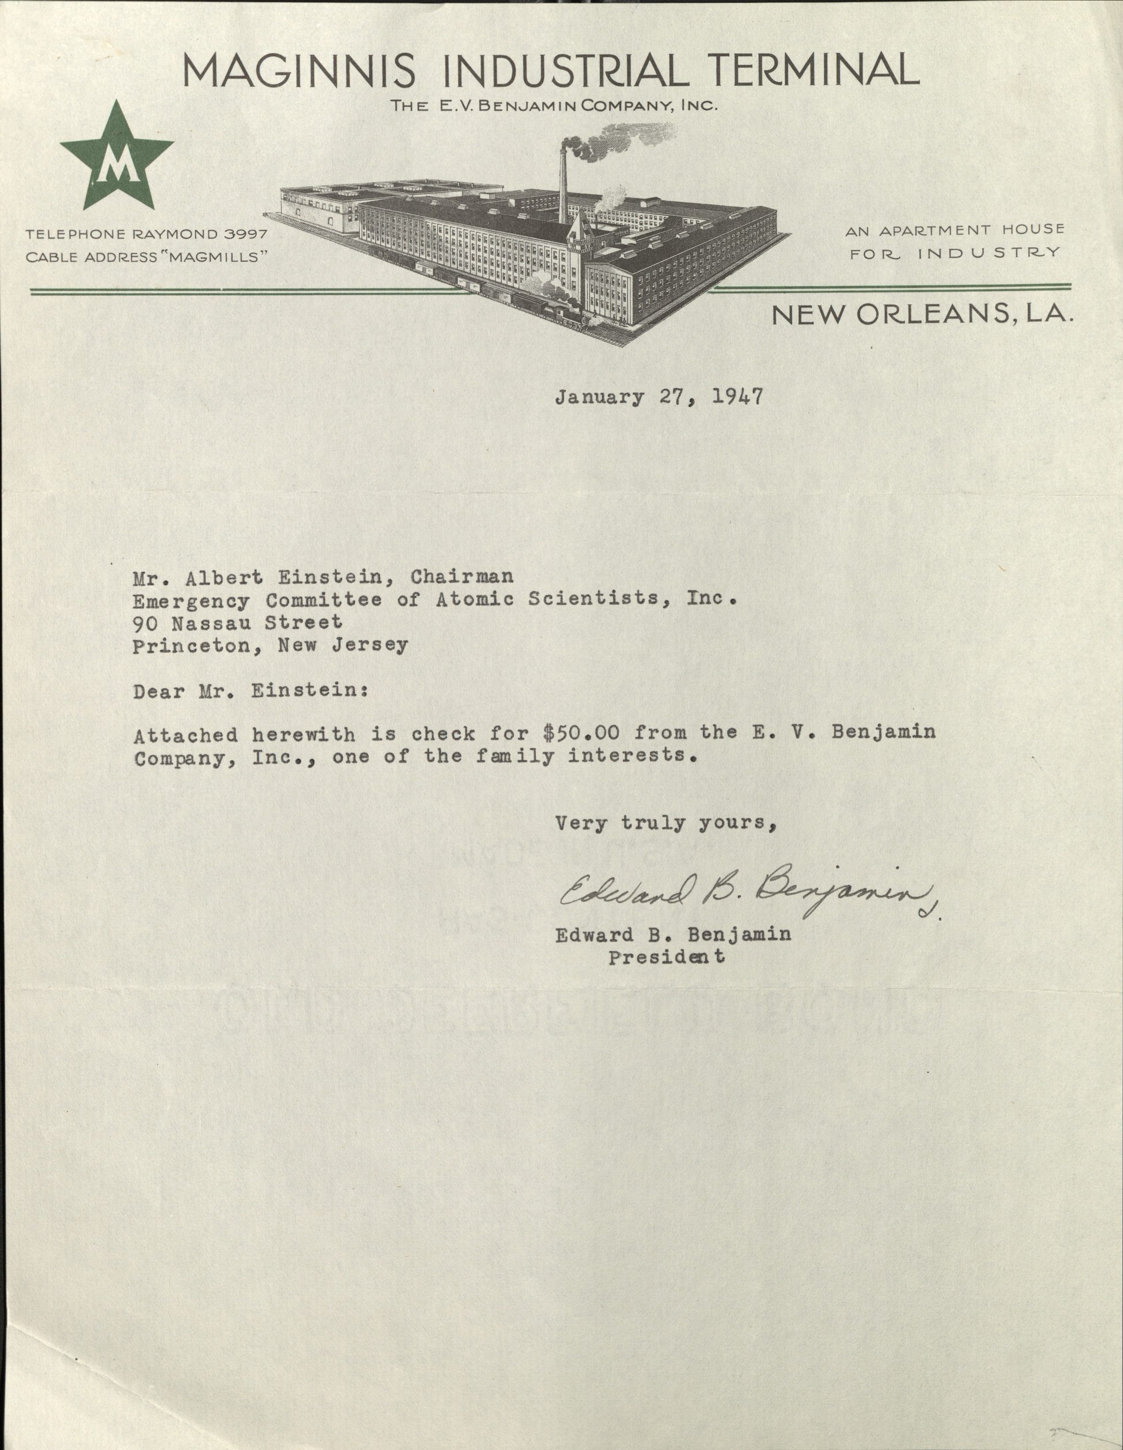
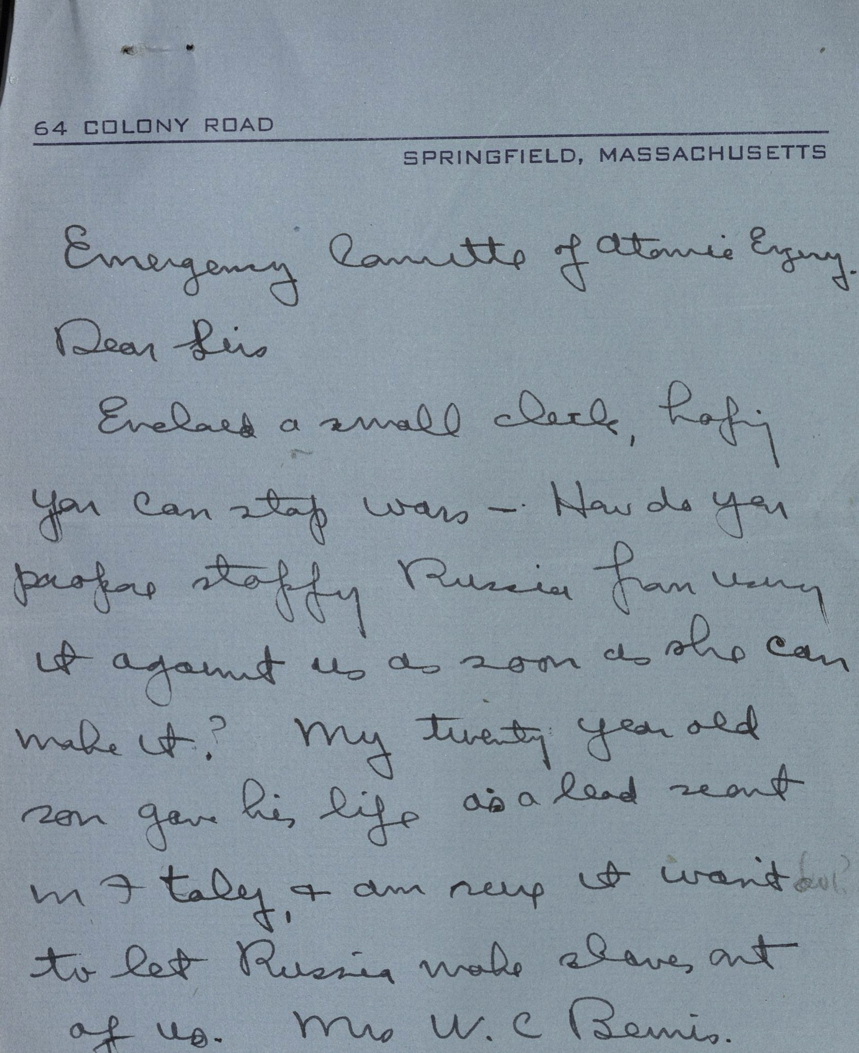
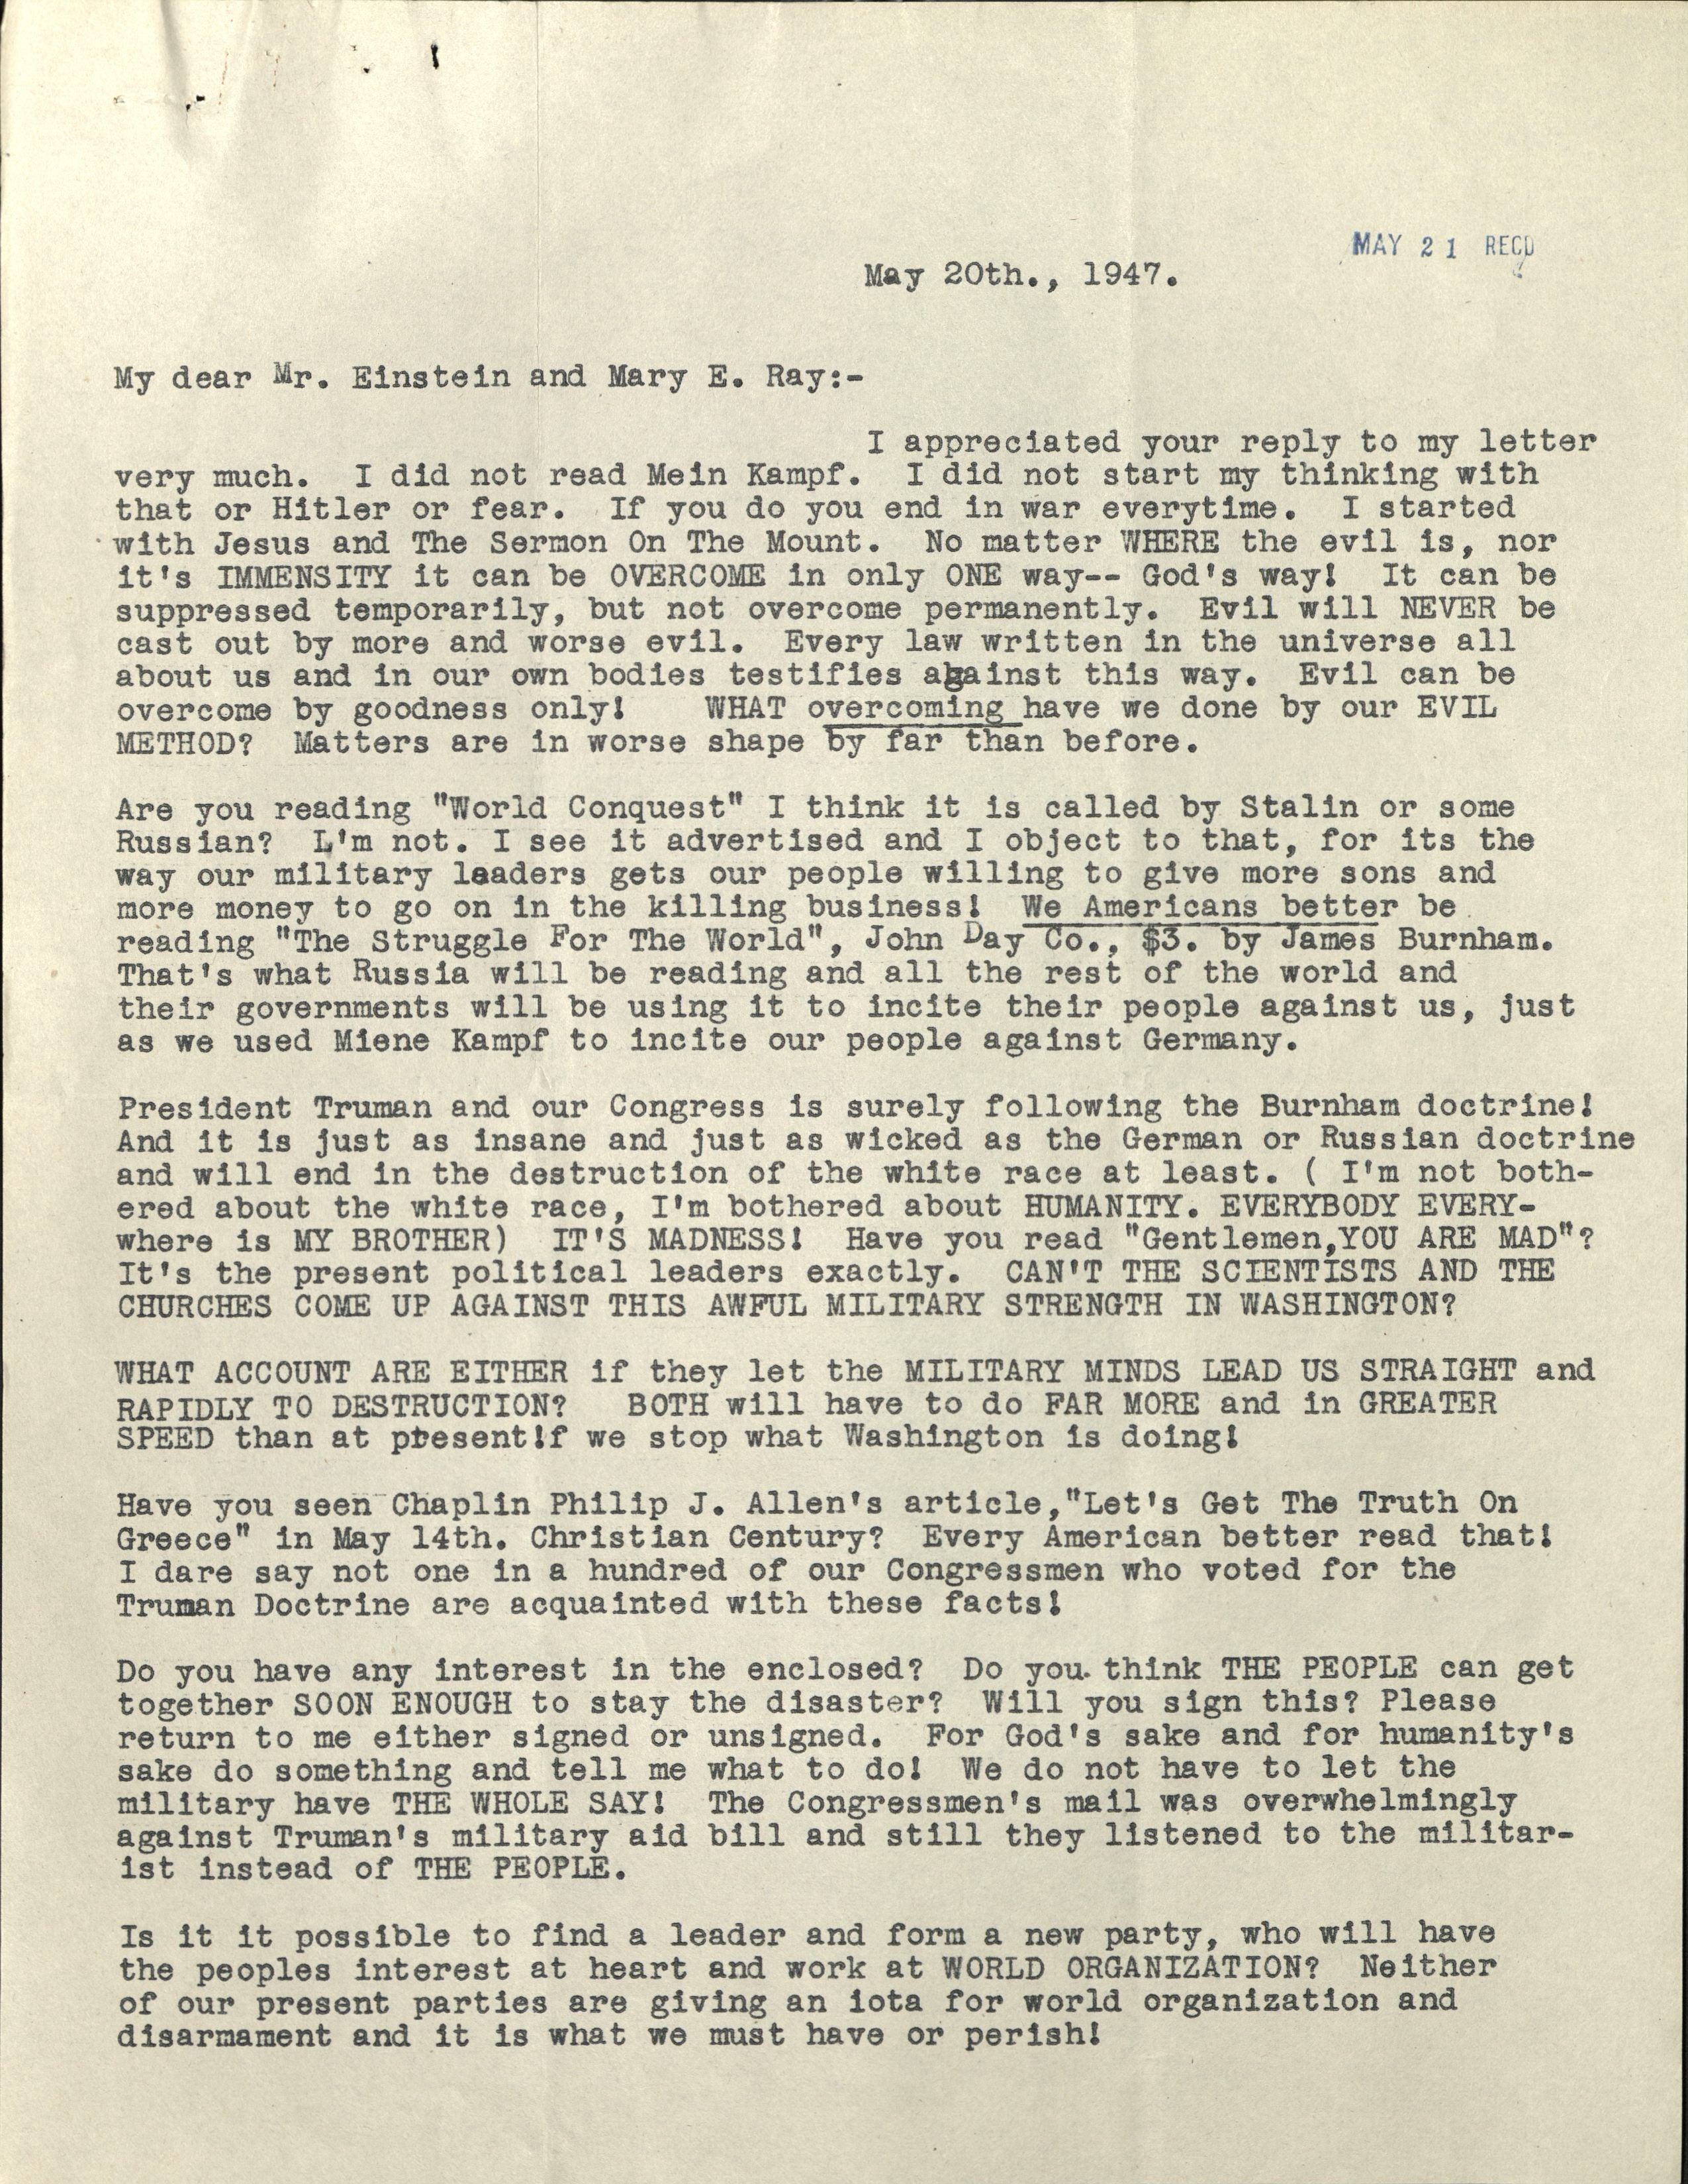
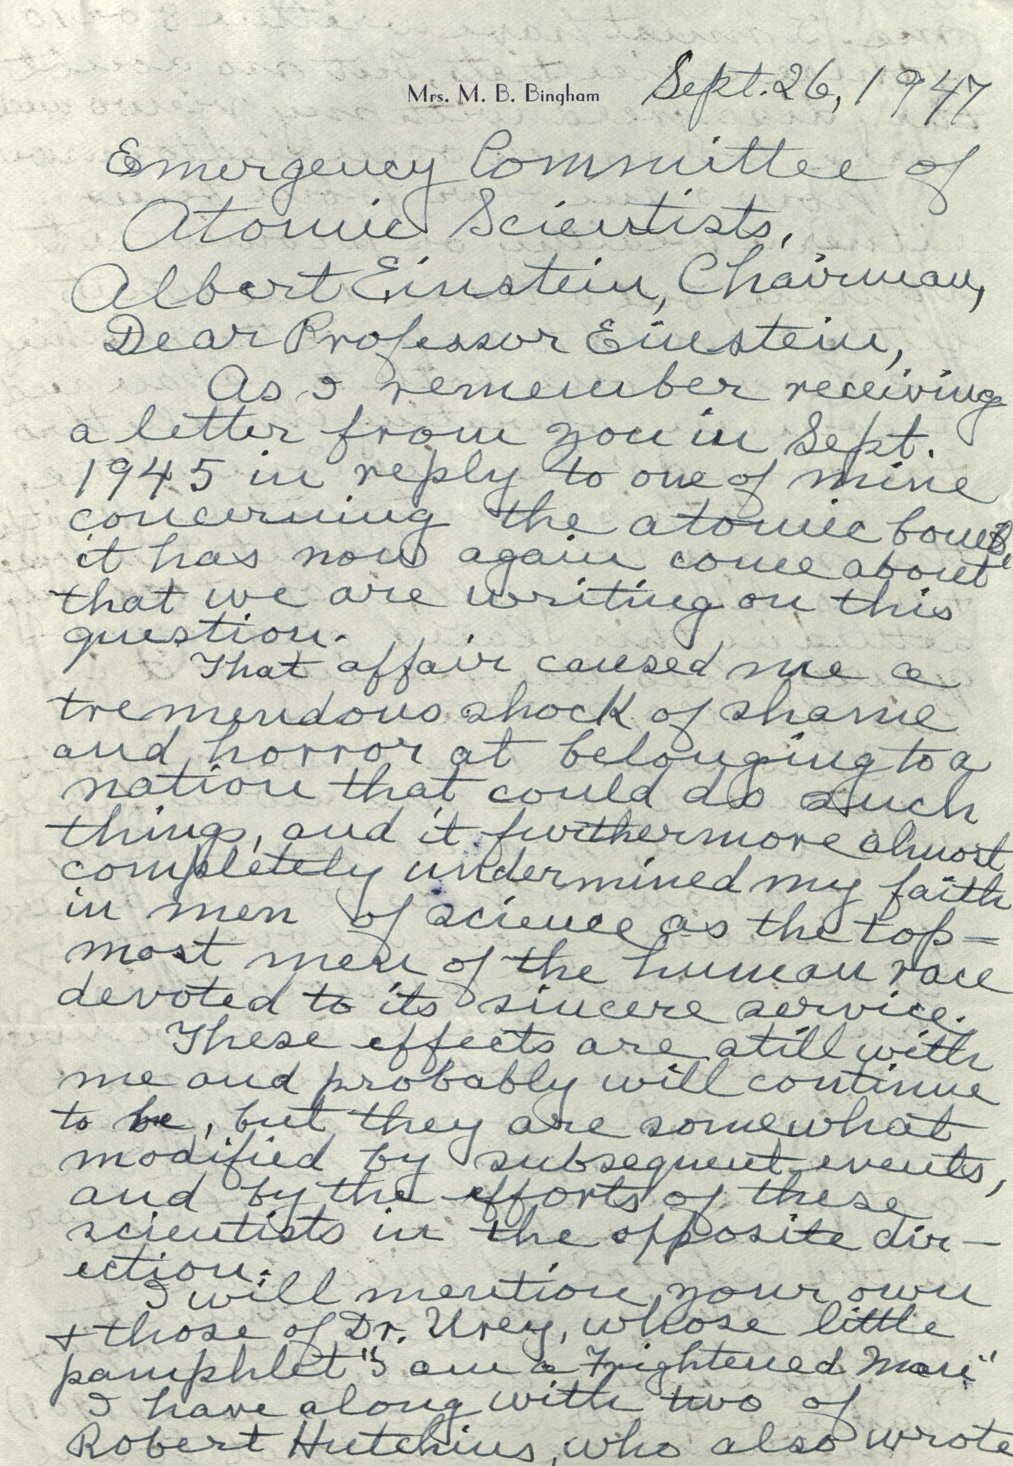
Notes:
The collection is comprised of thousands of letters responding to these appeals from ordinary Americans. They send donations of anything from $1 to $100,000, along with poignant letters expressing deep fear about the new world they live in. In a personal and even intimate tone, they write to Einstein expressing their distress at the idea of such a powerful and destructive weapon, and lament about the potential for atomic war. They suggest practical and political solutions to the regulation of this weapon, including everything from diplomacy to offensive attack. They write with criticisms of the Committee’s educational aims, frequently blaming Einstein and the other scientists for bringing this monster into the world. They write with encouragement, letting him know that he and the Committee are their only hope in a sea of despair.

Slide 5
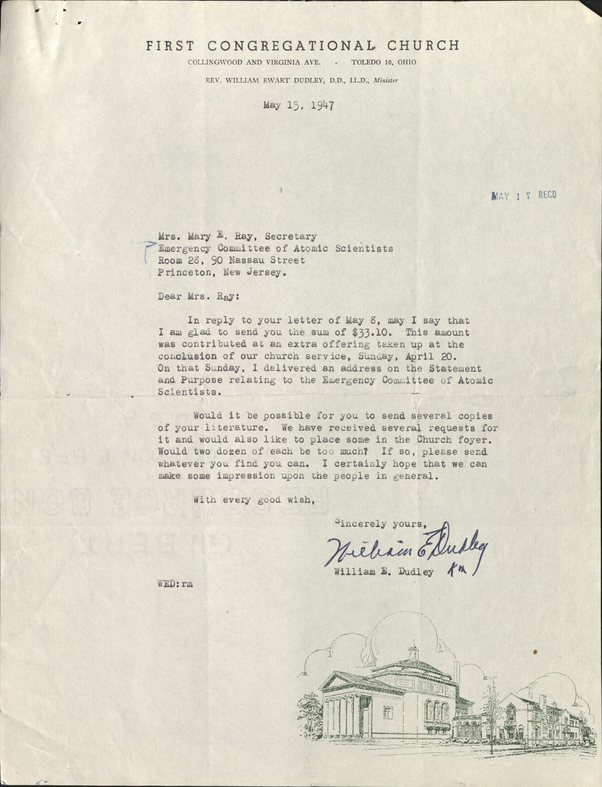
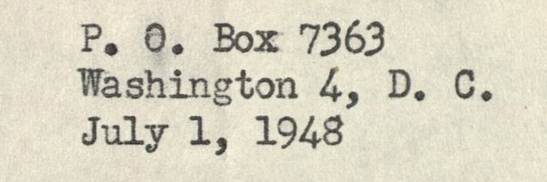
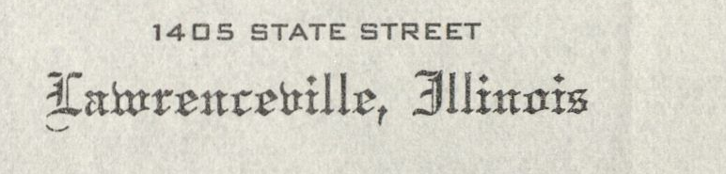
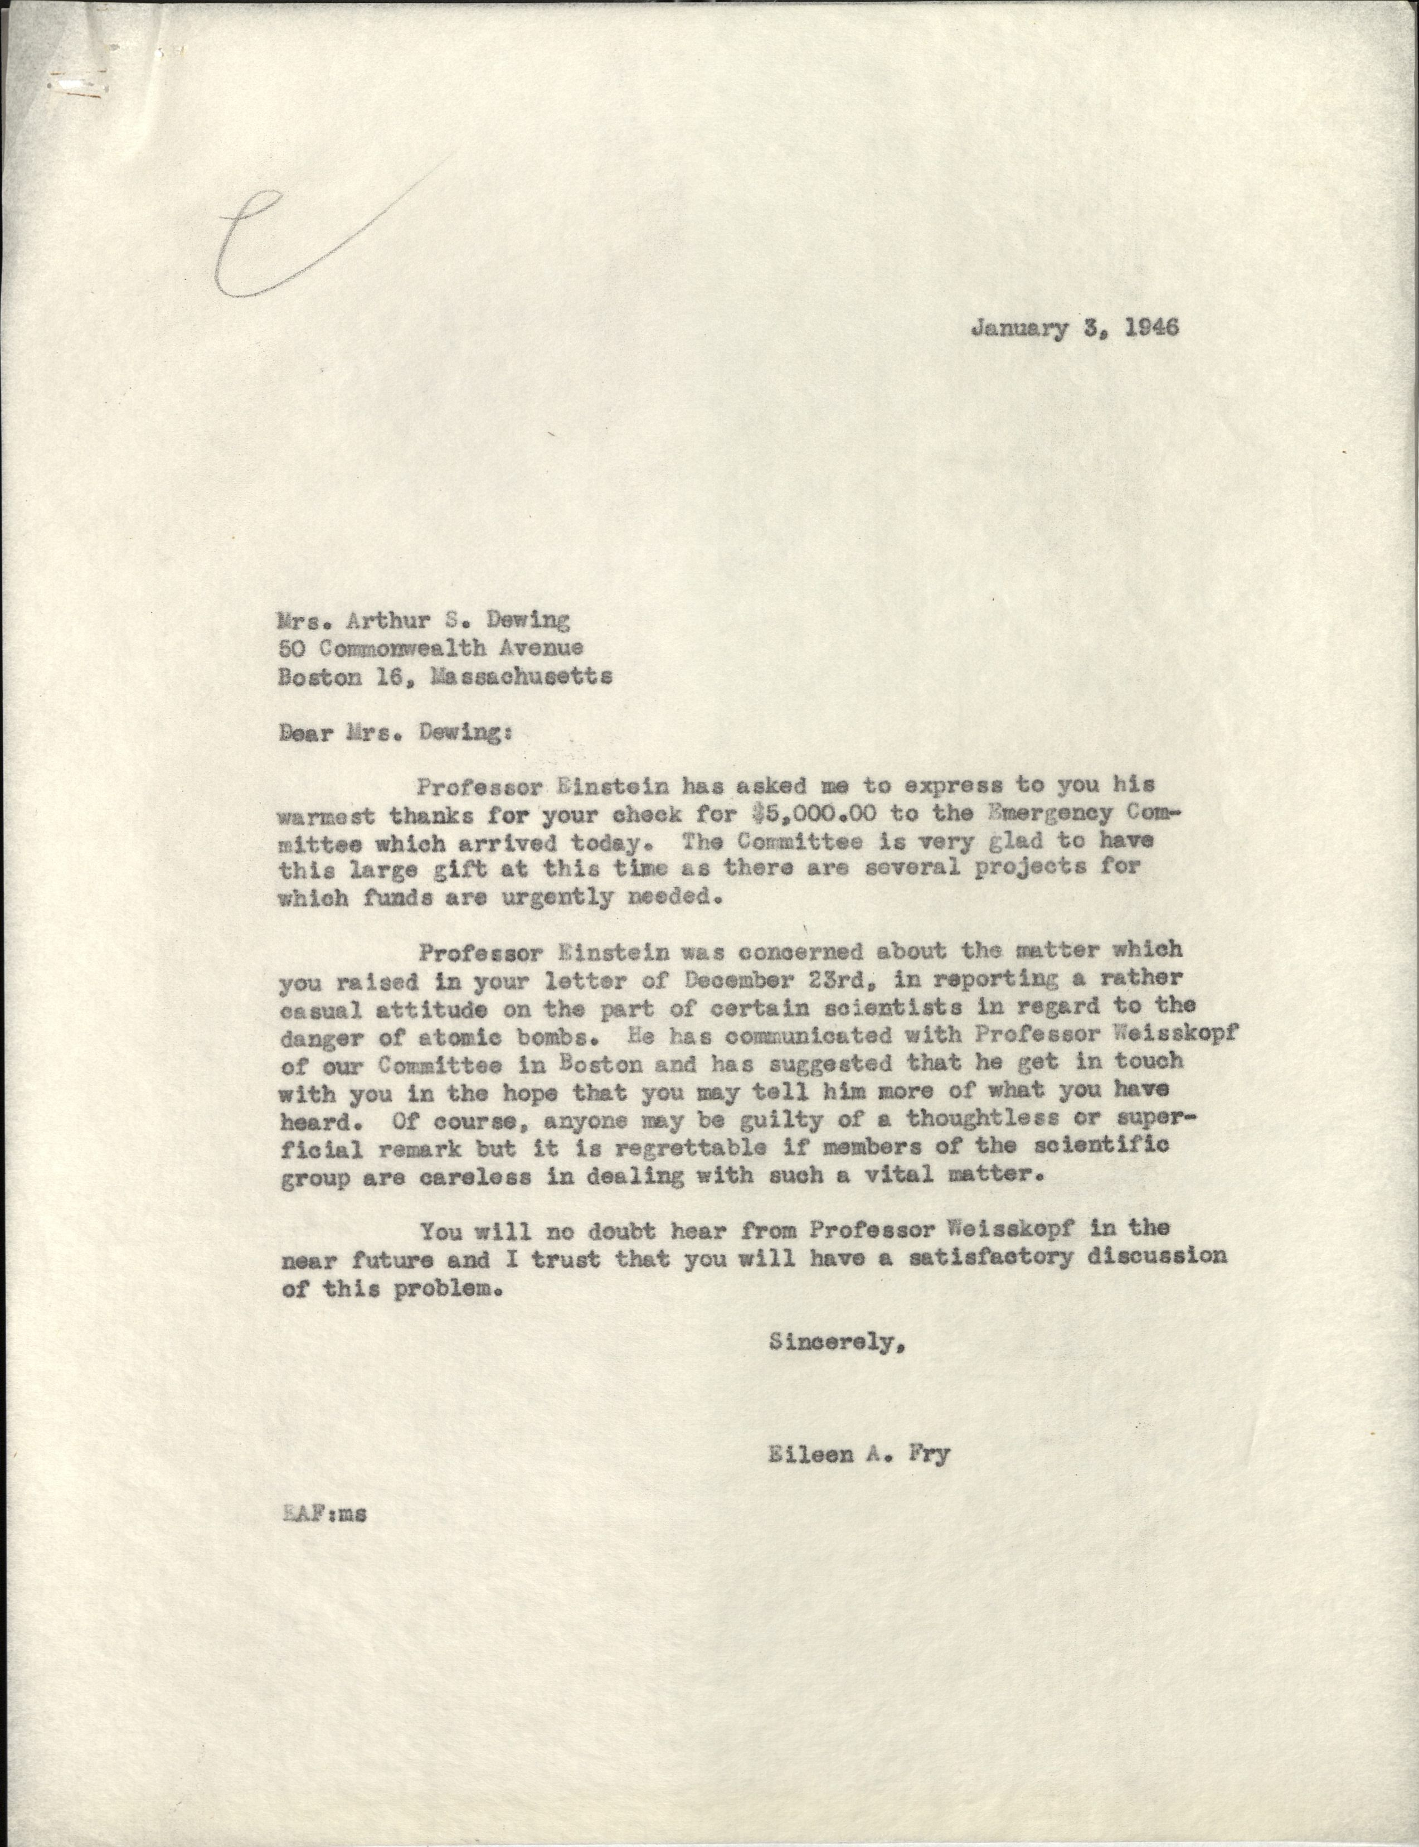
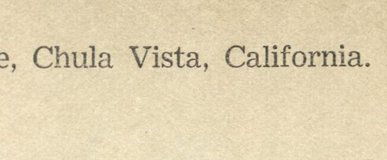
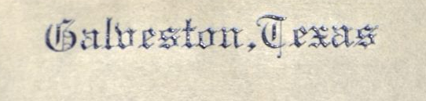
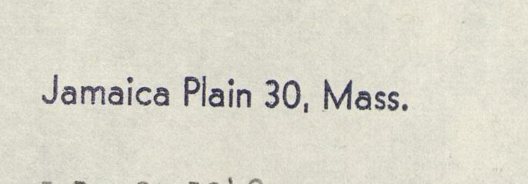
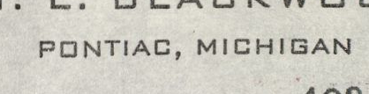
Notes:
But this touching collection of letters is also a collection of data: City and state,

Slide 6
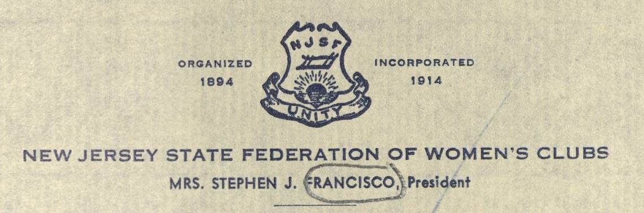
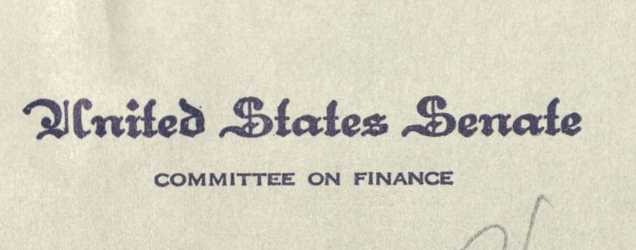
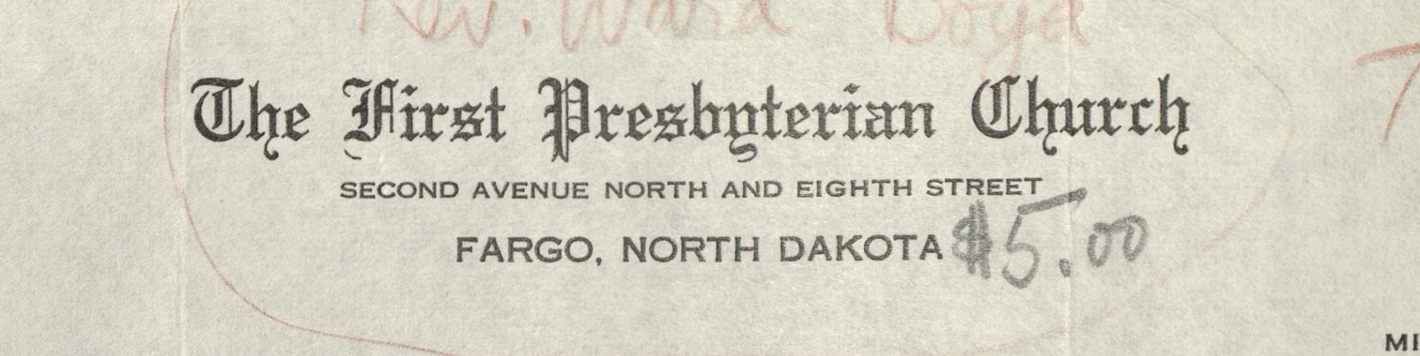
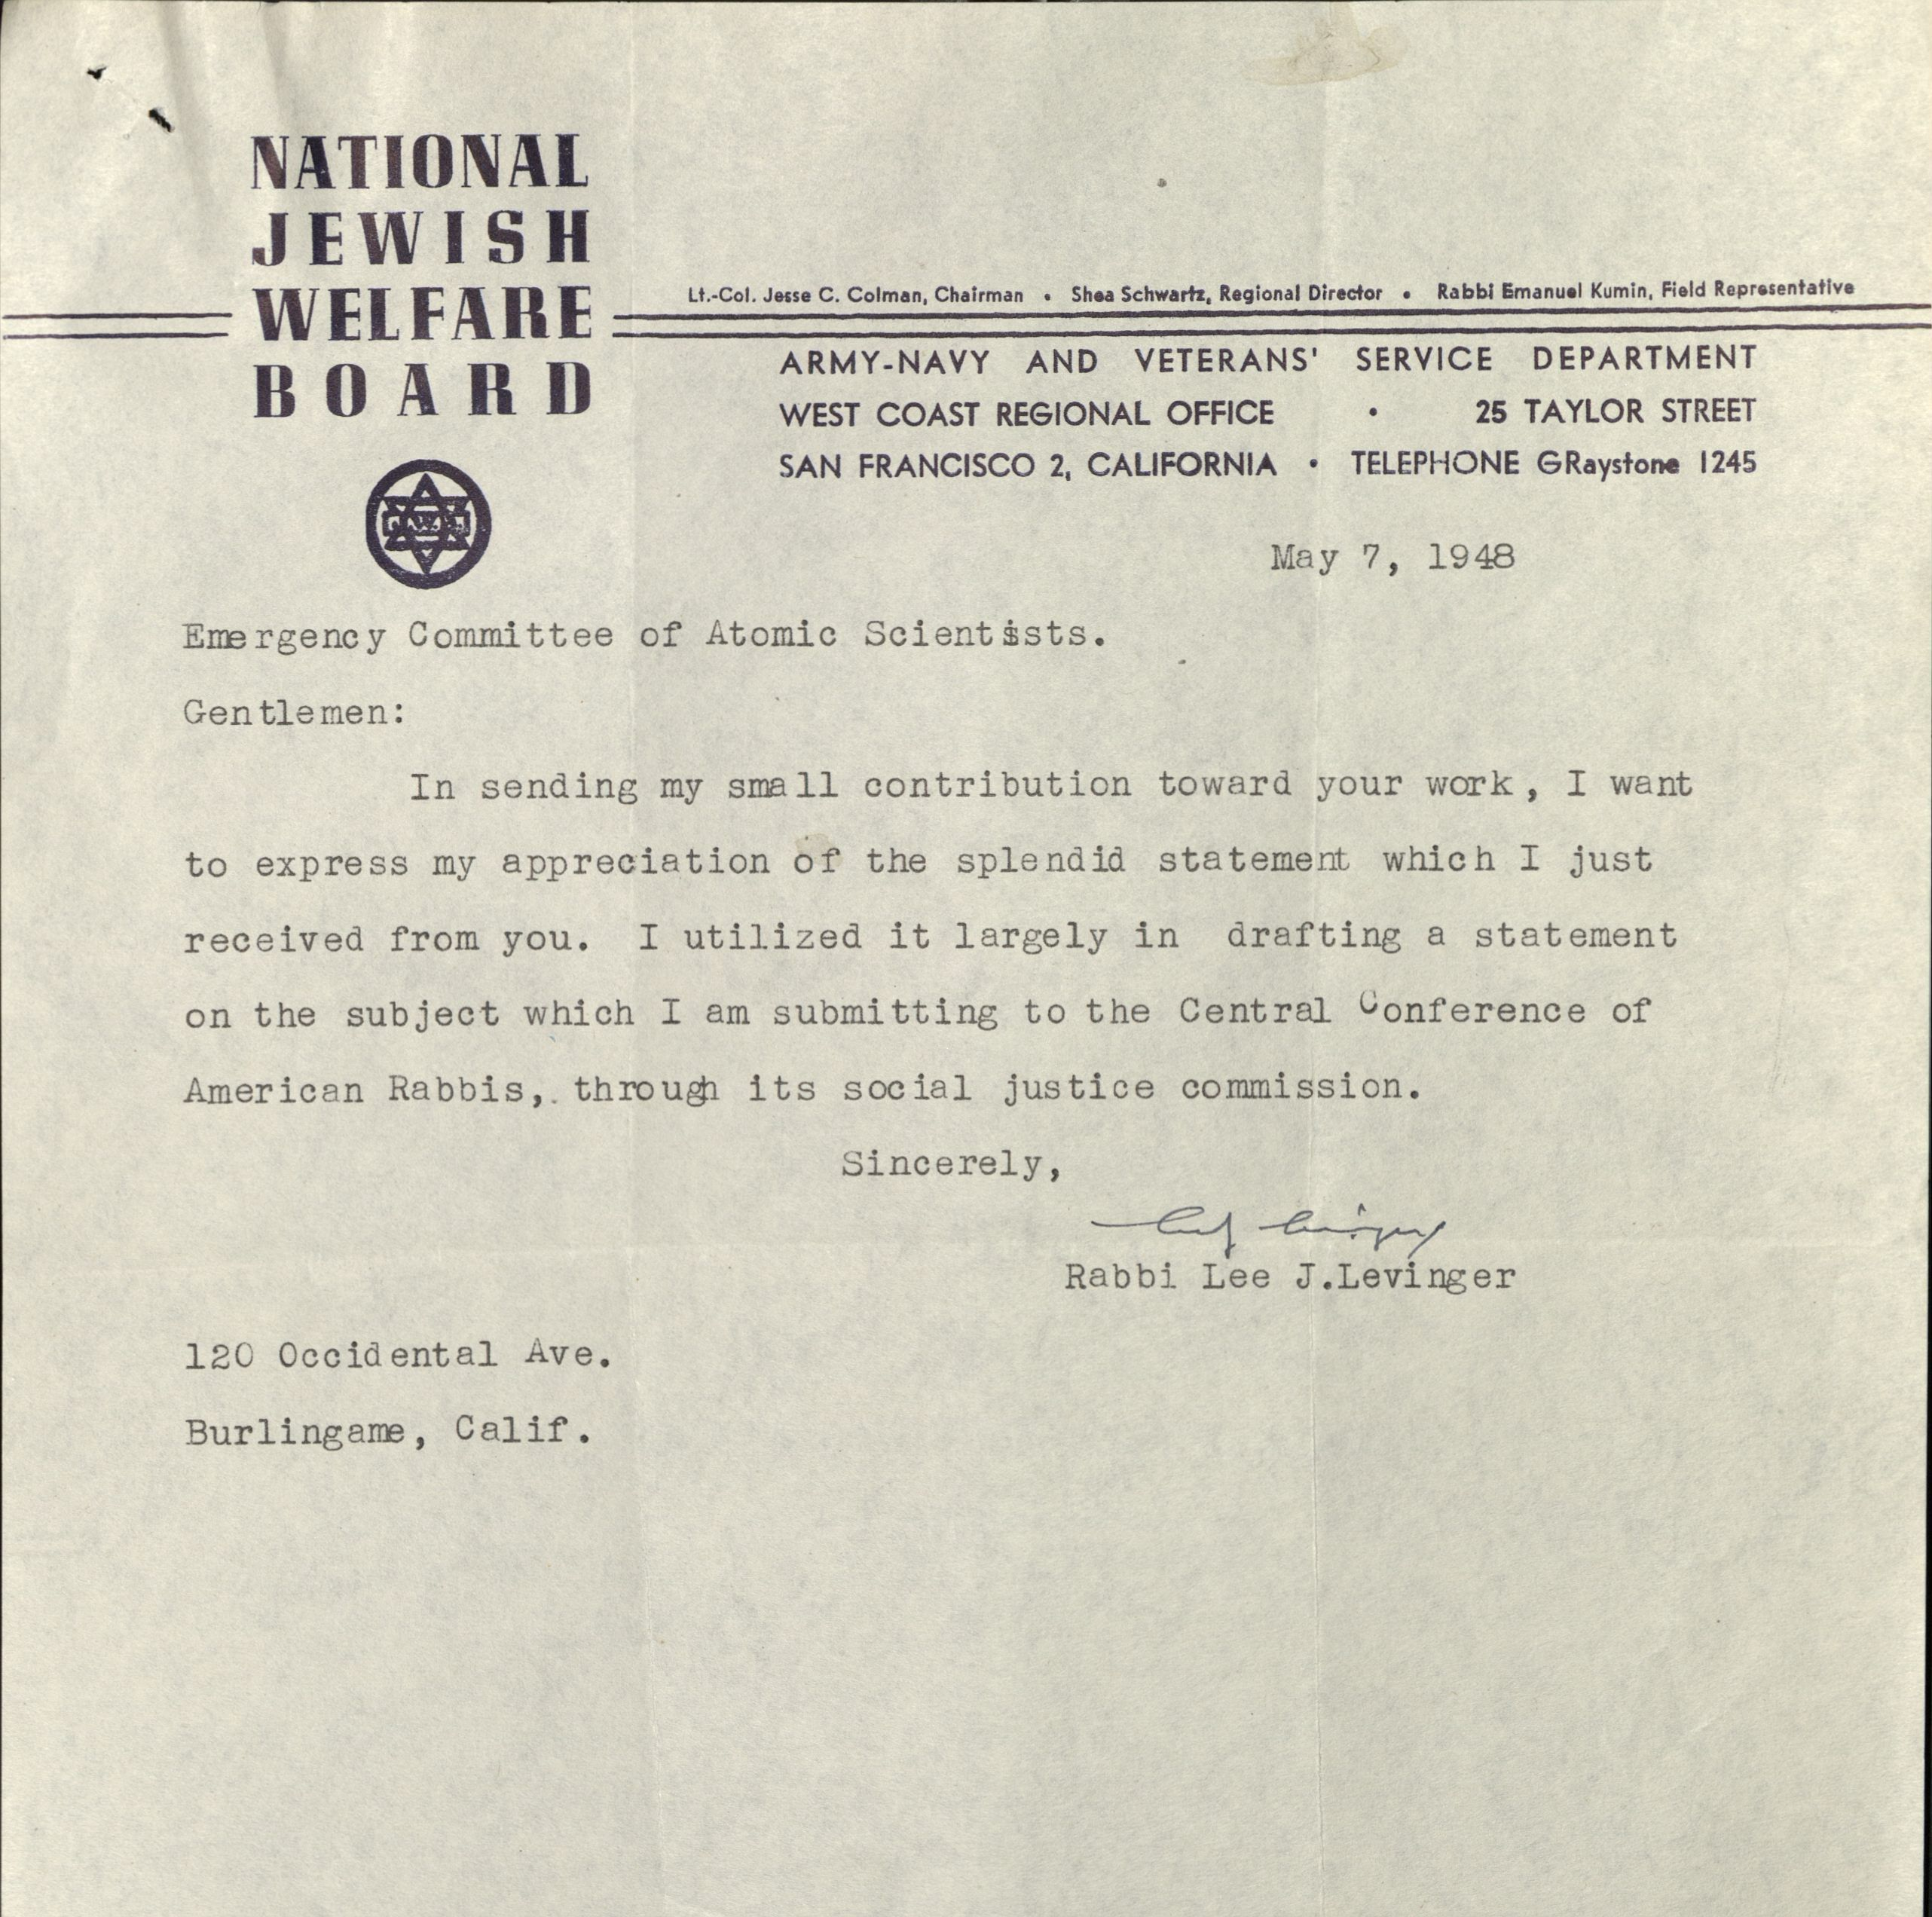
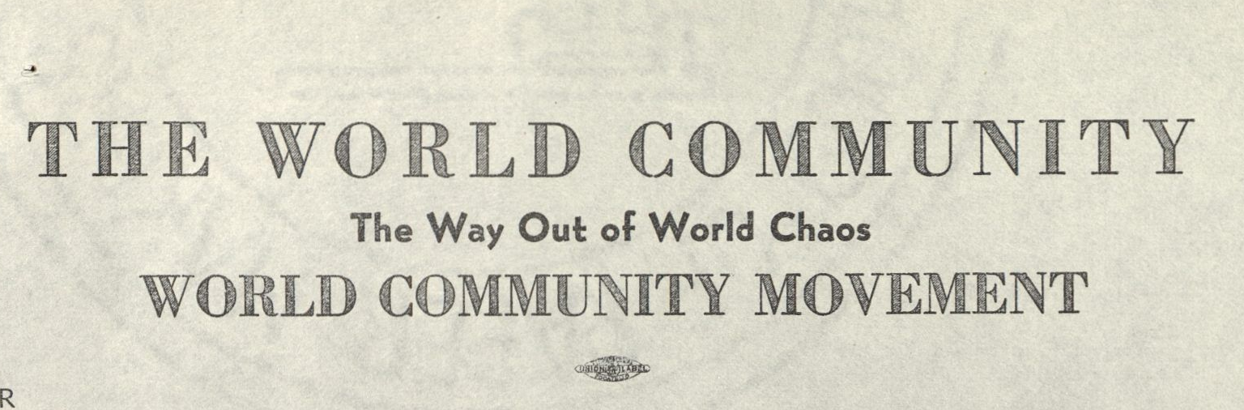
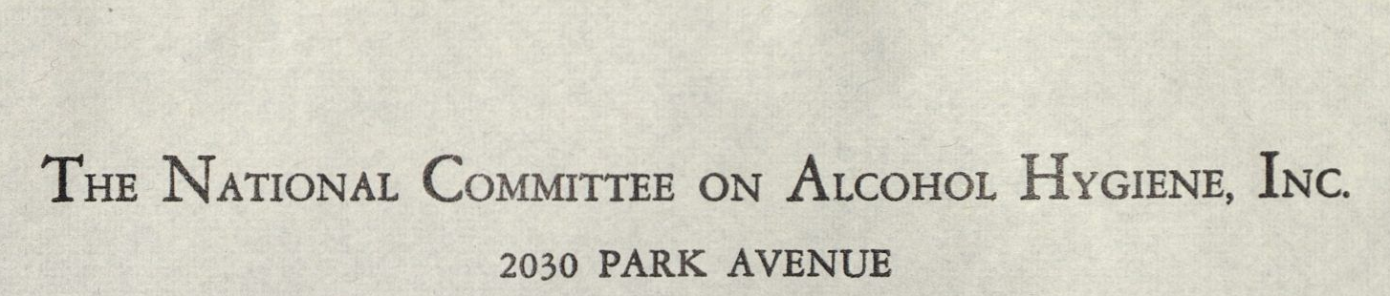
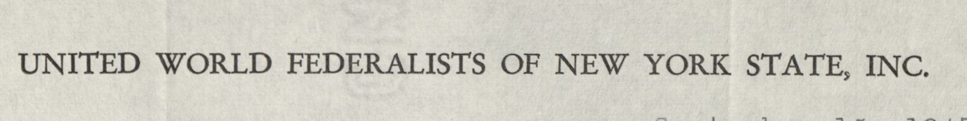
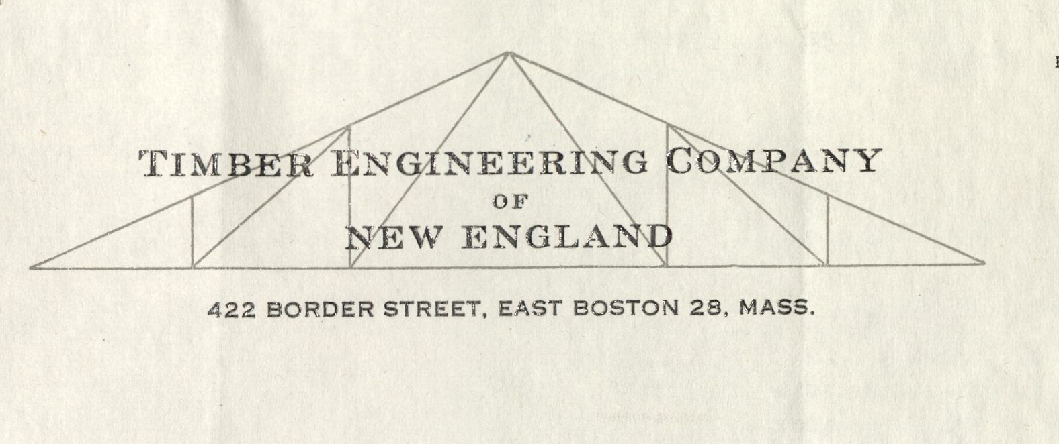
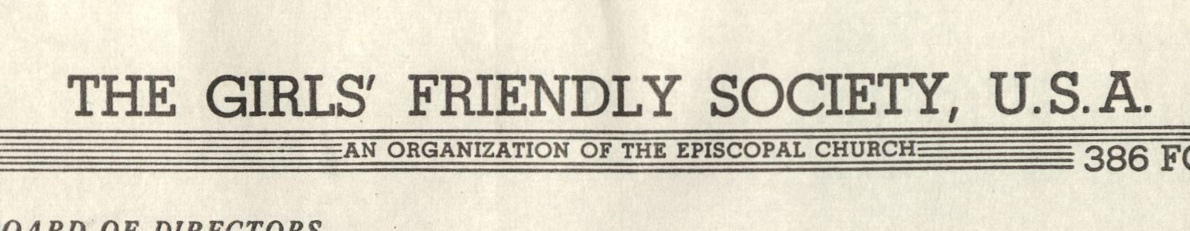
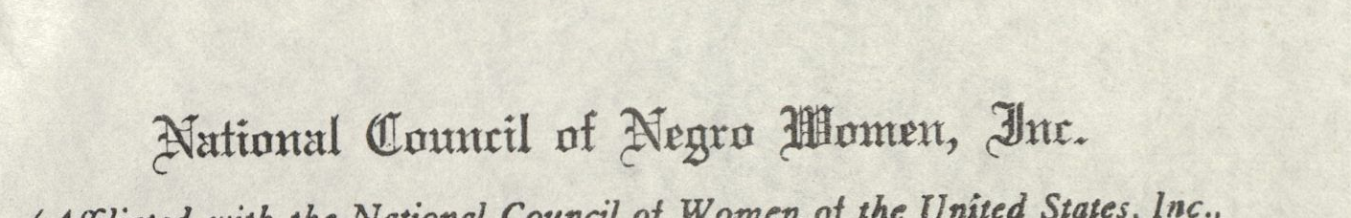
Notes:
organizational affiliation,

Slide 7
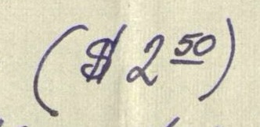





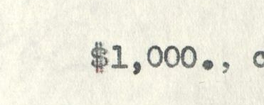
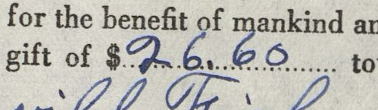


Notes:
donation amounts, and

Slide 8
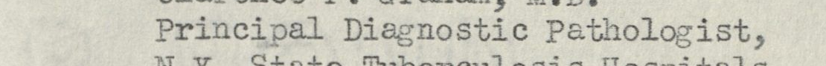
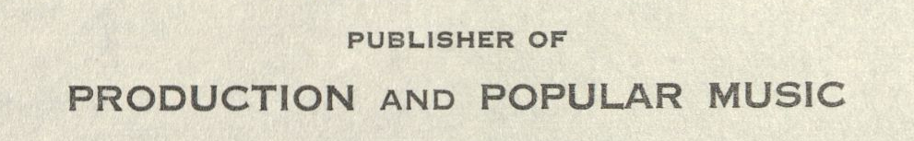
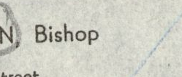
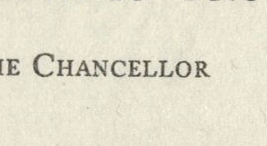
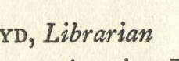
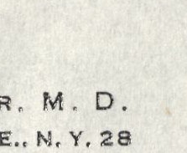
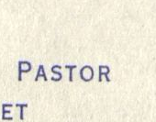
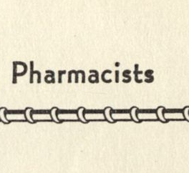
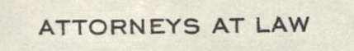
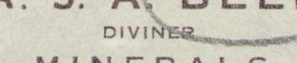
Notes:
occupations;

Slide 9
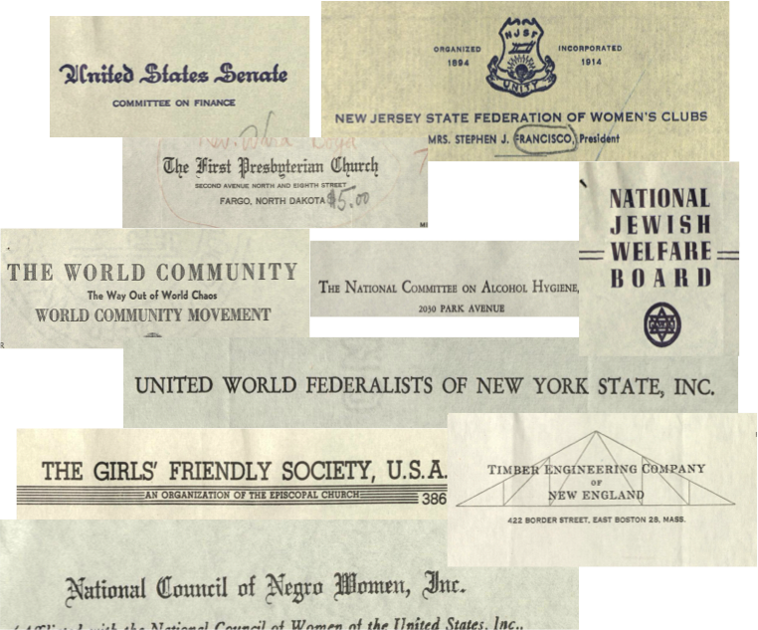
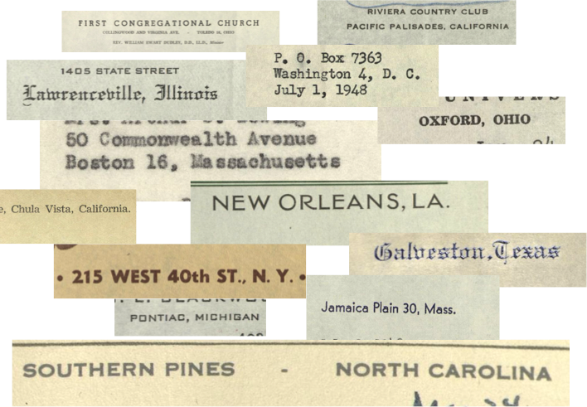
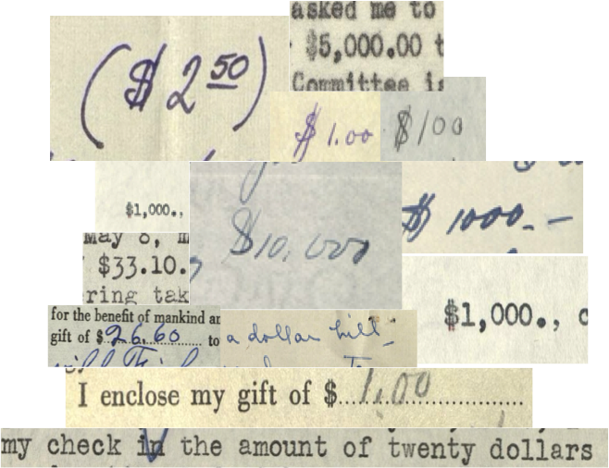
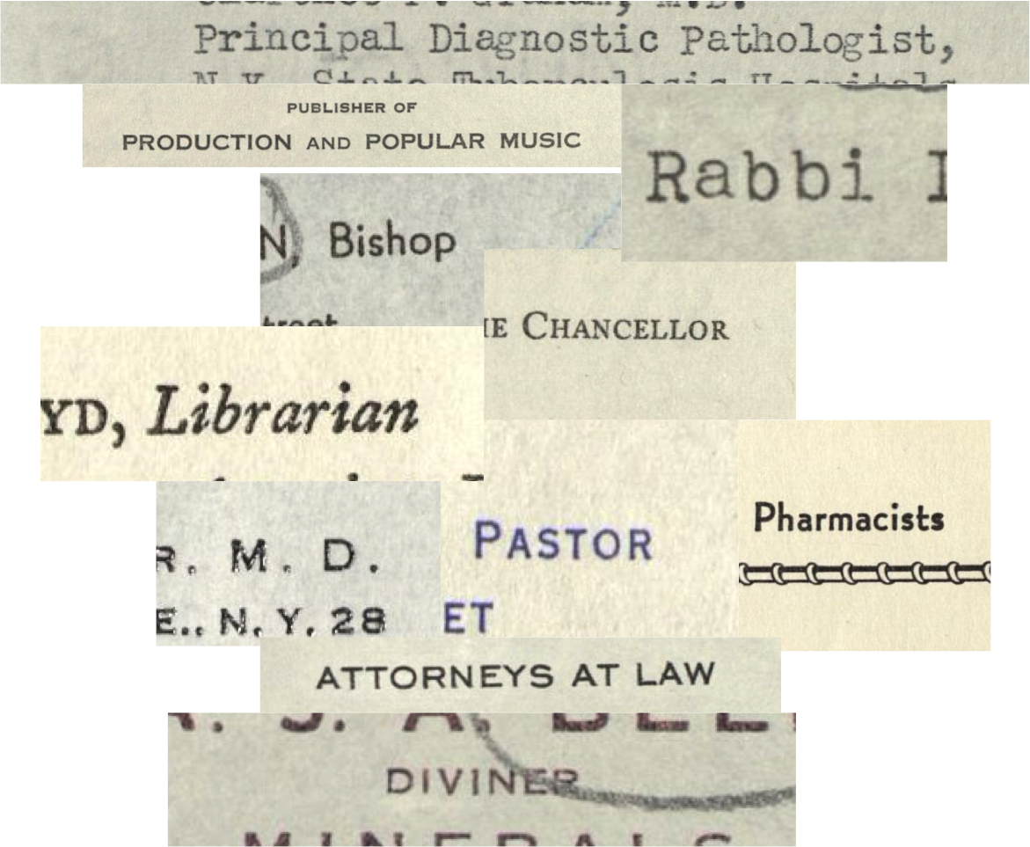
History of Science and Technology
Peace Studies
Public Policy
Sociology
Political Science
Cultural Studies
Communications
and more….
Notes:
and more, which, when compiled, manipulated, and visualized, provide interesting revelations for a number of questions about the work of the Emergency Committee of Atomic Scientists. Geographic concentrations, demographic patterns, and donation amounts can reveal its successes and failures in new ways.
At a macroscopic level, too, this collection of letters is an important source for understanding the dawn of the Cold War, the reactions of the American public to their government’s actions, trends in activism at the time, and the understanding, or lack thereof, of the science and technology that brought this weapon into the world. In other words, it is a collection with potential scholarly appeal to a broad swath disciplines in the humanities and social sciences—history of science and technology, peace studies, public policy, sociology, political science, communication, and more. But, it was rarely used, languishing with very little scholarly attention for over 20 years.
Recognizing its potential, we wanted to find new ways to connect this collection to those who might use it for different purposes. We developed a large-scale, quick-and-dirty digitization project with multiple components, and began work last February.

Slide 10
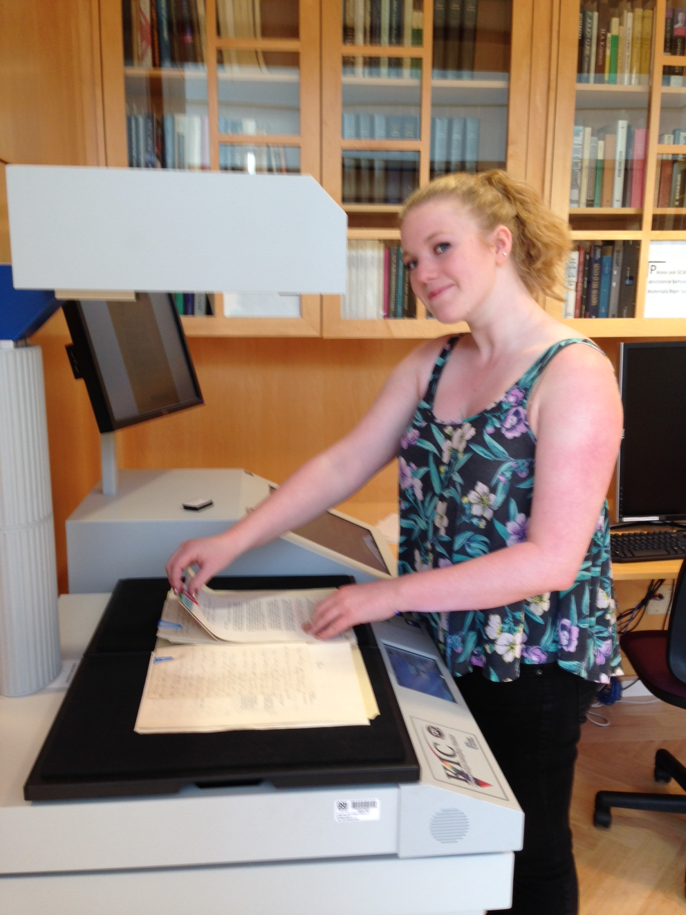
Digitization
Notes:
Our first component was digitization of the collection. Because these were mid-twentieth century materials in little danger of decay, and because we had limited staff and time to devote to the project, we decided that quick and dirty access copies would be best for the project. We were not interested in taking the time to make a perfect scan, and privileged readability and completeness instead. We decided that access copies made on our Reading Room Bookeye would suffice, and developed a workflow of scanning, naming, and sorting the images

Slide 11
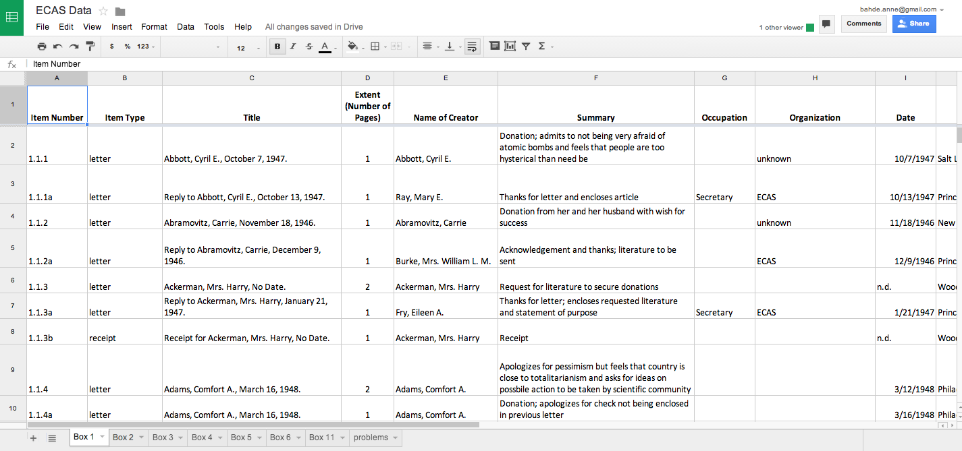
Description
Notes:
In the second component we described the collection. We planned descriptive item-level metadata that extracted important facets of each piece, including a summary of the letter and other details gleaned from reading each one of them. Looking ahead to the potential need for csv files to reuse and manipulate the data, we gathered metadata in a simple spreadsheet, mapping each field to Dublin Core fields.

Slide 12
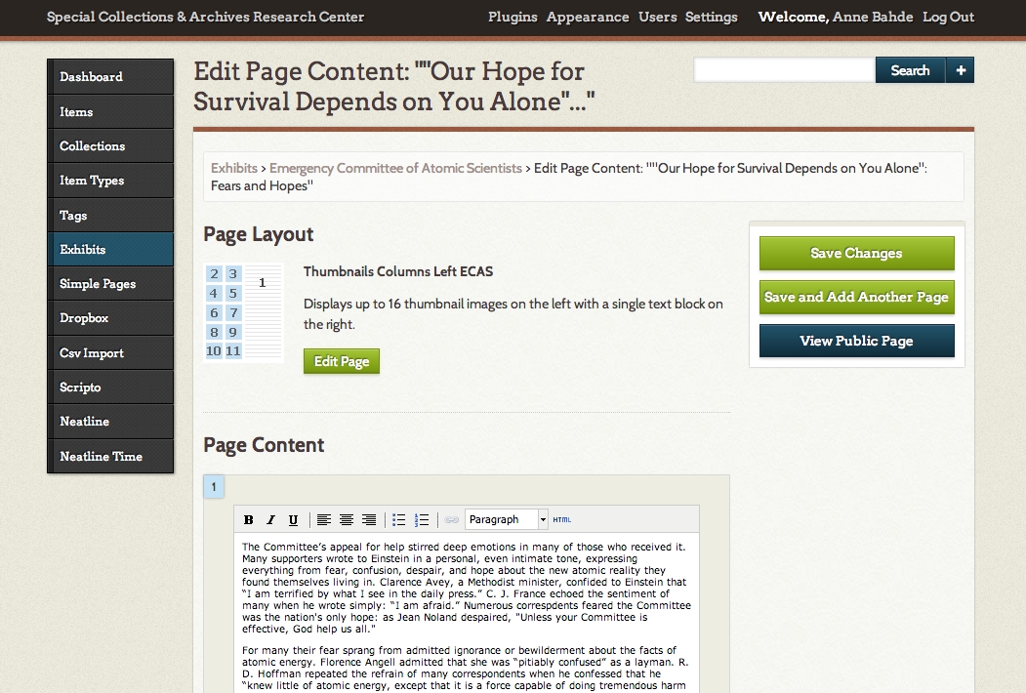
Deployment
Notes:
The third component was deploying the collection. We looked for a front-end that allowed for easy browsing and searching, appealed to multiple audiences, and that ideally included ways to understand the collection that were not available by physically consulting it in the reading room. We decided to use the open-source exhibit platform Omeka as the delivery tool, since we had already used it for other projects, and since it promised some exciting other possibilities for audience interaction and learning.
A collection like this one, with materials created from 1945 to 1951, obviously has a significant copyright issue attached to it. To deal these issues, we prepared a thorough fair use argument and adopted the recommendations of the OCLC Statement on Well-Intentioned Practices by identifying high-risk materials and not including them on the website, and by posting a liberal take down notice in the final product.

Slide 13
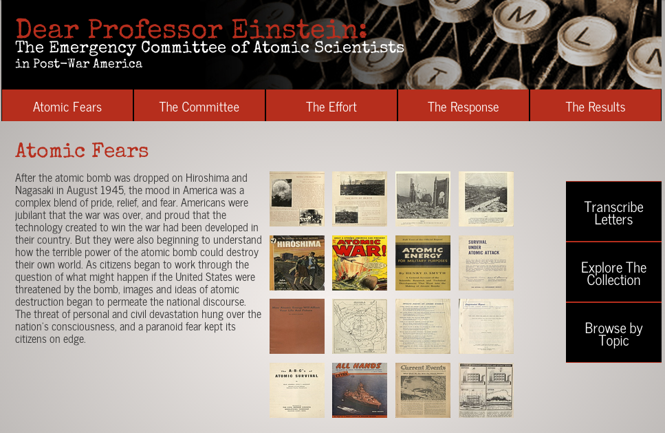
Notes:
The result is a readable, illustrated introduction to the Emergency Committee and the Americans who responded to its call. After exploring the cultural milieu in which it was conceived, as well as descriptions of its formation and effort, we highlight examples of the many types of letters that were sent to the ECAS:

Slide 14

Notes:
letters of criticism,

Slide 15

Notes:
encouragement,

Slide 16

Notes:
advice, solutions, as well as offers to help and interesting contributions in lieu of funds. We explore the results of the Committee’s work, or lack thereof, and briefly discuss their products and their legacy.

Slide 17

Notes:
Users can browse through the letters in any order, examining item and metadata together.

Slide 18
Notes:
Inspired by the University of Iowa’s incredible DIY History site, we enabled the Omeka plugin Scripto, which allows users to transcribe all types of letters to enhance the keyword searchability of the collections and enhance scholarly use.

Slide 19

Notes:
A topical tag cloud allows exploration of occupations, amounts, and organizations.

Slide 20

Notes:
Users can also explore the collection and play with the data using several data visualizers, including Viewshare, a free service from the Library of Congress that also allows for visualizations and data play, providing manipulatable facets, lists, geographic exploration, and charts.

Slide 21

Notes:
For example, this is a map of letters received from religious professionals such as rabbis, priests, ministers, or pastors, showing their donations, (at least for Boxes 1-4);

Slide 22

Notes:
this is a simple pie chart of giving by state.

Slide 23


Notes:
We are also using Neatline, an Omeka plugin that creates a visual timeline of letters received for working chronologically.

Slide 24

Notes:
We are also using RAW, a data visualizer that allows users to choose between 12 different graphs and visualizations, including circular dendrograms and circle clusters, to show other combinations of facets. For example, this is an alluvial graph that shows donation amounts by year. Here are all the amounts, and up here is zero—so this shows us that though they received the most letters in 1947, about half of those letters did not include donations, leading up to a considerable lack of support in 1948.
These exploration tools invite users to play with metadata in order to uncover correlations, patterns, and trends.
Currently, we have over half of the letters digitized and on the site since preliminary work began last February; we plan to launch with this set in mid-July. We average a total of about ten combined hours a week, in my time and student time, which means we get about four folders digitized, described, and on the site each week. We found that making only modest adjustments to the traditional processing, digitization, and online exhibit workflows yields so much more than what we typically provide. Performing metadata capture at the point of physical digitization was crucial to this rate. (Had this collection been unprocessed, we probably would have tried to integrate formal processing as well, but we were lucky in that some brave souls twenty years ago had created a container list with titles and dates for each individual item.) We repurposed metadata several different times, adjusting as needed for each system. And we curated the exhibit as we were doing these processes, because we were seeking ways to accomplish all or most of the project goals through only one contact with the materials. Despite this streamlining, we also added processes. I found myself cleaning data, writing scripts, and figuring out how in God’s name to join together two disparate columns into one column in Google spreadsheets. But being willing to do this as part of the workflow of creating a digital collection or an online exhibit yielded benefits to a wider audience of researchers than either a traditional digitization project or online exhibit might have, or at least that’s what we are hoping.

Slide 25
But WHY?
Notes:
Throughout the project, I’ve been asked a few times—But why? And why are YOU doing this, in special collections? Isn’t this what digital humanists are supposed to be doing—you’re not a digital humanist! In other words, who do you think you are?
Apart from the obvious reasons, the desire to bring life and attention to a rich nuclear history collection from the dawn of the atomic age, and the desire to fully digitize and make accessible a useful collection, there are a few reasons that we wanted to try such an experiment.

Slide 26
Digitize with abandon!
--Jackie Dooley
2008 RBMS Preconference
The future of special collections is openness.
The future of special collections is disintermediation.
--John Overholt
Five Theses on the
Future of Special Collections
What if our obligation were to play? To play in public? To make the things we want to see made? To collaborate like mad, with local scholars, with other librarians, and with the wider, public open source and open access community that encompasses them both?
--Bethany Nowviskie
Skunks in the Library:
A Path to Production for Scholarly R&D
“…[adopt] rapid, minimalist processes when possible and
intensive, detailed processes
when merited.”
--Shan Sutton
Balancing Boutique-Level Quality and Large-Scale Production: The Impact of More Product Less Process on Digitization in Archives and Special Collections
Notes:
First, inspired by recent observations and exhortations from a variety of leaders in both special collections and in digital humanities, we wanted to play with the scale and scope of traditional projects produced in special collections and archives environments to see if something called “digital humanities” could arise organically from our normal workflows. Bethany Nowviskie urged librarians to stop letting their service ethic get in the way of creating their own projects, and instead to “play—to play in public—to make the things we want to see, and to collaborate like mad, with local scholars, other librarians, and the wider public open source and open access community that encompasses them.” “Digitize with abandon,” implored Jackie Dooley; John Overholt asked us to imagine a future for special collections where openness and disintermediation are embraced. Shan Sutton challenged us to find the balance in digitization projects between “rapid, minimalist processes when necessary, and intensive, detailed processes when merited.”

Slide 27
Description
Digital Humanities History of Science
Interpretation
Notes:
We began by thinking differently about metadata and asking ourselves what researchers would really want to know about these letters. Many of us who work with special collections materials are uncomfortable with the idea of compromising on metadata or output quality in order to privilege large-scale digitization. Here, it was less a compromise than a transgression. The scans we produced are not perfect; the metadata isn’t either. We collected the barest details a researcher would need, and decided to forego some other fields (such as source, relation, coverage, contributor, format, language, etc), but also retrieved the bits that were not available in the traditional finding aid and that would not ever be recorded even by the most exhaustive and careful metadata. Collecting data such as organization or occupation or donation amount, crosses a line when special collections librarians and archivists do it. A step like this passes from description, our job, into the realm of interpretation, the scholar’s realm, the realm in which we may not belong. Many think we should not presume to know which information besides traditional fields in our collections to gather, to presume what would be important to the scholar. And I guarantee you that we overlooked or left out information that would undoubtedly be of importance to many scholars. But describing collections solely from the traditional realm is not always serving the scholars to whom the collections might appeal. In order to bring life to our collections, to connect them to the scholarship they might produce, we found we had to tread—just a little—into the other realm, striking a balance between simple and detailed to help facilitate access to the most important parts of this collection.

Slide 28





Student Graphic Designer
History of Science Librarian
Digital Humanities Librarian
Computer Science Major;
Programming
Collaboration
Openness
Non-hierarchical relations
Agility
Creativity
History of Science Ph.D Student
Metadata and Transcription
Library and Information Sciences
Workflow, Scanning Metadata
Digital Humanities Class
Environmental Sciences Ph.D. Student
Metadata and Transcription
Environmental Sciences Undergrad
Workflow; Scanning, Metadata
Notes:
Second, we recognized that a project like this one had the potential to be a teaching tool, both in process and in product, from a variety of angles, for a variety of audiences. Matthew Kirshenbaum characterizes DH as “a culture that values collaboration, openness, nonhierarchical relations, and agility…”. In viewing the project as an educational forum, we sought to value collaboration between disparate sets of people, working with each other in iterative, agile ways, in order to create a usable, interesting product. Besides a project leader who coordinated communication and workflow, there was an extremely flat hierarchy, with free exchange of ideas and improvements.
Since we began in earlier this year, there have been almost twenty students involved in its production. These students worked closely together on all aspects of creation, and have benefitted from the project in many ways—the CSS wizard and programmer, and graphic design student who designed the Omeka interface both got to use the project in their graduating portfolios; the library science graduate student gained experience in metadata and in planning for potential users; the history of science graduate students gained valuable research experience guided by the librarian. Early on, I met with our Digital Humanities Librarian about using the project in the first digital humanities class taught at OSU, and her twelve students adopted this as a class project, aiding in scanning and model testing in Viewshare. The product is also supporting learning at OSU: the exhibit, transcription features, and data visualizations are being used in upcoming history of science classes on 20th century political history and nuclear history, an Honors College course on the history of activism, and even an English class on rhetoric. There’s more to do that will open it to even more audiences; for example, cultural historians might use the transcriptions of the letters with computational linguistics and topic modeling to look at sentiment analysis to see the change in public sentiment about the bomb over the years of the Committee’s existence. This approach would shed even further light on how Americans grappled with the new atomic reality. The impact on learning that it has had only at OSU has already made it worth the time invested, and of course it might be used at other institutions and by other scholars as well. By using digital projects from the library and playing with data from archival collections, students begin to see how tools like those in this project can be applied to their own disciplines and careers, and grow into their role as the next generation of digital scholars.

Slide 29
Digital
History
Digital Humanities
History of Science
Humanities
Science
Notes:
Finally, we wanted to explore the boundaries of history of science collections for research and teaching. Much like the digital humanities, the history of science is by definition a hybrid field, enjoying a liminal existence at the intersection of history and science, and serving as a bridge between the two. With this experiment, I wanted to see how these two hybrids complement each other, and what mutual benefits they offer when paired.
Archival and manuscript collections in the history of science have a reputation for being either terribly exciting, or terribly dry. It is not a stretch, I think, to say that the majority of them languish, underused and underappreciated. Papers of faculty members that include box after box of old, seemingly outdated or superseded research (and not to mention all of those article reprints), are often overlooked by not only historians of science, but by scholars in every other discipline too. With this project, we wanted to explore how to present a traditional history of science archival or manuscript collection in ways that might render it relevant to scholars in sociology, linguistics, public relations and communication, human or political geography, cultural studies, rhetoric, and more. The collections that we traditionally define as “history of science” collections are full of unpublished, historical data that have the potential to unite fields and invite cross-disciplinary dialogues, making these collections particularly suited for digital humanities work.

Slide 30



Notes:
For example, these unpublished data tables and hand-drawn figures from one of our nuclear history collections show the incidence of congenital malformation worldwide correlated with the geomagnetic latitude, in a 1959 study looking at the biological effects of fallout from nuclear testing. Visually correlating this further with other historical, or even current data on any number of topics would engage multiple disciplines and offer the opportunity to unite disparate fields around the archival collection– for example, high school drop out rates in sociology, increases in rural or urban populations in human geography, vegetation die-off for botanists, literature with post-apocalyptic themes or themes of abnormality; the visual rhetoric of disfigurement in these different countries for cultural studies. Archival collections in the history of science offer tantalizing opportunities to engage scientists, social scientists, and humanists.

Slide 31

Notes:
The diversity of material types in history of science collections also invite innovation in digital humanities. Computer punch cards, lab or field notebooks, models, data logs, and images beckon with possible quantitative delights that would appeal to a number of scholarly endeavors.

Slide 32


Notes:
These data may seem inaccessible due to format and irrelevant because of time; but we now have possibilities for re-creating and recreating with that data that was never possible in the lifetime of the creator. These collections offer possibilities for discovery, for rendering, wrangling, and revealing patterns that were unimaginable to the original collectors of that data. Partnering these collections with digital humanities tools in geospatial analysis, social network analysis, automated extraction of information, and complexity modeling offer possibilities for changing the scale of study, combining disparate measurements and data sets, and aligning them with humanistic concerns in ways that might contribute not only to the work of humanities scholars, but potentially fields of science as well.
The history of science has had a long relationship with data play, whether it be through visualization, automation, or modeling. Archival and manuscript collections in the history of science are thus a natural partner to the digital humanities, and promoting the use of these collections for digital humanities projects might even inspire new ideas for interpretive models and tools among digital scholars. As special collections librarians and archivists who work with these collections through digitization, description, and outreach, we are specially poised to recognize the potential of the content within them, connect them to scholars, and open interdisciplinary dialogues that bring collections and people together.
Thank you!

