Slide 1
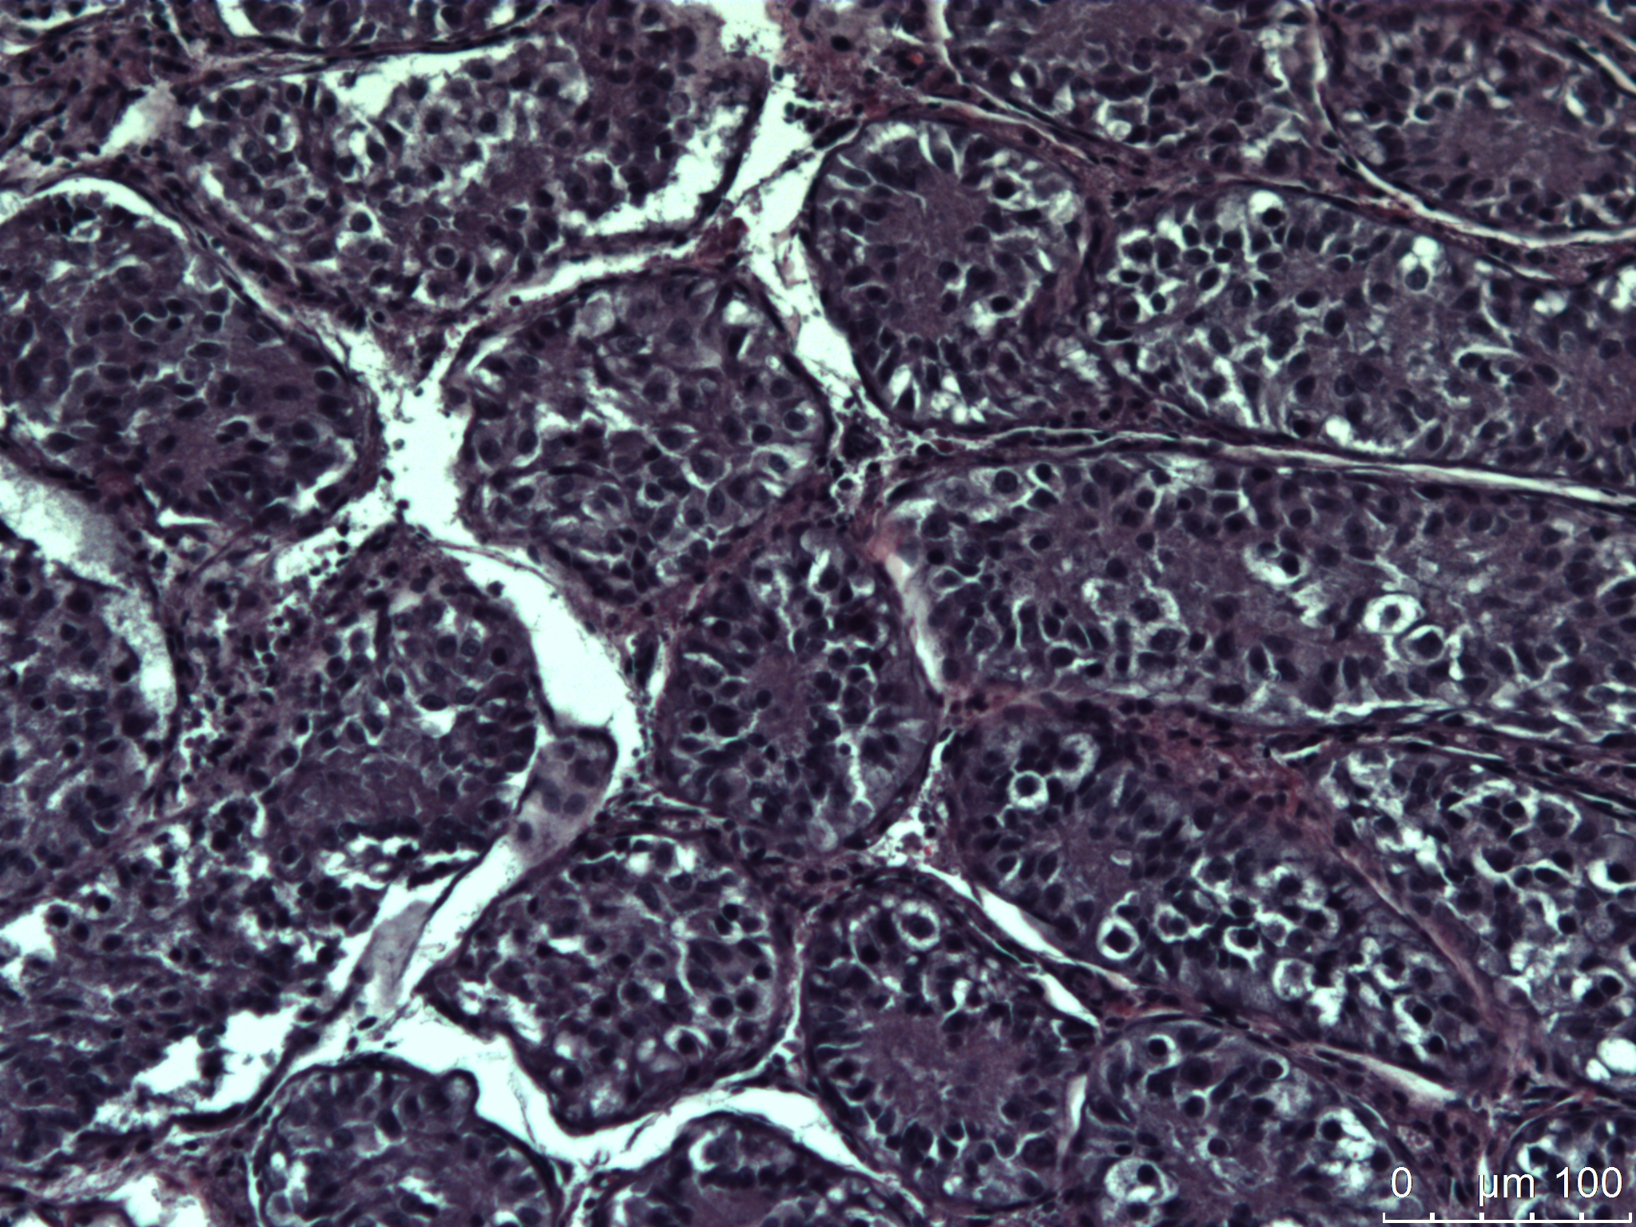
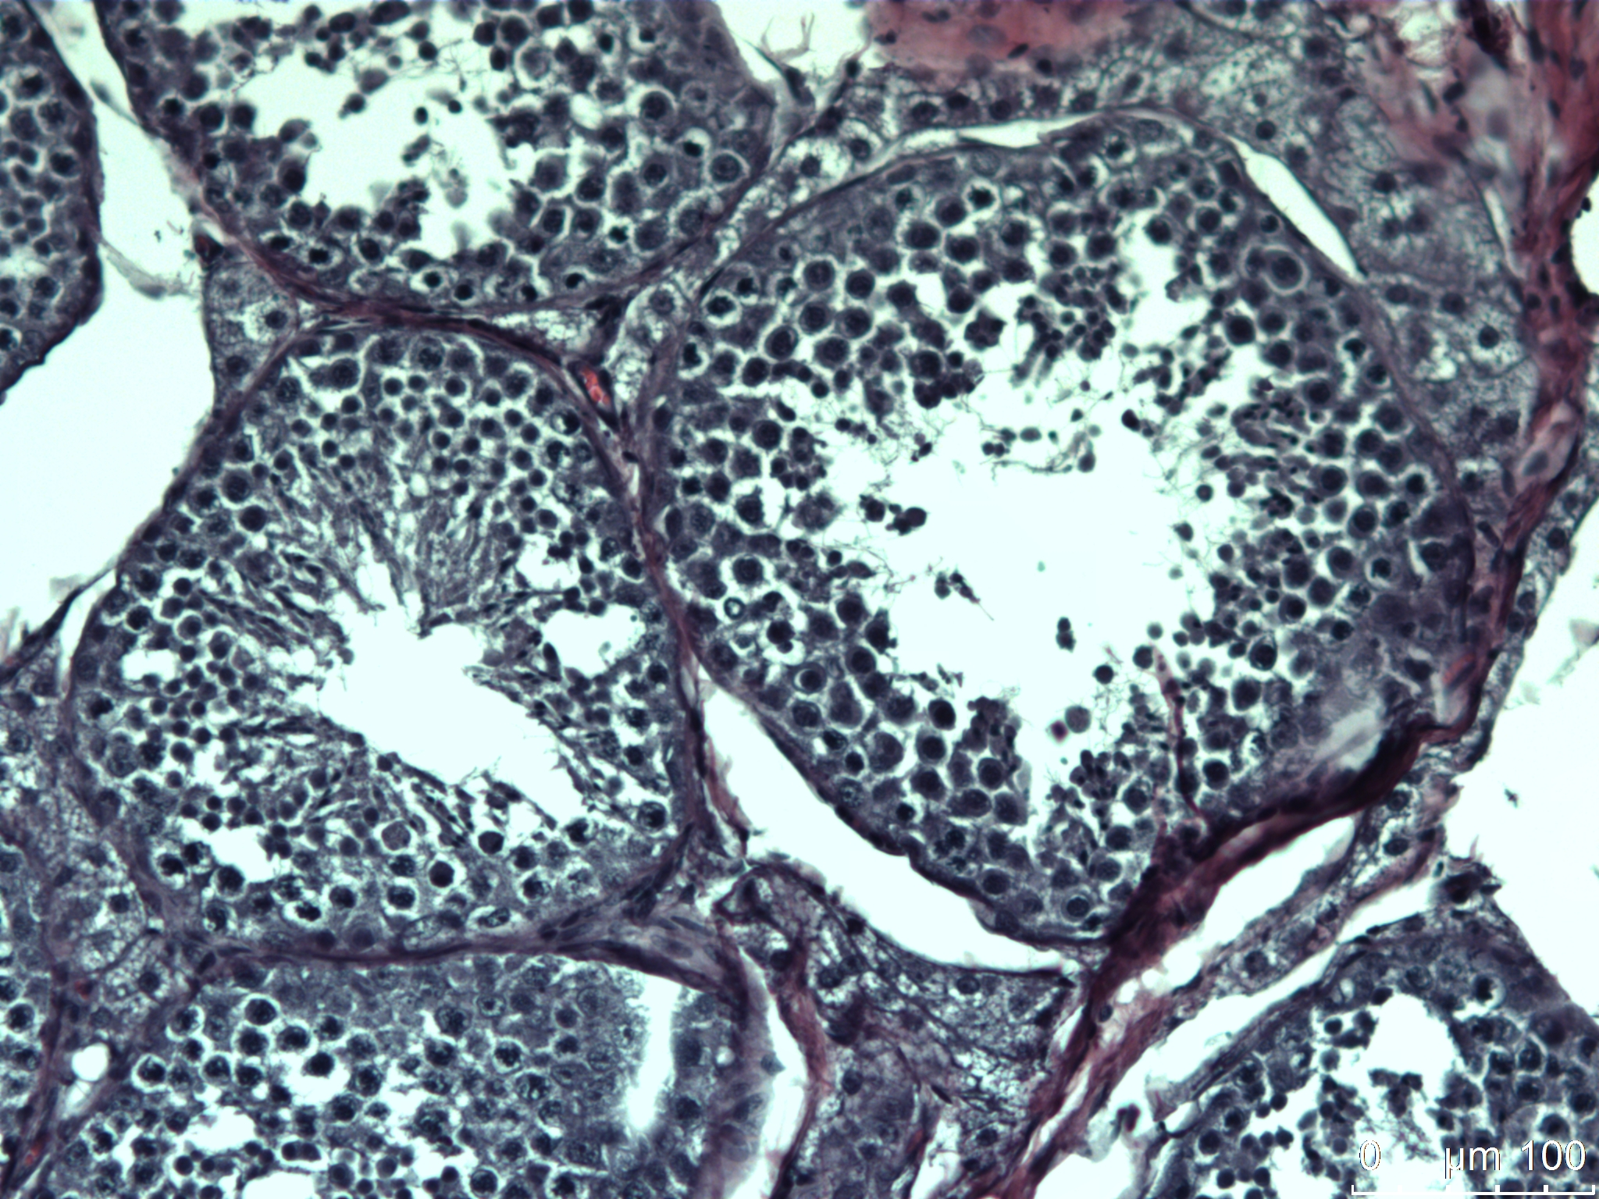
Histologic and Morphometric Evaluation of Testes of Feral Tom Kittens and Cats
Ellie Bohrerª, Anna Mihalyoª, Michelle Kutzler^{b}
ªDepartment of Zoology, College of Science; ^{b}Animal Sciences, College of Agricultural Sciences
Oregon State University, Corvallis, Oregon
INTRODUCTION
MATERIALS & METHODS
DISCUSSION
Even with the introduction of Trap-Neuter-Release programs, the world’s feral cat population continues to remain seemingly uncontrollable¹.
We are interested in discovering the biological reasons why feral cats are so reproductively successful.
Previous work by our laboratory has shown that normal morphologic sperm are present in vas deferens secretions of feral toms before 6 months of age.²
Feral toms were presented for castration at a local Humane Society during August-October 2014.
Age was determined by records provided from feral cat colony managers and confirmed with dental eruption patterns.
The age groups were: 2-2.5 months (weanling; n=6), 3-4 months (juvenile; n=6), 5-6 months (pubertal; n=6), and 12-24 months (adult; n=6).
General anesthesia was induced and a routine open castration was performed. Both testicles from each cat were hemi-sectioned, formalin-fixed, paraffin-embedded, cut into sections (6 µm), and stained with hematoxylin and eosin.
The slides were evaluated by a single observer (EB) blinded to age group using bright field microscopy (200X).
Evidence of spermatogenesis was determined on the basis of presence of spermatozoa in the seminiferous tubule lumen.
In addition, perpendicular diameters measured from 5 tubules for each testis were averaged and mean ± SD was determined for each age group.
Tubular diameter was compared using a Student’s t test where p < 0.05 was defined as significant.
The presence of spermatozoa in the lumen was compared using a Chi -square test.
Juvenile feral toms in the current study had significantly wider tubular diameter than previously reported for domestic toms under 5 months of age (86 µm).³
This supports our hypothesis that spermatogenesis is occurring at an earlier age in feral toms.
However, the time of year the previous measurements in domestics was not reported.
If these measurements were made outside of the breeding season, this may explain why the tubular diameters were smaller.
Future studies are planned to determine if folliculogenesis occurs earlier in queens as well.
OBJECTIVES & HYPOTHESIS
We hypothesize that the onset of spermatogenesis occurs before 6 months of age in feral toms.
The study objective was to histologically evaluate testes from weanling (2 months of age) through adulthood (24 months of age) to determine when the onset of spermatogenesis occurs in feral toms.
ACKNOWLEDGEMENTS
Special thanks to Heartland Humane Society for their help and support, and the Metaphorical Platypus website for the background photograph.
RESULTS
LITERATURE CITED
1. Tiptanavittana N., et al. Reprod Fert Dev 2014; 27(1):140.
2. Bohrer E., et al. Comparison of penile spines and sperm morphology between juvenile and adult feral cats. Society for Theriogenology Annual Conference Proceedings 2014 (abstract).
3. Sanchez B., et al. J Reprod Fert Suppl 1993; 47:343.
Evidence of spermatogenesis in weanling, juvenile, pubertal, and adult toms was 0%, 17%, 67%, and 100%, respectively (p < 0.05 between successive age groups).
The seminiferous tubular diameter was significantly larger in each successive age group (weanlings 88.10 ± 10.88 µm; juveniles 109.8 ± 8.89 µm; pubertal 142.2 ± 16.89 µm; adult 237.90 ± 52.45 µm).
Figure 1. Histopathology of seminiferous tubules in a pubertal feral tom cat.
Figure 2. Histopathology of seminiferous tubules in an adult feral tom cat.

