Slide 1
Knowles Creek Research Review
Patrick Bruce, OSU
Notes:
Who I am
What BRR is.

Slide 2
Involvement/Needs and Interests
Christine Hirsch, Siuslaw National Forest
Paul Burns, Siuslaw National Forest
Liz Vollmer-Buhl, Siuslaw Watershed Council
Rebecca Flitcroft, Pacific Northwest Research Station
Kate Field, OSU
Notes:
Siuslaw National Forest- Interested in what the long term data monitoring on Knowles Creek could show. They put in structures, and have been monitoring since early nineties.
Watershed Council- Data management needs. Field assistance associated with monitoring on Knowles.
PNW Research- Most interested in how Knowles restoration and habitat have changed over time.

Slide 3
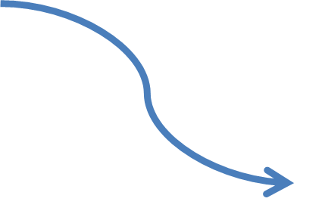
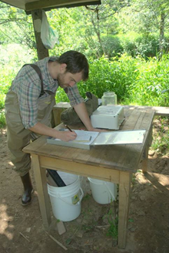
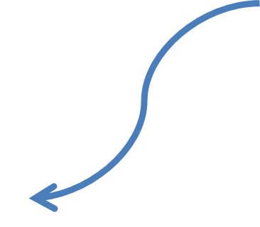
How This Collaboration Works
Notes:
Forest service “End of Year Funds” given to watershed council
Council in turn pays me through an internship
PNW “In kind support” including a work space, computer support, analytical support, and field assistance when necessary.
OSU, Supplemental scholorships are available for undergraduate research, and work study could also be utilized.
National Forest Also supplied a vehicle for trips to the study area which is an hour and a half away.

Slide 4
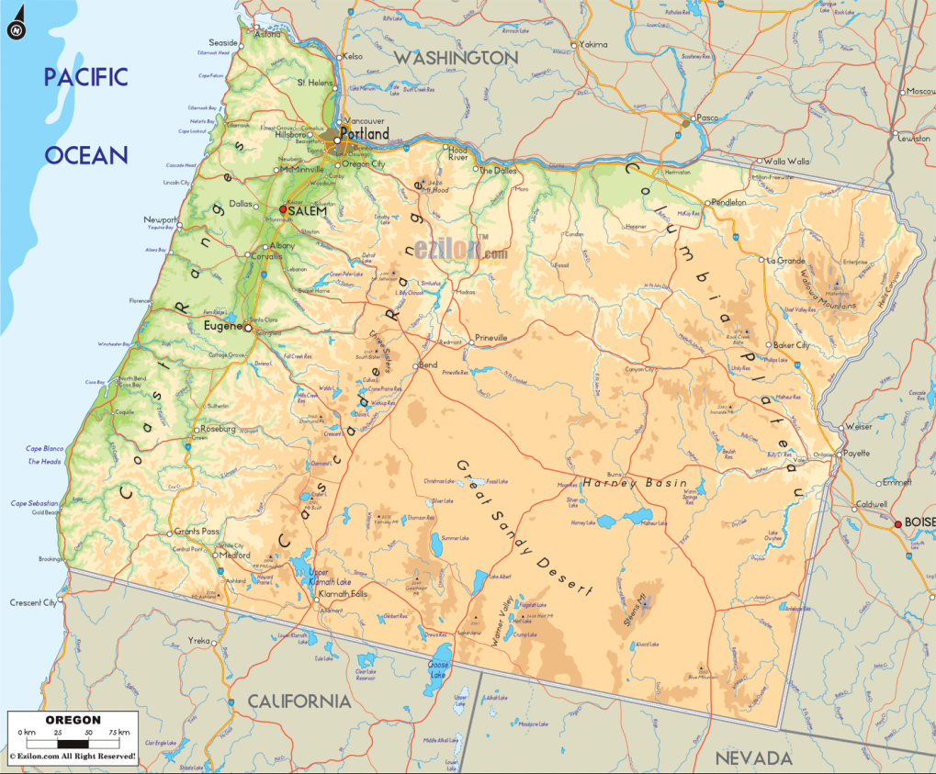
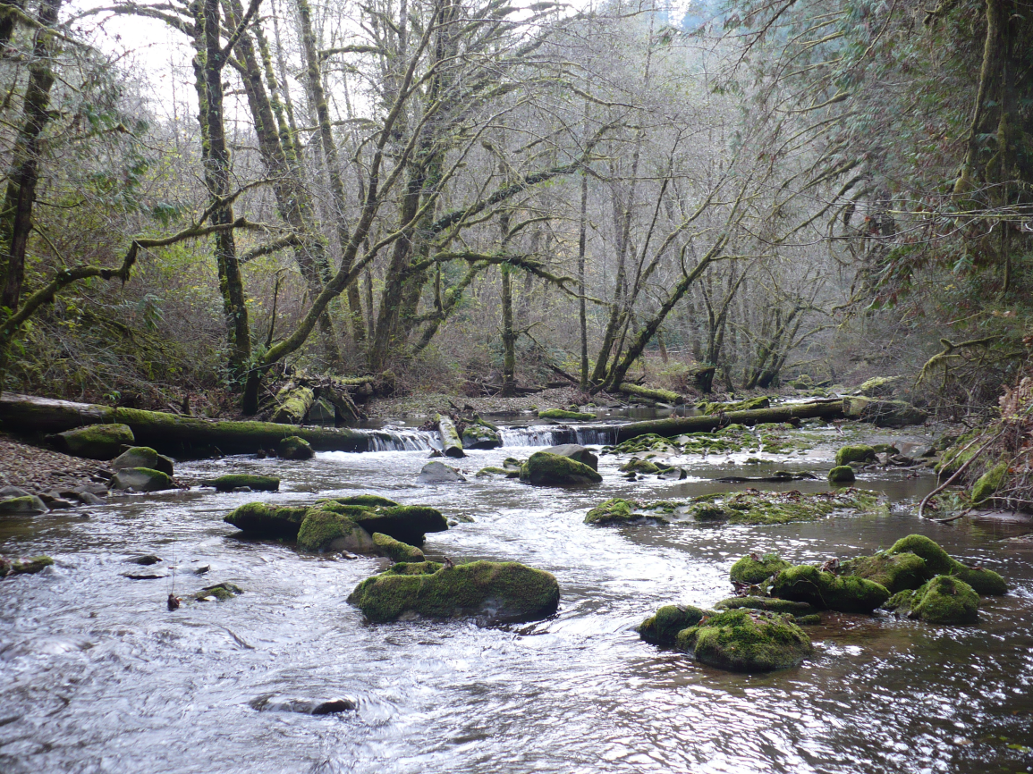
Knowles Creek
Notes:
A tributary of the Siuslaw River
Located just east of Florence on the central coast of Oregon
Annual Precipitation is 80-100in per year.
Been extensively logged for the past hundred years apart from a small old growth stand in an upper reach.
Very flashy, heavy rain events and no snow pack move significant amounts of water , sediment and debris quickly through the system.
The forest service has installed several large wood restoration sites in the stream channel.

Slide 5
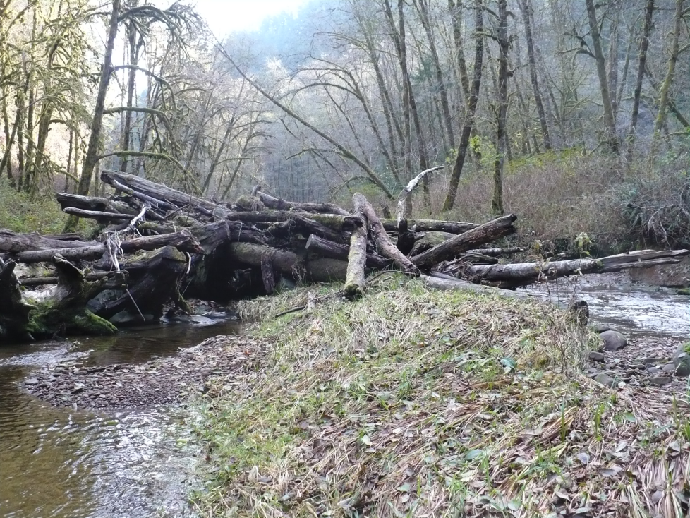
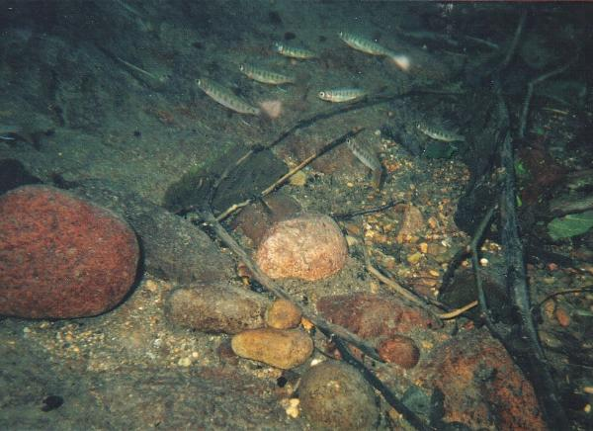
What is the effect of in-stream restoration on fish habitat and communities throughout the Knowles Creek watershed?
Source: USFS
Notes:
Research question- What effect have these restoration sites had on fish habitat on Knowles?
Have certain structures been more productive than others in providing this habitat, and how has disturbance played a role in that enhancement.

Slide 6
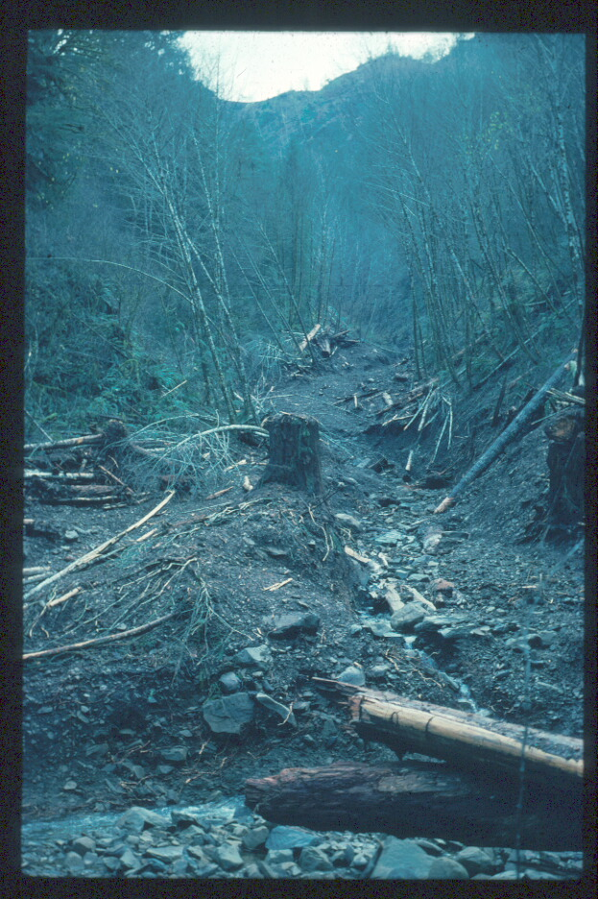
Are restoration projects a skeleton that natural disturbances can flesh out?
Sediment and wood: building blocks for habitat structure
Notes:
These structures can be thought of as a skeleton that has the ability to be fleshed out in a sense.
So is that combination of natural disturbance and restoration a driver for enhanced habitat on Knowles.

Slide 7
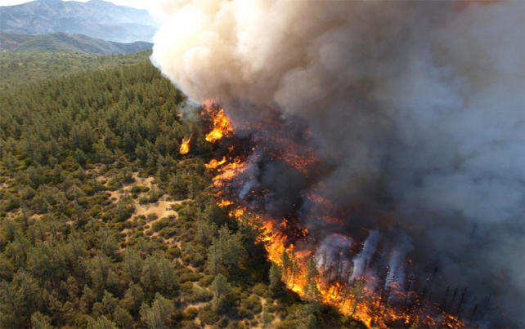
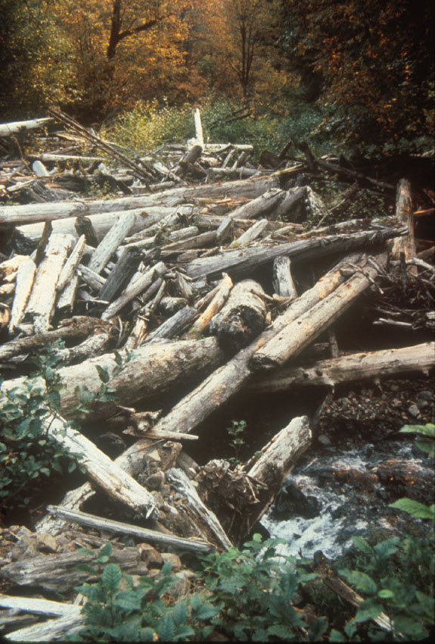
What sorts of disturbances are important?
Notes:
Fire often precipitates debris flows that deliver wood to streams. Fire is not frequent in western Oregon.
Natural disturbance such as debris flows and land slides also contribute wood and sediment to the system.
Here land practices such as timber harvest and ranching have historically resulted in a more chronic disturbance.
These chronic disturbances are in general less effective at enhancing habitat from these restoration skeletons.
The system seems to be able to organize this wood through stream flow easier with these natural disturbances.

Slide 8
Why is this research important?
Notes:
Figure displays magnitude and frequency of disturbance by stream order.
So the placement and longevity of these structures is going to be important
Placement must be in an area that has the potential to accept inputs
Must be engineered to withstand the frequency and magnitude of these inputs.

Slide 9
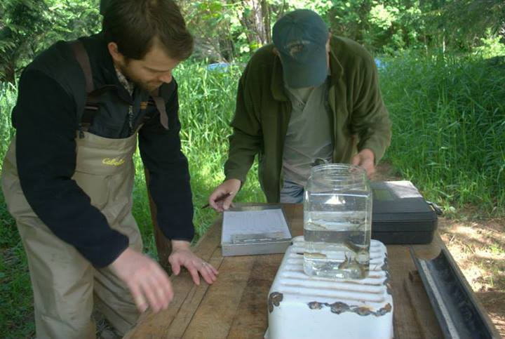
The Approach
Existing Data Assembly
a) Consolidating Datasets
b) Putting Data Into a GIS
Additional Fieldwork
Notes:
The approach is outlined in detail in the next few slides.
Assembly of existing data from USFS and Watershed council
Consolidating data and placing relevant pieces into a GIS
Also additional fieldwork is necessary to fill in some of the gaps in order to address the research question.

Slide 10
Datasets
Forest Service Monitoring
Watershed Council Monitoring
Digital Conversion
Notes:
Extensive datasets that needed to be tracked down.
Datasets were separated in many cases, so consolidation was key.
Some recent data was not in digital format, so conversion was necessary.

Slide 11
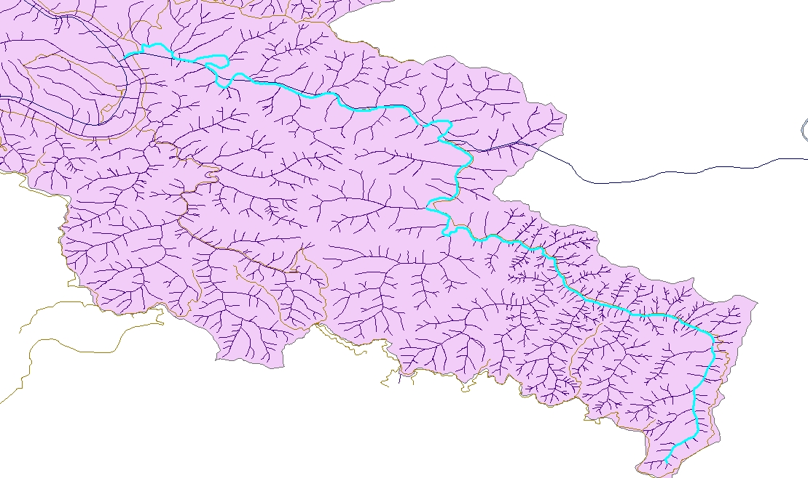
GIS
Conversion
Create Framework From Surveyed Reaches
Restoration Site Locations
Notes:
A preliminary GIS map. Knowles highlighted in blue.
GPS points and surveying data will be layered in
The survey data is broken up into reaches.
Once overlaid visual connections may begin to be made.
Correlations between restoration and abundance may start to unfold.

Slide 12
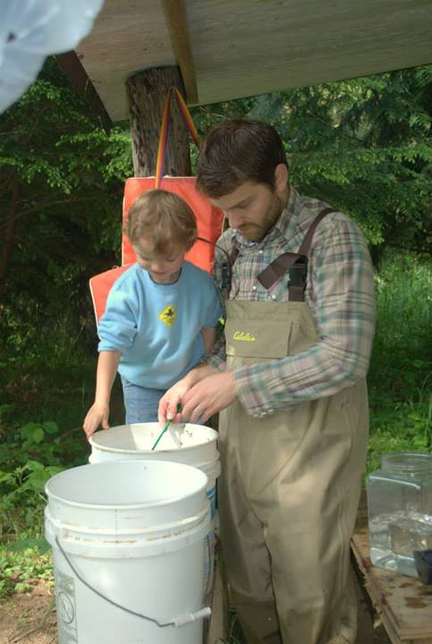
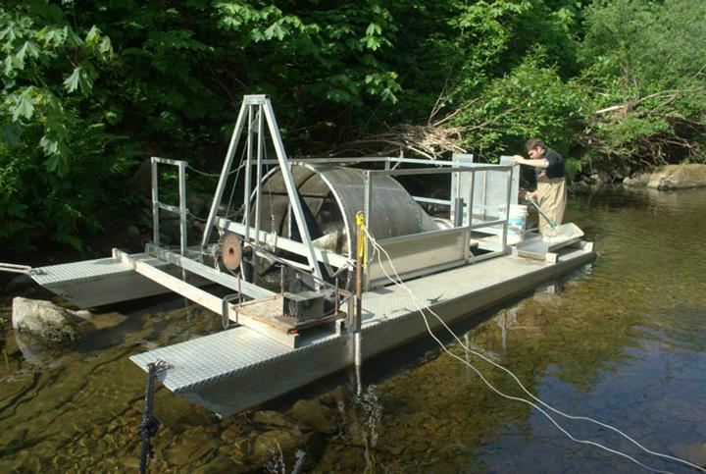
Smolt Trap
Knowles Community Collaboration
Notes:
The next few slides outline the field data collection on Knowles
Smolt trap run in the spring
Collaboration was very noticeable between council, forest service and the community. Student participation.
Really connects the community to the monitoring of the stream.

Slide 13
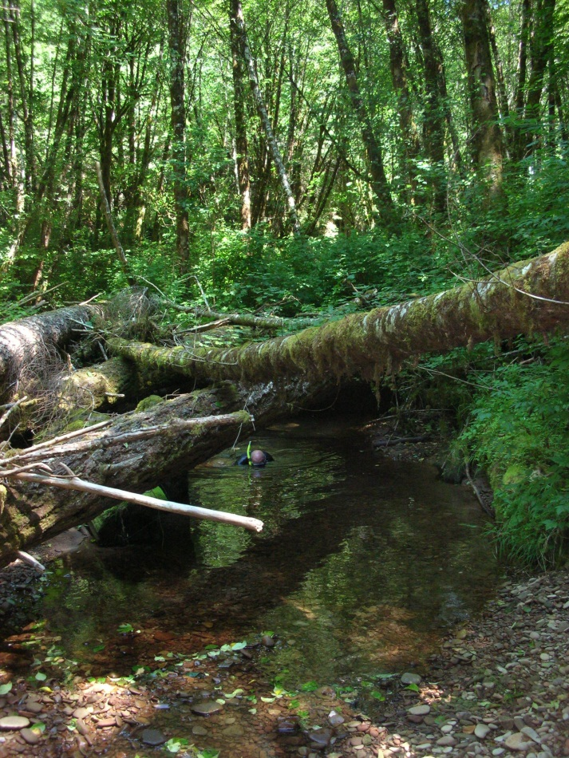
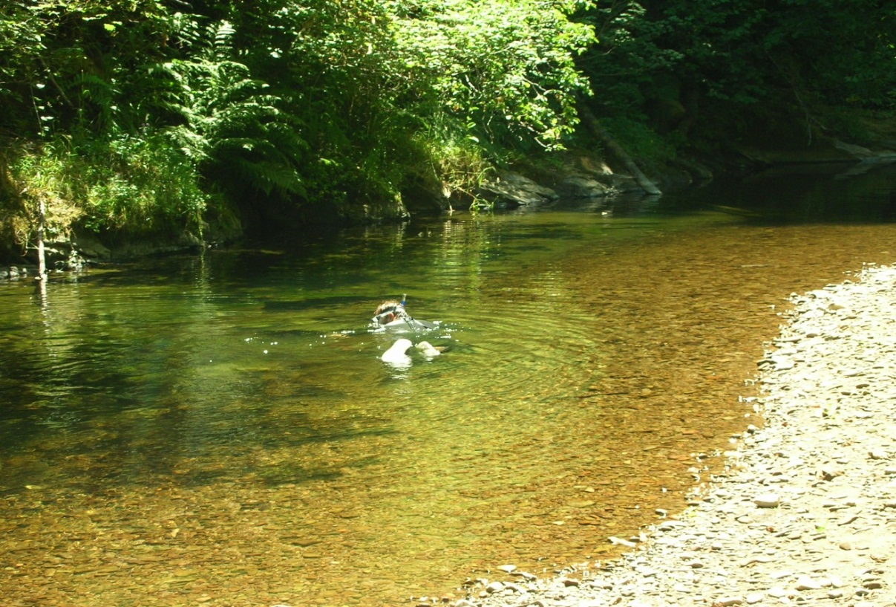
Summer Snorkel Surveys
Abundance and Distribution
Notes:
Snorkel surveys are done in the beginning of the summer.
Ongoing since 1992, substantial amount of unbroken data.
Connect data to the field
See first hand how these processes are happening

Slide 14
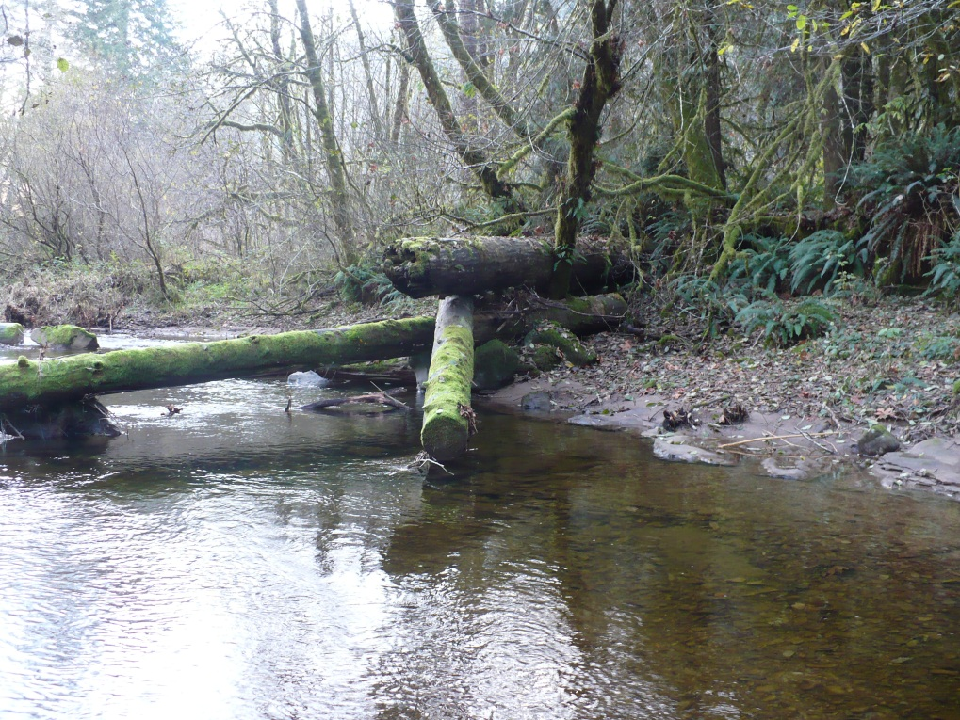
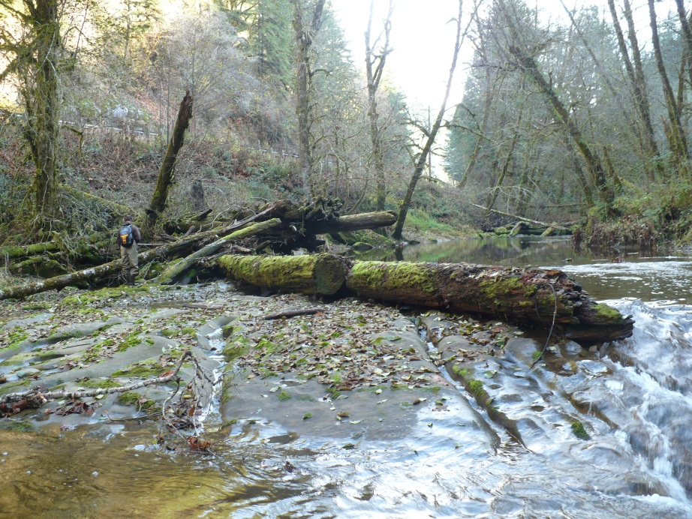
Mapping Restoration Site Locations
Notes:
Supplemental fieldwork to fill in the some gaps in datasets in order to address the question
Connect these points with the spawning data in order to see the connection between restoration and abundance
These shots illustrate that idea of a skeleton,

Slide 15
Compilation/Planned Analysis
Bringing the datasets together
Notes:
Currently were I’m at in the research.
Once datasets are compiled and GIS produced the analysis can begin
The analysis portion again will try and piece together the relationship between restoration and spawning fish.

Slide 16
Where to go from here
Notes:
Complete analysis and start thesis.
Give a seminar and hope to publish findings.

Slide 17
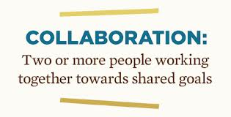
Take Home Message
Notes:
Collaboration between non-profits, the USFS district, and PNW Research can work well.
Students can be helpful in answering questions that managers may not have the time or expertise to respond to.
This is a great way to integrate districts and research
The research helps facilitate that integration.

Slide 18
Acknowledgements
Rebecca Flitcroft
Loretta Ellenburg
Kathryn Ronnenberg
Jean-Paul Zagarola
Christine Hirsch
Paul Burns
Liz Vollmer-Buhl
Ginger Cloutier
Notes:
There's a long list of people who have helped me out with this project, both in the field and in the office.

Slide 19
Thank You

