Slide 1
Xanthohumol derivatives improve insulin sensitivity in obese mice
Joshua Hay
Linus Pauling Institute, Oregon State University, Corvallis, OR, 97331

Slide 2
Metabolic Syndrome
Hypertension
Heart Disease
Abdominal Obesity
Metabolic Syndrome
Low Plasma HDLs
Stroke
High Plasma Triglycerides
Diabetes
Insulin Intolerance

Slide 3
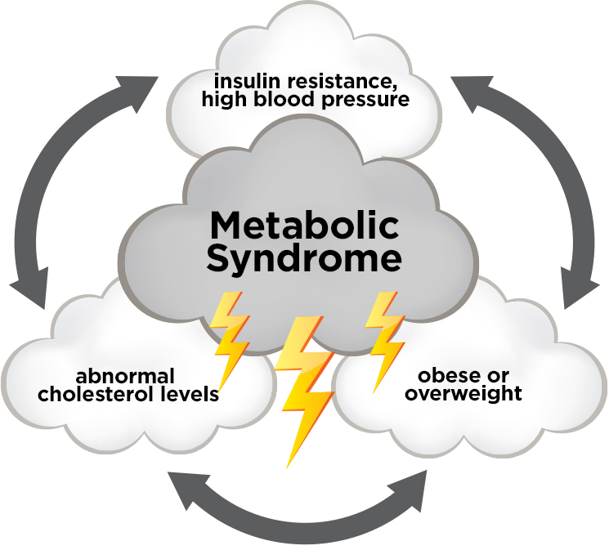
Metabolic Syndrome
More than 34% of Americans affected
Can be significantly reduced by proper diet and exercise
The solution sounds simple, but the incidence remains high
http://www.texasheart.org/HIC/WomenHeart/images/perfectstorm_1.jpg

Slide 4
Cardiovascular Disease
Leading cause of death worldwide
Responsible for 31.9% of deaths in the US in 2010
Many contributing factors, but risk is increased by metabolic syndrome
http://nclexpreceptor.com/wp-content/uploads/2013/06/heart-disease.jpg

Slide 5
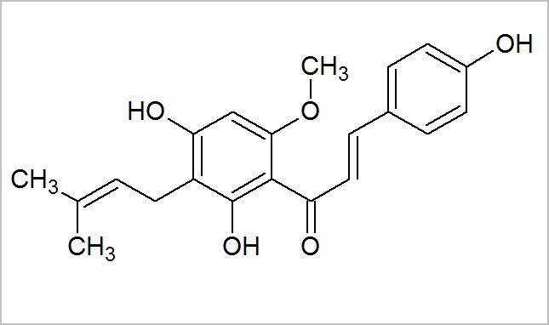
Xanthohumol
Humulus lupulus
Xanthohumol
http://www.kegworks.com/wp/wp-content/images/kwc/hops/hops.jpg
Some anticancer properties
Improved cognitive function

Slide 6
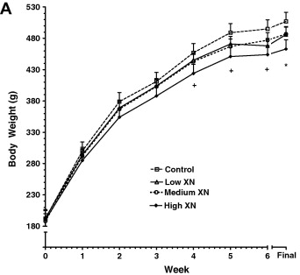
Reduction in weight gain
14% reduction in weight gain among male zucker rats
Improved fasting plasma glucose levels
Legette et al. Phytochemistry 2012 May 26.
http://www.iub.edu/~k536/images/etiology/fatrats.jpg

Slide 7
Xanthohumol in beer?
Small amounts in microbrews, but only trace amounts found in major brands
http://lygsbtd.files.wordpress.com/2011/08/beer_toast.jpg

Slide 8
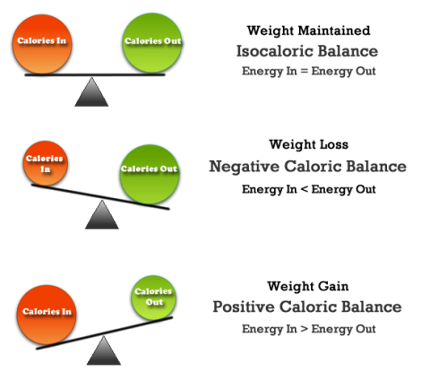
Mechanism of action
Obesity - An energy imbalance
Reduced weight gain = increased expenditure
Mitochondrial uncoupling/ protonophore activity?
https://steelcorefitness.files.wordpress.com/2014/05/balcalories2.png?w=470&h=432

Slide 9
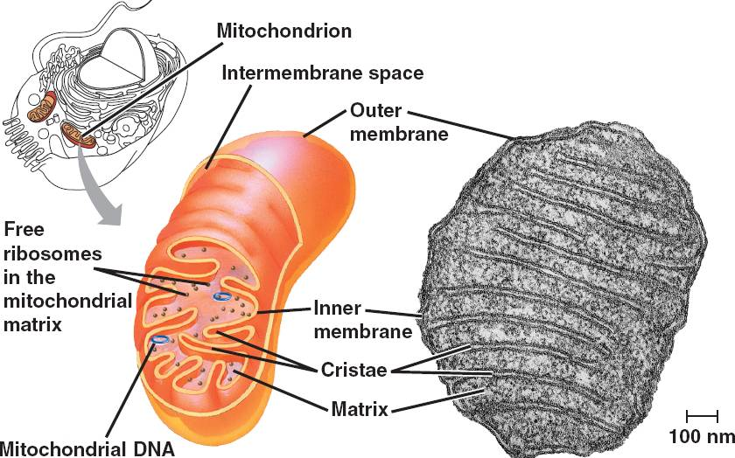
Mitochondrion
Mitochondrion
Major source of cellular energy
Present in nearly all cell types
Location of oxygen consumption
http://bio1151.nicerweb.com/Locked/media/ch06/06_17Mitochondrion_CL.jpg

Slide 10
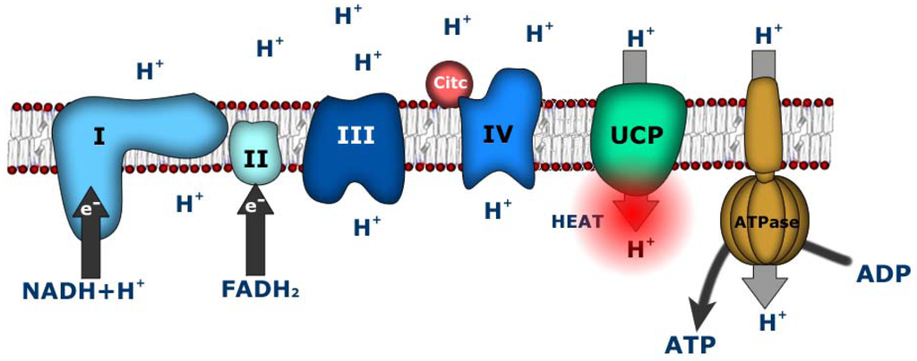
Mitochondrial Uncoupling
http://www.mdpi.com/cancers/cancers-02-00567/article_deploy/html/images/cancers-02-00567-g001-1024.png

Slide 11
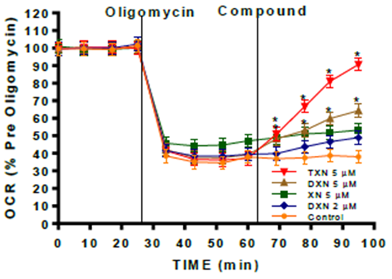
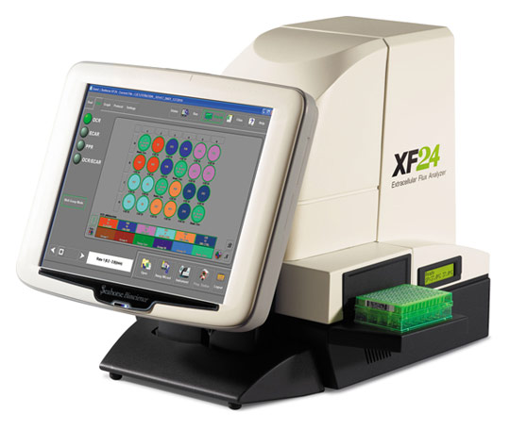
Seahorse Assay
Measurements
Oxygen consumption
Extracellular acidification
http://www.sanfordburnham.org/PublishingImages/sr_cancermetabolism/xf24.jpg

Slide 12
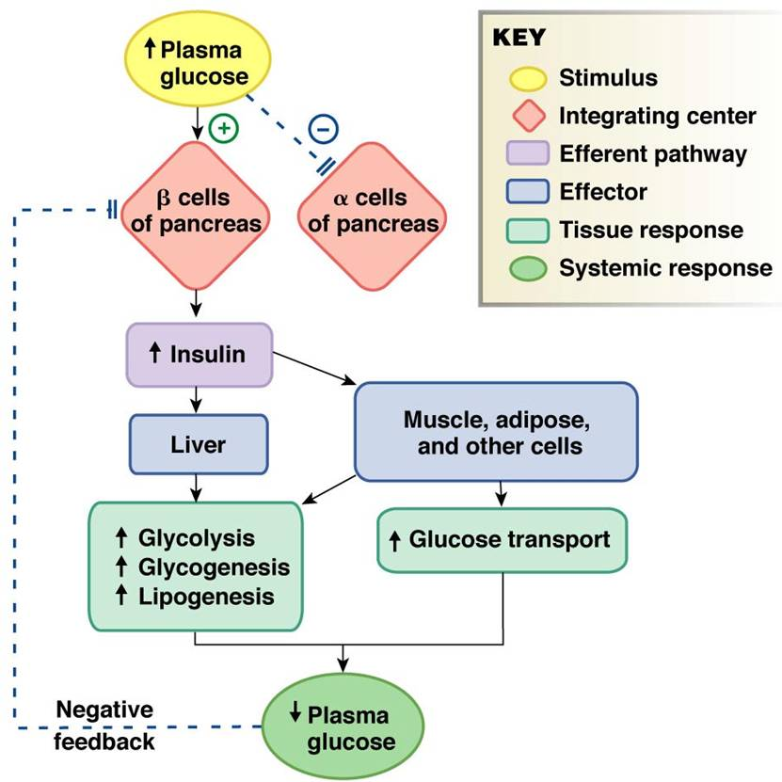
Glucose Metabolism
Glucose uptake by cells is mediated by insulin
Insulin sensitivity is decreased in type 2 diabetes, though mechanism is still poorly understood
http://www.austincc.edu/apreview/NursingPics/metabolismflowchart.jpg

Slide 13
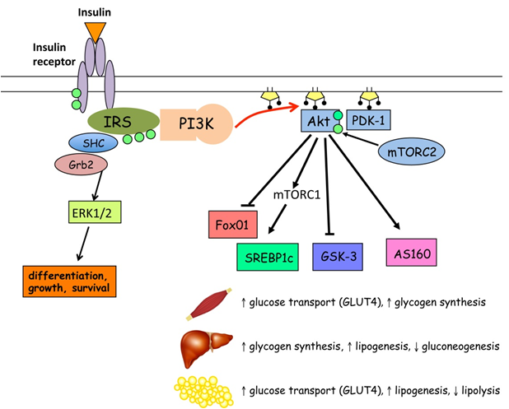
Insulin binding starts a signalling cascade, with a wide range of effects
High levels of free fatty acids are associated with poor insulin sensitivity
http://www.intechopen.com/source/html/45280/media/image1.jpeg

Slide 14
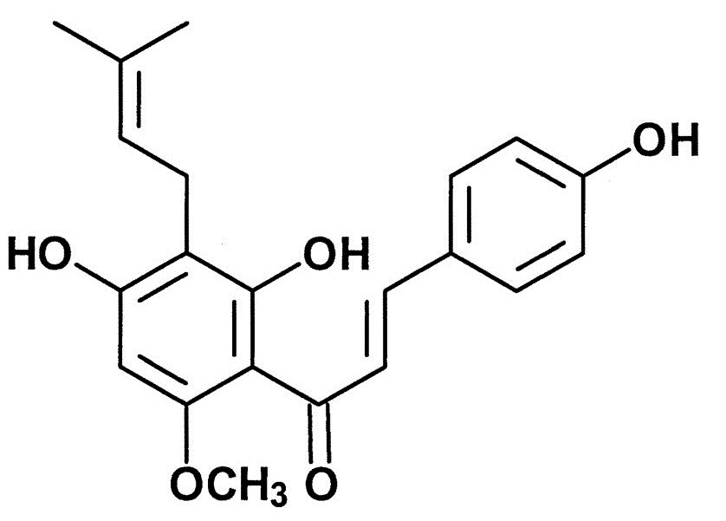
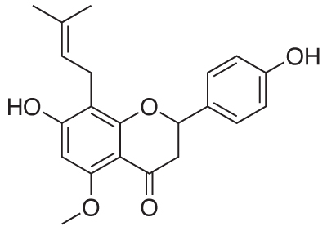
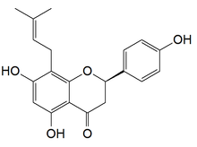
Xanthohumol limitations
Spontaneous
Xanthohumol
Isoxanthohumol
8-prenylnaringenin
8-prenylnaringenin
One of the most potent phytoestrogens known
Phytoestrogens carry both good and bad attributes - possible reduced disease risk, but can also disrupt endocrine function

Slide 15
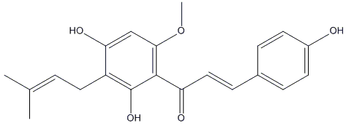
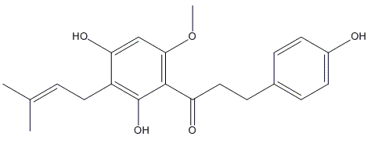
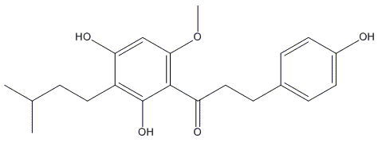
Dihydroxanthohumol and Tetrahydroxanthohumol
Dihydroxanthohumol (DXN)
Tetrahydroxanthohumol (TXN)

Slide 16
DXN and TXN advantage
Dihydroxanthohumol
Spontaneous
Isoxanthohumol
8-prenylnaringenin
Tetrahydroxanthohumol

Slide 17
Two questions
Is the greater increase in oxygen consumption caused by higher potency of DXN and TXN, or is compound getting into the cell?
Will the results of the cellular experiments correlate with in vivo experiments?

Slide 18
Hypotheses
Differences in oxygen consumption are due to differing cellular uptakes of the test compounds
DXN and TXN will induce weight loss and improve insulin sensitivity in mice on a high-fat diet more effectively than XN

Slide 19
Two experiments
Compare cellular uptake of XN, DXN and TXN in C2C12 mouse myoblasts
Compare the metabolic effects of XN, DXN and TXN to a vehicle control in mice

Slide 20
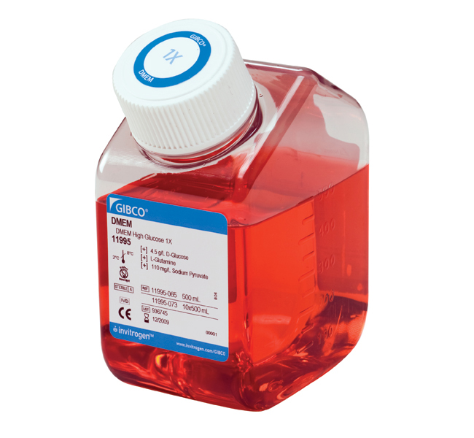
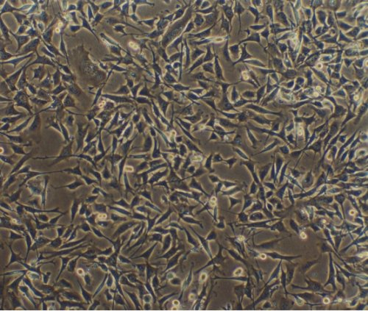
Materials and Methods
Cellular uptake of XN, DXN, and TXN
C2C12 mouse myoblasts
Growth Medium - Dulbecco’s modified eagle medium (DMEM), 10% fetal bovine serum (FBS), 1% Penicllin Streptomycin solution (PS)
https://tools.lifetechnologies.com/content/sfs/prodImages/high/11995073_650x600.jpg
http://images.iop.org/objects/ntw/news/2/8/12/180803.jpg

Slide 21
Cellular Uptake
Assay medium - 5 μM XN, DXN or TXN in DMEM, 1% FBS, 1% PS
5 replicates per compound
1 hour incubation
Collect cell medium and cell contents
Determine concentrations using liquid chromatography tandem mass spectrometry

Slide 22
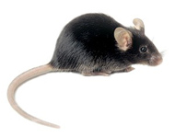
Mouse Feeding
Mouse feeding experiment - Male C57BL/6J for insulin resistance
Duration -12 weeks
High fat diet = 60% kcal - fat, 20% kcal - carbohydrates, 20% kcal - protein
Control
XN
DXN
TXN
n=12
High fat diet with 30 mg/kg XN
n=12
High fat diet with 30 mg/kg DXN
n=12
High fat diet with 30 mg/kg TXN
n=12
High fat diet only

Slide 23
Testing parameters
Food intake
Weight gain
Insulin tolerance (Glucose tolerance test)
Plasma glucose, cholesterol, insulin and triglyceride levels

Slide 24
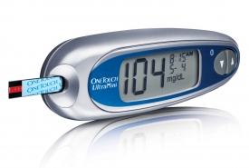
Glucose Tolerance Testing
Glucose tolerance testing
Performed at 4 weeks and 11 weeks, following 6 hour fast
Examine glucose levels at 5 time points
0 minutes (before injection), 15, 30, 60 and 120 minutes
Intraperitoneal injection of 2 g/kg body weight
Glucose testing performed using a OneTouchⓇ UltraⓇ Mini glucometer
Detection range: 20 mg/dL - 600 mg/dL
http://www.diabeteshealthysolutions.com/wp-content/uploads/2011/07/One-touch-glucose-meters.jpg

Slide 25
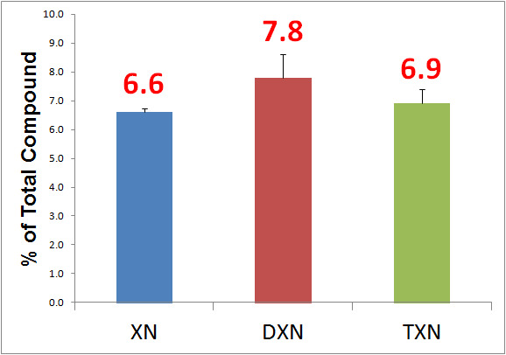
Results - Cellular Uptake

Slide 26
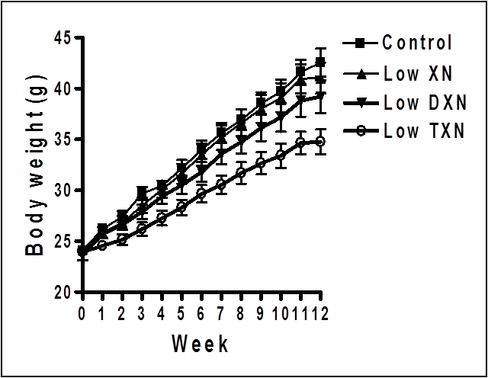
Weight Gain
Least weight gain among TXN treated mice
DXN reduced weight gain to a lesser extent

Slide 27
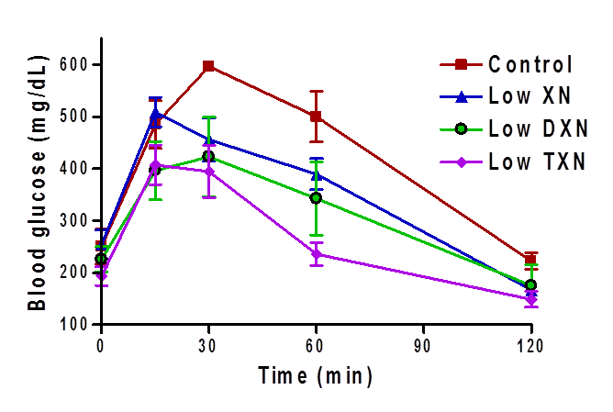
Glucose Tolerance Week 4
Slightly lower increases in the TXN and DXN groups, accompanied by faster recoveries
All treatment groups show higher sensitivity to insulin compared to control

Slide 28
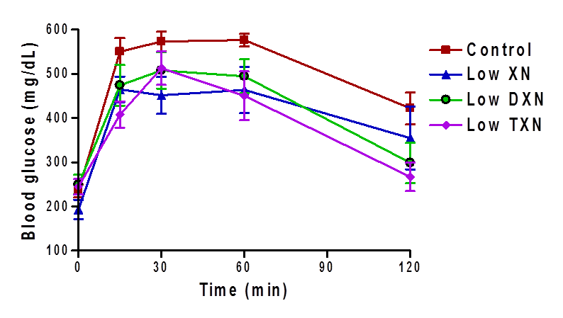
Glucose Tolerance Week 11
All groups showed higher insulin resistance compared to 4 week performance
Treatment groups showed improved, though still extended recovery times

Slide 29
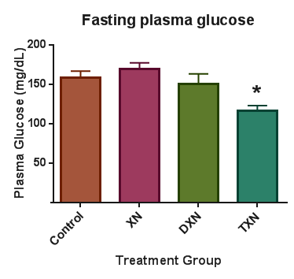
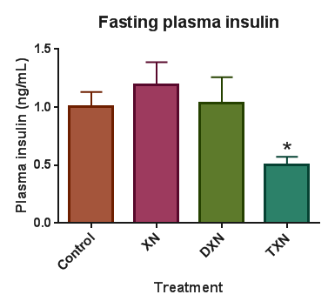
Plasma Glucose and Insulin

Slide 30
Discussion
Cellular Uptake
Small differences in uptake, but unlikely to be responsible for such dramatic differences in effect
Possible concerns of potency and safety with TXN, though no toxicity seen during mouse feeding experiment
Previous use of a mitochondrial uncoupler 2,4-dinitrophenol resulted in weight loss, but some fatalities

Slide 31
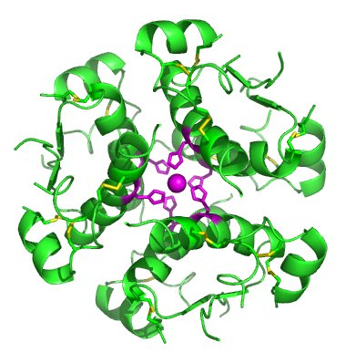
Insulin Sensitivity
Mouse feeding comparison
Higher insulin sensitivity among XN, DXN, and TXN groups compared to control
Prolonged high fat diet consumption deteriorated metabolic health of mice despite supplementation
http://upload.wikimedia.org/wikipedia/commons/0/0d/InsulinHexamer.jpg

Slide 32
Discussion
Study limitations
Feeding Study
Only one dose level tested
Food consumption was not uniform
Detection limit of glucometer may have skewed some results
http://www.slate.fr/sites/default/files/users/user9481/black-6.jpg

Slide 33
Conclusions
Mitochondrial uncoupling effect enhanced by lower polarity of DXN and TXN
XN, DXN and TXN can help reduce some conditions associated with metabolic disorder

Slide 34
Future Investigation
Investigate inflammatory markers in plasma to measure oxidative stress
Human pharmacokinetic investigation for DXN and TXN
Human consumption trials to compare metabolic and inflammatory effects of XN, DXN and TXN
Feeding experiment should be repeated using C57BL/6J female mice

Slide 35
Acknowledgements
Fred Stevens
Jaewoo Choi
Ralph Reed
Val Miranda
Lizzy Axton
Valerie Elias
Jeff Morre
Oriane De Montgolfier
Kate Field
Wanda Crannell

