Slide 1
Reducing Nonessential Cognitive Load to Improve Health-related Data-based Reasoning: Results from a Pilot Experiment
Sam Schimke – First Author
Kathryn Becker-Blease – Second Author
Thanks to Rose Nguyen and Christian Sinnott

Slide 2
Introduction and Purpose
Examine how people read and respond to scientific information
Use techniques to reduce cognitive load without reducing essential information
Apply techniques to create patient materials that help them better understand disease conditions (Cancer risk, diabetes, etc.)

Slide 3
Methods
Participants analyzed a graph containing information on Breast and Ovarian Cancer risk for patients carrying BRCA 1 and BRCA 2 mutations
Reduced cognitive load group: Received segmented, signaled information with audio recording alongside the graph. Received same information as text at the end
Non-reduced cognitive load group: Received only graph and additional paragraph of information
Understanding of graph analyzed by multiple choice quiz and free-response

Slide 4
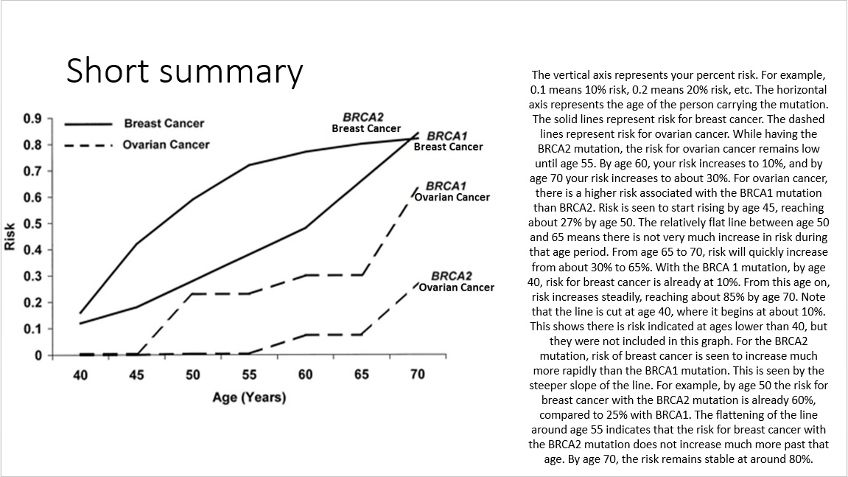

Slide 5
Results
No significant difference in answers correct between groups
Participants identified as pre-med scored slightly significantly higher (p<0.10)
No correlations seen with amount correct and high school GPA, self-reported math ability, or self-reported graph reading ability

Slide 6
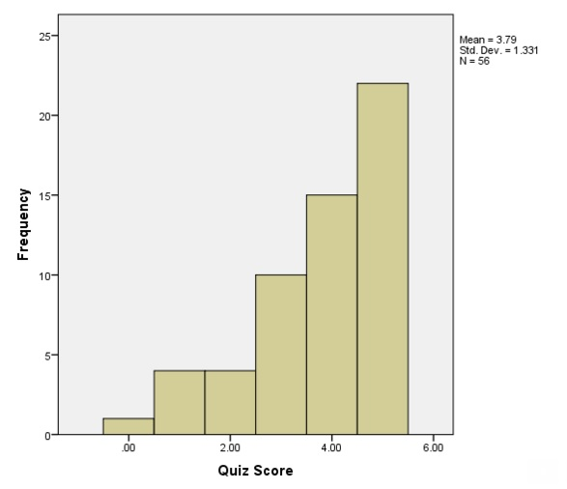
Distribution of Quiz Scores

Slide 7
Issues/Moving Forward
Quiz may have been too easy: may need to provide greater number of questions and make them more difficult
Both groups had the summary paragraph at the end alongside the graph while answering questions: so both groups may have only been using this one piece of information for answering questions

