Slide 1


Using Mass Spectrometry to Trace Polyphenols in Human Urine
Crystal V. Carrillo¹, Rachel Hahn^{1,2} , Jaewoo Choi², Gerd Bobe^{1,2}, and Jan F. Stevens Ph.D.^{2,3}
¹College of Agricultural Sciences, ²Linus Pauling Institute, ³College of Pharmacy,
Oregon State University

Slide 2
Outline
Background: DHQs, previous studies and why urine??
Materials and Methods: Taking two different approaches
Results: The truth is in the urine
Conclusion: Why mass spectrometry is better than DHQs

Slide 3
BACKGROUND
What you need to know about DHQs, Mass spectrometry, and previous studies have found
Notes:
So lets get stateted.

Slide 4



BACKGROUND
Diet History Questionnaires are currently used to get a rough estimate of nutritional intake.
But there are several limitations…
Photograph: Cine Text/Allstar/Sportsphoto Ltd
http://www.bbc.com/news/health-30834038
https://www.123rf.com/stock-photo/paper_stack.html
Notes:
Diet seems to a good indicator of a person’s health or lifestyle. Currently being used to get a rough estimate of what people lifestyles and nutrition intake. First many people believe that they will be judge based on their answer so they lie or are untruthful in the responses although they are told they wont be. The general length of questionnaires is 35 pages and 135 questions subjects usually lose interest long before completing the survey. Lastly people are told to recal what they have consumed in the last 3 weeks ot month before taking the survey. All of which leads to inaccurate measurement of their food intake.

Slide 5

What are polyphenols you ask…
Polyphenols are found in a variety of fruits, vegetables, cereals , beverages like teas and coffee
Molecularly diverse and play a important role in bioavailability and biological effects
http://www.mendocinocoastclinics.org/wellness_blog/how-to-add-more-fruit-and-vegetables-to-your-diet/
Notes:
Gut microbiota is the bacteria found in the stomach. The last 15 years have been spent on better understanding their occurrence, metabolism, bioactivites, bioavailability. Metabolites are the products of parent compounds due the microbiota in our guts.

Slide 6
Classification of Polyphenols
Polyphenols
Flavanoids
Anthocyanidins
Lignans
Stilbene
Phenolic acids
Naringenin
Cyanidin
Enterolactone
Resveratrol
Egallic acid
grapefruit
Red Raspberry
Strawberry
Peanut
Walnuts
Notes:
The 5 main classes of polyphenols are flavonoids, anthocyanidins, lignans, stilbene, and phenolic acid. Subclasses of each Favoninds plant pigments responsible for the red, purple, and blue colors in flower petals and veggies, and berries. Can be classes and subclasses based on carbon skeleton.

Slide 7
Flavonoids have been connected to anti-inflammatory, anti-glycemic, and cancer chemopreventive effects.
Notes:
Jan Fredrik Stevens co-authored a manuscript that discussed the gut microbiota influence on polyphenol bioavailability. Some glucuronides are turned back into aglycones(A-g-lie-cone) the reabsorped so are in the body for longer periods of time. Most metabolites go through hydrolysis. Metabolites of anthocyanidins and quercetin, protocatechin acid has shown to have anti-inflammatory, anti-glycemic and cancer chemopreventive effects.

Slide 8
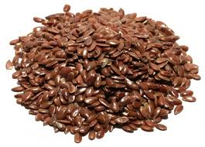
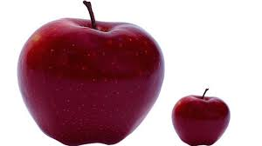
Previous Studies
There are many studies that show the positive effects of polyphenols in reducing chronic diseases.
Many do not represent accurate amounts consumed by subjects in their everyday lives.
https://www.youtube.com/watch?v=8nipm3eC74c
Provider:Kinaxis
Notes:
Delman. 2015. Flaxseed reduces mammary proliferation in breast cancer patients. Normalized several biomarkers in mammary gland tissues, suggested to impact risk for hormone-dependent cancers.
The studies do not accurately represtent the actual amount of polyphenol intake. Chronic diseases such as reduce cardiovascular disease, cancers, diabetes.Give example

Slide 9
Previous Studies
Secoisolariciresinol/Enterolactone-Metabolites Enterolactone and Enterodiol have altered estrogen signaling decreased mammary tumor (mice)
Naringenin-Reduced risk for Alzheimer’s disease.
Ellagintannin/Urolithins-Urolithins have shown antiestrogenic activities in breast cancer cells.
Dihydroxyphenyl-valeric acid sulfate-Anti-oxidant polyphenol.
Notes:
Revisit Devora Delman article. Naringenin. Urolthins-are metabolites of Ellagic acids and Ellagintannins. Urolithin A is a biomarker. Truchado writes urolithins inhibition of Wnt signaling pathway which is in a majority of colon cancers. Inhibit MM9-P expression in leukemia cells.

Slide 10
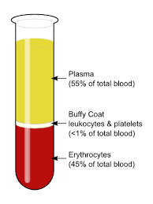
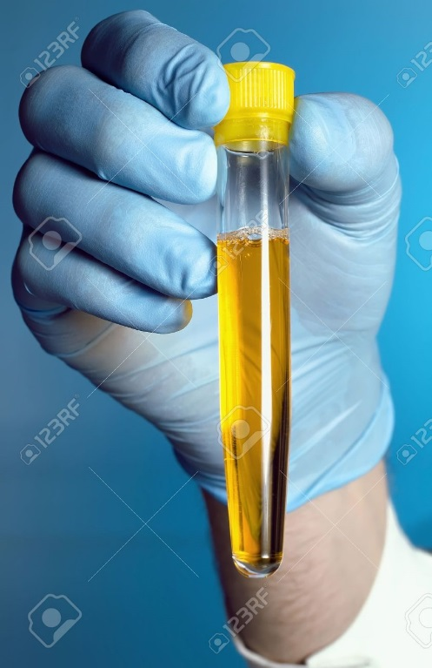
Why Human Urine?
Studies have used both plasma and urine
  Higher polyphenol concentrations when compared to plasma
  More direct sample processing before analysis (Zamora-Ros, 2014)
VS
en.wikipedia.org
www.123rf.com

Slide 11
OBJECTIVES
will show this by…
Validating the use of mass spectrometry in conjunction with online databases in comparison to DHQs
Creating Principal Component Analysis (PCA)
Notes:
Study aims to show that DHQs are too vague and show no way of proving which specific foods or polyphenols have been consumed. Mass spectrometry will show to be more impactful in focusing on specific compounds rather than using foods at all.

Slide 12
Hypothesis
There would be some type of correlation between DHQs and polyphenol concentrations.

Slide 13
Method and Materials
Taking two different approaches

Slide 14
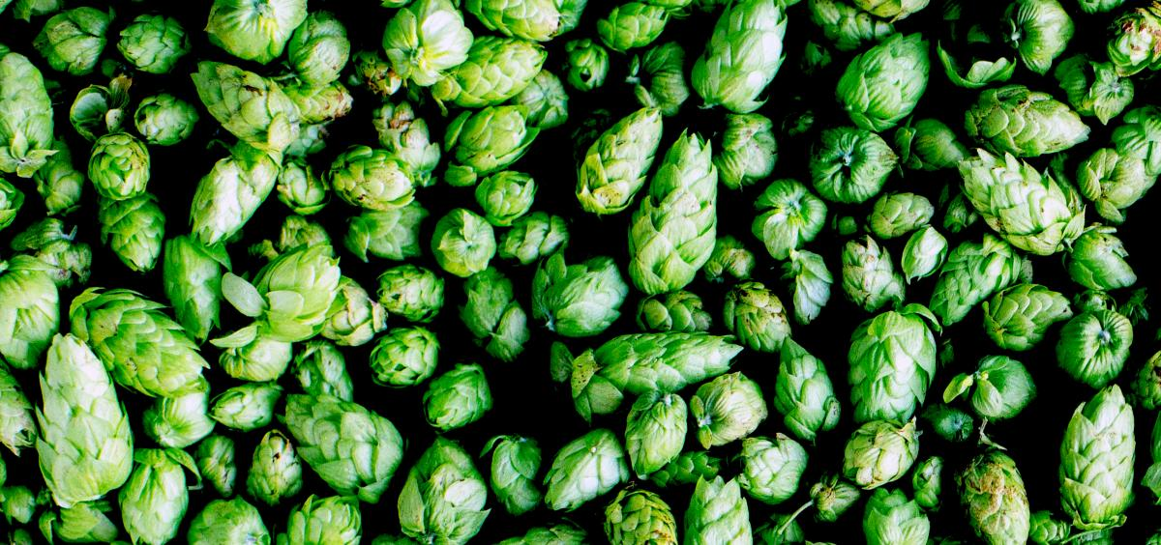
Urine was collected from a clinical study
Study looked into the effects in Xanthohumol and Prevention of Damaged DNA
Subjects had to restrain from eating flavonoids such as onions drinking
microbrews, black and green teas
Subjects could not smoke and or have a
too low LDL
There were 133 urine samples analyzed.
A few (13 subjects) didn’t complete the
study therefore don’t have a visit 5

Slide 15
Procedure Overview
A master list was created using METLIN and phenol-Explorer
DHQs data was manually logged using DHQ software
Principal Component Analysis (PCA)
Urine was analyzed using mass spectrometry
Dermot McBrierty,2016

Slide 16
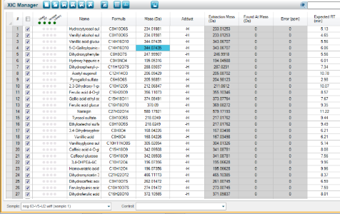
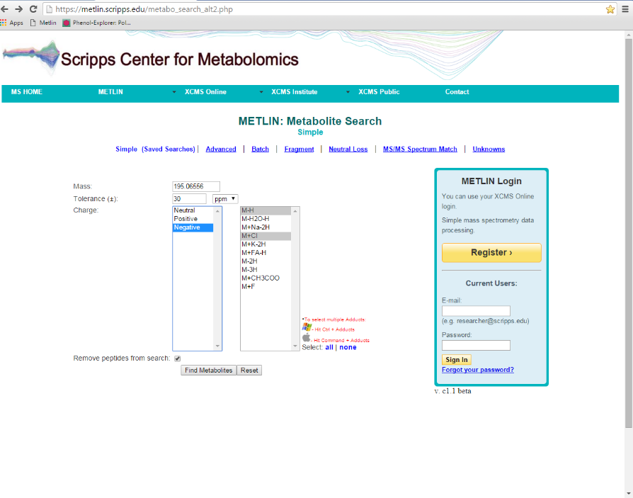
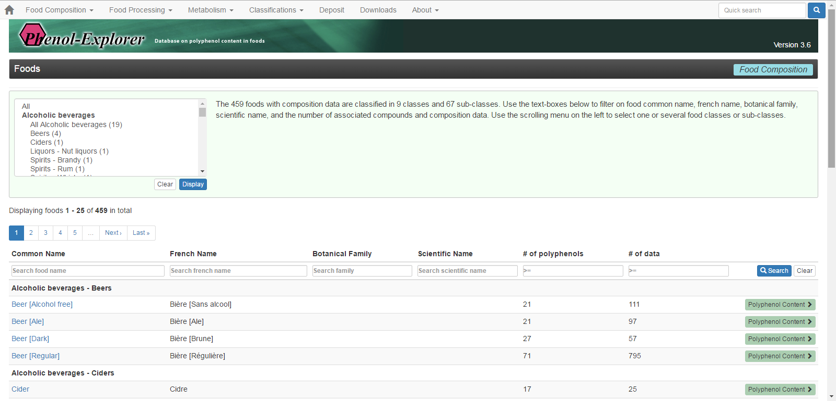
The Master list
A master list of polyphenols was created in PeakView using the Phenol-Explorer database.
Notes:
A master list of polyphenols was created using PeakView and Phenol-Explorer database. PEAKview is a software that will aid in finding the polyphenols at their designated molecular weight so that retention time can be found. Databases like Phenol-Explorer and METLIN will be two tools in order to measure the polyphenol intake accurately. Phenol-Explorer is a web database that stores 500 polyphenol food composition. Phenol explorer it is a polyphenol repository of polyphenol food composition data it contains the phenol name, class, subclass, molecular weight, chemical formula, and chemical structure. This database is able to show the composition of polyphenols in foods and beverages

Slide 17
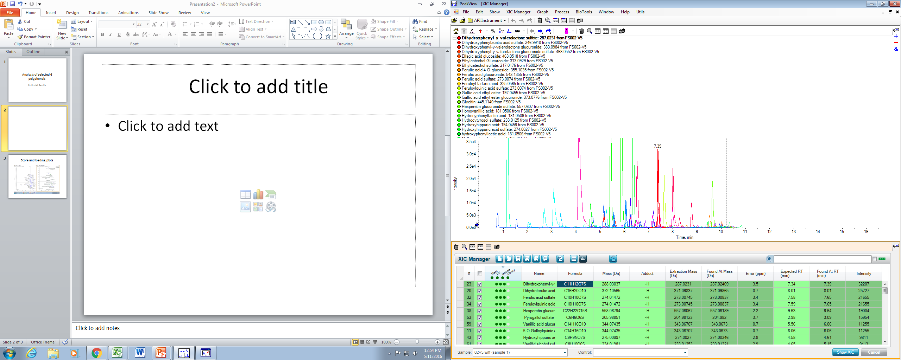
Mass spectrometric analysis of human urine: Biomarkers of food and nutrient intake to link dietary exposure to health effects
LC-QToF Extracted Ion Chromatogram
Time, min

Slide 18
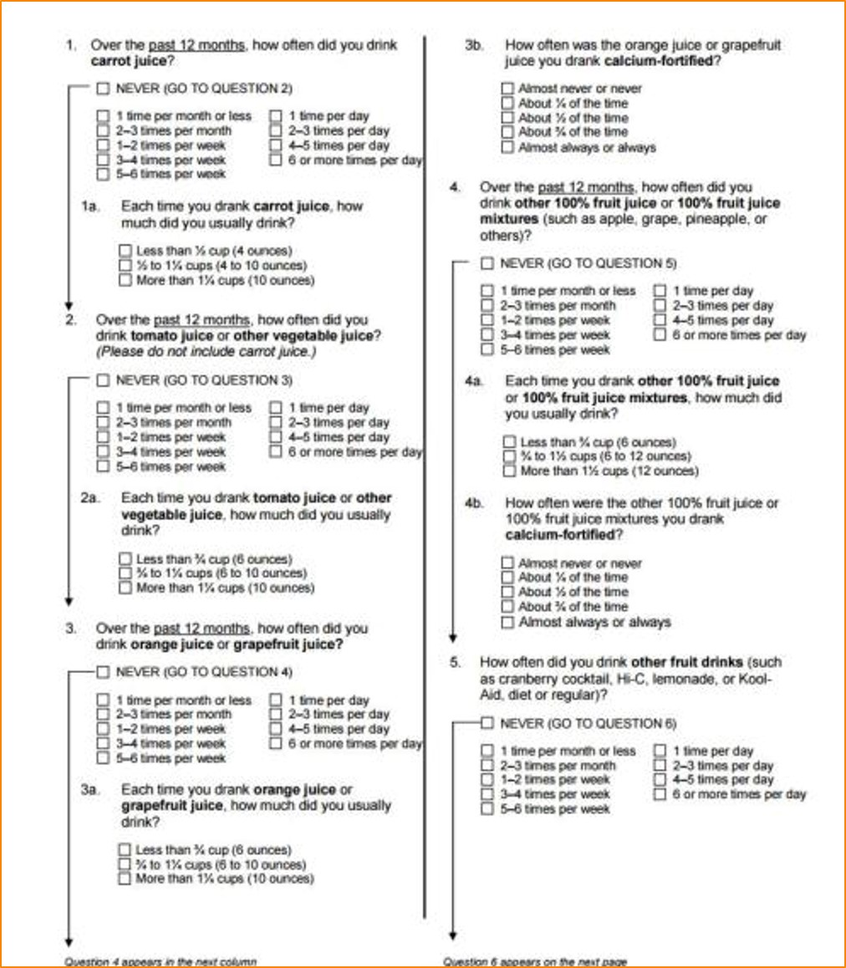
DHQs….
There were 133 Diet History Questionnaires
Each answer had to receive a
character( a,b,c,d,e,.,0,), 563 characters
were manually entered for each subject
Notes:
Each answer had to receive a character. There were 563 characters were manually entered. Then the txt file was uploaded using the NIH software that was downloaded. It would then created a file with the rough estimation of what people had consumed.

Slide 19
Raw data from DHQ

Slide 20
Urine preparation
50 µL of urine
250 µL of water/methanol
Aliquot 150 µL of supernatant
Mass spectrometry vial
Centrifuged vials vortexed and
then centrifuged
Urine was kept at -80º C
Notes:
The urine is diluted because it’s a technique called normalization to improve information recovery from high resolution mass spectrometry metabolomic profiles for human urine. From William M. B. Admands . Blanks were methanol.

Slide 21
The Idea with using PCA
PCA determines linear combination of the original variables that explain the variance in the date.
PCA is equivalent to rotating the axes so the one-PCA1- lies long the line of maximum variance.
Loading plot-indicates the direction of the new axes
Score plot-each sample(subject) can be given a value on the new axis which is called the score.

Slide 22
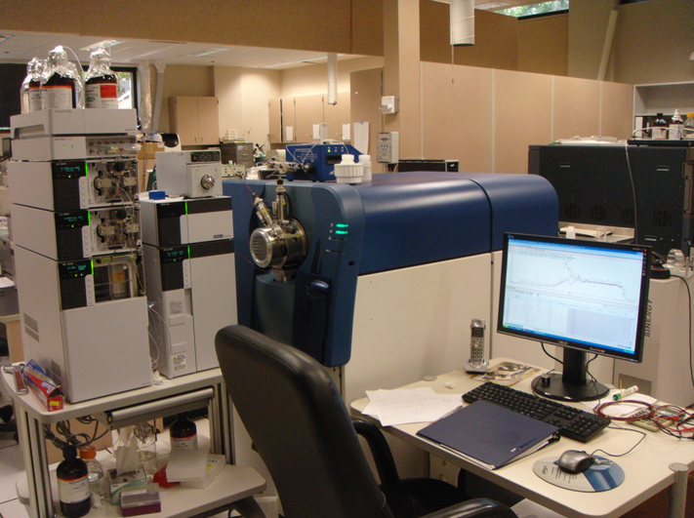
Instrumentation
Combines high-sensitivity detection, high resolution with the fast acquisition speeds, and stable mass accuracy.
AB Sciex 5600 TripleTOF coupled to Shimadzu Nexera UHPLC
Notes:
MS coupled with a UHPLC has beceom the most widely used technique for acquisition of metabolomics data. It allows the simultaneous detection of thousands of low molecular weight metabolites with a high degree of sensitivity resolution, reproducibility and a broad dynamic range.

Slide 23
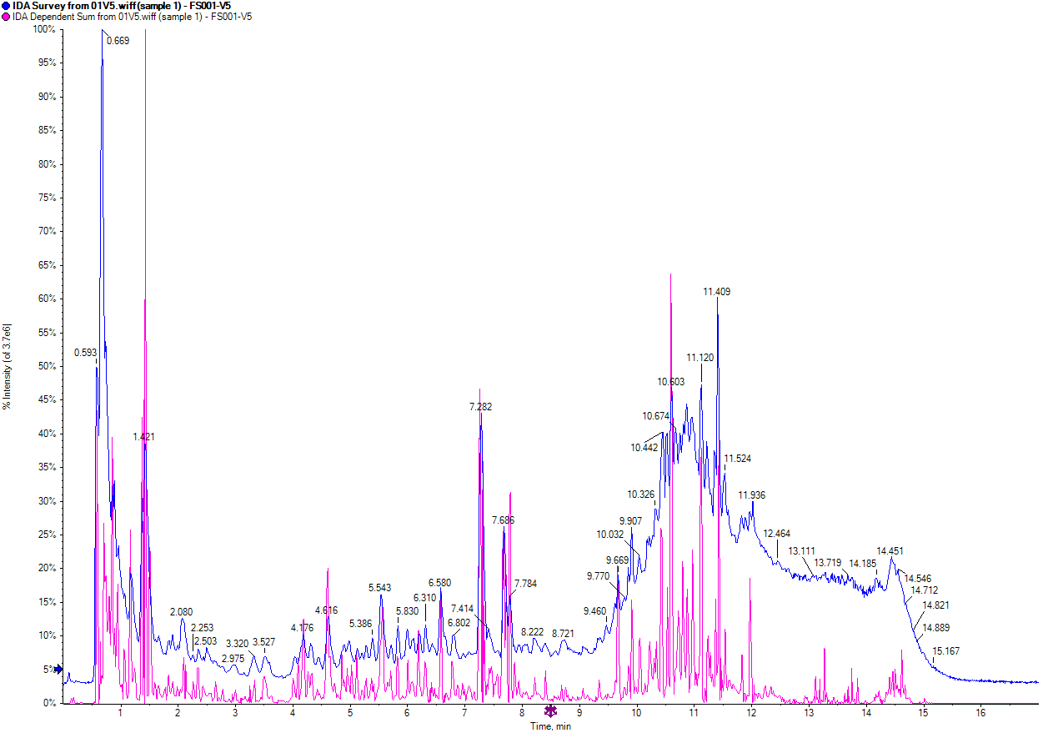
Raw data from urine samples

Slide 24
Putting it all Together: Method 1
Master Polyphenol list was created using Phenol-explorer and METLIN, made in PeakView
Collected human urine, used from an on-going clinical study. 133 Urine samples metabolome analysis (LC-MS)
133 Diet History Questionnaires from subjects (two visits)
Algorithm was created to compare the amount of food item consumed and polyphenols

Slide 25
Method 2
Specific foods (questions) relating to polyphenol were found in DHQs.
Collected human urine, used from an on-going clinical study. 133 Urine samples metabolome analysis (LC-MS)
PCA was created for the 32 of the 65 polyphenols that were identified using MarkerView
Master Polyphenol list was created using Phenol-explorer and METLIN, made in PeakView
Notes:
https://www.youtube.com/watch?v=UUxIXU_Ob6E

Slide 26
Results
The truth is in the urine
Notes:
All data was independent to were able to run parametric tests.

Slide 27
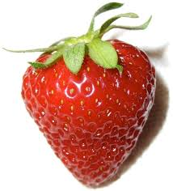
Method 1
Master Polyphenol list was created using Phenol-explorer and METLIN, made in PeakView
Collected human urine, used from an on-going clinical study. 133 Urine samples metabolome analysis (LC-MS)
133 Diet History Questionnaires from subjects (two visits)
https://en.wikipedia.org/wiki/Strawberry
Secoisolariciresinol found in strawberries showed the greatest correlation coefficient value.
The P-values was <0.05
Algorithm was created to compare the amount of food item consumed and polyphenols

Slide 28
Metabolism of the Lignan, SECO
H3CO
Enterodiol
OCH3
Secoisolariciresinol
Enterolactone

Slide 29
Enterolactone
(metabolite of SECO)
Enterolactone is a metabolite of secoisolariciresinol
Correlation coefficient 0.4 with a P-value < 0.05

Slide 30
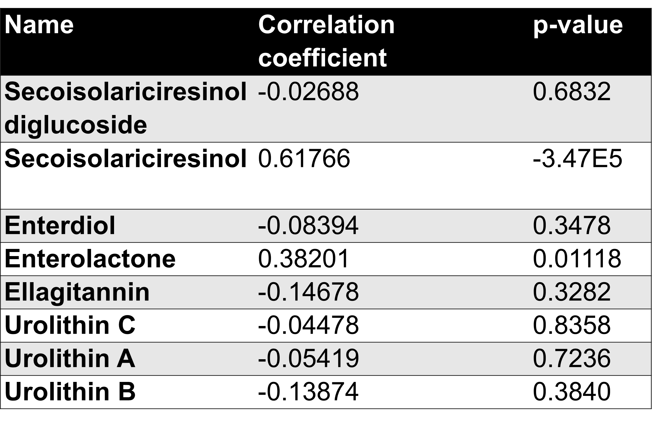
looked into the mechanism of both enterolignan glucuronides and ellagitannins
Notes:
Eelagi-tan-nins

Slide 31
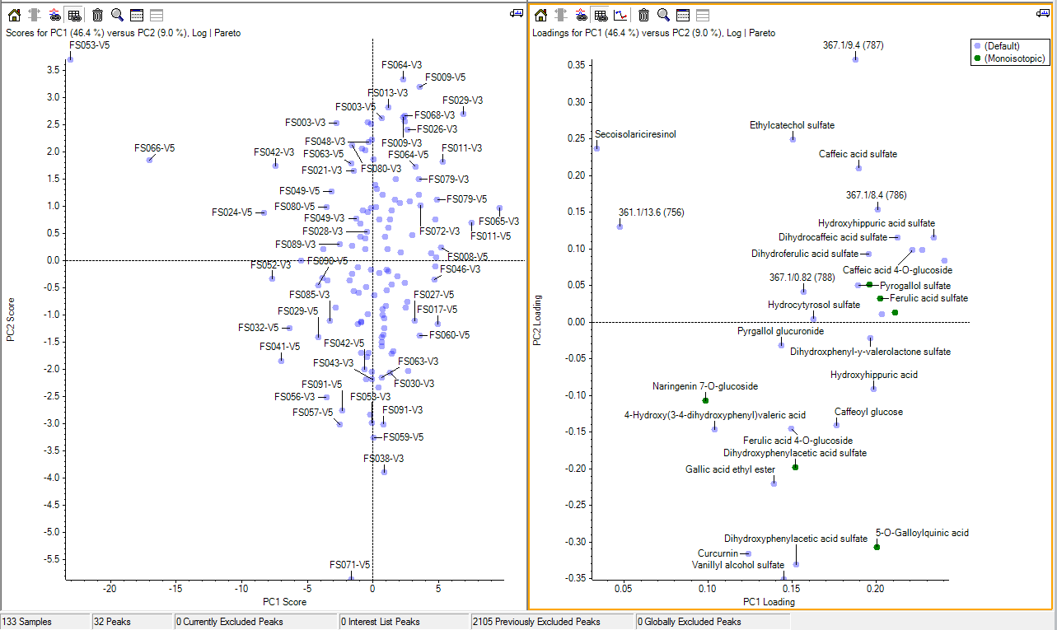
Principal Component Analysis (PCA)
Method 2
SCORE PLOT
LOADING PLOT
Specific foods (questions) relating to polyphenol were found in DHQs.
Collected human urine, used from an on-going clinical study. 133 Urine samples metabolome analysis (LC-MS)
PCA was created for the 32 polyphenols that were identified using MarkerView
Master Polyphenol list was created using Phenol-explorer and METLIN, made in PeakView

Slide 32
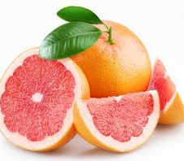
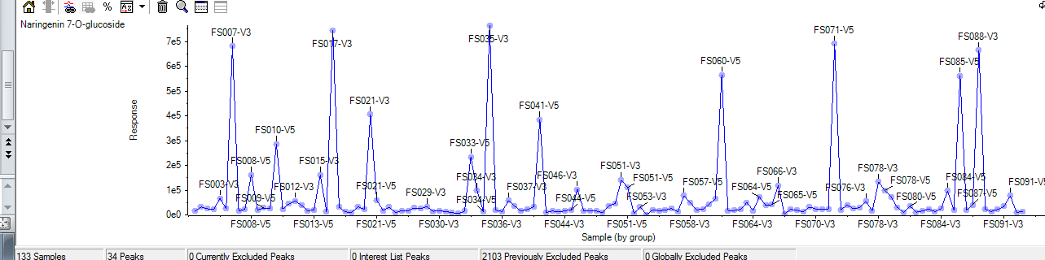
Naringenin 7-O-glucuronide
FS035_V3
FS071_V5
FS017_V3
http://www.medicalnewstoday.com/articles/280882.php
Naringenin 7-O-glucuronide can be found in grapefruit, tomato, and almonds

Slide 33
Grapefruit
FS017_V3
FS035_V3
FS071_V5
Area of Naringenin
Quantity of Grapefruit(citrus fruit) consumed

Slide 34
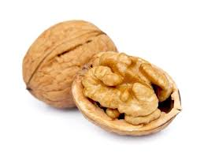
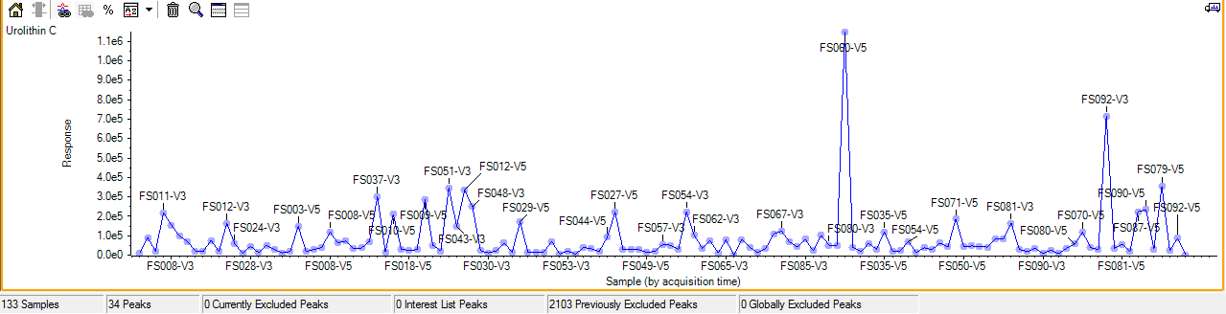
Urolithin C and Walnuts
FS060_V5
FS092_V3
Distinct peaks show which subjects had high amounts of Urolithin C in their urine

Slide 35
Walnuts
FS060_V5
Area of Urolithin C
FS092_V3
Quantity of walnuts(nuts) consumed

Slide 36
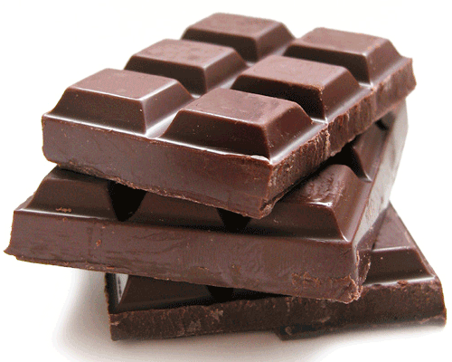
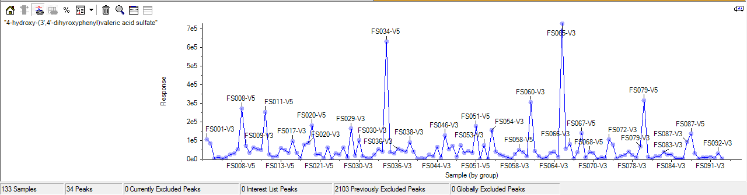
4-hydroxy-(3',4'-dihydroxyphenyl) valeric acid sulfate
FS034_V5
FS065_V3
FS079_V5
The distinctive peaks vary from subject to subject.

Slide 37
Chocolate
FS065_V3
FS034_V5
Area of valeric acid
FS079_V5
Quantity of chocolate consumed
Notes:
The somewhat disappointing graphs can largely be attributed to the overestimated value of the DHQs, which is, after all, an important finding.

Slide 38
Conclusion
Why mass spectrometry is better than DHQs

Slide 39
Broad DHQ prove to be un-useful
The lack of linear lines was largely due to the broad categories within the Diet History Questionnaire that grouped.
The groups should be based on the compounds found within the fruits and vegetables not the broad fruit and vegetable groups.
Notes:
The lack of linear lines which we were expecting to see was largely due to the broad categories within the Diet History Questionnaire that grouped.
It important to note the advantages of using Mass spectrometry along with databases such as Phenol-Explorer and METLIN to better asses the benefits of incorporating certain polyphenols to prevent chronic diseases.

Slide 40
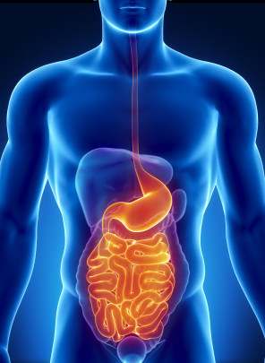
Holosymbiont
The most important uncontrolled factor is the different microbiota types or holosymbiont between human subjects.
http://www.kotsanisinstitute.com/services/digestive-disorders
Notes:
Holosymbiont is the host and the microbial species and taxa within the host. in subject that may have converted parent compound into another metabolite. People have different P450s depending on their enthnicity.

Slide 41
Limitations
  Not knowing when the food of interest was consumed which may yield a higher or lower intensity in the phenol depending on time of urine sample taken. (Lampe. 2003) and in this study we need to consider that urine was taken 24 hours leading up to visit.
  Which specific food may have lead to the shown intensities because multiple foods can accumulate for a single phenol
  Holosymbionts in subject that may have converted parent compound into another metabolite. People have different types of microbiota.

Slide 42
Future work
Next step would be to either create a more useful DHQ and eventually move away from DHQ entirely.
Allow subjects to keep a log of what they consumed 24 hours of urine sample then allow for urine to be collected 24-28 hours later.

Slide 43
The Bigger Picture
Less prone to
get breast cancer
Have very low
Oxidative DNA

Slide 44
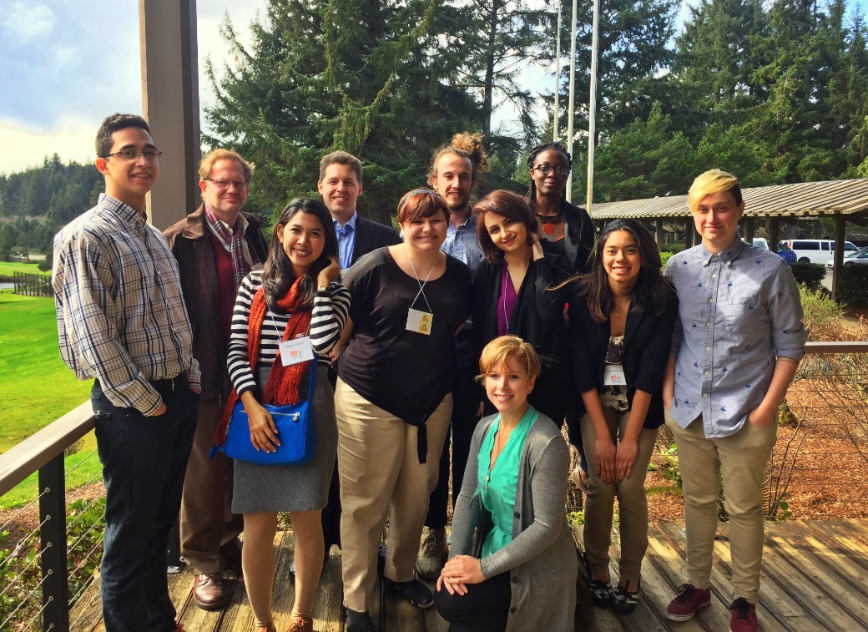
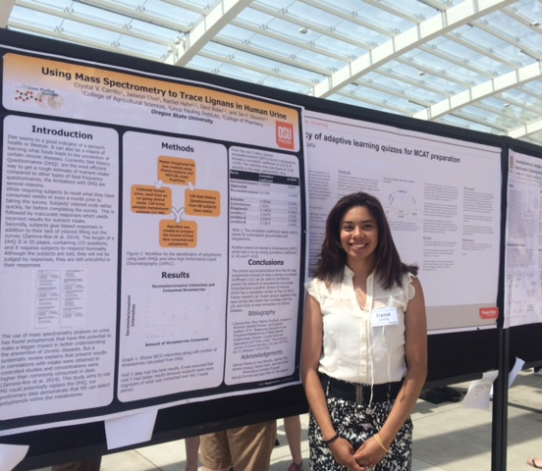
ACKNOWLEDGEMENTS
Stevens Lab:
Miranda, Cristobal L, Ralph L Reed, Lizzy Axton, Eleonso Cristobal, Josh Hay, Parnian Lak, Taylor Hughes, Jacki Toftner, Dena Crawford, Ines,
Sandra Uesegui
BRR Multicultural Scholars Program at Oregon State University Scholarship for its support.
Wanda Crannell and Kate Field for their guidance and advising.
Stevens Lab
Celebrating Undergraduate Excellence
Poster session

Slide 45
Works Cited
Zamora-Ros, Raul, Marina Touillaud, Joseph A. Rothwell, Isabelle Romieu, and Augustin Scalbert. 2014. “Measuring Exposure to the Polyphenol Metabolome in Observational Epidemiologic Studies: Current Tools and Applications and Their Limits.” The American Journal of Clinical Nutrition, July, ajcn.077743. doi:10.3945/ajcn.113.077743
Delman DM, Fabion CJ, Kimler BF, Yeh H, petroff BK.2015. “Effects of Flaxseed Lignan Secoisolariciresinol Diglucosideon Preneoplastic Biomarkers of Cancer Progression in a Model of Simultaneous Breast and Ovarian Cancer Development.” Nutrition and Cancer Journal 67(5):857-864.
Edmands, William M. B., Pietro Ferrari, and Augustin Scalbert. 2014. “Normalization to Specific Gravity Prior to Analysis Improves Information Recovery from High Resolution Mass Spectrometry Metabolomic Profiles of Human Urine.” Analytical Chemistry 86 (21): 10925–31. doi:10.1021/ac503190m.
Manach, Claudine, Augustin Scalbert, Christine Morand, Christian Rémésy, and Liliana Jiménez. 2004. “Polyphenols: Food Sources and Bioavailability.” The American Journal of Clinical Nutrition 79 (5): 727–47.
Manach, Claudine, Gary Williamson, Christine Morand, Augustin Scalbert, and Christian Rémésy. 2005. “Bioavailability and Bioefficacy of Polyphenols in Humans. I. Review of 97 Bioavailability Studies.” The American Journal of Clinical Nutrition 81 (1): 230S – 242S.
Mazur, W. M., M. Uehara, K. Wähälä, and H. Adlercreutz. 2000. “Phyto-Oestrogen Content of Berries, and Plasma Concentrationsand Urinary Excretion of Enterolactone after Asingle Strawberry-Meal in Human Subjects.” British Journal of Nutrition 83 (04): 381–87. doi:10.1017/S0007114500000489.
Pérez-Jiménez, J., V. Neveu, F. Vos, and A. Scalbert. 2010. “Identification of the 100 Richest Dietary Sources of Polyphenols: An Application of the Phenol-Explorer Database.” European Journal of Clinical Nutrition 64 (S3): S112–20. doi:10.1038/ejcn.2010.221.
Subar, A. F., F. E. Thompson, V. Kipnis, D. Midthune, P. Hurwitz, S. McNutt, A. McIntosh, and S. Rosenfeld. 2001. “Comparative Validation of the Block, Willett, and National Cancer Institute Food Frequency Questionnaires : The Eating at America’s Table Study.” American Journal of Epidemiology 154 (12): 1089–99.

Slide 46
On a side note

