Slide 1
Genetic diversity of benthic marine cyanophage as revealed by sequence analysis of various phage marker genes
Alec Vallota-Eastman¹, Kerry McPhail², Rebecca Vega-Thurber³
Bioresource Research¹, College of Pharmacy², Department of Microbiology³, Oregon State University, Corvallis, Oregon, 97331
Notes:
First I’d like to talk about the importance of drug discovery

Slide 2
The Antibiotic Apocalypse: a ‘post-antibiotic era'
“The rise in drug resistant infections is comparable to the threat of global warming, according to the chief medical officer for England.”
Gallagher, J. (2013, January 24). Antibiotic 'apocalypse' warning. In BBC News. Retrieved from http://www.bbc.com/news/health-21178718
Notes:
Without new drugs, we would be doomed
Bacteria evolves at a rapid rate and new strains are constantly developing resistance to existing antibiotics
Several medical proffessionals and scientists have warned that if we are not able to discover new drugs at a fast rate, we could face an antibiotic apocalypse that would result from bacteria becoming immune to all medications we currently have in use
The chief medical officer for england went as far as to compare the threat of resistance to global warming.

Slide 3
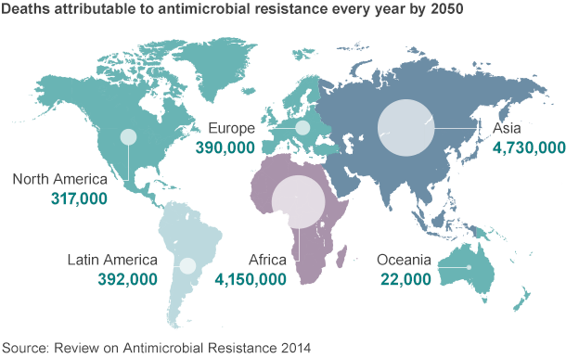
Antimicrobial Resistance
Projections of deaths from drug-resistant infections by 2050. Adapted from “Antibiotic resistance: World on cusp of 'post-antibiotic era’”
by James Gallagher, 2015, retrieved from http://www.bbc.com/news/health-34857015
Notes:
One study found antimicrobial resistance was responsible for more than 700,000 deaths worldwide in 2014 alone and could kill more than 10 million people each year by 2050.
Now as long as we keep discovering new drugs resistance isn’t a problem but unfortunately

Slide 4
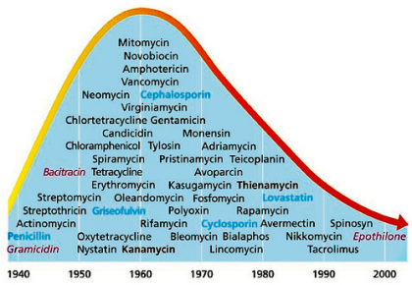
The Drug Deficit
Discovery Curve Decay. Adapted from “Applying Royal Society of Chemistry Cheminformatics Skills to Support the PharmaSea Project” by Anthony Williams, 2014, retrieved from
https://www.slideshare.net/karapetk/applying-royal-society-of-chemistry-cheminformatics-skills-to-support-the-pharmasea-project-41591040.
Notes:
As long as new drugs keep coming, resistance is not a problem.
But there has not been a new class of antibiotics discovered since the 1980s.
And the discovery of new drugs has been rapidly declining since as early as the 1960s
This is largely because for a long time, we’ve only been able to mine terrestrial environments for new drugs so we’ve isolated everything that’s easy to get

Slide 5
Earth’s Final Frontier
Greatest Source of Biodiversity
Inhabited by 34/35 known bacteria phyla
15/34 bacteria phyla exclusively
Marine Natural Products - greater chemical novelty
71% of all known molecular structures
More bioactive (1% vs 0.1%)
Research Area: Ocean Science and Engineering. Adapted from “MIT MechE”, 2017, retrieved from
http://meche.mit.edu/research/ocean
Notes:
Fortunately there is hope,
The advent of SCUBA has given us access to earth’s final fronteir, the ocean
The ocean is the earth’s greatest source of biodiversity
Once comparitive study compared the molecular structures of NPs found in the marine and terrestrial NP dictionaries
A separate study, conducted by the National Cancer Institute, screened marine and terrestrial samples for anticancer props.

Slide 6
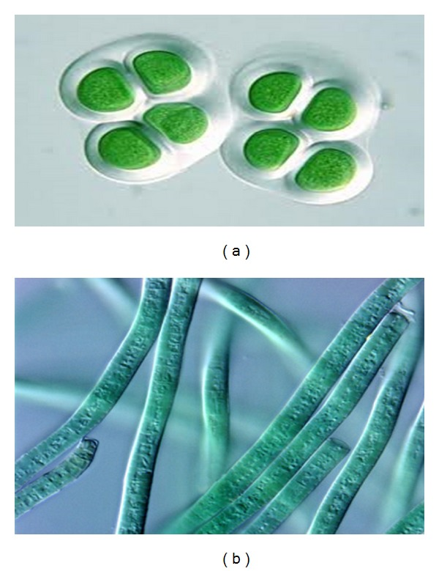
Marine Cyanobacteria
Gram-negative, photosynthetic prokaryotes
Unicellular or Multicellular (Filamentous)
Largely diverse
Produce a huge variety of unique chemicals
Anticancers
Antibacterials
Antivirals
Protease inhibitors
Chroococcus sp.
Phormidium sp.
Notes:
With so much diversity who do we focus on?

Slide 7
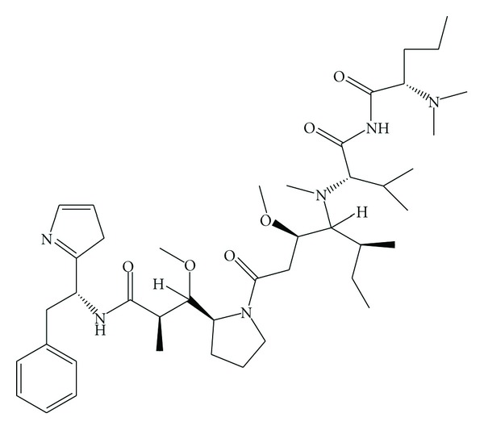
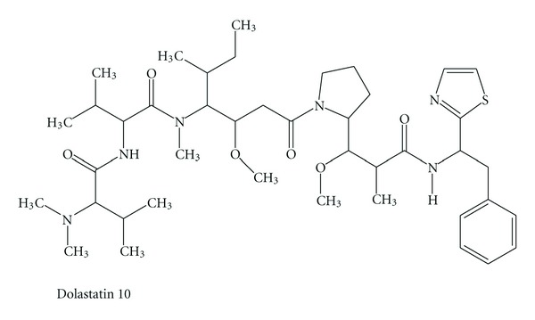
Marine Cyanobacteria
dolastatin 10
symplostatin 3
Uzair, B., Tabassum, S., Rasheed, M., & Rehman, S. F. (2012). Exploring Marine Cyanobacteria for Lead Compounds of Pharmaceutical Importance. The Scientific World Journal, 2012, 179782. http://doi.org/10.1100/2012/179782
Notes:
An increasing number of marine cyanobacterial compounds are found that target tubulin or actin filaments in eukaryotic cells,
Cyanos – an attractive source anticancer agents
Two such compounds are shown here symplostatin3 is currenlty under preclinical testing as an anticancer drug
Dolastatin 10 is currently in phase 1 clinical trials
Dolastatin 15 – a third generation analoug is currently in phase II (solid tumor testing)

Slide 8
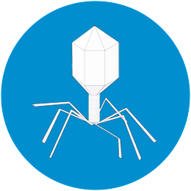
Bacteriophage
Viruses that infect bacteria
Dark matter of the ocean
10⁷ viruses per mL of ocean water
10x more abundant than the amount of bacteria per mL
Play many roles
Infection
Carbon/nutrient release
Population regulation
Protection
Transfer of unique genes through Horizontal Gene Transfer
Bacteriophage. Adapted from “BRIMMEDICAL”, retrieved from
http://www.brimmedical.com/home.html
Notes:
So now that we’ve talked about why cyanobacteria are amazing let’s talk about why we’re interested in phage
Bacteriophage are viruses that infect bacteria.
Cyanophage are viruses that infect cyanobacteria
And the reason we’re so interested in them is mostly because they are absolutely everywhere

Slide 9
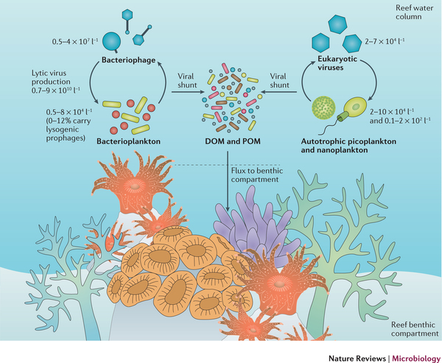
Who’s There?
Viruses in the water column of tropical reefs. Adapted from “Virus–host interactions and their roles in coral reef health and disease” by Dr. Rebecca Vega-Thurber et. al, 2017, retrieved from http://www.nature.com.ezproxy.proxy.library.oregonstate.edu/nrmicro/journal/v15/n4/full/nrmicro.2016.176.html
Notes:
How do we study them?
Marine environments are incredibly complex and there are many types of organisms constantly interacting with each other
As community microbiologists, we are mostly interested in postulating interactions within communities by first asking the question: who’s there?
We used to have to answer this question by getting a physical culture of members in the sample and looking at it in a microscope – painful
Fortunately the absolutely mind-blowing era of genomics has given us two other ways of doing this.
We don’t have to look at the whole organism anymore – we can just look at everyone’s DNA.

Slide 10
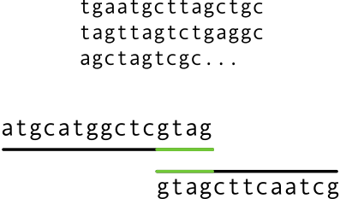
Who’s There? - Metagenomics
Fragmentation
Sequencing
Assembly
Binning
DNA
Bunch of letters
Notes:
Fortunately the absolutely mind-blowing era of genomics has given us two other ways of doing this.
We don’t have to look at the whole organism anymore – we can just look at everyone’s DNA.
One way is through a metagenomic analysis
This method tries to answer the question by looking at the collection of entire genomes of all organisms in the sample.

Slide 11
Who’s There? – Amplicon Analysis
e.g. 16S in Bacteria
Sequencing &
Analysis
Gene Selection
Amplification
Notes:
This way is very data intensive – genomes can be really big. Computationally, economically. Get things we might not be intersted in knowing about.
Second method: Amplicon Analysis.
Targetted to the specific type(s) of organisms you’re interested in
One example is 16S
This is the method we want to use since we’re only interested in looking at phage

Slide 12
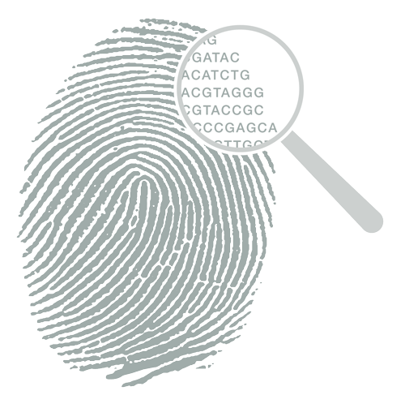
Detecting Phage
No 16S rRNA!
Notes:
reason 16S works is all bacteria have the gene no matter what. All eukaryotes have an 18S srRNA
Phage do not
No universally conserved genes for phage
Unlike ribosomal RNA (rRNA) genes found in cellular organisms viruses lack of universally conserved genes that can serve as molecular markers for classification and diversity in environmental samples.

Slide 13
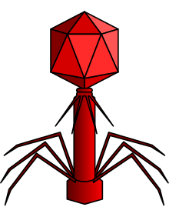
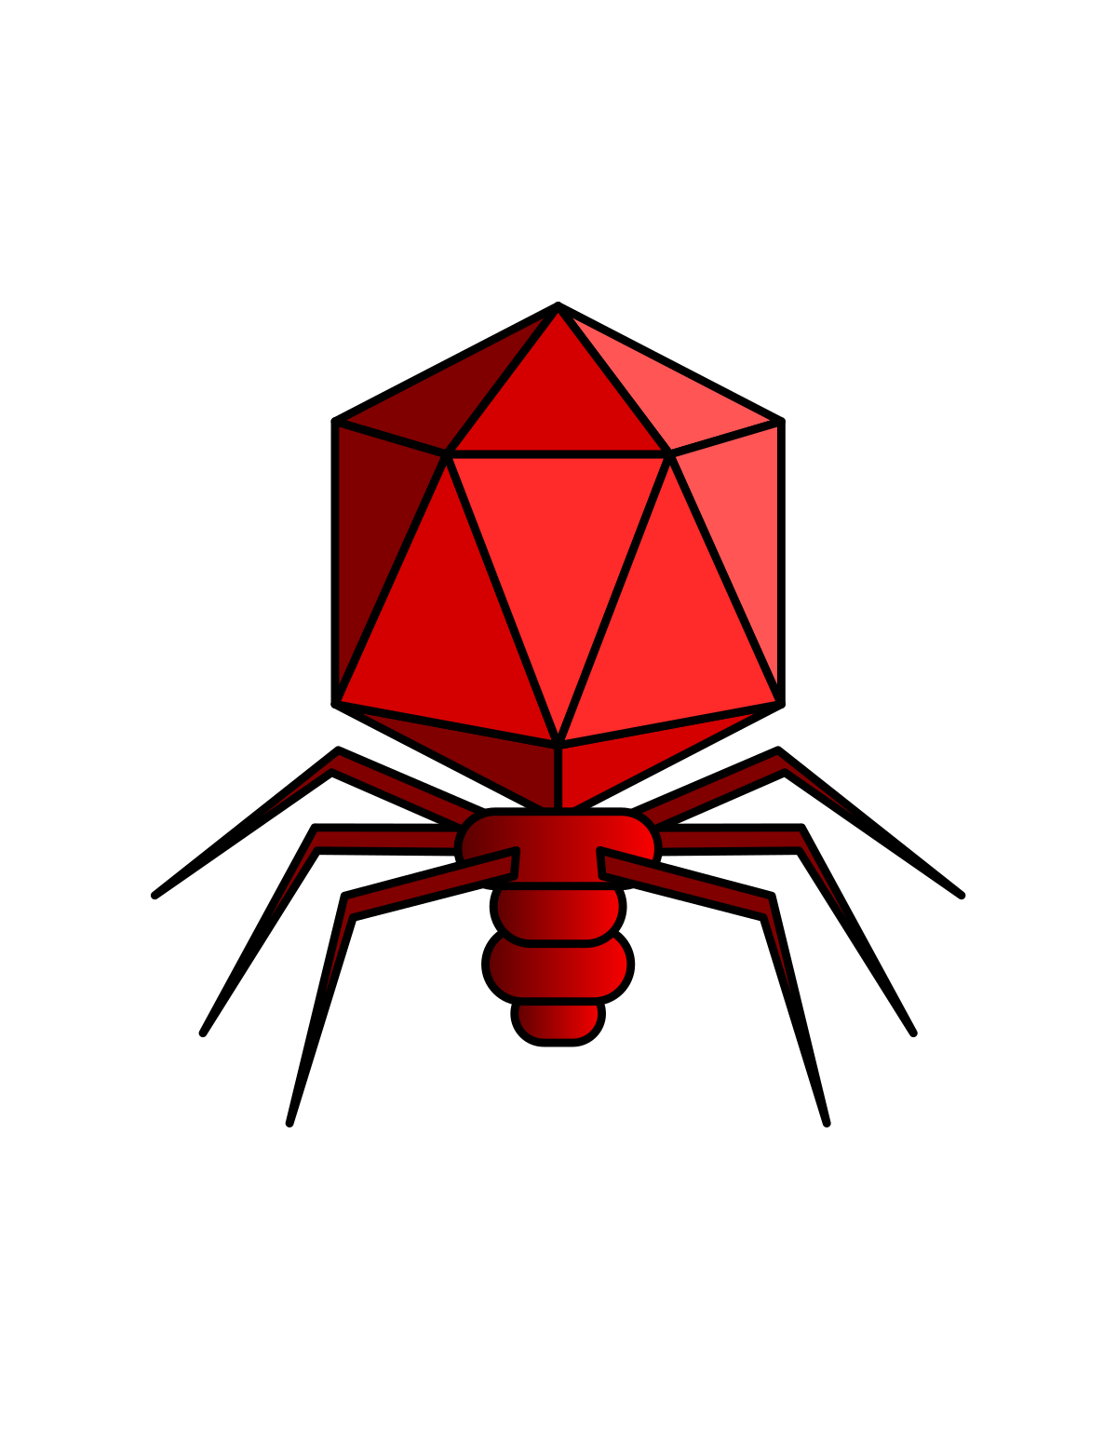
Phage Types
T7-like: Podoviridae
T4-like: Myoviridae
Notes:
By comparing phage genomes, people have found genes that ARE conserved between certain TYPES

Slide 14
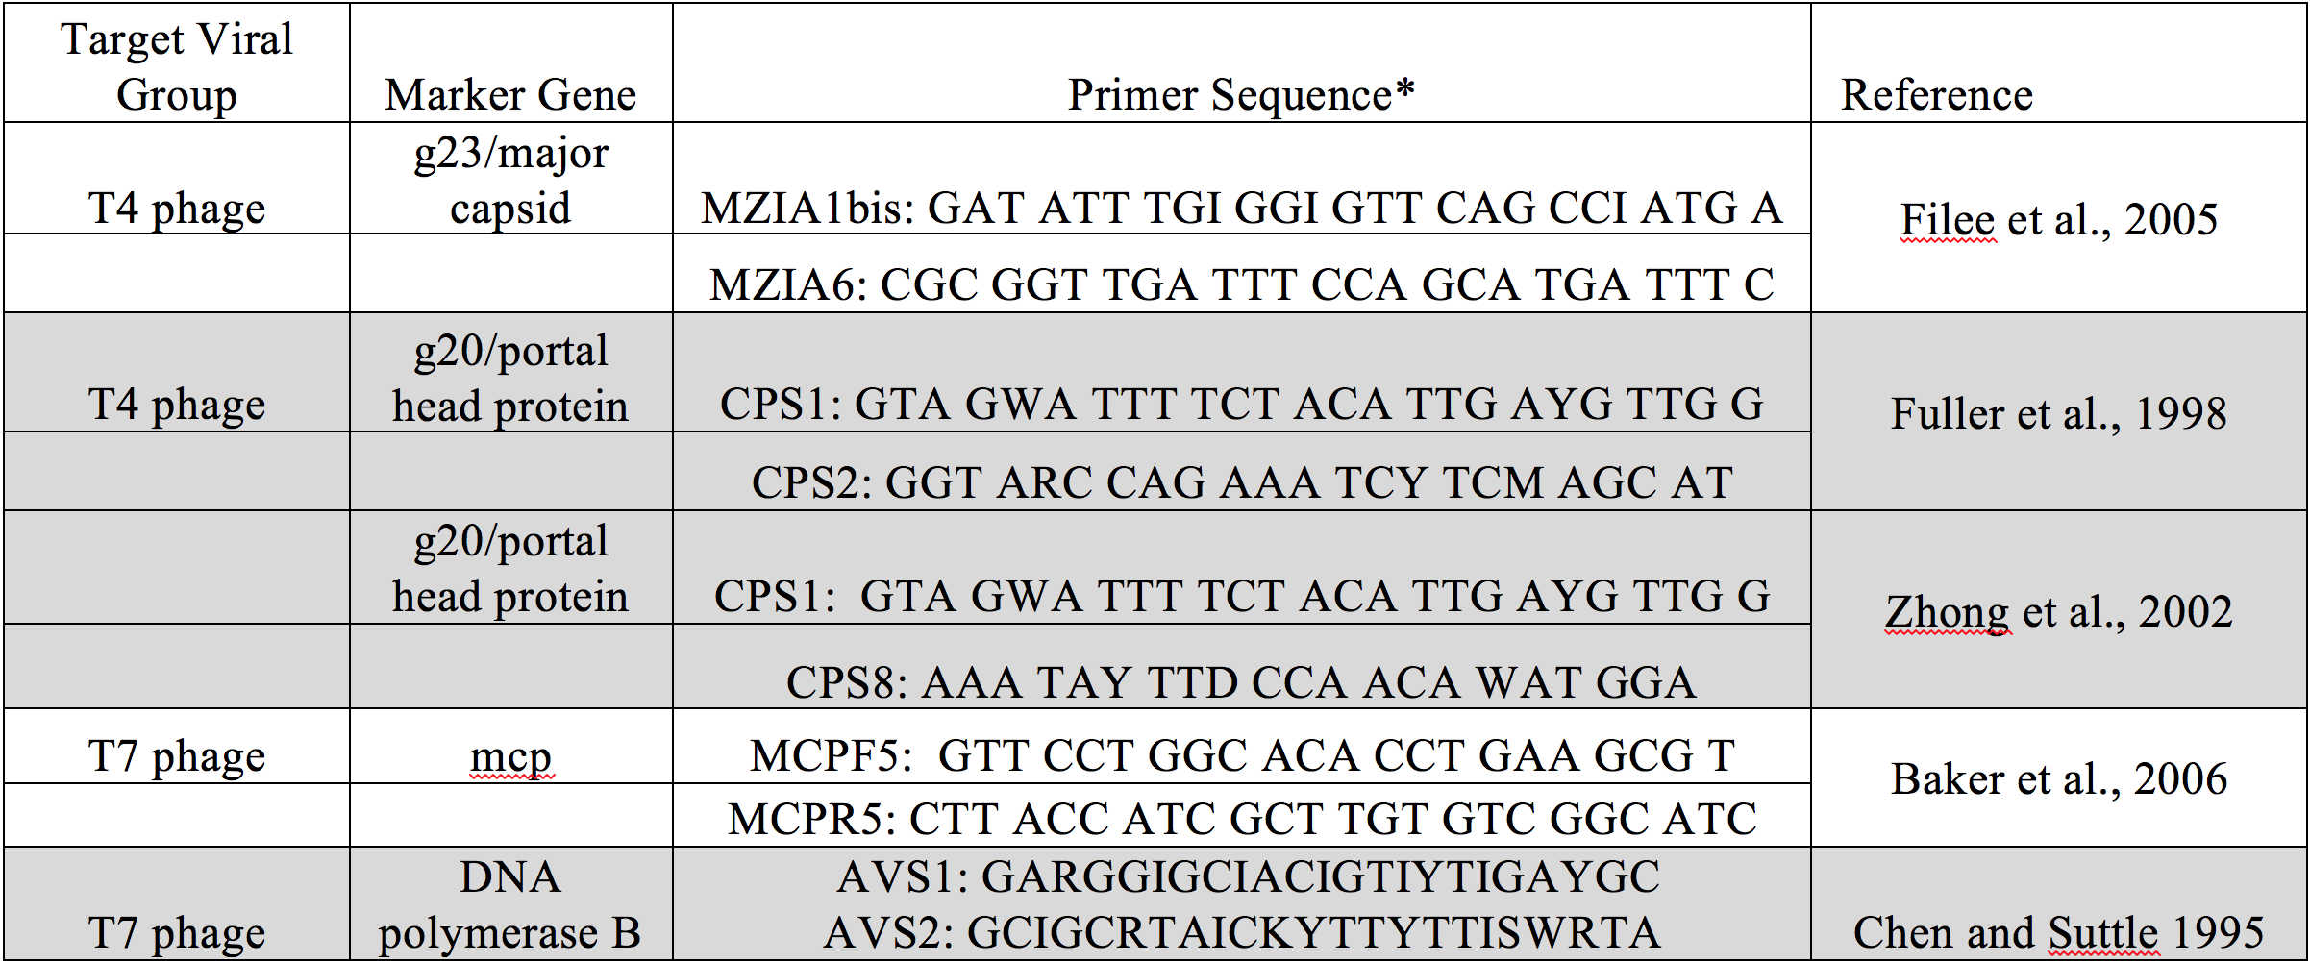
Detecting Phage
Commonly used viral marker genes and their primer sequences for the investigation of different groups of phages and eukaryotic viruses Adapted from “Virus–host interactions and their roles in coral reef health and disease” by Eastman, Alec et al. retrieved from http://www.nature.com.ezproxy.proxy.library.oregonstate.edu/nrmicro/journal/v15/n4/full/nrmicro.2016.176.html
Notes:
By using several marker genes at once we can get a better idea of the diversity of all types of phage in a sample
These are the genes we selected for our study that people designed primers for

Slide 15
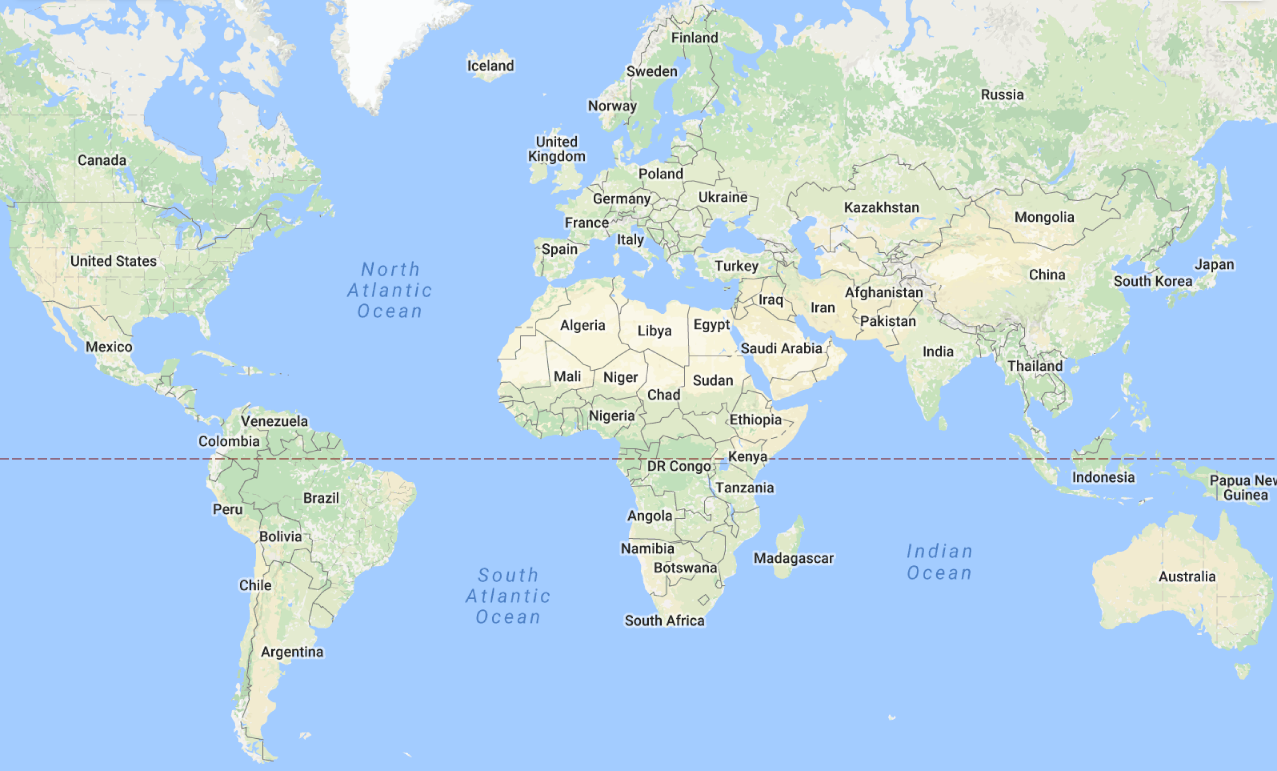
Project Scope
Cyanophage diversity within the Red Sea and the Gulf of Panama
Notes:
Project Scope
Analyze cyanophage diversity among benthic cyanobacteria matts sampled from the Red Sea and Panama

Slide 16
Project Scope
Hypotheses:
“Using a wide selection of primers for amplicon screening, we will be able to detect novel
phage types including members of the less inventoried T7-like Podoviridae.”
“Phage consortia will show marked differences between the Red Sea and Panama.”
Notes:
Consortia is a word that means community without inferring interactions
Because in science you can’t make stuff up.

Slide 17
Workflow
DNA Extraction
PCR of Marker Genes
Phage Marker Genes
Barcode
Data
Processing
Illumina Sequencing
Equimolar Pooling
Analysis
Notes:
CUT AT PCR OF MARKER GENES

Slide 18
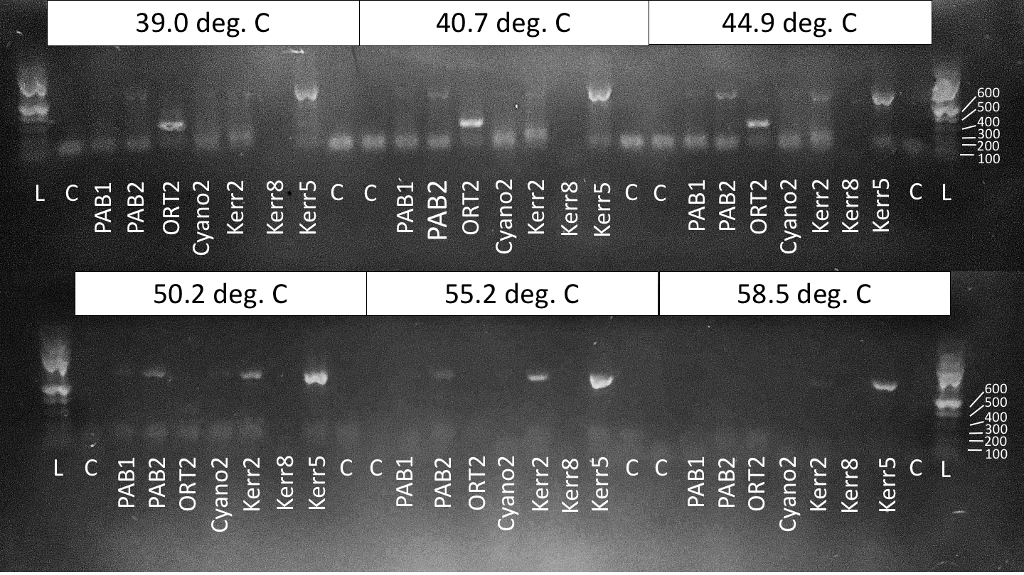
Phage Amplicon Primer Optimization
Notes:
e.g. g20
Following DNA extraction and purification, my first task was to optimize PCR conditions for each primer set, specific to a given marker gene.
Did PCR reactions with the same set of primers combined with DNA of seven different samples
Did 6 sets of these same PCR reactions with different annealing temperatures for each
Exp: ~680bp in length.
Get a lot of off-target amp at lower and less overall amp at higher. Little bit of a goldilocks game
50.2 was just right

Slide 19
Workflow
DNA Extraction
PCR of Marker Genes
Phage Marker Genes
Barcode
Data
Processing
Illumina Sequencing
Equimolar Pooling
Analysis

Slide 20
Phage Amplicon Bioinformatic Pipeline
Raw amplicon data
Paired end merging
Quality filtering
97% OTU Picking
Rarefaction
Diversity analyses
Notes:
STOP AT PAIRED END MERGING

Slide 21
Bioinformatic Pipeline
Forward Primer
Reverse Primer
Merged
Notes:
When we get our string of letters back, we have a string from the forward primer and a string from the reverse primer that are two ends of the same piece of DNA
We wan the whole sequence so we find an overlap in the middle and use it to merge the two reads into a single read
Raw reads are merged

Slide 22
Phage Amplicon Bioinformatic Pipeline
Raw amplicon data
Rarefaction
300 Seqs/Sample
Paired end merging
Quality filtering
97% OTU Picking
Diversity analyses
Notes:
After merging we filter out reads that have low quality scores. These scores are included in the file given to us from the sequencing machine
Then we group what’s left based on similarity. If one read is 97% as similar as another read, it gets put in the same group.
These groups are called OTUs (operational taxonomic unit). which is usually an assignment to a group of a specific family, genus, species, etc. that a specific group represents.
Unfortunately we weren’t able to find a reference database for cyanophage so that we could assign taxonomy. So in our case it’s like giving each group a fake name that just says that they’re different from the other groups. Just think of OTU as group.
Then we normalize the number of reads we’re looking at so that all OTUs are equally represented in the analysis. The OTU that had the least number of reads in my dataset had about 300 so we randomly picked out only 300 reads from every OTU.
We then ran diversity analyses on the resulting data using QIIME and the PhyloSeq package of R

Slide 23
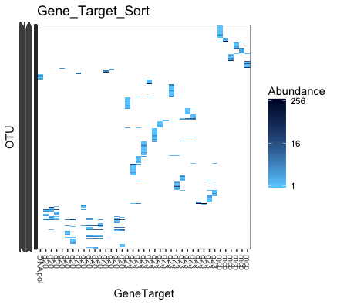
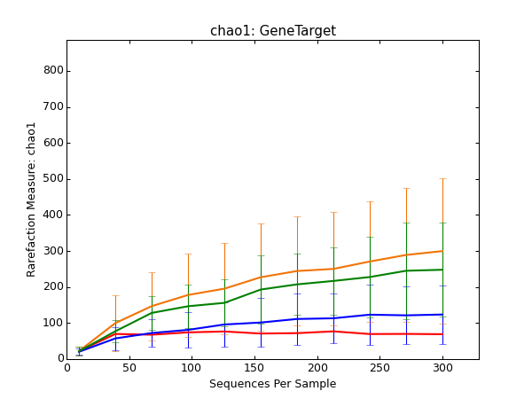
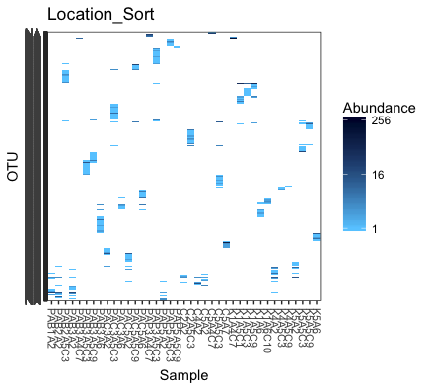
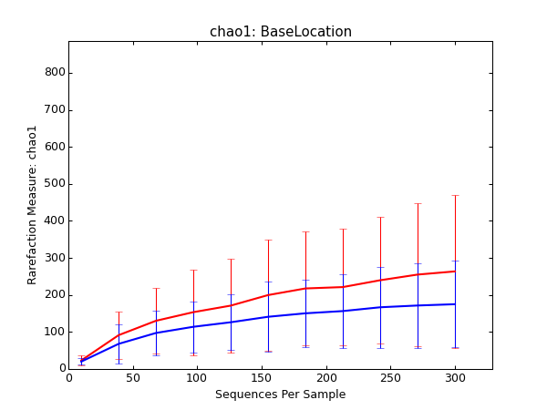
a.
b.
g23
mcp
g20
DNA pol. B
c.
d.
Panama
Red Sea
Notes:
Few analyses
Eyes adjusted to graphs then talk
First two heat maps: y axis, x axis, example
Other two rarefaction curves: plotted during subsampling
Randomly take 50 seqs per sample
This much within-sample div (called alpha) using the Chao1 metric
Keep doing that eventually amnt div levels off
Our 300 rarifaction capture most of the diversity (y)

Slide 24
Results
Notes:
1st way group by gene targetted
Sample grouped and labeled by gene targetted

Slide 25
Results
Notes:
When use diff genes get diff OTUs
G23 detects this group of OTUs and mcp this type.
DNA poly highly specific – only targets certain t7 clade?
Larger div. detected fromdiff gene markers Where DNA poly
G23 >>> dnapol

Slide 26
Results
g23
mcp
g20
DNA pol. B
Notes:
Backed up by rarifaction
DNA pol B alpha div capture after taking 50 seqs/samp
G23 takes many more seqs per samp until most diversity is captured.

Slide 27
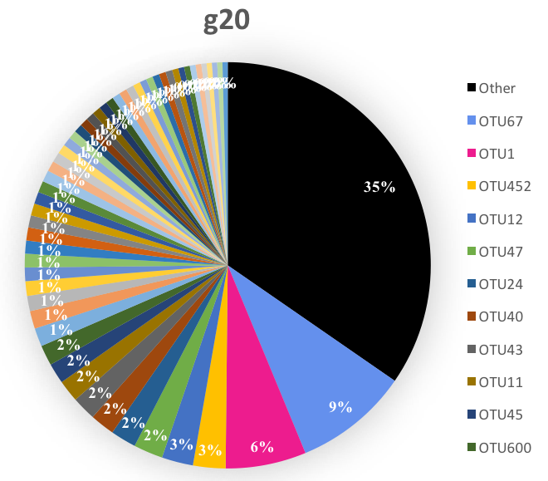
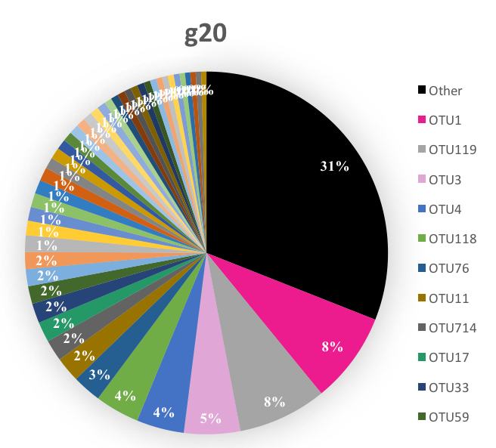
Results
Panama
Red Sea
Notes:
Another way to visualize
Diff colors
Other cat.
OTU1 and OTU11 shared

Slide 28
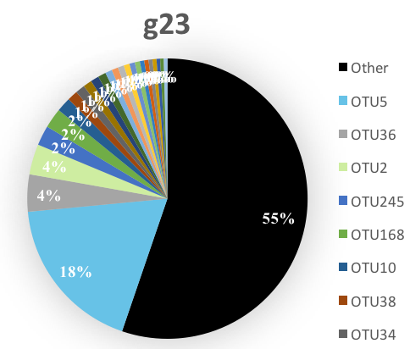
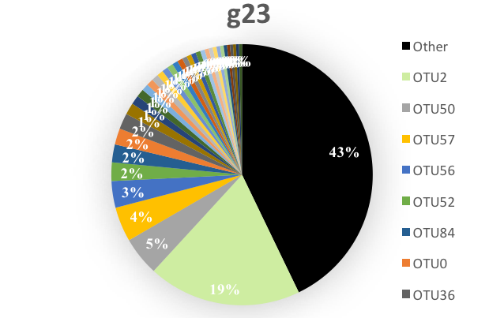
Results
Panama
Red Sea
Notes:
G23 gene OTUs
OTU2 found in both

Slide 29
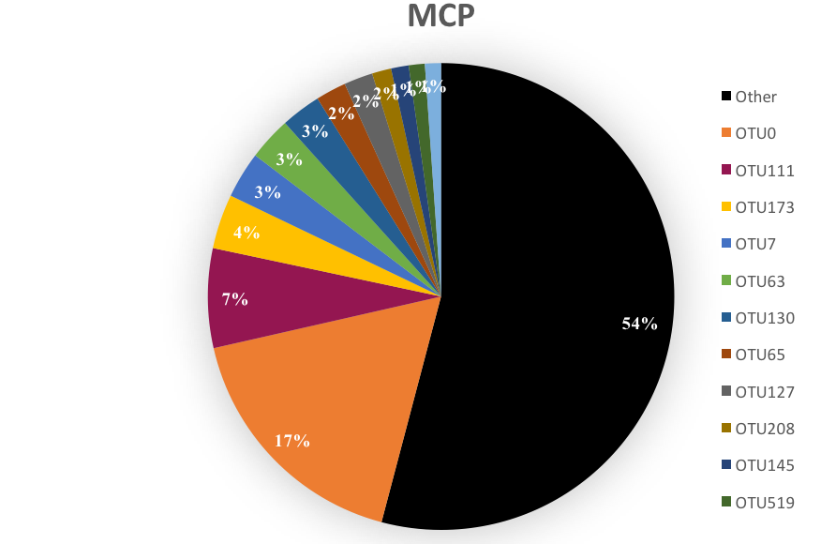
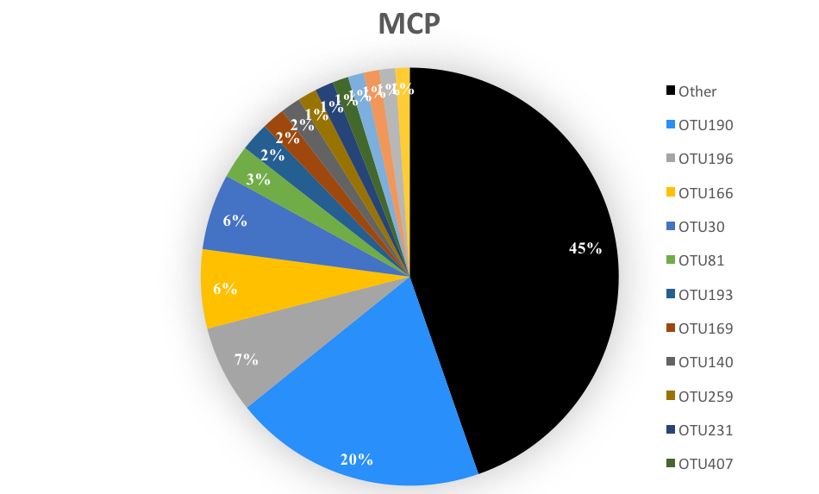
Results
Panama
Red Sea
Notes:
No similar OTUs

Slide 30
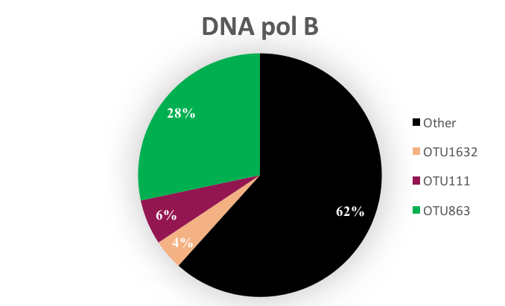
Results
Red Sea
Notes:
No panama sample amps
OTU111 found in panama mcp samples

Slide 31
Results
Panama
Red Sea
Notes:
Otu111 found in both
Only example across different marker groups
Mcp and DNA pol B for T7
OTU111 likely podo
Since abundant with cyanos, likely cyanophage

Slide 32
Notes:
OTUs 1,2,11, and 111 found in both locals

Slide 33
Results
Notes:
See evidence of this
Sorted by local
Panama on left
Box is universal OTUs but low abundance

Slide 34
Results
Notes:
Line between locals
Unique OUT groups per local
spread

Slide 35
Results
Panama
Red Sea
Notes:
Panama more average alpha div. than red sea

Slide 36
Discussion
1st Culture-independent amplicon analysis on phage of benthic mat-forming tropical marine cyanobacteria using multiple gene markers
To capture all phage diversity, use many primers
Different gene markers – more unique detection than expected
Marked differences in average alpha diversity between two locations
Some differences in OTUs between two locations
Notes:
1st analysis of…
Showed that in order to capture true diversity must….
Different marker genes showed more unique results form each other than expected.
Showed that there are some OTUs that were unique to each area

Slide 37
Future Work
“Do phage play a role in the evolution of novel biosynthetic gene clusters?”
Assign taxonomy (BLAST highly abundant OTUs)
Perform statistics on alpha diversity differences between locations
Compare cyanophage diversity with mass spectrometry data
Chemical signature diversity vs. cyanophage diversity
Notes:
Following these findings, we would like to investigate whether the difference in phage communities may be linked to unique chemical phenotypes found within cyanobacterial samples.
Does the presence of phage allow for the evolution of new biosynthesis?
To answer this we hope to compare cyanophage diversity to mass spectrometry data collected from each sample to form additional hypotheses on how phage diversity may inform natural product discovery and isolation.

Slide 38
Acknowledgements
Dr. Rebecca Vega-Thurber
Dr. Kerry McPhail
Dr. Thomas Sharpton
Dr. Ryan McMinds
Dr. Stephanie Rosales
Grace Klinges
Funding:
URISC, LSAMP, CAS, CoP, Department of Bioenergy

Slide 39
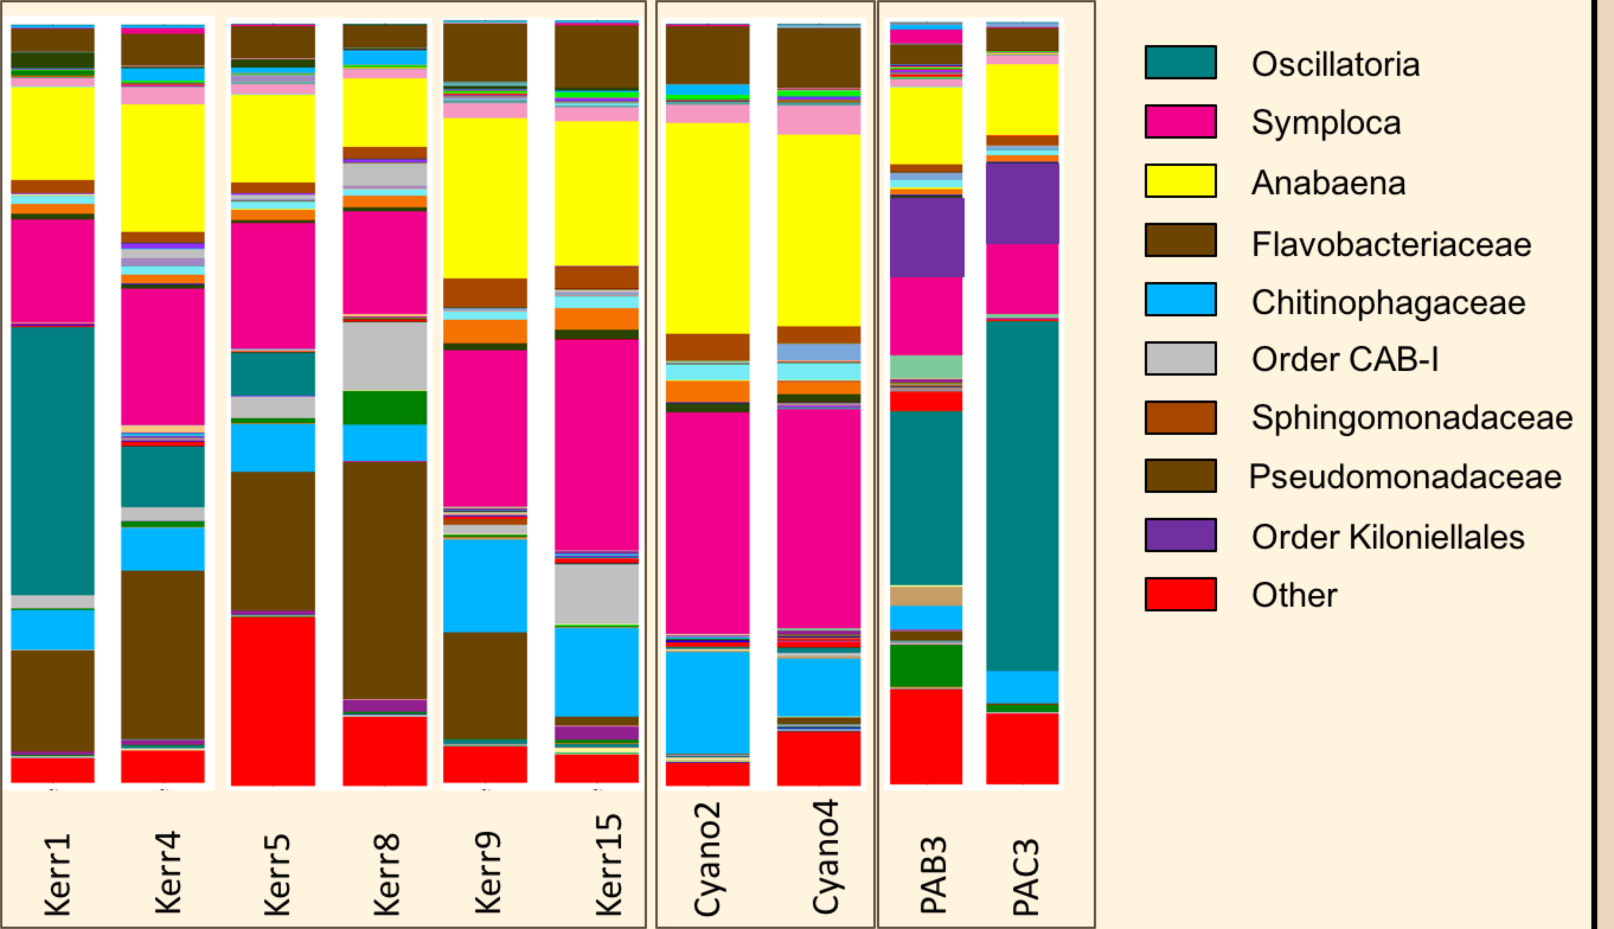
Viral Type Similarities

Slide 40
Anticancer Resistance
Walsh, F. (2011, July 14). Four in ten will get cancer. In BBC News. Retrieved from http://www.bbc.co.uk/news/mobile/health-14145773
Notes:
There is an urgent need of new anticancer drugs because tumor cells are developing resistance against currently available drugs, like vinca alkaloids and taxanes, which is thought to be a major cause of failure in the chemotherapeutic treatment of cancers.
used to be that one in three of us would get cancer,
risen to four in 10.
The charity Macmillan Cancer Support estimates that 42% of people will have had a cancer diagnosis by the time of their death.
Of these, 64% will die from cancer.
American Cancer Society estimates that 7.6 million people died from cancer in the world during 2007 (~13%)
Making it the leading cause of mortality worldwide
Walsh, F. (2011, July 14). Four in ten will get cancer. In BBC News. Retrieved from http://www.bbc.co.uk/news/mobile/health-14145773

Slide 42
Who’s There?
Metagenomics
Single Gene (e.g. 16S)
Full sequence of all genomes
More representative
Not targeted
Computationally expensive
Economically expensive
All sequences of a single gene
Relatively inexpensive

Slide 43
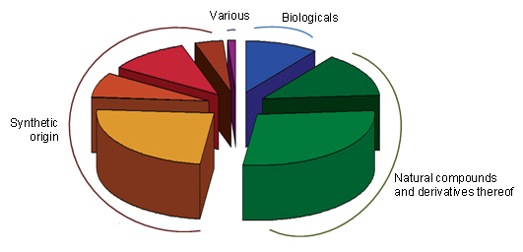
Why Natural Products?
Newman, D. J., & Cragg, G. M. (2012). Natural Products as Sources of New Drugs over the 30 Years from 1981 to 2010.
Journal of Natural Products, 75(3), 311–335. http://doi.org/10.1021/np200906s
Notes:
Over half of all drugs introduced between 1940 and 2006 were of natural origin or inspired by natural compounds.
“B” Biological; usually a large (>45 residues) peptide or protein either isolated from an organism/cell line or produced by biotechnological means in a surrogate host.
“N” Natural product.
“NB” Natural product “Botanical” (in general these have been recently approved).
“ND” Derived from a natural product and is usually a semi-synthetic modification.
“S” Totally synthetic drug, often found by random screening/modification of an existing agent.
“S*” Made by total synthesis, but the pharmacophore is/was from a natural product.
“V” Vaccine.
Newman, D. J., & Cragg, G. M. (2012). Natural Products as Sources of New Drugs over the 30 Years from 1981 to 2010. Journal of Natural Products, 75(3), 311–335. http://doi.org/10.1021/np200906s

Slide 44
The Antibiotic Apocalypse: a ‘post-antibiotic era'
Notes:
October 2015: Dr Margaret Chan, Director-General of the World Health Organization
“We are in a post-antibiotic era,"

Slide 45
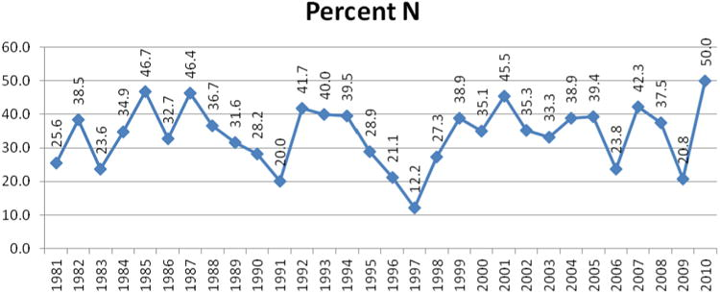
Why Natural Products?
Newman, D. J., & Cragg, G. M. (2012). Natural Products as Sources of New Drugs over the 30 Years from 1981 to 2010.
Journal of Natural Products, 75(3), 311–335. http://doi.org/10.1021/np200906s
Notes:
This is readily demonstrated in Figures 5 and
and
6 where the percentage of just the “N” linked materials is shown, with figures ranging from a low of 20.8% in 2009, to a high of 50% in 2010, with the mean and standard deviation for those 11 years being 36.5 + 8.6, without including any of the natural product inspired classifications (S*, S*/NM and S/NM).
Newman, D. J., & Cragg, G. M. (2012). Natural Products as Sources of New Drugs over the 30 Years from 1981 to 2010. Journal of Natural Products, 75(3), 311–335. http://doi.org/10.1021/np200906s

