Slide 1
NW5C Research Data Management & Curation Workshop
NW 5C
Reed College
18-19 June 2015
cp
Amanda L. Whitmire | @AWhitTwit
amanda.whitmire@oregonstate.edu

Slide 2
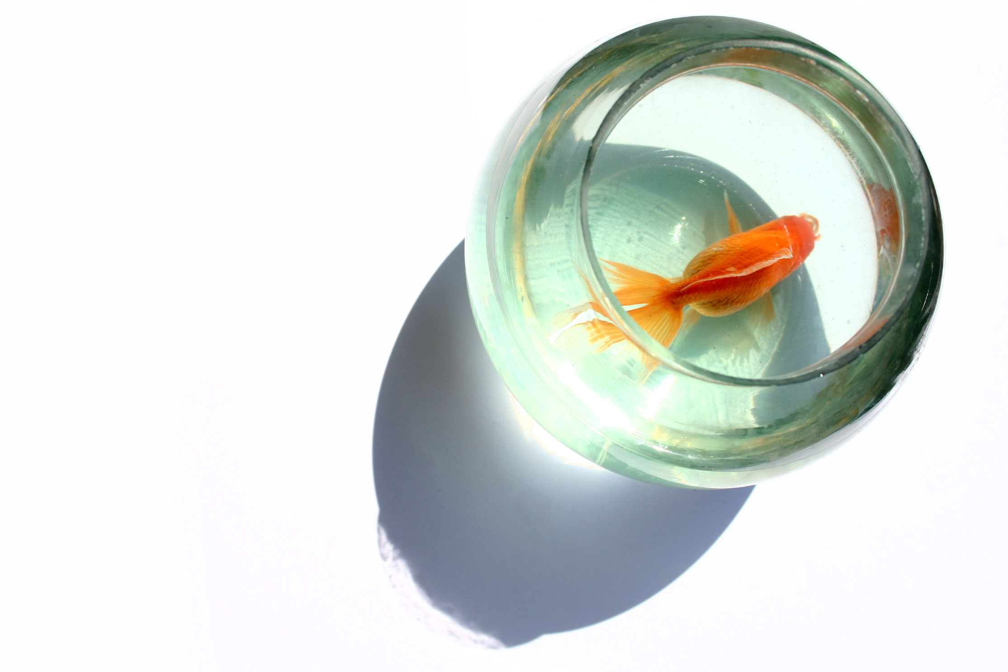
Overview
NW 5C
9 am - 5 pm
------
Research data management best practices
day
1
session
9 am - 12 pm
------
Apply best practices to your workflow & group
day
2
1
2
3
4

Slide 3
Session 1 ~ 9am – 12pm
NW 5C
Hello!
What is 1001101?
Research lifecycle
Organization
Backup & Storage
Notes:
This morning is going to be one LONG chunk. Please feel free to stretch your legs and use the facilities as you need to.

Slide 4
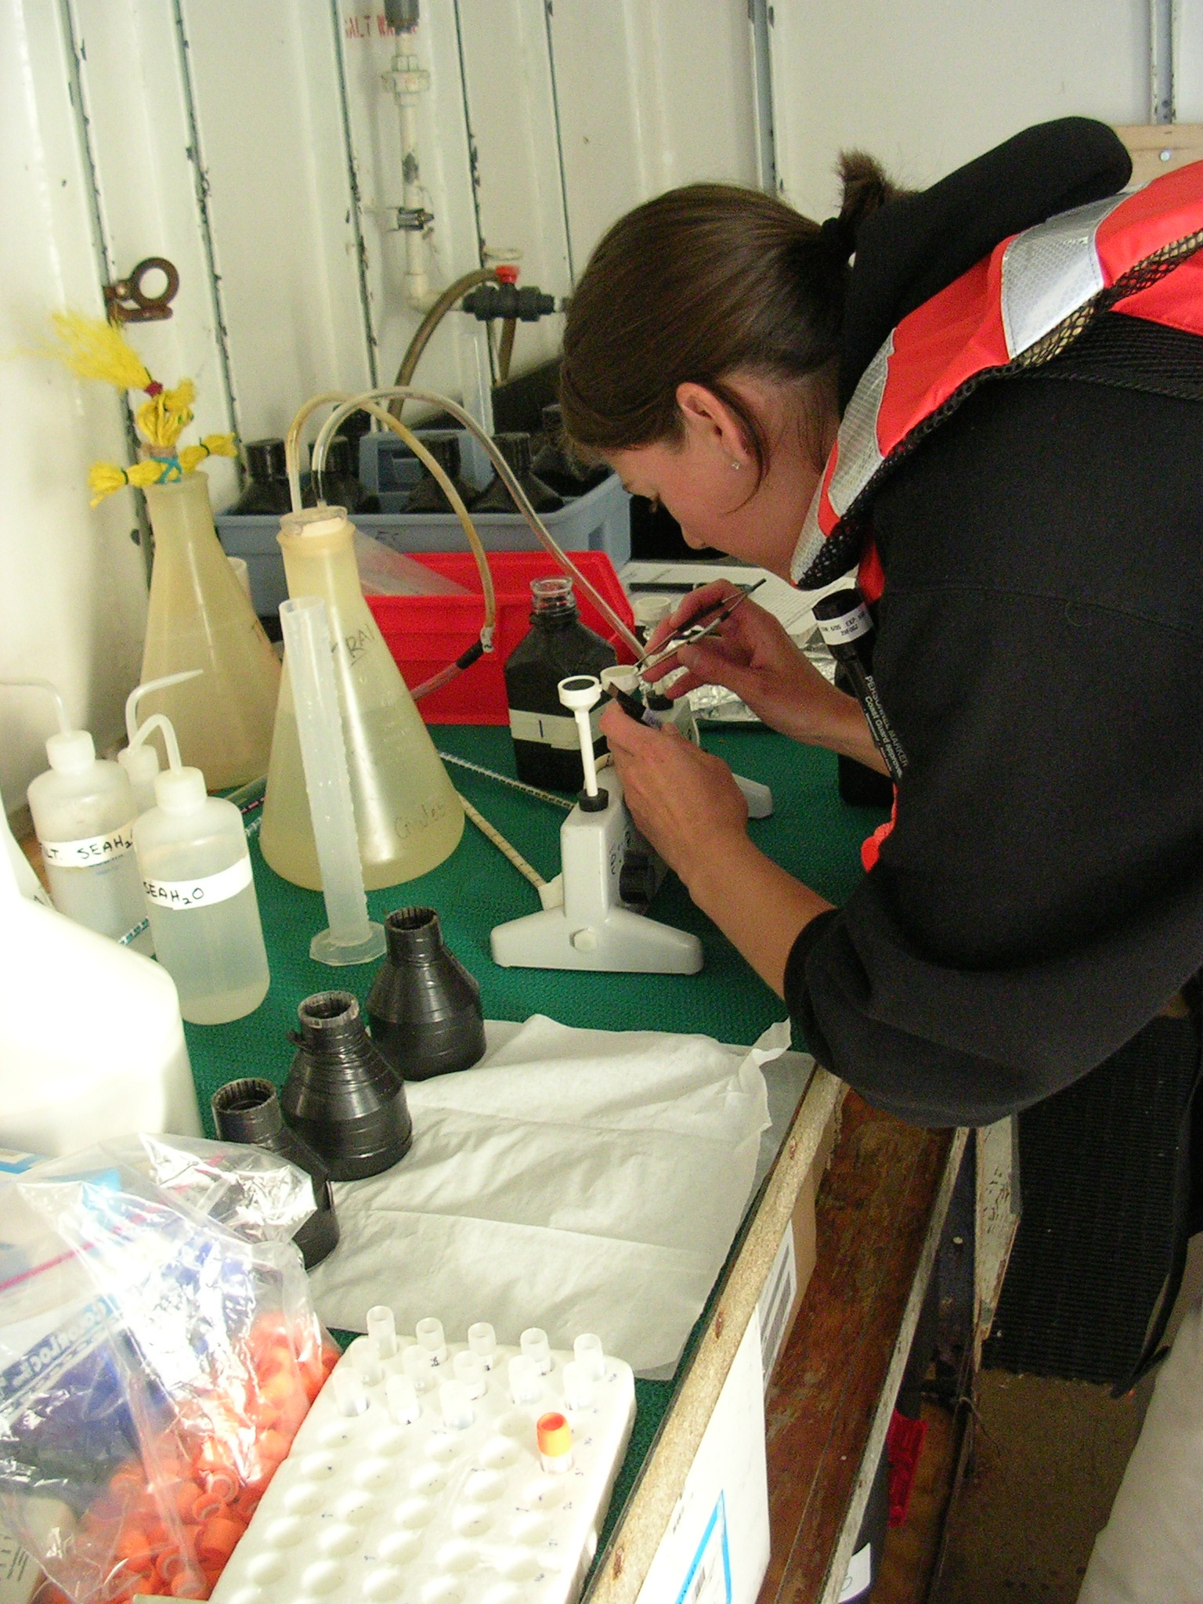
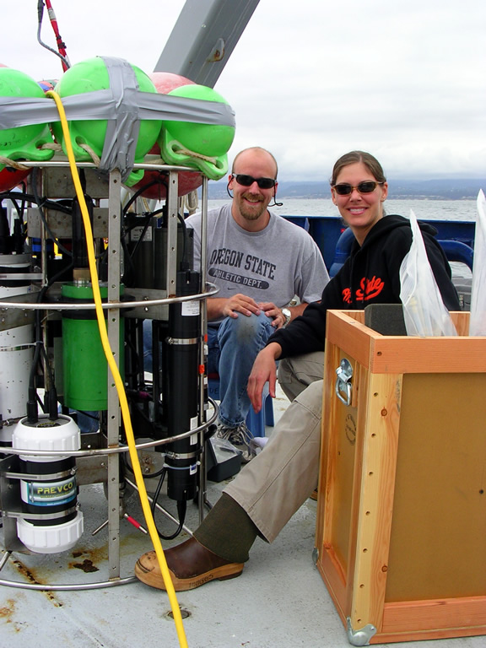
Notes:
I haven’t always been a librarian, but I’ve been a data specialist for a while…

Slide 5
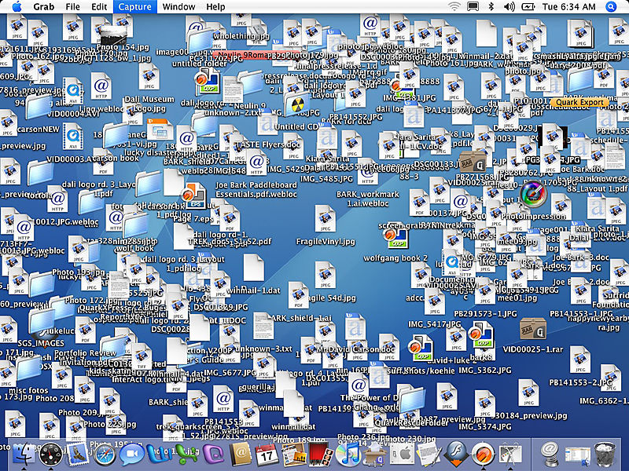
Notes:
I’m here to talk with you today about a problem that affects all of us …

Slide 6
hello!
Notes:
Before we delve into the particulars, let’s all get to know each other a little bit.
[Participants share their background, why they are here, what they struggle with; what they hope to learn, etc.]

Slide 7
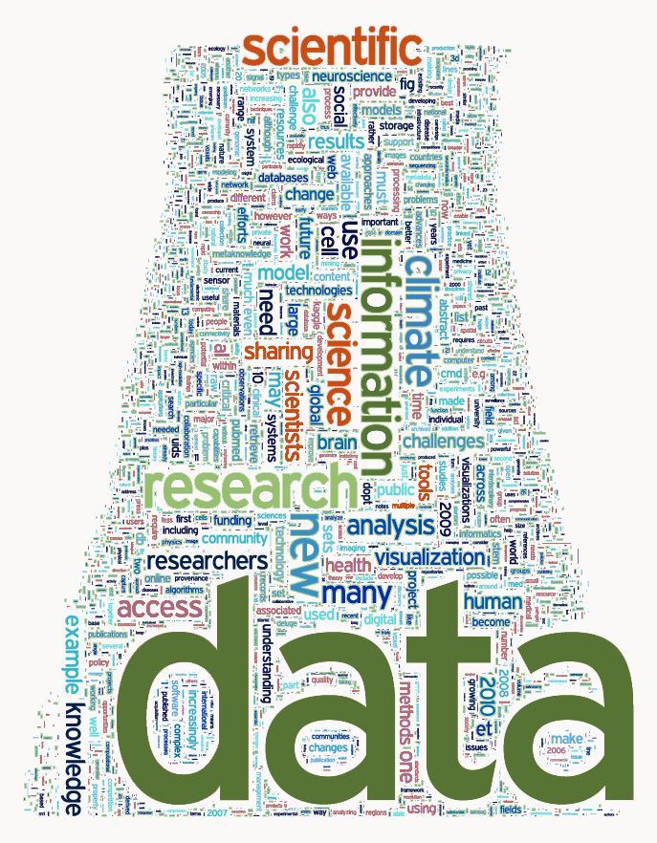
Notes:
Image credit: Science Magazine

Slide 8
What is research data?
“Unlike other types of information, research data are collected, observed, or created, for the purposes of analysis to produce and validate original research results.”
University of Edinburgh
MANTRA Research Data Management Training,
‘Research Data Explained’
Notes:
…”Data may be viewed as the lowest level of abstraction from which information and knowledge are derived.”

Slide 9
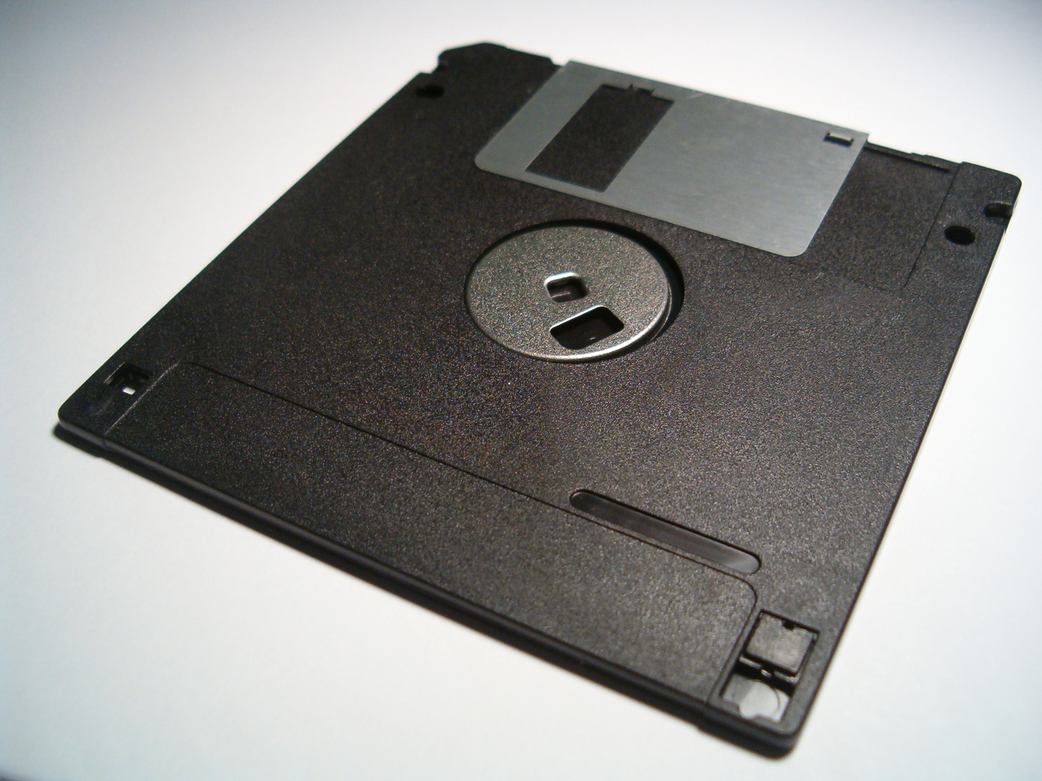
What is data management?
Actions that contribute to effective storage, preservation and reuse of
data and documentation throughout the research lifecycle.
Notes:
Data management is a verb – it involves intentional effort and activity.
The main goals of DM are preservation and reuse, for you and for others.
Covers all aspects of the data lifecycle from planning digital data capture methods, whittling down, ingestion to databases, providing for access and reuse, to transformation.

Slide 10
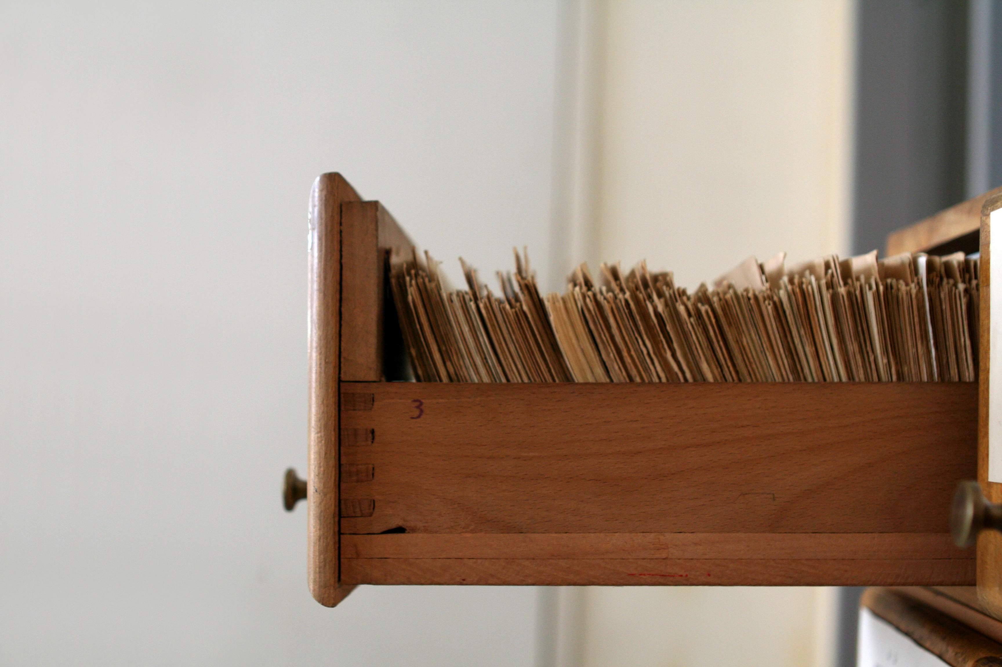
Why data management?

Slide 11
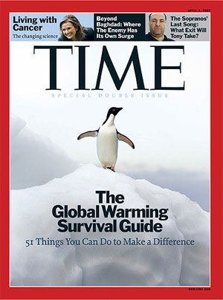
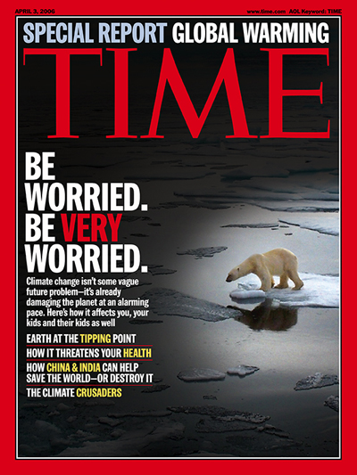
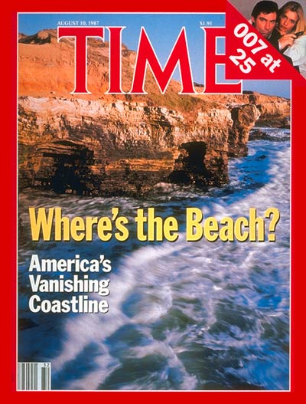
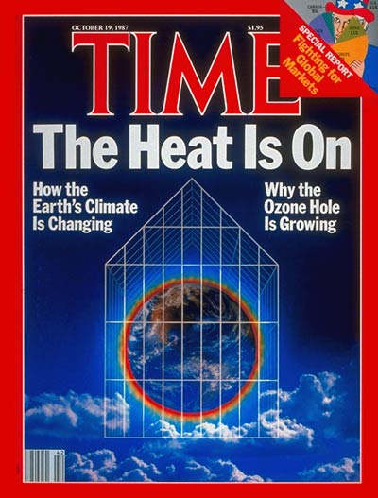
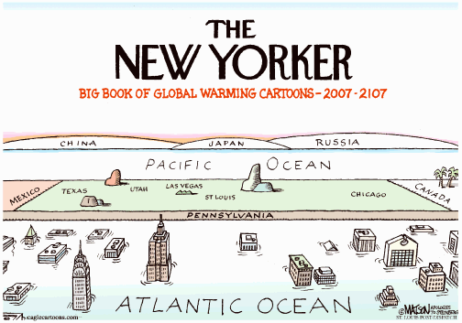
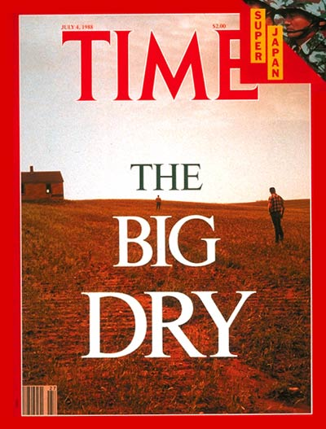
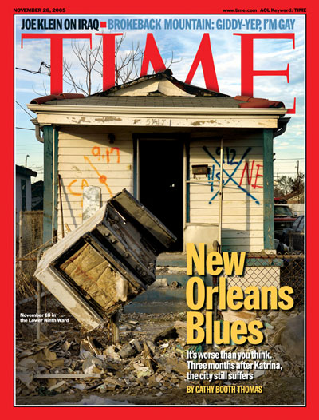
Images collected by DataOne.org
Notes:
Let’s look at one important area of scientific inquiry: climate change. What scale of data integration is necessary to study global trends over geologic timescales?

Slide 12
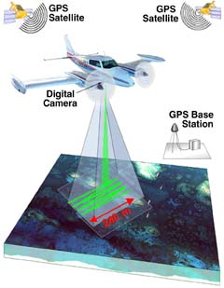
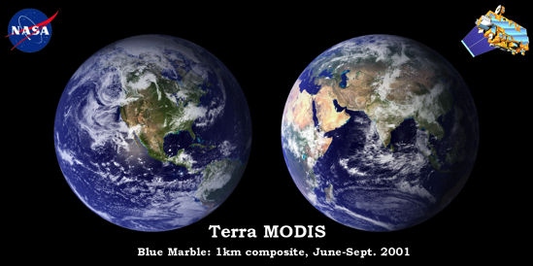
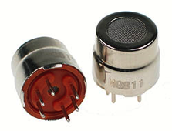
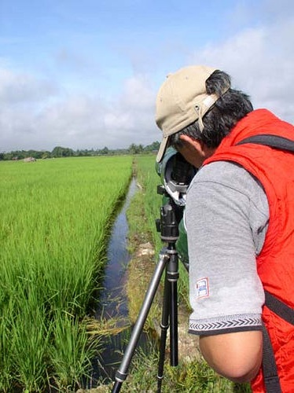
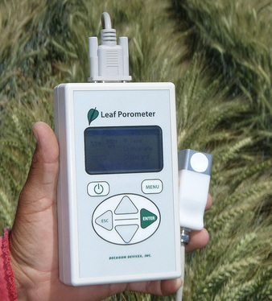
Data deluge
Data is collected from sensors, sensor networks, remote sensing, observations, and more - this calls for increased attention to data management and stewardship.
Photo courtesy of http://modis.gsfc.nasa.gov/
Photo courtesy of
http://www.futurlec.com
Photo courtesy of www.carboafrica.net
CC image by CIMMYT on Flickr
Image collected by Viv Hutchinson
CC image by tajai on Flickr
Notes:
Data are being generated in massive quantities daily. Improvements in technology enable higher precision and coverage in data acquisition and makes higher capacity systems store and migrate more data –increasing the importance of managing, integrating, and re-using data. In order to integrate these diverse datasets to answer questions of global significance, the data have to be well organized, well documented and described, preserved and accessible. It all depends of effective management of the data.
Slide credit: DataONE Education Module 1.

Slide 13
The World of Data Around Us
Transient information or unfilled demand for storage
Information
Petabytes Worldwide
Available Storage
Source: John Gantz, IDC Corporation: The Expanding Digital Universe
Notes:
The amount of available storage is not keeping up with the amount of data flooding in daily. How do we decide what data we keep?
Slide credit: DataONE Education Module 1.

Slide 14
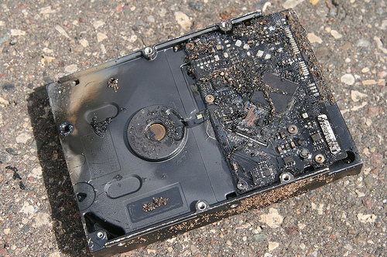
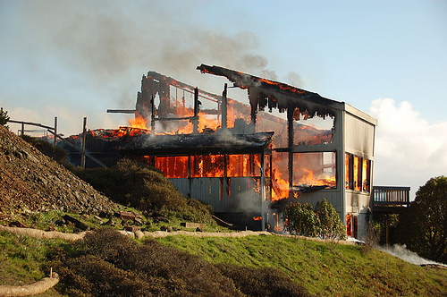
The World of Data Around Us: Data Loss
Natural disaster
Facilities infrastructure failure
Storage failure
Server hardware/software failure
Application software failure
External dependencies (e.g. PKI failure)
Format obsolescence
Legal encumbrance
Human error
Malicious attack by human or automated agents
Loss of staffing competencies
Loss of institutional commitment
Loss of financial stability
Changes in user expectations and requirements
CC image by Sharyn Morrow on Flickr
CC image by momboleum on Flickr
Notes:
Slide credit: DataONE Education Module 1.

Slide 15
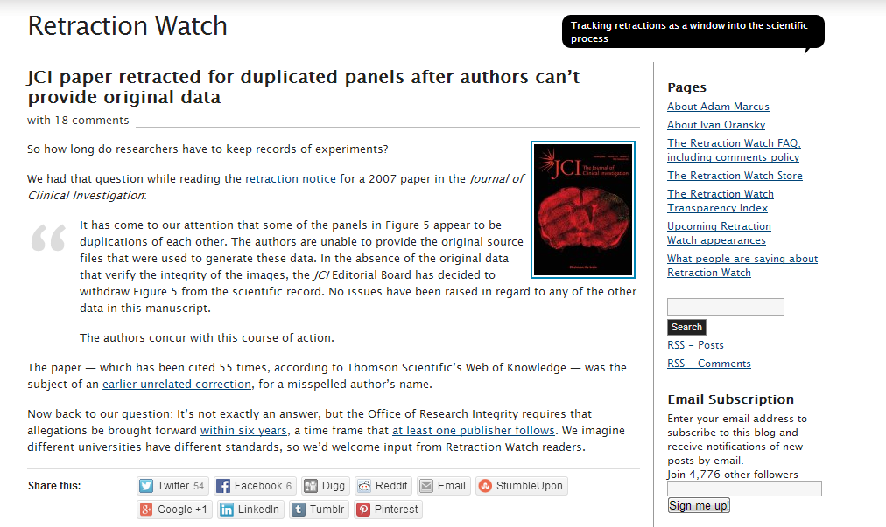
Notes:
“How long should I retain data?” is not a clear and cut data management question. Last year, for example, the JCI retracted a published article because one of its data tables was duplicated.
The publisher contacted the researchers to have them update the data, but they could not locate the original data files after six years, so the journal was forced to issue a retraction.
Slide credit: NECDMC, Module 1: Overview of Research Data Management

Slide 16
Why Data Management: Researcher Perspective
Manage your data for yourself to:
Keep yourself organized
Track your research processes for reproducibility
Better control versions of data
Quality control your data more efficiently
Notes:
Manage your data for yourself:
Keep yourself organized – be able to find your files (data inputs, analytic scripts, outputs at various stages of the analytic process, etc.)
Track your science processes for reproducibility – be able to match up your outputs with exact inputs and transformations that produced them
Better control versions of data – identify easily versions that can be periodically purged
Quality control your data more efficiently
Slide credit: DataONE Education Module 1.

Slide 17
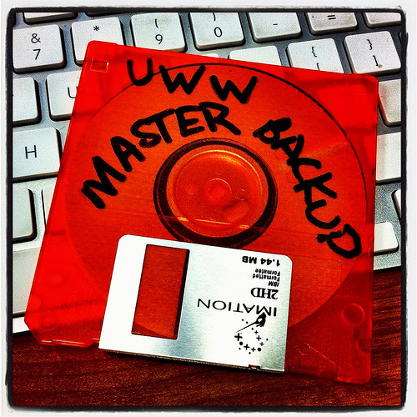
Why Data Management: Researcher Perspective
Make backups to avoid data loss
Format your data for re-use (by yourself or others)
Be prepared: Document your data for your own recollection, accountability & re-use (by yourself or others)
Prepare it to share it – gain credibility & recognition for your science efforts!
CC image by UWW ResNet on Flickr
Notes:
Slide credit: DataONE Education Module 1.

Slide 18
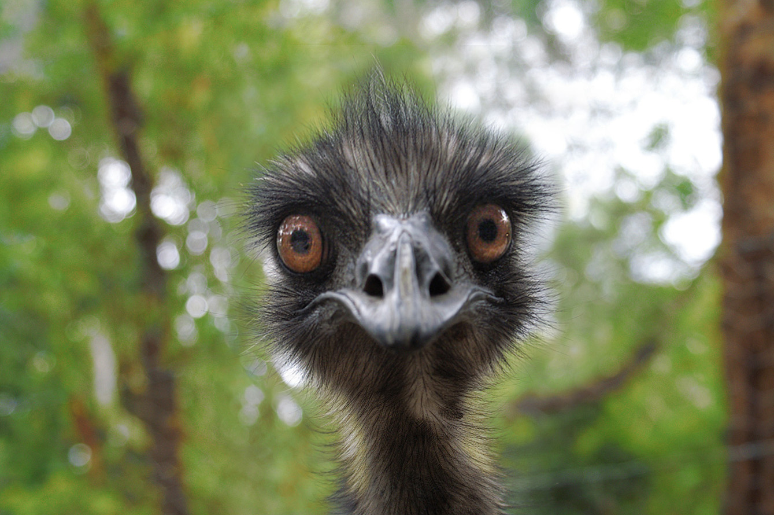
???

Slide 19
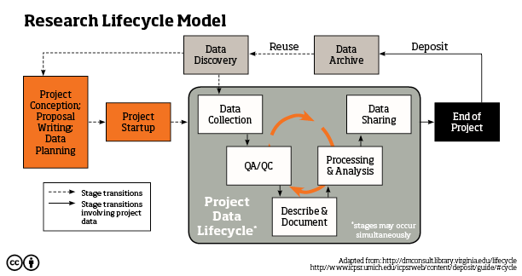
Data management in the lifecycle
Notes:
Today we are going to focus on the research lifecycle by examining the various types and formats of data, and phases that they go through during the data and project lifecycles.
Get the whole lifecycle graphic here: “Data management throughout the research lifecycle. Amanda Whitmire. figshare. http://dx.doi.org/10.6084/m9.figshare.774628”

Slide 20
Data Types: Observational
Captured in situ
Can’t be recaptured, recreated or replaced
Examples: Sensor readings, sensory (human) observations, survey results
Notes:
Image credit: Stock X.chnge

Slide 21
Data Types: Experimental
Data collected under controlled conditions, in situ or laboratory-based
Should be reproducible, but can be expensive
Examples: gene sequences, chromatograms, spectroscopy, microscopy, cell counts
Notes:
Image credit: OSU media services

Slide 22
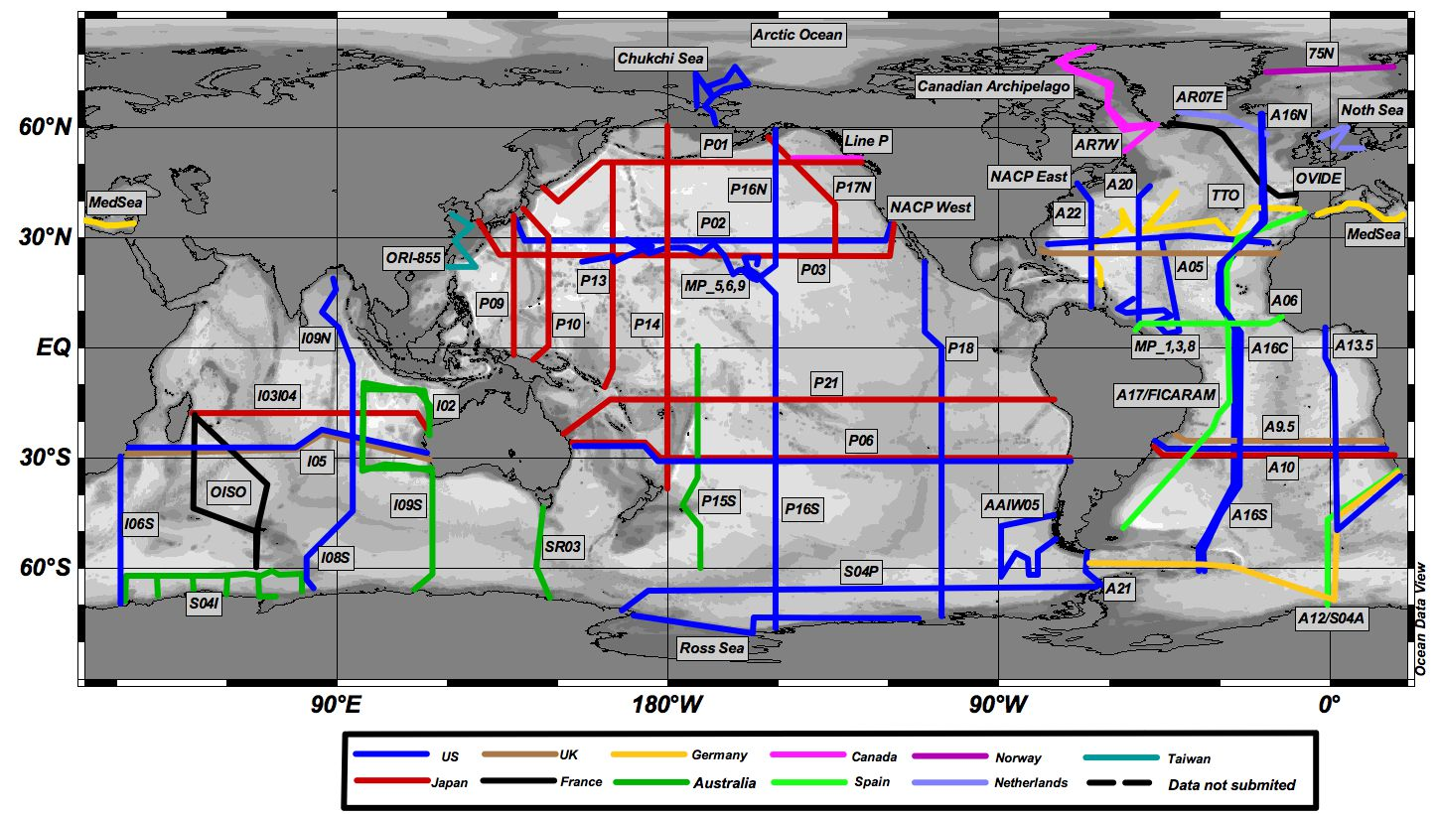
Data Types: Derived or Compiled
Compiled: integration of data from several sources (could be many types)
Derived: new variables created from existing data
Reproducible, but can be very expensive
Examples: text and data mining, compiled database, 3D models
Notes:
For example, in climate science, HUGE amounts of data are compiled: http://www.realclimate.org/index.php/data-sources/
In the example image, hydrographic data from all over the world are compiled into a database, and new variables can be derived from them. For example, depth profiles of seawater density from measurements of pressure, temperature, and salinity (via conductivity measurements).
Image credit; http://cdiac.ornl.gov/oceans/RepeatSections/CDIAC_CLIVAR_global_map.jpg

Slide 23
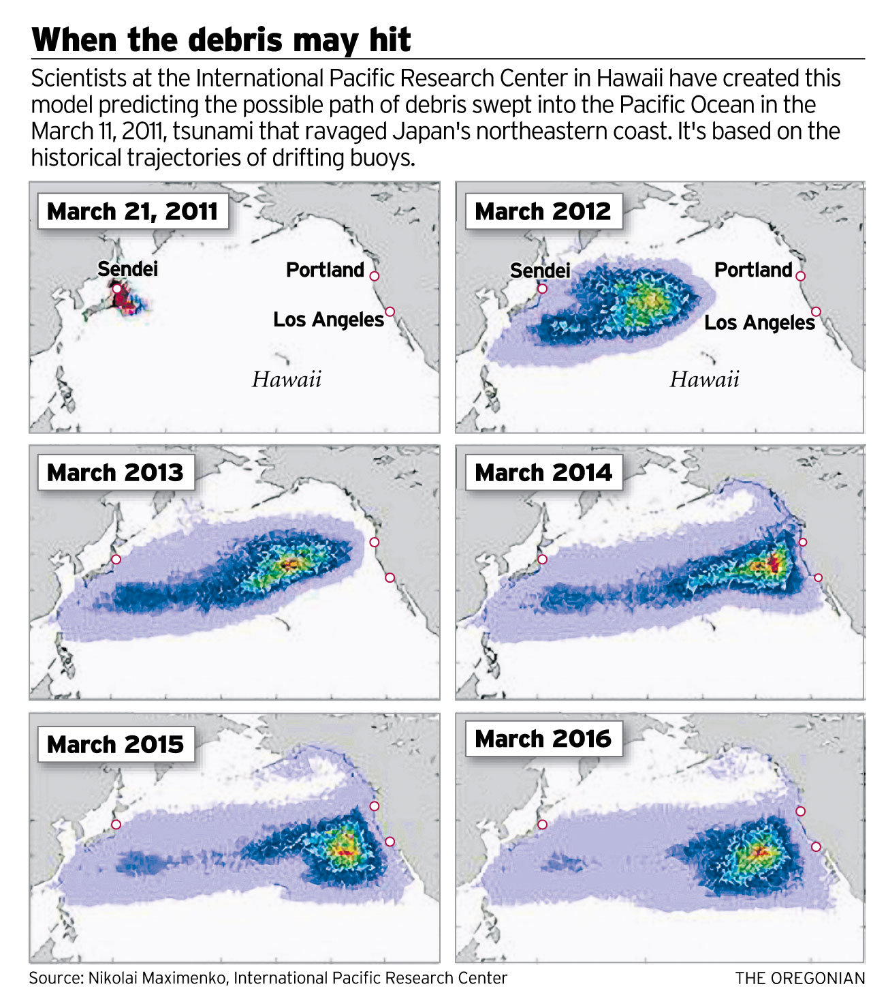
Data Types: Simulation
Results from using a model to study the behavior and performance of an actual or theoretical system
Models and metadata, where the input can be more important than output data
Examples: climate models, economic models, biogeochemical models
Notes:
Image credit: http://media.oregonlive.com/pacific-northwest-news/photo/gs61tsun103jpg-730687c0e8a35305.jpg
This model of tsunami driftage is based on ocean topography and surface winds. See: http://iprc.soest.hawaii.edu/research/research.php, research by N. Maximenko.

Slide 24
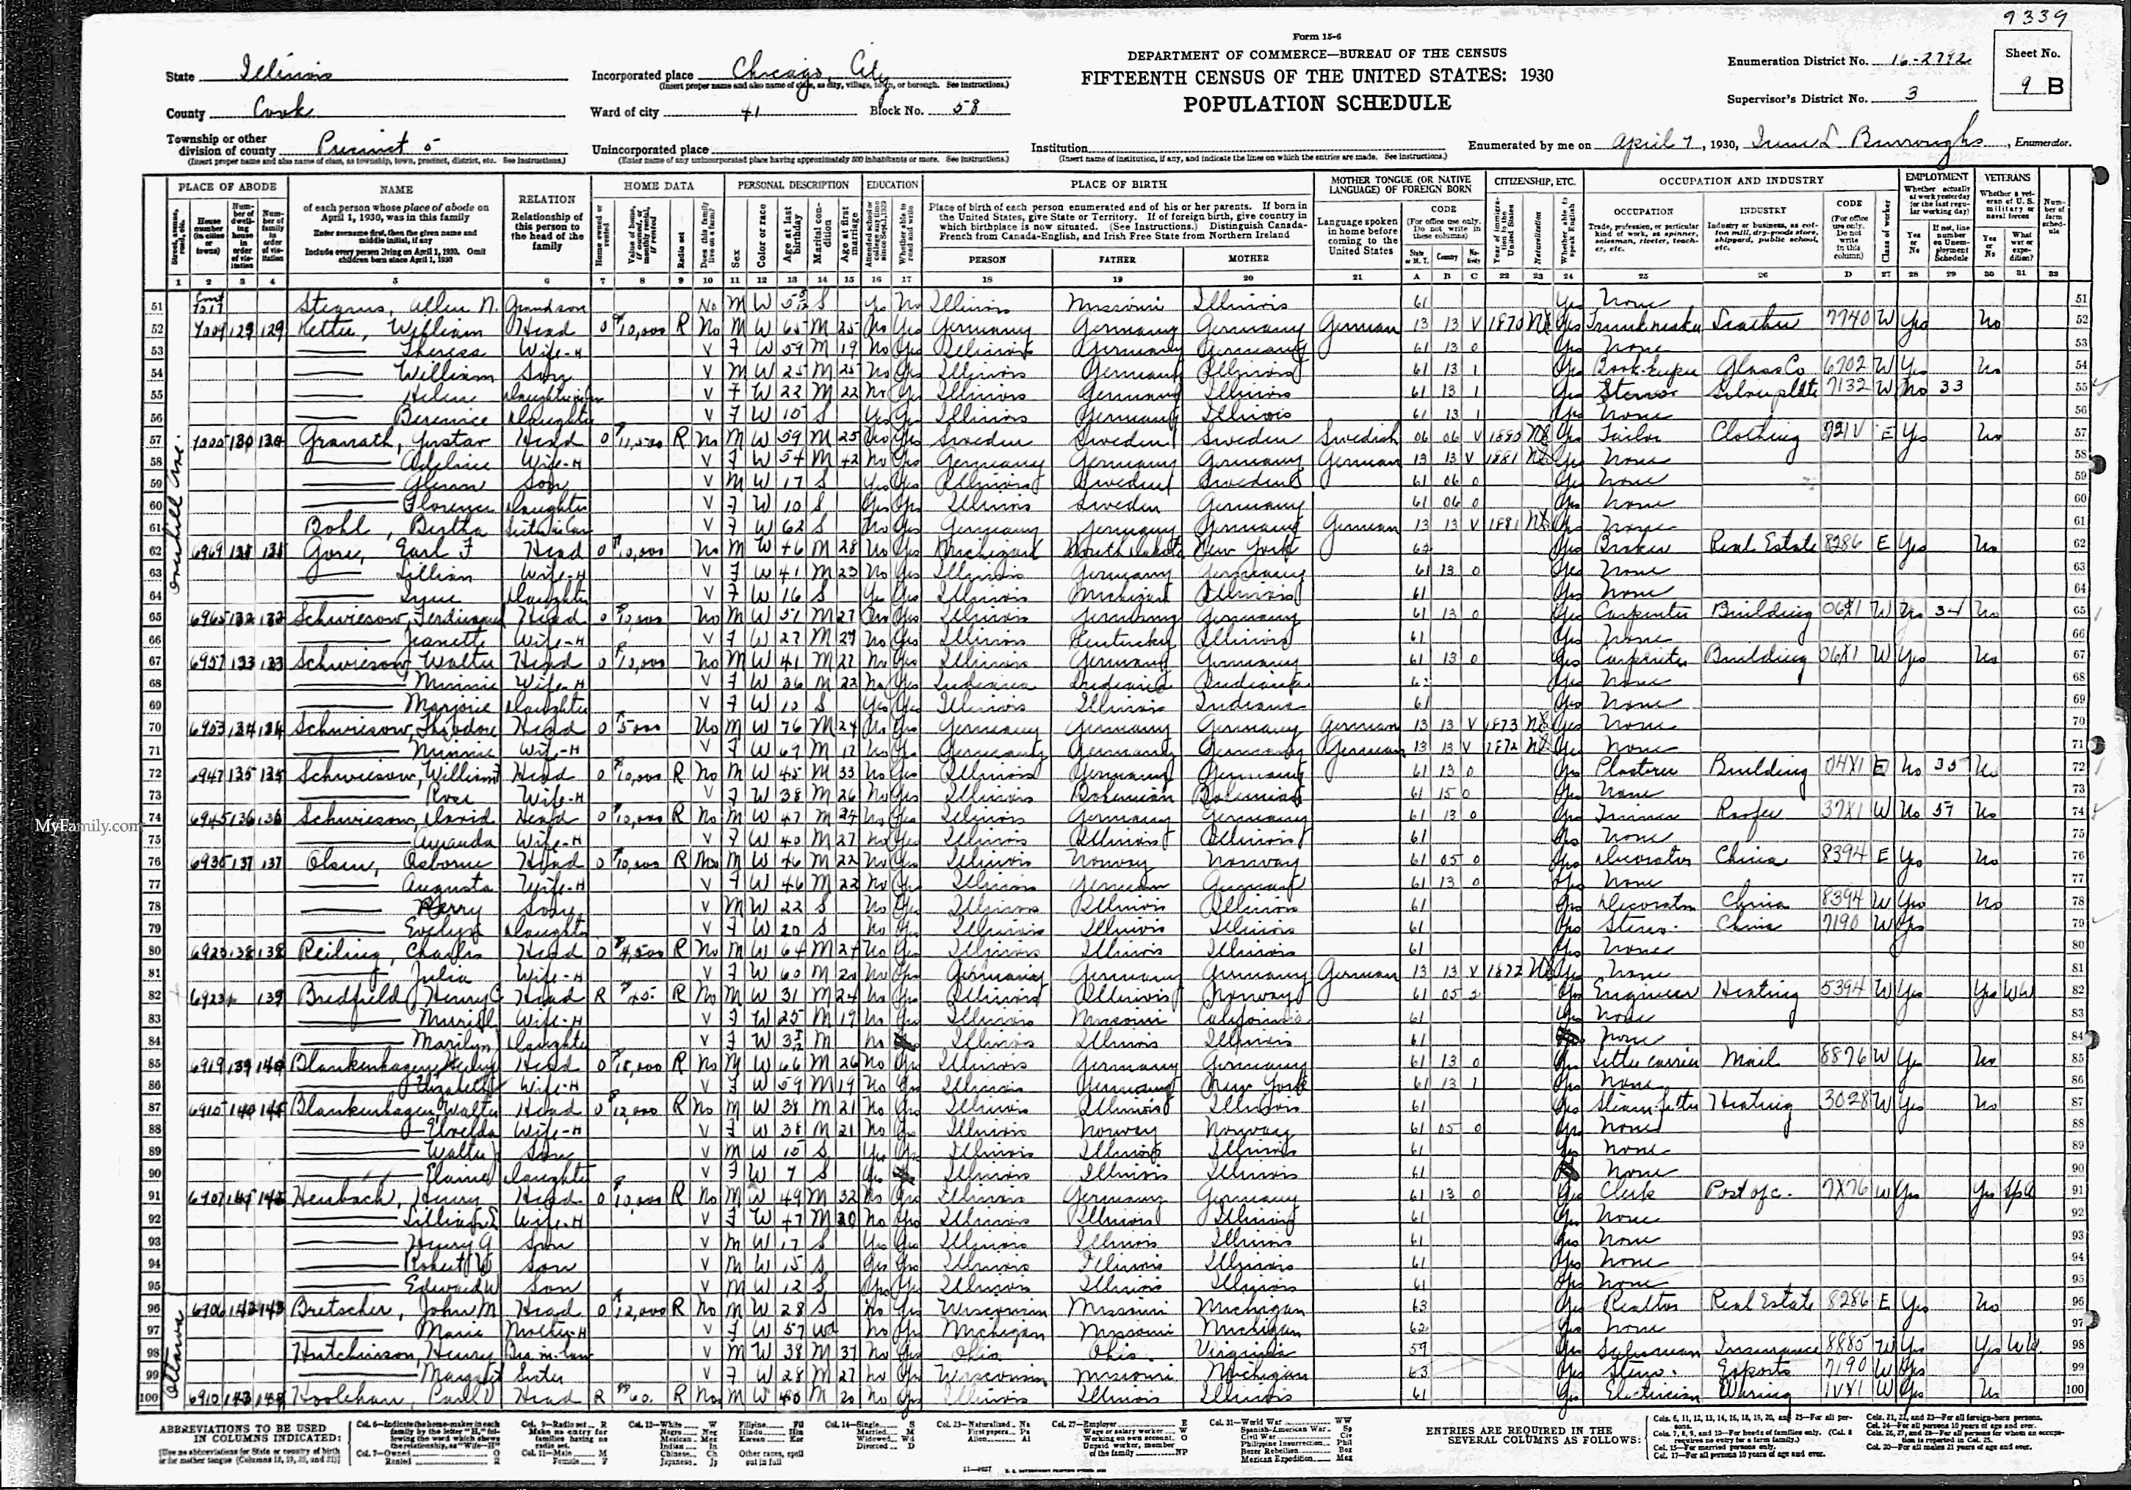
Data Types: Reference/Canonical
Static or organic collection [peer-reviewed] datasets, most probably published and/or curated.
Examples: gene sequence databanks, chemical structures, census data, spatial data portals
Notes:
Image credit: http://upload.wikimedia.org/wikipedia/commons/6/66/1930_census_Olsen_Schmidt.gif
Most research uses multiple data types & formats. My own dissertation included the generation or use of all of the data types that we’ve discussed (which might help to explain why it took me 7 years to earn a Ph.D.). http://hdl.handle.net/1957/9088

Slide 25
Data types: another classification
Qualitative data “is a categorical measurement expressed not in terms of numbers, but rather by means of a natural language description. In statistics, it is often used interchangeably with "categorical" data.” See also: nominal, ordinal
Quantitative data “is a numerical measurement expressed not by means of a natural language description, but rather in terms of numbers. However, not all numbers are continuous and measurable.”
“My favorite color is blue-green.” vs. “My favorite color is 510 nm.”
Source: Wikibooks: Statistics
Notes:
http://en.wikibooks.org/wiki/Statistics/Different_Types_of_Data/Quantitative_and_Qualitative_Data
More on qualitative data: ”Although we may have categories, the categories may have a structure to them. When there is not a natural ordering of the categories, we call these nominal categories. Examples might be gender, race, religion, or sport.
When the categories may be ordered, these are called ordinal variables. Categorical variables that judge size (small, medium, large, etc.) are ordinal variables. Attitudes (strongly disagree, disagree, neutral, agree, strongly agree) are also ordinal variables, however we may not know which value is the best or worst of these issues. Note that the distance between these categories is not something we can measure.”
More on quantitative data: “However, not all numbers are continuous and measurable. For example, the social security number is a number, but not something that one can add or subtract.”

Slide 26
More common data types
Geospatial data has a geographical or geospatial aspect. Spatial location is critically tied to other variables.
Digital image, audio & video data
Documentation & scripts Sometimes, software code IS data; likewise with documentation (laboratory notebooks, written observations, etc.)
Notes:
See more on geospatial analysis here: http://en.wikipedia.org/wiki/Geospatial_analysis

Slide 27
File Formats
“A file format is a standard way that information is encoded for storage in a computer file. It specifies how bits are used to encode information in a digital storage medium.” - Wikipedia
Data type
Possible formats
Qualitative, tabular
experimental data
Excel spreadsheet (.xlsx)
Comma-delimited text (.csv)
Access database (.mdb/,accdb)
Google Spreadsheet
SPSS portable file (.por)
XML file

Slide 28
Preferable Format Types for Long-Term Access to Data
Data formats that offer the best chance for long-term access are both:
Non-proprietary (also known as open) +
Unencrypted & uncompressed
Notes:
Non-proprietary or Open Formats are Readable by more than just the equipment and/or program that generated it. Sometimes proprietary file formats are unavoidable. However, proprietary formats can often be converted to open formats.
Unencrypted / uncompressed Formats: Offer the best prospects for long-term access. If files are encrypted and/or compressed, the method used will need to be both discoverable and usable for file access in the future.
slide credit: NECDMC

Slide 29
What types & formats of data will you be generating and/or using?
Reflective Writing: 60 seconds
Observational | Experimental | Derived | Compiled | Simulation | Reference/Canonical
Qualitative | Quantitative | Geospatial
Image/audio/video | Scripts/codes
Notes:
Why is this important? The data types that you are creating and/or using have implications for data documentation, storage and backup, data citation & ethics or reuse, and preservation and sharing (basically, all aspects of data management.

Slide 30
Back to the research lifecycle
Notes:
Now we are going to examine the research lifecycle, phases of research data, and associated data management actions.
Get the whole lifecycle graphic here: “Data management throughout the research lifecycle. Amanda Whitmire. figshare. http://dx.doi.org/10.6084/m9.figshare.774628”

Slide 31
Stage 1: Project conception & planning
Project ideas are developed and fleshed out.
Actions
Review existing datasets.
Determine where you will archive the data (your funder may have a required location), and consult with the archive about metadata and data formatting requirements.
Plan consent for data sharing, if needed.
Determine costs related to data storage & archiving.
Data management plan (DMP) is created.

Slide 32
Stage 2: Project startup
Actions
Finalize plans for data documentation & storage procedures.
Revise DMP if necessary.
Communicate data responsibilities to project members.
Establish, document and communicate protocols and methods.

Slide 33
Stage 3: Data lifecycle*
Each lifecycle stage has it’s own set of data management actions
Data Collection
QA/QC
Describe & Document
Processing & Analysis
Data Sharing
*Research is an iterative process. As a result, all of these stages may occur simultaneously.

Slide 34
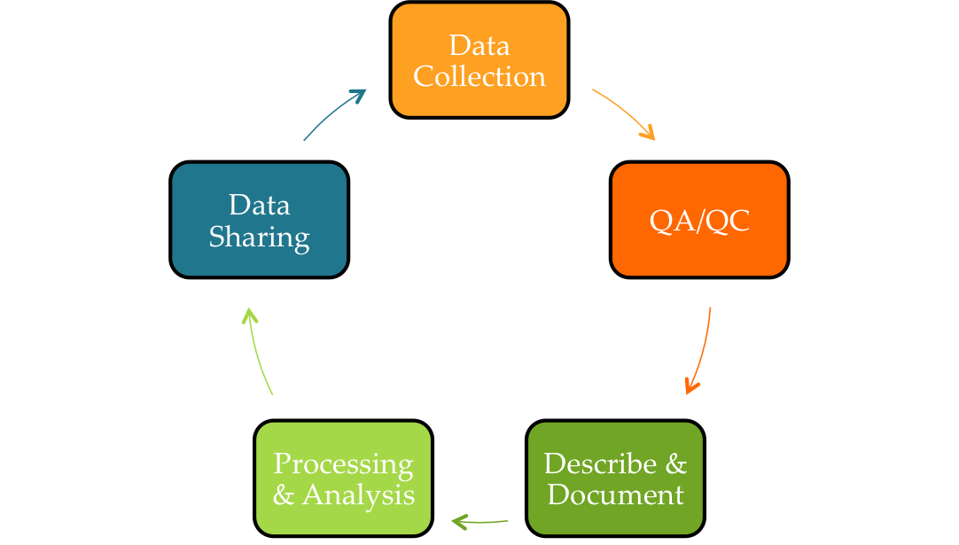
Stage 3: Data lifecycle
Lifecycle stage
Data stage
Data Collection
Raw
Actions
Organize files; use consistent, thoughtful file-naming conventions;
Carry out regular backups (rule: LOCKSS);
Consider access control & security.

Slide 35
Stage 3: Data lifecycle
Lifecycle stage
Data stage
QA/QC
Intermediate
Raw
Actions
Assign clear roles for QA/QC;
Check instrument precision, bias, and scale; replicates where possible;
Use controlled vocabulary on log/data sheets;
Check for out-of-range values, empty cells, etc.

Slide 36
Stage 3: Data lifecycle
Lifecycle stage
Data stage
Describe & Document
Intermediate
Actions
Document the context of data collection;
Data-level documentation;
Document protocols, conditions, etc.
Document how figures are produced

Slide 37
Stage 3: Data lifecycle
Lifecycle stage
Data stage
Processing & Analysis
Intermediate
Actions
Document and manage file versions;
Document file manipulations;
Document analysis procedures;
Write software codes with future sharing in mind;
You should still be doing regular backups.

Slide 38
Stage 3: Data lifecycle
Lifecycle stage
Data stage
Data Sharing
Final
Actions
Determine appropriate file formats;
Finalize data documentation;
Decide which data need to/should be/can be shared;
Share data within project team for analysis & interpretation.

Slide 39
Back to the research lifecycle
Notes:
Refresher on where we are – through the data lifecycle, and heading into end of project…

Slide 40
Stage 4: End of Project
Project is wrapping up; manuscripts in prep.
Actions
Write paper(s);
Contact archive for up-to-date requirements; deposit data in archive or repository;
Establish links between dataset(s) and paper(s) via citation and the use of identifiers (DOI, ORCID, etc.);
Perform data management audit against DMP.

Slide 41
Stages 5 & 6: Data Archived & Shared
Data are available for discovery &reuse, by you & others

Slide 42
Take results from previous activity & place them in the research lifecycle
Small group work: 3 minutes
Observational | Experimental | Derived | Compiled | Simulation | Reference/Canonical
Qualitative | Quantitative | Geospatial
Image/audio/video | Scripts/codes

Slide 43
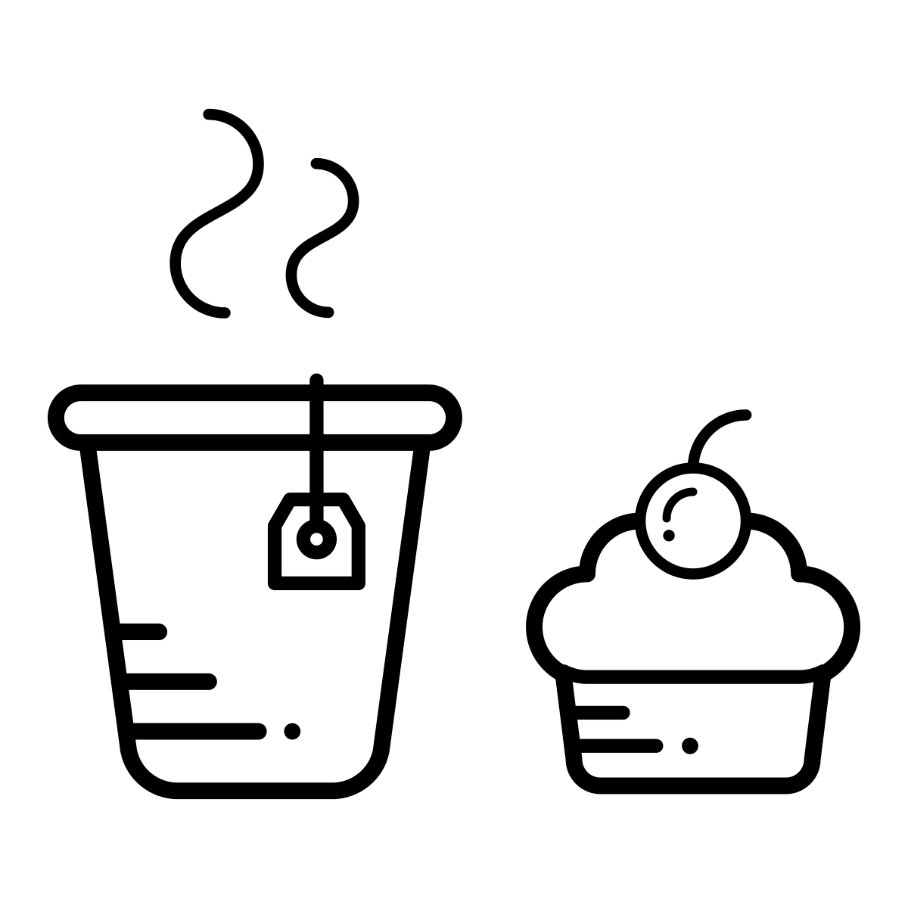
Notes:
Lunch!

Slide 44
Session 1 ~ 9am – 12pm
NW 5C
Hello!
What is 1001101?
Research lifecycle
Organization
Backup & Storage
Notes:
This morning is going to be one LONG chunk. Please feel free to stretch your legs and use the facilities as you need to.

Slide 45
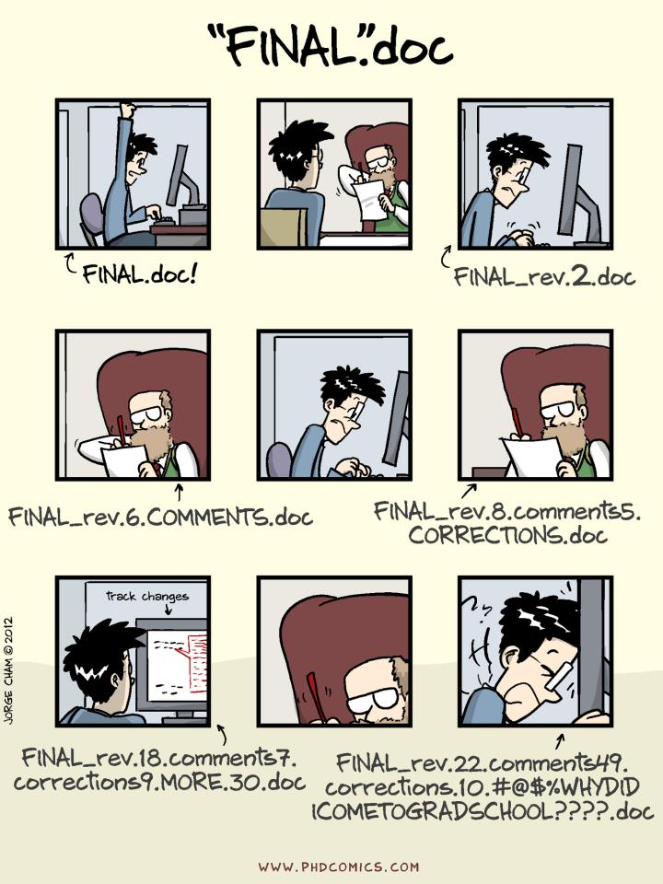
PhD Comics
Notes:
Source: phdcomics.com

Slide 46
Dilbert
Notes:
Source: Dilbert

Slide 47
PhD Comics
Notes:
Using a thoughtful, consistent file-naming strategy is the easiest way to make a big difference in organizing your files, and making them easy to find (not just by you, but by others in your group and your adviser).
[image credit: PhDComics.com]

Slide 48
Notes:
http://retractionwatch.com/2014/10/17/this-situation-left-me-ashamed-and-infuriated-with-myself-scientist-retracts-two-papers/

Slide 49
Principal investigator Jorge Leitão gave us a quick recap:
“A problem with a malfunctioning computer and image storage and mislabeling led to the assembling by one of the co-authors of images that were previously published by our research group. I didn’t detect the problem when the manuscript was sent for publication. Although the conclusions were not compromised in any of the two papers, we retract the papers precisely because some images were wrongly used.”
First author Christian Ramos:
“In the 2011 paper, it was first submitted to other 2 journals, whom requested a lot of modifications, and therefore, we accumulated a lot of processed data files. In between the process, the hard-drive of the computer that was used to store the data files (which is shared by 5 research groups) stopped working due data overloading. Nonetheless, we were able to retrieve the original data, or so we thought. At the time, I was responsible for composing the final figures of each paper that we produced, and asked the team members to give me the files. In Figure 8 of this paper, it seemed that there has been a labeling error in the source files, and I did not realize that some images where duplicated in the experiment that was being represented, neither that parts of the image had already been published.”
Notes:
Yowza. After this, the post-doc, Ramos, was fired.

Slide 50
File-naming strategies (1)
BE CONSISTENT
Have conventions for naming:
(1) Directory structure
(2) Folder names
(3) File names
Always include the same information
(e.g. date and time)
Retain the order of information
(e.g. YYYYMMDD, not MMDDYYY )

Slide 51
File-naming strategies (2)
BE DESCRIPTIVE
Try to keep file and folder names under 32 characters
Within reason, Include relevant information such as:
Unique identifier (ie. Project Name or Grant # in folder name)
Project or research data name
Conditions (Lab instrument, Solvent, Temperature, etc.)
Run of experiment (sequential)
Date (in file properties too)
When using sequential numbering, make sure to use leading zeros to allow for multi-digit versions. For example, a sequence of 1-10 should be numbered 01-10; a sequence of 1-100 should be numbered 001-010-100.
No special characters: & , * % # ; * ( ) ! @$ ^ ~ ' { } [ ] ? < > - + /
Use only one period and before the file extension
(e.g. name_paper.doc NOT name.paper.doc OR name_paper..doc)

Slide 52
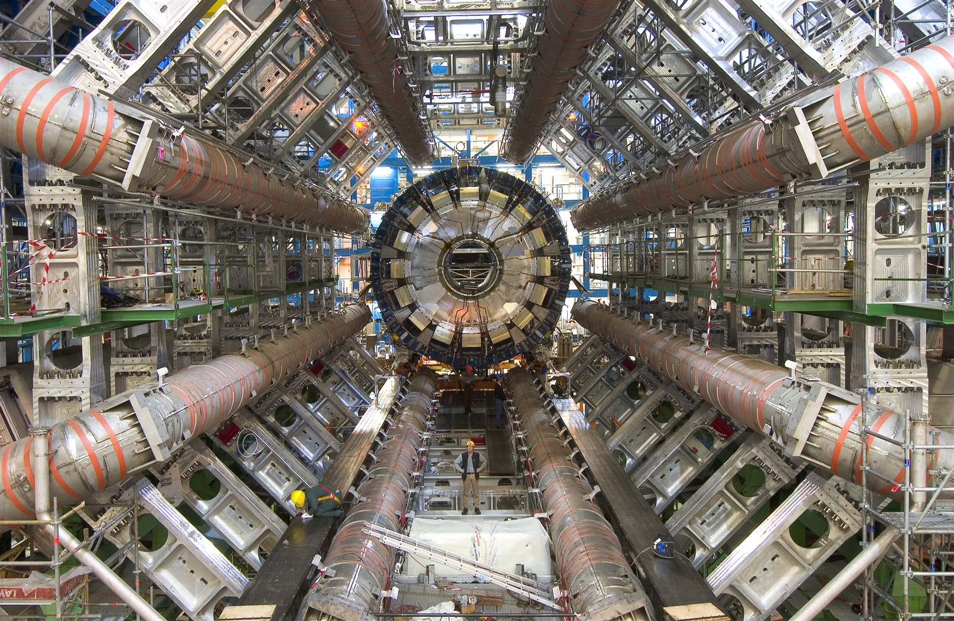
File naming conventions
s/n, variable
Retain order
Project_instrument_location_YYYYMMDDhhmmss_extra.ext
Index/grant
conditions
Leading zero!

Slide 53
File naming strategies
Order by date:
19550412_notes_MassObs.docx
19550412_questionnaire_MassObs.pdf
19631215_notes_Gorer.docx
19631215_questionnaire_Gorer.pdf
Order by subject:
Gorer_notes_19631215.docx
Gorer_questionnaire_19631215.pdf
MassObs_notes_19550412.docx
MassObs_questionnaire_19550412.pdf
Order by type:
Notes_Gorer_19631215.docx
Notes_MassObs_19550412.docx
Questionnaire_Gorer_19631215.pdf
Questionnaire_MassObs_19550412.pdf
Forced order with numbering:
01_MassObs_questionnaire_19550412.pdf
02_MassObs_notes_19550412.docx
03_Gorer_questionnaire_19631215.pdf
04_Gorer_notes_19631215.docx
Notes:
Once you have a file naming convention sorted out, think about the order of information in the file name. There is no right or wrong way to do this – just order the information in a way that works for you, be consistent, and WRITE IT DOWN so that others will understand it.

Slide 54
Standard date format:
why?
US standard | MM/DD/YY | DD/MM/YY | YYYY-MM-DD
January 12, 2011 | 01/12/11 | 12/01/11 | 2011-01-12
February 15, 2011 | 02/15/11 | 15/02/11 | 2011-02-15
March 27, 2011 | 03/27/11 | 27/03/11 | 2011-03-27
April 11, 2011 | 04/11/11 | 11/04/11 | 2011-04-11
May 20, 2011 | 05/20/11 | 20/05/11 | 2011-05-20
June 6, 2011 | 06/06/11 | 06/06/11 | 2011-06-06
July 18, 2011 | 07/18/11 | 18/07/11 | 2011-07-18
August 7, 2011 | 08/07/11 | 07/08/11 | 2011-08-07
September 9, 2011 | 09/09/11 | 09/09/11 | 2011-09-09
October 14, 2011 | 10/14/11 | 14/10/11 | 2011-10-14
November 24, 2011 | 11/24/11 | 24/11/11 | 2011-11-24
December 18, 2011 | 12/18/11 | 18/12/11 | 2011-12-18
January 19, 2012 | 01/19/12 | 19/01/12 | 2012-01-19
February 27, 2012 | 02/27/12 | 27/02/12 | 2012-02-27
March 15, 2012 | 03/15/12 | 15/03/12 | 2012-03-15
April 27, 2012 | 04/27/12 | 27/04/12 | 2012-04-27
May 11, 2012 | 05/11/12 | 11/05/12 | 2012-05-11
June 17, 2012 | 06/17/12 | 17/06/12 | 2012-06-17
July 16, 2012 | 07/16/12 | 16/07/12 | 2012-07-16
August 4, 2012 | 08/04/12 | 04/08/12 | 2012-08-04
September 14, 2012 | 09/14/12 | 14/09/12 | 2012-09-14
October 26, 2012 | 10/26/12 | 26/10/12 | 2012-10-26
November 26, 2012 | 11/26/12 | 26/11/12 | 2012-11-26
December 8, 2012 | 12/08/12 | 08/12/12 | 2012-12-08
January 22, 2013 | 01/22/13 | 22/01/13 | 2013-01-22
February 20, 2013 | 02/20/13 | 20/02/13 | 2013-02-20
March 26, 2013 | 03/26/13 | 26/03/13 | 2013-03-26
April 18, 2013 | 04/18/13 | 18/04/13 | 2013-04-18
May 23, 2013 | 05/23/13 | 23/05/13 | 2013-05-23
Dates listed in order of collection
Notes:
It’s easy to sort by date in Excel, because it is possible to assign a number format in each cell that Excel understands means ‘date’.
However, if you put the date in the filename, your computer will sort these dates as TEXT, not as date-formatted numerical values.
Let’s look at how this plays out in filenames, under different number order schemes. (pretend that all ‘/’ are ‘-’, for the sake of consistency)

Slide 55
Standard date format:
why?
US standard | MM-DD-YYYY | DD-MM-YYYY | YYYY-MM-DD
January 12, 2011 | 01-12-2011 | 12-01-2011 | 2011-01-12
January 19, 2012 | 01-19-2012 | 19-01-2012 | 2012-01-19
January 22, 2013 | 01-22-2013 | 22-01-2013 | 2013-01-22
February 15, 2011 | 02-15-2011 | 15-02-2011 | 2011-02-15
February 20, 2013 | 02-20-2013 | 20-02-2013 | 2013-02-20
February 27, 2012 | 02-27-2012 | 27-02-2012 | 2012-02-27
March 15, 2012 | 03-15-2012 | 15-03-2012 | 2012-03-15
March 26, 2013 | 03-26-2013 | 26-03-2013 | 2013-03-26
March 27, 2011 | 03-27-2011 | 27-03-2011 | 2011-03-27
April 11, 2011 | 04-11-2011 | 11-04-2011 | 2011-04-11
April 18, 2013 | 04-18-2013 | 18-04-2013 | 2013-04-18
April 27, 2012 | 04-27-2012 | 27-04-2012 | 2012-04-27
May 11, 2012 | 05-11-2012 | 11-05-2012 | 2012-05-11
May 20, 2011 | 05-20-2011 | 20-05-2011 | 2011-05-20
May 23, 2013 | 05-23-2013 | 23-05-2013 | 2013-05-23
June 6, 2011 | 06-06-2011 | 06-06-2011 | 2011-06-06
June 17, 2012 | 06-17-2012 | 17-06-2012 | 2012-06-17
June 26, 2013 | 06-26-2013 | 26-06-2013 | 2013-06-26
July 16, 2012 | 07-16-2012 | 16-07-2012 | 2012-07-16
July 18, 2011 | 07-18-2011 | 18-07-2011 | 2011-07-18
July 22, 2013 | 07-22-2013 | 22-07-2013 | 2013-07-22
August 4, 2012 | 08-04-2012 | 04-08-2012 | 2012-08-04
August 7, 2011 | 08-07-2011 | 07-08-2011 | 2011-08-07
August 8, 2013 | 08-08-2013 | 08-08-2013 | 2013-08-08
September 9, 2011 | 09-09-2011 | 09-09-2011 | 2011-09-09
September 14, 2012 | 09-14-2012 | 14-09-2012 | 2012-09-14
September 19, 2013 | 09-19-2013 | 19-09-2013 | 2013-09-19
October 14, 2011 | 10-14-2011 | 14-10-2011 | 2011-10-14
October 26, 2012 | 10-26-2012 | 26-10-2012 | 2012-10-26
If we sort by MM/DD/YY,
dates are out of order.
Notes:
Filenames listed in the typical “US” fashion will be out of order, as all January data files will be listed first, then February, and so on. If this sort order is necessary for some reason, then use it. But be aware that multi-year data will be out of order.

Slide 56
Standard date format:
why?
US standard | MM-DD-YYYY | DD-MM-YYYY | YYYY-MM-DD
August 4, 2012 | 08-04-2012 | 04-08-2012 | 2012-08-04
June 6, 2011 | 06-06-2011 | 06-06-2011 | 2011-06-06
August 7, 2011 | 08-07-2011 | 07-08-2011 | 2011-08-07
August 8, 2013 | 08-08-2013 | 08-08-2013 | 2013-08-08
December 8, 2012 | 12-08-2012 | 08-12-2012 | 2012-12-08
September 9, 2011 | 09-09-2011 | 09-09-2011 | 2011-09-09
December 10, 2013 | 12-10-2013 | 10-12-2013 | 2013-12-10
April 11, 2011 | 04-11-2011 | 11-04-2011 | 2011-04-11
May 11, 2012 | 05-11-2012 | 11-05-2012 | 2012-05-11
January 12, 2011 | 01-12-2011 | 12-01-2011 | 2011-01-12
September 14, 2012 | 09-14-2012 | 14-09-2012 | 2012-09-14
October 14, 2011 | 10-14-2011 | 14-10-2011 | 2011-10-14
February 15, 2011 | 02-15-2011 | 15-02-2011 | 2011-02-15
March 15, 2012 | 03-15-2012 | 15-03-2012 | 2012-03-15
July 16, 2012 | 07-16-2012 | 16-07-2012 | 2012-07-16
June 17, 2012 | 06-17-2012 | 17-06-2012 | 2012-06-17
April 18, 2013 | 04-18-2013 | 18-04-2013 | 2013-04-18
July 18, 2011 | 07-18-2011 | 18-07-2011 | 2011-07-18
December 18, 2011 | 12-18-2011 | 18-12-2011 | 2011-12-18
January 19, 2012 | 01-19-2012 | 19-01-2012 | 2012-01-19
September 19, 2013 | 09-19-2013 | 19-09-2013 | 2013-09-19
February 20, 2013 | 02-20-2013 | 20-02-2013 | 2013-02-20
May 20, 2011 | 05-20-2011 | 20-05-2011 | 2011-05-20
January 22, 2013 | 01-22-2013 | 22-01-2013 | 2013-01-22
July 22, 2013 | 07-22-2013 | 22-07-2013 | 2013-07-22
May 23, 2013 | 05-23-2013 | 23-05-2013 | 2013-05-23
November 24, 2011 | 11-24-2011 | 24-11-2011 | 2011-11-24
March 26, 2013 | 03-26-2013 | 26-03-2013 | 2013-03-26
June 26, 2013 | 06-26-2013 | 26-06-2013 | 2013-06-26
If we sort by DD/MM/YY,
dates are out of order.
Notes:
Even if you store your date in sequential order (day-month-year), it will sort based on ‘day’ and again produce an out of sequence list of data files.

Slide 57
Standard date format:
why?
US standard | MM-DD-YYYY | DD-MM-YYYY | YYYY-MM-DD
January 12, 2011 | 01-12-2011 | 12-01-2011 | 2011-01-12
February 15, 2011 | 02-15-2011 | 15-02-2011 | 2011-02-15
March 27, 2011 | 03-27-2011 | 27-03-2011 | 2011-03-27
April 11, 2011 | 04-11-2011 | 11-04-2011 | 2011-04-11
May 20, 2011 | 05-20-2011 | 20-05-2011 | 2011-05-20
June 6, 2011 | 06-06-2011 | 06-06-2011 | 2011-06-06
July 18, 2011 | 07-18-2011 | 18-07-2011 | 2011-07-18
August 7, 2011 | 08-07-2011 | 07-08-2011 | 2011-08-07
September 9, 2011 | 09-09-2011 | 09-09-2011 | 2011-09-09
October 14, 2011 | 10-14-2011 | 14-10-2011 | 2011-10-14
November 24, 2011 | 11-24-2011 | 24-11-2011 | 2011-11-24
December 18, 2011 | 12-18-2011 | 18-12-2011 | 2011-12-18
January 19, 2012 | 01-19-2012 | 19-01-2012 | 2012-01-19
February 27, 2012 | 02-27-2012 | 27-02-2012 | 2012-02-27
March 15, 2012 | 03-15-2012 | 15-03-2012 | 2012-03-15
April 27, 2012 | 04-27-2012 | 27-04-2012 | 2012-04-27
May 11, 2012 | 05-11-2012 | 11-05-2012 | 2012-05-11
June 17, 2012 | 06-17-2012 | 17-06-2012 | 2012-06-17
July 16, 2012 | 07-16-2012 | 16-07-2012 | 2012-07-16
August 4, 2012 | 08-04-2012 | 04-08-2012 | 2012-08-04
September 14, 2012 | 09-14-2012 | 14-09-2012 | 2012-09-14
October 26, 2012 | 10-26-2012 | 26-10-2012 | 2012-10-26
November 26, 2012 | 11-26-2012 | 26-11-2012 | 2012-11-26
December 8, 2012 | 12-08-2012 | 08-12-2012 | 2012-12-08
January 22, 2013 | 01-22-2013 | 22-01-2013 | 2013-01-22
February 20, 2013 | 02-20-2013 | 20-02-2013 | 2013-02-20
March 26, 2013 | 03-26-2013 | 26-03-2013 | 2013-03-26
April 18, 2013 | 04-18-2013 | 18-04-2013 | 2013-04-18
May 23, 2013 | 05-23-2013 | 23-05-2013 | 2013-05-23
If we sort by YY/MM/DD,
dates are in order.
Notes:
Finally, if we use descending sequential numbering for dates in file names (year-month-day), the data files, when sorted by file name, will be in the correct date order (ascending or descending depending on what you want).

Slide 58
Leading zeroes : why?
Notes:
Left column: the numbers sorted as numeric values, as they would be in Excel.
Middle column: same numbers, sorted as text, as they would be in a file name.
Right column: same numbers, sorted as text with leading zeroes, as they would be in a file name.

Slide 59
Notes:
Questions before our activity?
image credit: Question by Greg Pabst from The Noun Project

Slide 60
Pair & share – 10 minutes
5 minutes: generate potential file names for your data & document your strategy
3 minutes: share your strategy with another group & hear what they came up with
2 minutes: volunteer to share your idea with the class
s/n, variable
Retain order
Project_instrument_location_YYYYMMDDhhmmss_extra.ext
Index/grant
conditions
Leading zero!
Notes:
Think about your project, the types and formats of data you have now and/or will generate, and how you might want to sort them, for example. Is a date important? A location, subject population, or attribute of the specimen or subject?
SHORT BREAK HERE?

Slide 61
File Organization
Notes:
Image credit: Archive by Michela Tannoia from The Noun Project

Slide 62
Organization methods
there is no
‘one-size-fits-all’
approach to organization

Slide 63
Organization methods
When naming & organizing
your files and folders…
be thoughtful
be consistent
document your approach

Slide 64
Amanda’s approach*
Top-level folders:
Top Level Name | 2nd Level | 3rd Level Naming Convention
Documents
Instruction
Projects
Rcode
Service

Slide 65
Amanda’s approach*
Top-level folders:
Top Level Name | 2nd Level | 3rd Level Naming Convention
Documents
Instruction
Projects
Rcode
Service
*My actual approach is messier than this.

Slide 66
Amanda’s approach
Top-level folders:
Top Level Name | 2nd Level | 3rd Level Naming Convention
Documents | CDSS_General | varies
 | ConferenceDocs | YYYYMMDD_ConfName
 | DMP_Reviews | YYYYMM_LastName
 | Funding | YYYY_Agency
 | Manuscripts_Mine | FirstAuthLastName_Journal_YYYY
 | Manuscripts_Reviews | Journal_ManID_YYYY
 | PromTenure | varies
 | Travel | YYYY_ConfName_DocName*
*File names. All other naming conventions shown for for third-level folders

Slide 67
Amanda’s approach
Top-level folders:
Top Level Name | 2nd Level | 3rd Level Naming Convention
 | DataInfoLit | varies*
Instruction | DataONE_Modules | L##_Topic*
 | GRAD520 | ContentType
 | GRAD521 | ContentType
 | NECDMC_Resources | ContentType
 | Pedagogy | varies*
 | UKDA_Resources | LessonTopic_Type*
 | Workshops | WorkshopName
*File names.

Slide 68
Amanda’s approach
Top-level folders:
Top Level Name | 2nd Level | 3rd Level Naming Convention
 | IMLS_DART* | ConferenceDocs
 |  | DMP_NonNSF_Resources
Projects |  | DMP_NSF_Guidance
 |  | DMP_ReviewData
 |  | DMPs
 |  | InfrequentlyUsed
 |  | LitReview
 |  | MeetingMinutes
 |  | Outputs_PapersPostersEtc
 |  | RubricDevelopment
*This is a shared Google Drive folder for a collaborative research project
Notes:
Project website: http://bit.ly/dmpresearch

Slide 69
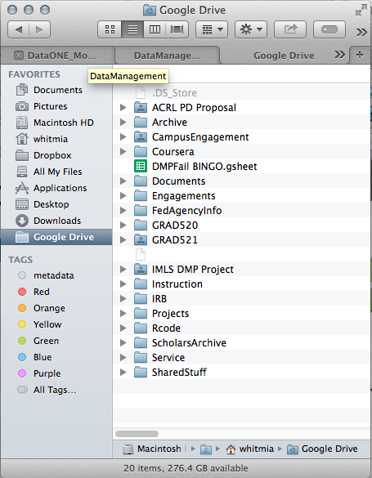
Amanda’s approach
Top-level folders:
Top Level Name | 2nd Level | 3rd Level Naming Convention
Documents
Instruction
Projects
Rcode
Service
All of these folders reside in my local Google Drive folder. They are automatically synced to the web in real time, which is good for collaboration, for keeping websites up to date & for backups of my most important stuff.

Slide 70
Organization methods
When naming & organizing
your files and folders…
be thoughtful
be consistent
document your approach

Slide 71
Notes:
image credit: Question by Greg Pabst from The Noun Project

Slide 72
Session 1 ~ 9am – 12pm
NW 5C
Hello!
What is 1001101?
Research lifecycle
Organization
Backup & Storage
Notes:
We are in the home stretch before lunch!

Slide 73
“Your data are the life blood of your research.
If you lose your data recovery could be
slow, costly or even worse…
it could be impossible.”
Notes:
Quote from: UE RDM Kit
Why data storage, backup & security are important – let’s review a few real-world scenarios.

Slide 74
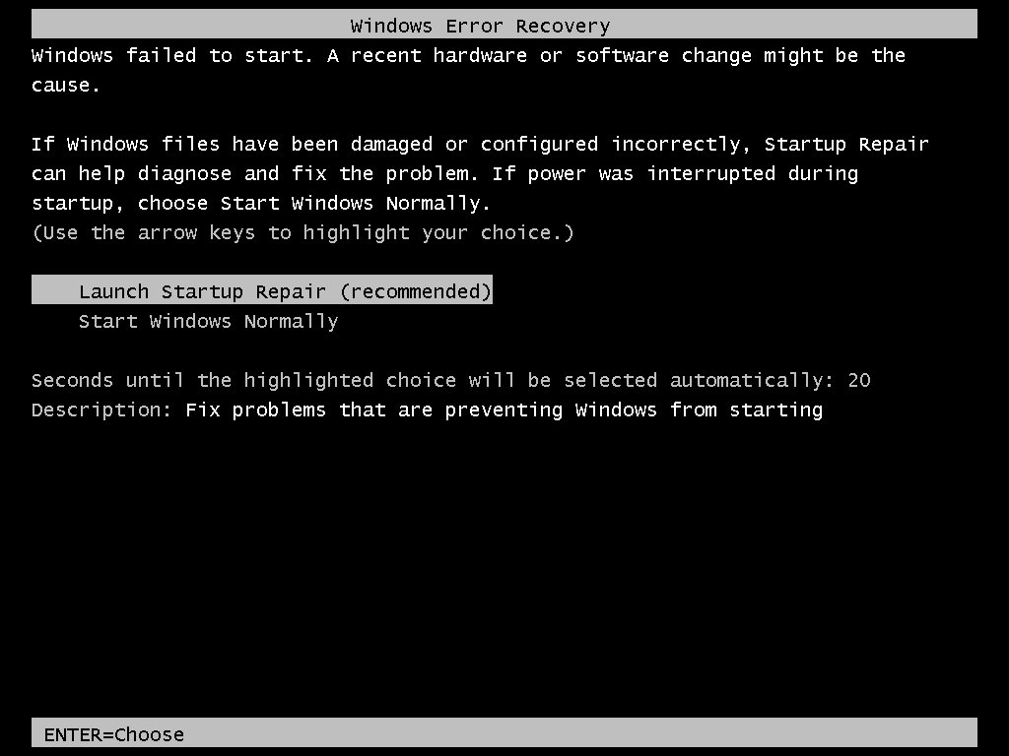
Most common loss scenario: drive failure
Notes:
Hard drive failures happen ALL THE TIME, without notice. There’s a one-liner that goes something like, “There are two kinds of people in this world: those who have had a hard drive fail, and those who haven’t had a had hard drive fail…yet.” (ha ha)
Personal example: tell the story about Maria’s hard drive failure, and expensive partial recovery of her dissertation data.
image credit: http://www.johnytech.com/wp-content/uploads/2012/09/booterrors.jpg

Slide 75
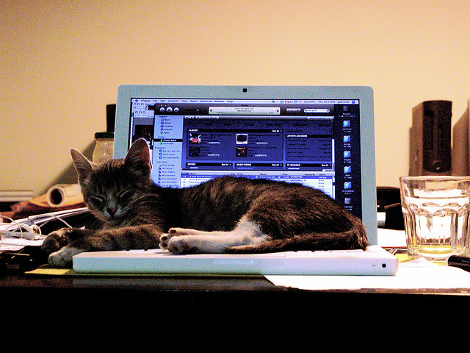
This happens a lot: physical theft & unintentional damage
Not a valid security plan.
Notes:
Something else that happens ALL THE TIME: your computer get stolen (Wiley, post-research cruise theft example). Or, you crash your bike and your computer goes flying (Angel).
image credit: http://www.flickr.com/photos/jeffreywarren/299422173/

Slide 76
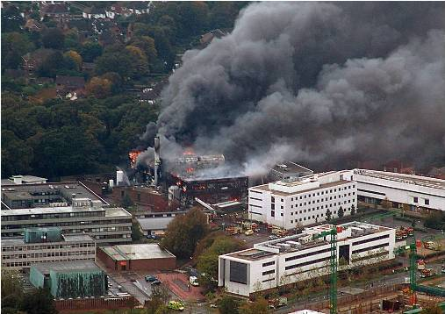
Rare, unexpected events happen
University of Southampton, School of Electronics & Computer Science, Southampton, UK, 2005
Notes:
Lesson: offsite, redundant storage is strongly encouraged.

Slide 77
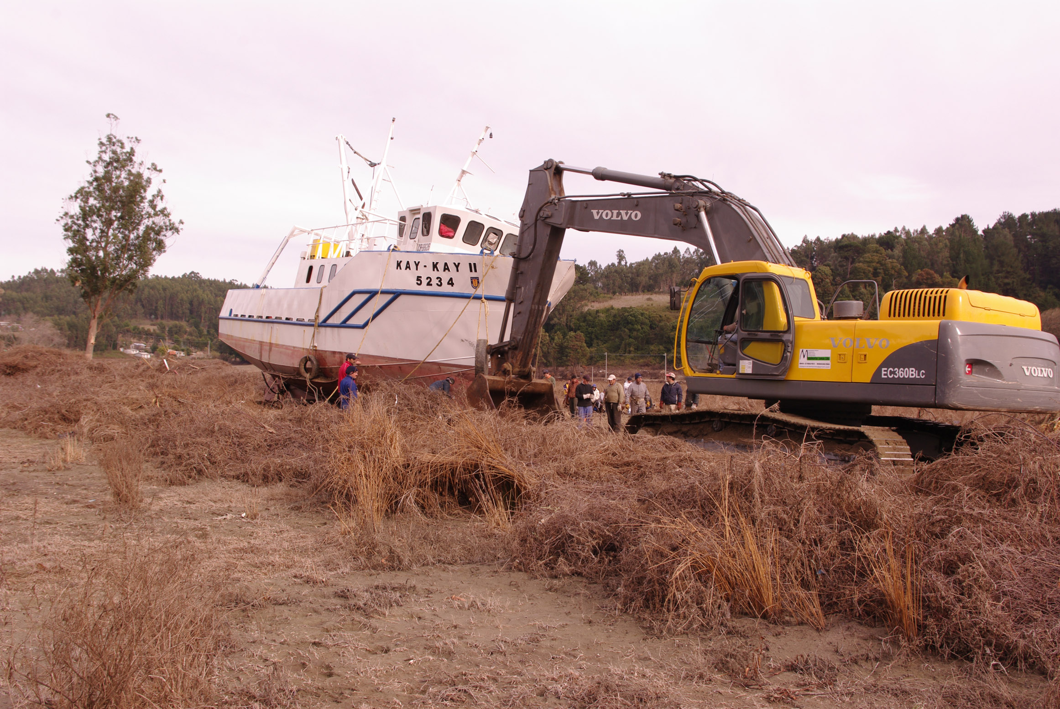
It CAN happen to you
Notes:
From my post-doctoral work: Following the Chile earthquake in 2010 (M8.8), a tsunami devastated the coastal town of Dichato, and moved the Universidad de Concepcion’s research vessel 1 km inland. The marine research station was left standing, but everything in it was destroyed (including our samples and data servers). Luckily, we had the data server replicated at OSU, so we only lost the physical samples that were in Chile. Think it can’t happen to you? Yeah, I thought the same thing.
[photo credit: http://www.ocean-partners.org/attachments/473_Being%20towed.JPG]

Slide 78
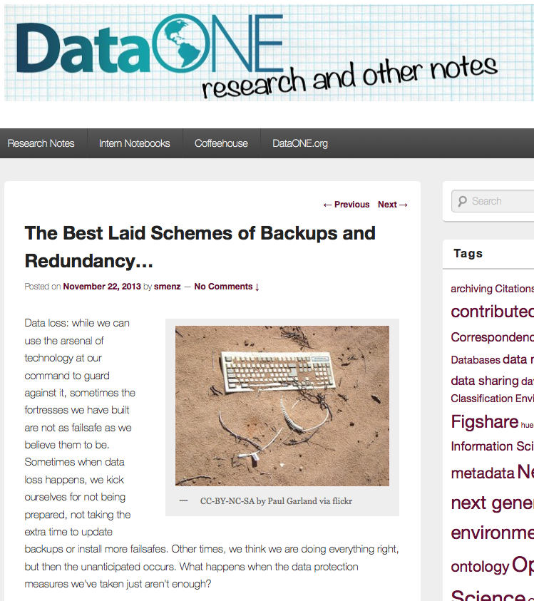
Real-world lesson: Audit your backups…
Notes:
Not from my personal experience: from the DataONE Data Stories project: https://notebooks.dataone.org/data-stories/the-best-laid-schemes-of-backups-and-redundancy/
Basic synopsis of this story: A researcher had made regular backups of her data, 5 GB worth, to an external drive. Her computer hard drive failed, so she sent it to IT, had it repaired, and went to restore her data using what was on her external backup drive. Unfortunately, only 30% of the data were accessible from the drive. “The only thing they could determine was that the software used to back up the data was not compatible with the recovery process.”
Lesson: “As it turned out, creating backups was not enough to completely guard against tragedy; the only way to make sure those backups could serve their purpose in the event of an emergency was to check them regularly and ensure the data they contained were recoverable.”

Slide 79
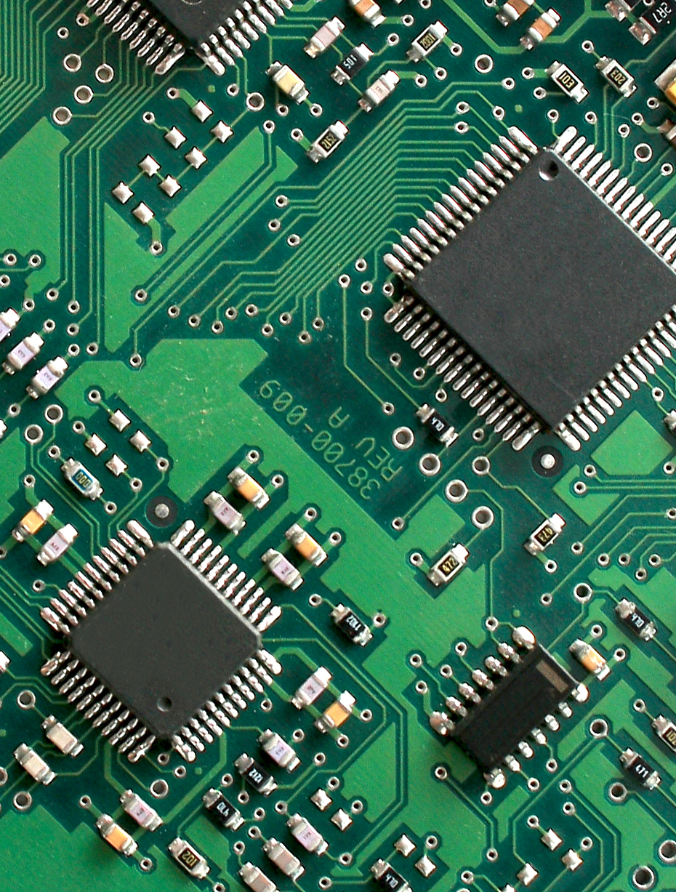
Data storage options
Personal computers (PCs) & laptops
External storage devices
Networked Drives
Cloud servers
Notes:
We will talk about the advantages, disadvantages and longevity of each.

Slide 80
Storage: PC/laptop
Advantages
Convenient
Disadvantages
Drive failure common
Laptops: susceptible to theft & unintentional damage
Not replicated
Bottom Line
Do NOT use to store master copies of data
Not a long term storage solution
Back up important data & files regularly
Notes:
Some content from: UE RDM Kit

Slide 81
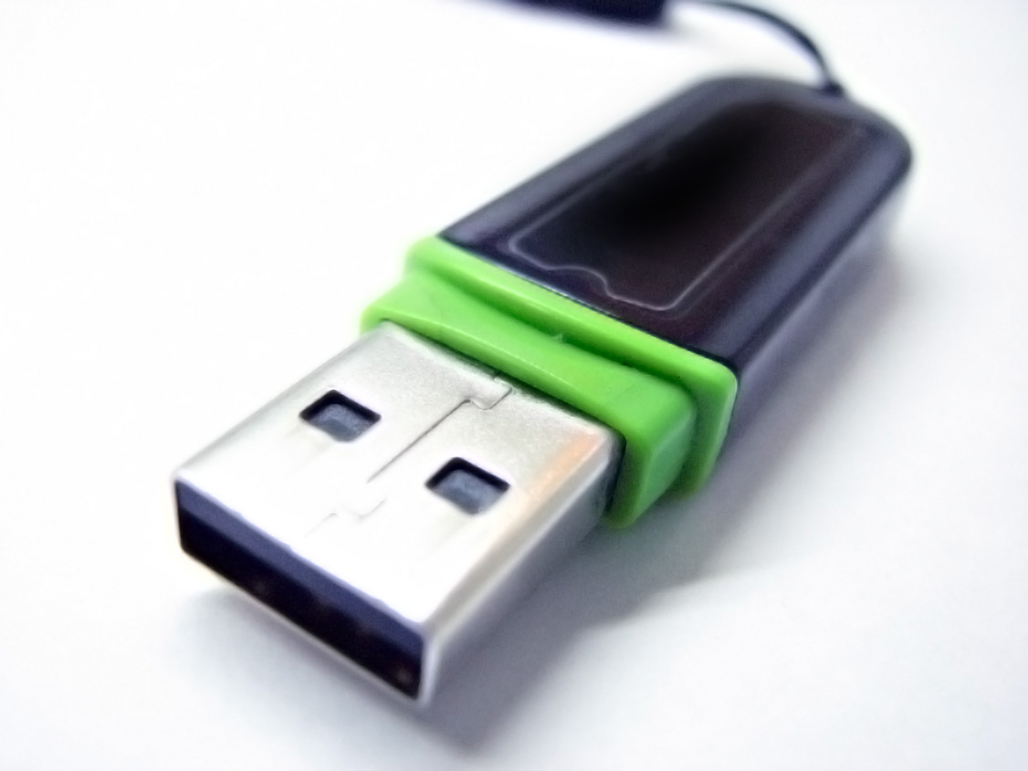
Storage: external storage devices
Advantages
Convenient, cheap & portable
Disadvantages
Longevity not guaranteed (e.g. Zip disks)
Errors writing to CD/DVD are common
Easily damaged, misplaced or lost (=security risk)
May not be big enough to hold all data; multiple drives needed
Bottom Line
Do NOT use to store master copies of data
Not recommended for long-term storage
Notes:
USB flash drives, Compact Discs (CDs) and Digital Video Discs (DVDs)
If you choose to use CDs, DVDs and USB flash drives (for example, for working data or extra backup copies), you should:
Choose high quality products from reputable manufacturers.
Follow the instructions provided by the manufacturer for care and handling, including environmental conditions and labeling.
Regularly check the media to make sure that they are not failing
periodically 'refresh' the data (that is, copy to a new disk or new USB flash drive); every 2-5 years
Ensure that any private or confidential data is password-protected and/or encrypted.
Some content from: UE RDM Kit

Slide 82
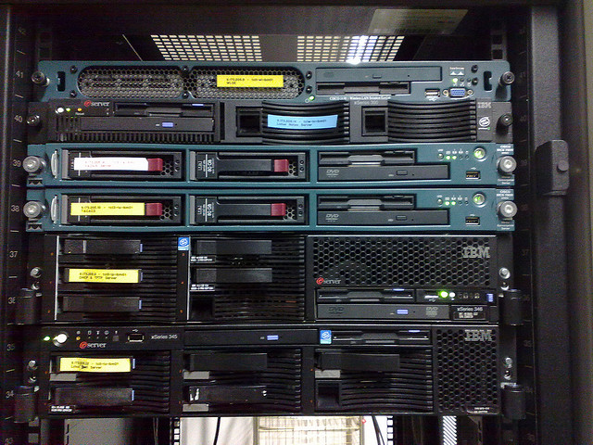
Storage: networked drives
Advantages
Data in single place, backed up regularly
Replicated storage not vulnerable to loss due to hardware failure
Secure storage minimizes risk of loss, theft, unauthorized use
Available as needed (assuming network avail.)
Disadvantages
Cost may be prohibitive; export control
Bottom Line
Highly recommended for master copies of data
Recommended for long-term storage (~5 years)
Notes:
For example:
Fileservers managed by your research group, unit or department
Fileservers managed by Information Services
image credit: http://www.flickr.com/photos/ketmonkey/3329372324/
Some content from: UE RDM Kit

Slide 83
Storage: cloud storage
Advantages
Data in single place, backed up regularly
Replicated storage not vulnerable to loss due to hardware failure
Secure storage minimizes risk of loss, theft, unauthorized use
Disadvantages
Cost may be prohibitive
Upload/download bottleneck & fees
Longevity?
Export control
Bottom Line
Possibly recommended for master copies of data
Not recommended for in-process data, large files
Notes:
For example: DropBox, SkyDrive, Box, Mozy,
Image credit: Cloud by Benni from The Noun Project
Some content from: UE RDM Kit

Slide 84
Storage: Google Drive for OSU
Advantages
All same advantages of network & cloud storage
File sharing & collaboration w/variable access levels
Unlimited storage (GD), 10 TB non-GD
Automatic version control on GD
Disadvantages
Space available may not be enough
Upload/download bottleneck
Bottom Line
Possibly recommended for master copies of data
Possibly not recommended for in-process data, large files
Notes:
See more info here: http://oregonstate.edu/helpdocs/software/google-apps-osu
Fully encrypted; data will not be indexed or harvested by Google (per the “Apps for Education” agreement).
Image credit: Cloud by Benni from The Noun Project
Some content from: UE RDM Kit

Slide 85
?
?
?
?
Notes:
Before I move on – questions about anything so far?

Slide 86
Data backup
“Keeping backups is probably your most important data management task.”
-Everyone
Notes:
From NECDMC Module 4: Backup allows you to restore your data in the event that it is lost.
A backup strategy is a plan for ensuring the accessibility of research data during the life of a project. What your strategy will be depends on the amount of data you are working with, the frequency that your data changes, and the system requirements for storing and rendering it.

Slide 87
Data backup
Best Practice ➔ 3 Copies of datasets
Original
External Local
External Remote
Notes:
LOCKSS: lots of copies keeps stuff safe

Slide 88
Data backup
Best Practice ➔ 3 Copies of datasets
Original
External Local
External Remote
1 TB USB Drive
Laptop
Network Server &
GDrive
100% AUTOMATED

Slide 89
Backups: bottom line
Pick a strategy
Be consistent
Test your approach!
Notes:
Let’s stop here and have a quick chat about backups – who is doing them? How are they being done?

Slide 90
Notes:
Lunch!

