Slide 1


Adjuvant Vitamin E and Ovarian Cancer
Alysha Hartman
Mentor: Debbie Mustacich, Ph.D.
Linus Pauling Institute
Oregon State University

Slide 2
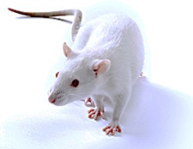
Outline
Introduction
  Ovarian Cancer
  Cisplatin
  Vitamin E
Question
Hypothesis
Experimental Design
Results
Summary
Future Studies
F344 Female Rats
Notes:
Brief outline of the talk
F344 Rat –an immune competent laboratory strain

Slide 3
Ovarian Cancer
5th leading cause of cancer-related deaths in women in the U.S.
  Accounts for about 6% of deaths
Highest mortality rate of gynecologic cancers
Most patients have widespread disease at diagnosis
Notes:
Ovarian cancer is the 5th leading cause of cancer-related deaths in women in the United States and has the highest mortality rate of all gynecologic cancers.
A key reason for the high mortality rate is that most patients have widespread disease at the time of diagnosis

Slide 4
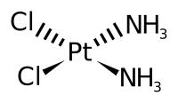
Cisplatin (CDDP)
Platinum containing chemotherapeutic drug
Highly active against a number of cancers:
  Ovarian, Lung, Cervical, Head & Neck, Testicular
Side effects include:
  Nephrotoxicity, ototoxicity, and neurotoxicity
Notes:
One of the drugs used to treat ovarian cancer is Cisplatin.
Cisplatin is a platinum containing anti-cancer agent that commonly used to treat aggressive or late stage cancers, including ovarian cancer.
However, it also comes with painful side effects including toxicity of the kidneys, inner ear, and nervous system.

Slide 5
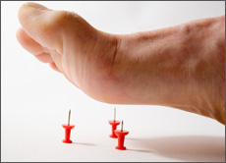
CDDP-Induced Neuropathy (CIPN)
Affects the nerves that carry sensations to the brain
Major dose-limiting adverse side effect of CDDP
Symptoms include:
    Tingling & burning in hands and feet
    Tremors
    Numbness
Notes:
CIPN is brought on by damage to nerves that carry sensations to the brain. This is very painful for patients and often causes them to drop out of chemotherapy before receiving the recommended cumulative dose of Cisplatin. There are several symptoms of CIPN however the tingling and burning in hands in feet is probably the most painful one and patients have compared it to walking on pins and needles .

Slide 6
CDDP-induced Neuropathy & Vitamin E
Mechanism of CIPN is undetermined.
  Platinum accumulation
Clinical and histologic features are similar to those seen in Vitamin E deficiency neuropathy.
(Muller ‘83, Sokol ’88)
CDDP decreases plasma Vitamin E in humans.
(Weigl ’98)
Notes:
CDDP-induced tissue damage is associated with the accumulation of platinum.
However, the mechanism of CDDP-induced neuropathy (CIPN) is currently unknown.
Interestingly, the features of the CIPN are very similar to the neuropathy that accompanies Vitamin E deficiency.
In addition, Cisplatin decrease plasma Vitamin E levels in human patients.
Taken together, these data suggest that altered Vitamin E status may play a role in Cisplatin induced neuropathy.

Slide 7
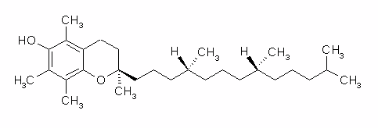
Vitamin E (RRR-α-Tocopherol)
RRR-α-Tocopherol (α-T): natural form of vitamin E preferentially retained in the body. (Traber ’05)
Notes:
For the sake of my presentation today I will be using Vitamin E and alpha-tocopherol interchangeably.
The RRR form of alpha-tocopherol is one the natural forms of Vitamin E and it is the one that we used for our study because it is the form of Vitamin E that is maintained at the highest concentrations in the body.
This is the chemical structure of RRR-alpha-tocopherol and the three “R”s correspond to the orientation of these three chiral centers.

Slide 8
Antioxidant role of α-T
Lipid soluble antioxidant
  Found in cell membranes
Protects cellular lipids from oxidation
  lipid peroxidation
Biomarkers of Lipid peroxidation:
  F₂-Isoprostanes
  Malondialdehyde (MDA)
Notes:
Alpha-tocopherol is a very important lipid soluble antioxidant.
It is found in the cell membranes where it protects cell lipids from the oxidative process of lipid peroxidation which damages the cell membrane
Biomarkers of lipid peroxidation include F2-Isoprostanes and Malondialdehyde. We are measuring both of these parameters and I will be presenting our F2-isoprostane data today.

Slide 9
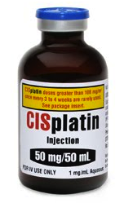

Central Question
Can the neurotoxicity of CDDP be mitigated to allow increased survival without decreased quality of life for ovarian cancer patients?
Notes:
All this information brings us to the following central question:

Slide 10
Central Hypothesis:
CDDP depletes tissue α-T by an oxidative stress mechanism leading to neurotoxicity
Adjunct α-T will prevent CDDP-mediated α-T depletion, thereby preventing neurologic damage
Adjuvant α-T will not decrease CDDP anti-tumor efficacy
Notes:
Thus we come to the central hypothesis of our studies. The 3 parts of which are …
1, 2, 3
My summer project focused on the first two parts of our hypothesis however I will be presenting a little data from the anti-tumor efficacy portion today.

Slide 11
Pre-clinical Model of Ovarian Cancer
Vitamin E (α-T) and Cisplatin (CDDP) Treatment Schedule
Days: |  | Week 1 | Week 4 (Sun, Tue, Thur) |  | Week 5 (Friday) | Weeks 5-8 (Mon & Thur) | Weeks 5-8 (Tues & Fri) | Week 9
GROUP |  | TREATMENT
A | Saline | IP inject cells | SC saline | SC saline |  | SC saline | SC saline | Sacrifice
B | α-T | IP inject cells | SC α-T | SC saline |  | SC α-T | SC saline | Sacrifice
C | Cisplatin | IP inject cells | SC saline | SC saline IP CDDP |  | SC saline | SC saline IP CDDP | Sacrifice
D | α-T/Cisplatin | IP inject cells | SC α-T | SC saline IP CDDP |  | SC α-T | SC saline IP CDDP | Sacrifice
* Rats treated with CDDP receive an accumulative dose of 18mg / kg
Notes:
To test our hypothesis we used a pre-clinical model of ovarian cancer with an intensive treatment regimen
As you can see: all rats were injected with cancer cells at week one, we then waited 3 weeks to allow the tumors to grow in the rats before starting treatments. At week four we began our treatments.
Group A received only Saline and served as our tumor-control rats.
Group B received alternating Vitamin E and saline
Groups C received Cisplatin and saline
And Group D received Cisplatin, vitamin E, and saline
These treatments were administered over the course of five weeks until week nine, at which point we sacrificed the rats
18 mg/kg is dosage at which enough platinum accumulates to produce symptoms of CIPN

Slide 12
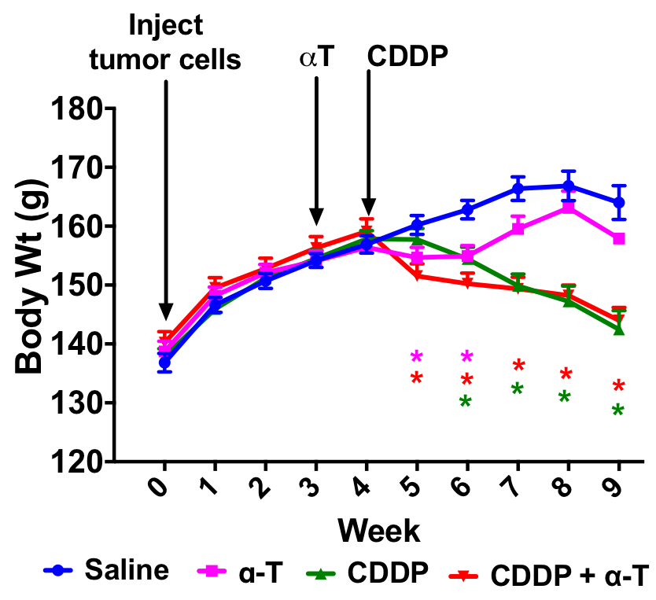
Adjuvant α-T does not alter CDDP-induced weight loss
Notes:
The first results we found were that adjuvant Vitamin E does not alter the weight loss caused by Cisplatin.
This figure shows the average rat body weight on the y-axis, and time (by week) on the x-axis. Rats in both
Cisplatin treatment groups (green and red lines) experience weight loss and we can see that adding alpha-tocopherol to the CDDP regimen does not alter this.

Slide 13

Adjuvant α-T increases CDDP
Anti-tumor Efficacy
Saline
CDDP
CDDP and α-T
Notes:
An exciting finding from this study was that alpha-tocopherol increases the anti-tumor efficacy of Cisplatin and the results are rather dramatic.
These are images of the rat omentum tumor burdens and you can see the omentum of rats treated with only saline (so they had no cisplatin or VE) was fully encrusted with 100’s of tumors.
These tumors are sensitive to Cisplatin and this was demonstrated by the decrease in tumor numbers in rats treated with CDDP.
But the really exciting finding is here in the group that received both CDDP and vitamin E. These have no grossly evident tumors.

Slide 14
Adjuvant α-T decreases Tumor Incidence and Multiplicity
 | Number of Rats Per Group
Tumors Per Rat | 0 | <10 | 10-50 | 50-100 | 100+
Group A |  |  |  | 2/8 | 6/8
Group B |  |  | 1/12 | 8/12 | 3/12
Group C | 2/16 | 2/16 | 1/16 | 8/16 | 3/16
Group D | 10/16 | 2/16 | 2/16 | 1/16 | 1/16
Notes:
This table summarized the tumor burdens of our rats and as you can see our tumor control rats experienced higher tumor burdens than our other groups. When we look at the rats who received both vitamin E and cisplatin we see a large reduction in the number of tumors found in most of our rats suggesting that adjuvant Vitamin E decreases tumor incidence.

Slide 15
Adjuvant α-T prevents tumor- and CDDP-induced depletion of α-T
* = p<0.05 vs. non-tumor controls; # = p<0.05 vs. saline treated tumor-bearing rats
* = p<0.05 compared to non-tumor controls; # = p<0.05 compared to saline treated tumor-bearing rats.
* = p<0.05 compared to non-tumor controls; # = p<0.05 compared to saline treated tumor-bearing rats.
Notes:
Similar to the human patient study I mentioned earlier, we found that CDDP decreased plasma vitamin E levels in our tumor-bearing rats compared to both the tumor control rats and a group of non-tumor control rats. The addition of alpha-tocopherol not only prevents this decrease but it increases plasma alpha-tocopherol above that of the non-tumor controls.* This same trend was present in the tissue, including the tumors.
One additional take-home message here is that the presence of the high tumor burdens seen in this model leads to decreased vitamin E levels in most of the tissue which is demonstrated when comparing the tumor control rats with non-tumor control rats.

Slide 16
Adjuvant α-T improves spinal cord α-T levels compared to CDDP alone
* = p<0.05 compared to non-tumor controls; # = p<0.05 compared to saline treated tumor-bearing rats.
* = p<0.05 compared to non-tumor controls; # = p<0.05 compared to saline treated tumor-bearing rats.
Notes:
When we looked at the the VE levels in the spinal cord we saw similar trends that were present in the tissue, although the spinal cord data was not as significant. (cervical) We found a decrease in Vitamin E due to tumor presence and cisplatin that was improved with alpha-tocopherol supplementation.

Slide 17
Adjuvant α-T prevents tumor- and CDDP-induced elevation of plasma F₂-Isoprostanes
* = p<0.05 compared to non-tumor controls; # = p<0.05 compared to saline treated tumor-bearing rats.
Notes:
We next determined the plasma levels of the F2-isoprostanes. Remember, these are biomarkers of lipid peroxidation. Interestingly, the presence of tumors increased these biomarkers and treatment with CDDP further increased the isoprostane levels. Importantly, addition of alpha-tocopherol brings the levels of these biomarkers of lipid peroxidation below that of the non-tumor controls.

Slide 18
Adjuvant α-T reduces spinal cord and lung platinum but not tumor platinum
* = p<0.05 compared CDDP alone
Notes:
And lastly, if you recall, CDDP toxicity is associated with accumulation of platinum. Thus we measured tissue platinum levels and found some interesting results: Importantly, alpha-tocopherol does not alter the accumulation of Platinum in tumors. * However, adjuvant vitamin E did decrease the accumulation of platinum in spinal cord tissues. This suggests that the addition of a-tocopherol to Cisplatin treatment regimens may diminish CIPN which is localized in the lower regions of the spinal cord. We have histologic analysis underway to determine if this decreased accumulation will result in decreased tissue damage.

Slide 19
Summary
α-T plus CDDP:
Increases CDDP anti-tumor efficacy
  Decreased tumor burden
Prevents CDDP-induced decreases in tissue and plasma α-T
Prevents tumor- and CDDP-induced lipid peroxidation
Decreases accumulation of platinum in spinal cord tissues but not tumors
Notes:
To summarize, we found that …

Slide 20
Ongoing & Future Studies
Ongoing Studies:
Tissue analysis
  MDA – oxidative stress
  Glutathione – antioxidant
Histology
  proliferation markers
Future Work:
Adjuvant Vitamin C
Clinical Trials
Notes:
There is still a lot of work to be done in the lab for this study. Ongoing research includes MDA and Glutathione assays as well as the histological analysis that is well underway. In the future we hope to address how adjuvant Vitamin C would affect treatments. And of course our ultimate goal is to continue our research with clinical trials.

Slide 21
Acknowledgements
Debbie Mustacich, Ph.D.
Shannon Pease
Michelle Beehler
Devin Corrigan
Giovanna Coto, M.A., DVM
Christiane Löhr, DVM, Ph.D.
F344 Rats
Kevin Ahern, Ph.D.
ACS Research Scholar grant 120548-RSG-11-075-01-CCE
Linus Pauling Institute
URISC
Notes:
There were a lot of people involved with this project. I would like to thank my mentor Dr. Mustacich, and my lab mates Shannon Pease, Michelle Beehler, and Devin Corrigan. As well as Giovanna Coto and Dr. Lohr for assisting with necropsies and histological analyses. And of course the F344 Rats that allowed us to carry out our work.
I would also like to thank Dr. Kevin Ahern for putting all his time into making this summer symposium possible.
Here is the funding associated with this project.

Slide 22
Questions?

Slide 23
Pilot Study in Healthy Rats: CDDP Decreases Ganglia α-T **
** Columns within the same tissue but with different letter designations are significantly different, p< 0.05
Notes:
Based on the

Slide 24
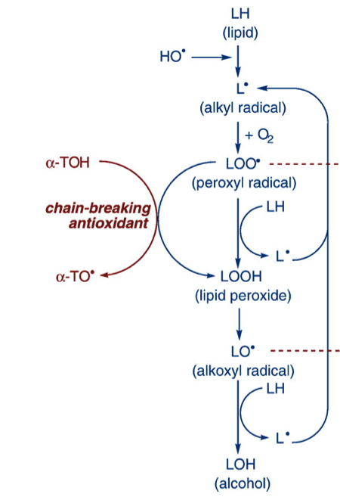
Lipid Peroxidation
Initiation
  Production of a carbon radical
Propagation
  Peroxyl radical and an additional carbon radical are formed
Termination
  Two peroxyl radicals combine to stop the chain reaction
Notes:
A little more on lipid peroxidation..
As I said in the previous slide: lipid peroxidation is a chain reaction started by Oxygen free-radicals that convert the lipids of the cell membrane into alcohols. There are three basic steps to lipid peroxidation that creates a cycle of lipid degradation. The first step is initiation in which the free-radical (who needs an electron) takes a Hydrogen atom from an unsaturated lipid in the cell membrane. This produces a carbon radical which reacts with molecular Oxygen to form a peroxyl radical during the second step known as propagation. (read traber again and finish) Quote Traber
This violent cycle only finally ends on the off chance that two peroxyl radicals (likelihood?) meet and combine, thus inactivating each other and stopping the cycle.
Propagation is where the chain reaction starts (and MDA produced?)

Slide 25
F₂-Isoprostane from Arachidonic Acid
Notes:
The non-enzymatic oxidation of arachidonic acid is responsible for producing the family of F2-isoprostanes that we used as markers of oxidative stress. We measured the levels of 8-iso-PGF-alpha which belongs to the 15 series, and we also measured the series 5 metabolites. The other two series (in the middle) are produced in much smaller quantities so their presence is not as easily detected as the five and fifteen series Isoprostanes.

