Slide 1

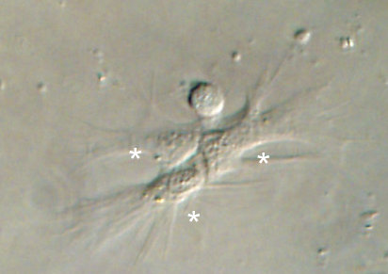
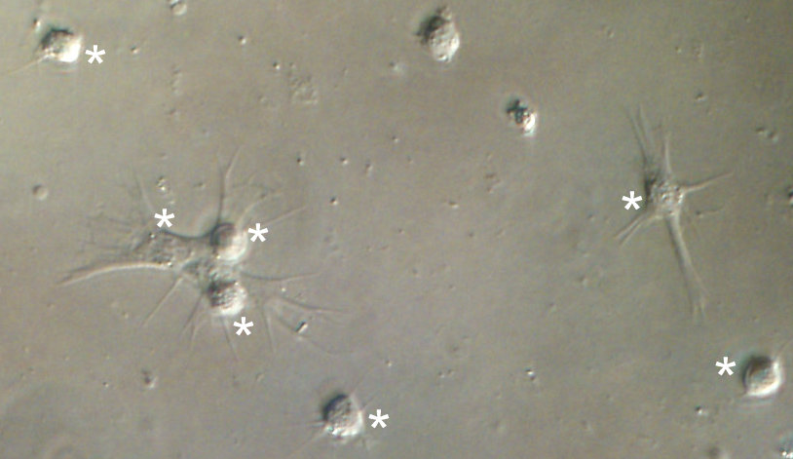
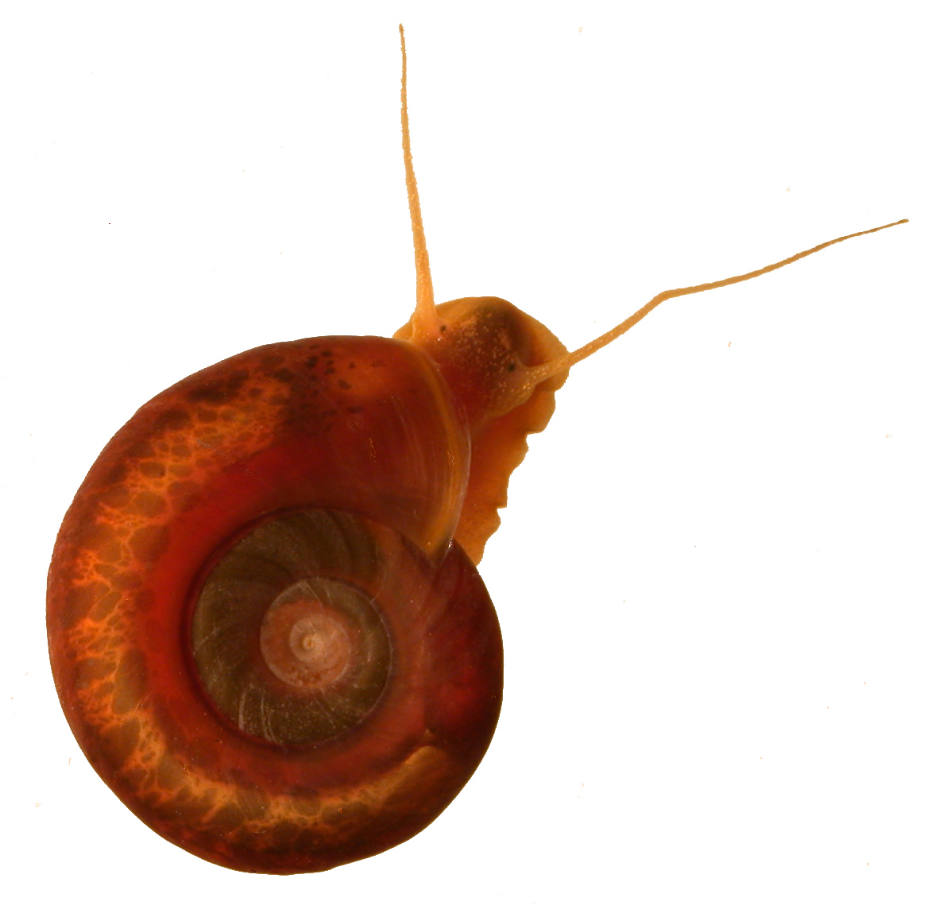
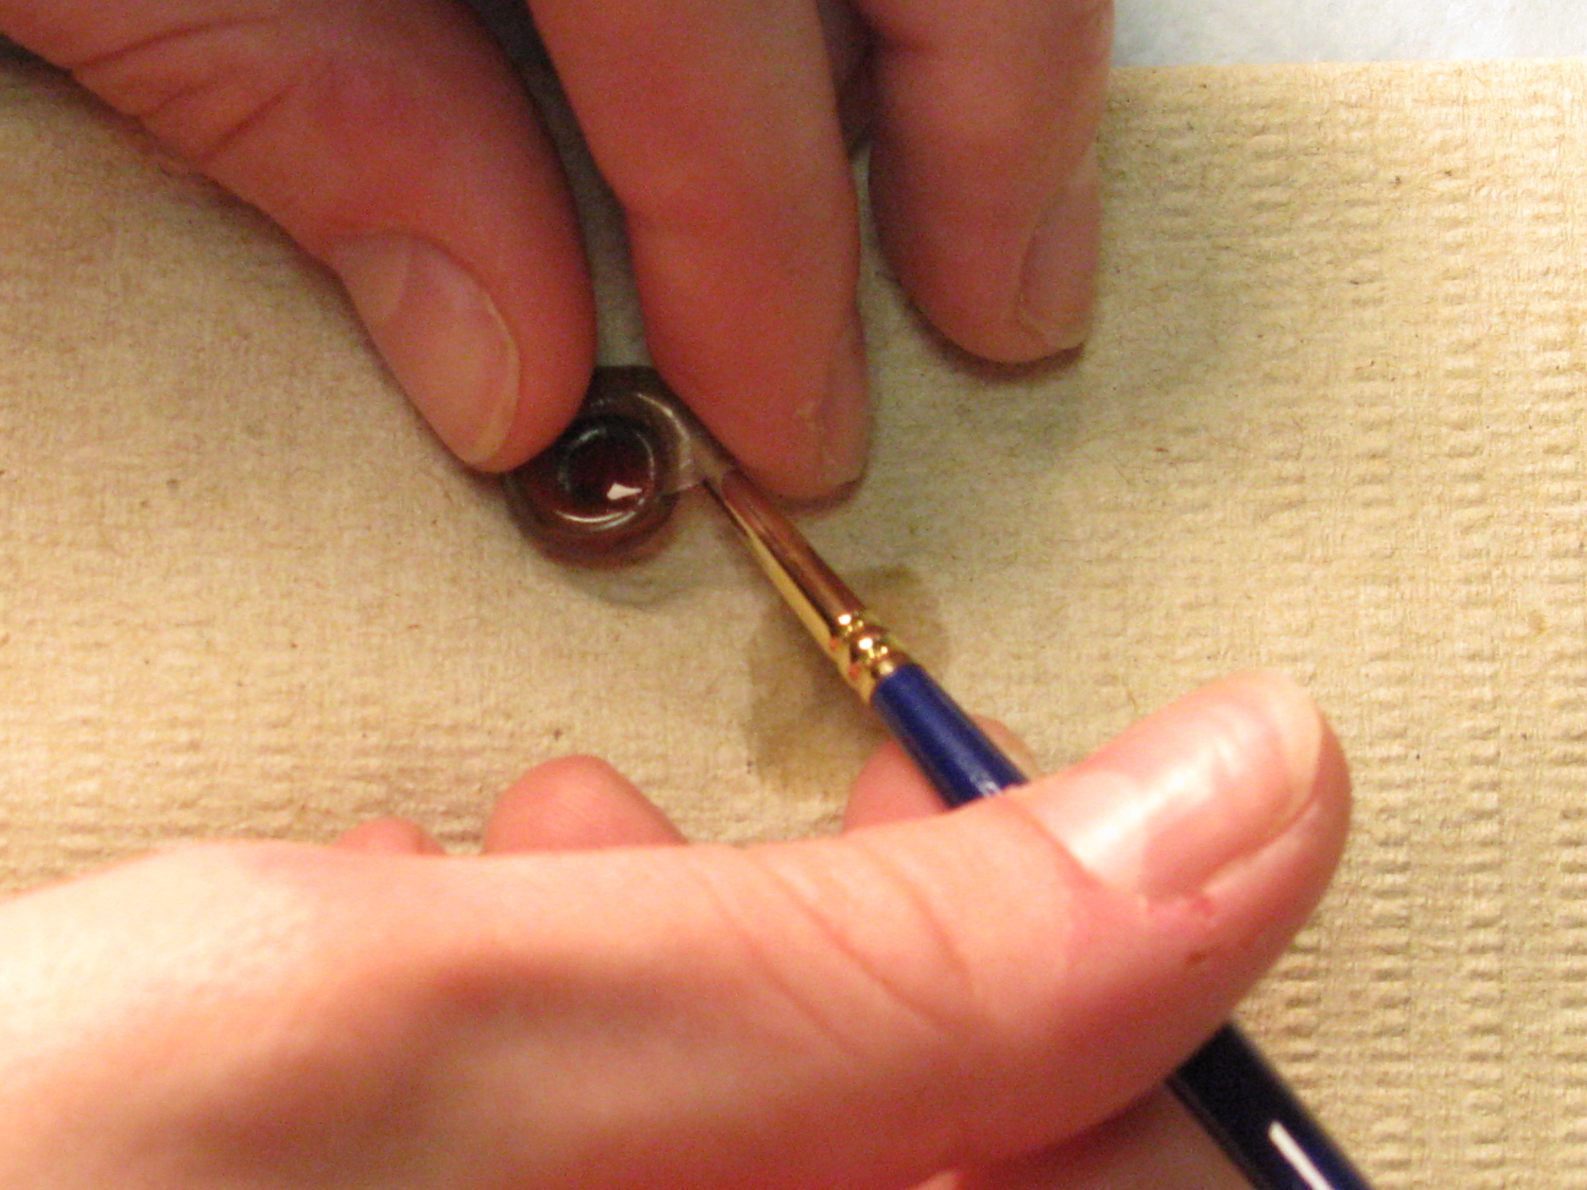
Resistance to Schistosoma mansoni is correlated with the number of spreading granulocytes in Biomphalaria glabrata.
Piera M. Callahan, *Maureen K. Larson, Randall C. Bender, & Christopher J. Bayne
Department of Zoology, Oregon State University – Corvallis, Oregon 97331-2914
Abstract
Results
Discussion
Molluscan internal defenses rely heavily on circulating hemocytes. In most cases, encounters with large foreign bodies result in recognition by hemocytes followed by spreading of these defense cells over the object’s surface. The resulting encapsulation concentrates the force of the hemocytes’ assault on the foreign object.
B. glabrata snail lines obtained by self-fertilization of isolated 13-16-R1 [Oregon] individuals have yielded multiple inbred families in which genes are fixed at ~88% of the loci. Among the phenotypic traits that we have measured in 20 of these families are susceptibilities of snails to the PR1 [Oregon] strain of Schistosoma mansoni, and hematocrits of quickly spreading granulocytes present in the hemolymph. Higher numbers of these cells predict a snail phenotype that is resistant to S. mansoni infection. Both resistant and susceptible snails are found in families with intermediate hematocrits. We infer that within the parental 13-16-R1 population hemocyte numbers are varied. When sufficiently numerous, a snail’s hemocytes can generally prevent parasitic infection. At lower hematocrits, a more complex set of variables interact to determine the outcome of an infection.
Question: Do resistant families differ from susceptible ones in number of circulating pseudopod-producing hemocytes?
The objective of this study was to examine B. glabrata’s resistance to S. mansoni infection in the context of circulating hemocyte numbers, in particular hemocytes that form pseudopodia. This is an important trait as it signifies the host’s readiness for defense against foreign bodies. Our development of inbred families of snails allowed us to sample and phenotype individuals with greater than 88% homozygosity.
Our study sheds light on the importance of circulating hemocyte number, and more specifically on the hemocyte’s ability to sense environmental changes. Snail families which possess high PPH/µL are more resistant to infection by S. mansoni. On the other hand, if the parasite encounters very few hemocytes, it avoids or survives their attacks and proliferates.
In snails with intermediate numbers of hemocytes, other factors should emerge as deterministic of the susceptibility phenotype. We are presently measuring the expression of several genes involved in cell function, particularly immunity. We anticipate that in snails with intermediate PPH quantities, expression differences will more clearly correlate with resistance. Other questions raised by this study include: What percentage of circulating hemocytes is represented by pseudopod-producing hemocytes, and do percentages differ among susceptible and resistant families? Is cell adhesiveness variable among families? Our work continues to focus on answering these crucial questions about snail hemocyte involvement in resistance to S. mansoni.
Figure 1
Snail hemolymph at 400X showing pseudopod-producing hemocytes (*).
Figure 2
Susceptibility phenotypes depicted over their entire range, and related to PPH/µL. Blue data points have %S=0 and are staggered to show S.E.M.
Significant and moderately strong (p=0.0235, r²=0.2670) correlation between susceptibility and cell count (Linear Regression Analysis).
Resistant snails are more likely to have PPH/µL over 100 (Fisher Exact Test, p=.0172, two-tailed).
Introduction
Biomphalaria glabrata is the intermediate host for Schistosoma mansoni.
Miracidia from S. mansoni penetrate the molluscan headfoot and immediately transform into sporocysts. Asexual reproduction results in daughter sporocysts which migrate to the snail mid-gut gland. Once established, the parasite proliferates again asexually, forming cercariae which exit the snail. All this occurs under the scrutiny of circulating hemocytes, part of the snail’s innate defense mechanisms.
Snail hemocytes are involved in recognition of foreign bodies, phagocytosis, encapsulation, and cytotoxic reactions, and in many of these processes develop pseudopodia to monitor and interact with their environment. Snail hemocyte number has also been implicated in resistance to infection.
In our lab, we inbred a 70% resistant snail population in order to establish snail families with greater than 88% homozygosity. Families were phenotyped for resistance to S. mansoni, and constitutive numbers of pseudopod-producing hemocytes in circulation were compared.
Materials & Methods
Inbred snail lines were derived from individuals of the 13-16-R1 (Oregon) stock of Biomphalaria glabrata. Snails were ‘selfed’ for 3 generations (88% homozygosity), and susceptibility/resistance to Schistosoma mansoni was scored by exposing each 12 mm snail to five S. mansoni miracidia, followed by assessment of parasite shedding 5, 7, and 9 weeks later.
Inbred snails were maintained in 26⁰C de-chlorinated water supplemented with shell hardener (480 µM CaCO₃, 82 µM NaCl, 58 µM MgCO₃, and 13 µM KCl). Filters also contained crushed coral for buffering capacity. To minimize the chances of stress-related effects, snails were sampled 2 to 4 weeks after water change. The snails were fed washed green leaf lettuce ad libitum and kept in an environment with a 12 hour light cycle.
Counts of pseudopod-producing hemocytes (PPH) were made for snails of 12 to 14 mm diameter. To minimize stress, each snail was placed in a small dish containing tank water at 26⁰C. Sterile balanced salt solution (CBSS; 48 mM NaCl, 2 mM KCl, 0.5 mM Na₂HPO₄, 0.6 mM NAHCO₃, 5.5 mM glucose, and 2.9 mM trehalose; Chernin 1963) was pre-warmed to 26⁰C. Directly prior to bleeding, snail shells were cleaned with dechlorinated water and swabs. Cardiac punctures were performed and only hemolymph which pooled on the shell was sampled; hemolymph released from the head foot was not used. Hemolymph from an individual snail was placed on Parafilm™, and shell debris was allowed to settle for 30 seconds. The upper 20 µL of hemolymph was mixed 1:1 with CBSS, and 10 µL was loaded on a Neubauer Improved hemacytometer. The slides were incubated in a humid chamber at 26⁰C for 30 minutes, and cells with pseudopodia were counted in five 1 mm squares at 200x. The final number of cells was calculated using the following formula: cells counted x dilution x 10 / number of 1 mm squares counted.
Figure 3
The median value for all resistant families was 162.7 (IQR=149.2) which differed significantly (p=0.01 Mann-Whitney) from the susceptible median of 93.8 (IQR=51.0).
Susceptible did not differ from resistant in variance within families (SD as a percentage of the mean; S = 37.0 ± 7.3, R = 56.0 ± 5.7. p=0.162, Unpaired t-test).
‘Resistant’ is defined as fewer than 50% susceptible snails.
Relevant References
Martins-Souza, R. L., Pereira, C. A. J., Coelho, P. M. Z., Martins-Filho,O. A., Negrão-Corrêa, D. 2009. Parasitology. 136(1): 67–76.
Oliveira AL, Levada PM, Zanotti-Magalhaes EM, Magalhães LA, Ribeiro-Paes JT. 2010. Genet Mol Res. 9(4):2436-45.
Barçante, T.A., Barçante, J.M. P., Fujiwara, R.T., Lima,W.S. 2012. J.of Parasit Res. Article ID 314723, 6 pages, 2012. doi:10.1155/2012/314723
Acknowledgements
Douglas R. Batson assisted with bleeding and counts. Dr. Camille Paxton helped capture images. Dr. Michael Blouin, Dr. Jacob Tennessen, and their associates provided feedback. Financial support was from NIH Award A1016137.

