Slide 1
Posttranslational modifications of the core histone tails and their importance for gene silencing
Madison Esposito
Oregon State University, Corvallis, Oregon. 97331
Bioresource Research Program, College of Agricultural Sciences
Department of Biochemistry and Biophysics, College of Science
Notes:
Let everyone settle in, give initial thanks to everyone for coming
Today I will be presenting my thesis on how posttranslational modifications on the histone H3 tail affects gene silencing

Slide 2
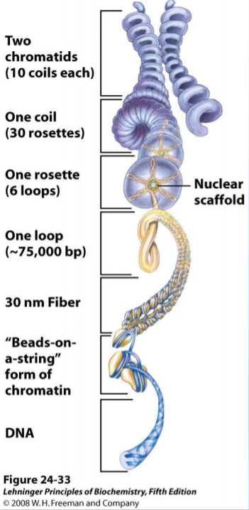
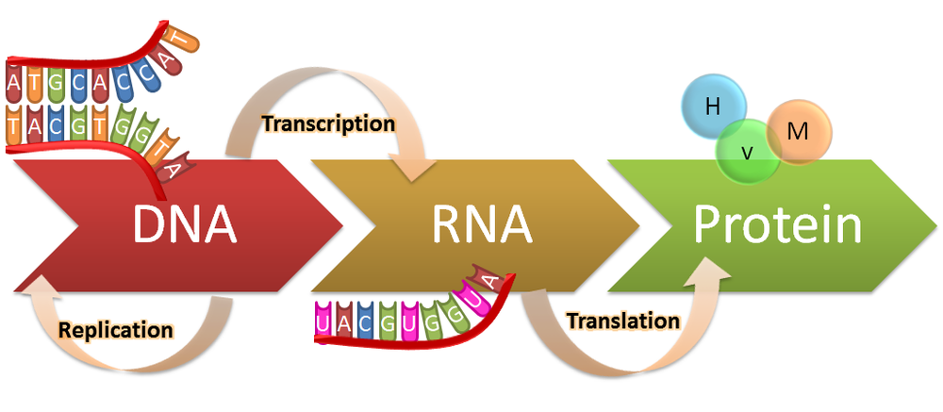
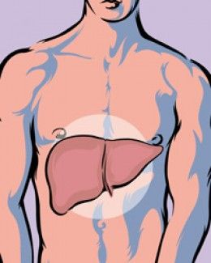
All cells contain the same genes but do not produce the same proteins
S media cache © 2017
Notes:
We will begin with the basics
As we all know every cell in your body contains the same genetic code (genome)
DNA makes up genes which are expressed through transcription and translation to make proteins
CLICK
That’s a lot of genes to hold in the nucleus, DNA must be compacted (2-10 microns sig small that hair tip)
Double strand DNA > Beads on a string (nucleosome 147 bp, fundamental unit of chromatin) > Rosette > Chromatids (seen in cell division)
CLICK
Necessary so the right cells make the right proteins (skin doesn’t make liver cells)
Mandatory for complex multicellular life

Slide 3
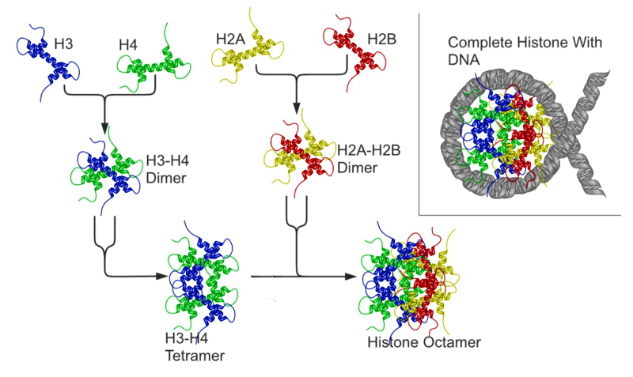
Histones are arranged in an octamer
Nucleosome_structure.png: Richard Wheeler (Zephyris)
Notes:
The histone octamer which makes up the core of the nucleosome is comprised of 4 protein subunits
Subunits > dimers > other dimers > tetramers > two tetramers > octamer of the nucleosome core
CLICK
We will be focusing on histone H3 seen here in the red box

Slide 4
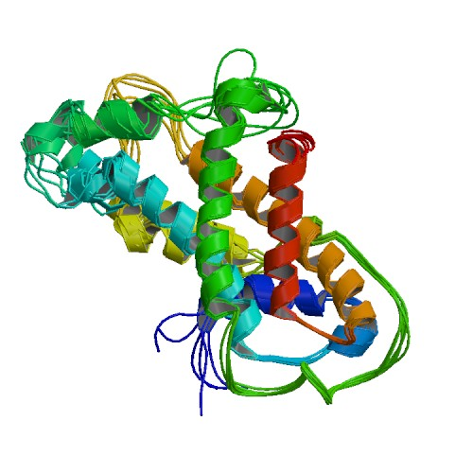
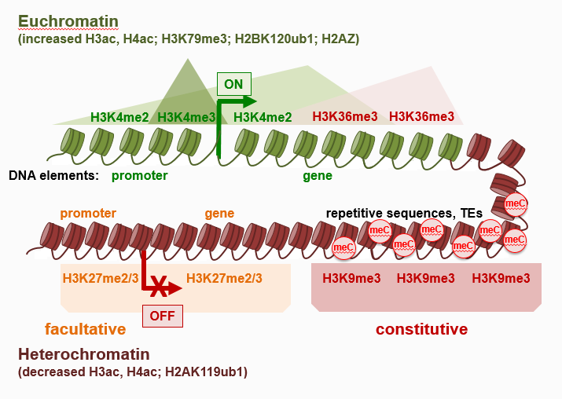
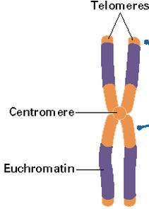
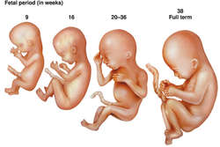
Chromatin modifications are involved in gene expression
Freitag, M. © 2017
Zhou. Z et al. © 2011
Notes:
We chose to focus on H3 because its importance in chromatin modification
Histones within a nucleus are generally arranged in two distinct structures (euchromatin and heterochromatin)
Euchromatin describes an environment of chromatin which is spacious and relaxed, this allows the transcriptional machinery to easily access the genes associated with the histones in that environment
Heterochromatin is the opposite and consists of densely packed areas of histone which do not have the physical space to accommodate transcriptional machinery.
CLICK
Shown here the di methylation of H3K4 and tri methylation of H3K36 creates the environment I just mentioned where transcription can occur (signified by this arrow) and proteins can eventually be produced from these genes
CLicK
Below are the two types of densely packed heterochromatin.
CLICK
Constitutive heterochromatin = teleomeres, always there
CLICK
Facultative = developmental, comes and goes with time
Arrow shows transcription does not occur

Slide 5
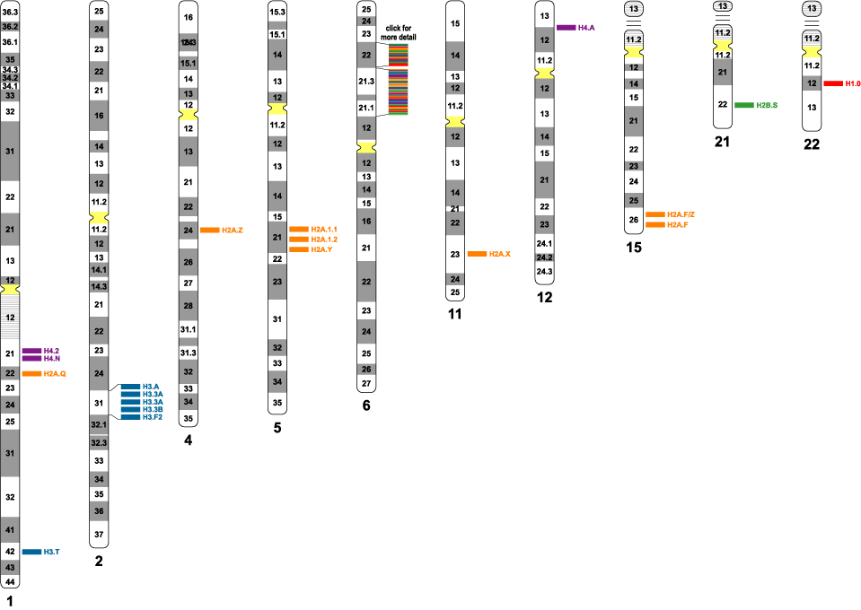
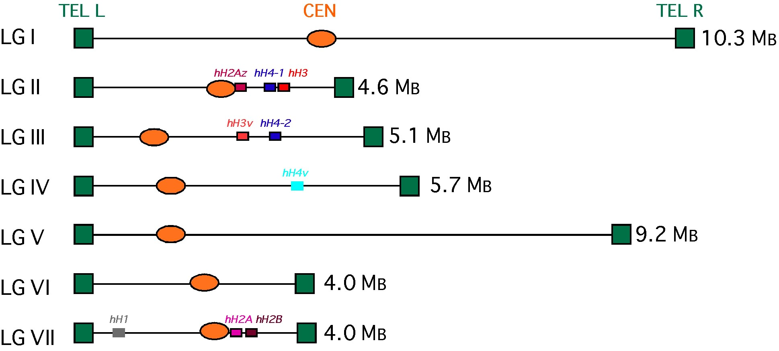
Fungal models are ideal for histone mutagenesis because they contain fewer histone related genes
Human
Neurospora
Freitag, M. (2017) Functional analysis of histone modifications (PowerPoint slides).
Notes:
Shown here are the human chromosome which contain genes for the histone subunits
(Point to the blue ones) these spans shown in blue are just the genes which encode either canonical H3 or its other variants seen in humans.
Click
The fungus Neurospora, however, has only one H3 gene (LGII)
Low # of genes makes it much more simple to work with as a model
Even more simple that yeast which is the classic model in these types of studies

Slide 6
Fusarium and Neurospora are established model organisms for chromatin structure research
Presence of methylation
Histone
Freitag, M. © 2017
Notes:
The fungal models we selected are shown here with As. Nidulan as a comparison
Listed above each strain are the histone which, as a showed on a previous slide, are methylated in the process of creating an environment which is either conducive or non conducive to gene expression
All the species listed have the activating mark
Click
They also all have the mark for constitutive heterochromatin
Click
However on NC and FG have the H3K27 mark for facultative heterochromatin
FG and NC remain robust even without any PTM
Using NC and FG allows us to study each type of PTM

Slide 7
Histone amino acid residues can be covalently modified
HN
O
O
H₂N
N
HN
O
P
O
Lysine Methylation
Lysine Acetylation
O
Serine, Threonine, and Tyrosine
Phosphorylation
HN
NH₂
N
NH₂
N
NH
O
NH
NH
NH
O
Arginine Methylation
Serine and Threonine Acetylation
Notes:
Methylation of Lysine is not the only kind of PTM which occus or has significance in gene silencing.
Arginines positive charge and Lysines can both be mono di or tri methylated
CLICK
Lysine, Serine, and Thronine can all be acetylated
CLICK
And Serine Thronine and Tyrosine all have the ability to be phosphorylated negative charge
Each PTM does not behave in the same way when applied to every residue and the action they provoke can depend on where the specific residue which has been modified
And don’t always occur on every histone or even on the same histone (for example, in our model organism, H3K9 methylation (constitutive) would never coincide with H3K27 methylation (facultative)
Not all made by the same enzyme, specific to modification and localization of mark

Slide 8
Hypothesis : Substitution of residues neighboring the ARKS region will alter specificity for H3K9 and H3K27 PTM
Histone H3 (gene)
1 4 9 14 18
M A R T K Q T A R K S T G G K A P R K
ATG GCC CGC ACT AAG CAG ACC GCC CGC AAG TCC ACC GGT GGC AAG GCC CCC CGT AAG
23 27 36
Q L A S K A A R K S A P S T G G V K K
CAG CTC GCT TCC AAG GCT GCC CGC AAG TCC GCC CCC TCC ACC GGC GGT GTC AAG AAG
Notes:
So what do the regions that are modified look like?
This figure list both DNA and peptide sequence of the K9 (constitutive) and K27 residues in the hH3 protein tail
The numbers above signify what number the residue is
“M cut off protein” after translation
As you can see the residues surrounding K9 and K27 are identical
CLICK
except for these two residues
An element of our hypothesis was to see if switching these residues would cause the areas known to contain H3K9 me to switch to having high levels of H3K27 and vice versa

Slide 9
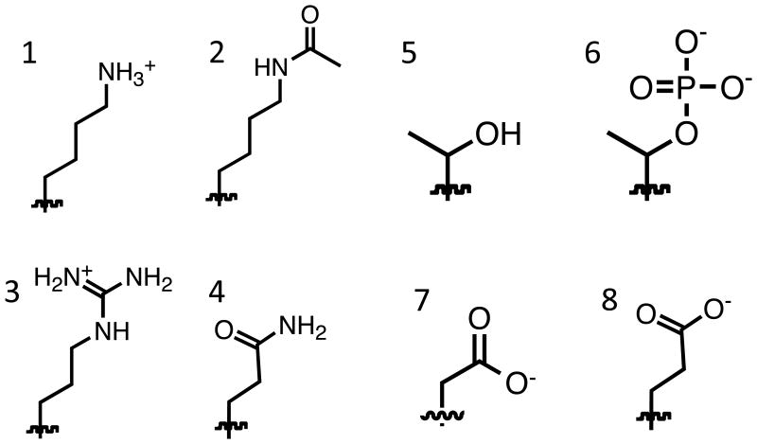
Hypothesis: Substitution of residues with genetic mimics will alter gene silencing
Genetic mimics of Lysine
1. Unmodified Lysine
2. Arginine: mimics unmodified Lysine
3. Acetylated Lysine
4. Glutamine: mimics acetylated Lysine
5. Methylated Lysine
6. & 7. Methionine and Leucine: mimic methylated Lysine
00
00
Howard CJ et al. © 2015
Notes:
We also made substitutions of PTM residues with genetic mimics
Define genetic mimics “locked in one state” “locks in acetylated state: changes from can be acetylated”
Go through list
Will histones with these mimics in place of their normal residues still behave as they usually would, will the PTMs still spread

Slide 10
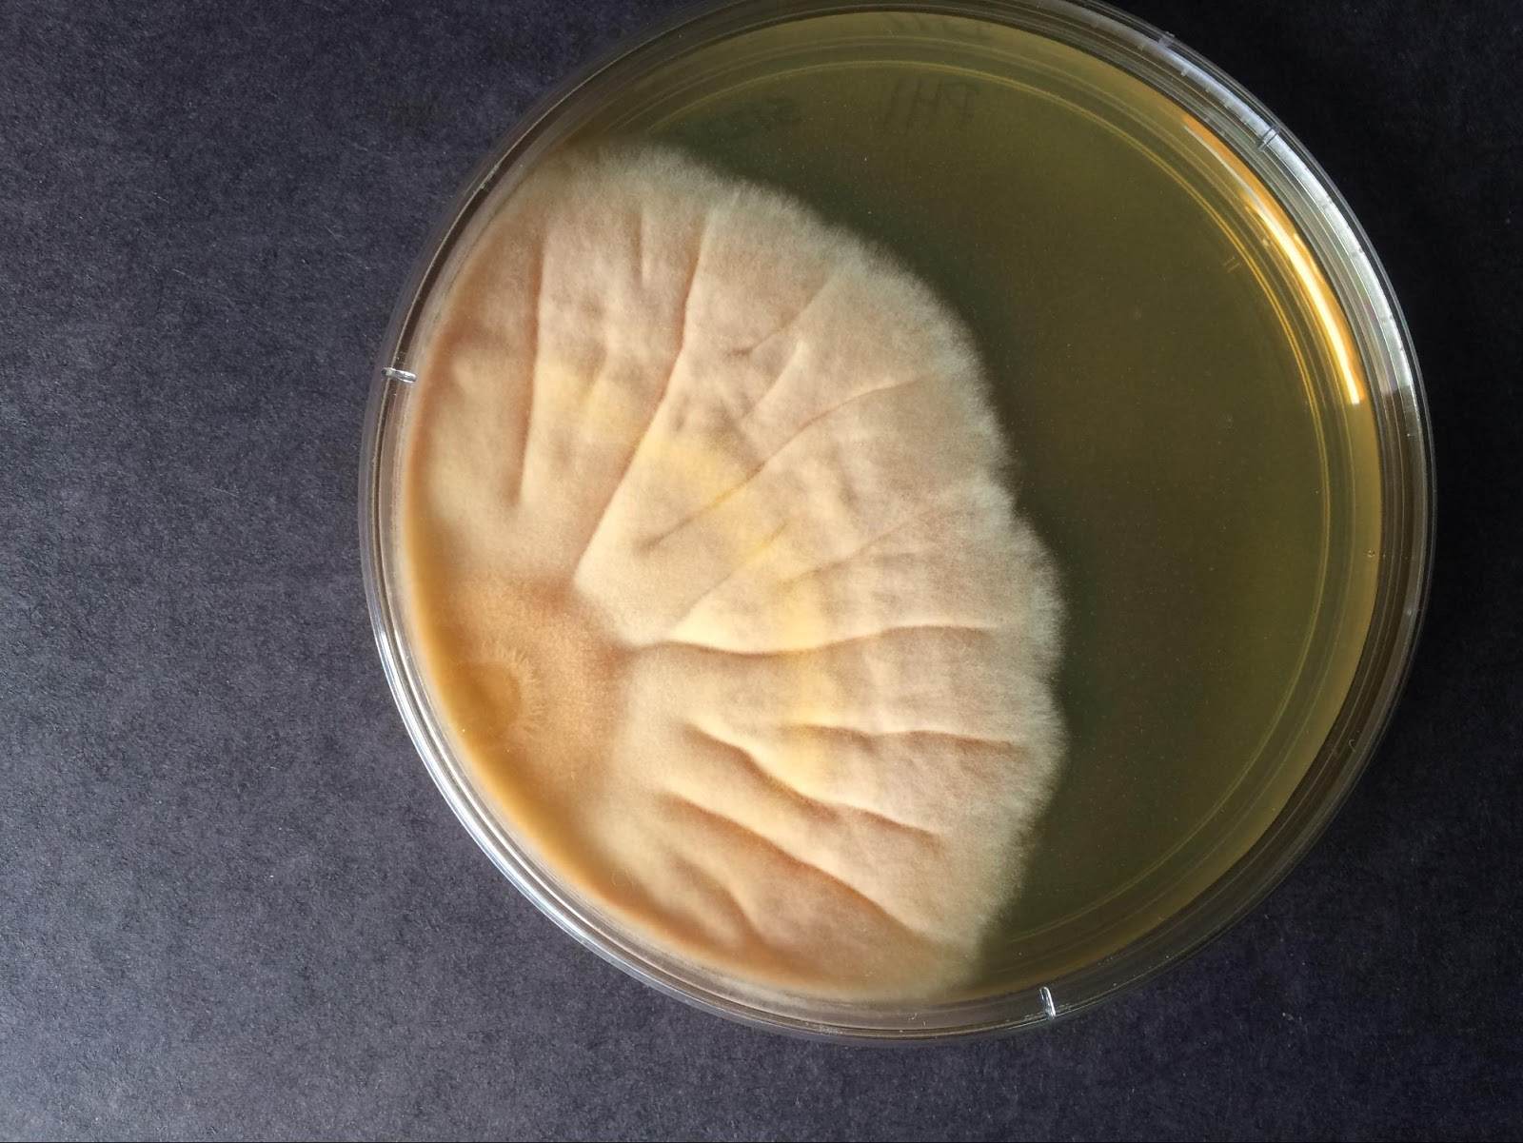
Hypothesis
Changes to the histone H3 (hH3) gene will affect gene silencing and chromatin structure.
Expected Results
Strains containing these mutations will have no phenotype, will be “sick”, or non-viable
WT
Sick
Notes:
Our hypothesis and expected results were rather straight forward
Describe PHI, sick is strain defective in silencing

Slide 11
Aim: Obtain Histone H3 mutations of residues of interest
F. graminearum will be used as a model for H3K27 methylation and gene silencing
N. crassa will be used as a model for centromere assembly and maintenance
(pRG9)
By Quickchange:
R2L
T3S
T3A
K4L
K4M
K4R
K4Q
T6A
A7M
R8A
K9M
K9R
K9L
K9Q
S10A
S10T
T11A
G12P
(pSF6)
Key:
ARKS region
By Cloning:
pEB9 – H312GG pEB10 – H3G13M
pEB15 – H3R17L
pEB16 – H3K18Q
pEB17 – H3K18R
pEB18 – H3K23Q
pEB19 – H3K23R
pEB21 – H3S28A
pEB22 – H3K36L
MF337 – H3A15P
By Quick-change:
T3S
T3A K4M
K4R
K4Q
K9Q
K9L
K9M
S10A
S10T
K14L
K14M
K14R
K14Q
A15M
A15P
P16A
K56R
K56M
K56L
K64L
Q68A
Q68S
K79Q
K79R
K79M
K79L K122LE133A
R134A
K14L
K14M
K14R
K14Q
A15M
A15P
P16A
K18M
K18L
K18R
K18Q
K23M
K23L
A24T
A25M
R26A
K27L
K27M
K27R
K27Q
S28T S28A
A29M
A29T
K36Q
K36R
K36M
K37Q K37R
K37M
K37L
K37Q
R40A
Y41A
K42A
K56Q
K18M
K18L
K23M
K23L
A24T
A25M
R26A
K27L
K27M
K27R
K27Q
S28T
S28A
A29M
A29T
K36R
K36M
K36L
K36Q
K37L
K37M
K37R
K37Q
R40A
Y41A
K42A
K56Q
K56R
K56M
K56L
K64L
Q68A
Q68S
K79Q
K79R
K79M
K79L
K122L
E133A
R134A
Notes:
Purpose of each model
95 unique mutations, 143 in total
Done by qC or cloning
Arks region is highlighted

Slide 12
Aim: Obtain Histone H3 mutations of residues of interest
_{me}
_{ac}
_{me}
_{ac}
_{ph}
_{ac}
_{me}
_{ac}
_{me}
_{ac}
_{me}
_{ac}
_{ph}
_{ac}
_{me}
_{ac}
_{me}
_{ac}
_{me}
_{ph}
_{ph}
_{me}
_{ph}
_{me}
_{me}
_{me}
NH₂ – M A R T K Q T A R K S T G G K A P R K Q L A S K A A R K S A P S T G G V K K
1 4 9 14 18 23 27 36
P H R Y K P G T V A L R E I R R Y Q K S T E L L I R K L P F Q R L V R E I A Q D F K S
40 56 62 64 70 79
D L R F Q S S A I G A L Q E S V E S Y L V S L F E D T N L C A I H A K R V T I Q S K D
¹²²
I Q L A R R L R G E R N ---COOH
¹³⁵
Key:
Mimics Methylation
Mimics Acetylation
Can be Phosphorylated
Modifies Structure
Mimics Unmodified
Lysine
L S L A M L L A A P M L M A L L L T M A L A T L L
L S L A M L L A A P M L M A L L L T M A L A T L L
MRQ
MRQ
T
MRQ
MRQ
MRQ
MRQ
T
M
MRQ
MRQ
A
P
A
MRQ
MRQ
T
MRQ
P
MRQ
MRQ
MRQ
T
M
MRQ
MRQ
_{me}
_{ac}
_{me}
_{ac}
_{me}
_{ac}
_{me}
_{ph}
_{me}
A
A
A
LMRQ
L
AS
LMRQ
A
A
A
LMRQ
L
AS
LMRQ
_{me}
_{ac}
L
L
A
A
A
A
Notes:
“underlined is globular region”
Arg is 1
PTM listed in color above
CLICK
Colors represent mimics explain reasoning (say AA name then letter)
Almost Every K > LMRQ

Slide 13
Approach: Introducing point mutations into existing plasmids with wildtype hH3 gene
pSF6
Has N. crassa flanks
pRG9
Has F. graminearum flanks
hph
NchH3
Notes:
So how will we make these mutant H3 alleles (alternative genes)
Used plasmids
(circular DNA that contained our gene and gene for selectable marker hph)
The plasmids also had flanking regions complimentary to the fungus they would be transformed into
to increase the chance for recombination the NcH3 gene was used with both plasmids regardless of model being used
NcH3 is similar enough and contains only a few SNPs that differ from fgH3 but because of these snips the whole gene is integrated
Steve Freed-min and Rodrigo Gone-call-vez

Slide 14
Approach: Introducing point mutations into existing plasmids with histone genes
Quick-Change PCR
Creates base pair mutations, leading to a change in amino acid.
9
K
AAG->CTC
4715 K9L_Forward Primer 53.4 CCGCCTCTCCACCGGTGGCAAGGCCC 68.0
5’-AATGGCCCGCACTAAGCAGACCGCCCGCAAGTCCACCGGTGGCAAGGCCCCCCGTAAGC
M A R T K4 Q T A R K9 S T G G K14A P R K18
3’-TTACCGGGCGTGATTCGTCTGGCGGGCGTTCAGGTGGCCACCGTTCCGGGGGGGCATTC
60.4 GTGATTCGTCTGGCGGGCGGAGAGGTG 4716 K9L_Reverse Primer
From DNA to Genetic Genealogy. (2017). Stevemorse.org. Retrieved 11 February 2017, from http://stevemorse.org/genetealogy/dna.htm
Notes:
We synth plasmids with allele of interest with Quick Change method
Changes codon (point in the right direction 5’ to 3’ )
Change at 3’ so annealing still happens
CLICK
Here are some examples of other changes we made

Slide 15
Cloning
Quick-Change PCR
Ligation
Digestion
Sanger Sequence Confirmation
Transform into N. crassa / F. graminearum
DNA Prep
PCR Validation
Screening
Notes:
Flow chart of project (visual methods)
“cloning didn t work”
“moving existing allele”

Slide 16
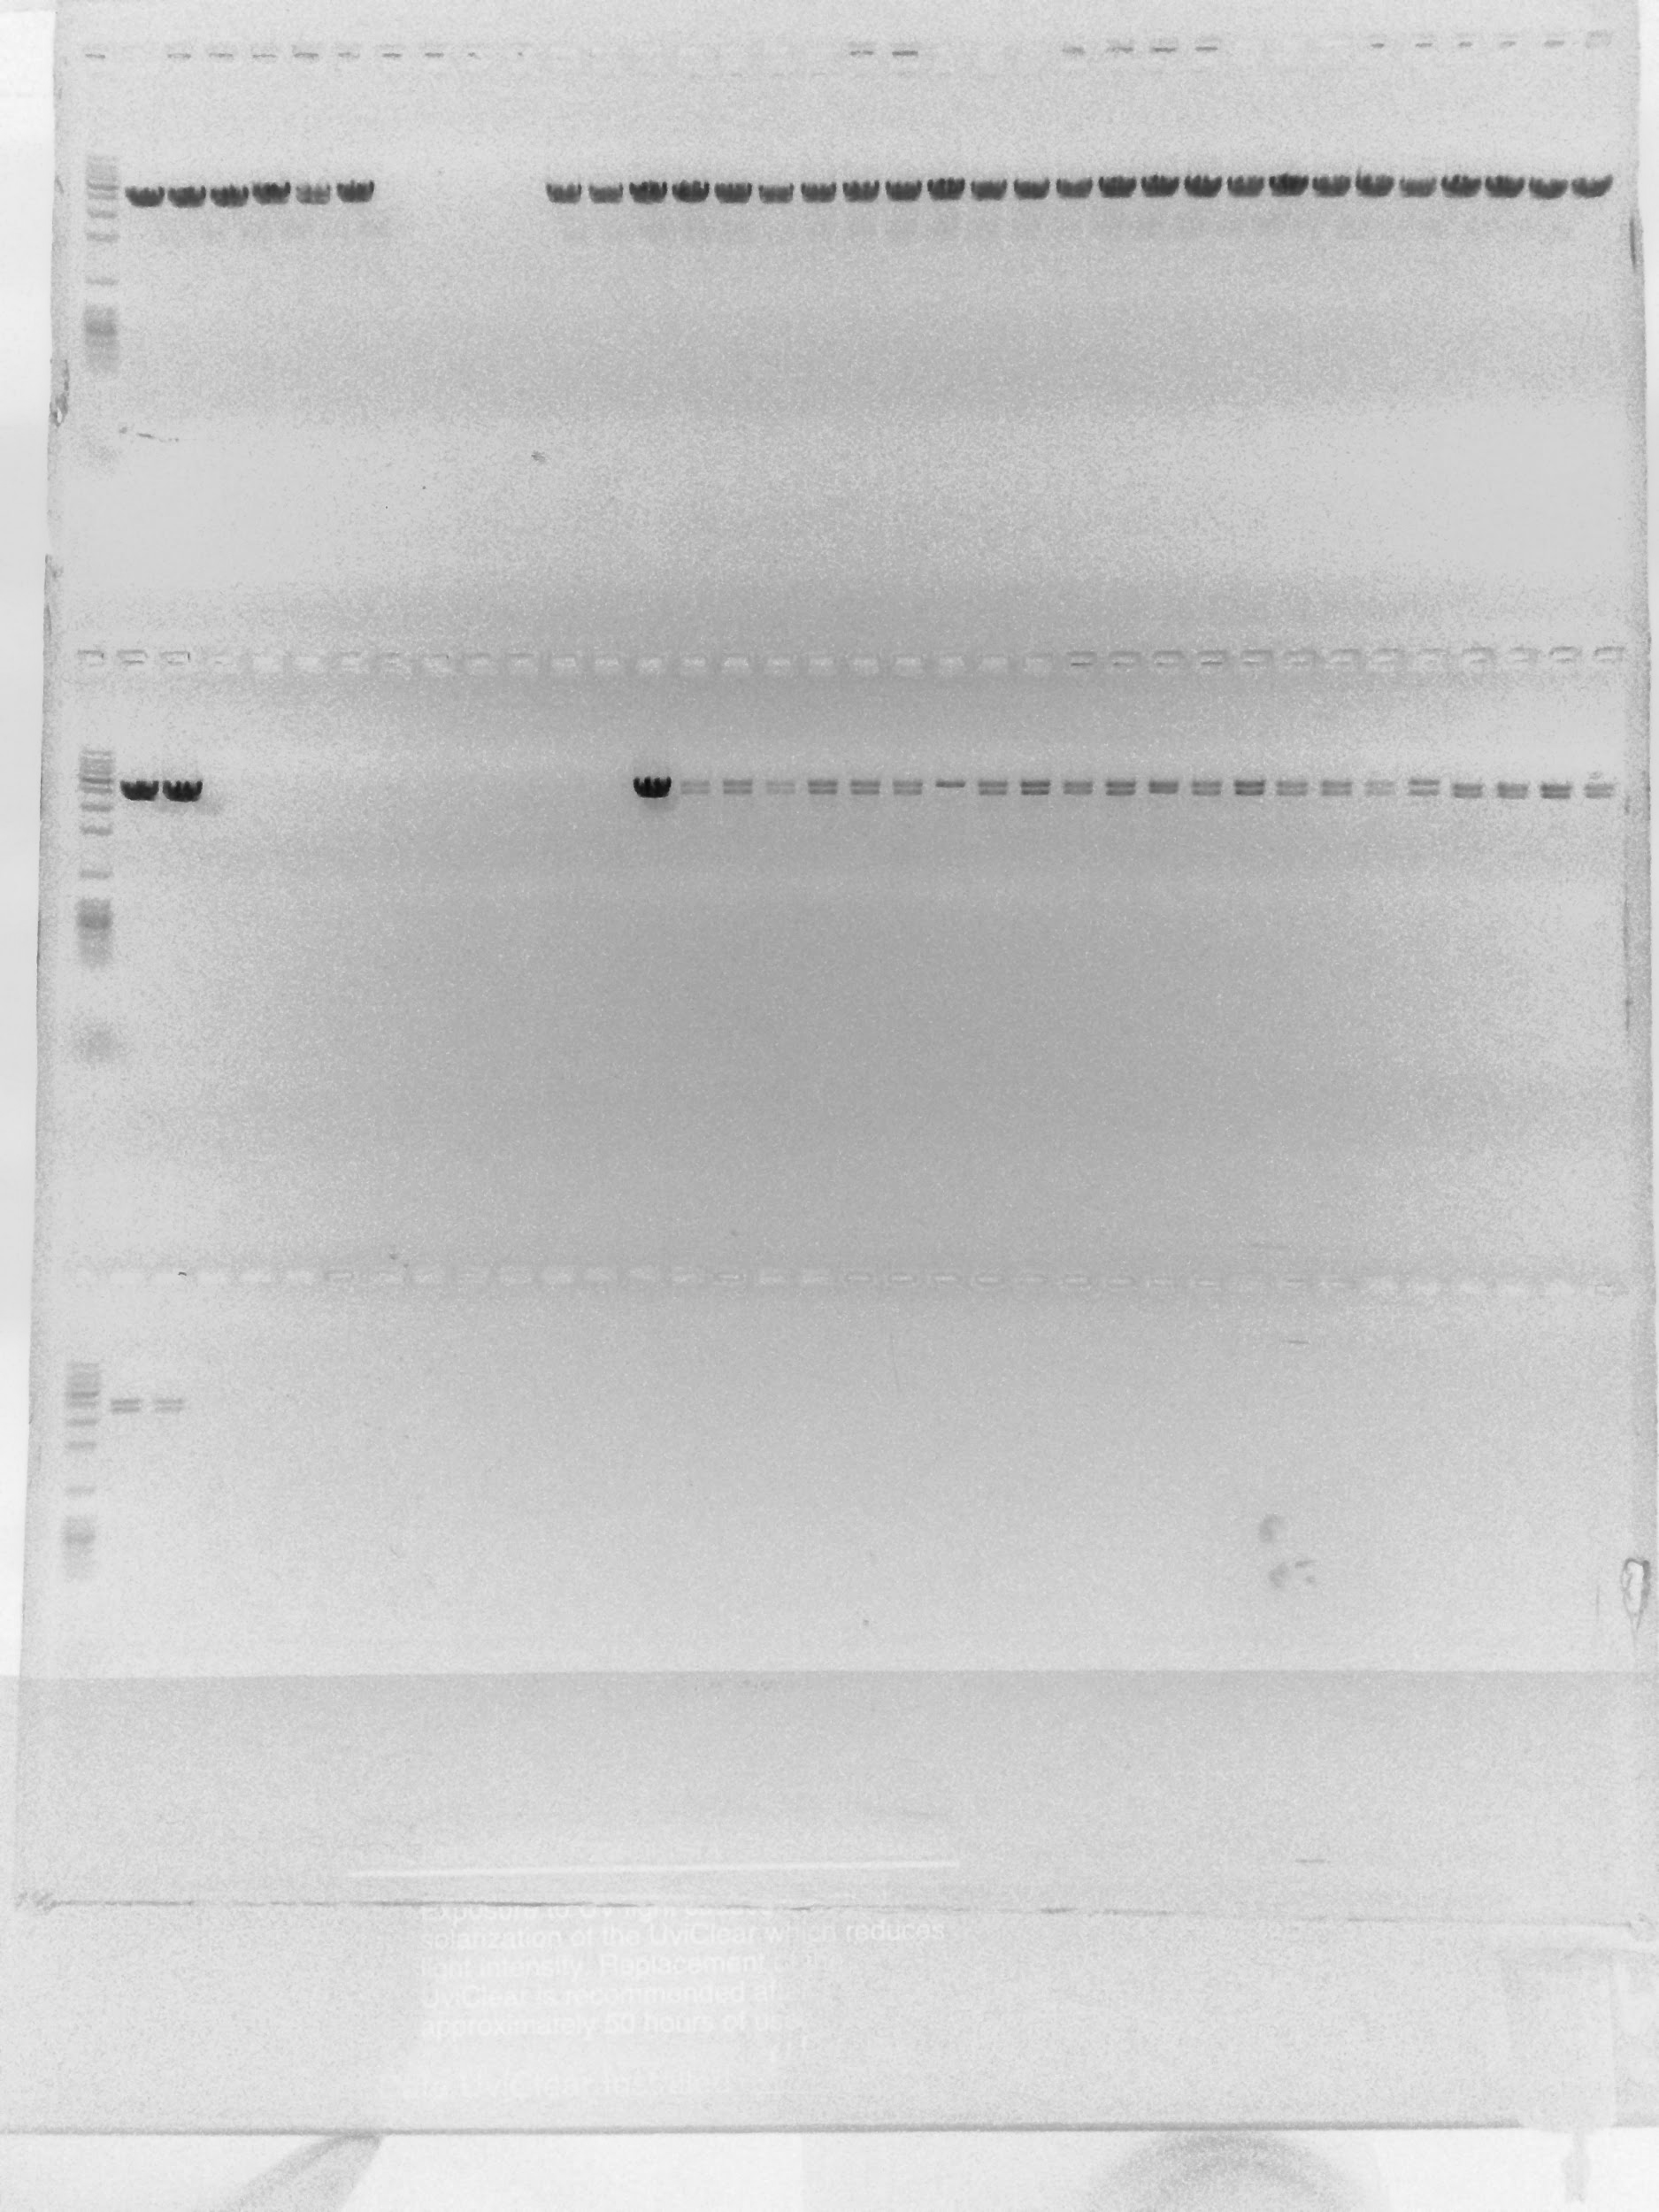
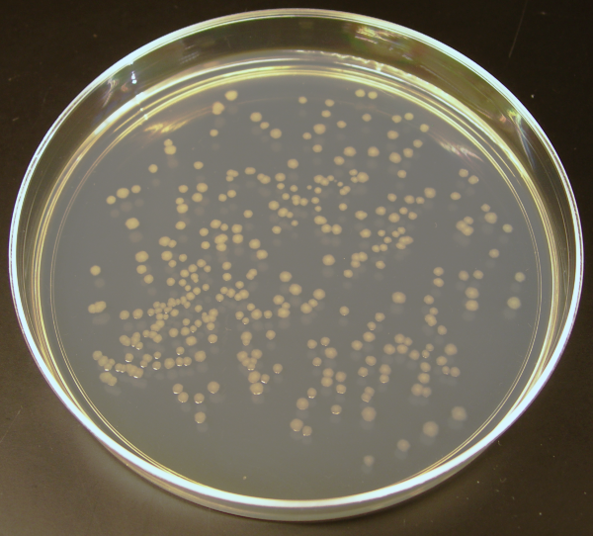
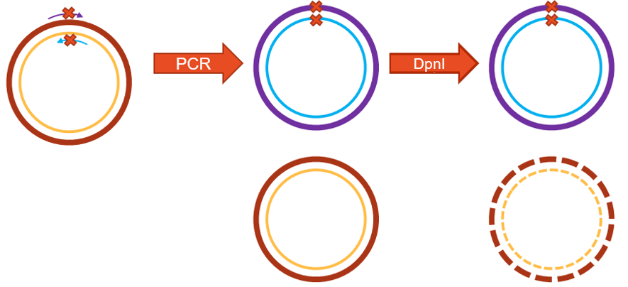
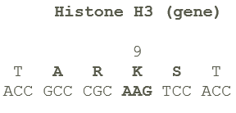
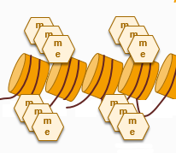
Method: Histone alleles with point mutations were created by an improved “Quick Change PCR” method
Digestion Confirmation
1 235 Kb
Step 1:
Plasmids are made by QuickChange PCR
Plasmids are transformed into E.coli
Step 2:
1 235 Kb
T11A
ACC -> GCC
T6T
ACC -> ACT
Plasmids are digested for confirmation.
Step 3:
K9L
AAG -> CTC
Plasmids are sent to be Sanger sequenced
Step 4:
1 235 Kb
LB+AMP
Kpn1 digest:
4.1 and 3.5 kb fragments
Agilent Technologies
Notes:
Now we are going to take a deeper look into the Quick change process
“top and bottom stand of methylated parent strand”
“way more new product but can still have background must get rid of parent
Parent plasmid is methylated in E.coli so can be digested by DpnI
CLICK
For methylation, ligation, and amplification of plasmid
CLICK
No band low DNA
1 band incomplete digestion or restriction site mutated
2 bands plsmid is good and can go to seq
CLICK
Three examples of interesting mutations you can find
T11A, arks
K9L methyl mimic
T6T silent mutation (no change in residue )

Slide 17
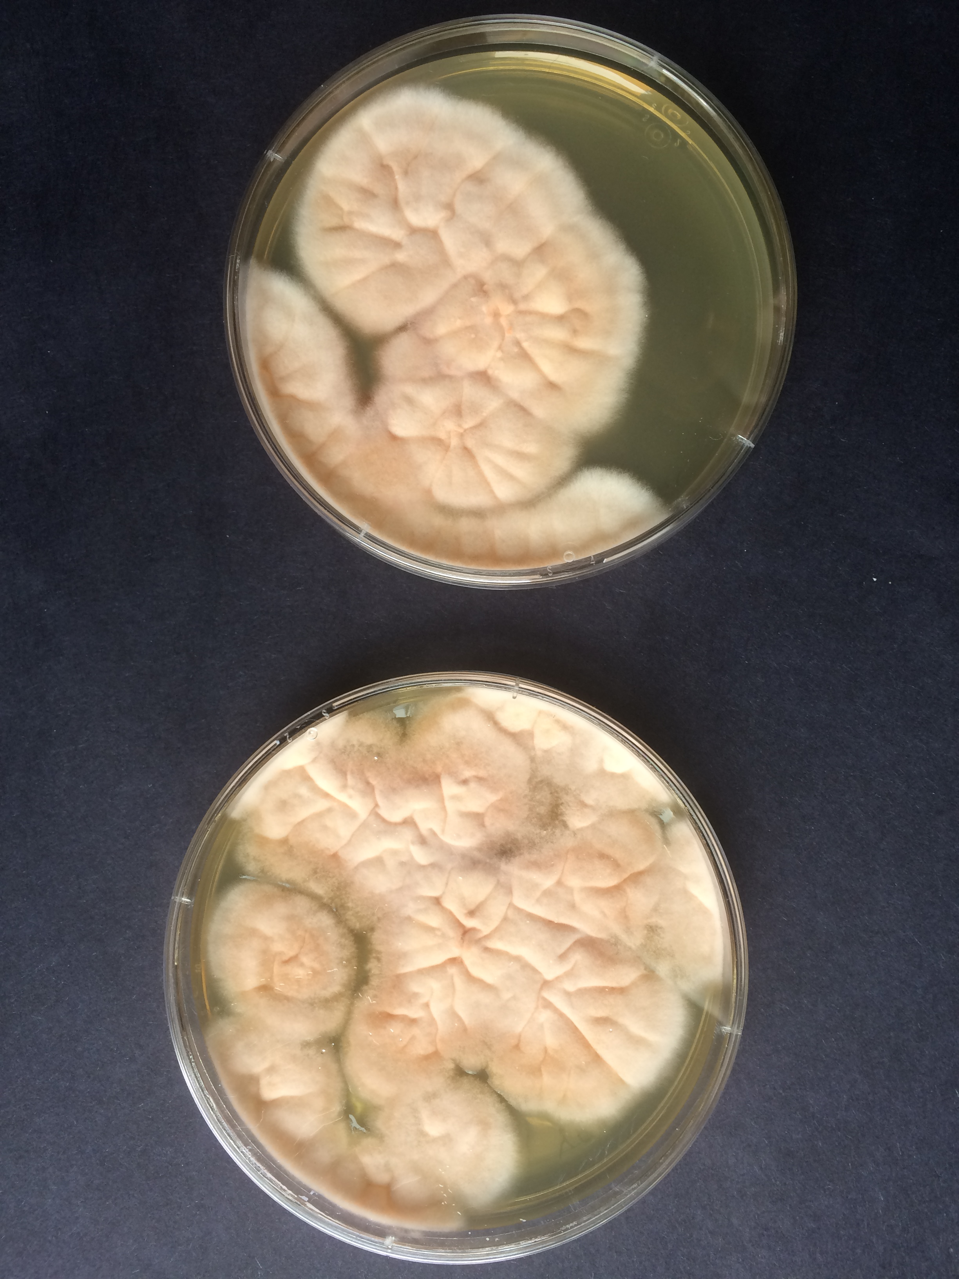
Method: Split-markers were used to create overlapping fragments for F. graminearum transformation
3’ Frag
Fusarium is digested to yield protoplasts
Protoplasts are transformed with split-marker fragments
Split-marker fragments are isolated from gel
Transformed cells are plated and left to grow
5’ and 3’ plasmid fragments are amplified
5’ Fragments for transformation
5’ Frag
1 2 3 5 Kb
3’ Frag
hph
NchH3
5’ Frag
Notes:
So once our histone allele is made and in the right plasmid how do we get it into the actual fungus
Explain split marker (overlapping fragments) (FG flanks)
Click
Fragments are run out on poly gel and isolated to be used for transformation
Click
Out WT strain PHI is digested in diselase to create protoplast (cells w/o cell porous cell walls) allows DNA through
Click
DNA is introduced to protoplast and then
CLICK
Plated to grow transformants.
A second layer of selective media is poured over the slide after 1 day of growth
This is where the hph selection gene becomes important. If the H3 allele has been incorporated the hph gene [would] also have been incorporated so the transformant will be able to grow through the encriched layer
Single transformants that grow through the top layer will be picked from each plate (before they have a chance to touch and possibly exchange genetic information) and are plated on smaller isolated plates

Slide 18
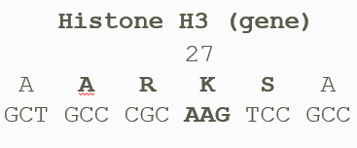
Result: Mutation of hH3 produced “sick” phenotype in F. graminearum transformants
WT
Sick
Key:
ARKS region
K18L
K14M
A24T
A24T
K64L
R2L
ypd
Y+h
Notes:
The strains shown here are the transformants we were able to produce from this study “not to scale K14M”
The ones outlined in orange look like sick blue= WT
This one is within the ARKS region
The others are methylation mimics

Slide 19
Method: hH3 targeting was confirmed by PCR and Southern blotting
HindIII
SacI
1.2 Kb
6.9 kb
2.26 kb
Notes:
Even though the allele may have gotten into the strain we needed to make sure it had actually replaced the WT H3
Click
PCR amplified 5’ end of H3 to hph mid
Click
Southern HindIII
Click
Southern SacI
Probed with hph gene
A24T, R2L, and SacI K64L (4) look good but need further confirmation by probing with 5’ or 3’ fragments

Slide 20
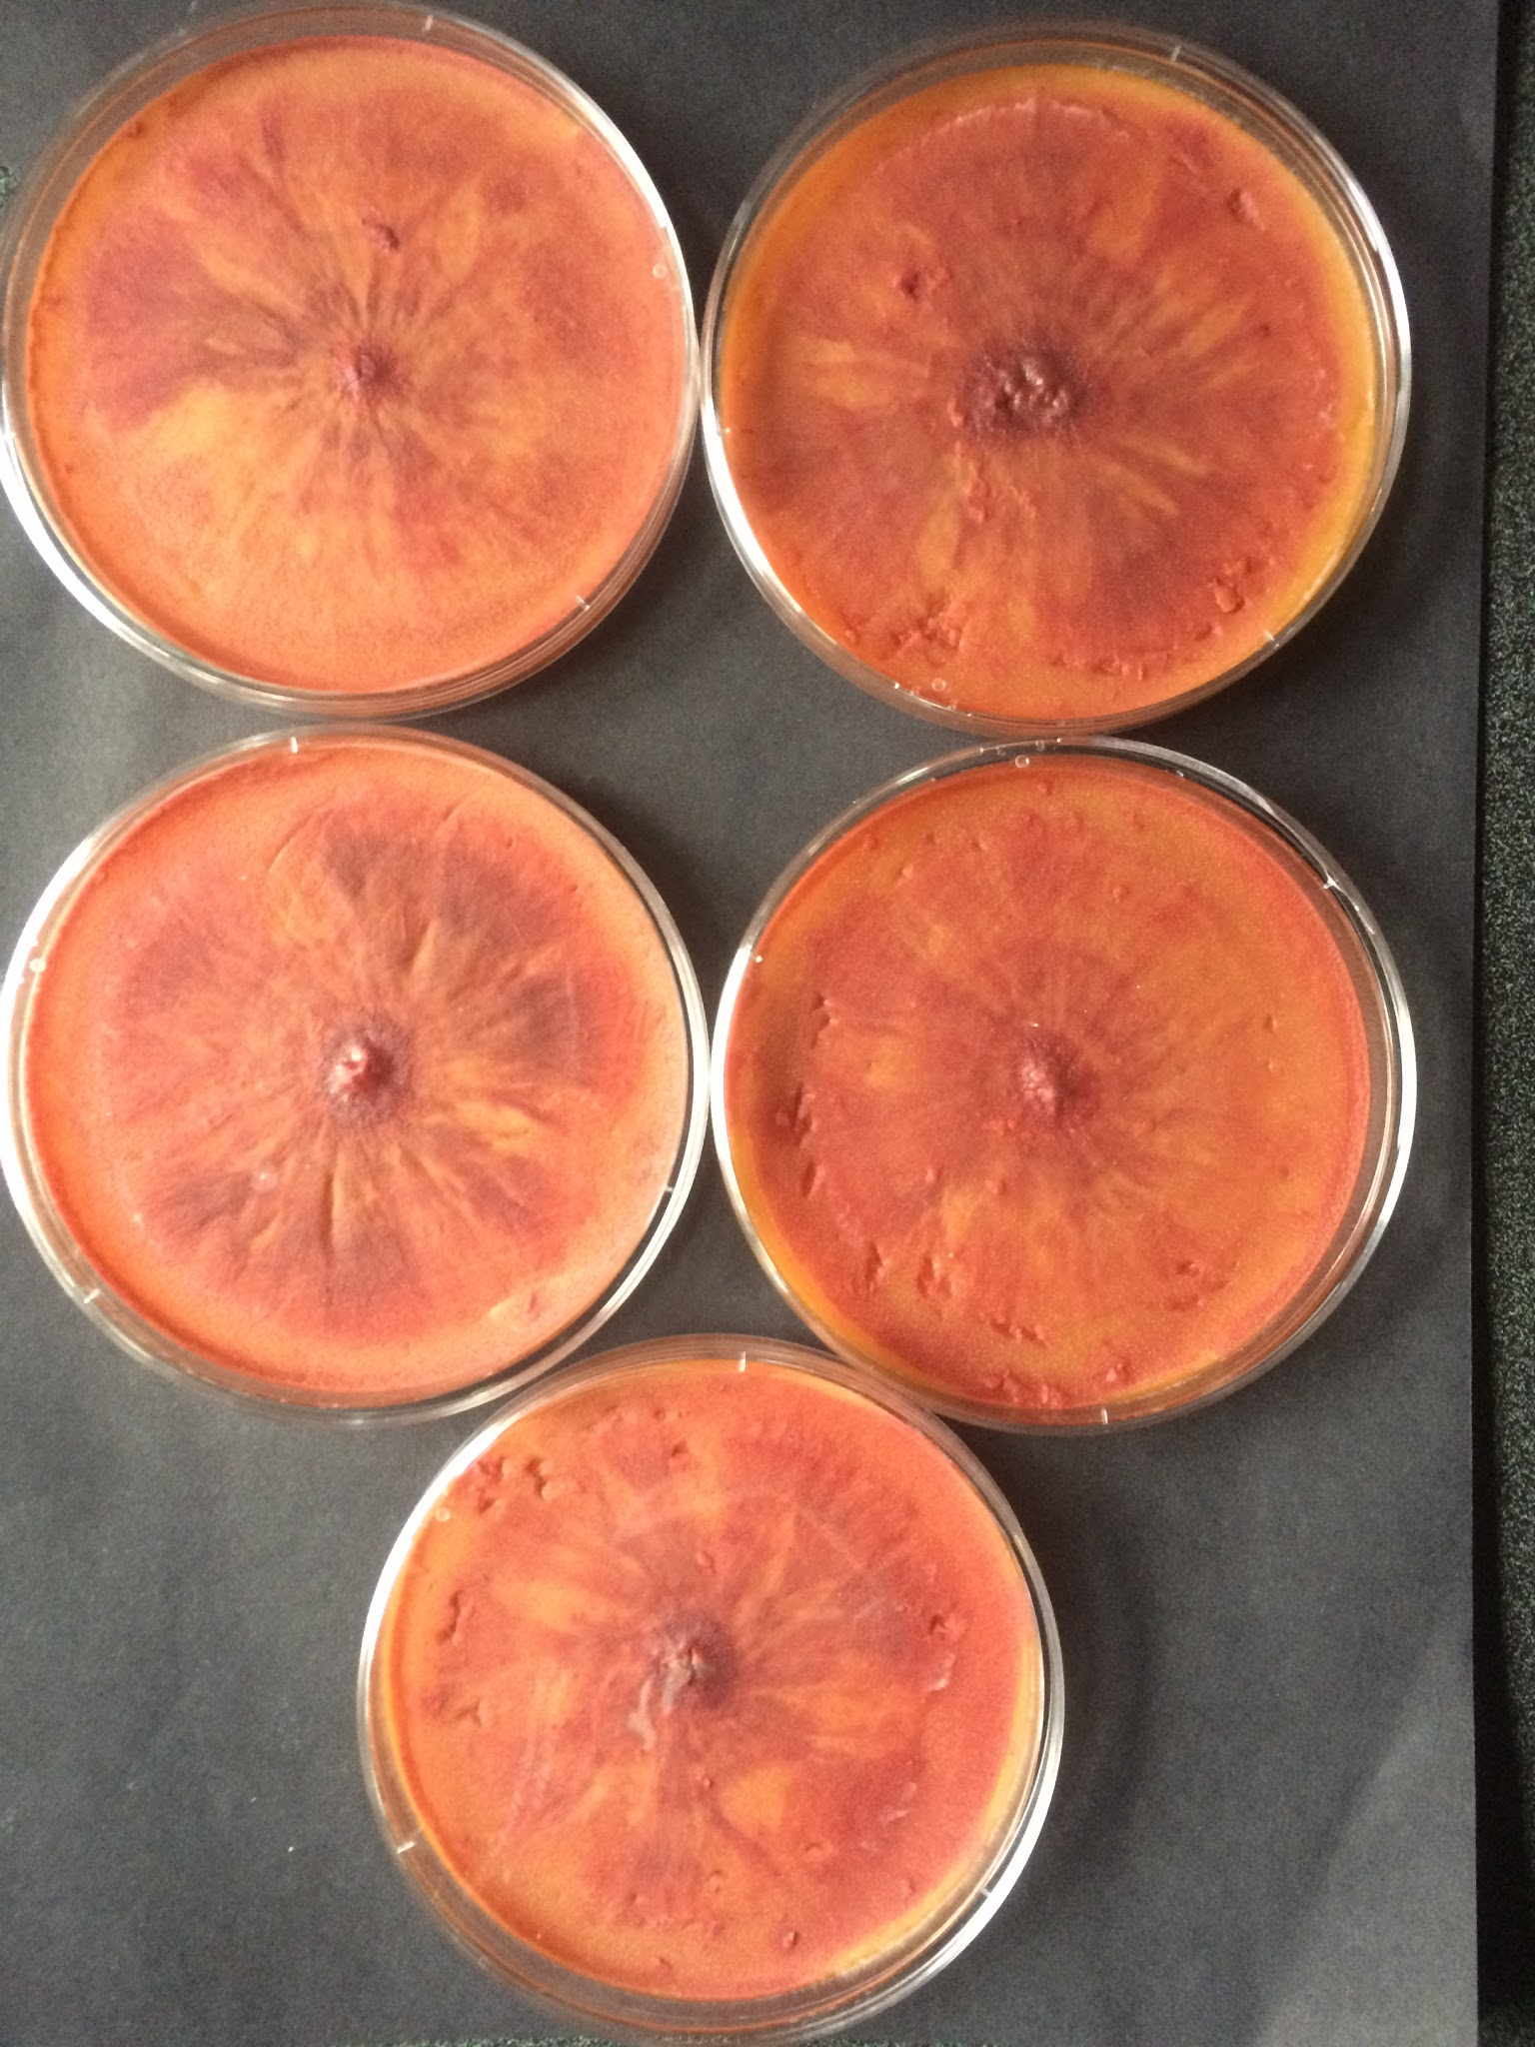
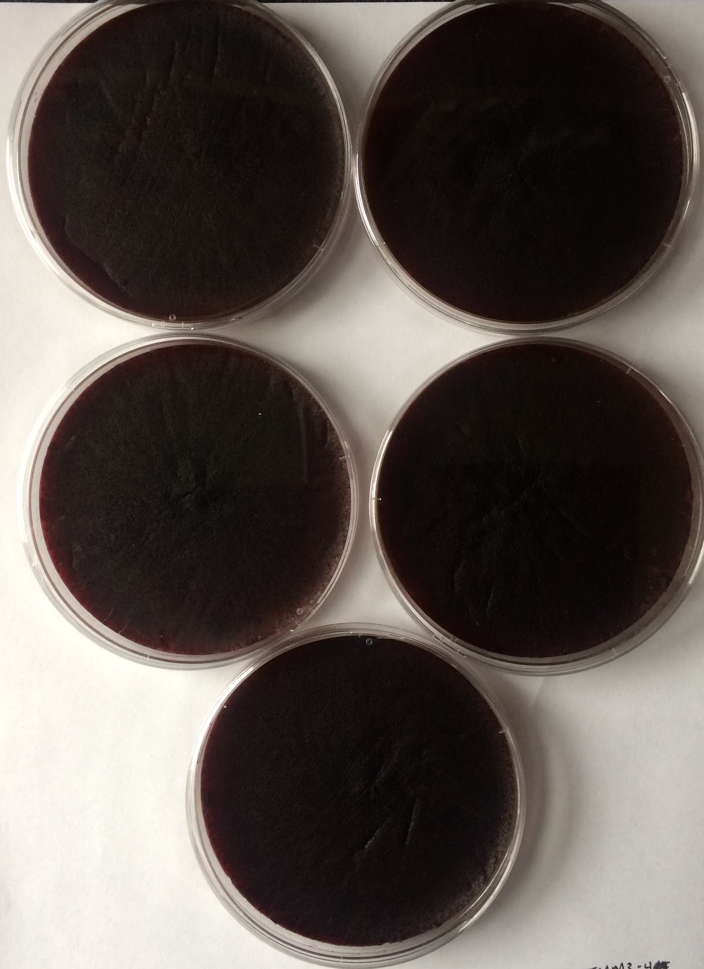
Method: Heterokaryotic transformants were purified by out-crossing
2nd Cross
1st Cross
WT
WT
Δkmt6
K14M x 842
651 x K14M
PH1
Crossing creates “clean” strain
1st cross with histone mutants produced no fruiting bodies
Suggests sterility
651 x K18L
K18L x 842
Notes:
Transformants are typically Heterokaryons, meaning their cells could contain different frquencies of the mutant allele we used in transformation
Crossing must be done to obtain a “clean” homokaryotic strain
f.g is useually a self fertile fungus, doesnt need a partner” “does mutation affect selfing”
“want to look at phenotypes that will get altered pleiotropic” “ most interested in gene silencing and centromere biology localization (EED-gfp) of kinetochore proteins” “temp sensitivity” “DNA methylation”
Spores are obtained from corsses and plated at low concentrations
Single germlings (spores just starting to put out hyphae) are picked and inoculated into separate wells in 64 well plate (assures homokary)

Slide 21
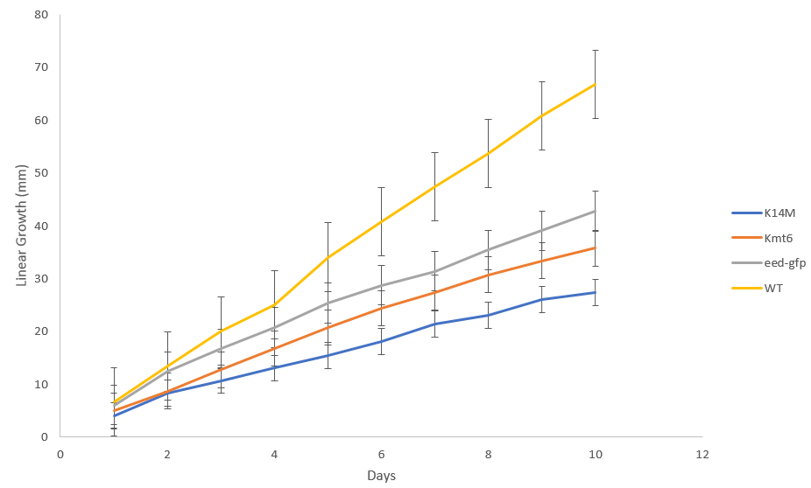
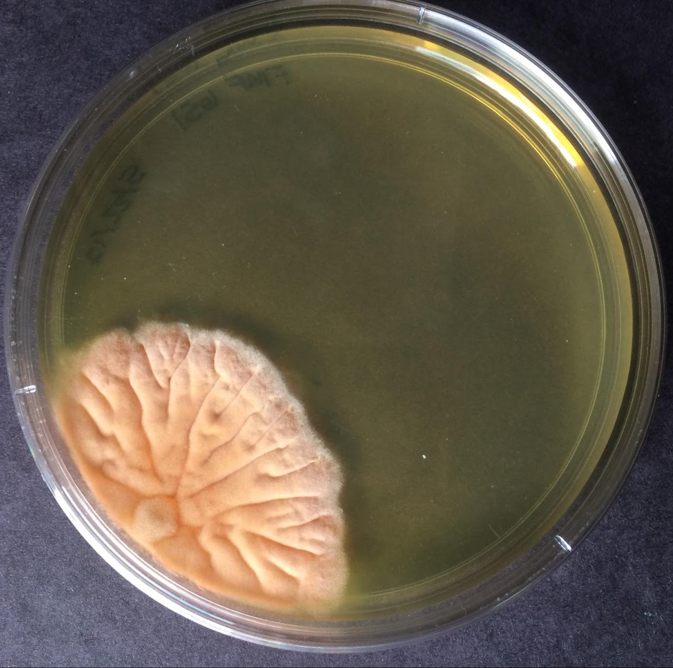
Result: Growth phenotype and linear growth assay of H3K14M shows similarities to the Δkmt6 strain
K14M
eed-gfp⁺ + K14M
WT
CAR
WT vs. H3K14M: p<< .05
Δkmt6 vs. H3K14M: p> .05
K14M
Δkmt6
eed-gfp⁺
WT
YPD
Notes:
Explain phenotyping
CLICK
Remember this is what K14M looked like before crossing
Phenotype is recessive?
Explain growth assay
CLICK
Although difference in growth seem significant stats says otherwise

Slide 22
The maintenance of genetic expression and silencing is mandatory for proper growth and development
Wild Type (WT)
“SICK” MUTANT
Connolly, L., Smith, K., and Freitag, M., unpublished data
Notes:
numbers -15 on avg 0.00000015 reads per kb per exon per mb sequencing (a way to normalize)
looking at yellow not blue 20read per kb per mb of sequence
overexpression of genes that are normally seen as lowly expressed

Slide 23
Polycomb Repressive Complex 2 (PRC2) generates H3K27 methylation
Facultative Heterochromatin
PRC2
KMT6
Catalytic subunit
Methylates lysine in histone tails
Unknown mode of targeting
me
me
me
me
me
me
me
me
me
me
me
me
me
me
me
me
me
me
me
me
me
EED
SUZ12
KMT6^{KMT6}
Connolly, L. (2015) Chromatin regulation of gene transcription (PowerPoint slides).
Notes:
Talk about PRC2 subunits
Green fluorescent protein used in cross to facilitate visualization in microscopy

Slide 24
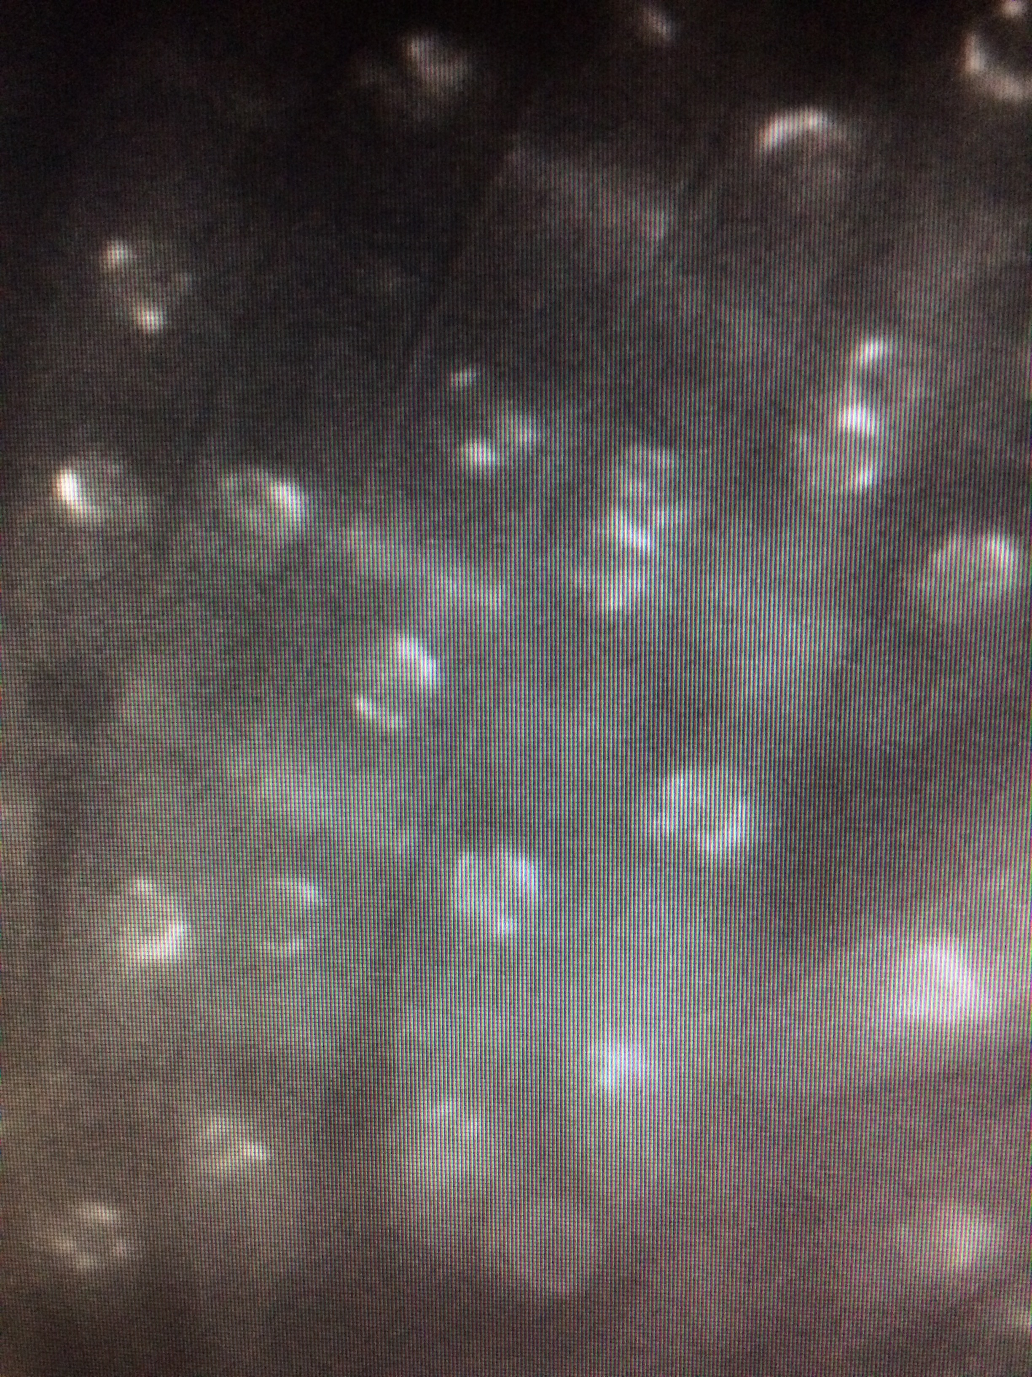
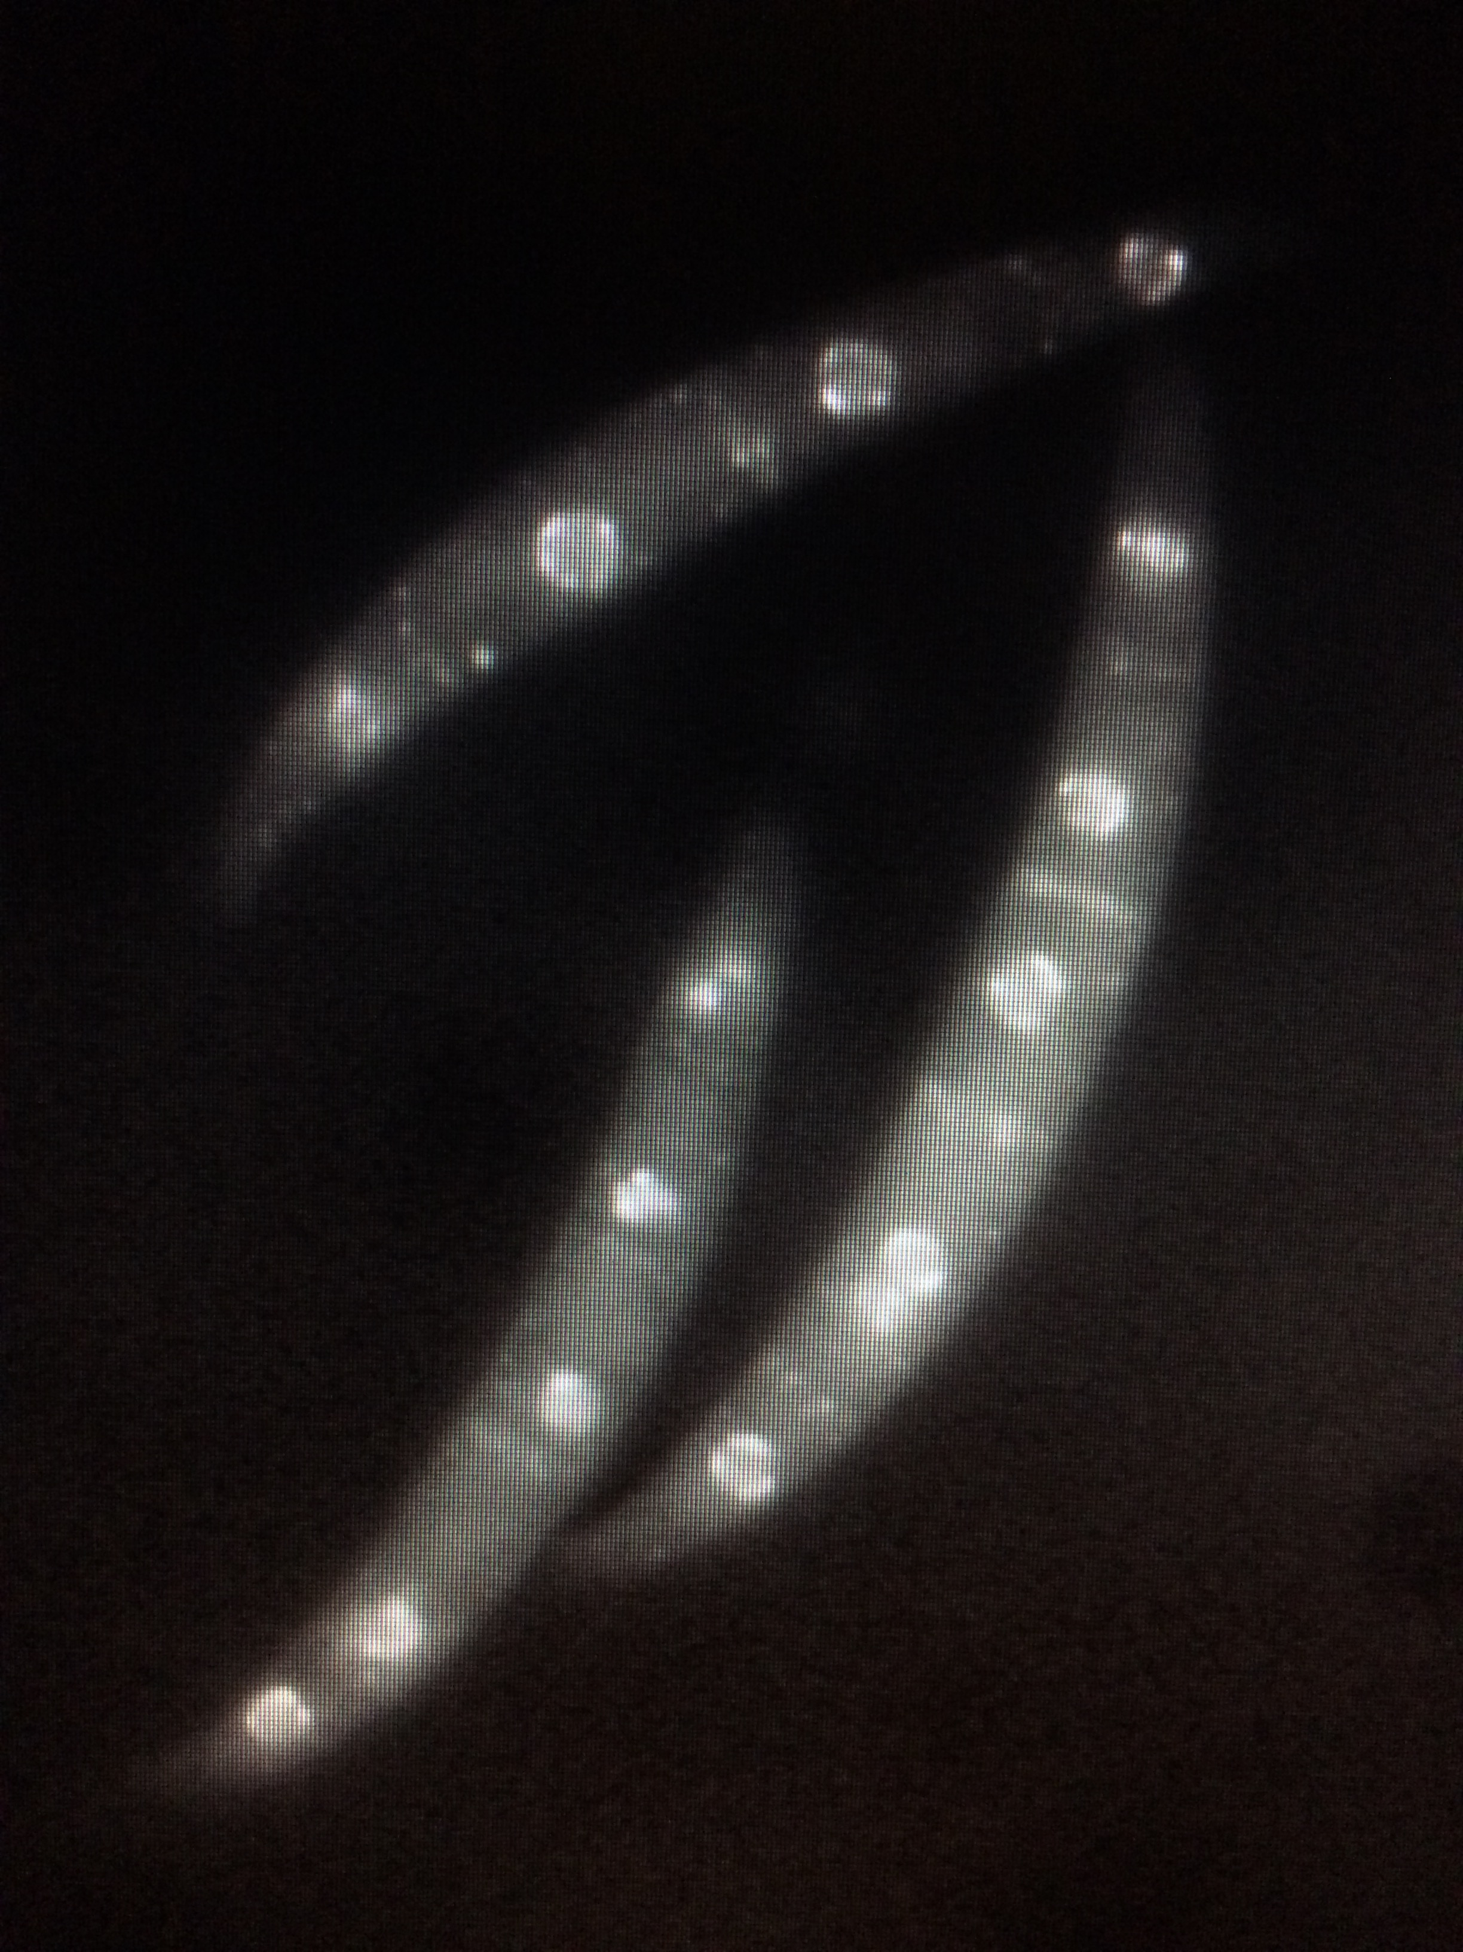
Result: H3K14M mutant expresses eed-gfp⁺, and localizes EED-GFP similar to wildtype
K14M
WT
Notes:
Touch back on crosses (EED-gfp)

Slide 25
Result: Summary of all H3 mutations
F. graminearum
N. crassa
(pRG9)
By Quickchange:
R2L
T3S
T3A
K4L
K4M
K4R
K4Q
T6A
A7M
R8A
K9M
K9R
K9L
K9Q
S10A
S10T
T11A
G12P
(pSF6)
Key:
In development
Confirmed plasmid
Confirmed strain
By Cloning:
pEB9 – H312GG pEB10 – H3G13M
pEB15 – H3R17L
pEB16 – H3K18Q
pEB17 – H3K18R
pEB18 – H3K23Q
pEB19 – H3K23R
pEB21 – H3S28A
pEB22 – H3K36L
MF337 – H3A15P
By Quick-change:
T3S
T3A K4M
K4R
K4Q
K9Q
K9L
K9M
S10A
S10T
K14L
K14M
K14R
K14Q
A15M
A15P
P16A
K27R
K27Q
S28T S28A
A29M
A29T
K36Q
K36R
K36M
K37Q K37R
K37M
K37L
K37Q
R40A
Y41A
K42A
K56Q
K14L
K14M
K14R
K14Q
A15M
A15P
P16A
K18M
K18L
K18R
K18Q
K23M
K23L
A24T
A25M
R26A
K27L
K27M
K56R
K56M
K56L
K64L
Q68A
Q68S
K79Q
K79R
K79M
K79L K122LE133A
R134A
K18M
K18L
K23M
K23L
A24T
A25M
R26A
K27L
K27M
K27R
K27Q
S28T
S28A
A29M
A29T
K36R
K36M
K79R
K79M
K79L
K122L
E133A
R134A
K36L
K36Q
K37L
K37M
K37R
K37Q
R40A
Y41A
K42A
K56Q
K56R
K56M
K56L
K64L
Q68A
Q68S
K79Q
Key:
ARKS region
Notes:
No cloning worked

Slide 26
Current Progress
F. graminearum
N. crassa
K14M has been assessed for phenotype
K18L waiting to be phenotyped
3 strains waiting to be confirmed
31 Quick change plasmids waiting to be used in transformation
34 Quick change plasmids left to be made
2 strains to be assessed for phenotype
22 Quick change plasmids waiting to be used in transformation
33 Quick change plasmids left to be made
Both
43 hH3 alleles of 95 total
Notes:
how many left to do
how many to cross use
x mutations to be made ones we’ve made how many transformants both
growth phenotype (growth curve for 1 mut more in pipeline, loc of PRC2)

Slide 27
Up Next
Assess effect of K14M on gene expression through RNA-seq
Perform transformations of remaining plasmids to create new mutants
Further attempts in cloning previously mutated hH3 genes from old plasmids into pSF6 and pRG9
Perform western blots on mutants containing substitution in “ARKS” region to record changes in H3K9me2/3 and H3K27me3

Slide 28
Limitations
Lack of overt phenotypic changes due to hH3 mutation
Pleiotropic effects

Slide 29
Acknowledgements
Mark Geisler (co-worker on the project)
Lanelle Connolly
Steve Friedman, Rodrigo Goncalves (plasmids)
Brett Pierce (KMT6 and H3 point mutants)
Brian Josephson (KMT6 mutants and ChIP)
Other Freitag lab members for suggestions and discussions
OSU College of Agricultural Sciences (E.R. Jackman grant)
OSU STEM Leadership Academy (Internship funding)
USDA Multicultural Scholars Program (Internship funding)
National Science Foundation grant MCB1515998 (MF)
Committee
Michael Freitag
Gary Merrill
Kate Field
Special Thanks
Wanda Crannell
Annette and Larry Esposito
Tyme Maidu Tribe

