Slide 1
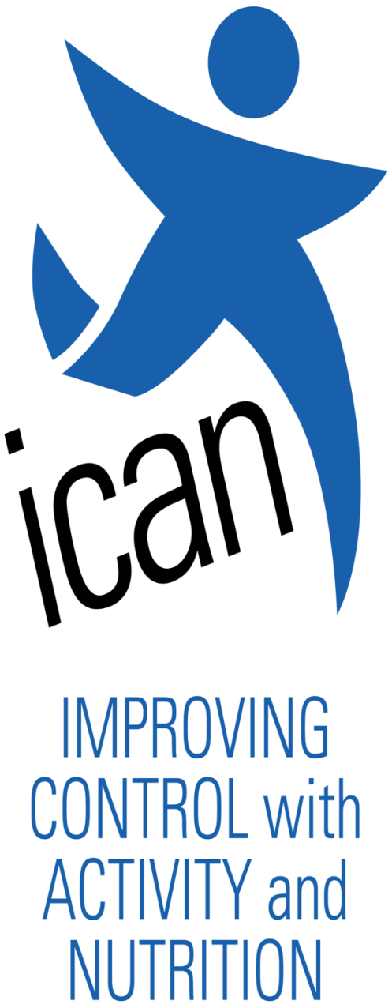
COLLEGE OF PUBLIC HEALTH AND HUMAN SCIENCES
Effect of Social Support on Control of Blood Sugar Levels
Marissa Yee, Undergraduate Research Awards Program
Introduction
Background:
Improving Control with Activity and Nutrition (ICAN):
Five year randomized clinical trial with 431 adult participants from 4 regions in Virginia (Harrisonburg/Valley, Charlottesville, Roanoke, Richmond/Metro), diagnosed with type 2 diabetes, use diabetes medications, BMI ≥ 27 kg/m², age ≥ 20 years
Eligible participants were randomly assigned to one of two groups – a “life style case management group” or a “life style intervention group”
Objectives:
Determine the association between blood sugar control levels and social support among people with type 2 diabetes enrolled in a lifestyle intervention program
Determine whether the association of glycemic control to social support depends only on social support received or the congruence of desired support to received support
Study Question:
Is there a statistically significant association between the degree to which blood sugar levels changed and the levels of help and support actually received by patients as compared to their desired levels of help and support?
Study Design/Methods Used
Data from ICAN was used to investigate associations between the change in glycemic control and social support received by participants compared to their desired levels of help and support
ICAN participants were given and completed questionnaires at the beginning (baseline) and every six months for 42 months
Questionnaires assessed support desired and support received for meal planning, physical activity, blood sugar testing, medication use, foot care, and emotional support
The numerical item scale went from Strongly Disagree (1) to Strongly Agree (5) with Does Not Apply (6)
Congruence between measures of support received and support desired was calculated
Results
Support congruence
Participant responses varied on the proportion who agreed or strongly agreed that they received support for meal planning, physical activity, blood sugar testing, medication use, foot care, and emotional support.
Figure 3. Congruence of Desired and Received Support
Congruence
Received less support than desired
Received more support than desired
Results
Support desired and received
A majority of participants agreed or strongly agreed that they desired support for meal planning and physical activity, but fewer participants reported desiring support for medication use, foot care, blood sugar testing and general emotional support.
Figure 1. ICAN Study Design
Figure 2. Comparison of Desired to Received Support
Summary/Conclusion
There was sufficient variation in congruence to support its use as an independent predictor of glycemic control in our ongoing analyses.
Ongoing analyses will examine the association between social support received, social support congruence, and both cross-sectional glycemic control and changes in glycemic control over the course of the intervention.
Intensive intervention
6 RD visits
5 fitness visits
6 group visits
12 months
1:1
randomization
stratified by study site
Life style case management
Ongoing primary care
3 RD visits/year
3 fitness visits/year
3 group classes
ad hoc email, phone
Acknowledgements
Viktor E. Bovbjerg, Ph.D. MPH
University of Virginia Health System
Southern Health – A Coventry Health Care Plan
Oregon State University – College of Public Health and Human Sciences, Undergraduate Research Awards Program (URAP)
Life style intervention
Ongoing primary care
30 months

