Slide 1
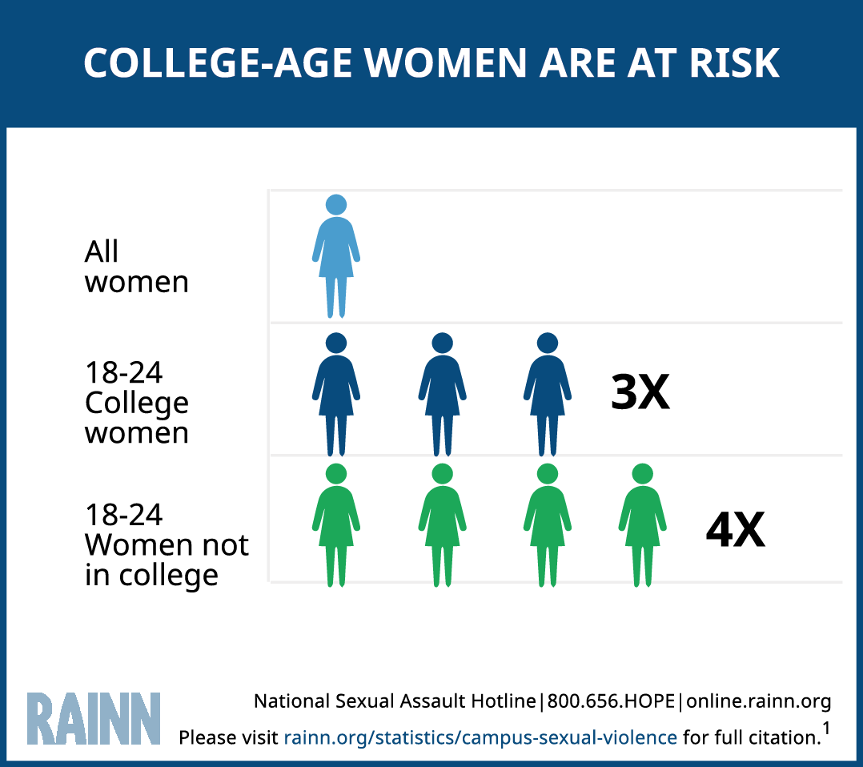
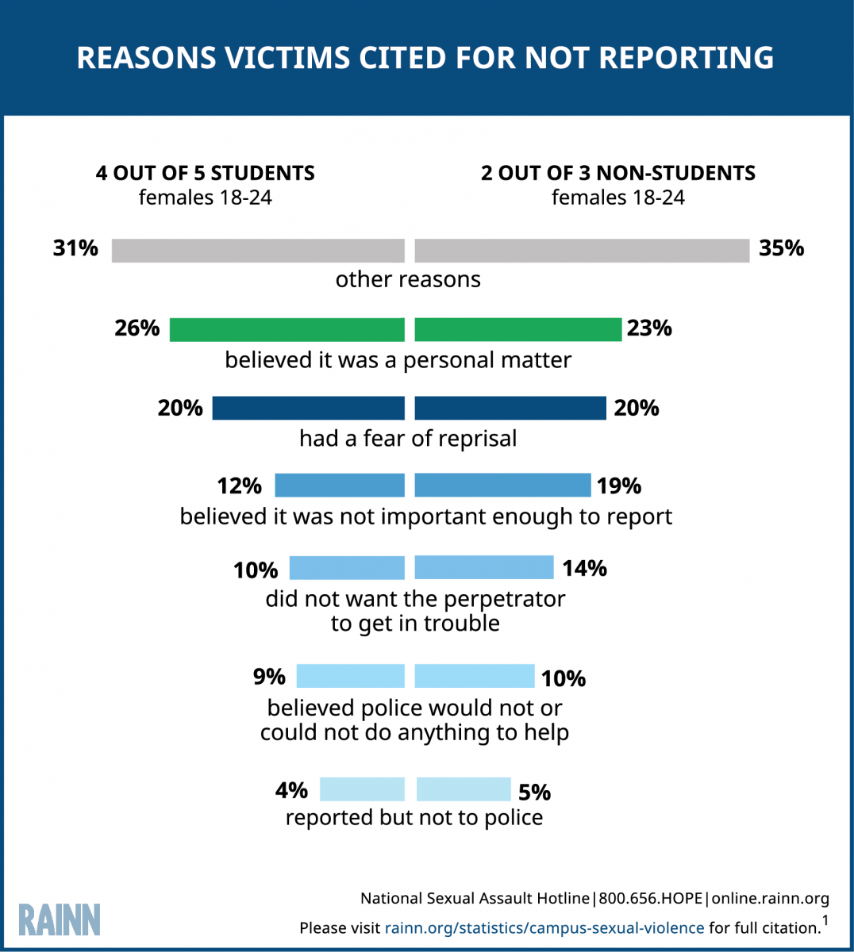
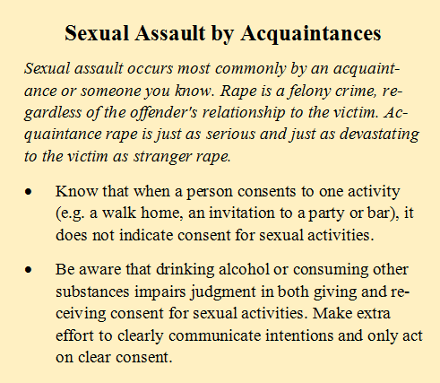
Student Perceptions of Two Versions of a Campus Sexual Assault Resource Guide
Jazlyn Mitchell, Kathryn Becker-Blease, Ph.D.
School of Psychological Science, Oregon State University
http://www.campbellsoupcompany.com/pressrelease/campbell-to-remove-bpa-from-packaging-by-mid-2017
Discussion and Future Projects
Introduction
Materials
University campuses market themselves as safe, but this is not always the case, 11.2% of all students on university campuses will experience rape or sexual assault through physical force, violence, or incapacitation (RAINN, 2015) while attending school. Research has shown that the way in which institutions, such as universities, respond to violence can worsen post-traumatic outcomes (Smith & Freyd, 2013). When an institution causes harm to an individual who trust and depends on them for safety and wellbeing, it is called institutional betrayal (Smith & Freyd, 2014). Institutional betrayal can manifest itself in many ways that include denial of allegations, lack of language and awareness of issues that continually arise, and value of reputation over the well-being of it’s members to name a few (Smith & Freyd). Institutions can also become sources of justice, healing, and support (Freyd, 2014) as when Oregon State University issued a public apology to Brenda Tracey, a survivor of sexual assault, in regards to how the university treated her report almost a decade previously.
The materials that will be used will consist of the current sexual assault resource guide, created and distributed by the Oregon State Police and the Department of Public Safety, and the revised version that was edited and reviewed by a panel of undergraduate psychological researchers at Oregon State University using the Illinois Rape Myth Acceptance Scale rape myth measure. While keeping with similar framework of the original sexual assault resource guide, many things were omitted and changed.
Understanding the scope and impact that institutional involvement has in traumatic events like sexual assault and rape requires a willingness to examine the ways in which a trusted institution may foster abuse and to recognize that this potential does not rest on the individual but on the system as a whole. This willingness to be aware of institutional wrongdoing is certainly growing, and the current research objective hope to contribute to this awareness. We are currently awaiting IRB approval to begin the study but we hope to begin collecting data very soon.
Below, is an excerpt from the current sexual assault resource guide titled, Be Alert When With Acquaintances:
Resources and Support
If you or anyone you know has experienced sexual violence or assault, listed below both on- and off-campus resources and organizations created to support and protect survivors.
Survivor Advocacy and Resource Center (541-737-2030)
311 Plageman Building, Student Health Services
survivoradvocacy@oregonstate.edu
Counseling and Psychological Services (CAPS) (541-737-2131)
500 Snell Hall
CAPS@oregonstate.edu
Center Against Rape and Domestic Violence (CARDV) (541-758-0219
4786 SW Philomath Blvd, Corvallis, OR 97333
Sexual Assault Nurse Examiners (SANE) at Student Health Services (541-737-9355)
Plageman Building
studenthealth.oegonstate.edu
RAINN (Rape, Abuse and Incest National Network)
1-800-656-HOPE (4673)
https://www.rainn.org
Below, is an excerpt from the revised sexual assault resource guide titled, Sexual Assault by Acquaintances:
To prevent violence, it is crucial that resources from law enforcement and university organizations accurately address sexual assault and do not encourage beliefs that perpetuate violence . The current research objective is focused on student perception of the Office of Public Safety’s current sexual assault resource information and our revised version of the content. The study is in its preliminary stages, but we eventually hope to gather evidence demonstrating that our revised version of the content better provides information regarding sexual violence prevention and awareness. We hypothesize that students, especially those who have survived an assault, will report higher institutional support after reading the revised version.
References
Campus sexual violence: statistics, 2016). Retrieved from https://www.rainn.org/statistics/campus-sexual-violence
Freyd, J. J., 2014). Official campus statistics for sexual violence mislead. Retrieved from http://america.aljazeera.com/opinions/2014/7/college-campus-sexualassaultsafetydatawhitehousegender.html
McMahon, S., & Farmer, G. L. (2011). An updated measure for assessing subtle rape myths. Social Work Research, 35(2), 71-81.
Payne, D. L., Lonsway, K. A., & Fitzgerald, L. F. (1999). Rape myth acceptance: Exploration of its structure and its measurement using the Illinois Rape Myth Acceptance Scale. Journal of Research in Personality, 33, 27–68
Smith, C. A., Freyd, J. J. (2015). Institutional Betrayal. American Psychologist 69 (6), 575-587
Email: Kathryn.Blease@oregonstate.edu
Presented at Oregon State University’s Celebrate Undergraduate Excellence Symposium, Corvallis, OR. May 19th, 2017
Notes:
The traditional framework of health-care has been conventionally one-way. As health information becomes more widely available with the advent of the internet, more models of patient-centered care are being performed. That said, socioeconomic status and culture lend themselves into the quality and delivery of health care. The resulted disparity is observed through difference in health literacy.
Patients report a need for more autonomy in mediating their care – a task that is linked with understanding of health information. Thus, healthcare professionals have the responsibility to present risks and health management information in formats that patients could comprehend. Our offered solution is through managing cognitive load to ensure all essential health information is delivered.
((Removed from poster but could still be in presentation: Strategies to improve communication between patients and health care providers increase health literacy, reduce health inequities, and build social capital)

