Slide 1
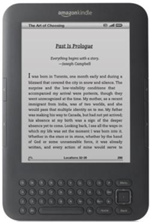
We Ditched our Kindles and You Can, Too!
Jane Nichols
Uta Hussong-Christian
Oregon State University Libraries & Press
Notes:
Jane
OSU Libraries & Press (OSUL&P) has circulated Kindle ereaders as a way to offer our students and faculty a popular reading collection. As you saw in the abstract we started with 60 staff-selected and now the collection has grown to over 600 largely patron-selected titles. So, why consider ditching our Kindles in favor of…tablets? Over the next few minutes, I’ll share our thinking and progress so far.

Slide 2
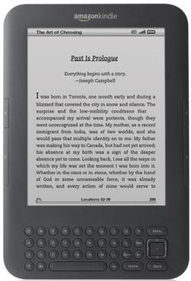
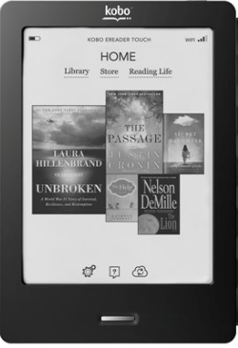
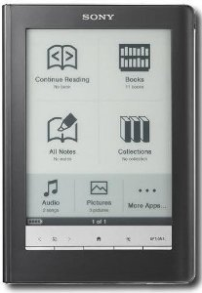
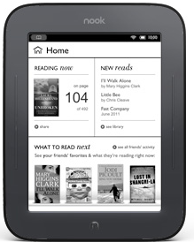
eReader Study
Kindle Keyboard
with ads
Kobo
Touch
Sony Digital
Reader
Nook
Touch
1 year
4 eReaders
30 librarians & press staff
Notes:
Jane
We began to revisit lending Kindles while undergoing a study about our colleagues and why they adopted-or not—one of the four eReaders you see here. We hoped to learn what motivates us to adopt ereaders and if that might influence the development of library services. Of course since we began the study the eReader landscape has changed significantly and the rise of tablets greatly influenced our thoughts (and findings?). For example adoption of tab One take away from the We also hoped to learn how adoption affects development of services for our patrons

Slide 3
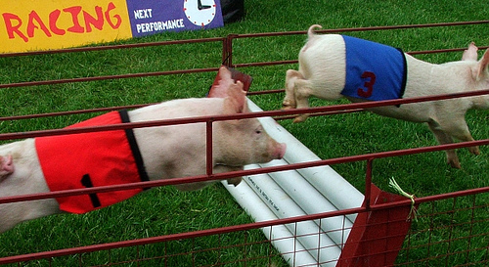
Flickr: jasfrtas
Notes:
Jane
our users were very confident that their ereaders would be self-explanatory and that they would be able to use them with ease; we use computers and cell phones every day; why would an ereader have a learning curve? So it was quite unexpected when we encountered hurdles. And, because there were so many hurdles, I don’t think we were quite as gleeful about them as these guys…
http://www.flickr.com/photos/89348550@N00/ jasfrtas

Slide 4
Hurdles Encountered
Notes:
Uta
Problems ranged from finding content to just getting the device going. finding and accessing content turned out to be fairly complex because many of our participants wanted to read articles which were served up in pdf format. Only one of the readers, the Sony, reflowed the text so it was properly formatted to fit the screen. And that was only some of the articles, not all. Many of us wanted to read books; but having to transfer a file from our desktop using Adobe Reader was annoying at best and a significant barrier for several folks unused to this type of workflow.

Slide 5
Another Device
Notes:
Given the hurdles encountered you will not be surprised that by the end of the study 21 of our participants were using another device in addition to or instead of their ereader for eReading purposes. As you can see the Sony was not a favored device.
Total: no 9 yes 21

Slide 6
2009-13
2011-12
Fall 2012
Dec 2012
Jan/Feb 2013
Propose Tablet Lending
License Issues!
Beta Tablet Lending
Kindle Lending
eReader Study
Notes:
Uta
Looking at the big picture, the roots for supporting ereading go back to 2009 with the start of our Kindle Lending program. The eReader study advanced our thinking about offering access to more content and providing more functionality in an easy to use device. Last fall we developed device requirements and settled on the relatively inexpensive Google Nexus 7 tablet. We’ve spent the winter addressing licensing issues, programming and developing a marketing campaign.

Slide 7
Kindle Lending
6 Kindles including DX
2 week checkout
Patrons submit eBook purchases
with hold
645-title collection
Some rights reserved by needoptic (flickr))
Notes:
Uta
Let’s take a moment to look at some of the details of the Kindle lending program. We circulate 5 second generation Kindles and one 1 Kindle DX all registered to the same Amazon account. Patrons can submit up to 2 title requests which we purchase when they place a hold. We’ve had a wait list for 4 years and don’t see that slowing down. When asked why they borrow the Kindles, a primary reason is to try out an eReader. Given that success…

Slide 8
Tablets
Flickr: barkbud
Notes:
Why tablets:
Well, we believed that ereaders would be overtaken in popularity by tablets. We recognized that our students and faculty might prefer a multi-functional device over a single purpose one. Tablets appeal included being able to use productivity software, play games, watch videos and more. We also assumed that our patrons would enjoy features like using a touch screen or a stylus which our Kindles didn’t offer. We also saw this as a test bed to eventually replace our circulating laptops.

Slide 9
Options
Flickr: wfryer
Notes:
Jane
A major interest in moving away from Kindle readers was offering a device agnostic reading experience. Since we, like you, have significantly increased our ebook holdings—we hoped supporting our users by offering a device that could read ebooks from numerous content providers would encourage their adoption of our ebooks. With a tablet, our thinking was, we can still continue our Kindle ebook program…we just are no longer tied to the reader. And we can offer ebooks from other vendors. But wait there’s more! Our patrons would also have an easier time of reading pdfs which apps like google books handle much better than many ereaders.
http://www.flickr.com/photos/wfryer/7043065437/

Slide 10
The Vision
Notes:
Uta
Our vision was a tablet pre-installed with apps and web shortcuts that supported library use, academic reading, pleasure reading, writing, note taking, other academic tasks, and social interaction. We wanted patrons to have immediate access to productivity tools and reading apps even though we were pretty sure they would use the device for many other things as well.

Slide 11
Notes:
Uta
Our programmer set to work using an enhanced version of Google’s official open source Android operating system. This operation system, CyanogenMod, is built and maintained by the CyanogenMod community. He made customizations like creating website shortcuts and installing selected apps and modified the update and reset process; so we can continuously update the build. The CM Updater talks to our library server-based web update service and the result…easy wireless updates.

Slide 12
“Love the way it integrated with Google…that is a bit scary at the same time.”
“[Difficulty] figuring out where files went after downloading them.”
Staff said…
“I…find the Android functionality to be less intuitive and user-friendly than Apple [has Android and iOS devices.]”
“Small size is nice…carried it instead of iPad a couple of times.”
Notes:
Uta
Even with its enhanced functionality, our staff testers had both successes and frustrations with the device. They noted that the file download process was cumbersome and that article access through our library discovery service meant clicking through several similarly-labeled Full Text links. Having to enter personal banking information for other apps or services was a surprise and hindrance to some staff.

Slide 13
We’re Ditching Our Kindles…
…But Should You, Too?
Notes:
Uta
To counter some of these challenges and surprises we are employing user education through online guides and bag inserts. In the meantime we encountered licensing restrictions that we addressed through work arounds. However, these were onerous to point that we considered renaming our presentation to what you see here (ADDITIONAL CLICK).

Slide 14
Google Play Terms of Service
Sharing. You may not use Products as part of any service for sharing, lending or multi-person use, or for the purpose of any other institution, except as specifically permitted and only in the exact manner specified and enabled by Google (for example, through “Social Recommendations”).
Notes:
Jane
If you look closely you’ll see that Google Play, the app store for the Nexus is really intended for individual use. Definitely that’ is the experience you get when you open the device and get it going…much of the set up is tied to a single person.

Slide 15
Flickr: helmsp
Notes:
Jane
We’re interpreting Google Play’s Terms of Service pretty narrowly at this point to apply only to apps on the device and not to the device itself. We have not sought legal advice from OSU Counsel about our interpretation at this point, although that is a possibility as we continue to develop the service. What this has meant for out tablet lending program is significant customization of the operating system to meet our current needs. So for now, we walk a fine line.

Slide 16
Nexus 7 Lending_{β}
9 tablets
1 week checkout
App “light”
Bookmarked webpages
Personalization-friendly
Notes:
Uta
While scaled back from our first vision of the service, our beta tablet lending program offers these features that we feel will still be well received. The 12 available devices were all out the door within the first few hours of the new service going live! It will be very interesting to note if the lack of pre-installed apps is remarked upon by our users or if, like with the Kindles, part of the draw is simply the opportunity to try a tablet.

Slide 17
Flickr: flattop
Notes:
Uta
One particular issue our Circ staff will need to pay close attention to is ensuring that personal information is completely removed from the device upon its return to us. Unfortunately the factory reset does not erase automatically-created app-related folders and files saved on the “virtual” memory card. It is an extra manual step for our Circ staff but we are committed to maintaining patron confidentiality and the security of all their personal information.

Slide 18
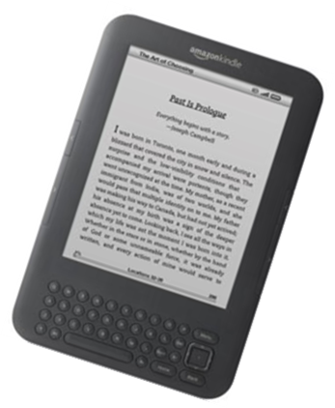
and the Kindles…?
Notes:
Jane
For now we are circulating them with the Kindle content. Our programmer is developing a build to include a Kindle app. Once that is complete we’ll register 6 of the tablets to the library Kindle account and loan those tablets as Kindle readers…
Then we’ll test out loaning the Kindle readers without any content and allow users to register their account; which of course we will remove when it’s returned. And we’ll keep loaning them until they’re worn out. At that time we’ll decide whether to get more.

Slide 19
Learn from Others
Concordia University Libraries
iPads and Tablets in Libraries: Tumblr
Harvard
NCSU
Notes:
Jane
I wanted to close with reference to others who have also developed lending programs…despite the o
Only 6 devices tied to one account
http://www.amazon.com/gp/help/customer/display.html?nodeId=200699130
http://www.amazon.com/gp/feature.html/ref=mas_dp_eula?ie=UTF8&docId=1000667601
http://www.amazon.com/gp/help/customer/display.html/?&nodeId=200506200
http://www.amazon.com/gp/help/customer/display.html/ref=hp_200699130_storeTOU1?nodeId=201014950

Slide 20
Thanks!
uta.hussong-christian@oregonstate.edu
jane.nichols@oregonstate.edu
Notes:
Jane
Learn more from us about our program; how it’s going; preliminary feedback from users or if you have questions about setting up a similar service. Thanks so much for your time and attention!

