Slide 1
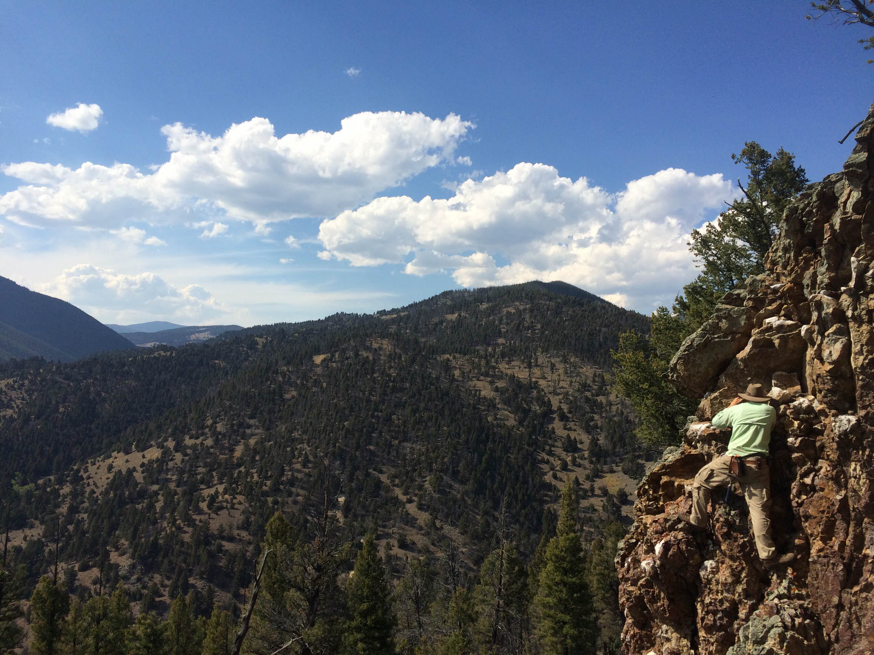
Vein Orientation and Structural Geology of the Boulder Batholith, Mount Thompson Quadrangle, southwestern Montana
Neal Mankins, John Dilles, Nansen Olsen, Michael Sepp, Jacob Blessing

Slide 2
Introduction
Project Goals
Create an improved 1:24,000 scale map of the Mt. Thompson Quadrangle
Understand the nature of the veins, their orientations, and overall structural geology of the Mt. Thompson Quadrangle
Use field descriptions, hand samples, and thin sections to determine crosscutting relations, alteration types, and sulfide mineralization
Improve correlation of units within the Mt. Thompson Quadrangle and those of neighboring quadrangles

Slide 3
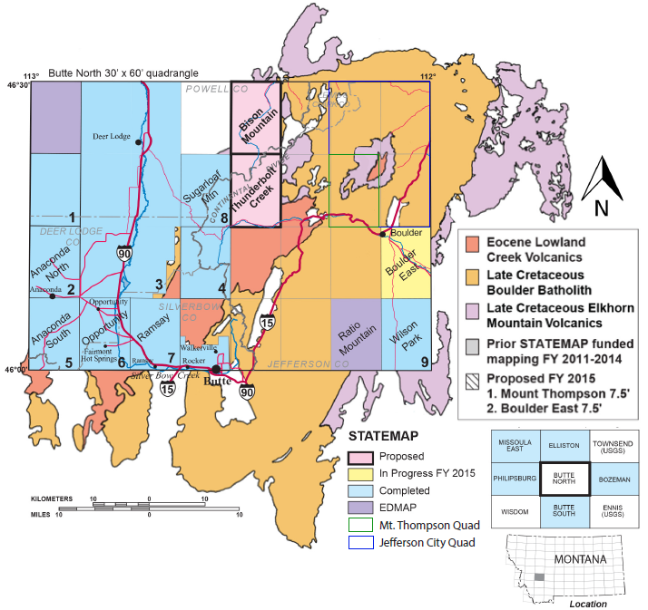
Background
Mt. Thompson Quadrangle
Located 23 miles NE of Butte, Montana
Contains a number of inactive mines
Few paved roads in the area
(accessible via dirt service roads)

Slide 4
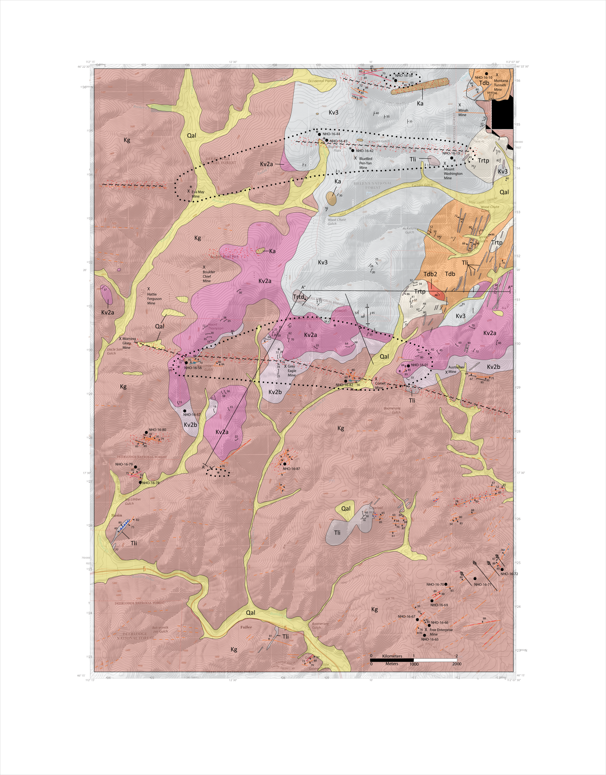
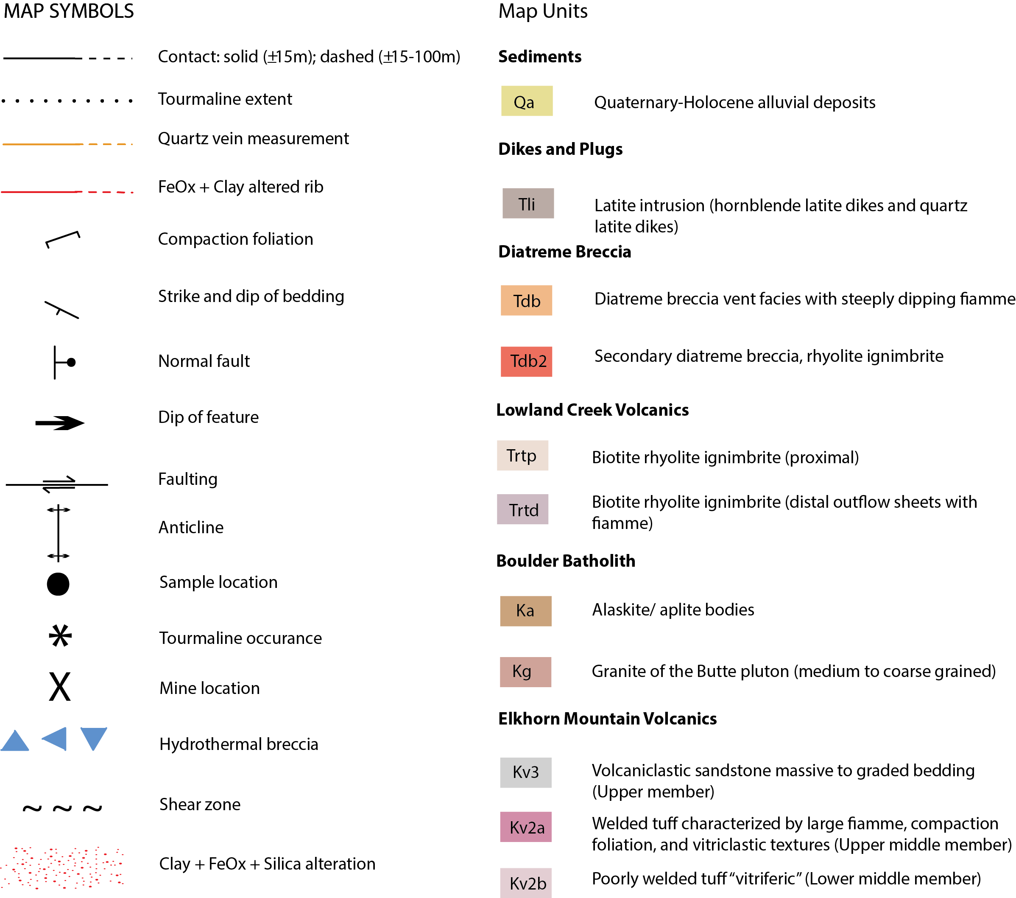
Geologic Setting

Slide 5
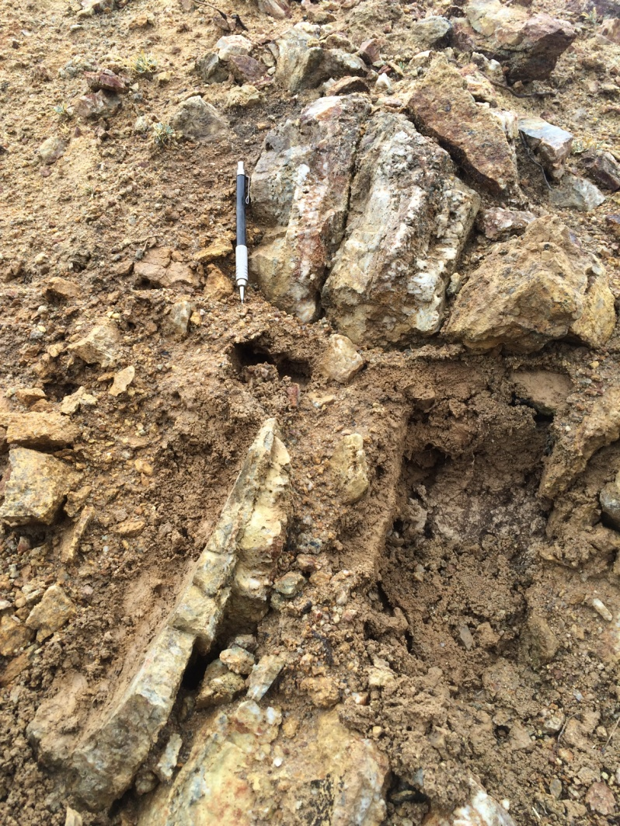
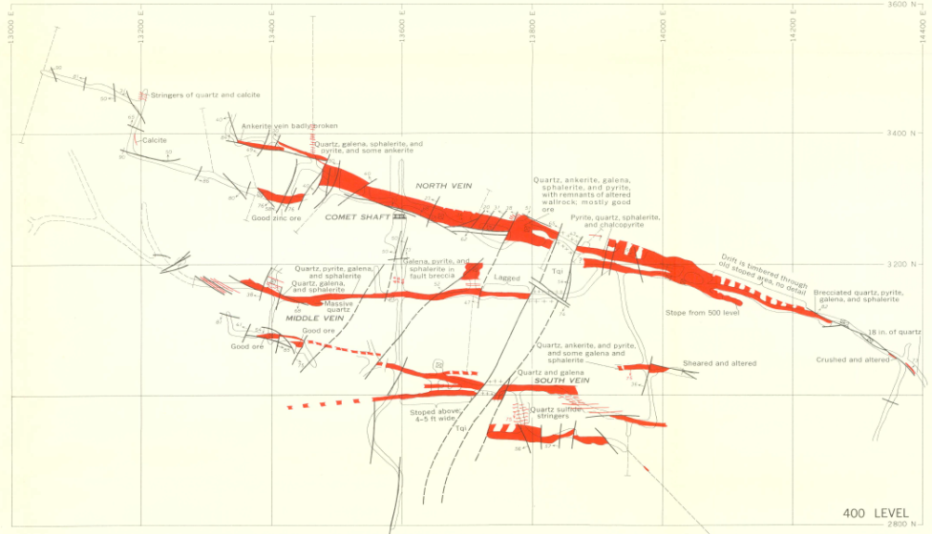
Methods
Field descriptions
Hand samples
Reflected light petrography
Historic mine plates & previous work (Brecraft et al. 1963)

Slide 6
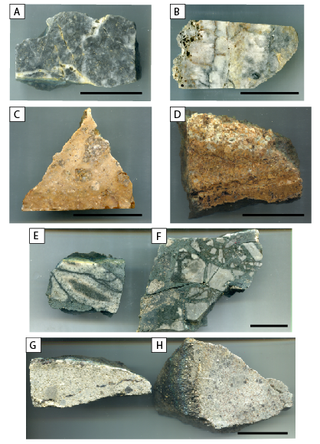
Hand Sample Analysis
Four dominant vein mineralogy’s identified
A & B: Massive grey quartz 70-80% of which are locally vuggy quartz with abundant sulphides (Py>Gn>Sp)
C & D: Quartz-sulphide-poor veins 65% with chalcedony
E & F: Cm-scale milky quartz veins 70% with tourmaline
G & H: Sulphide-rich (Py>Gn>Sp>Ccp>Mo) veins at the Montana Tunnels (mineralization associated with diatreme)

Slide 7
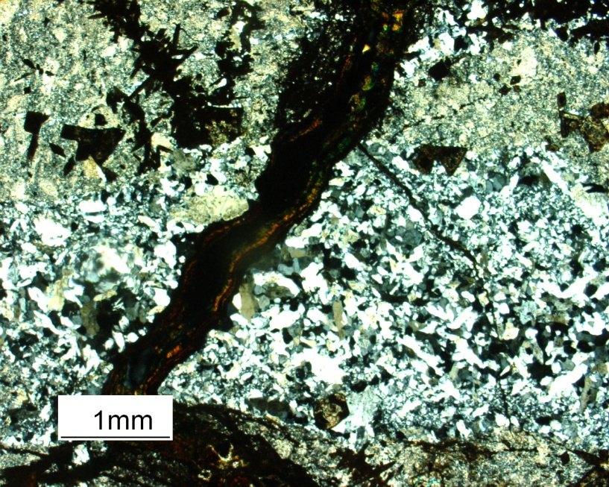
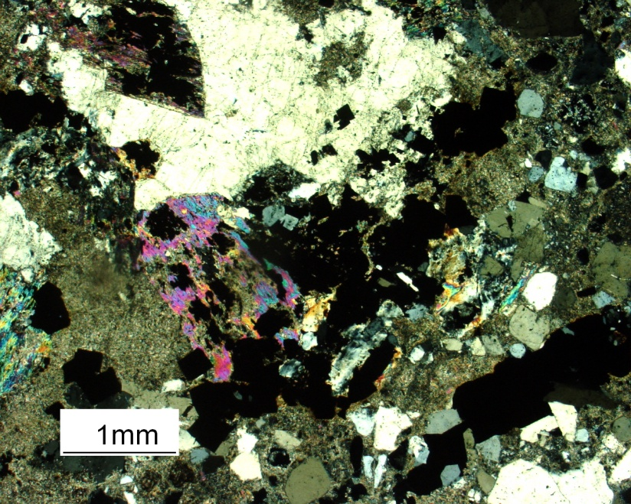
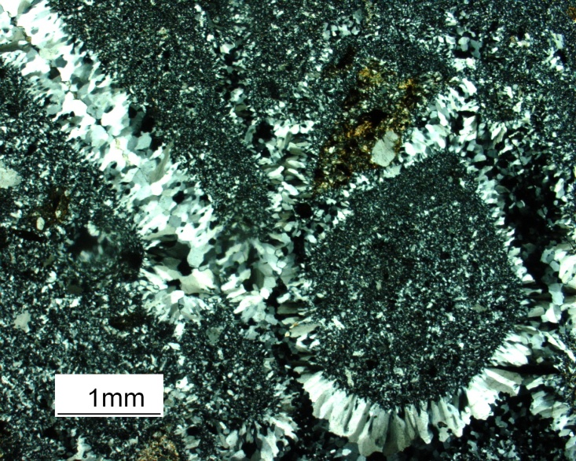
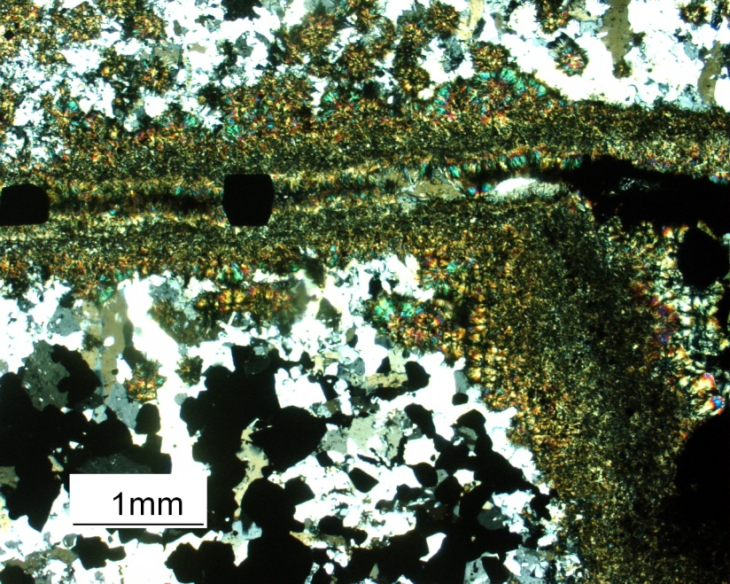
Reflected Light Petrography
1. Goethite vein crosscutting quartz vein
2. Alteration of mafics (Montana Tunnels)
3. Chalcedony veinlets in quartz sulfide poor vein
4. Tourmaline vein crosscutting quartz
1
2
3
4

Slide 8
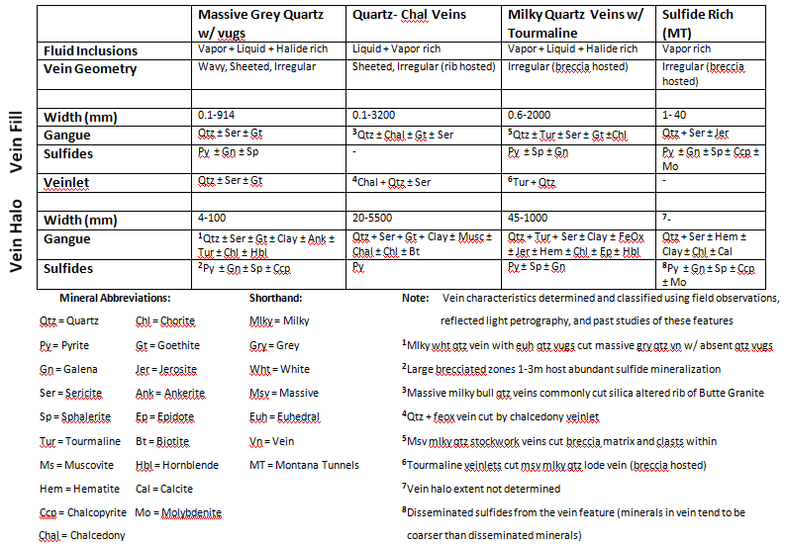
Vein Characteristics

Slide 9
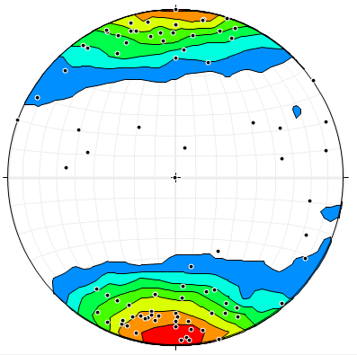
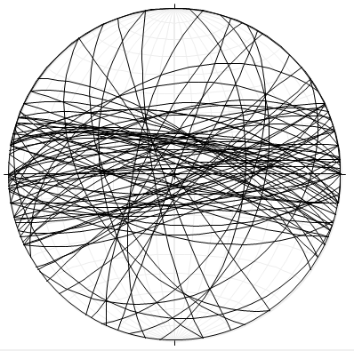
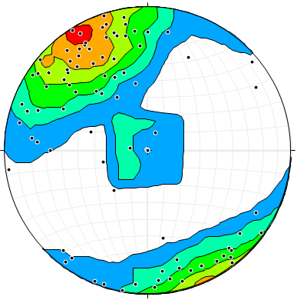
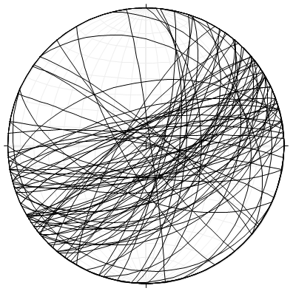
Vein Orientations
Lower Hemisphere Equal Area Projections
Massive milky-grey East-West 98˚ striking quartz veins with dip range of 73˚North-72˚South
NE-SW (azimuth 157˚) striking quartz-chalcedony veins with dip range 65˚NW-76˚SE

Slide 10
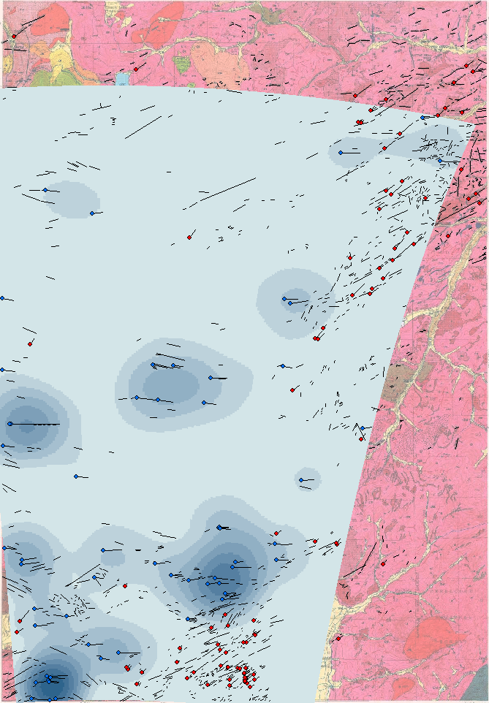
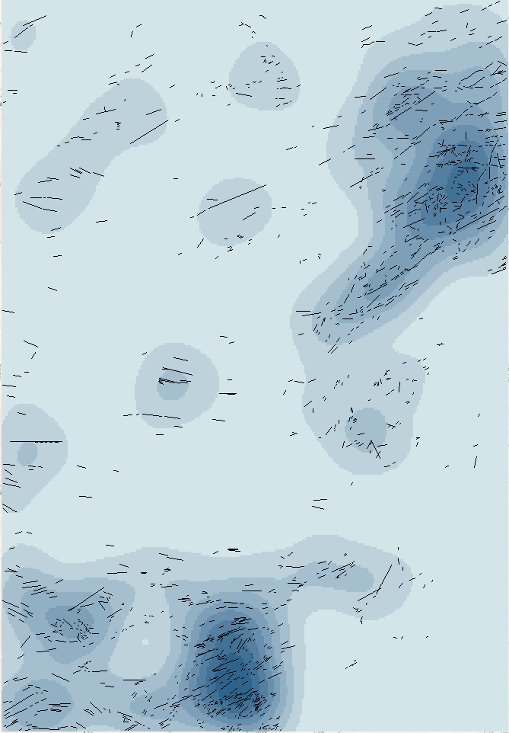
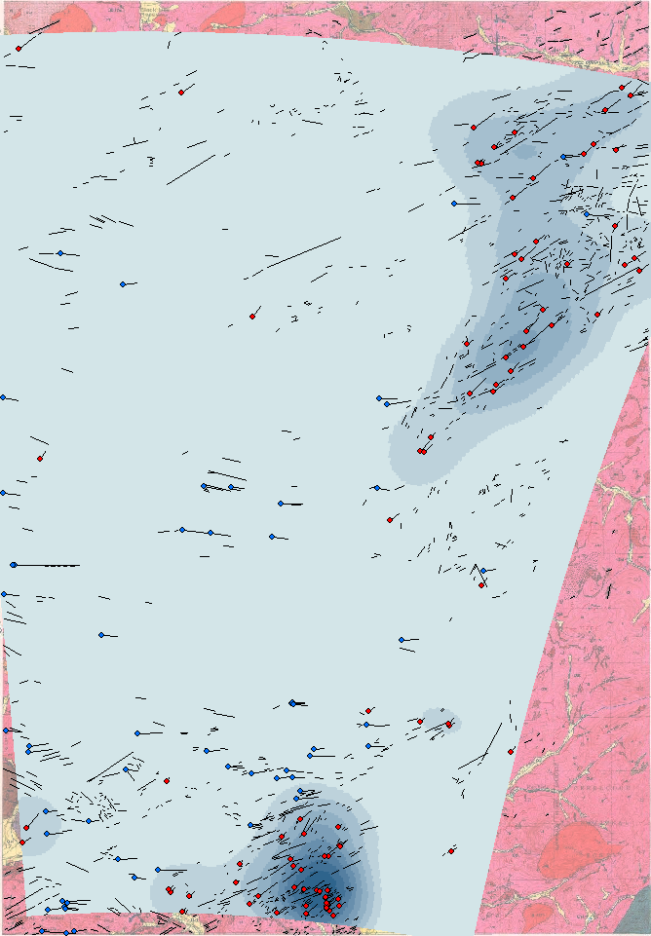
Spatial Analysis
All vein features
E-W 98˚ striking
Kernel density plots using ArcGIS
0 1 2
Miles
NE-SW azimuth 157˚
0 1 2
Miles
0 1 2
Miles

Slide 11
Conclusion
Veins of the Mt. Thompson quadrangle occupy E-W to NE-SW faults and shear zones
Alteration of vein features differ throughout the quadrangle and are related to hydrothermal fluids
Sulfide mineralization associated with shear zones (diatreme breccia at Montana Tunnels)
Zonation of minerals observed as a function of temperature related to heat centers

Slide 12
Questions?

