Slide 1
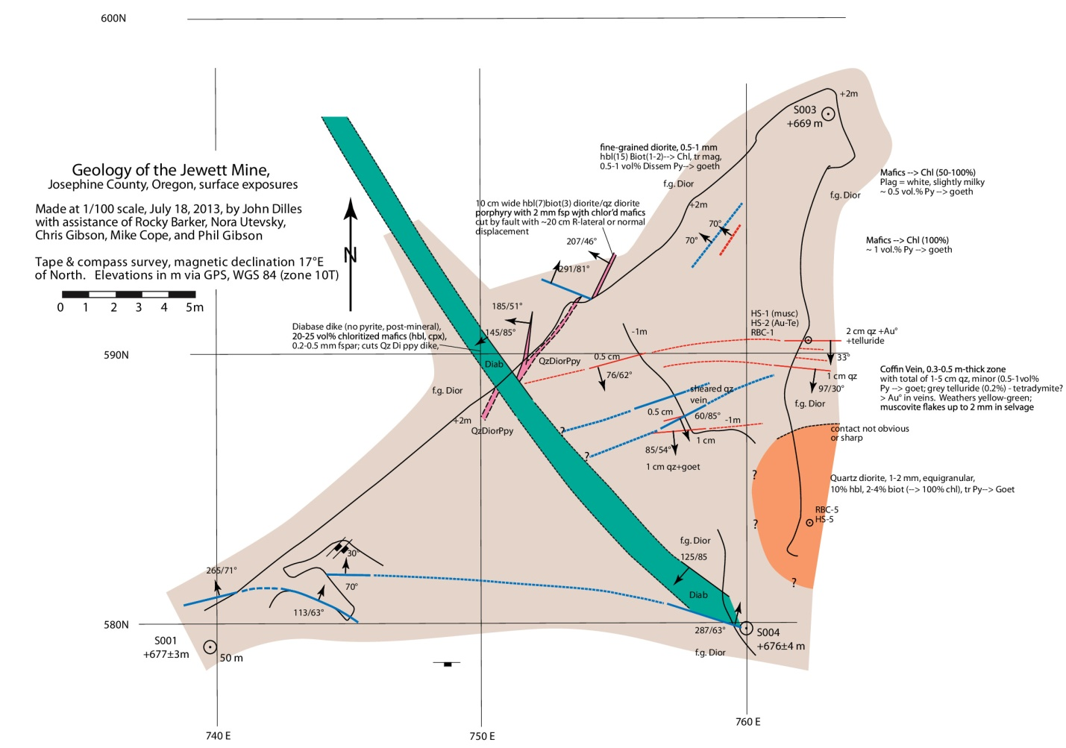
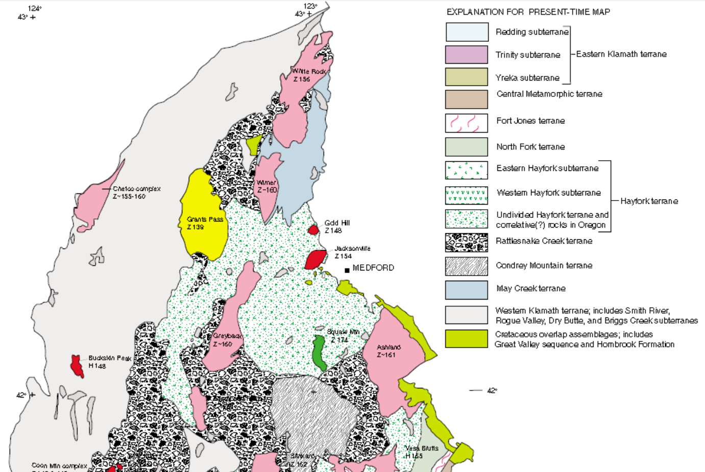
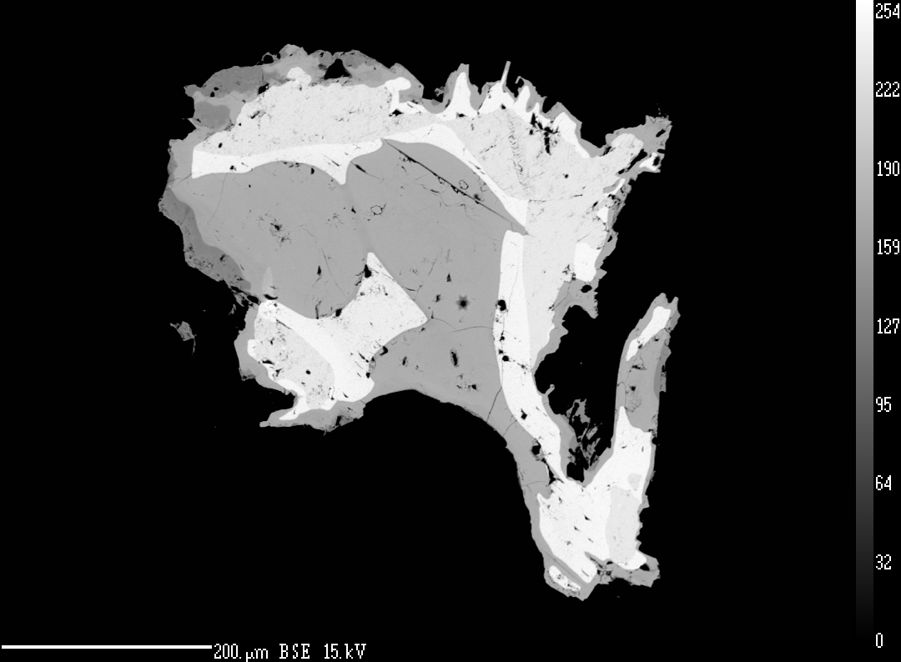
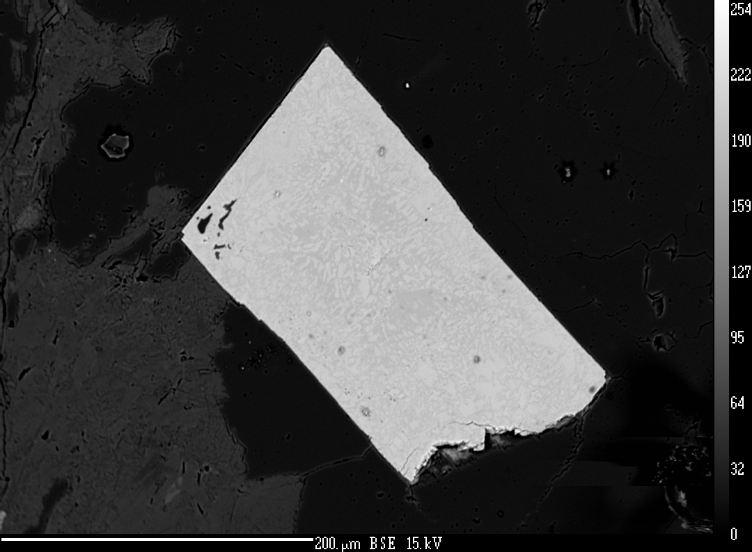
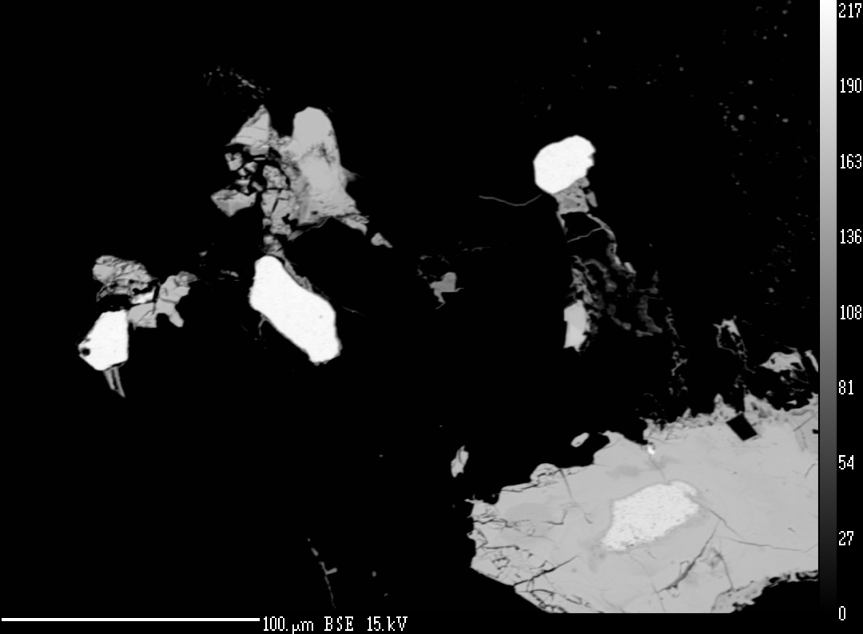
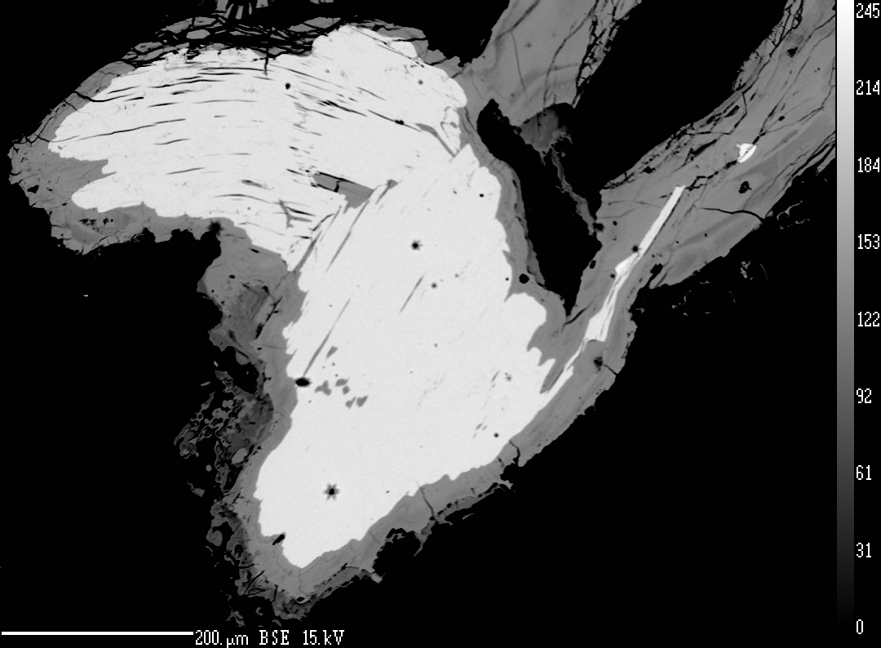
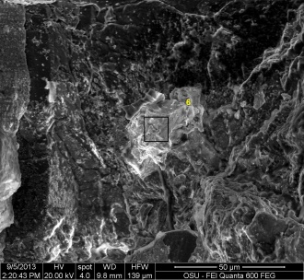
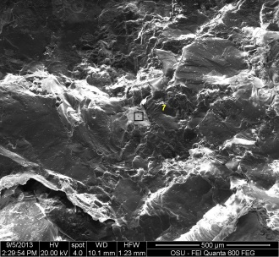
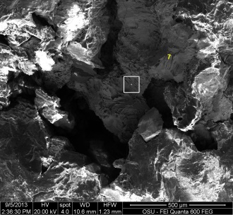
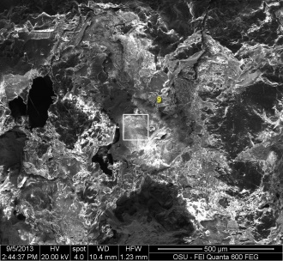
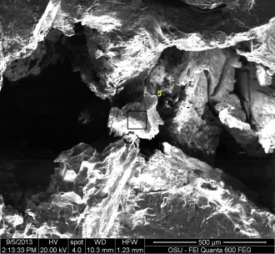
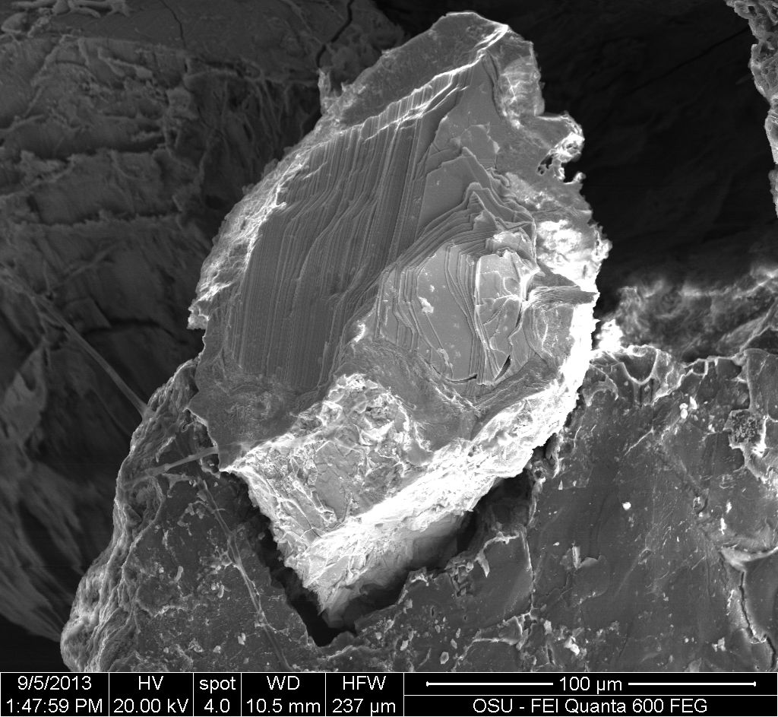
Analysis of Au-Te-bearing ores of the Jewett Mine, Josephine County, Oregon Rocky D. Barker, John H. Dilles
Introduction
Geologic Background
Objectives and Methods
Fig. 18. ⁴⁰Ar/³⁹Ar age spectrum with Age in Ma (y-axis) vs. cumulative 39Ar released in percent (x-axis) created from hydrothermal muscovite in the Coffin Vein show a closing age of 153.67 ± 0.46 Ma indicated by the weighted plateau created during progressive heating of the sample. No argon loss or gain is evident.
The Jewett Mine is a hard rock mine located on the southern flank of Mount Baldy, approximately 1.6 km from Grants Pass in Josephine County, Oregon on the Grants Pass mining district (Garcia, 1996). The Jewett Group contains 7 separate claims (Oregon Department of Geology and Mineral Industries, 1952) totaling approximately 1.42 km² and consists of several workings including an open pit and approximately 300 m of underground workings following a series of thin hydrothermal quartz-calcite breccia veins containing free gold and tellurides (Garcia, 1996).
History of the Jewett Mine
The Klamath Mountain geological province consists of a series of accretionary episodes that began in the Lower Devonian and continue for approximately 260-284 Ma. There are eight separate episodes that make up the terranes of the Klamath Mountains (Irwin, 1998).
The Jewett Mine is located just southeast of the known boundary of the Grants Pass pluton, situated in the Applegate Group metasedimentary and metavolcanic rocks of the Hayfork terrane.
The Applegate Group is an Early Permian to Late Triassic (Hotz, 1971) formation on the Western Paleozoic and Triassic Belt of the Klamath Mountain geologic province. Protoliths of the Applegate Group consists primarily of submarine volcanic rocks as well as metasedimentary rocks that include argillite, slaty siltstone, chert, altered tuffaceous sedimentary rock, quartzite, conglomerate and marble (Ramp & Peterson, 1979). A large number of hydrothermal gold vein prospects exist in the Applegate Group.
The Grants Pass Pluton is an Early Cretaceous Diorite-Qtz Diorite-Qtz Monzonite intrusion located in southwestern Oregon in the Klamath Mountain geological province. Zircons from the pluton yield a U/Pb age of 139 +/- 2 Ma (Harper et. al., 1994) making it the youngest intrusion in the western Klamath Mountains.
The purpose of this project is to describe the mineralogy and petrology of the Jewett Mine and locate the hydrothermal fluid source in order to better understand the paragenesis of the Au-Te ores. I propose that the system responsible for the deposit at Jewett is not only spatially but also genetically related to the creation of the neighboring Grants Pass Pluton, in which the hydrothermal fluid, carrying the gold and tellurides, was fractionated from the magma body and forced into the country rock through areas of weakness, such as faults and fractures. Several methods may be used to test my hypothesis, by obtaining chemical compositions of minerals and chemical compositions and lithologies of associated rocks including visual observations and descriptions of thin sections collected from the Jewett Mine.
The scanning electron microscope (SEM) was used to obtain photos of the Te-bearing minerals (fig. 17) for the purpose of describing their crystallography for identification.
The SEM energy dispersive x-ray spectrometer (SEM-EDS) was used to identify the presence of specific elements within the tellurides in order to focus standardization on the electron microprobe analyzer (EMPA).
The EMPA was used to measure the chemical composition of the gold and telluride minerals within the quartz vein.
Hydrothermal mica within the quartz vein was used for ⁴⁰Ar/³⁹Ar dating using the OSU Argon mass spectrometry lab in order to associate the timing of mineralization with the proposed source of fluids.
The Jewett mine was discovered in 1860 by Thomas Jewett. By 1863 the mine was fully operational with an 8-stamp mill. The mine went out of business sometime before April 29th, 1897 when it was reopened under new ownership with a 5 stamp mill. By December 2nd of the same year a full workforce was operating the mill on a 24 hour rotational
Discussion
The mineralization at the Jewett Mine occurred as some fluids (hydrothermal or metamorphic) moved through faults and joints carrying the Au-Te as a magmatic source, an assimilated source or some combination of each. SEM photos, SEM-EDS and EMPA identify a bismuth telluride which is considered to result form a low-temperature (<300°C) fluid (Cook et. al., 2009). The source of heat was previously hypothesized to be from the nearby Grants Pass pluton. According to ⁴⁰Ar/³⁹Ar radiometric dating the deposit is approximately 14 m,y. older than the pluton, making the previous prediction unlikely. Instead, the heat is from some other source likely of similar age such as the Jacksonville pluton, approximately 20 km away. The distance away from the deposit, especially when compared to the proximity of the G.P. pluton, makes this a questionable yet possible source. The age of this pluton is similar to that of the mineralization at the Jewett but further investigation is needed in order to confirm or deny its involvement in the mineralization.
Fig 1. Plan view map of Crown Zone surface exposure at Jewett mine by J. Dilles using Anaconda Method.
Fig. 2. Plutons and accretionary units of the Klamath Geological Province. Location of the Jewett Mine in red showing spatial relationship to the Grants Pass and Jacksonville plutons. Adapted form Irwin (1999)
Schedule (Oaks, 1998-B). The mine remained operational until 1915 producing thousands of ounces of gold before operation ceased (Garcia, 1996). In 1922 the mine was sold but never again put into full production (Oaks, 1998-A). Little information is available from 1922 to present exept that the Oregon Metal Mines Handbook (1952) reported that the mine remained inoperational from 1922 to 1952, with no plans of development, only the occasional leasing of the property for small scale prospecting. Currently the mine is in development under the ownership of the American Mining Company.
Observations
Jewett Mine
Thin sections from rock units around the current workings of the Jewett show that the country rock (sample RBC-2) is a gabbro that contains disseminated pyrite and magnetite. Small dikes of quartz diorite cut portions of the host rock on the north side of the pit. The most prominent of these is a 10 cm thick branching dike (sample RBC-3) on the north wall of the pit being cut and displaced approximately 20 cm by the brown dike and cut and displaced ~20 cm by a right-lateral/normal fault approximately 4 m northeast of the brown dike. The surface exposure is approximately 8 m in length terminating approximately 1.5 m southwest of the brown dike and approximately 2 m northeast of the fault. A quartz diorite body (sample RBC-5) can be seen in the southeast corner of the pit approximately 2 m from the Coffin Vein zone (fig. 1).
The largest and most obvious of the intrusions is a late steeply dipping brown diorite dike locally known as “The Brown Dike” (sample RBC-4). It intrudes upon the country gabbro, cross-cutting several small dikes and sills including the Coffin Vein, itself only being cut by a fault on the south end of the pit.
The Coffin Vein is a brecciated zone approximately 20-50 cm thick with irregular 1-5 cm-thick quartz veinlets that swell and pinch following fractures within the gabbroic host rock. The vein exposure is approximately 10m in length, crossing the center of the pit and terminates at the brown dike. Two other veinlet systems occur parallel to the Coffin Vein and have an average south-southeast dip of ~45° exposed to the north and run approximately 2-3 meters above the Coffin Vein. Visible native gold and tellurides are irregularly distributed within the quartz veinlets (0.2-0.5 vol%).
Conclusion
The ore minerals at the Jewett Mine are hosted in a series of stacked south-southeast dipping fault controlled hydrothermal quartz veinlets
Ore minerals consist of gold, tetradymite and tellurobismuthite
Age of mineralization is 153.67 ± 0.46 Ma, approximately 14 m.y. older than the previously proposed fluid source, the Grants Pass pluton
Possible Questions to Ask
Is there another unknown pluton nearby that could be the source of fluids?
Could the Jacksonville pluton be the source?
Or is the fluid from some metamorphic origin brought on by one of the accretionary episodes that created the Klamath Mountains?
Bi₂Te₃
Au
Bi₂Te₂S
FeO(OH)
Au
Au
Bi₂Te₂S
Bi₂Te₂S
Fig. 3-6. Backscatter electron images of opaque mineralization of the Coffin Vein system at the Jewett Mine. Figure 3 shows sulfur and non –sulfur tetradymite end members (tetradymite and tellurobismuthite respectively) with an oxidized zone around and through the telluride. Figure 4 is a pyrite cube altered mostly to goethite. Figure 5 shows native gold and tetradymite and figure 6 shows twinned tetradymite with basal cleavage.
References
Images obtained with the SEM of the tellurides show an isometric crystal form with basal cleavage, in the rare case that the telluride was in its crystalline form.
Energy peaks from the SEM-EDS indicate the presence of tellurium, bismuth, silicon and oxygen (carbon peak caused by carbon coating of sample) (fig. 7-16).
Cook, N. J., Ciobanu, C. L., Spry, P. G., & Voudouris, P. (2009). Understanding gold-(silver)-telluride-(selenide) mineral deposits. Episodes, 32(4), 249.
Garcia, G. (1996). Jewett Gold Mine, Jewett Mine Reports, 3-6. Oregon Historical Mining Information, Oregon Department of Geology and Mineral Industries. Retrieved from http://www.oregongeology.org/sub/milo/ohmi-josephine.htm
Harper, G. D., Saleeby, J. B., & Heizler, M. (1994). Formation and emplacement of the Josephine ophiolite and the Nevadan orogeny in the Klamath Mountains, California-Oregon: U/Pb zircon and ⁴⁰Ar/³⁹Ar geochronology. Journal of Geophysical Research, 99(B3), 4293-4321.
Hotz, P. E. (1971). Plutonic rocks of the Klamath Mountains, California and Oregon. US Government Printing Office.
Irwin, W. P., & Mankinen, E. A. (1998). Rotational and accretionary evolution of the Klamath Mountains, California and Oregon, from Devonian to present time. The Survey.
Irwin, W. P., & Wooden, J. L. (1999). Plutons and accretionary episodes of the Klamath Mountains, California and Oregon. US Geol. Surv. Open File Rep., 99, 374(1).
Oaks, M. (1998). Josephine County Historical Society, Jewett Mine Letters, 4-5. Oregon Historical Mining Information, Oregon Department of Geology and Mineral Industries. Retrieved from http://www.oregongeology.org/sub/milo/ohmi-josephine.htm
Oaks, M. (1998). Josephine County Historical Society, Jewett Mine Reports, 11-12. Oregon Historical Mining Information, Oregon Department of Geology and Mineral Industries. Retrieved from http://www.oregongeology.org/sub/milo/ohmi-josephine.htm
Oregon Department of Geology and Mineral Industries (1952). Oregon metal mines handbook, v. II, section 1, 2nd ed.--Josephine County: Oregon Department of Geology and Mineral Industries Bulletin No. 14-C, 238 p.
Ramp, L., & Peterson, N. V. (1979). Geology and mineral resources of Josephine County, Oregon. State of Oregon, Department of Geology and Mineral Industries.
Fig. 17. SEM image of bismuth bearing telluride with a 237 micrometer field of view. Shows basal cleavage and what appears to be a hexagonal crystal shape.
The EMPA showed a composition of Bi₂Te₂S and Bi₂Te₃ (tetradymite, and tellurobismuthite respectively) in the unknown samples.
Use of the ⁴⁰Ar/³⁹Ar step heating method for radiometric dating at the Oregon State University Argon Lab produces a closure age of 153.67 ± 0.46 Ma on samples of hydrothermal muscovite taken from the Coffin Vein.
Fig. 7-11. SEM images of tellurides showing the SEM-EDS analysis points. Fig. 12-16. SEM-EDS spectrums corresponding to each SEM image above with X-ray counts (y-axis) versus energy in keV (x-axis). All histograms have Te and Bi peaks with some having C, O, Fe and Si. Carbon coating can account for the carbon peak, the surrounding quartz vein is likely the cause of the Si and O peaks while Fe can be attributed to iron oxide staining or goethite in the weathered rock.

