Slide 1
STEM Learning in the Library Learning Commons: Examining Whiteboards for Evidence of Learning Through Student-Generated Visualizations
Uta Hussong-Christian
Instruction & Science Librarian
Rick Stoddart
Assessment Librarian
Notes:
Good Afternoon everyone! Rick and I are delighted to be talking to you today about our study of student learning at Oregon State University’s Valley Library. As the title suggests, we’ll focus on STEM learning though the study as a whole goes beyond STEM learning. Rick will start us off with some context and background on how we’re approaching this project.

Slide 2
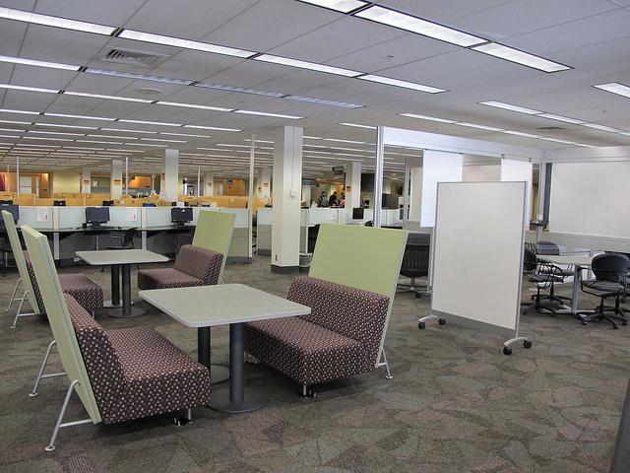
Learning
in the Commons
Notes:
So this is the Learning Commons at Oregon State University Libraries… Like many library commons this is a vibrant area where students gather to study, write papers, and do research both individually and in groups. The challenge, as we saw it, was to figure out a way to capture and describe the learning that happens here. Our usual library metrics were not going to cut it. Gate counts, floor sweeps, and desk stats didn’t capture what these students were doing though they do help us point to how well learning spaces and library services are utilized. However, in order to make the connection to student learning, we needed to get beyond the traffic counts and tick marks and take a deeper look at the activities taking place in our learning commons.

Slide 3
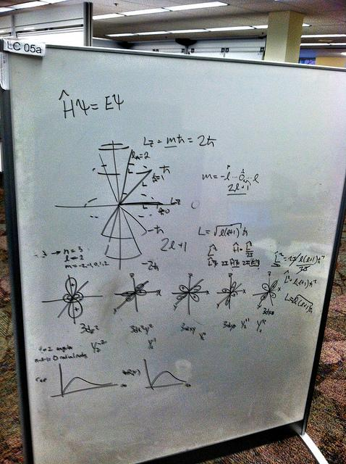
Cognitive Artifacts
“... informational devices such as maps, white boards, paper pads, etc., which are specifically designed to display and maintain information in an accessible way to several people at the same time.”
Garbis and Wern, 1999
Notes:
The answer was right in front of us (literally). The whiteboards in the learning commons provide a form of evidence of learning or what is known in the education literature as a “cognitive artifact”. Much like grabbing samples of student written work to do citation analysis or examining the incorporation of information sources -- why not look toward whiteboards as authentic examples of student learning.
1. “A cognitive artifact is an artificial device designed to maintain, display, or operate upon information in order to serve a representational function” Norman (1991)
2. Cognitive artifacts changes the task. “New things have to be learned, and old procedures and information may no longer be required. The person’s cognitive abilities remain unchanged.“(Norman 1991)

Slide 4
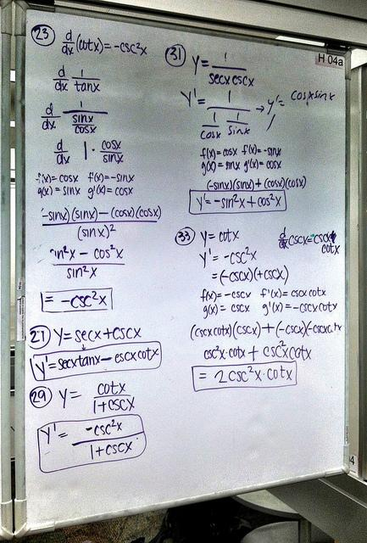
Notes:
Just like when we are math class and were asked to “show our work” -- Whiteboards as cognitive artifacts give students the chance to produce study notes or visual artifacts, which in turn, allow us to peer into their learning process.

Slide 5
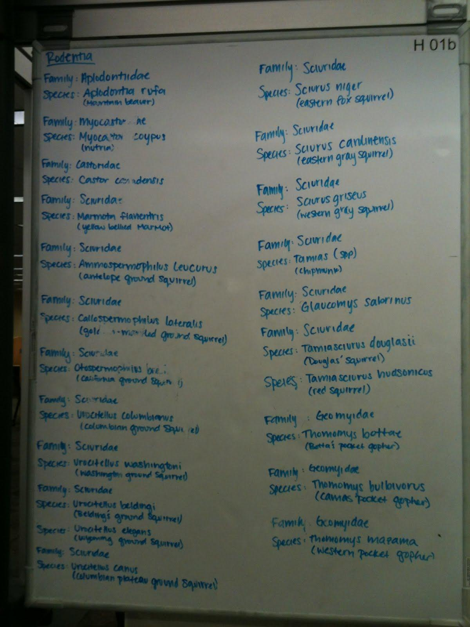
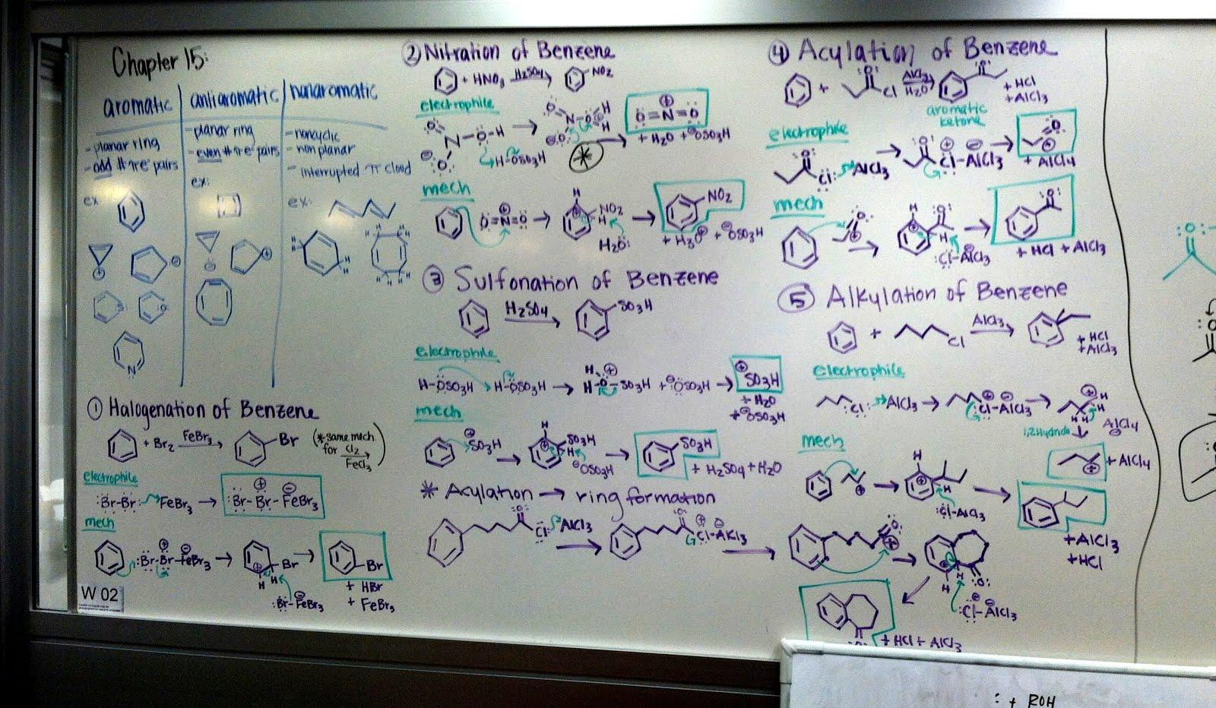
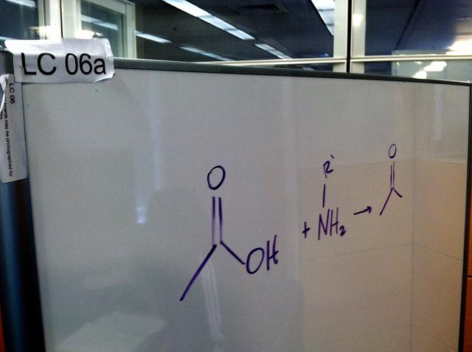
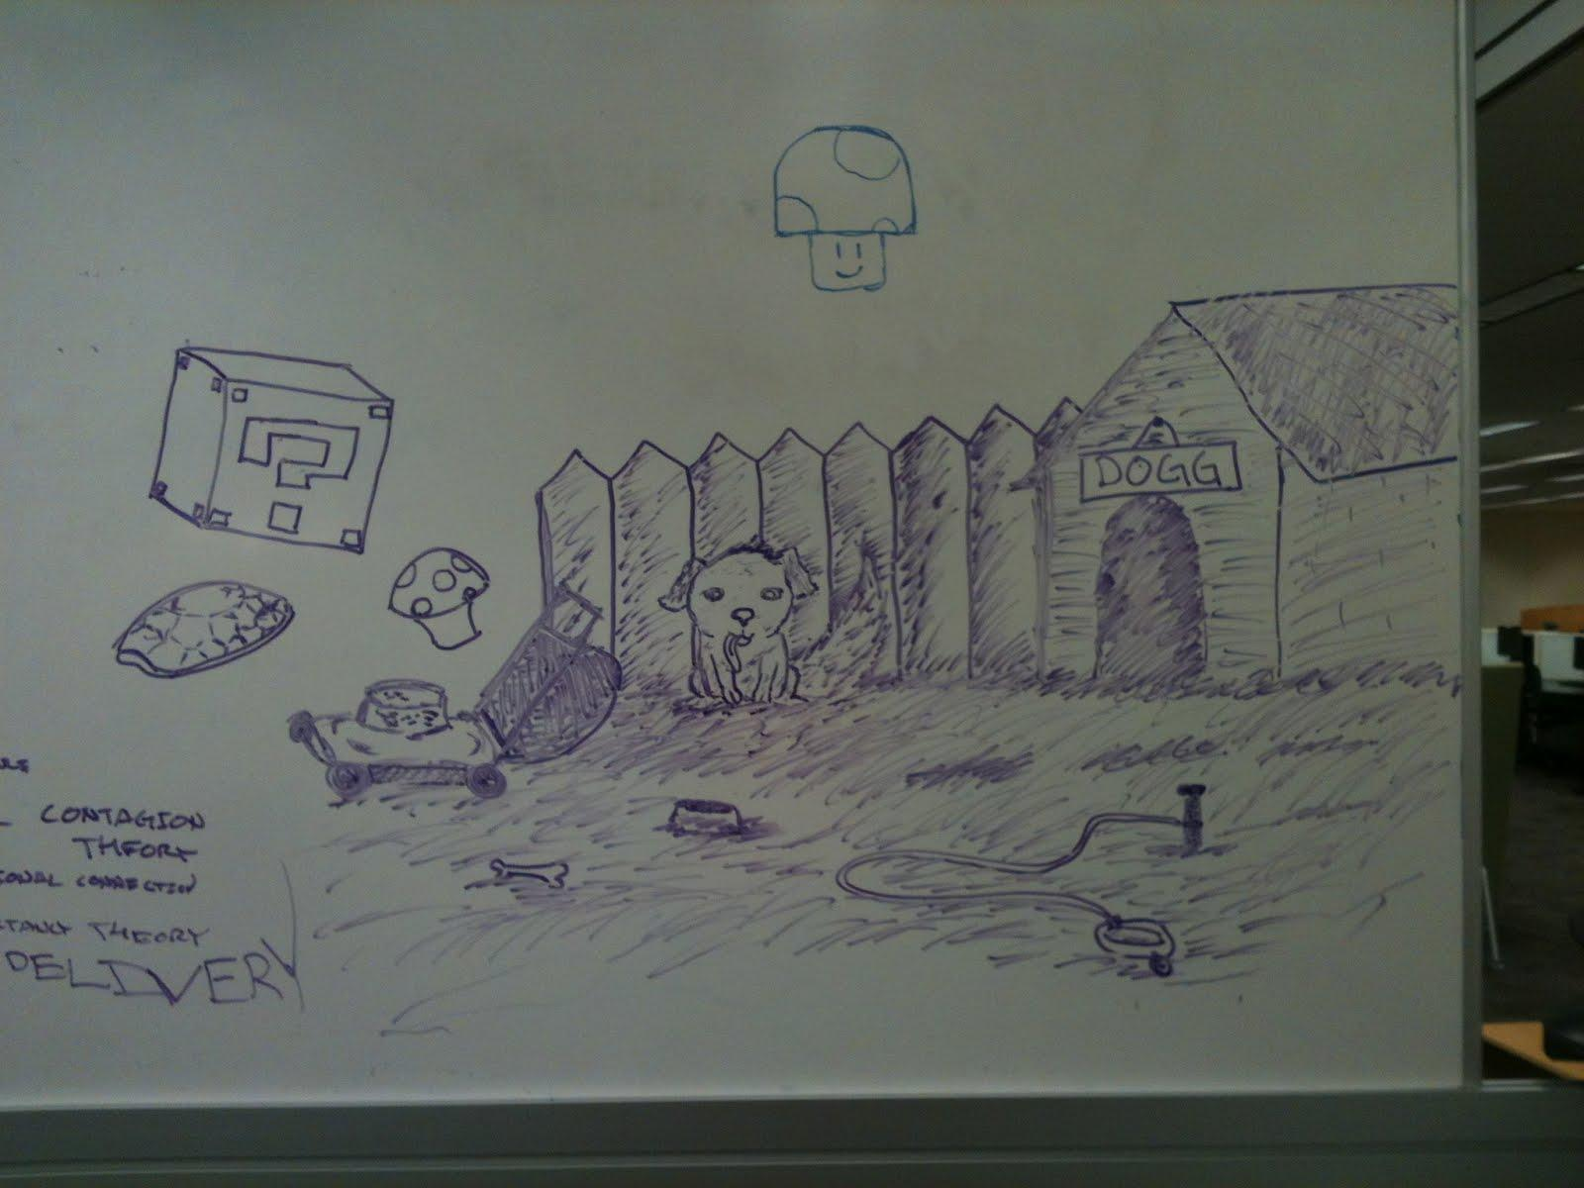
Notes:
And peer we did. Over the course of one 10-week term, we captured nearly 300 images. Captured on our phones and uploaded to a flickr account. We photographed on Thursday afternoon (lighter learning commons traffic as students get ready for weekend) and first thing Monday morning (after Sunday evening study sessions). The variety was amazing and really interesting.

Slide 6
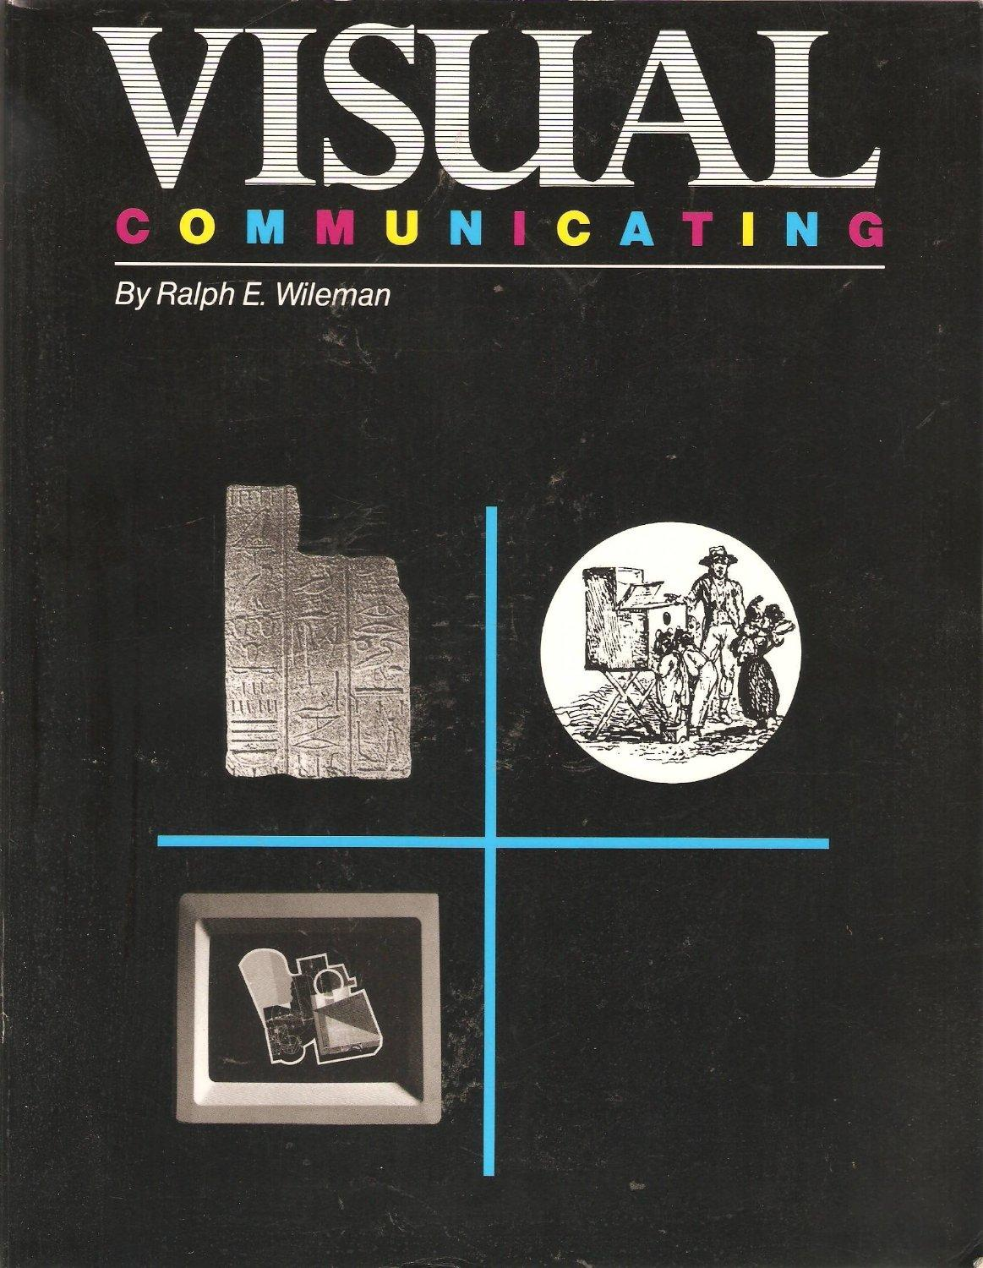
Visualization in Learning
Process is important for sense-making (Wileman, 1993)
Product helps with info retrieval
dual coding of information - verbal and pictorial increases likelihood of retrieval of
knowledge (Paivio, 1986)
Notes:
In thinking about analyzing whiteboards, the concepts of visualization and visual literacy were obvious frameworks to apply. One of the scholars we leaned heavily on in our process was Wileman (who wrote about teachers creating visuals for use in teaching). Wileman states that visualization is both a process and a product. He goes onto say that the developer of visualizations must “grapple intellectually with the message before arriving as a visual solution”.
In the whiteboard visualizations that we captured, students were clearly grappling with processing their content whether it be study notes, equations, chemical bonds, etc. and they used visualization as an aid to make sense of the content they were studying. The products of these whiteboard visualizations then became evidence of the process of learning and mastering content. Thus something for us to analyze.
But, in addition, visualizations also aid in the later retrieval of the knowledge. Paivio says that visualization enhances retrieval because info is dual-encoded, in both verbal and visual form. Therefore the likelihood of retrieval increases as the learner is not relying on simply one coding scheme (usually verbal) to retrieve information. Thus, visualizations provide different ways to “remember” content both verbal as well as pictorially and it is good to have a balance between the two formats to draw from.

Slide 7
Initial Rubric
Study notes both pictorial and verbal
Study notes indicate distinctiveness from another concept or from something of personal importance by including highlighting
Study notes are organized to show interrelatedness
Study notes show relatedness to something the learner already knows
Cifuentes,1991
Notes:
Wileman’s work on visual communicating led us to Lauren Cifuentes who did her doctoral work on visualization as a study strategy. As part of her work, she characterized the skills involved in study note visualizations as a way to both figure out how to teach students ways to visualize but also as a way to assess the visualizations they created. Her rubric addressed the creation of verbal and pictorial notes and the balance between the two as Rick mentioned a moment ago, ways to distinguish concepts and ways to show how content was interrelated. Her rubric also addressed students relating the content to something they already knew.
Overall, this rubric worked well for what we wanted to do. But we had to drop the idea of assessing what our students already knew. We had no contact with the creators of our visualizations and therefore had no way of knowing their prior knowledge.

Slide 8
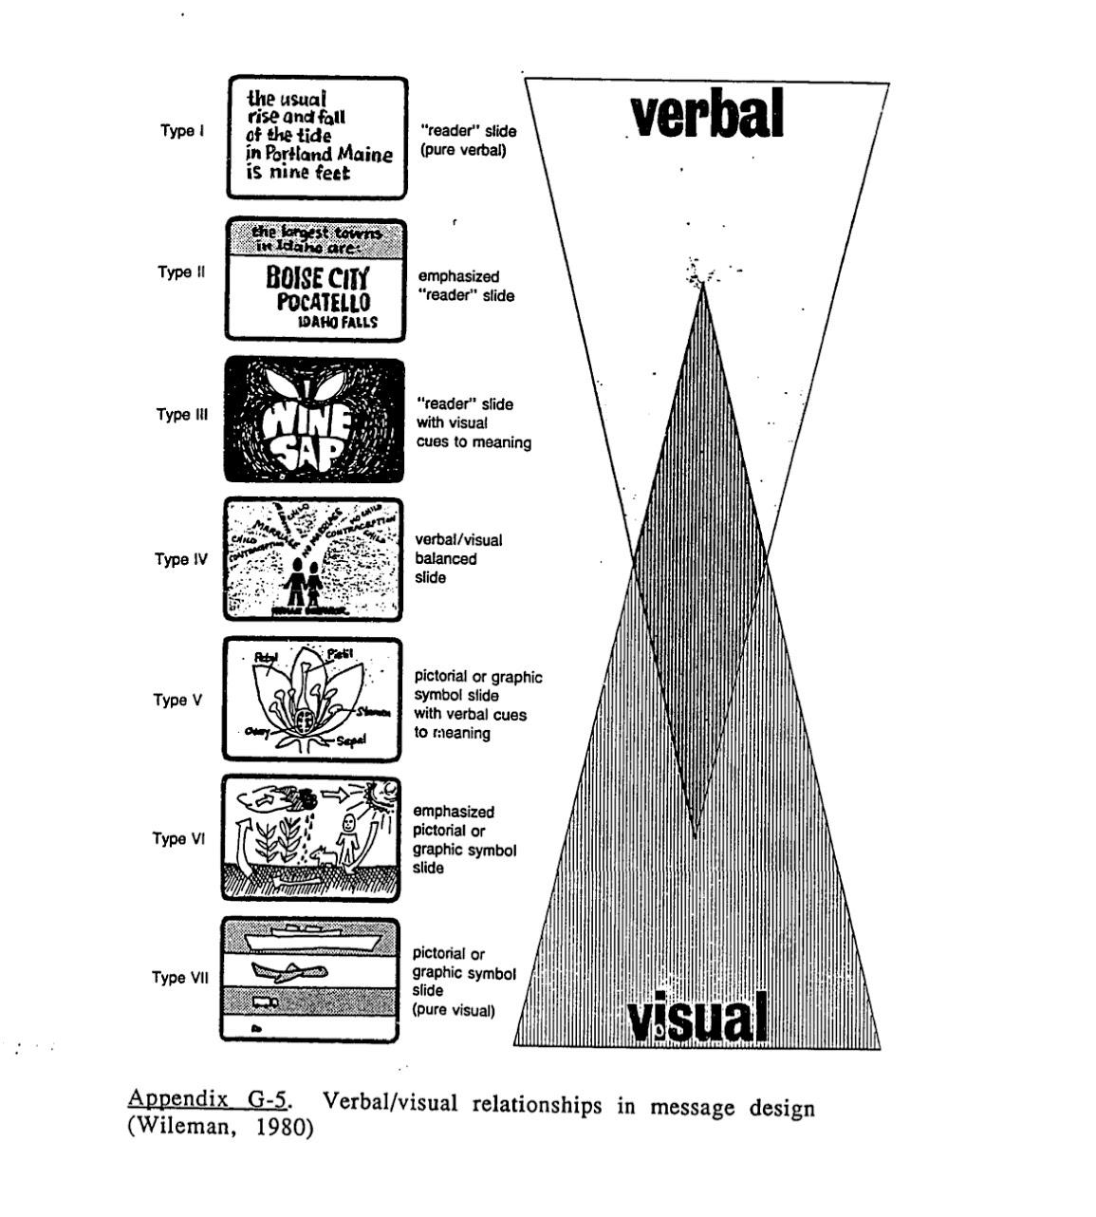
Whiteboard Codes
1. Subject (STEM, Social Sciences, Arts & Humanities, or Misc)
2. Balance (pictorial vs verbal)
3. Distinctiveness (circles, colors, highlighting)
4. Interrelatedness (arrows, structural diagram, etc.)
4a. Pictorial Types (matrixes, tables, charts, diagrams, timelines, maps, icons).
Cifuentes, 1991
Notes:
Our coding of whiteboard visualizations fell into these categories:
The board’s subject content along with Balance, distinctiveness and interrelatedness which are the central ideas addressed by Cifuente’s rubric.
Balance is important as both pictorial and verbal visualizations give students those multiple ways to retrieve knowledge that Paivio addressed.
With interrelatedness, we broke this down a bit and have started looking at the number and types of pictorial visualizations that students used to represent interrelatedness among concepts.

Slide 9
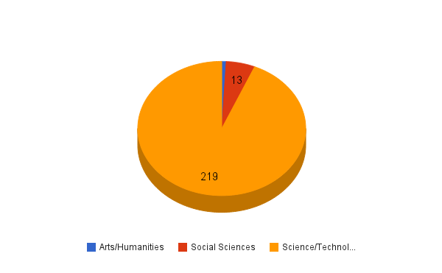
Visualizations by Discipline Group
Notes:
So what have we found. Of the 234 whiteboards that we coded into a discipline (only 1 discipline per board), over 90% of them represented students working in STEM disciplines. This is not unexpected given our campus focus on STEM disciplines. However, our College of Liberal Arts is a huge college and it is somewhat surprising that we did not see more representation from their disciplines. Arts and Humanities was represented on only 2 boards, but those boards were visualization dense.

Slide 10
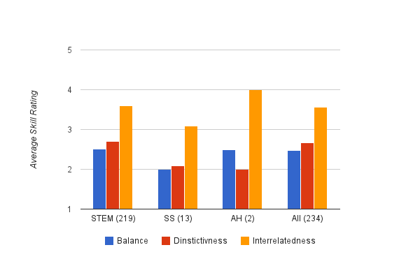
Visualization Skill Scores
Subject | Avg Rubric Score
STEM | 8.81
SS | 7.16
AH | 8.5
All | 8.61
Notes:
Cifuentes’ rubric helped us gain insight into the ways that students visualized the content they were working with. Overall STEM students were better at balancing pictorial and verbal visualizations (represented by BLUE) and at adding elements to their visualizations that distinguished different concepts (represented by RED). In terms of identifying interrelatedness among concepts, the addition of pictorial elements resulted in a higher score (represented by YELLOW). On average, STEM boards included more pictorial elements to show interrelatedness than did Social Science boards. However, STEM boards did not score better than Arts/Humanities boards (though there were only two of those boards).
When the three skill scores were totaled, students visualizing STEM content had the highest rubric average.

Slide 11
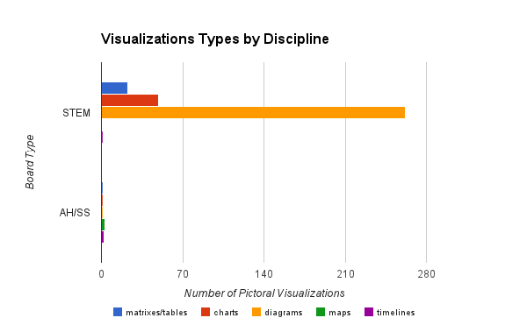
Pictorial Visualization
# Boards | Pic Type
17 | Matrix/Table
26 | Chart
133 | Diagram
1 | Map
3 | Timeline
12 | Icon
Notes:
As I noted earlier, we dug into the representation of interrelatedness with pictorial visualizations by identifying the total number and kinds of pictorial visualizations students were using. As you can see from the graph, overall, STEM students used many more pictorial elements on their boards than did students in other discipline groups. Diagrams, in particular, seems to help the most with processing STEM information. The literature tell us that these types of pictorial visualizations helps students “see” the unseen.
The full range of pictorial types represented on the boards and given in the chart on the right, hints at the wide range of information students are visualizing. What was interesting, however, is that most individual boards only contained 1 type of pictorial element. Only 22 boards contained 2 or more pictorial elements. So the content students are working with clearly seems to drive the kinds of pictorial elements they use in their visualizations. One thing we neglected to do was a similar analysis on the types of verbal visualization represented on the boards so we’ll need to follow up on that.

Slide 12
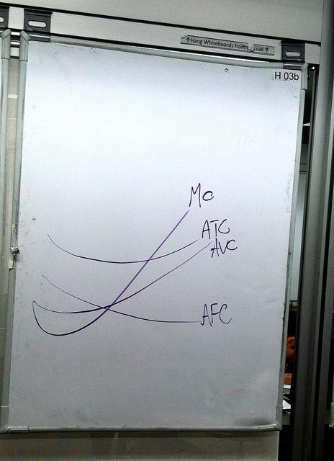
Summary
Whiteboards supports STEM student learning per evidence of heavy use
STEM whiteboards contain more pictorial visualizations than other disciplines
STEM is slightly more visually “balanced” compared to AH/SS
Low technology = High learning impact
Notes:
To summarize what we’ve learned thus far...the whiteboards in our learning commons clearly support students working in multiple disciplines, though the learning that we can most clearly peer into is in the STEM disciplines.
We’re learning that pictorial visualizations are very important to STEM students given that sheer number that they use
While STEM students use lots of pictorial visulization, they also include lots of verbal visualiztion which results in boards that are slightly more visually “balanced” when compared to AH/SS
And finally, we see how relatively Low tech whiteboards have a relatively high learning impact; high tech is not always preferrable

Slide 13
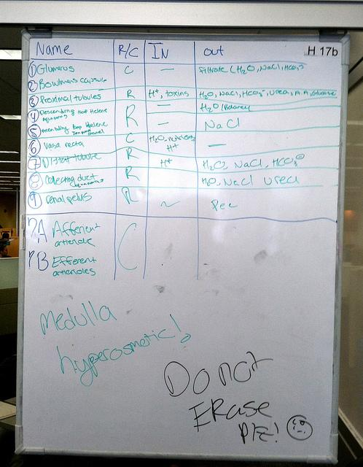
Possible Study Outcomes
Graph whiteboards to support STEM visualizations
Whiteboard checkout to support asynchronous learning
Visualization / Visual Literacy workshops to enhance study skills, cognition, and information retention of students.
Notes:
So what kinds of actionable outcomes might this information lead us to:
Perhaps we need to investigate providing whiteboards that help STEM students create high-quality pictorial visualizations - so something like the whiteboard equivalent of graph paper
Perhaps we need to think about checking whiteboards out to students to support their asynchronous learning or at the very least allow them to pick up where they left off
Or maybe we need to offer Visualization / Visual Literacy workshops to enhance students study skills and cognition processes, thus increasing their information retention.

Slide 14
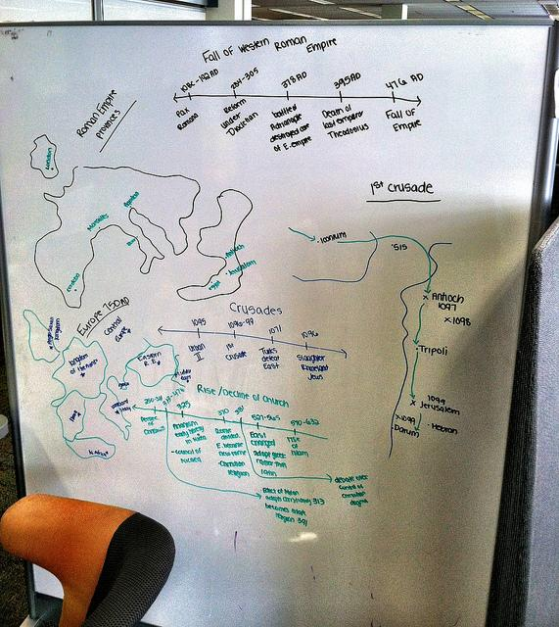
Further Research
How do students characterize the usefulness of visualizations?
Why the library? Just about space/whiteboards?
How can the library better help students learn?
Notes:
To wrap up, I’ll just note that we feel there is much work to do. This study raised a number of questions that we hope interviews and focus groups with students will help us answer. I, personally, am really curious about what students will say about why the library, specifically, is such a destination space on our campus for engaging in the learning that our learning commons whiteboards showed us is happening.
Thank you!

Slide 15
References & Image Credits
Cifuentes, L. D. (1991). The effects of instruction in visualization as a study strategy. (Ph.D.), The University of North Carolina,
Chapel Hill.
Garbis, C., & Waern, Y. (1999). Team coordination and communication in a rescue command staff: The role of public
representations. Travail humain (Paris), 62(3), 273-291.
Larkin, J. H., & Simon, H. A. (1987). Why a diagram is (sometimes) worth 10000 words. Cognitive Science, 11(1), 65-99. doi:
10.1016/s0364-0213(87)80026-5
Norman, D. A. (1991). Cognitive Artifacts. In J. M. Carroll (Ed.), Designing Interaction: Psychology at the Human-Computer
Interface (pp. 17-38). Cambridge: Cambridge University Press.
Paivio, A. (1986). Mental Representations: A Dual Coding Approach. Oxford University Press: New York.
Philips, L.M., Norris, S.P., & Macnab, J.S. (2010). Visualization in Mathematics, Reading and Science Education. Springer:
Dordrecht.
Tang, A., Lanir, J., Greenberg, S., & Fels, S. (2009). Supporting transitions in work: informing large display application design
by understanding whiteboard use. Paper presented at the Proceedings of the ACM 2009 international conference on
Supporting group work, Sanibel Island, Florida, USA.
Wileman, R. E. (1993). Visual communicating. Englewood Cliffs, New Jersey: Educational Technology Publications.
Keep Calm: http://www.keepcalm-o-matic.co.uk/p/keep-calm-and-show-your-work-100/
Open for New Ideas: https://www.flickr.com/photos/sirwwoods/5019863323/
Visual Communicating: http://www.amazon.com/Visual-Communicating-Ralph-E-Wileman/dp/0877782482

Slide 16
