Slide 1
Continuous Hydrologic Simulation of Johnson Creek Basin
and
Assuming Watershed Stationarity
Rick Shimota, P.E.
Hans Hadley, P.E., P.G.
The Oregon Water Conference 2011
Corvallis, OR

Slide 2
Engineering Hydrology
    Often a minor project component
    Watershed stationarity typically assumed
    Historical data preferred methodology (look back)
      Regression equations
      Log Pearson III
      NOAA Atlas 2

Slide 3
Outline
Background information
  Purpose of study
  Watershed description
Hydrologic Model
  Development
  Calibration
  Continuous Simulation
Comparison of Model Results
Lessons learned

Slide 4
Purpose of study
    To develop peak discharge-frequency estimates for revision to the FEMA Flood Insurance Study
  10, 50, 100, and 500 year peak discharge estimates
    18 small basins (< 4 mi²)
    hydrology for 29 points
    Current land use conditions

Slide 5
Johnson Creek Watershed
Located in Portland Metropolitan area
Mixed land use
Study area approximately 26 mi²
Data rich
  5 precipitation gages
    18 –61 years of hourly precipitation data
  3 stream gages
    9 –23 years of hourly discharge data
    69 years of annual peak flow data
Notes:
5

Slide 6
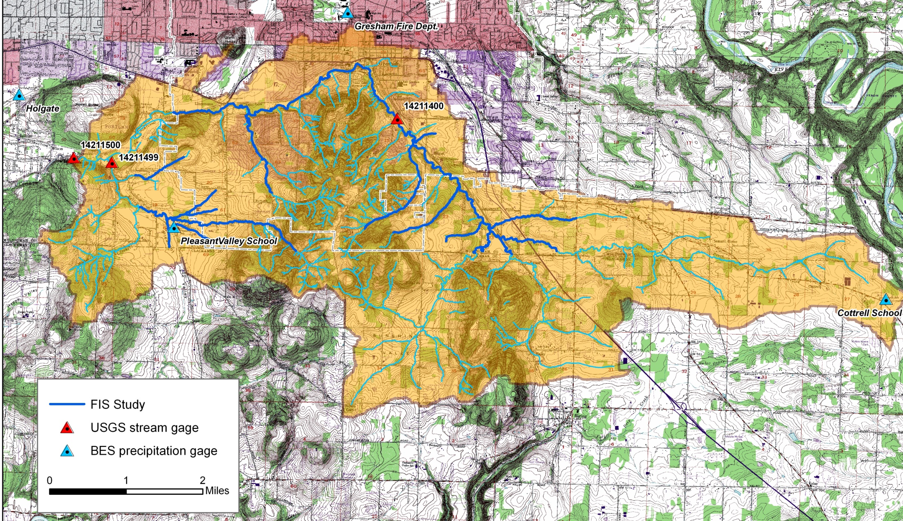
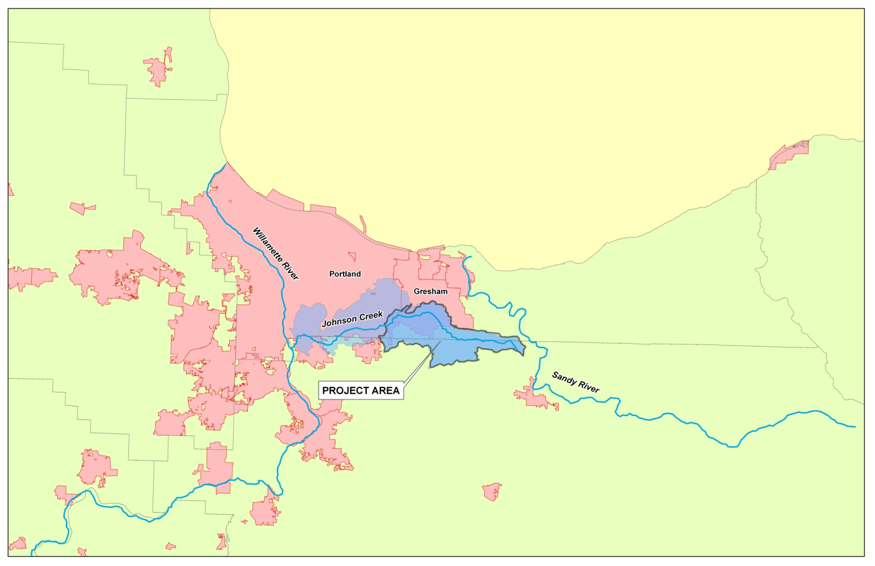
Johnson Creek Watershed
Notes:
6

Slide 7
Hydrology by Continuous Simulation
  Peak flow estimates of small watersheds with unique characteristics
  Land use
  Soil Characteristics
  Watershed slope
Data availability
Statistical approach using current land use conditions

Slide 8
Peak Discharge Development
Hydrologic Model Development
  Basin parameter development
  Calibration / Verification
  Continuous Simulation
  Extract annual peak flow events
  Flood Frequency Analysis (Log Pearson III) on peak events

Slide 9
Hydrologic Model Development
HEC-HMS
Loss method
  Deficit and constant rate
    Simplified soil moisture accounting method
    Transform Method
  Clark Unit Hydrograph
    Storage Component R
    Time of Concentration Tc
    Related by Constant C = R/(Tc + R)

Slide 10
Hydrologic Model Development
Meteorological Data
Five precipitation gages available
  4 gages near or within watershed
    18 – 33 years of hourly data
  Portland Airport precipitation gage
    61 years of hourly data

Slide 11
Calibration
Calibration storm event - January 2, 2009
  Current land use conditions
  3rd largest flow event of record
  14-yr recurrence interval
Notes:
Magnitude of Peak Discharge
Runoff volume of simulation Period
Hydrograph Shape
Accurately reflect current land use conditions , storm events within the last 20 years were only considered.
FEMA guidelines recommends a storm event of 10-years or greater.

Slide 12
Calibration
Notes:
Magnitude of Peak Discharge
Runoff volume of simulation Period
Hydrograph Shape
Accurately reflect current land use conditions , storm events within the last 20 years were only considered.
FEMA guidelines recommends a storm event of 10-years or greater.
Peaks and volumes comparable at three gages
Confident of model is a representation of basin rainfall-runoff process
Limitation – Not a low flow model

Slide 13
Calibration Results
Peaks and volumes comparable at three gages
Confident of model is a representation of basin rainfall-runoff process
Limitation – Not a base flow model
Notes:
Low flow better modeled by soil moisture accounting method loss method

Slide 14
Continuous Simulation - Issues
HEC-HMS / DSS data processing limitation
  file size (~8 GB)
  61 years broken into 10 year intervals
Soil moisture recovery
  Direct function of ET only
  No deep infiltration
Model calibrated to winter storm events
  Large events in summer
  Limitation of loss method?
Notes:
Low flow better modeled by soil moisture accounting method loss method

Slide 15
FEMA Model Acceptance
Hydrologic model 100-yr result must compare within one standard error to other discharge frequency relationships
  USGS regression equations (NSS - urban equations)
  Log Pearson III analysis of stream gage data
  Comparison at USGS Gage 14211500
  Downstream extent of study area
  69 years of annual peak data

Slide 16
FEMA Model Acceptance
  Comparison of 100-yr peak discharges
  Regression equation 3,890 cfs (2,990 – 4,780 cfs)
  Log Pearson Analysis 3,300 cfs (2,490 – 3480 cfs)
  Simulation - 3,870 cfs

Slide 17
FEMA Model Acceptance
Model results do not agree within one standard error of most reliable discharge-frequency relationship
Assumption of stationarity valid??
  Land use change
  Climate change?

Slide 18
Land Use Changes
  City of Gresham approximately 30% of basin area
    1940 Population – 1,951
    2008 Population – 101,221

Slide 19
PDX Annual Precipitation
  record length 1950 – 2009
  Average - 36.6 in/yr
  Last 30 years – 35.4 in/yr
  Previous 30 years – 37.7 in/yr

Slide 20
FEMA Model Acceptance- Continued
  Comparison at USGS Gage 14211500
  Assume hydrologic stationarity last 20 years of gage record
  Comparison of 100-yr peak discharges
  Log Pearson Analysis 3,580 cfs (2,990 – 3,990 cfs)
  Simulation - 3,870 cfs

Slide 21
Lessons Learned
Stationarity Dead?
Continuous Simulation acceptable approach
Need for “look forward” hydrologic tools
  Standardized
  Simplistic
  Accepted
Notes:
21

