Slide 1
(A)
(B)
SW480
LoVo
*
***
*
***
***
***
***
***
*
***
***
(C)
HCT-116
*
*
*
***
***
***
Fig.1 Lee et al.

Slide 2
(A)
(B)
(C)
SW480
LoVo
HCT-116
*
***
**
***
***
Fig.2 Lee et al.

Slide 3
(A)
SW480
(B)
LoVo
(C)
HCT-116
24 h 48 h
24 h 48 h
24 h 48 h
0 50 100 0 50 100
0 50 100 0 50 100
0 50 100 0 50 100
β-catenin
β-catenin
β-catenin
Cyclin D1
Cyclin D1
Cyclin D1
Actin
Actin
Actin
(D)
SW480
(E)
LoVo
Capsaicin (100 µM)
Capsaicin (100 µM)
0 12 24 36 48 h
0 12 24 36 48 h
β-catenin
β-catenin
Cyclin D1
Cyclin D1
Actin
Actin
SW480
LoVo
*
*
*
*
*
#
*
*
*
*
*
#
*
*
#
#
*
#
#
#
Fig.3 Lee et al.

Slide 4
(A)
SW480
(B)
LoVo
Nucleus Cytosol
Nucleus Cytosol
– + – + Capsaicin
– + – + Capsaicin
β-catenin
β-catenin
C/EBPα
C/EBPα
Actin
Actin
(C)
SW480
(D)
LoVo
Nucleus Cytosol
Nucleus Cytosol
– + – + Capsaicin
– + – + Capsaicin
GFP (β-catenin)
GFP (β-catenin)
C/EBPα
C/EBPα
Actin
Actin
Fig.4 Lee et al.

Slide 5
(A)
SW480
(B)
Capsaicin (μM)
SW480
0 50 100
*
β-catenin
**
GAPDH
**
**
(C)
(D)
SW480
SW480
*
**
***
***
Fig.5 Lee et al.

Slide 6
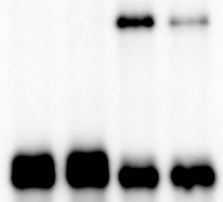
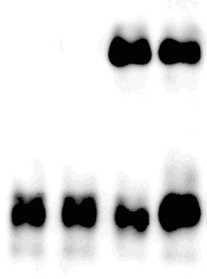
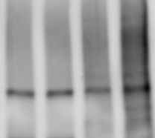
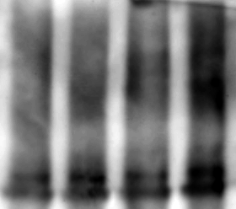
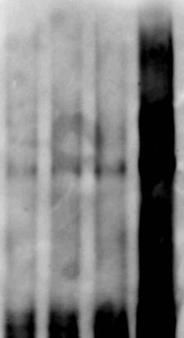
(A)
SW480
(B)
LoVo
(C)
SW480
DMSO MG-132
DMSO MG-132
EtOH Capsaicin
– + – + Capsaicin
– + – + Capsaicin
0 24 48 0 24 48 h CHX
β-catenin
β-catenin
GFP
Actin
Actin
Actin
(D)
SW480
(E)
LoVo
LoVo
IP
IP
IP
IgG β-catenin
IgG β-catenin
IgG β-catenin
– + – + Capsaicin
– + – + Capsaicin
– + – + Capsaicin
β-catenin
β-catenin
β-catenin
IgG
IgG
IgG
Ub
Ub
Ub
Fig.6 Lee et al.

Slide 7
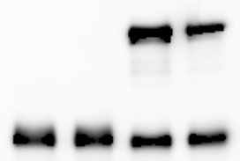
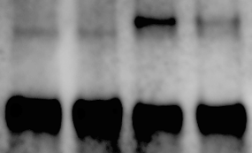
(A)
SW480
(B)
LoVo
(C)
HCT-116
IP
IP
IP
IgG β-catenin
IgG β-catenin
IgG β-catenin
– + – + Capsaicin
– + – + Capsaicin
– + – + Capsaicin
β-catenin
β-catenin
β-catenin
IgG
IgG
IgG
TCF-4
TCF-4
TCF-4
(D)
SW480
(E)
LoVo
(F)
HCT-116
24 h 48 h
24 h 48 h
24 h 48 h
0 50 100 0 50 100
0 50 100 0 50 100
0 50 100 0 50 100
TCF-4
TCF-4
TCF-4
Actin
Actin
Actin
Fig.7 Lee et al.

