Slide 1
Using data management plans as a research tool: an introduction to the DART Project
Amanda L. Whitmire, PhD
Assistant Professor Data Management Specialist
Oregon State University Libraries
NISO Virtual Conference
Scientific Data Management: Caring for Your Institution and its Intellectual Wealth
Wednesday, February 18, 2015
Notes:
Hello!

Slide 2
Acknowledgements
Jake Carlson ─ University of Michigan Library
Patricia M. Hswe ─ Pennsylvania State University Libraries
Susan Wells Parham ─ Georgia Institute of Technology Library
Lizzy Rolando ─ Georgia Institute of Technology Library Brian Westra ─ University of Oregon Libraries
This project was made possible in part by the Institute of Museum and Library Services grant number LG-07-13-0328.
Notes:
This project would not have been possible without the excellent contributions of my co-PIs. Likewise, generous support from the IMLS has also helped to make this work possible.

Slide 3
Where are we going today?
1
2
Rubric development
Rationale
Testing & results
3
4
What’s next?
Notes:
This presentation is intended to be an introduction to the project, to give you an idea of what the project is all about: what we hope to achieve and how we plan to do it. I’ll spend most of the time sharing the process of creating the rubric, but will save a few minutes to share a few tidbits from our first round of testing. There is A LOT that I don’t have time to cover, so feel free to ask questions in the Q&A box, and if I don’t get to them during my allotted time, we can try to circle back at the roundtable discussion at the end of the day. If your question still doesn’t get addressed, please feel free to contact me.

Slide 4
DART Premise
Research Data Management
DMP
knowledge
capabilities
practices
needs
researcher
Notes:
As an instrument created by researchers themselves, data management plans are a rich source of information about an institution’s researchers and their research data management (RDM) knowledge, capabilities, and needs. With the caveat that what is written in a plan isn’t necessarily (or even very likely to be) what researchers will actually do, it’s pretty safe to assume that what they include as a part of a funding proposal is at least what they think they should be doing. Which, given some of the results so far, is very interesting…

Slide 5
DART Premise
Research Data Management
knowledge
capabilities
practices
Research Data Services
needs
Notes:
So, from our perspective, a structured review of DMPs could identify gaps and weaknesses in faculty understanding and application of data management concepts and practices, and identify barriers in applying best practices. As such, the assessment of DMPs can uncover important insights about local RDM practices and aptitudes, which can then inform the development of RDM services.

Slide 6
“Of the 181 NSF DMPs that were analyzed, 39 (22%) identified Georgia Tech’s institutional repository, SMARTech.”
“We have a clear road ahead of us: we will target specific schools for outreach; develop consistent language about repository services for research data; and focus on the widespread dissemination of information about our new digital preservation strategy.”
Notes:
Our premise is based on the prior work of one of the co-PIs on our project, Susan Parham. Review of DMPs is demonstrably informative to efforts to tailor RDM Services to the local community.
More recent work, by Mischo et al. has also found that DMPs are an extremely rich source of information about the proposed data management practices of UIUC faculty. “Mischo, William H.; Schlembach, Mary C.; and O'Donnell, Megan N.. (2014). "An Analysis of Data Management Plans in University of Illinois National Science Foundation Grant Proposals." Journal of eScience Librarianship 3(1): Article 3. http://dx.doi.org/10.7191/jeslib.2014.1060”

Slide 7
We need a tool
Notes:
So, we decided that what we really need to facilitate (click) and standardize the assessment of NSF DMPs, is a tool that any academic librarian could use.

Slide 8
We need a tool
Notes:
So, we decided that what we really need to facilitate (click) and standardize the assessment of NSF DMPs, is a tool that any academic librarian could use. We wanted something that would be easy to use.
An ideal tool would be simple and concise, and should be able to be used by multiple assessors in wide range of settings. So, even though our target audience is academic librarians, anyone who wanted to evaluate or assess a DMP should be able to use our tool. And, it’s easy to imagine how researchers could use our tool, either to evaluate their own DMP prior to submission, or, use it as a part of their stint on a proposal review panel, so that everyone on the panel is using the same diagnostic criteria for evaluating DMP content.

Slide 9
Solution: An analytic rubric
 |  | Performance Levels
Performance Criteria |  | High | Medium | Low
 | Thing 1
 | Thing 2
 | Thing 3
Notes:
A rubric is basically a descriptive scoring scheme. “A rubric is simply a scoring tool that identifies the various criteria relevant to an assignment or learning outcome, and then explicitly states the possible levels of achievement along a continuum.” http://teachingcommons.depaul.edu/Feedback_Grading/rubrics.html
A holistic rubric generally provides an overall score for the thing being evaluated, while an analytics rubric provides more detailed information about sub-components of the work through independent evaluation of various criteria. For our purposed, it was pretty clear that an analytic rubric would be necessary to provide sufficient detail from a DMP review.
A shortcoming of using an analytic rubric is that there is a trade-off between rater consistency and level of diagnostic assessment. -> More granular assessment (one with more levels) leads to more variability in ratings (more room for error). This is foreshadowing…
So, what you’ve been looking at while I’ve been rambling on is a blank example of an analytic rubric (perhaps not surprisingly).

Slide 10
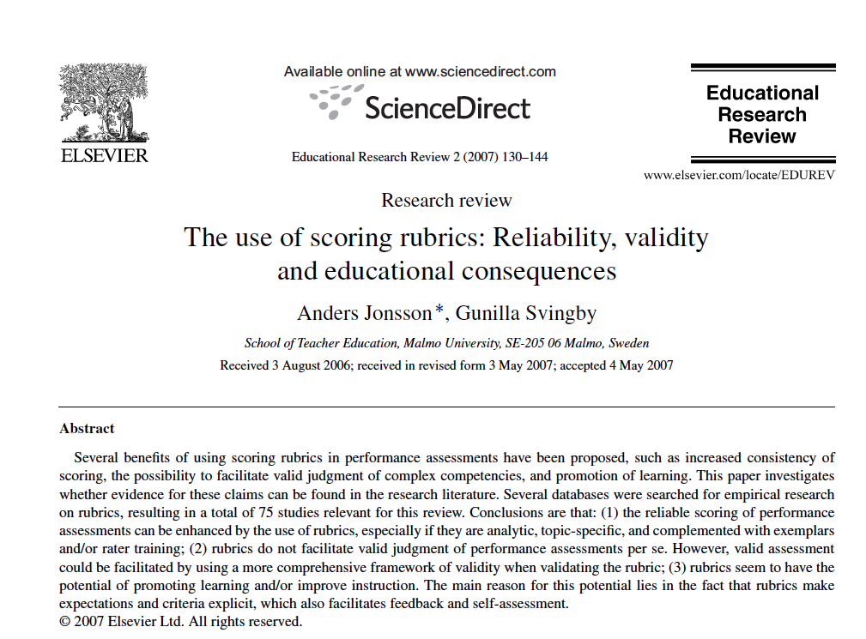
Literature review on creating & using analytic rubrics
Notes:
So, our process in developing a rubric was to begin by doing a little autodidactic learning on how rubrics are made, and how they are used. To be honest, I had never even heard of rubrics until I was tossing my proposal idea around with some of my data librarian buddies. I think it was Brian Westra, in fact, who said, “I think what you’re talking about is creating a rubric.” 10 points for Brian!

Slide 11
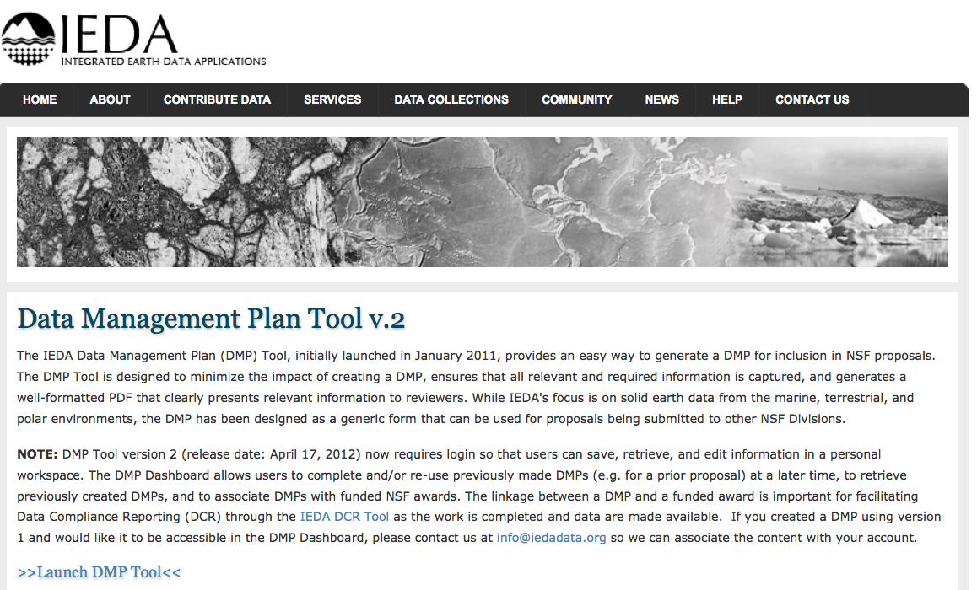
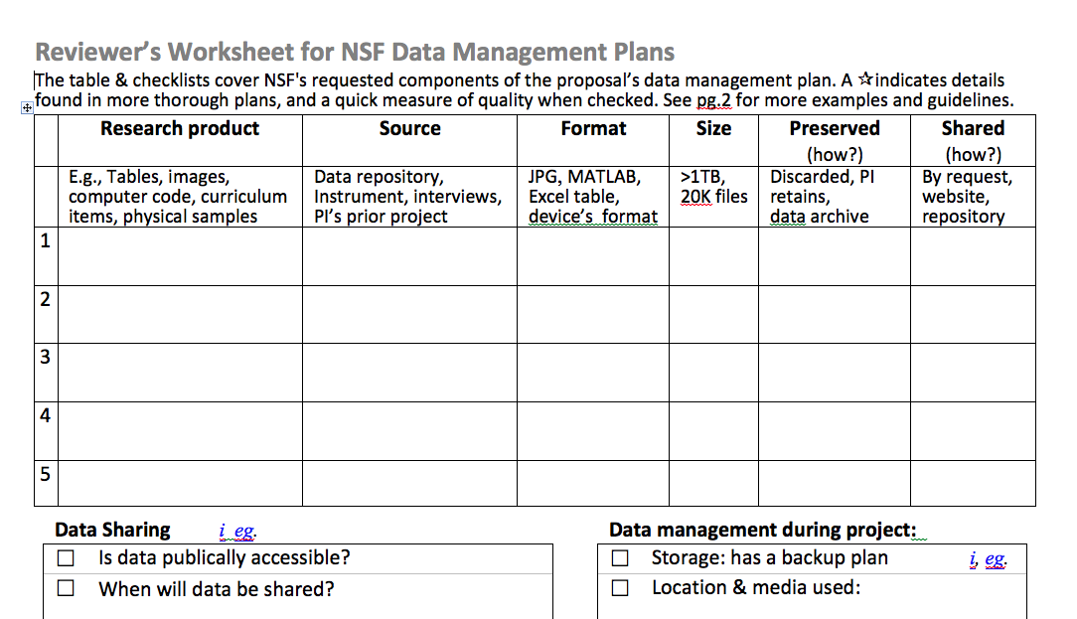
NSF-tangent & 3rd-party DMP guidance
Notes:
We also searched for and familiarized ourselves with as much of the existing resources for creating a data management plan as we could. Anyone who has read the NSF general guidance on what to include in a DMP knows that that guidance is vague at best, and intentionally so. We thought it would be a good idea to see how others were interpreting the guidance, in terms of what the required components are, etc. However, and this is another bit of foreshadowing, we should have recognized that anything that was much more specific than the NSF guidance might be a little too prescriptive relative to how researchers were interpreting the guidance. It’s hard not to encourage researchers to include the things that you think they should include in a DMP, but how fair is it to evaluate their performance based on what you think they should be doing versus what the NSF is asking them to do? But, again, this is getting ahead of myself.

Slide 12
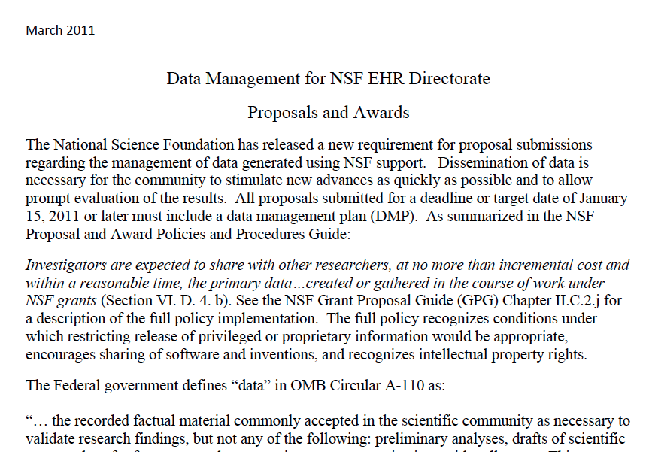
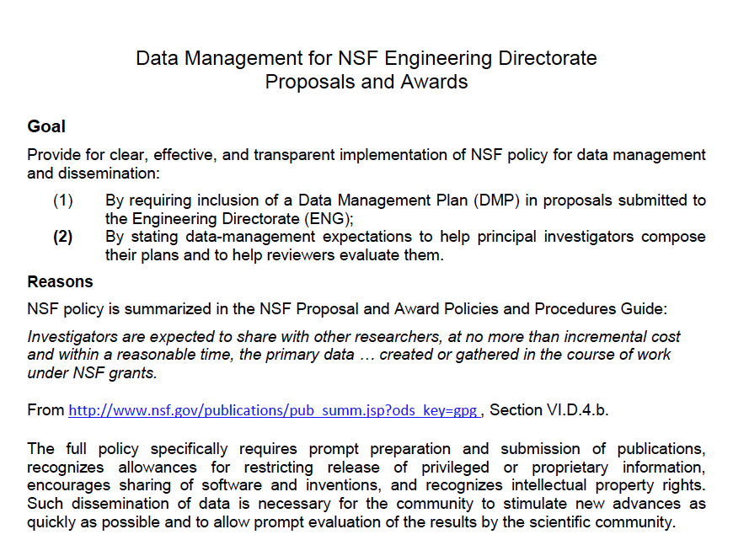
NSF DMP guidance
Notes:
Last but not least, we read every single line of NSF DMP guidance that we could find. These are just a few examples of directorate- and division-specific DMP guidance documents.

Slide 13
*
NSF Directorate or Division
BIO | Biological Sciences
DBI | Biological Infrastructure
DEB | Environmental Biology
EF | Emerging Frontiers Office
IOS | Integrative Organismal Systems
MCB | Molecular & Cellular Biosciences
CISE | Computer & Information Science & Engineering
ACI | Advanced Cyberinfrastructure
CCF | Computing & Communication Foundations
CNS | Computer & Network Systems
IIS | Information & Intelligent Systems
EHR | Education & Human Resources
DGE | Division of Graduate Education
DRL | Research on Learning in Formal & Informal Settings
DUE | Undergraduate Education
HRD | Human Resources Development
ENG | Engineering
CBET | Chemical, Bioengineering, Environmental, & Transport Systems
CMMI | Civil, Mechanical & Manufacturing Innovation
ECCS | Electrical, Communications & Cyber Systems
EEC | Engineering Education & Centers
EFRI | Emerging Frontiers in Research & Innovation
IIP | Industrial Innovation & Partnerships
GEO | Geosciences
AGS | Atmospheric & Geospace Sciences
EAR | Earth Sciences
OCE | Ocean Sciences
PLR | Polar Programs
MPS | Mathematical & Physical Sciences
AST | Astronomical Sciences
CHE | Chemistry
DMR | Materials Research
DMS | Mathematical Sciences
PHY | Physics
SBE | Social, Behavioral & Economic Sciences
BCS | Behavioral & Cognitive Sciences
SES | Social & Economic Sciences
*
*
*
********
division-specific guidance
*
Notes:
For those of you who haven’t done a close-read of the NSF Org Chart, here is the list of Directorates (in bold) and the divisions within them. The directorates with an asterisk to the LEFT have directorate-wide guidance only, meaning that all divisions under each of them is supposed to follow the same recommendations for DMP content. Geosciences and Math & Physical Sciences, however, have division-specific guidance for every division shown, with the exception of Polar Programs. There is also sometimes guidance within some of the divisions, for specific research programs (EarthScope is one example).
So, when you add it all up, we had a LOT of information to compile.
As a first step, we consolidated division- and directorate-specific guidance into one document, by DMP section (1-5)

Slide 14
Consolidated guidance
Source | Guidance text
NSF guidelines | The standards to be used for data and metadata format and content (where existing standards are absent or deemed inadequate, this should be documented along with any proposed solutions or remedies)
BIO | Describe the data that will be collected, and the data and metadata formats and standards used.
CSE | The DMP should cover the following, as appropriate for the project: ...other types of information that would be maintained and shared regarding data, e.g. the means by which it was generated, detailed analytical and procedural information required to reproduce experimental results, and other metadata
ENG | Data formats and dissemination. The DMP should describe the specific data formats, media, and dissemination approaches that will be used to make data available to others, including any metadata
GEO AGS | Data Format: Describe the format in which the data or products are stored (e.g. hardcopy logs and/or instrument outputs, ASCII, XML files, HDF5, CDF, etc).
Notes:
For each DMP section, we had in one place what each of the directorates and divisions provided in their guidance documentation. In this example, here is some of the excerpted guidance on section 2 of an NSF DMP. You can see the general guidance at the top, and some of the directorate-specific information below. We called this thing a “requirements matrix”.

Slide 15
An analytic rubric
WE WANT
Background info (DMPs & rubrics)
WE HAVE
+
NSF’s guidance
Notes:
Check check-in on where we are: We know what we want to do, and we have the information to do it. This will be easy, right?

Slide 16
Project team testing & revisions
Feedback & iteration
Rubric
Advisory Board
Notes:
Though the idea is simple, the process has been much more of a challenge than we had anticipated. But, before I start off on a tangent, let me describe our process.
Since there are conveniently five universities on our project, we each took a section of the DMP and created a rubric using the criteria that we pulled from the requirements matrix
We then exchanged sections, and did some editing, and repeated that process several times until the law of diminishing returns won out. We iterated seemingly endless times on details, some major (performance vs. compliance scale), some minor (wording)
Sent rubric out to our advisory board for feedback
Feedback was extremely useful, though was directly contradictory at times (so it goes).
Made more changes to rubric, eventually decided that it was time to test it out on a common set of DMPs.
Decided to use Qualtrics as data recording and data consolidation method (will get to that)

Slide 17
 |  | Performance Level
 | Performance Criteria | High | Low | No | Directorates
General Assessment Criteria | Describes what types of data will be captured, created or collected | Clearly defines data type(s). E.g. text, spreadsheets, images, 3D models, software, audio files, video files, reports, surveys, patient records, samples, final or intermediate numerical results from theoretical calculations, etc. Also defines data as: observational, experimental, simulation, model output or assimilation | Some details about data types are included, but DMP is missing details or wouldn’t be well understood by someone outside of the project | No details included, fails to adequately describe data types. | All
Directorate- or division- specific assessment criteria | Describes how data will be collected, captured, or created (whether new observations, results from models, reuse of other data, etc.) | Clearly defines how data will be captured or created, including methods, instruments, software, or infrastructure where relevant. | Missing some details regarding how some of the data will be produced, makes assumptions about reviewer knowledge of methods or practices. | Does not clearly address how data will be captured or created. | GEO_AGS, GEO_EAR_SGP, MPS_AST
 | Identifies how much data (volume) will be produced | Amount of expected data (MB, GB, TB, etc.) is clearly specified. | Amount of expected data (GB, TB, etc.) is vaguely specified. | Amount of expected data (GB, TB, etc.) is NOT specified. | GEO_EAR_SGP, GEO_AGS
 | Discusses the types of data that will be shared with others | Clearly describes the types of data to be shared (e.g., all data will be shared vs. only a subset of raw data; quantitative, qualitative, observational, etc.) | Provides vague/limited details regarding the types of data that will be shared | Provides no details regarding the types of data that will be shared | CISE, EHR, SBE
Notes:
An example of the rubric – NOT a final version (and isn’t complete for Section 1 due to space constraints).
This is missing the example text for each assessment criterion

Slide 18
 |  | Performance Level
 | Performance Criteria | High | Low | No | Directorates
General Assessment Criteria | Describes what types of data will be captured, created or collected | Clearly defines data type(s). E.g. text, spreadsheets, images, 3D models, software, audio files, video files, reports, surveys, patient records, samples, final or intermediate numerical results from theoretical calculations, etc. Also defines data as: observational, experimental, simulation, model output or assimilation | Some details about data types are included, but DMP is missing details or wouldn’t be well understood by someone outside of the project | No details included, fails to adequately describe data types. | All
Directorate- or division- specific assessment criteria | Describes how data will be collected, captured, or created (whether new observations, results from models, reuse of other data, etc.) | Clearly defines how data will be captured or created, including methods, instruments, software, or infrastructure where relevant. | Missing some details regarding how some of the data will be produced, makes assumptions about reviewer knowledge of methods or practices. | Does not clearly address how data will be captured or created. | GEO_AGS, GEO_EAR_SGP, MPS_AST
 | Identifies how much data (volume) will be produced | Amount of expected data (MB, GB, TB, etc.) is clearly specified. | Amount of expected data (GB, TB, etc.) is vaguely specified. | Amount of expected data (GB, TB, etc.) is NOT specified. | GEO_EAR_SGP, GEO_AGS
 | Discusses the types of data that will be shared with others | Clearly describes the types of data to be shared (e.g., all data will be shared vs. only a subset of raw data; quantitative, qualitative, observational, etc.) | Provides vague/limited details regarding the types of data that will be shared | Provides no details regarding the types of data that will be shared | CISE, EHR, SBE

Slide 19
 |  | Performance Level
 | Performance Criteria | High | Low | No | Directorates
General Assessment Criteria | Describes what types of data will be captured, created or collected | Clearly defines data type(s). E.g. text, spreadsheets, images, 3D models, software, audio files, video files, reports, surveys, patient records, samples, final or intermediate numerical results from theoretical calculations, etc. Also defines data as: observational, experimental, simulation, model output or assimilation | Some details about data types are included, but DMP is missing details or wouldn’t be well understood by someone outside of the project | No details included, fails to adequately describe data types. | All
Directorate- or division- specific assessment criteria | Describes how data will be collected, captured, or created (whether new observations, results from models, reuse of other data, etc.) | Clearly defines how data will be captured or created, including methods, instruments, software, or infrastructure where relevant. | Missing some details regarding how some of the data will be produced, makes assumptions about reviewer knowledge of methods or practices. | Does not clearly address how data will be captured or created. | GEO_AGS, GEO_EAR_SGP, MPS_AST
 | Identifies how much data (volume) will be produced | Amount of expected data (MB, GB, TB, etc.) is clearly specified. | Amount of expected data (GB, TB, etc.) is vaguely specified. | Amount of expected data (GB, TB, etc.) is NOT specified. | GEO_EAR_SGP, GEO_AGS
 | Discusses the types of data that will be shared with others | Clearly describes the types of data to be shared (e.g., all data will be shared vs. only a subset of raw data; quantitative, qualitative, observational, etc.) | Provides vague/limited details regarding the types of data that will be shared | Provides no details regarding the types of data that will be shared | CISE, EHR, SBE

Slide 20
 |  | Performance Level
 | Performance Criteria | High | Low | No | Directorates
General Assessment Criteria | Describes what types of data will be captured, created or collected | Clearly defines data type(s). E.g. text, spreadsheets, images, 3D models, software, audio files, video files, reports, surveys, patient records, samples, final or intermediate numerical results from theoretical calculations, etc. Also defines data as: observational, experimental, simulation, model output or assimilation | Some details about data types are included, but DMP is missing details or wouldn’t be well understood by someone outside of the project | No details included, fails to adequately describe data types. | All
Directorate- or division- specific assessment criteria | Describes how data will be collected, captured, or created (whether new observations, results from models, reuse of other data, etc.) | Clearly defines how data will be captured or created, including methods, instruments, software, or infrastructure where relevant. | Missing some details regarding how some of the data will be produced, makes assumptions about reviewer knowledge of methods or practices. | Does not clearly address how data will be captured or created. | GEO_AGS, GEO_EAR_SGP, MPS_AST
 | Identifies how much data (volume) will be produced | Amount of expected data (MB, GB, TB, etc.) is clearly specified. | Amount of expected data (GB, TB, etc.) is vaguely specified. | Amount of expected data (GB, TB, etc.) is NOT specified. | GEO_EAR_SGP, GEO_AGS
 | Discusses the types of data that will be shared with others | Clearly describes the types of data to be shared (e.g., all data will be shared vs. only a subset of raw data; quantitative, qualitative, observational, etc.) | Provides vague/limited details regarding the types of data that will be shared | Provides no details regarding the types of data that will be shared | CISE, EHR, SBE

Slide 21
 |  | Performance Level
 | Performance Criteria | High | Low | No | Directorates
General Assessment Criteria | Describes what types of data will be captured, created or collected | Clearly defines data type(s). E.g. text, spreadsheets, images, 3D models, software, audio files, video files, reports, surveys, patient records, samples, final or intermediate numerical results from theoretical calculations, etc. Also defines data as: observational, experimental, simulation, model output or assimilation | Some details about data types are included, but DMP is missing details or wouldn’t be well understood by someone outside of the project | No details included, fails to adequately describe data types. | All
Directorate- or division- specific assessment criteria | Describes how data will be collected, captured, or created (whether new observations, results from models, reuse of other data, etc.) | Clearly defines how data will be captured or created, including methods, instruments, software, or infrastructure where relevant. | Missing some details regarding how some of the data will be produced, makes assumptions about reviewer knowledge of methods or practices. | Does not clearly address how data will be captured or created. | GEO_AGS, GEO_EAR_SGP, MPS_AST
 | Identifies how much data (volume) will be produced | Amount of expected data (MB, GB, TB, etc.) is clearly specified. | Amount of expected data (GB, TB, etc.) is vaguely specified. | Amount of expected data (GB, TB, etc.) is NOT specified. | GEO_EAR_SGP, GEO_AGS
 | Discusses the types of data that will be shared with others | Clearly describes the types of data to be shared (e.g., all data will be shared vs. only a subset of raw data; quantitative, qualitative, observational, etc.) | Provides vague/limited details regarding the types of data that will be shared | Provides no details regarding the types of data that will be shared | CISE, EHR, SBE

Slide 22
 |  | Performance Level
 | Performance Criteria | High | Low | No | Directorates
General Assessment Criteria | Describes what types of data will be captured, created or collected | Clearly defines data type(s). E.g. text, spreadsheets, images, 3D models, software, audio files, video files, reports, surveys, patient records, samples, final or intermediate numerical results from theoretical calculations, etc. Also defines data as: observational, experimental, simulation, model output or assimilation | Some details about data types are included, but DMP is missing details or wouldn’t be well understood by someone outside of the project | No details included, fails to adequately describe data types. | All
Directorate- or division- specific assessment criteria | Describes how data will be collected, captured, or created (whether new observations, results from models, reuse of other data, etc.) | Clearly defines how data will be captured or created, including methods, instruments, software, or infrastructure where relevant. | Missing some details regarding how some of the data will be produced, makes assumptions about reviewer knowledge of methods or practices. | Does not clearly address how data will be captured or created. | GEO_AGS, GEO_EAR_SGP, MPS_AST
 | Identifies how much data (volume) will be produced | Amount of expected data (MB, GB, TB, etc.) is clearly specified. | Amount of expected data (GB, TB, etc.) is vaguely specified. | Amount of expected data (GB, TB, etc.) is NOT specified. | GEO_EAR_SGP, GEO_AGS
 | Discusses the types of data that will be shared with others | Clearly describes the types of data to be shared (e.g., all data will be shared vs. only a subset of raw data; quantitative, qualitative, observational, etc.) | Provides vague/limited details regarding the types of data that will be shared | Provides no details regarding the types of data that will be shared | CISE, EHR, SBE
Notes:
An example of the rubric – NOT a final version (and isn’t complete for Section 1 due to space constraints).
This is missing the example text for each assessment criterion
Some challenges that we have faced:
*Developing the rubric was challenging because:
The NSF requirements / guidelines are not always clear
How to cover multiple directorates within a single rubric while streamlining the form & process?
What is a reasonable level of granularity?
How to ensure consistency across reviewers?
*Wording in DMPs indicates that concepts are not well understood
Questions on what was meant by statements like “no restrictions on access”
*There is potentially useful information in DMPs that is not captured by only evaluating NSF requirements
E.g., did they mention the IR?

Slide 23
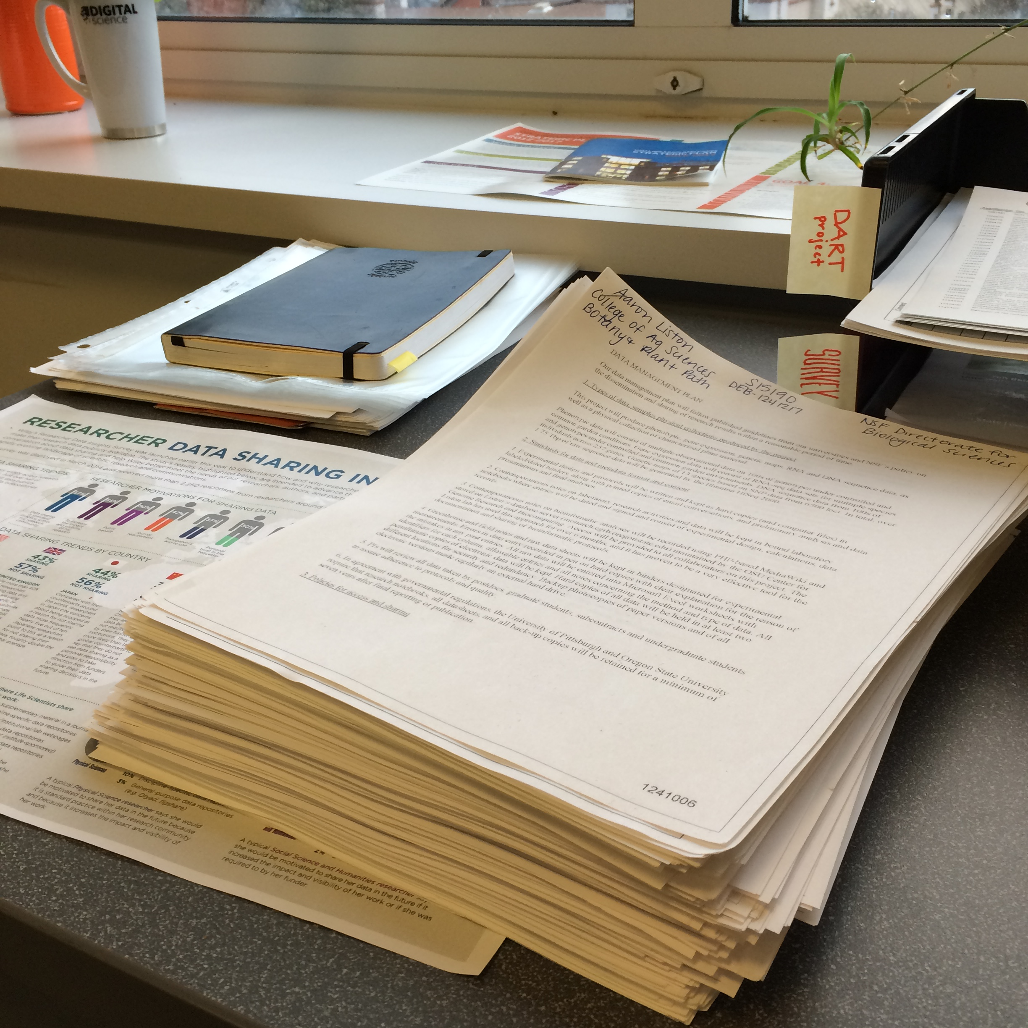
Notes:
A stack of ~250 DMPs from OSU researchers with successful NSF proposals.

Slide 24
“Mini-review”
Notes:
5 DMPs from each institution -> 25 DMPs total
We intentionally spread out the directorates & divisions to cover a range with some depth where possible
We all reviewed them, without talking to one another about them
Recorded results via Qualtrics

Slide 25
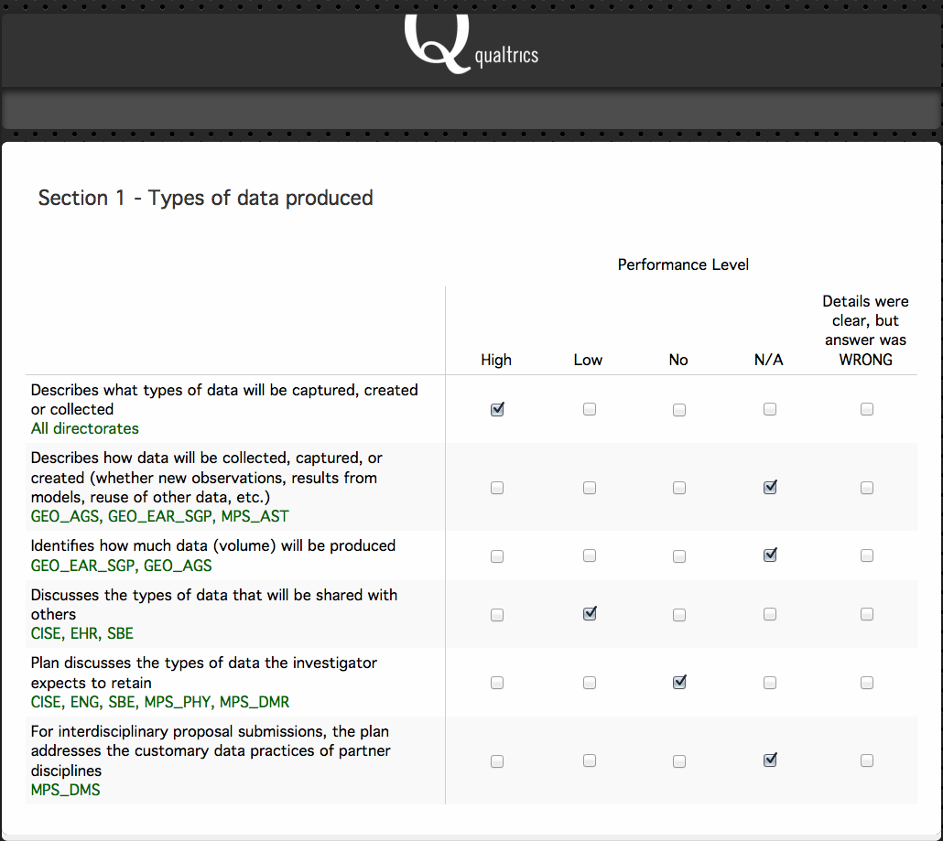
Notes:
A screenshot of the Qualtrics form we used to collect review data.
Next time – use branch logic to create custom paths through rubric depending on directorate or division?
Survey Monkey could accomplish the same thing, albeit more basically (without branch logic, for example).

Slide 26
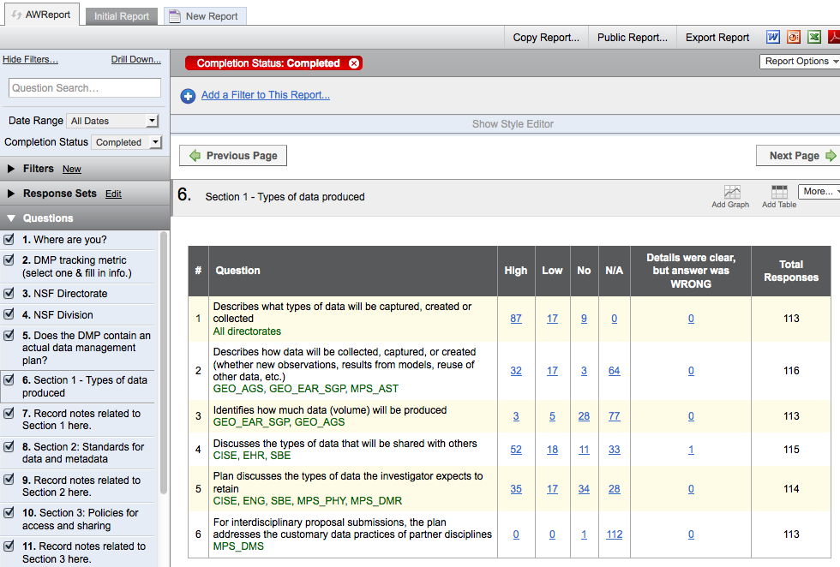

Slide 27
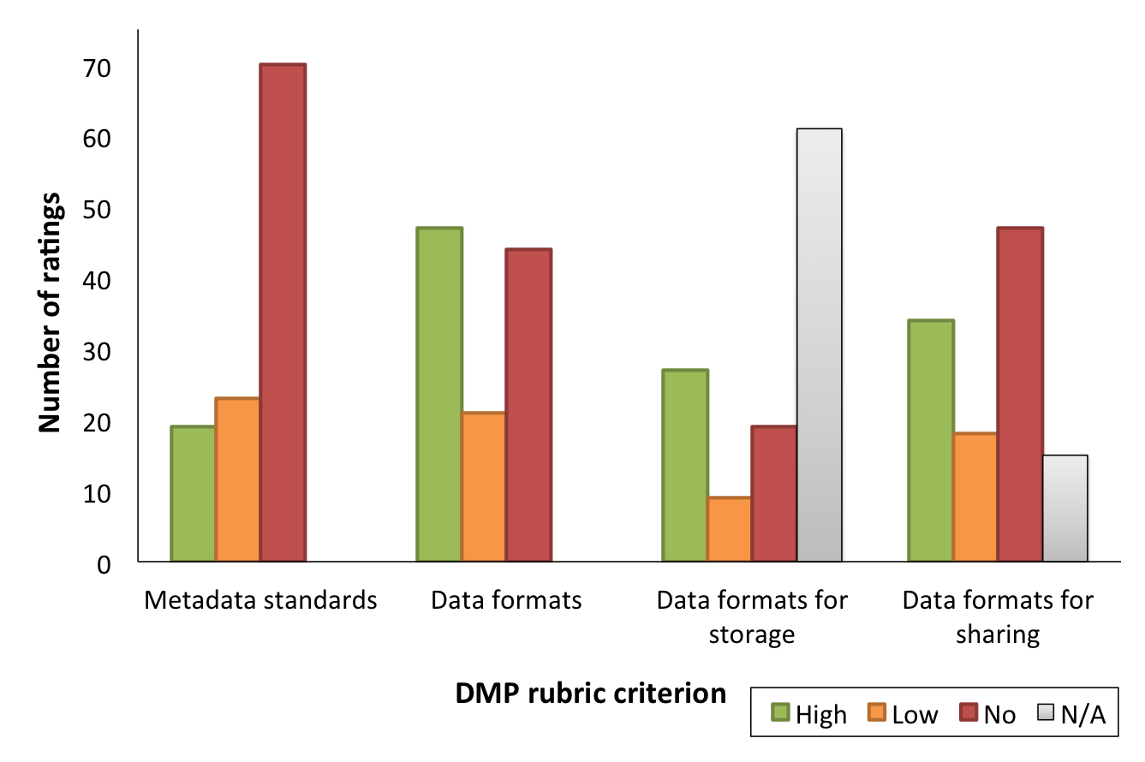
Notes:
Go over colors/performance levels, which section of the rubric this is.

Slide 28
Required for all

Slide 29
Required for all
GEO_AGS,
MPS_AST,
MPS_CHE
ENG, CISE,
GEO_AGS,
EHR, SBE,
MPS_AST,
MPS_CHE

Slide 30
10 consensus
1 “High”
11 consensus
5 “High”
11 consensus
4 “High”
4 consensus
3 “High”
Notes:
Metadata standards: we reached consensus on 10 of 25 DMPs
1 DMP was rated “High”, 9 were rated “No” – we didn’t agree on any that were rated “Low”
In 6 cases where we disagreed, we voted across “High-Low-No” ratings
In 9 cases where we disagreed, we either voted “High-Low” or “Low-No”
In only 5 cases, in the entire mini-review, did we agree that a DMP preformed in the “Low” category for a given criterion.
Best case: consensus on 15/25 DMPs, on the first criterion: “describes the data types captured or created”

Slide 31
Notes:
So, what did this process tell us?

Slide 32
There is still ambiguity in the rubric as to what constitutes “High”, “Low”, and “No” performance
Notes:
There is still ambiguity in the rubric in what constitutes “High”, “Low”, and “No” performance
How much of this can we eliminate via improving the rubric, and how much is am unavoidable component of subjective analysis?

Slide 33
Large proportion of researchers bombed Section 4 – policies on reuse, redistribution and creation of derivatives.
Notes:
Either the NSF guidance language was poorly or insufficiently worded, our rubric assessed it poorly, or researchers really need some outreach & training in this area. I suspect some combination of all three.

Slide 34
Need to build a greater path for consistency - reduce areas of having to make a decision on something

Slide 35
To sum up…
Developing a rubric to empower academic librarians in providing research data support
http://bit.ly/dmpresearch
@DMPResearch
Notes:
We are nearly finished developing the rubric, and look forward to sharing it with the community as soon as we can. What I covered today was simply an introduction to the project itself, and some very early results from testing a beta version of the rubric.

Slide 36
Notes:
Where are we going from here?
We need to incorporate the results and observations from the mini-review into revisions of the rubric, and conduct another mini-review. If we perform well enough on that test, we will move forward with the full DMP review, which consists of each of us reviewing at least 100 DMPs.
We will be on the conference circuit this spring and summer, so look for us at ACRL (poster), RDAP (I’m on the assessment panel) and IASSIST (we will have a whole panel to ourselves).

Slide 37
Notes:
https://flic.kr/p/acViqJ – photo by Alice Popkorn

