Slide 1
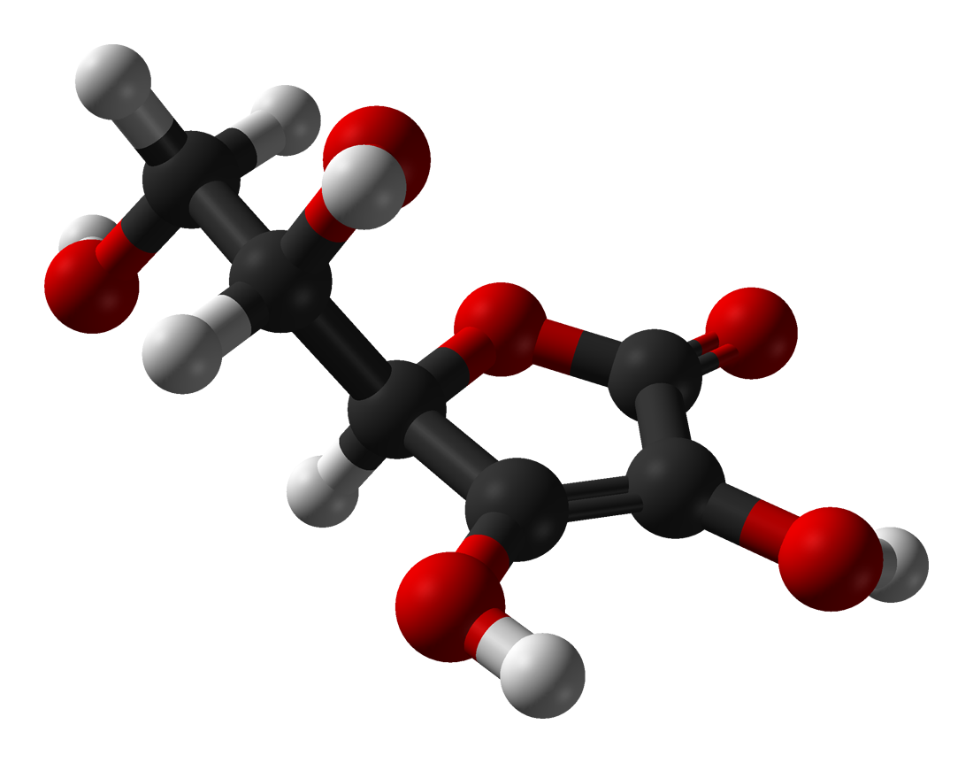
An Epigenetic Perspective on Pharmacologic Ascorbate in Colon Cancer
Matthew Kaiser
Frei Lab
&
Dashwood Lab
Linus Pauling Institute
Oregon State University
Institute of Bioscience and Technology
Texas A&M Health Science Center
“Epigenetics refers to changes in gene expression caused by mechanisms other than changes in the underlying DNA sequence.”

Slide 2
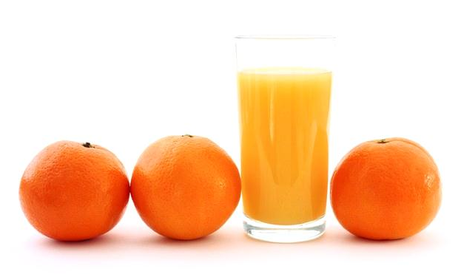
Pharmacologic ascorbate and cancer
In the 80 years since the discovery of vitamin C (ascorbic acid, ascorbate), the number of its biological functions is expanding.
In addition to its role as a water-soluble reducing agent and anti-oxidant, ascorbate can also have pro-oxidant effects, generating hydrogen peroxide
Uptake of ascorbate from the intestinal tract is tightly controlled. Maximal plasma ascorbate concentrations achievable with oral ingestion is 220 μM, compared to 30 mM e.g., by i.v. injection.

Slide 3
Pharmacologic ascorbate and cancer
PharmAscorbate is a prodrug for H₂O₂; e.g. in extracellular fluid, 8 mM Asc = 8-35 μM H₂O₂
PharmAscorbate, inhibits tumor growth in mice, and is in multiple human clinical trials (grants.gov)
H₂O₂ is reported to inhibit histone deacetylase (HDAC) activity
HDAC inhibition influences the acetylation status of both histone and non-histone proteins
Alterations in protein acetylation can have acute effect on cell behavior
Chen Q et al. PNAS 2007;104:8749-8754
Hypothesis:
Anticancer effects of pharmAsc stem from H₂O₂ generation and HDAC inhibition

Slide 4
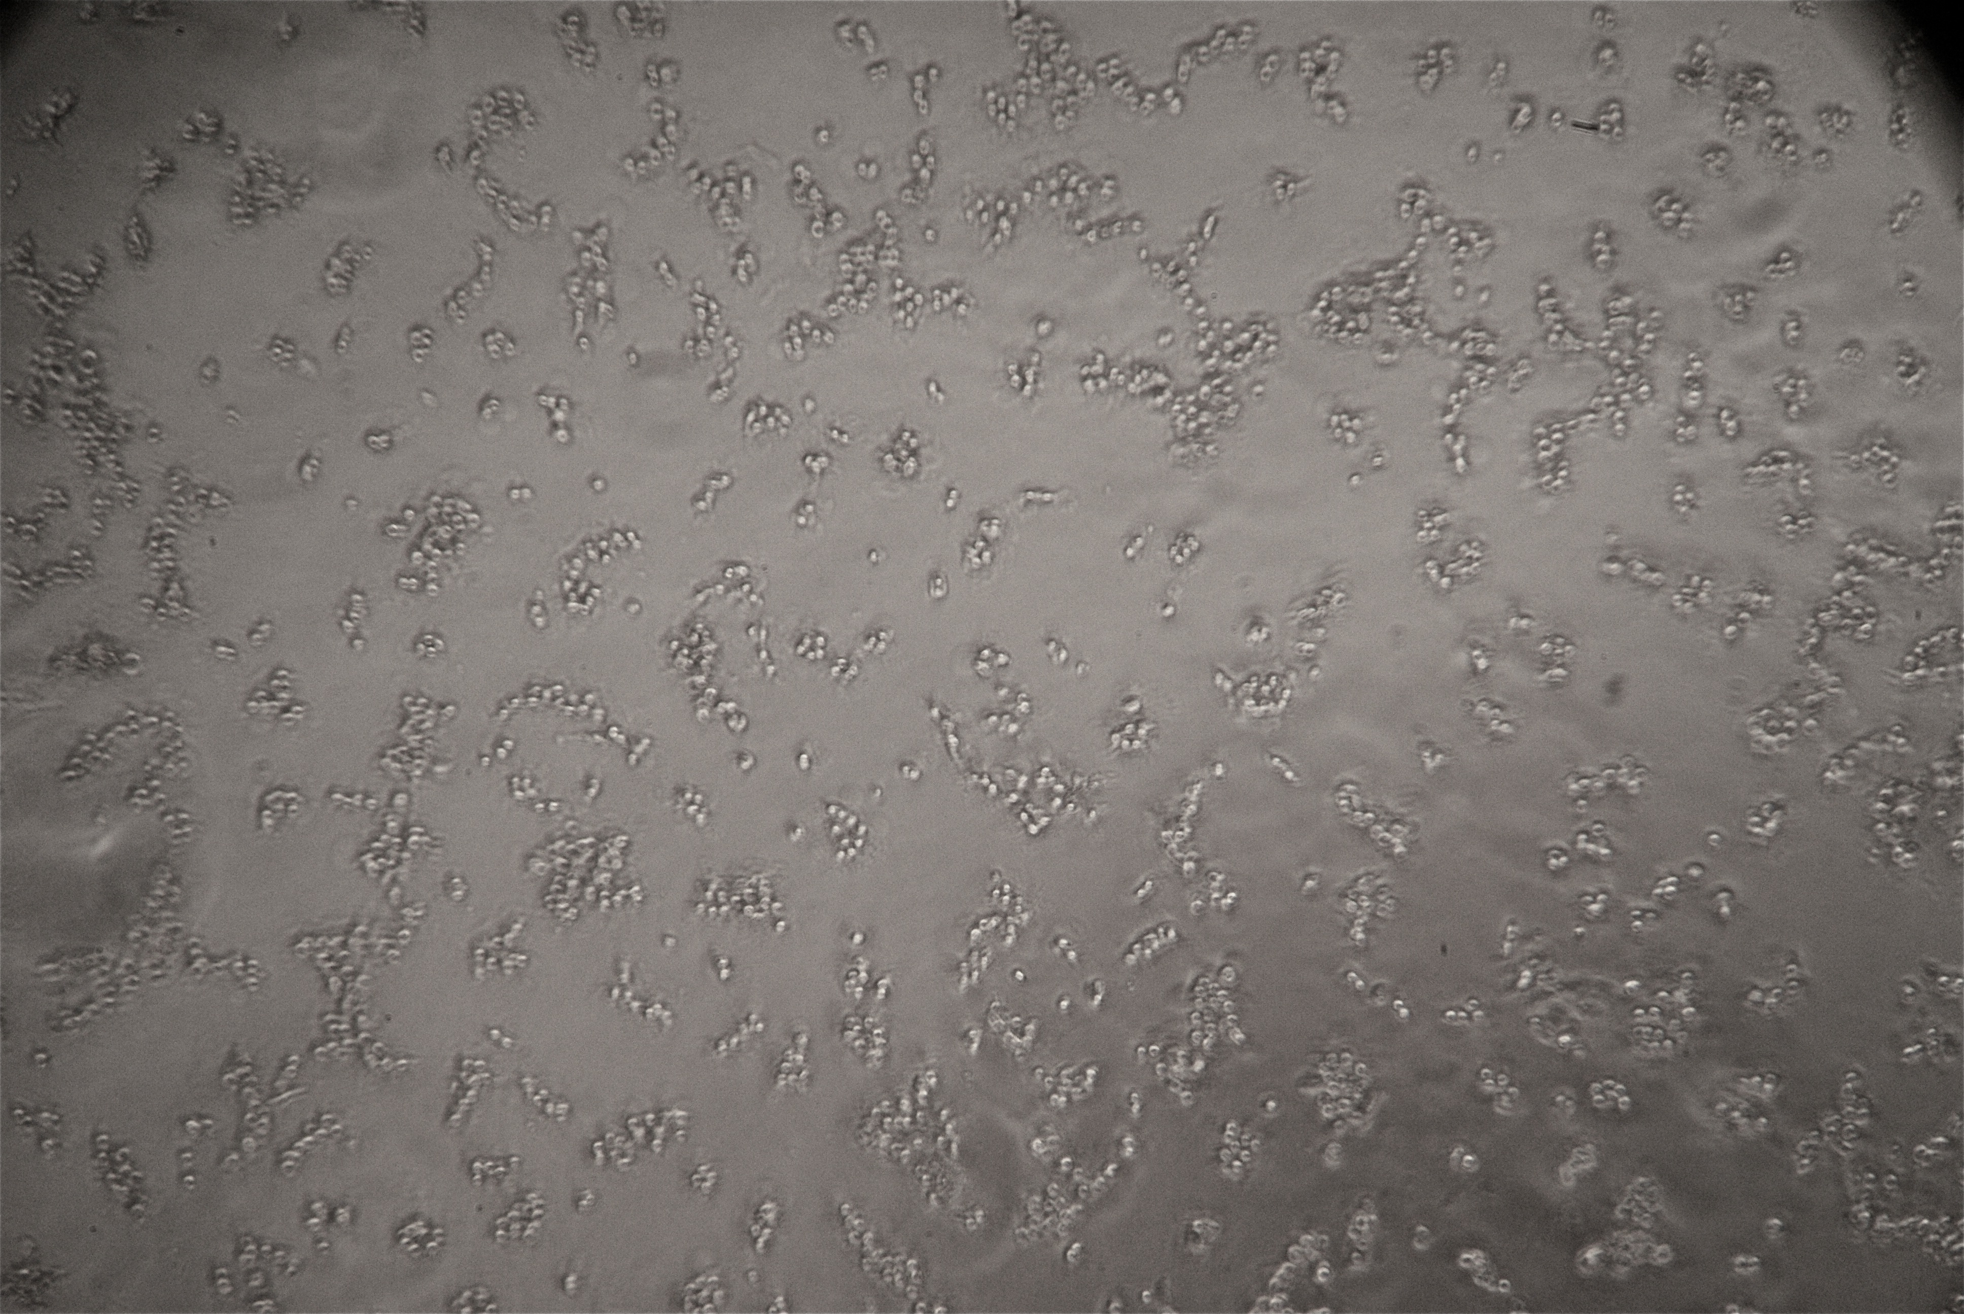
Methodology: H₂O₂ vs PharmAsc
Colon cancer cells and normal colon cells were treated with ascorbic acid (0.125–16 mM, ± catalase), Ascorbate-2-phosphate (0.125-52 mM), and hydrogen peroxide (12.5-400 μM) in medium containing 10% serum
HCT116 = human colon epithelial adenocarcinoma cancer cells
CCD841= human non-transformed normal colonic epithelial cells
Effects were assessed via
Cell morphology
MTT assay
Trypan blue exclusion
Asc-induced cell rounding
Tyrpan Blue stain
HDAC activity via a fluorescence-based assay
Cell-free = nuclear extracts treated directly with ascorbate
Cell-based = cells treated with ascorbate and the lysates then tested
Western blotting for HDACs and other proteins in whole cell lysates at 6 h
Intracellular ascorbate accumulation via HPLC

Slide 5
Inhibition of cell viability by PharmAsc
Percent live cells (MTT assay)
HCT116 cancer cells IC₅₀= 3 mM, 24 h
Pharmacologic Ascorbate (mM)

Slide 6
PharmAsc effect confirmed by Trypan Blue
Does PharmAsc effect on HDAC activity?
Trypan Blue Assay
Number of cells/10⁴
Percent live cells (MTT assay)
HCT116 cancer cells IC₅₀= 3 mM, 24 h
Pharmacologic Ascorbate (mM)

Slide 7
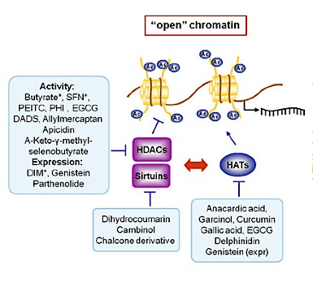
Chromatin remodeling and gene regulation
Aberrant HDAC activity is a hallmark of several cancers
HDAC hyperactivity can lead to gene silencing
HDAC inhibition is a focus of pharmaceutical anticancer R&D

Slide 8
Histone acetylation and gene regulation
No direct effect of ascorbate on HDAC activity (cell free assay)
AFU/min/µg protein
Ascorbate

Slide 9
Histone acetylation and gene regulation
HDAC inhibition in HCT116 cell lysates after pharmAsc treatment
AFU/min/µg protein
TSA
CTR
1 mM
10 mM
Vitamin C does not directly inhibit HDACs
PharmAsc
PharmAsc treated cells show attenuated HDAC activity
What happens to individual HDAC expression?

Slide 10
PharmAsc effects on HDAC expression
CTR
2
4
8 mM
HDAC1
HDAC1 induction was countered by loss of several other HDACs, e.g., HDAC4, HDAC6, SIRT3, SIRT4, and SIRT6
Class I
HDAC2
HDAC3
HDAC4
HDAC substrates stretch beyond just histone proteins
Class II
HDAC6
HDAC7
HDAC6 is a reported tubulin deacetylase, whereas HDAC4 acts on p53 acetylation status
SIRT1
SIRT3
Class III
SIRT4
Do these important proteins for cancer development become acetylated by pharmAsc?
SIRT6
β-Actin
HCT116 cells at 6 h

Slide 11
PharmAsc induces tubulin, p53 acetylation
CTR
2
4
8 mM
CTR
2
4
8 mM
HDAC1
AcTub
Class I
HDAC2
Tubulin
HDAC3
Acp53
HDAC4
p53
Class II
HDAC6
This is the first evidence for changes in acetylation status of tubulin and p53 by PharmAsc.
HDAC7
SIRT1
SIRT3
Class III
SIRT4
SIRT6
β-Actin
HCT116 cells at 6 h

Slide 12
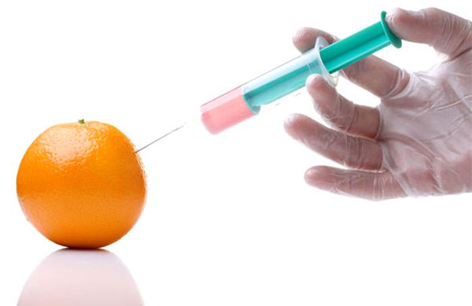
Cancer vs Normal
Cancer vs Normal
Cancer cells are more susceptible than normal
Is pharmacologic ascorbrate a selective killer?
Percent cell growth (MTT assay)
HCT116 cancer cells IC₅₀=3 mM
CCD841 normal cells
IC₅₀=8mM
Pharmacologic Ascorbate (mM)

Slide 13
Differential effects of PharmAsc
on HDAC expression between cancer and non-cancer cells
Cancer vs Normal
PharmAsc effects on HDAC expression
HCT116 6h
CCD841 6h
CTR
2
4
8 mM
CTR
2
4
8 mM
HDAC4
HDAC6
SIRT3
β-Actin
HDACs are overexpressed in cancer cells
Unlike in normal cells, HDACs in cancer cells are sensitive to pharmAsc
Differential effects of PharmAsc
on HDAC expression between cancer and non-cancer cells
Differential effects of PharmAsc
on HDAC expression between cancer and non-cancer cells
Differential effects of PharmAsc
on HDAC expression between cancer and non-cancer cells
HCT116 6h
CCD841 6h
HCT116 6h
CCD841 6h
HCT116 6h
CCD841 6h
CTR
2
4
8 mM
CTR
2
4
8 mM
CTR
2
4
8 mM
CTR
2
4
8 mM
CTR
2
4
8 mM
CTR
2
4
8 mM
HDAC4
HDAC4
HDAC4
HDAC6
HDAC6
HDAC6
SIRT3
SIRT3
SIRT3
β-Actin
β-Actin
β-Actin

Slide 14
Cancer vs Normal
Intracellular Asc concentration
HPLC data
In cancer cells, HDAC loss corresponded with Asc accumulation
SVCT control intracellular Asc levels under physiological conditions

Slide 15
Cancer vs Normal
PharmAsc effects on non-HDAC targets
HCT116 6h
CCD841 6h
CTR
2
4
8 mM
CTR
2
4
8 mM
CTip
Catalase
β-Actin
DNA repair protein CtIP is upregulated in normal cells with Asc
Asc uptake in cancer cells resulted in increased catalase expression
Differential effects of PharmAsc
on HDAC expression between cancer and non-cancer cells
Differential effects of PharmAsc
on HDAC expression between cancer and non-cancer cells
Differential effects of PharmAsc
on HDAC expression between cancer and non-cancer cells
HCT116 6h
CCD841 6h
HCT116 6h
CCD841 6h
HCT116 6h
CCD841 6h
CTR
2
4
8 mM
CTR
2
4
8 mM
CTR
2
4
8 mM
CTR
2
4
8 mM
CTR
2
4
8 mM
CTR
2
4
8 mM
HDAC4
HDAC4
HDAC4
HDAC6
HDAC6
HDAC6
SIRT3
SIRT3
SIRT3
β-Actin
β-Actin
β-Actin

Slide 16
Cancer vs Normal
PharmAsc effects on non-HDAC targets
HCT116 6h
CCD841 6h
CTR
2
4
8 mM
CTR
2
4
8 mM
CTip
Catalase
Severe DNA damage in cancer, but not normal cells…
pH2Ax
H2Ax
AcH3
H3
β-Actin
Differential effects of PharmAsc
on HDAC expression between cancer and non-cancer cells
Differential effects of PharmAsc
on HDAC expression between cancer and non-cancer cells
Differential effects of PharmAsc
on HDAC expression between cancer and non-cancer cells
HCT116 6h
CCD841 6h
HCT116 6h
CCD841 6h
HCT116 6h
CCD841 6h
CTR
2
4
8 mM
CTR
2
4
8 mM
CTR
2
4
8 mM
CTR
2
4
8 mM
CTR
2
4
8 mM
CTR
2
4
8 mM
HDAC4
HDAC4
HDAC4
HDAC6
HDAC6
HDAC6
SIRT3
SIRT3
SIRT3
β-Actin
β-Actin
β-Actin

Slide 17
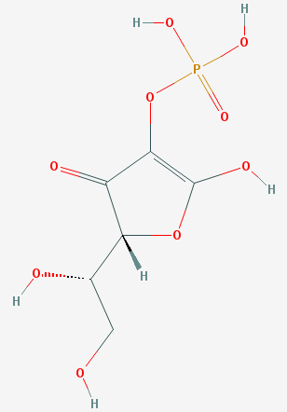
The H₂O₂ scavenger catalase
protects cancer cells against pharmAsc
>80% protection with catalase co-treatment
AA+CAT HCT116
Percent live cells (MTT assay)
AA HCT116
Ascorbate-2-phosphate
Pharmacologic Ascorbate (mM)

Slide 18
Non-H₂O₂ producing ascorbate 2-phosphate has little effect on cancer cells
AAp+ HCT116
AA+CAT HCT116
Percent live cells (MTT assay)
AA HCT116
Pharmacologic Ascorbate or Ascorbate-2-phosphate (mM)

Slide 19
IC₅₀ values for exogenous H₂O₂ vs. pharmAsc
Hypothesis:
Anticancer effects of pharmAsc stem from H₂O₂ generation and HDAC inhibition
HCT116 cancer
cells IC₅₀=65 μM
HCT116 cancer cells IC₅₀=3 mM
Percent live cells (MTT assay)
Hydrogen Peroxide (μM)
Pharmacologic Ascorbate (mM)

Slide 20
Differential effects of
PharmAsc and exogenous H₂O₂
PharmAsc
Hydrogen Peroxide
CTR
2
4
8 mM
25
50
100 μM
HDAC4
HDAC4, HDAC6 and SIRT3 are diminished by pharmAsc but not by H₂O₂…
HDAC6
SIRT3
β-Actin
HCT116 cells at 6 h

Slide 21
Differential effects of
PharmAsc and exogenous H₂O₂
Alternative hypothesis:
PharmAsc does not always act as a H₂O₂ prodrug; HDAC inhibition and non-histone protein acetylation may be key for some of the anticancer effects.
Ascorbic Acid
Hydrogen Peroxide
CTR
2
4
8 mM
25
50
100 μM
HDAC6
HDAC4, HDAC6 and SIRT3 are diminished by pharmAsc but not by H₂O₂…
SIRT3
AcTub
H₂O₂ induced p21 and reduced acTubulin levels
p21
pH2Ax
PharmAsc may not simply be a prodrug for H₂O₂
H2Ax
β-Actin
HCT116 cells at 6 h

Slide 22
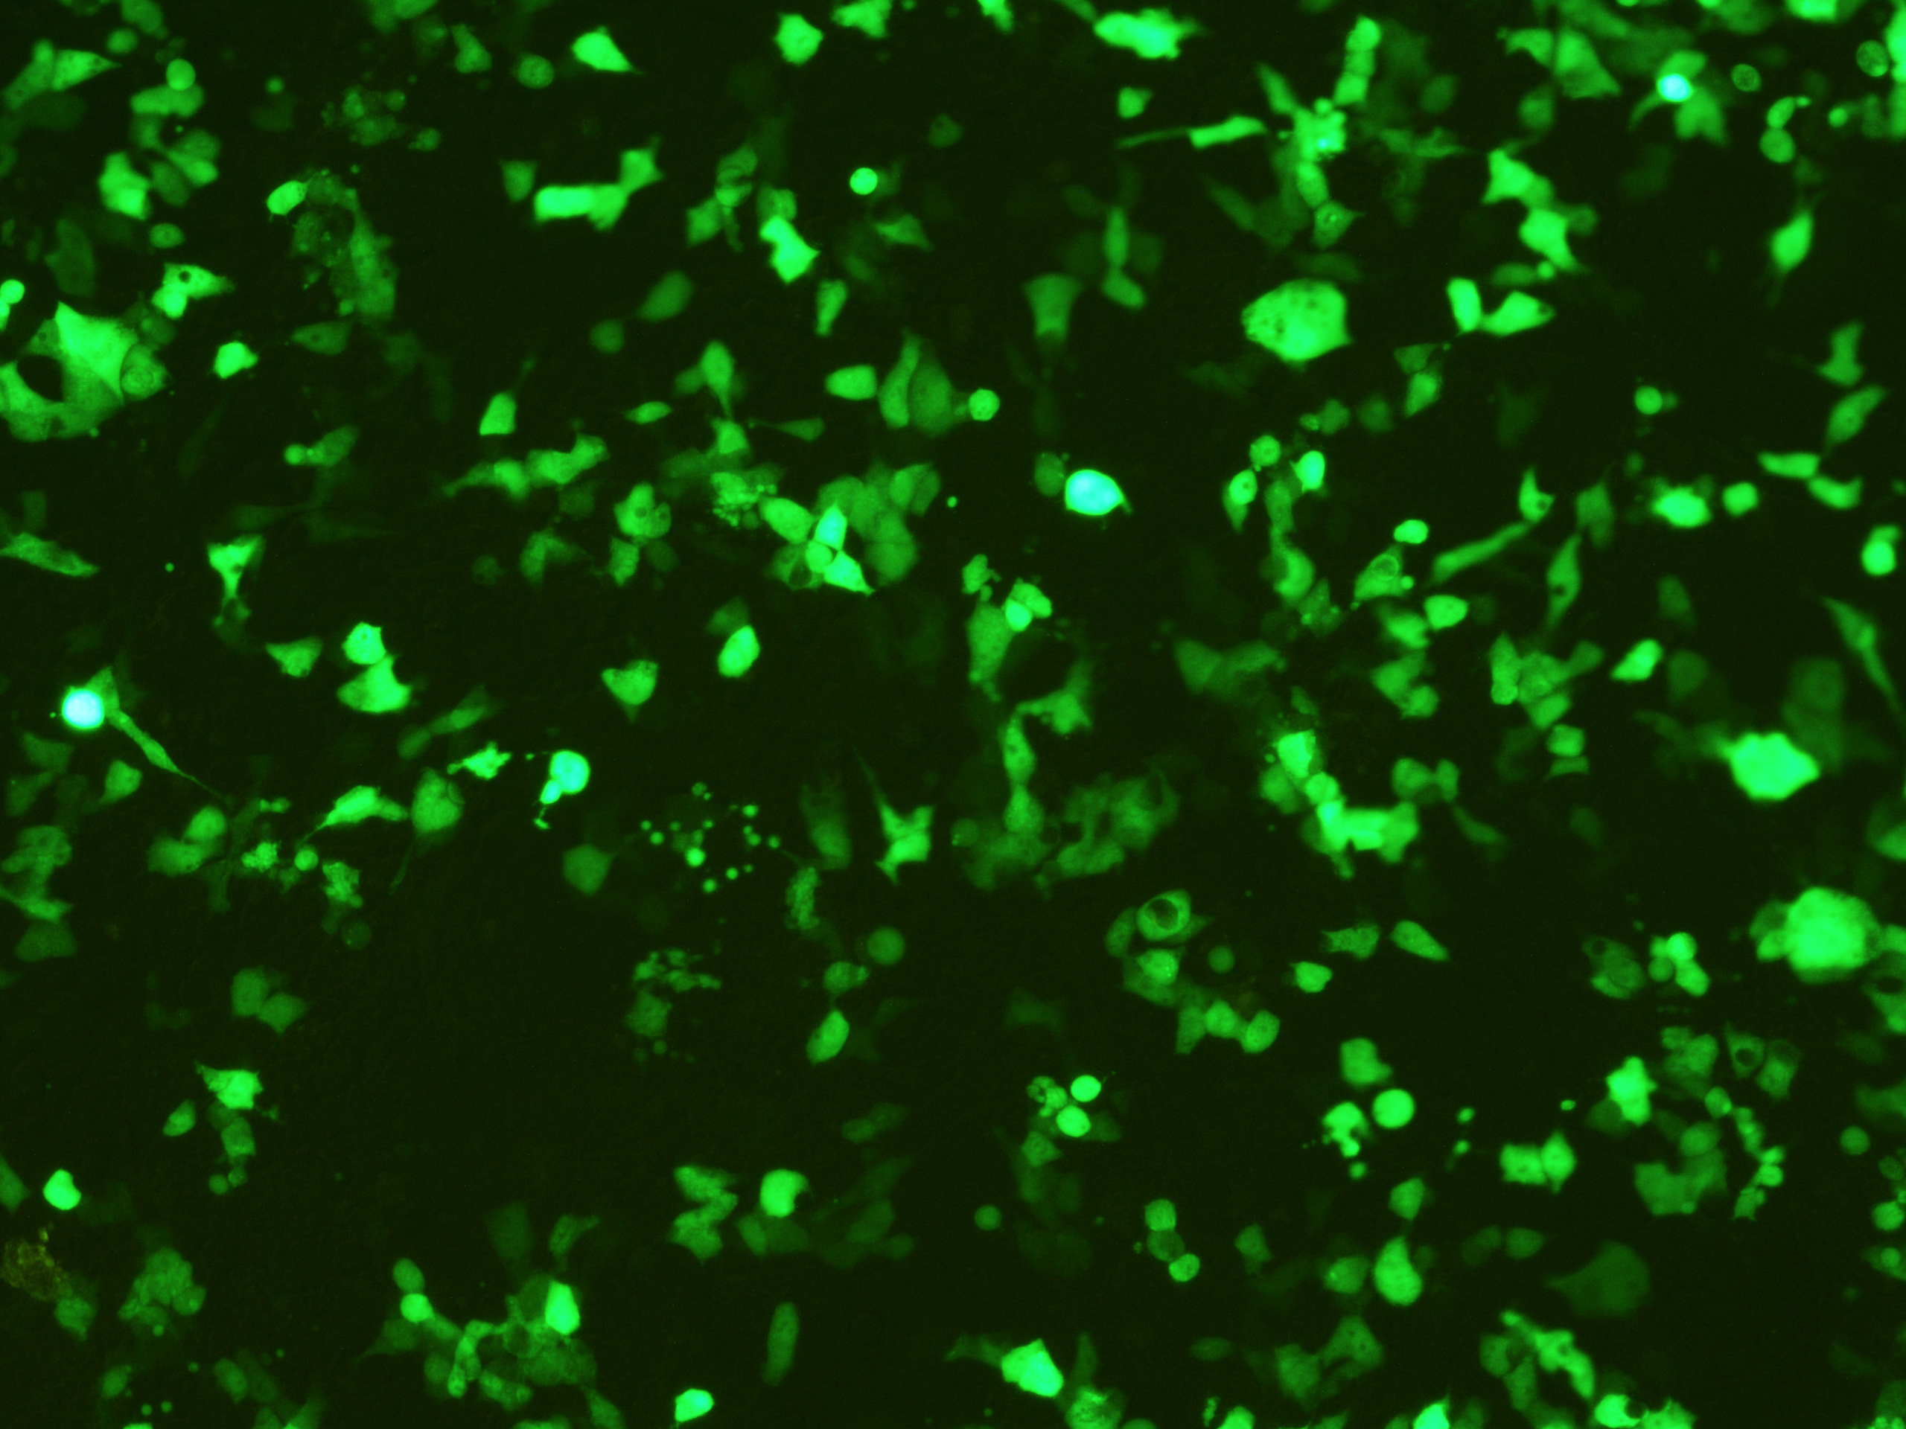
Conclusions and future work
Colon cancer cells are more susceptible than normal colon cells to pharmacologic ascorbate
PharmAsc induced HDAC expression (class II & III HDACs), while modifying the acetylation status of p53 and tubulin in colon cancer cells
A role for H₂O₂ was implicated (catalase, AAp data), however…
PharmAsc had differential effects from H₂O₂ on specific HDACs, sirtuins, and non-histone proteins (p21, p53, tubulin)

Slide 23
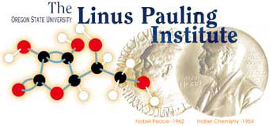
INSTITUTE OF BIOSCIENCES & TECHNOLOGY
HEALTH SCIENCE CENTER
Acknowledgements
Dr. Rod Dashwood and lab (IBT)
Dr. Balz Frei, Dr. Alex Michels (LPI) Dr. Mark Levine (NIH)
Helen P. Rumbel Fellowship
OSU Honors College and Honors Experience Scholarship Program
OSU Undergraduate Research, Scholarship, and the Arts Program
Howard Hughes Medical Institute
Undergraduate Research, Innovation, Scholarship and Creativity (URISC) Program
Dr. Allen Wedell, professor emeritus, Colorado State University

Slide 24
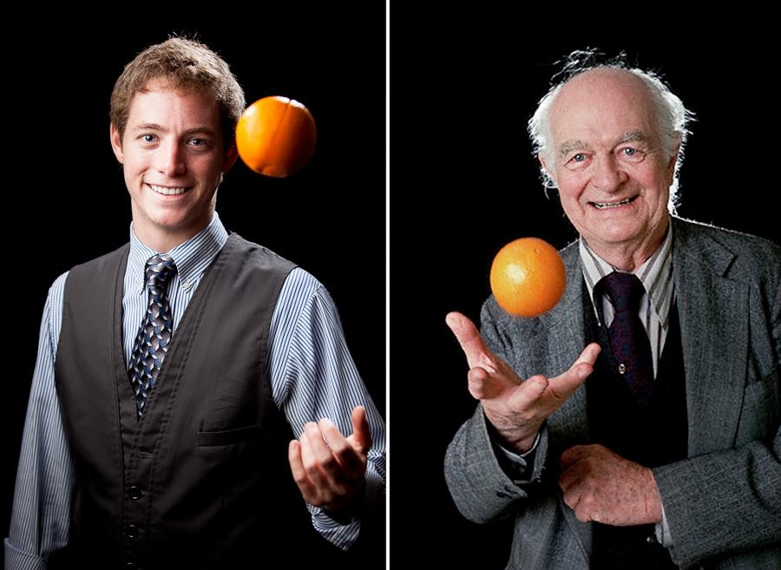
Thank You
Thank You
Dr. Linus Pauling

Slide 25
Additional Notes and Material

Slide 26
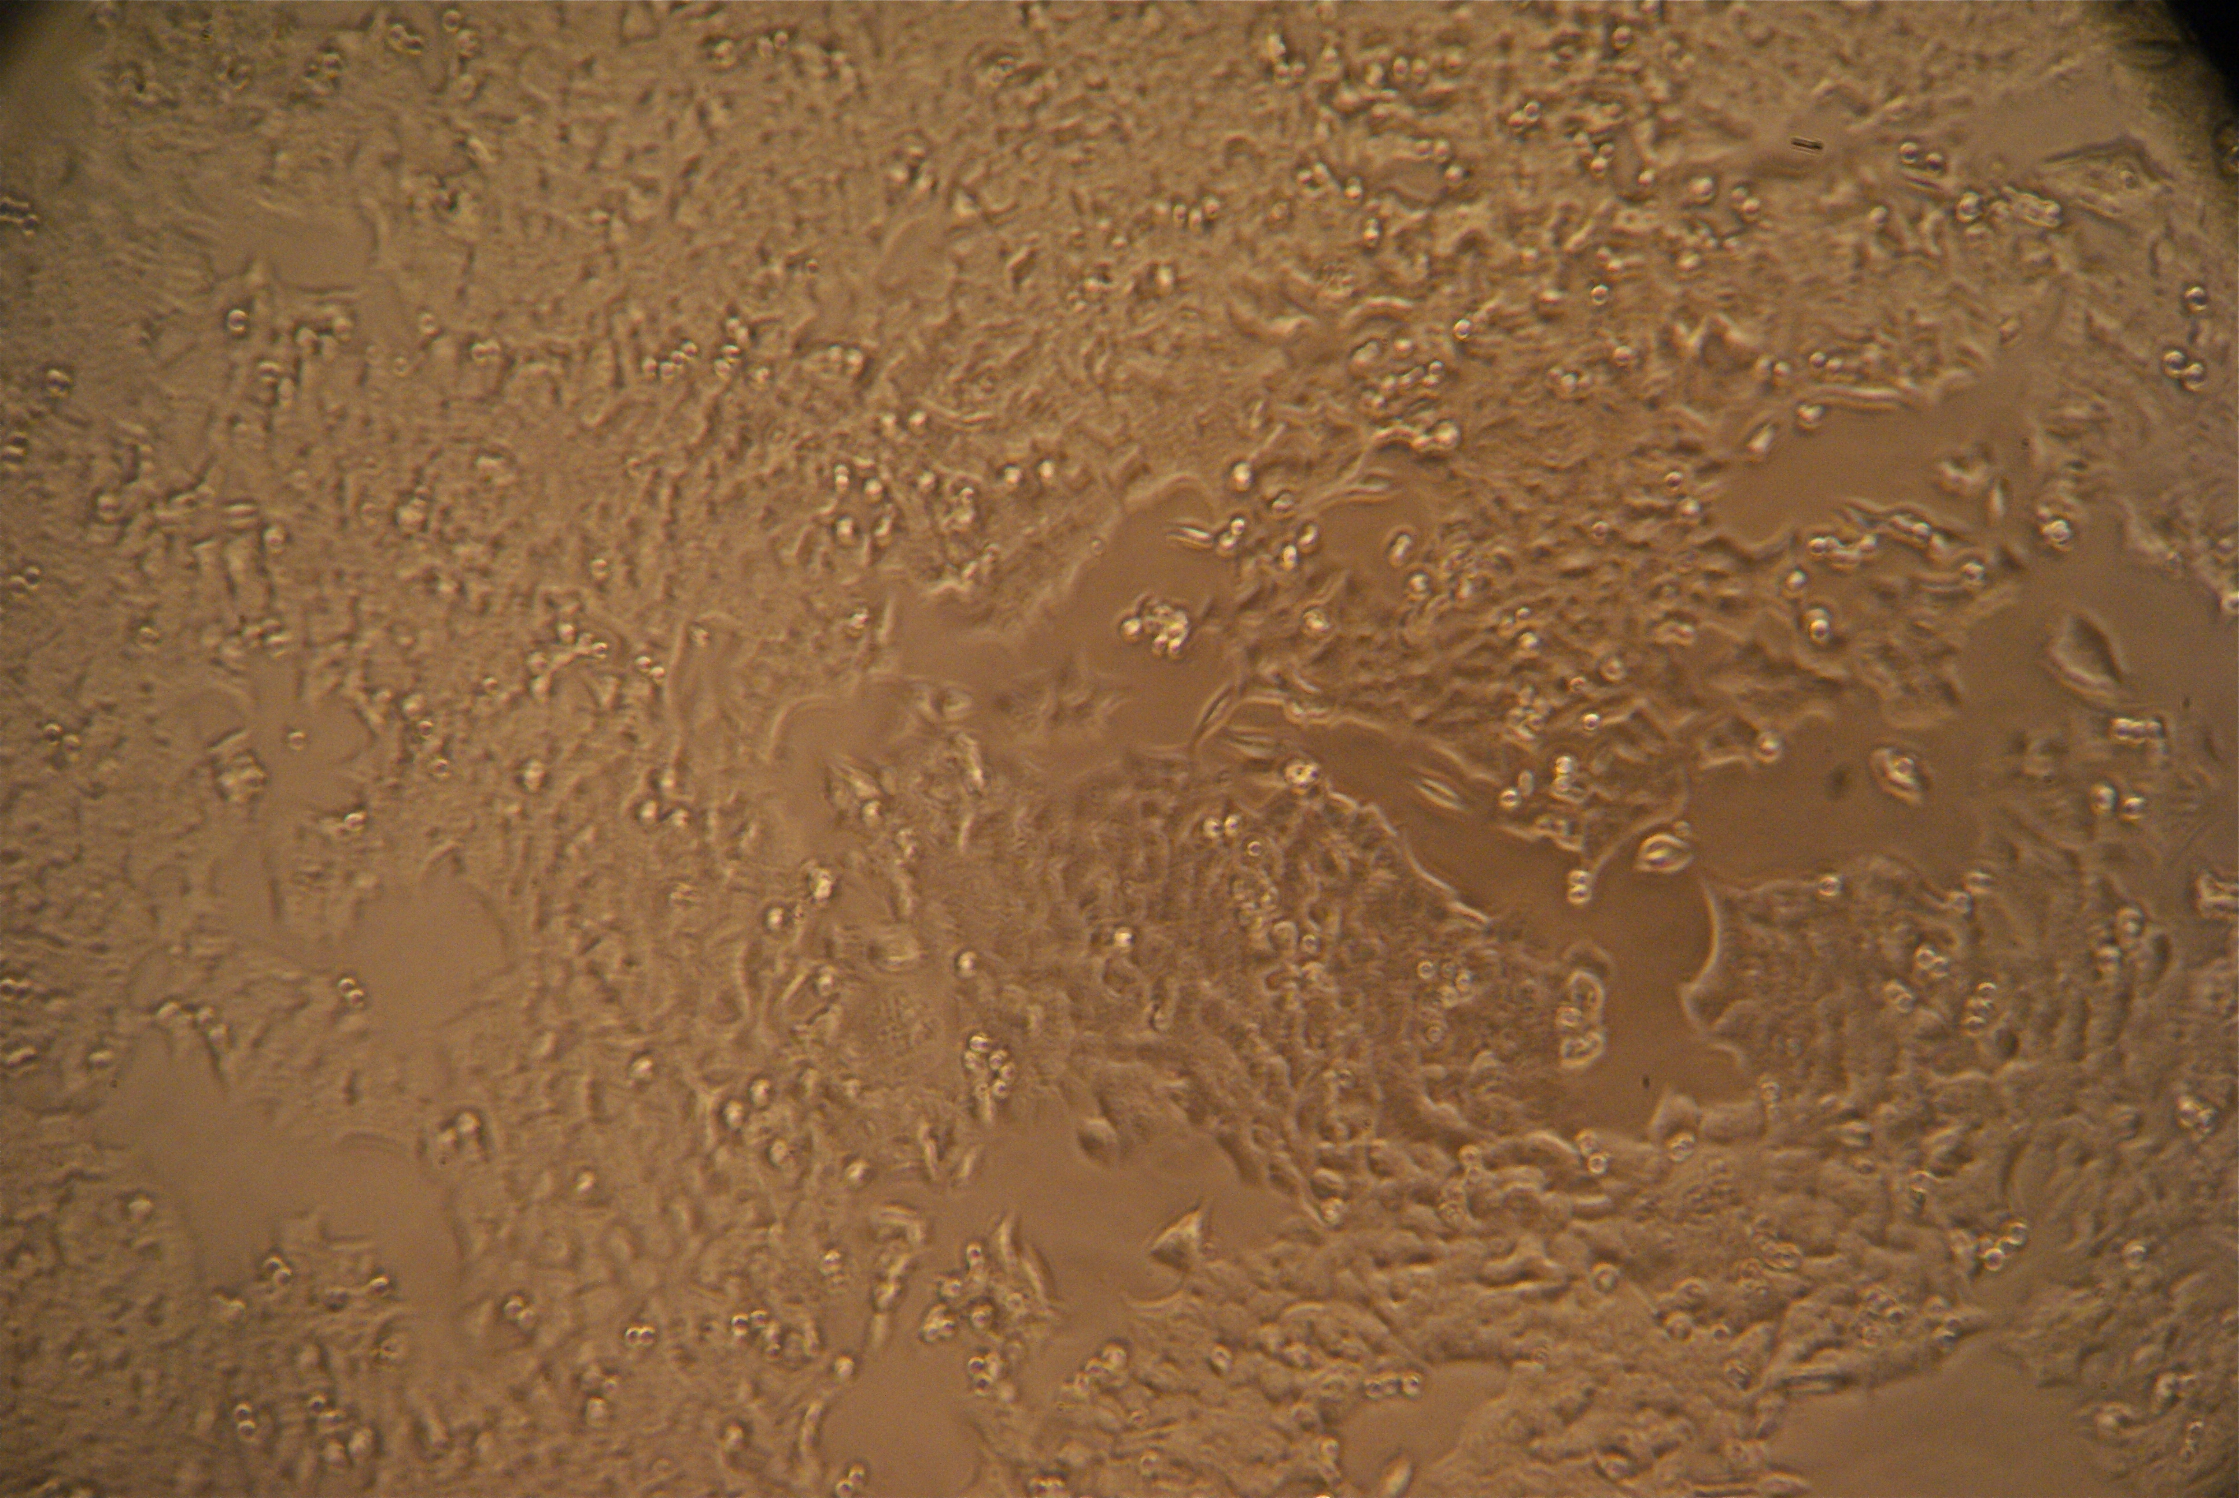
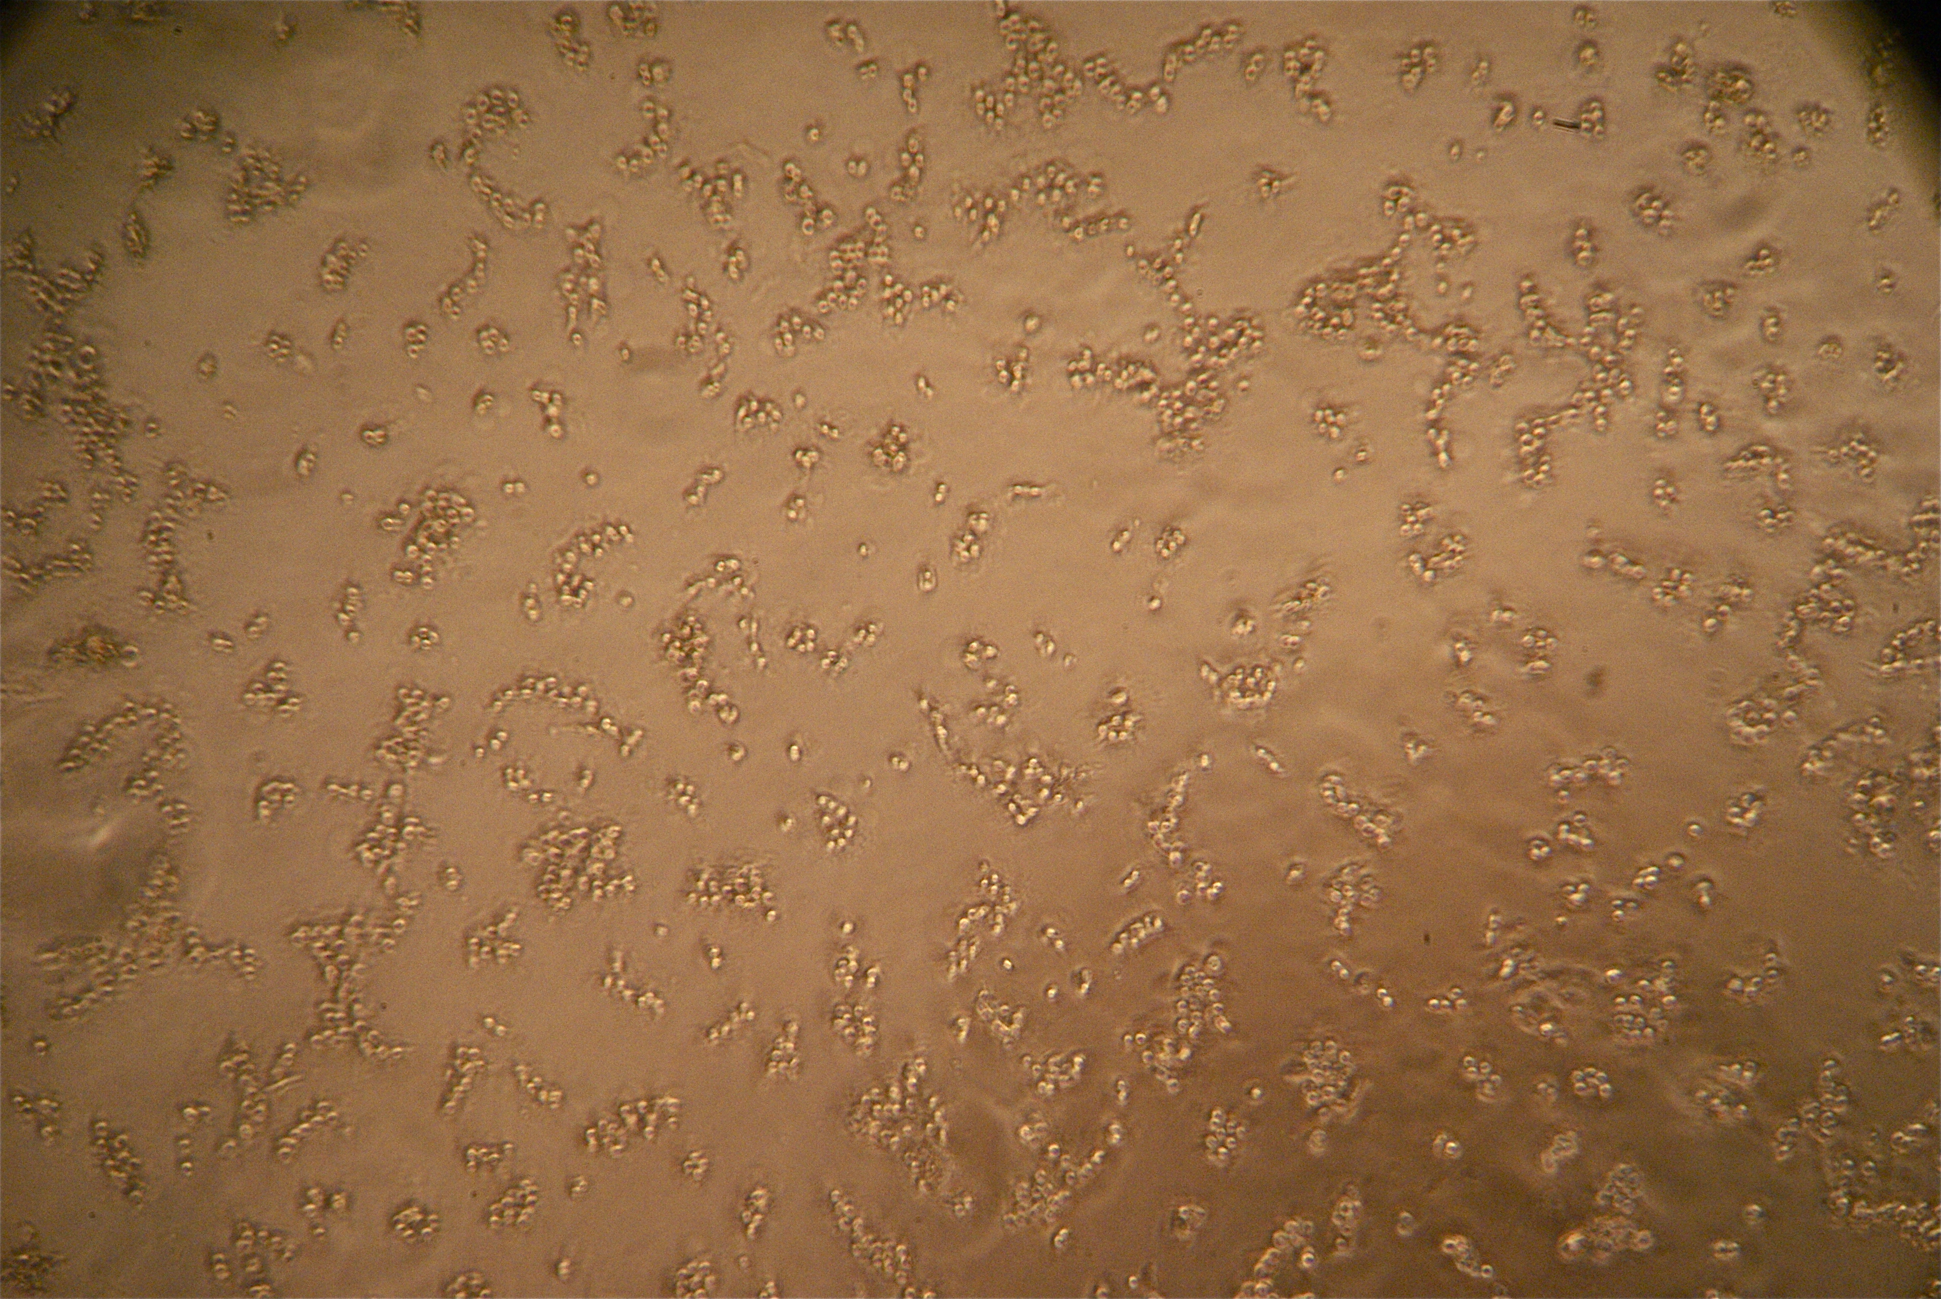
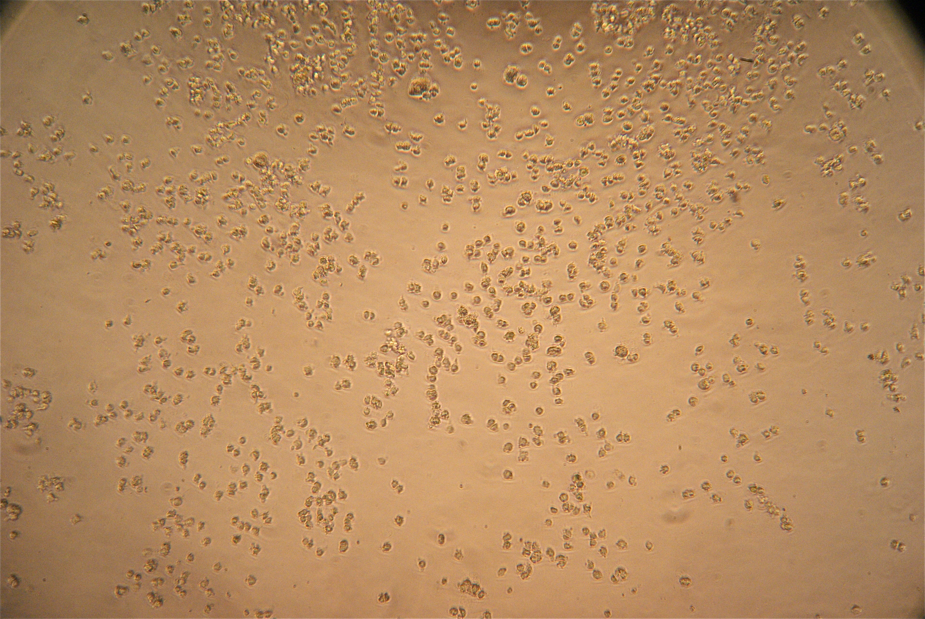
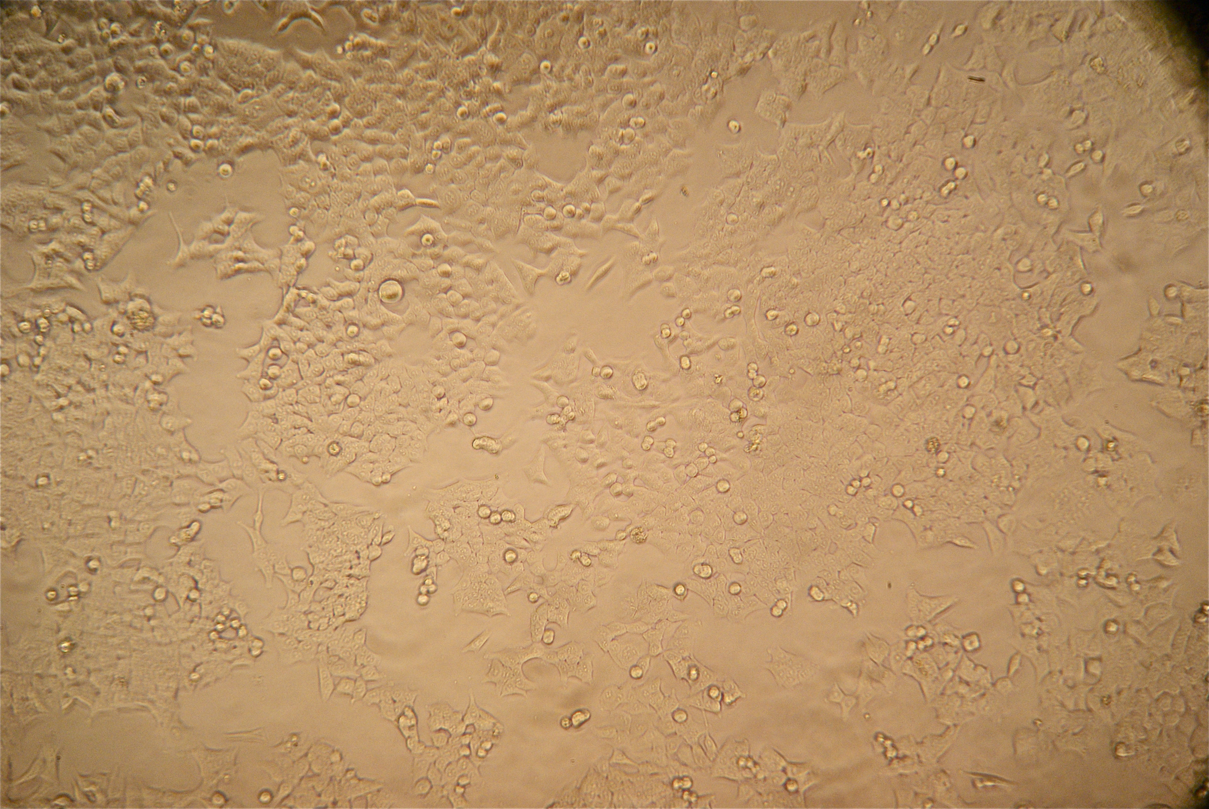
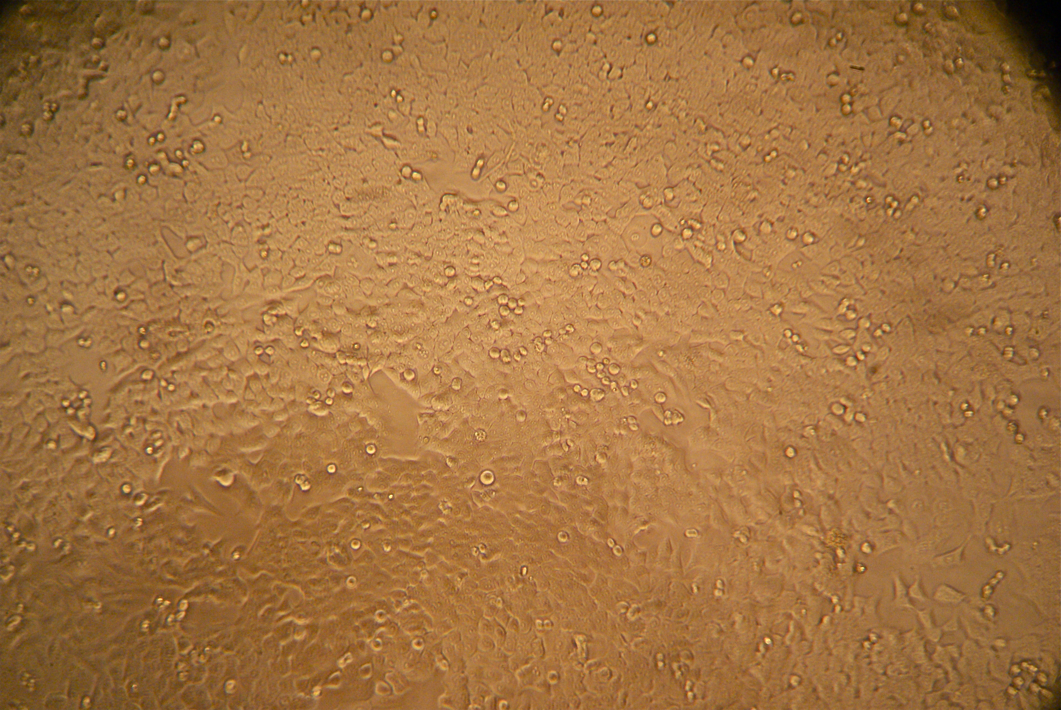
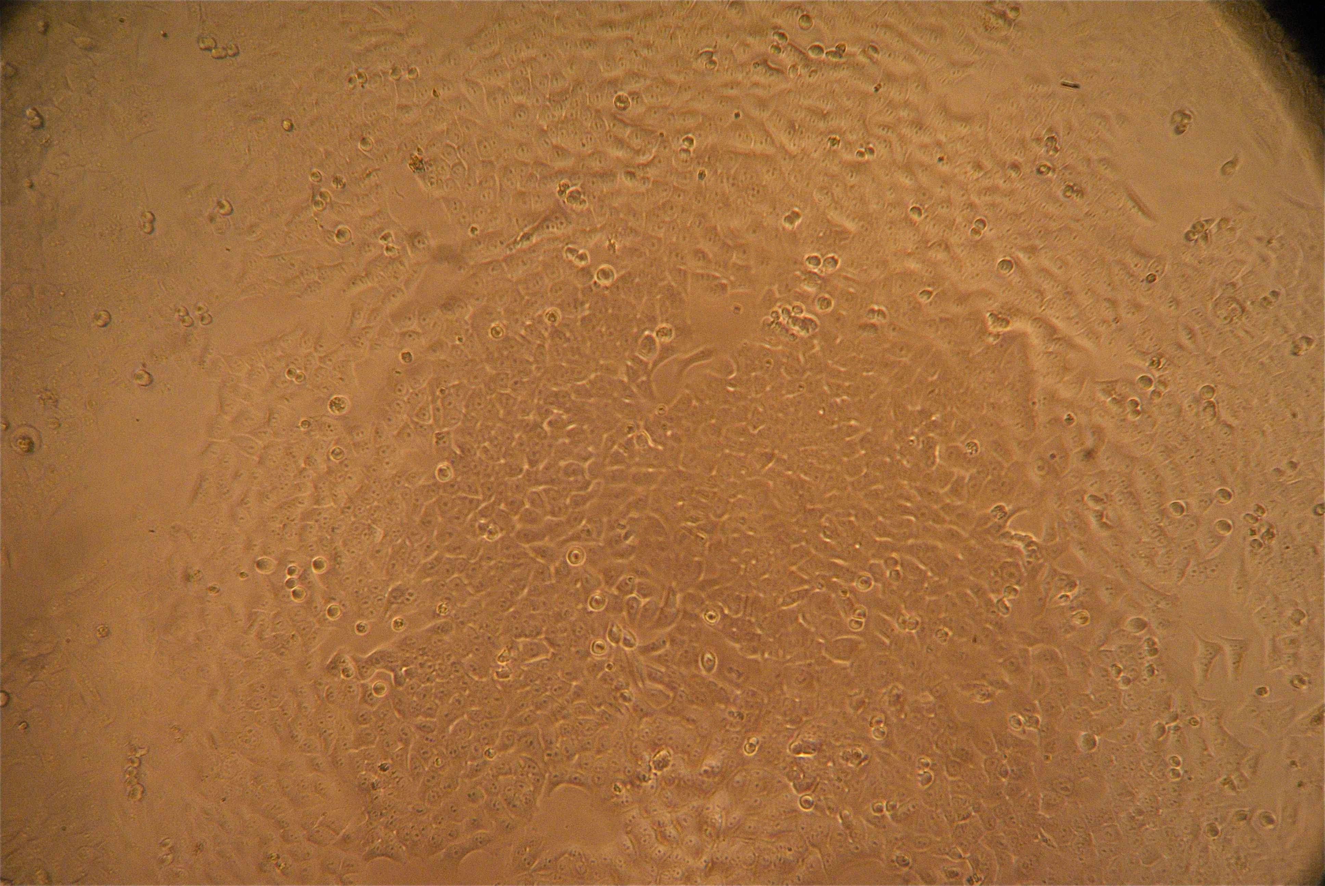
Changes in cellular morphology (HCT116)
No treatment
PharmAscorbate
H₂O₂
CAT (Catalase)
PharmAscorbate + CAT
H₂O₂ + CAT
These results provide preliminary evidence for a possible role of H₂O₂ in ascorbate-induced toxicity.
Notes:
Ascorbate and H202 treated cells displayed rounded morphologies, an indication of apoptosis, which as you can see is effectively blocked by catalase
Form colonies adhere to the plastic, but with treatment cells are rounded spread out/detached from the plastic
Changes in cell morphology with increase concentrations of Vit C
These results provide evidence supporting a fundamental role for H₂O₂ in ascorbate-induced toxicity.
Ascorbate and H₂O₂ induced cancer cell rounding, indicative of apoptosis, which was blocked by CAT

Slide 27
6Hr Whole-Cell Lysates of HCT116 and CCD841
HCT116
CCD841
Ascorbic Acid
Hydrogen Peroxide
Ascorbic Acid
CTR
2
4
8 mM
25 uM
50
100
200
400
CTR
2
4
8 mM
PARP
Catalase
H3

Slide 28
6Hr Whole-Cell Lysates of HCT116 and CCD841
HCT116
CCD841
Ascorbic Acid
Hydrogen Peroxide
Ascorbic Acid
CTR
2
4
8 mM
25 uM
50
100
200
400
CTR
2
4
8 mM
SIRT3
HDAC4
AcH4
AcH3
H3

Slide 29
6Hr Whole-Cell Lysates of HCT116 and CCD841
HCT116
CCD841
Ascorbic Acid
Hydrogen Peroxide
Ascorbic Acid
CTR
2
4
8 mM
25 uM
50
100
200
400
CTR
2
4
8 mM
P21
P53
H3

Slide 30
24Hr Whole-Cell Lysates of HCT116: Wt and P53 null
HCT116 Wt
HCT116 p53 null
Ascorbic Acid
Hydrogen Peroxide
CTR
2
4
8 mM
25 uM
50
100
200
400
CTR
SIRT3
SIRT1
Ph2Ax
H2Ax
HDAC6

Slide 31
6Hr Whole-Cell Lysates of HCT116 (2nd repeat)
Ascorbic Acid
Hydrogen Peroxide
CTR
2
4
8 mM
25 uM
50
100
SIRT1
SIRT3
SIRT5
HDAC1
HDAC4
HDAC6
β-Actin

Slide 32
6Hr Whole-Cell Lysates of HCT116 (n=2)
Ascorbic Acid
Hydrogen Peroxide
CTR
2
4
8 mM
25 uM
50
100
PH2Ax
H2Ax
AcH4
P21
P53
LCB3
β-Actin

Slide 33
6Hr Whole-Cell Lysates of HT29
Ascorbic Acid
Hydrogen Peroxide
CTR
2
4
8 mM
25 uM
50
100
SIRT1
SIRT3
SIRT4
p53
HDAC4
HDAC6
β-Actin

Slide 34
6Hr Whole-Cell Lysates of HT29
Ascorbic Acid
Hydrogen Peroxide
CTR
2
4
8 mM
25 uM
50
100
AcH4
H2AX
PH2AX
SIRT5
β-Actin

Slide 35
24Hr WCL of HCT116: Wt and P53 null
HCT116 Wt
HCT116 p53 null
Ascorbic Acid
Hydrogen Peroxide
Ascorbic Acid
CTR
2
4
8 mM
25 uM
50
100
200
400
CTR
2
4
8 mM
CytC
p53
P-ATM
PARP, Caspase-3, LC3B, Sirtuins – To do

Slide 36
6Hr Whole-Cell Lysates of HCT116
Ascorbic Acid
Hydrogen Peroxide
Ascorbate-2-phosphate
CTR
2
4
8 mM
25 uM
50
100
2
4
8 mM
AcP53
AcH4
PARP
β-Actin

Slide 37
6Hr Whole-Cell Lysates of HCT116 and CCD841
HCT116
CCD841
Ascorbic Acid
Ascorbic Acid
CTR
2
4
8 mM
CTR
2
4
8 mM
HDAC2
HDAC8
HDAC4
HDAC6
SIRT1
SIRT3
β-Actin

Slide 38
6Hr Whole-Cell Lysates of HCT116 and CCD841
HCT116
CCD841
Hydrogen Peroxide
Hydrogen Peroxide
CTR
25
50
100 uM
CTR
25
50
100 uM
HDAC1
SIRT1
pH2Ax
H2Ax
AcH3
H3
β-Actin

Slide 39
6Hr Whole-Cell Lysates of HCT116 and CCD841
HCT116
CCD841
Ascorbic Acid
Ascorbic Acid
CTR
2
4
8 mM
CTR
2
4
8 mM
CTip
Catalase
AcTub
HDAC4
CytoC
PARP

