Slide 1
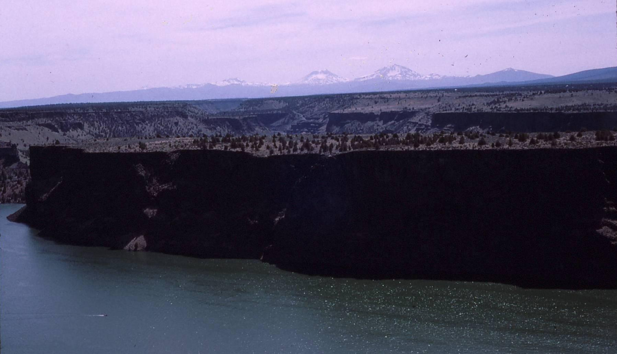
The Island
A Proposed National Natural Landmark
From eastern Oregon
Notes:
This presentation is about a unique Natural Area called, “The Island”, which is proposed as a National Natural Landmark from the Columbia Plateau of eastern Oregon. This is a photograph of the island looking southwest towards the Three Sisters volcanoes in the central Oregon Cascades (south and middle sisters are the large snow covered mountains in the middle. The snow covered peak below the n and d of “Island” in this slide is Broken Top.

Slide 2
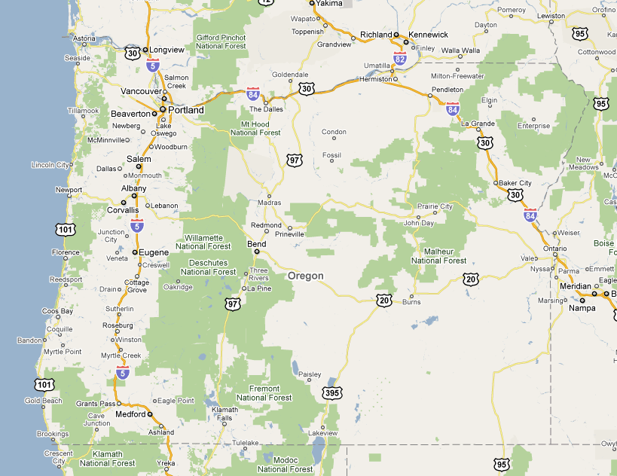
The Island is located near Madras, Oregon, in Jefferson County, 25 miles north of Bend
Notes:
The Island is located in central Oregon, in an area of plateaus and canyons sometimes called the high lava plains. It is not far from the small agricultural town of Madras, and the two booming recreational small cities of Redmond and Bend.

Slide 3
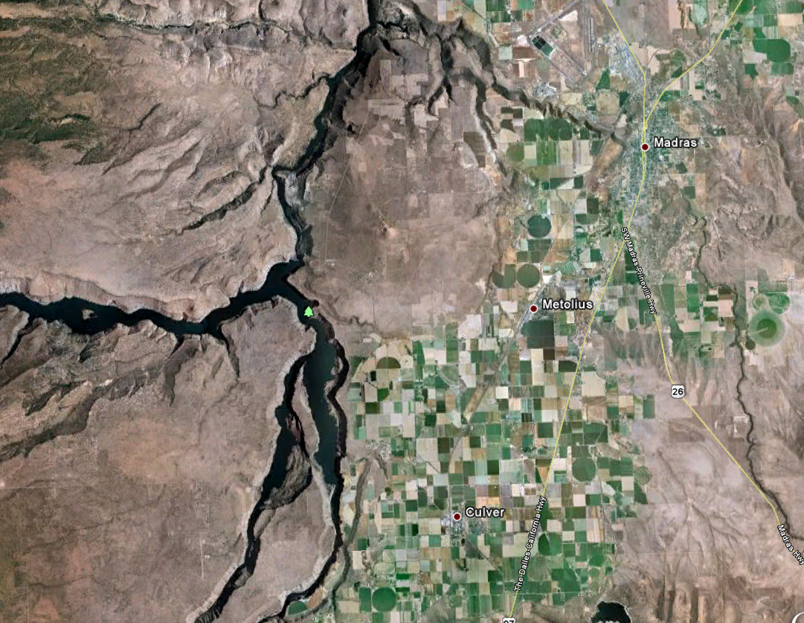
The Island is actually Peninsula, located at the confluence of the Deschutes River and the Crooked River, but is isolated and protected due to its geography. It looks like an island.
Notes:
The Island is located at the confluence of two major rivers in Eastern Oregon, the Deschutes to the west, and the Crooked River to the east. These rivers became part of Lake Billy Chinook with the construction of the Round Butte Dam, which can be seen just north of the Island in this air photograph from Google Earth. The Deschutes River continues almost due north to the Columbia River. The river that can be seen running west to east just north of The Island is the Metolius River.

Slide 4
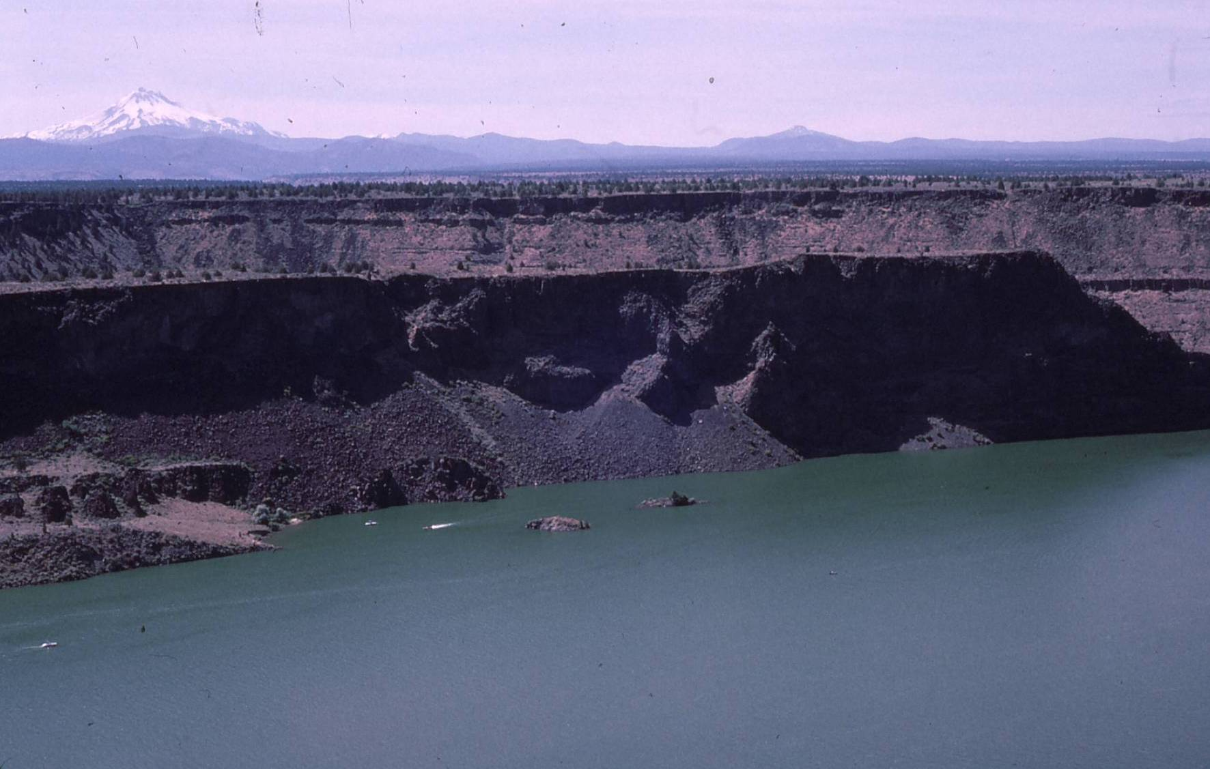
View of The Island from the east, looking across the Lake Billy Chinook and the Crooked River. The steep cliffs protect the area from disturbance.
Notes:
Mount Hood can be seen in the background, although The Island affords spectacular views of Mount Jefferson, and many of the other Cascade Mountain volcanoes.

Slide 5
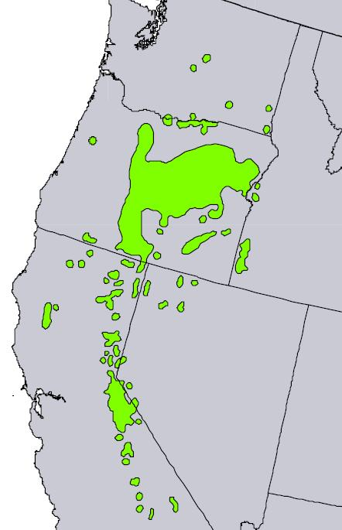
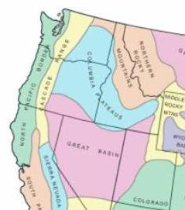
The Island is located in the National Natural Landmark’s Columbia Plateau Bio-physiographic Region
It occurs in the center of the global distribution of Western juniper (Juniperus occidentalis), shown in green (from Little’s 1971 atlas of U.S. Trees)
Notes:
The site and the North Pacific Border Region includes mostly the wet coastal Pacific Northwest conifer forests of Douglas-fir and western hemlock. But it also includes the open, interior valleys of Western Oregon and the Puget Trough in Washington, which were historically quite different. In newer ecoregional maps, the southwestern Interior Valley’s have been moved into the Klamath Mountains Ecoregions of northern California and Southern Oregon, also part of the North Pacific Border Region.

Slide 6
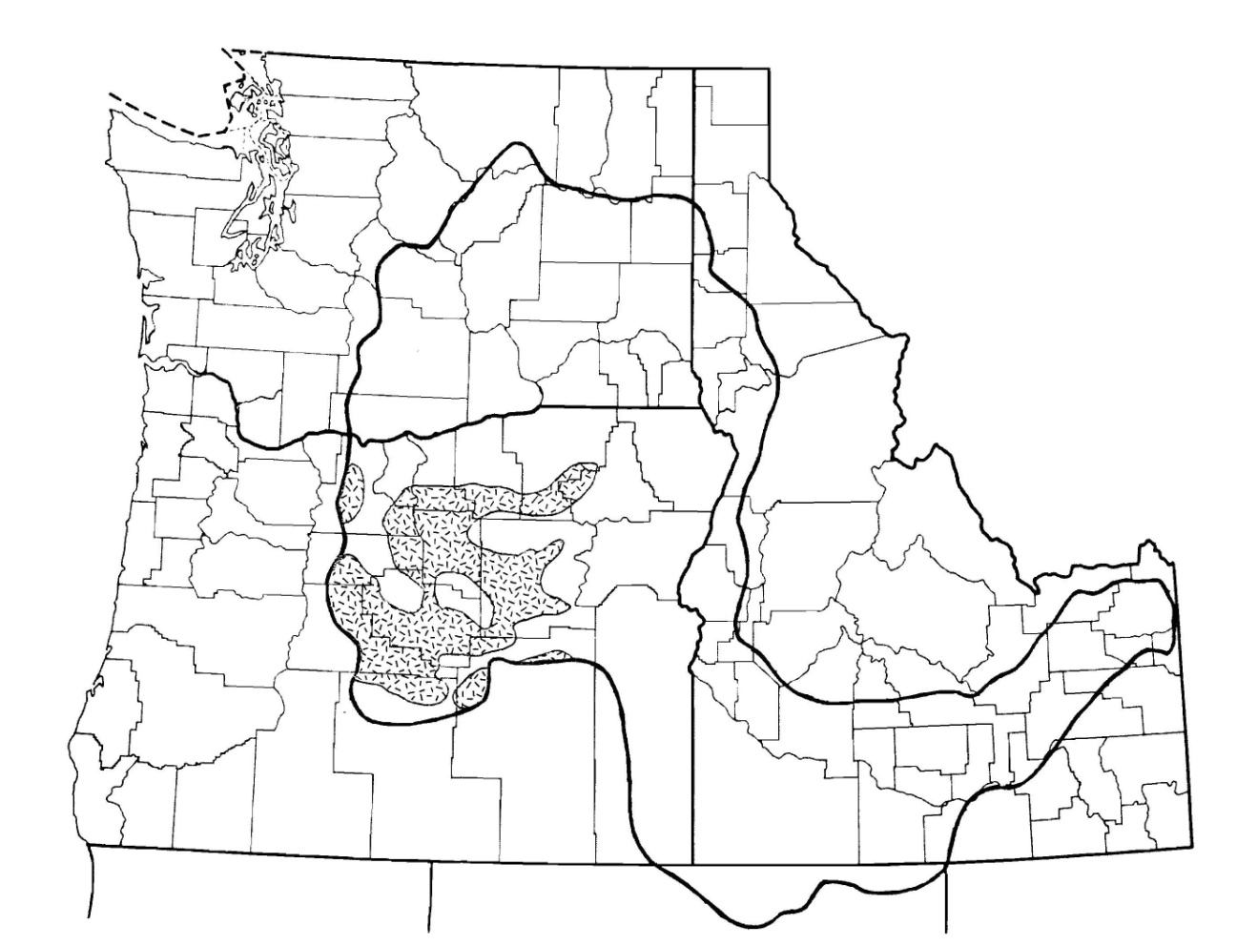
Distribution of the “Pumice Western Juniper Steppe” subtheme
Notes:
The Island is the representative of the “Pumice Western Juniper Steppe” Subtheme. The “Montane Western Juniper” Subtheme represents the other part overall Western Juniper Theme from the Columbia Plateau Bio-Physiographic Region. This map is from the 1987 Theme Study. In Oregon, much of this area had been named the High Lava Plains by Franklin and Dyrness in their 1973, Natural History of the Oregon and Washington.

Slide 7
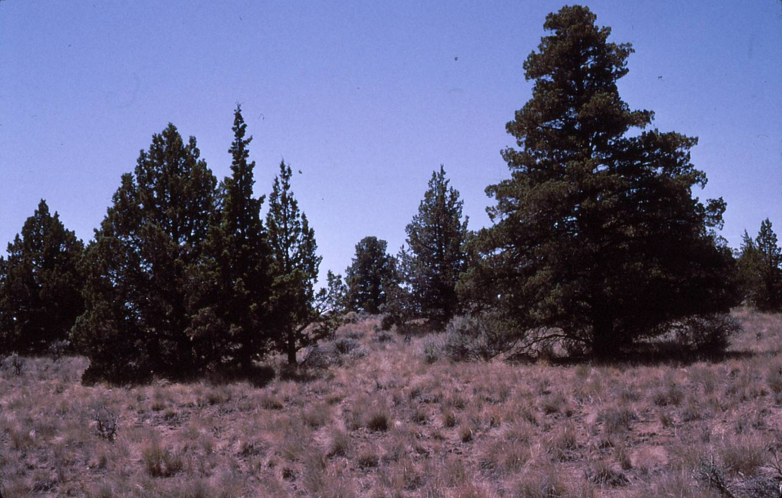
Western Juniper woodland
Notes:
While the site is a mix of open juniper woodlands and steppe, The Island is recommended as a National Natural Landmark because its geography and history has left it remarkably undisturbed. This is an example very high quality native juniper habitat on the relatively flat top of the peninsula. The large juniper on the right side of this photograph is probably over 500 years old.

Slide 8
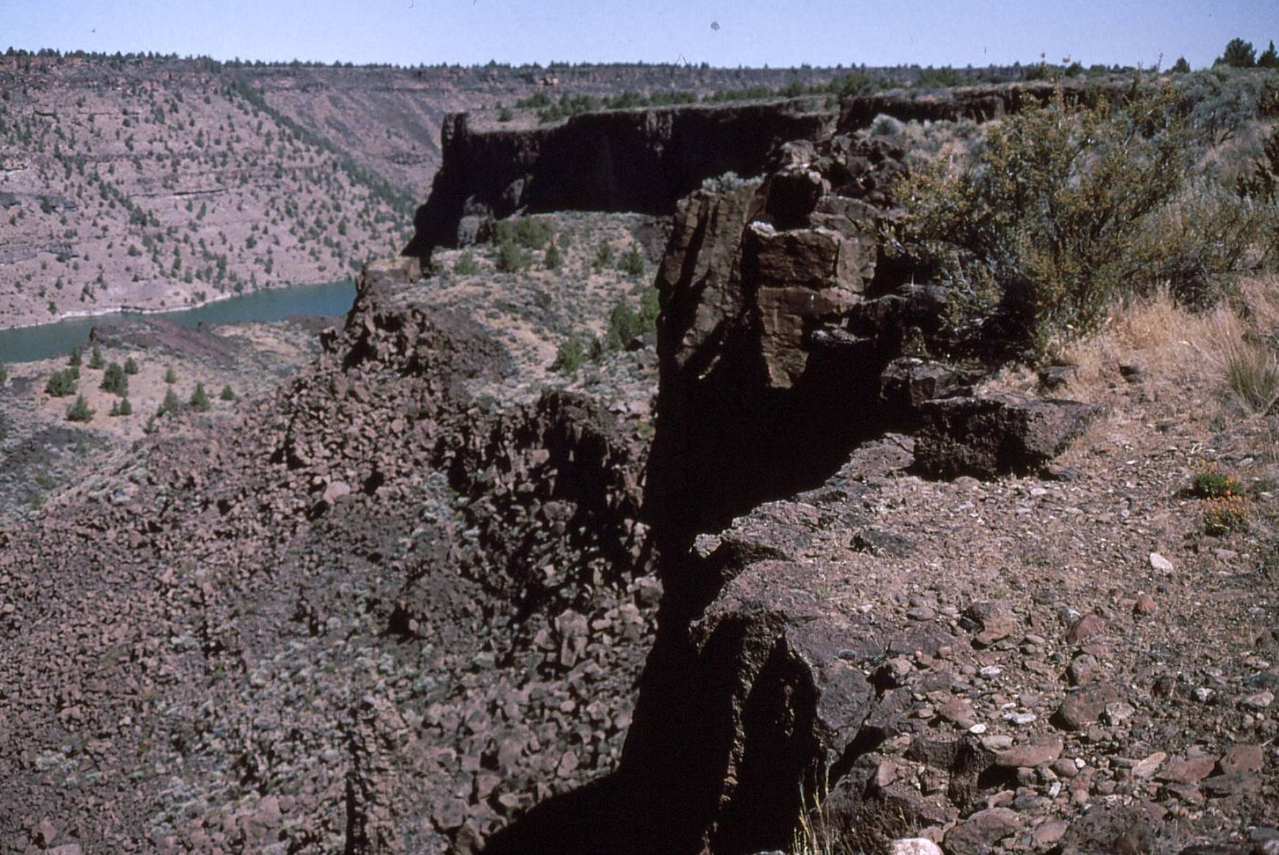
While the entire area is characterized as Western Juniper steppe, it is locally quite diverse
Notes:
The Island and the lands around it are characterized by a mix of open western juniper woodlands and shrub steppe dominated by bitterbrush (Purshia tridentata) seen in the foreground by the cliff in flower (with yellow flowers) and big sagebrush (Artemisia tridentata), the grayish shrub behind the bitterbrush. There are extensive canyon slopes and basalt cliffs where exposed lava rocks are largely un-vegetated.

Slide 9
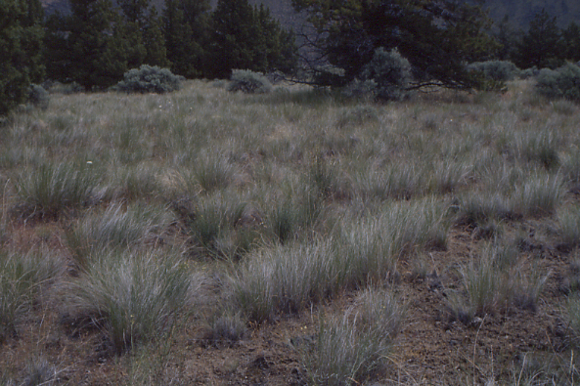
Low cover of shrubs and trees are characteristic of pristine stands
Notes:
Also characteristic of pristine sites is the moss and lichen cover in between the bunchgrass.

Slide 10
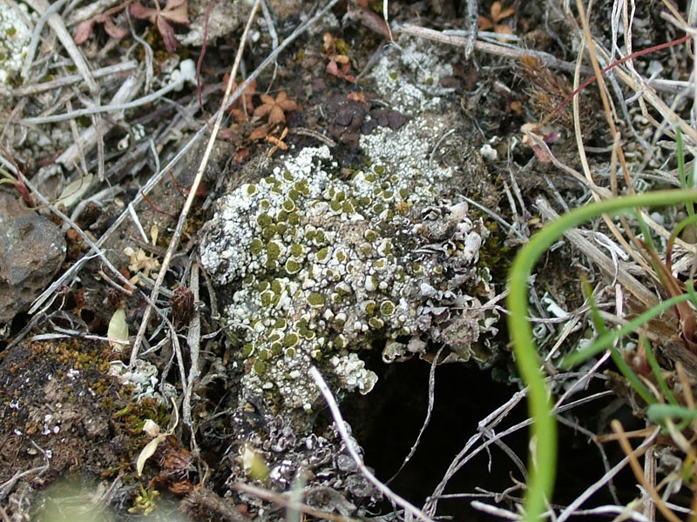
The rare woven-spored lichen (Texosporium sancti-jacobi) is found growing between the bunches of native grasses at The Island.
Notes:
One of the sensitive species is a crustose (hard, ground-growing) lichen named woven-spored lichen (Texosporium sancti-jacobi). This is an image of this lichen taken by Rick Demmer from the U.S. Forest Service.

Slide 11
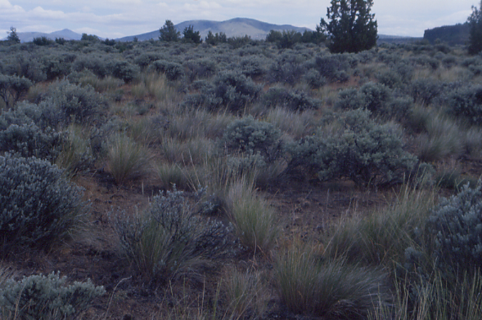
The sagebrush steppe and Western Juniper steppe are dominated by bluebunch wheatgrass, and are in pristine condition ….one of the least disturbed sites anywhere
Notes:
This pictures shows what sagebrush steppe and juniper steppe is supposed to look like. The large bunchgrasses in these arid environments are extremely sensitive to overuse by domestic livestock, particularly cattle and sheep. With overgrazing, these bunchgrasses are replaced by the introduced annual grass, cheatgrass (Bromus tectorum).

Slide 12
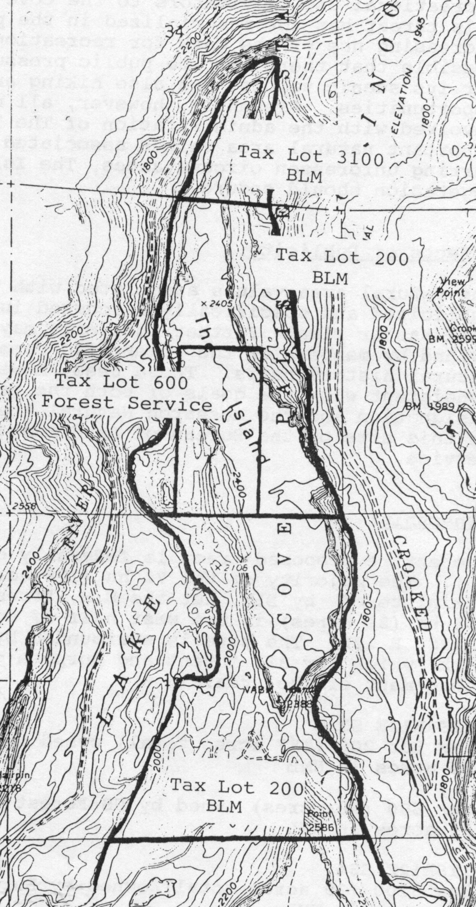
The Island – Ownership
The proposed NNL is 208 acres.
The majority of the area is administered by the BLM, but the Forest Service manages about 17 ha (42 acres), tax lot 600.
The site is surrounded by Cove Palisades State Park, which acts as a “gate keeper” and oversees day to day management of the area.

Slide 13
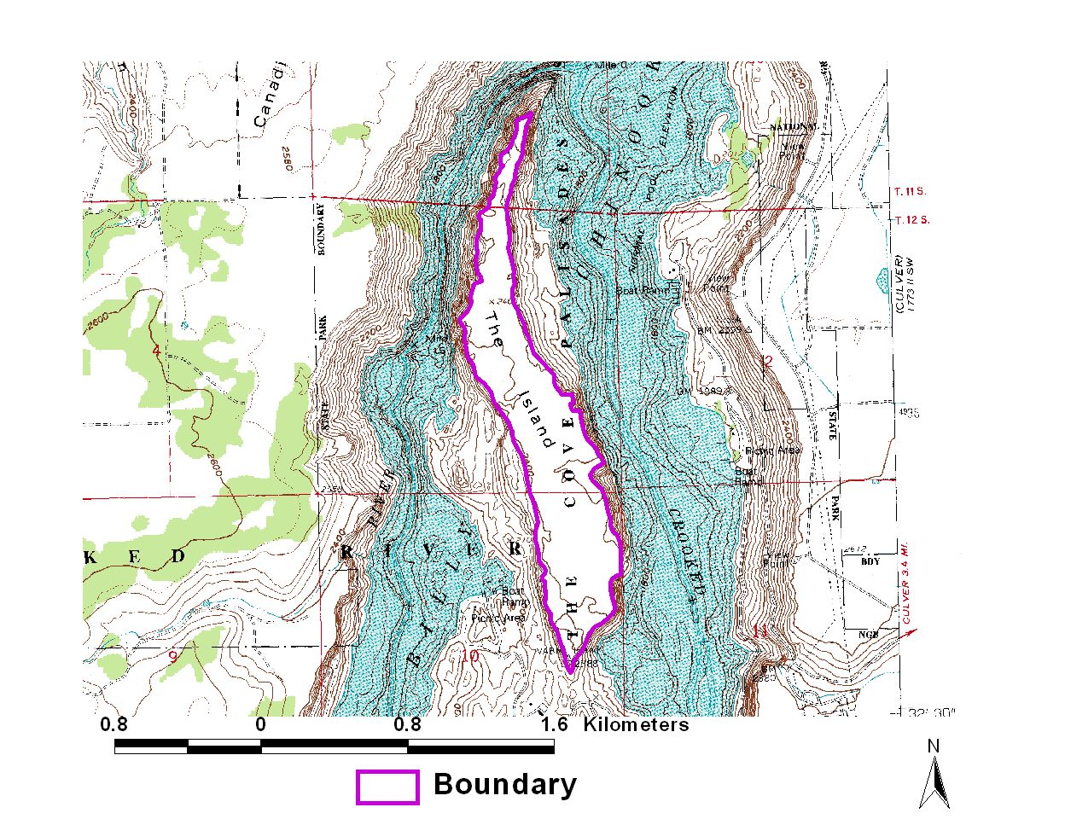
Notes:
The Boundary of the Proposed NNL is the boundary of the established or proposed Research Natural Area, which was established to cover the entire top of The Island.

Slide 14
The Island Management and Access
Notes:
Access to The Island is controlled by the Oregon Parks and Recreation Department, through their Cove Palisades State Park. The trail to the park has been officially closed, except for research purposes. Research permits have issued, and visitation information is available. Since the trailhead was closed in 1997, the average is 46 visitors per year.

Slide 15
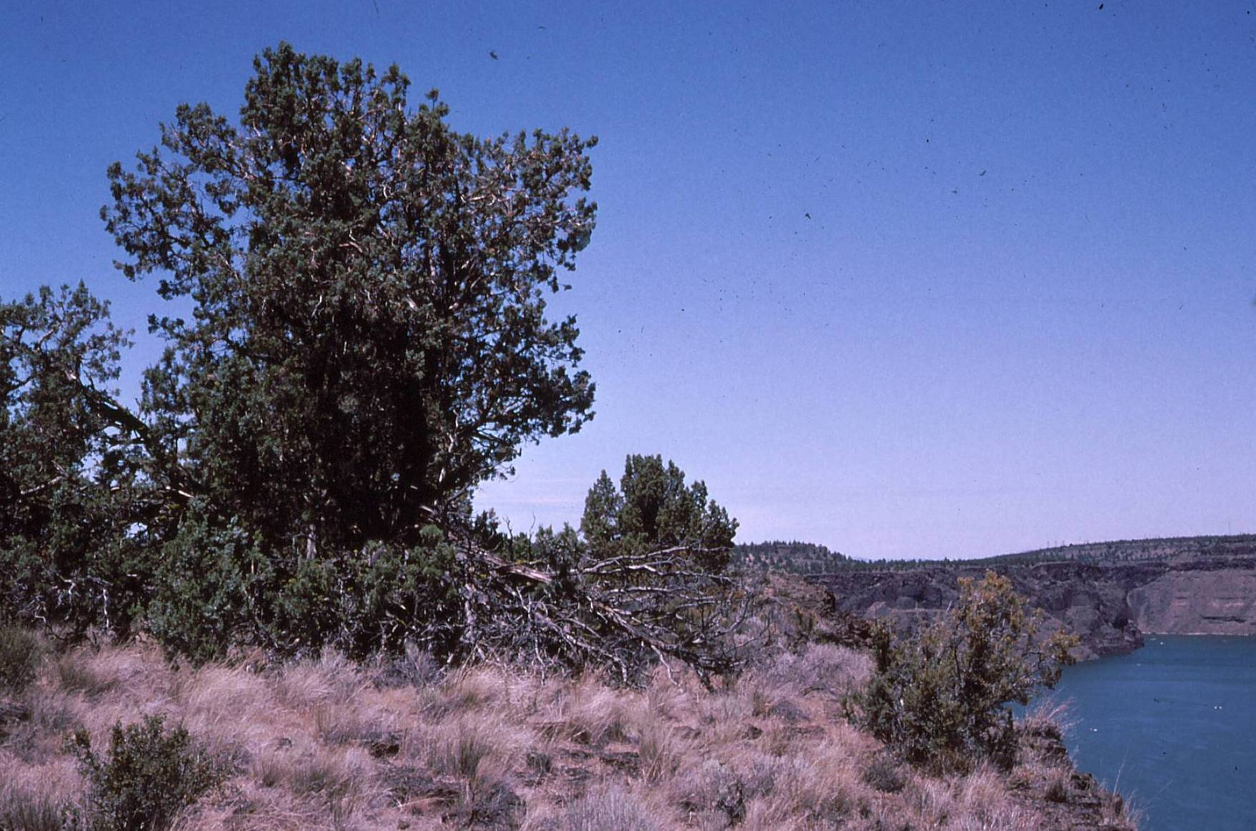
Notes:
The Island is a unique and spectacular natural area, and an excellent candidate as a National Natural Landmark.

