Slide 1
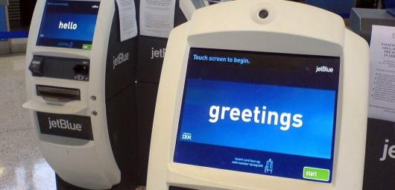
Learning from Safeway and Jet Blue: Libraries and Self-Service
| Online NW, 2009
| Hannah Gascho Rempel and Margaret Mellinger, OSU Libraries
Notes:
http://flowingdata.com/2008/07/13/my-ugly-experience-with-the-jetblue-kiosk/
Margaret
Welcome to our presentation on libraries and self –service. Hannah and I have divided the presentation into three parts
The evolution of self –service technologies
An overview of a self-service project we did at OSU Libraries, and
A discussion of the advantages and disadvantages of self-service technologies in libraries.
***************************************************************************************
Our culture has been shifting toward an expectation of self-service for over a decade. In banks, grocery stores, gas stations and airports, people are becoming accustomed to self-service. Libraries have also joined this larger trend by implementing ways to allow patrons to interact with services in a disintermediated manner if they so choose. At Oregon State University Libraries, we hoped that a video demonstration kiosk of commonly performed but sometimes difficult tasks, such as using the e-scanners, adding money to a copy card or using databases, would help patrons learn how to use our tools better and might help make them more confident library users. As a result, we created a point-of-service video pilot project.
In addition to describing the pilot project at Oregon State University Libraries, we will review self-service options in public and academic libraries and other public places. We will discuss some of the reasons to adopt self-service, such as being responsive to a variety of learning styles, giving patrons more autonomy, and the need to use staff time judiciously. We will also address technological aspects involved in implementing these types of services.

Slide 2
Part 1
Evolution of Self-Service Technologies
Notes:
Margaret
We’ll get started by talking a little bit about the background of self-service technologies

Slide 3
Notes:
Margaret - 2 minutes up to here…
The concept of disintermediation is the precursor to self-service technologies. It is often characterized as “removing the middleman,” and it’s been happening in a number of arenas for years. The term disintermediation came from banking in 1970s when people began to buy securities directly without going through a broker. The classic example is the printing press, but that was just the beginning of disintermediation of media – a more current example is how patients can use Web MD or Medline Plus to gather information about their medical symptoms without going through their doctor.
Disintermediation and user independence as a trend, appears to have been largely missed by library futurists up until the 1980s , but in fact it may not have been missed, so much as dismissed. Disintermediation as an approach was seen as a direct challenge to the librarian’s identity as an intermediary between the user and the universe of information. This view places a librarian’s central role as service point and gatekeeper. In 1980, as personal computers were becoming more common, Eugene Garfield said that “The role of the library will in no way be diminished by these new systems and the service they offer. I cannot envision information retrieval as being entirely self-service!” Imagine someone saying that in the age of Google.
While library futurists may not have seen the disintermediation that was coming, the rest of society was busy doing it.

Slide 4
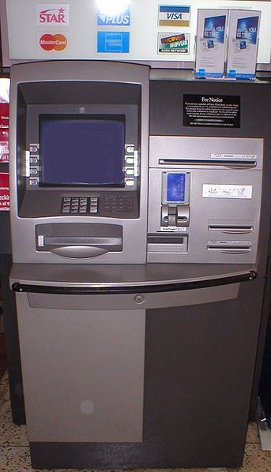
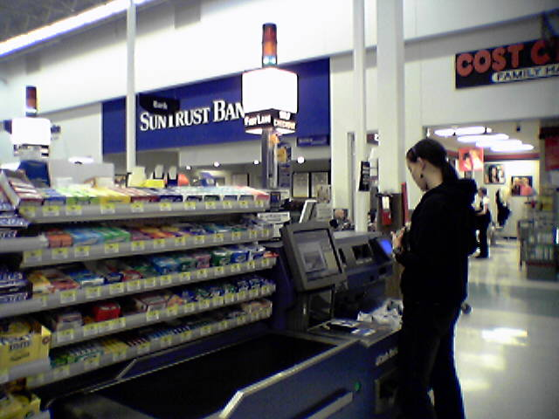
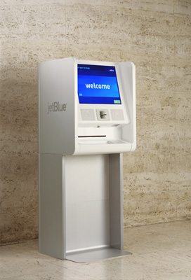
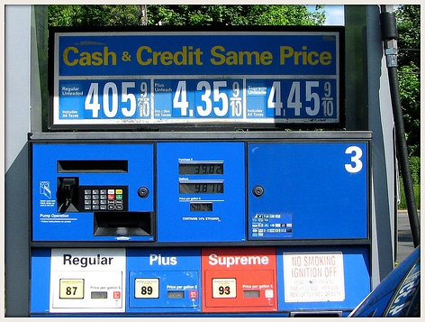
Notes:
Hannah
US culture has been shifting toward an expectation of self-service for decades. In banks, grocery stores, gas stations and airports, people are accustomed to self-service. Business researchers predict that self-service will continue to be a critical component of customer interactions.
What are some of the self-services you have noticed lately?
http://www.flickr.com/photos/gembone/2506448840/ (gasoline)

Slide 5
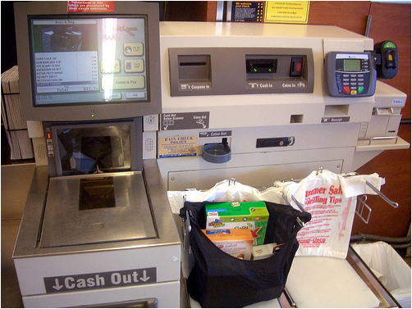
checking out
saralynncantor
| self-service options
| grocery stores
Notes:
Hannah
I will briefly illustrate some of the self-service options in businesses that have become ubiquitous as well as successful. Businesses have been rapidly implementing self-service technologies. As consumers, we have grown used to seeing self-service options in so many places, sometimes we may forget that there used to be other, more human-mediated ways of doing business.
Grocery stores have long been evolving toward a more self-service model. They have transitioned from the Little House on the Prairie days when everything was behind the counter, to getting items off the shelf by yourself, to checking things out yourself.
In 1999, only 6% of supermarkets had self-checkout lanes; in 2003, 38% did . Some of the major grocery stores and stores such as Home Depot say that about a third of shopping trips to their stores now end at self-checkout machines. There are holdouts. Safeway, has rejected the idea of self-checkout because of their customer service values – greeting, home delivery. (which is ironic since we used them in the title of our talk as an example of a grocery store self-check out. Since then, we’ve decided that we meant to juxtapose Safeway with JetBlue’s model).
I n addition to self checkout, which most of us are used to seeing, there are some new innovations appearing in select stores such as a Pay By Touch system, in which you can pay with a fingerprint This used by the Piggly Wiggly chain in S. Caro and Some Giant grocery stores and other grocers now offer handheld devices that let customers scan items and view a running total as they shop.

Slide 6
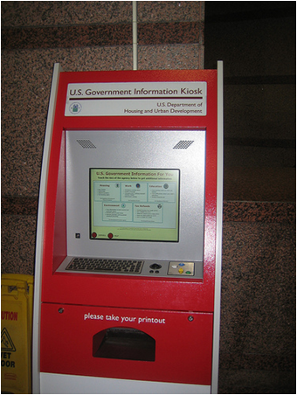
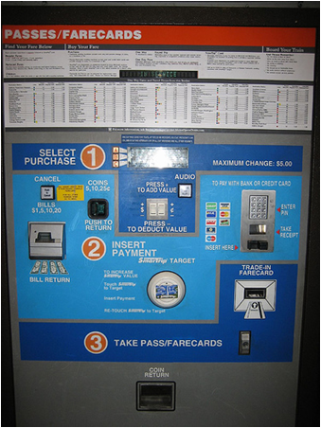
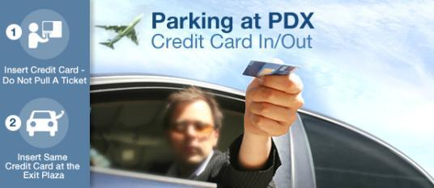
| self-service options
| transportation
Notes:
Hannah
Transportation and government services also commonly use self-service technologies for routine tasks such as buying stamps, paying for airport parking, or buying a subway ticket. These self-service kiosks can range from fairly sophisticated computer screens to older push button options. More of the work is shifted to the consumer who must take the time to read the instructions on the screen and work through the steps to get the service they desire. Customers expect that the trade-off for navigating through the self-check machine is that the line for the machine is faster than the line being managed by a human.

Slide 7
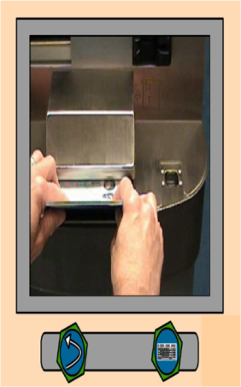
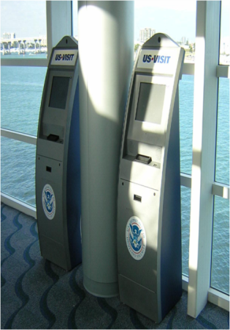
interfaces that require non-linguistic cues
| self-service options
| transportation
Notes:
Hannah
US Government Airport Passport Fingerprinting
It isn’t only the consumers who must put some effort into using self-service technologies. Developers of these interfaces must pay careful attention to their users needs and go through significant usability testing to make sure customers can use these machines with limited guidance. One example we found was of a U.S. Government Airport Passport Fingerprinting machine. The targeted audience were people arriving in U.S. airports, who might be non-English speakers who were likely to be unfamiliar with American culture, with little formal education and little to no experience with computers. As a result, these developers could not use words, numbers, left-to-right ordering, or Western symbols, like check marks in the directions.
In the end these designers created a video to show users how to complete the process, and made sure the video didn’t advance until the person had completed the task. And as a side note, the department in charge of this self serve unit ended up deciding to have people staff these kiosks as well instead of requiring travelers to use it on their own.

Slide 8
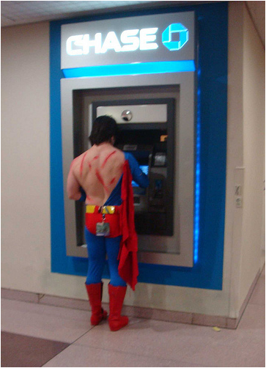
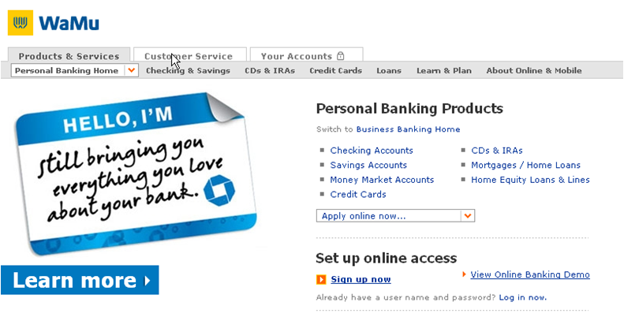
| self-service options
| banking
Notes:
Hannah
Self-serve banking options, particularly ATMs have been used widely since the 70s and have been found to not hurt bank loyalty. Rolph Anderson, a Drexel University marketing professor, said that he doubts self-checkout machines would hurt other businesses. "When you're offering options, even if they aren't used, it just makes people feel you're more accommodating, more caring," he said.

Slide 9
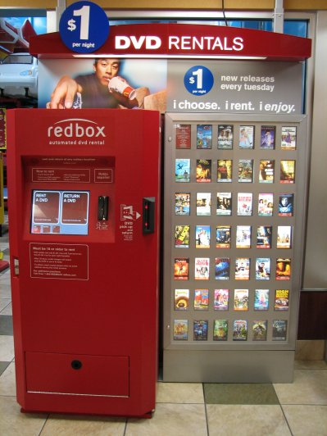
movie rentals…
at McDonald’s
| self-service options
| retail
Notes:
Hannah
A more recent self-service technology is the automated check out of movie rentals. How many of you have used one of these? Well, the main self-check movie rental company, Redbox, started as an afterthought to a convenience store type kiosk that would dispense sandwiches and other perishable food items. On the side, they also dispensed movies. The perishable food dispensing part flopped, but the movies became very popular and can now be found at fast food restaurants and grocery stores.

Slide 10
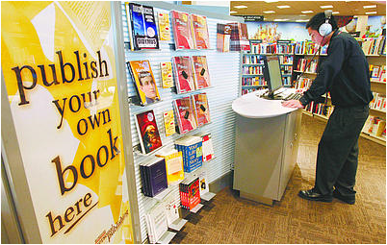
print on demand
burn your own CDs
print your own books
| self-service options
| retail
Notes:
Hannah
Bookstores may be another place where self-service technologies will start popping up. At a concept store in Ann Arbor, Michigan, Borders bookstore offers a variety of self service technologies. They allow customers to burn music CDs; download music, audiobooks and e-books; and print photos. While much of this is not entirely new, Borders intends to make the process accessible to older, non -- tech-savvy customers by having staff on hand to help.

Slide 11
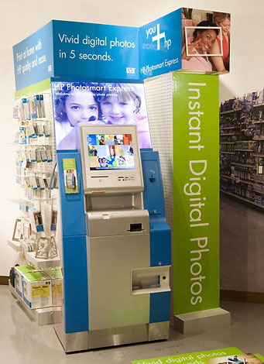
Print photos from memory cards or online photo-sharing services
| self-service options
| retail
Notes:
The last business self-service option that I will feature is the option to print photos from memory cards or straight from an online photo-sharing service like Picasa or Flickr. Connecting self-service technologies with Web 2.0 tools will be an interesting field to keep an eye on, and something that librarians in particular may want to pay attention to.
Hannah 5 minutes for these slides… 7 minutes total

Slide 12
Provider Perspective
Advantages
Disadvantages
Reduce overall costs
Improve service delivery
Staffing
System failures
Weakens customer loyalty
Initial costs
Notes:
Margaret
A 2003 article by Curran et al. in the Journal of Service Research details advantages and disadvantages of self-service technologies from both the provider and customer point of view. The biggest advantage for providers is that SST’s can reduce costs and increase productivity. Providers like that self-service technologies can increase the speed of delivery of a service, while offering more precision and customization. One of the ways this happens is that with self-service, businesses are able to shift staff responsibilities from lower level to higher-level tasks. Some self-service technologies can also increase customer satisfaction and loyalty and enhance a company’s reputation for using technology to reach customers.
There are some decided disadvantages, as well. When there are failures in the service encounter, self-service technologies are far more limited than human counterparts in the ability to troubleshoot a problem. While self-service may provide a more consistent customer experience, it can also make it more difficult to build strong bonds with consumers – the researchers recommend bundling self-service technologies with other richer customer experiences to help forge those bonds. The costs, fees and maintenance for self-service technologies make it critical for providers to understand how and why customers use them.
Curran, et al. 2003. Intentions to use self-service technologies: a confluence of multiple attitudes. Journal of Service Research 5 (3): 209-224.

Slide 13
Consumer Perspective
Advantages
Disadvantages
Time-saving
Convenience
Control
Easy to use
A threat
Technology anxiety
Prefer to deal with people
Notes:
Customers like self service technologies because they save time and reduce waiting in line, they are more convenient than alternatives, or are in convenient locations, they provide a level of user control and are easy to use. Some users experience enjoyment from using technology, and others like that it allows them to avoid contact with a provider’s staff.
Potential disadvantages are that some people are highly anxious and uncomfortable around technology and see the introduction of it into the service encounter as a threat. A percentage of people (especially older people) see the service encounter as a social experience and therefore prefer to deal with people. Others do not see significant benefit to taking the time to learn a new technology and will continue to do things as they always have.
While we are not suggesting that libraries are or should be like businesses, we are approaching this topic as part of a larger societal trend. As Karen Coyle has said: The future of libraries is inherently integrated with the future of a larger context: economics, technologies, social developments. It seems that libraries have not adopted self-service at the same rate as businesses – in the physical library, anyway. --- here are some examples of physical self-service points in libraries.

Slide 14
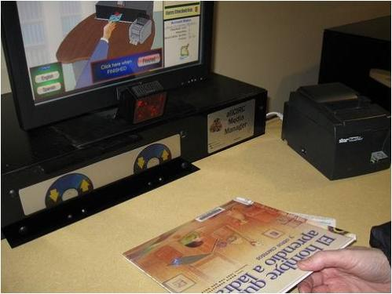
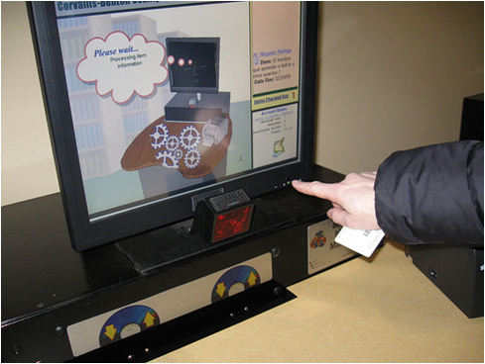
checking out
| self-service options
| libraries
Notes:
Margaret
Now we’ll look at some instances of self-service technologies in libraries. Everyone will recognize the most common example – the self-check machines that have been in libraries since they were introduced in 1993 by 3M. One of the first libraries to adopt self-check was the Westerville Public library in central Ohio.
http://www.westervillelibrary.org/help/about/
Thousands of units are now in widespread use, probably in your own library. This example is from the Corvallis Benton County Public Library, where a recent remodel expanded the number of self-check machines and reconfigured the service desks. With the change to this increased system of self check, they have gone from 35% self check to 80% self check (they went from 35 to 60% in the first 2 weeks)
Librarians embrace self-check technology for two main reasons—improving service for patrons and increasing the efficiency of their limited budgets. At CBCPL, there was an element of cost-savings in their decision to go with self check: it has helped with staffing. Staff are no longer trapped behind the desk and can help patrons locate things like large print for example, they get out more, they get to do more one on one work with patrons, and they really like it. –There are still three people in the lobby area – but only one is behind the customer service desk, the other two are a lobby ambassador, and one rover. Reactions to the new arrangement have been overwhelmingly positive with a few exceptions… at one town hall meeting a few people did say that it feels like they’ve “taken all the people away”

Slide 15
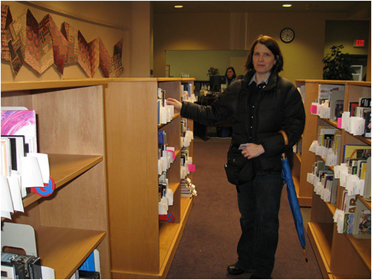
self-service holds at Corvallis Benton County Public Library
| self-service options
| libraries
Notes:
Margaret
In addition to the expanded self-check options, Corvallis Public Library has also instituted self-service holds. Patrons place their own holds online using their library account numbers. When holds are processed, they are placed in open shelving units in the lobby for patrons to pick up at their convenience. (and take to the self-check machines, if they wish). The community uses this service to the tune of 20K holds/month, and even with 9000 holds that are not picked up each month, the staff time saved by not having to retrieve holds from behind the service desk is considerable.

Slide 16
Notes:
Margaret
Photo credit http://cliftonparklibrary.greentouchscreen.com/
An example of a different sort of self service technology is found at the Clifton Park-Halfmoon Public Library in Clifton Park NY where a new LEED certified Green library was built in 2006. To showcase some of the environmental features of the building, they created and installed a touch screen kiosk in their atrium entrance. The kiosk also has floor plans and other library information
{GreenTouchscreen® hardware requires two things to operate: a standard high speed internet connection made available through an RJ-45 jack located within 20 feet of the kiosk and a standard electrical outlet located within 10 feet of the kiosk. It is recommended that a power strip with a surge protector and/or an interruptible power supply be used for the kiosk.
19″ wall mounted kiosks require a dedicated CPU within 10 feet of the touchscreen monitor. This size can not be operated from a remote CPU or server due to lag time from touch to monitor reaction. All large format displays have an integrated CPU into the touchscreen monitor.}

Slide 17
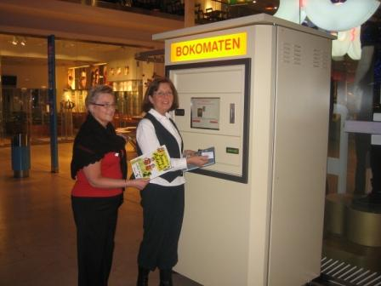
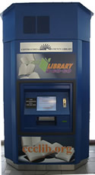
| self-service options
| libraries
Notes:
Margaret
In California , the Contra Costa Library has installed self-contained book lending machines in two Bay Area Rapid Transit (BART) stations. They call this service “library a-go-go” The Units are very much like an ATM or the Red Box DVD and hold about 400 volumes. Anyone with a Contra Costa Library Card is able to check out and return books via Library a go-go. Contra Costa library system is using the units in areas where commuters congregate, but is also considering using them in areas of the county where no library services exist.
“Library-a-Go-Go offers passengers a library experience that is fast, available at convenient hours, easy to use and customer focused.” says Joel Keller, a BART director. They see it as a way to bring books right to the people.

Slide 18
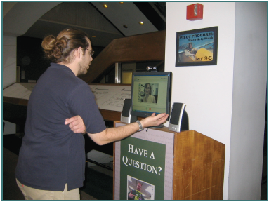
| self-service options
| libraries
Notes:
Margaret 7 minutes or now we are up to 14 minutes
A couple years ago, Char Booth, Chad Boeninger and other librarians at Ohio University Libraries piloted a project using Skype for reference assistance. One aspect of the pilot was to add a voice over IP option for virtual reference. Another aspect was to address reference needs within the library building. The reference desk is situated in the learning commons on the 2nd Floor, far away from where patrons seemed to be needing help. The circulation, reserves and ILL services are on the 4th floor entrance. So they placed a kiosk running Skype on the 4th floor. Librarians covering chat or email reference staff the video kiosk, at the same time, and if there were reference questions at the circulation area on the 4th floor, patrons could be referred to the video kiosks.
Booth presented this project at the CNI Fall Meeting in 2007 . She noted that patron reaction to the technology was “mixed but promising.” Users were not sure what the kiosk was for, so the team needed to refine the signage on the kiosk to make it very clear. Keeping an open video connection was also disarming for librarians who are not entirely comfortable being on-screen. Booth talked about the importance of the location and configurations of video kiosks and the need for staff training.
The call-in service requires fewer resources than staffing an additional service point. Kiosks could are promising as ways to connect branches to reference services in a main library, or as a way for different service points to communicate and refer questions.

Slide 19
Part 2
OSU Libraries Project: Point of Service Help Screen
Notes:
Hannah
So now, I’d like to briefly describe the self-service pilot project Margaret and I worked on at our library. We (along with some other colleagues) had been talking about how opportunities for new student orientations to the library had been diminishing and how it is impossible for a library staff member to orient students to all of the features in the library anyway. We starting brainstorming about some additional ways we could help students learn how to use various tools in the library without necessarily asking a person for help. In other words, we were trying to think of some type of self-service technologies to teach repetitive, often frustrating tasks.

Slide 20
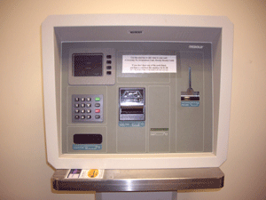
project background
Notes:
Hannah
We applied for and received an in-house grant and began working on a pilot project to provide a point of service video help screen in our copy room next to a machine that frequently baffles our patrons – the add money to your copy card or ID machine. The idea was if the pilot went well, then we could expand the service to other areas as well.

Slide 21
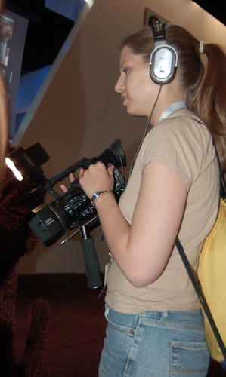
scripting, filming, editing
Notes:
Hannah
Our next step was to create the instructional video that would play on the kiosk next to the add-value machine. We solicited the help of several reference desk student workers to create the video. We gave them an outline of what we wanted, and because they frequently worked with patrons who struggled with the add-value machine, they could see why this project made sense. We asked the students to create a script for the video to guide the actions needed. Then we arranged for them to check out a video camera from our multimedia services group and film someone walking through the steps of adding money to a card. Luckily one of our reference desk students was in a film editing class, so she was able to edit the video for us as well. That all sounds pretty straightforward – in reality, coordinating with our student workers was a much more time consuming process than we had anticipated.

Slide 22
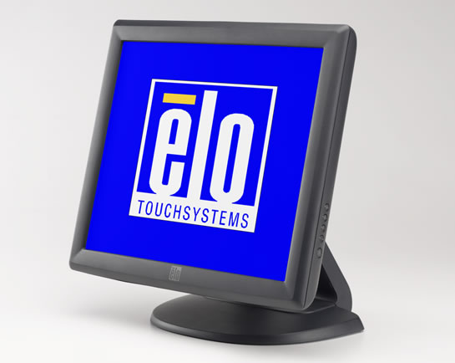
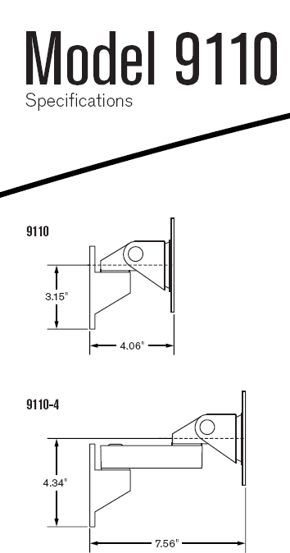
technology
Notes:
Margaret
For this project, we were able to use an existing touch screen and PC. We had to order a part for the touch screen to install it on the wall. Although Hannah felt fully capable of installing arm and screen with her trusty cordless drill, we went through the proper channels and got the proper people to properly install said arm and monitor. We also needed to get an internet port turned on to be able to send the video over the internet to this monitor. Library Technology was helpful to us in all these steps, but even with the advantage of existing hardware, tech support and someone to install, it took months to get through all the steps.
Given that most kiosks and self-check machines are computers, you can expect the same sorts of problems with them as you have with any computer. Crashes, hard drive failures, software problems, interoperability problems, support issues. We tried to think these through beforehand, but as we were learning along the way, things went awry at times.
If we were going to buy this equipment, it would break down to
Touch Screen: 400- over $1,000.
CPU: $400
Arm: $120
Installation: $80
Video equipment: $500-600
Student time: $500 - $800
Port activation and maintenance fee: don’t know but something…

Slide 23
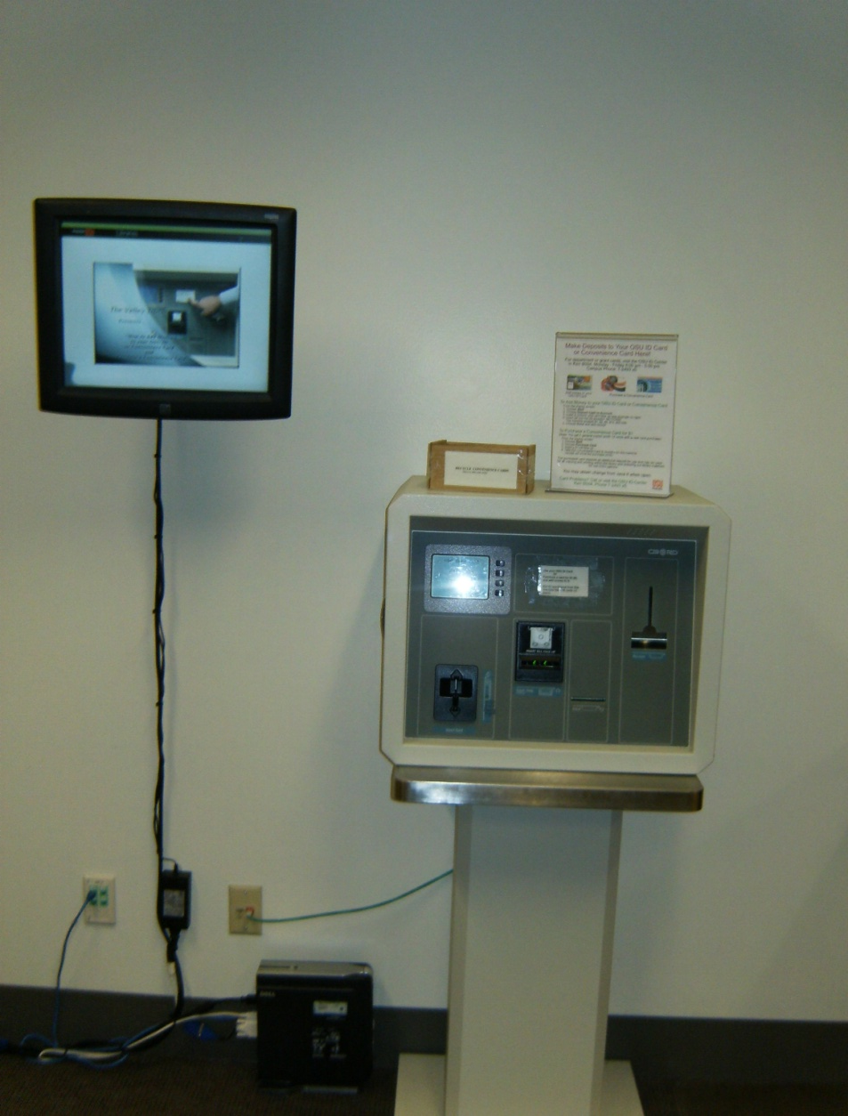
technology
Notes:
Margaret
Here’s what our current set-up looks like. It’s not the most elegant configuration… the CPU is sitting on the floor, the cords are visible… and the add-value machine is an old monster…
One thing we didn’t really think about in advance was accessibility --- this is a pilot project, but if it becomes more permanent or we make another, we must lower the monitor down to 33 -38 inches so that someone using a wheelchair could start it. We should also consider adding sound to the video, as some people tend to like auditory instructions.
We’ve been having some trouble with the screen getting stuck and the video not being in the position to start. We have been collecting web statistics since the beginning of the year but we find that they are inconclusive and we’ll need to look at that further.

Slide 24
current
version
Notes:
Margaret 6 minutes for this section: {20 minutes total}
Don’t play the whole thing.
http://osulibrary.oregonstate.edu/POS/POS_screen.html

Slide 25
Part 3
Self-service technologies and you
Notes:
Margaret
Now we’ll switch gears and have a discussion about some of the assumptions people make regarding the positives and negatives of self-service in libraries.

Slide 26
Q
Questions
A
Agree
D
Disagree
E
Examples
Notes:
Hannah
So as Margaret said, we will be having a discussion. In order to hopefully make the discussion more interesting we’re going to do an activity called listening with a task in mind.
People with Q's will come up with questions – mainly for future thinking
People with A's will make statements that agree with the assumptions we make
People with D’s will counter the assumptions we make
People with E's will generate examples of the points we make
Each group will report out after a few minutes.

Slide 27
"The rush to self-service, the current fad of library administrators, is robbing libraries of one of their unique and very important qualities. It separates libraries from other agencies and institutions of life in modern society: city hall, the motor vehicle department, the supermarket, and even the doctor's office and the pharmacy. It is the guarantee that when patrons use a library, they will be afforded human interaction with people who are smiling, like their jobs, and know they are there to help. It takes a trained, educated human to make certain the patron's encounter with the library is as rich as possible, especially those first and final bits of business, checking borrowed materials in and out."
Notes:
Hannah 2 minutes to read and 5 minutes for discussion {29 minutes up to here}
There is a tension in the library world about the role of self-service… we going to read two excerpts that illustrate two different ways of viewing the place of self-service in libraries.
In LJ in 2004, John Berry wrote an article called "Dehumanizing the Library: We lose more than we save with self-service"
He states:
"The Rush to self-service, the current fad of library administrators, is robbing libraries of one of their unique and very important qualities. It separates libraries from other agencies and institutions of life in modern society: city hall, the motor vehicle department, the supermarket, and even the doctor's office and the pharmacy. It is the guarantee that when patrons use a library, they will be afforded human interaction with people who are smiling, like their jobs, and know they are there to help. It takes a trained, educated human to make certain the patron's encounter with the library is as rich as possible, especially those first and final bits of business, checking borrowed materials in and out."

Slide 28
There is no doubt that self-checkout options allow greater productivity for library staff. With an increase in demand for public library services at the same time that library budgets remain stagnant, or are even being cut, greater productivity gains are vitally important. What may not be apparent is that by freeing up staff from routine, time-consuming tasks, self-checkout systems allow for greater personal interactions . . . .
Notes:
Self-Service at Your Library (And Now at PLA)
There is no doubt that self-checkout options allow greater productivity for library staff. With an increase in demand for public library services at the same time that library budgets remain stagnant, or are even being cut, greater productivity gains are vitally important. What may not be apparent is that by freeing up staff from routine, time-consuming tasks, self-checkout systems allow for greater personal interactions.
Self-service also has an impact on recruitment and retention of staff. Public libraries search out employees with customer service experience and expertise, yet often these same staff members must spend the bulk of their day handling routine clerical transactions and not working on the public service floor. This can be extremely frustrating for folks who truly enjoy personal interactions and can ultimately lead to retention issues.
Circulation is not the only transaction that may be handled by the library user. In many libraries, users can place their own reserves and renew items online or by phone; and in some libraries, users can even pick up reserves from lockers or sealed envelopes, all without any interaction with a staff member. Other libraries have self-return machines, sometimes combined with sorting equipment. Still others have begun to use automatic payment machines to free staff from, collecting fines and allowing users to privately settle their accounts. Again, no interpersonal interactions are necessary.
AUTHOR:CAROL SHEFFER
SOURCE:Public Libraries 47 no5 7-8 S/O 2008

Slide 29
Q
Questions
A
Agree
D
Disagree
E
Examples
Notes:
Hannah report out 2 minutes {31}
Report out time
Then SWITCH for next section

Slide 30
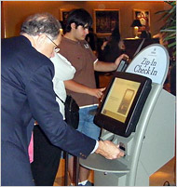
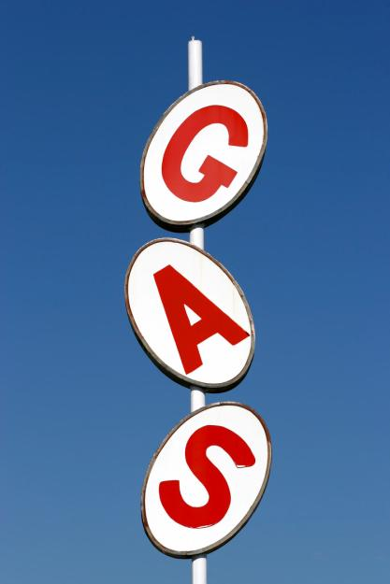
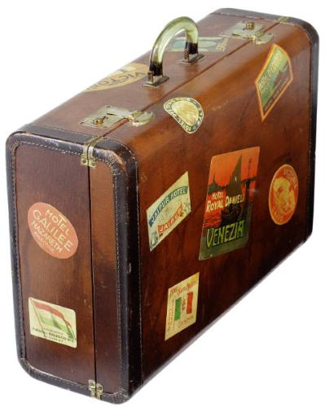
gen y preferences
Notes:
Hannah 2 minutes
Another facet of the conversation about self-service technologies is assumptions about user demographics
One common thread in the thinking about self-service technologies is that older people hate them and younger people love them. Joan Lippincott reports that members of Generation Y, don't use manuals or lengthy help docs, aren't drawn to text heavy web enviros, expect service customized to their needs, and Want library to identify and anticipate their needs before they know they need it.
The business world is paying attention to these trends as well:
An exploratory report addressing insurance needs of Gen Y found that this tech-savvy group is likely to seek self-service activities, such as managing and updating policies and viewing a statement online. The researchers largely came to this conclusion based on the fact that, Gen Yers are used to engaging in these administrative tasks online in other financial services sectors, such as banking and mutual funds. This generation are growing habituated to these types of tasks.
A survey of college students’ self-service technology preferences showed that one area in which students did prefer more interpersonal interaction was in buying a car, an area in which they do not feel they are an expert and don’t see an efficiency advantage to using SST – unlike gathering information, which they preferred to do in an unmediated way, and in which they see themselves as fairly expert.

Slide 31
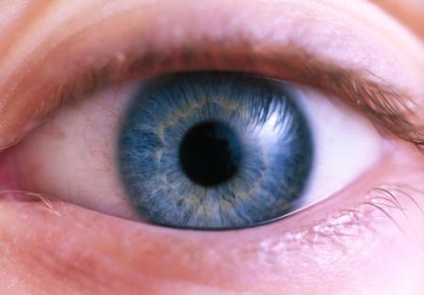
gen y learning preferences
| interactivity
| point of need
|visual
Notes:
Margaret 1 minute
Another consideration about offering self-service technologies is how people learn.
Generation Y students find pictures and images more accessible than text. Gen Y’ers also tend to like to learn in an active or kinesthetic way, so modeling the behaviors that they need to do to complete a task is beneficial for this group. While it’s not exactly a learning style in the VARK vein… students also tend to want assistance at all times of the day and show preferences for self-paced learning and customized products and experience. Again from Joan Lippincott, Gen Y’ers like to learn just in time, not just in case, they Learn when and where they want, they like Visually oriented interfaces, and appreciate interactive online tutorials for help and instruction, and want Self-Service at the Point of need. A survey by OCLC found that one of students’ top suggestions for libraries was to offer interactive maps, study tips, and guides.
Take a few minutes in your groups to formulate your top QADE and choose a person to report out afterwards.
Learning Style Preferences of Gen Y. http://www.library.csuhayward.edu/staff/ginno/ACRL/examples.htm

Slide 32
Q
Questions
A
Agree
D
Disagree
E
Examples
Notes:
Margaret 5 Minutes report back {40-41 minutes total}
Take a few minutes to formulate your Questions, Agreeing Statements, Disagreeing Statements and Explanations. We’ll have one person from each of the letters report out afterwards.
People with Q's will come up with questions
People with A's will make statements that agree with the assumptions we make
People with D's will counter the assumptions we make
People with E's will generate examples of the points we make

Slide 33
Self-service technologies allow patrons to choose their own level of service
Notes:
Hannah 9 minutes conclusions
Overall, the most important thing we have learned as a result of working on this point-of-service project and researching what other people, both inside and outside of the library, are thinking about self-service technologies, is that it all comes back to providing a variety of service options. By offering patrons a choice in their level of service, you are indicating that you value their different tastes and different needs. Aaron Schmidt refers to this kind of service as “radical customer service.” Joan Frye Williams talks about… how libraries “should work on creating opportunities for patrons to use the library on their own terms. Users will choose the library only if their library experience integrates well with their own view of themselves and their priorities. They don’t want librarians to be helpers so much as catalysts or facilitators, whose primary job is to welcome support, stimulate, delight and inspire them.”
Comments and questions {total 50 minutes}

Slide 34
Photo credits
Slide 1 http://flowingdata.com/2008/07/13/my-ugly-experience-with-the-jetblue-kiosk/
Slide 3: http://johnniemoore.com/blog/images/dalek.jpg
Slide 4: Wikipedia; http://www.flickr.com/photos/gembone/2506448840/ . http://www.idsa.org/idea/idea2005/images/1200-S-JetBlueKiosk.jpg
Slide 7: http://www.flickr.com/photos/compujeramey/473664038/
and http://www.flickr.com/photos/goldberg/367726950/
Slide 8: Safeway.com and http://www.flickr.com/photos/scantor/828709135/
Slide 9: Racine and Nilsson, 2005 – Video in User Interfaces that Require Non-linguistic Cues passport and fingerprinting
Slide 10: http://www.flickr.com/photos/lickyoats/2465809224/
Slide 11: : http://thecentsiblesawyer.blogspot.com/2008_04_27_archive.html
Slide 12: Paul Alvarez / The Press-Enterprise
Slide 17: http://www.libraryjournal.com/article/CA6535617.html; http://ccclib.org/locations/libraryagogo.html
Slide 18, Char Booth http://www.slideshare.net/charbooth/moving-communication-forward-internet-voice-and-video-in-libraries
Slide 22: http://www.elotouch.com/
Notes:
LickyOats and saralynncantor pics will have to be removed from PP before storing on scholars archive. All rights reserved.

Slide 35
Bibliography
Berry, John. 2004. Dehumanizing the library. Library Journal 129 (13): 10.
Booth, Char, 2007. Moving communication forward: internet voice and video in libraries. Presentation, CNI Fall Task Force 2007. http://www.slideshare.net/charbooth/moving-communication-forward-internet-voice-and-video-in-libraries
Burling, Stacey . 2006. Is it self-service or disservice? The Philadelphia Inquirer, April 30, sec. BUSINESS; Pg. E01.
Coyle, Karen 2007. The future of library systems, seen from the past. Journal of Academic Librarianship 33 (1): 138-140
Curran, et al. 2003. Intentions to use self-service technologies: a confluence of multiple attitudes. Journal of Service Research 5 (3): 209-224.
Dabholkar, Pratibha A. and Richard P. Bagozzi. 2002. An attitudinal model of technology-based self-service: moderating effects of consumer traits and situational factors. Journal of the Academy of Marketing Science 30 (3): 184-201.
Deloitte Research. 2008. Insuring the catalyst-customer: generation Y and the insurance industry. August 12. http://www.deloitte.com/dtt/cda/doc/content/us_fsi_insuringcatalyst_customer_genYandInsurance081208.pdf.
Disintermediation. In Encyclopedia of New Media. Thousand Oaks, CA: Sage Media, 2003: 150-151.
Hale, Dena, and Ramendra Thakur. 2006. Self-service technologies and generation Y: are they beyond the personal touch? International Journal of Electronic Marketing and Retailing 1, no. 2 : 132 - 154.

Slide 36
Bibliography
Library a-Go-Go program first in nation offering book lending machines. http://www.contra-costa.lib.ca.us/press_releases/library-a-go-go.html
Lippincott, J. K. 2005. Net generation students and libraries. Educause Review 40, no. 2: 56-66.
Meuter, Matthew L. et al. 2000. Self-service technologies: understanding customer satisfaction with technology-based service encounters. Journal of Marketing 64 (July): 50-64.
Nawotka, Edward. 2008. The future is now for Borders. Publishers Weekly 255 (7) : 2, 4.
Racine, S., and R. Nilsson. 2005. Use of video in user interfaces that require non-linguistic cues. In Conference on Human Factors in Computing Systems, 1022-1036. ACM New York, NY, USA.
Rayport, Jeffrey F, and Bernard J Jaworski. 2004. Best Face Forward.
Sheffer, Carol. 2008. Self-service at your library (and now at PLA). Public Libraries 47 (5): 7-8.
Summit, Roger K. 1980. "1985: New technology for libraries." Library Journal 105 (13): 1473.
Vaughan, J., & Fabbi, J. (2008). Self-check systems. Computers in Libraries, 28 (2), 29-35

Slide 37
Self-service technologies allow patrons to choose their own level of service
Notes:
Hannah 9 minutes conclusions
Comments and questions {total 50 minutes}

