Slide 1
Honey Bees and Agricultural Chemicals: Global to Micro Perspectives
Ann Bernert
Ramesh Sagili, PhD
Department of Horticulture, Oregon State University,
Corvallis, OR 97331

Slide 2
Part I
Global Perspectives in Honey Bee (Apis mellifera) Health

Slide 3
Photo by Stephen Ward
Pollination services
Economically valuable (Calderone 2012; Hein 2009)
Increasing food demand (Tilman et al. 2011)
Notes:
Bee products, pollination, Pollination & beekeeping, Global colony decline, Increasing food demand

Slide 4
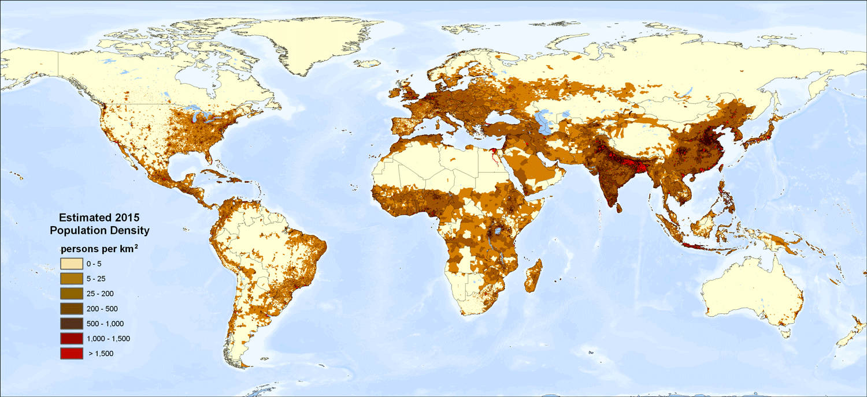

Slide 5
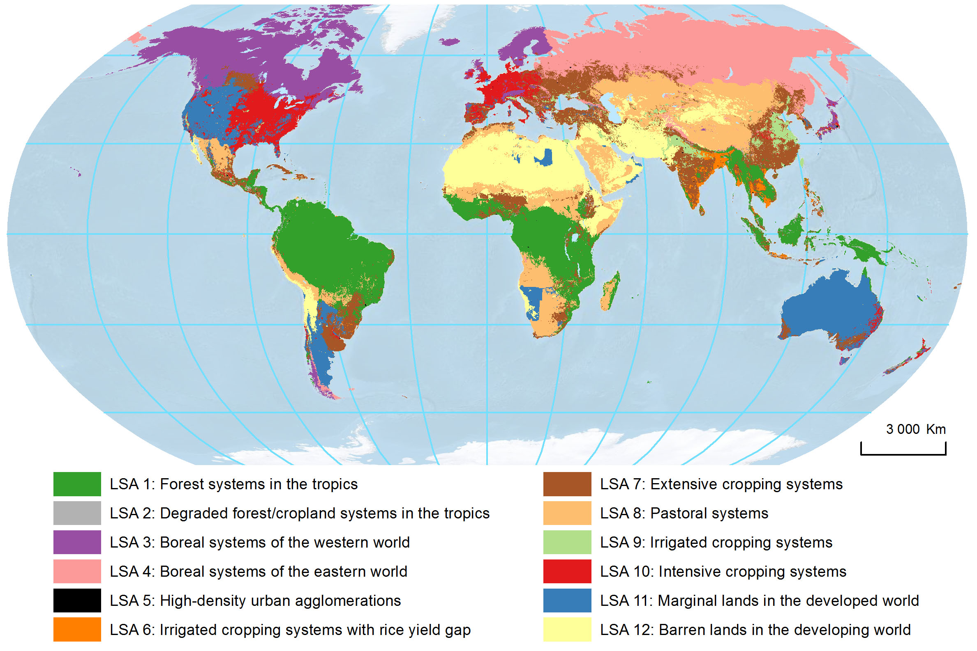

Slide 6
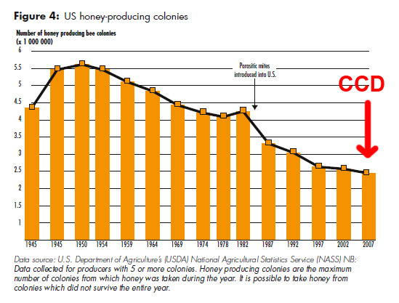

Slide 7
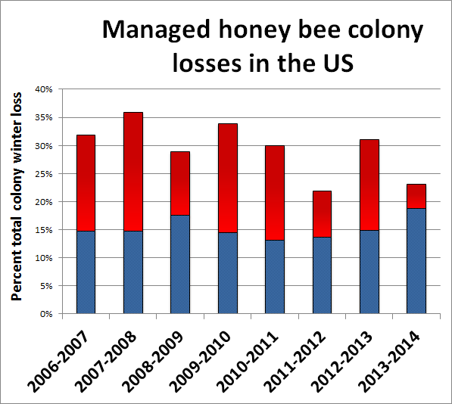

Slide 8
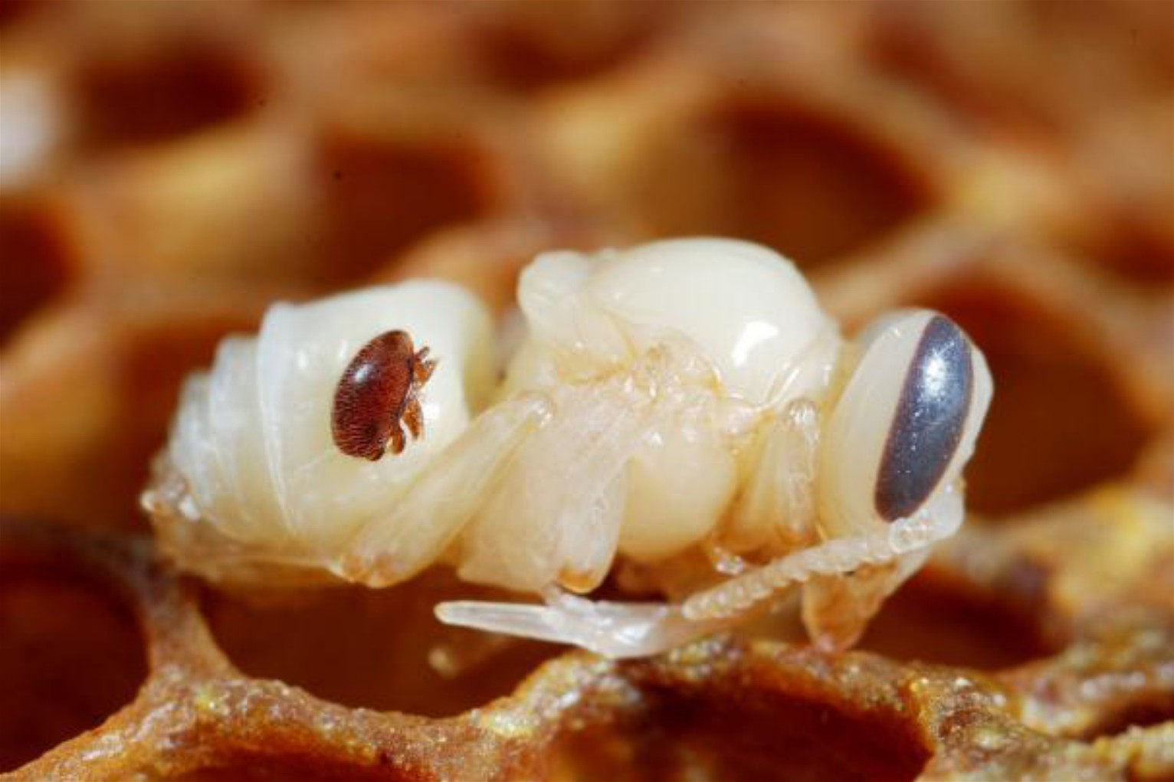
Causes of honey bee decline
Pests & Pathogens
Migratory beekeeping
Nutrition
Pesticides

Slide 9
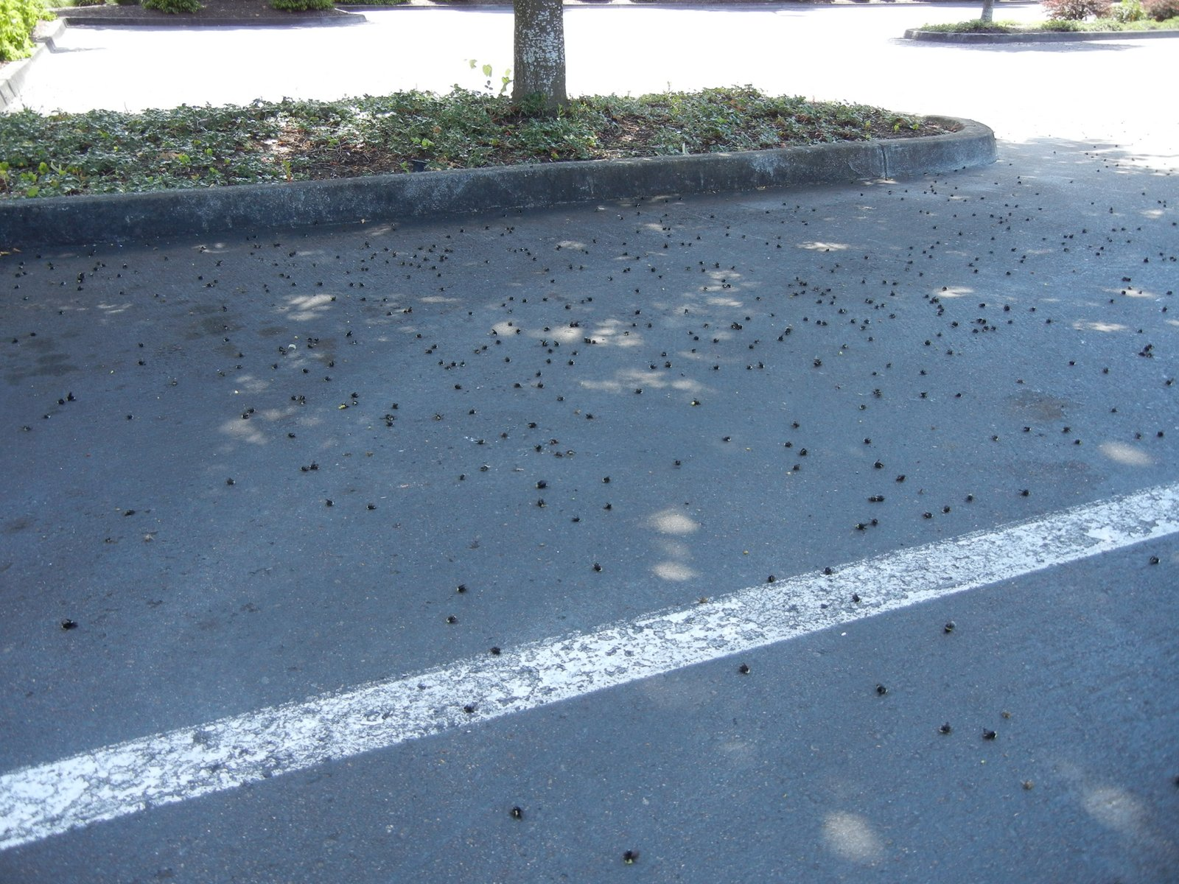
Pesticides
Neonicotinoids
Problems
Controversy
Notes:
There are over 650,000 acres of almonds in California, which supply almost 80% of world’s requirements
Over a million honey bee hives are needed to pollinate the almond crop

Slide 10
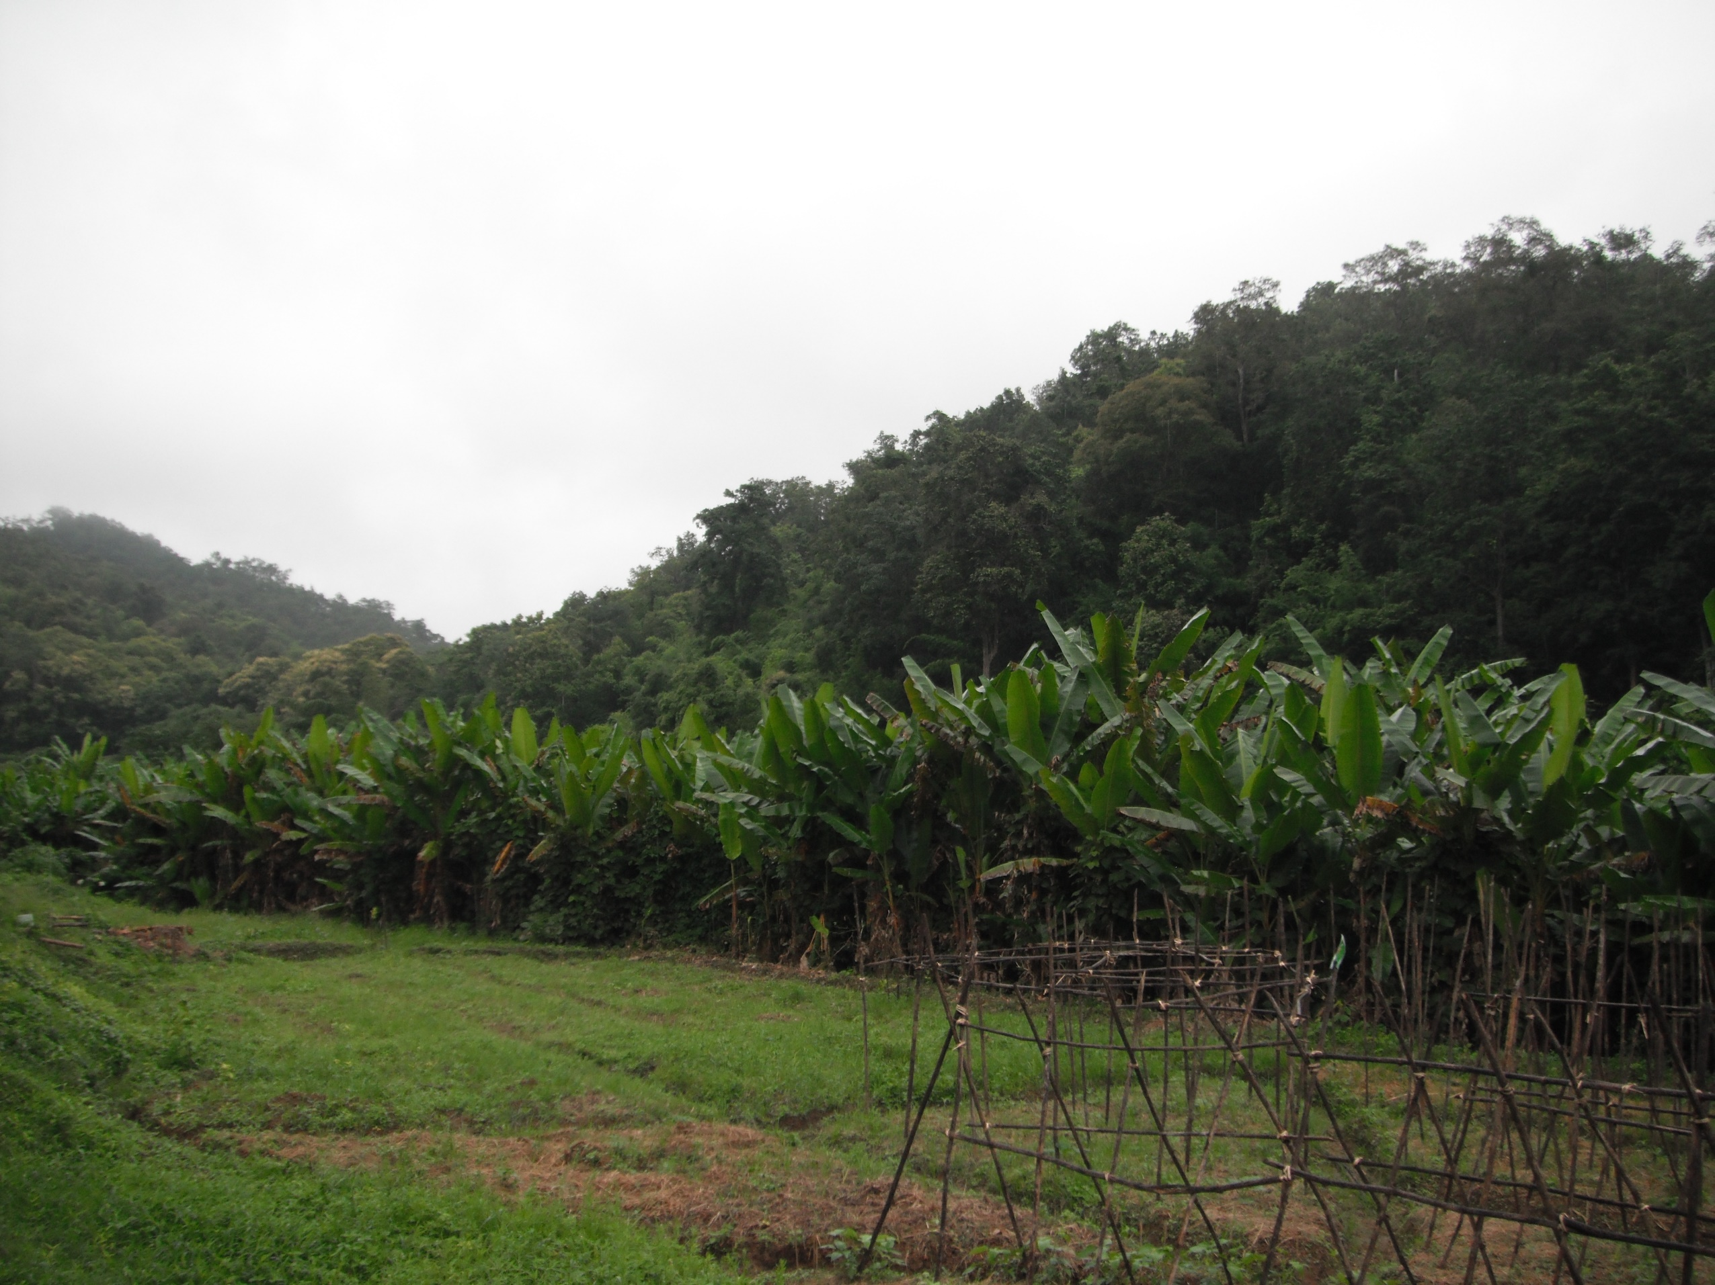

Slide 11
Part II
Fungicide sensitivity of honey bee associated fungi

Slide 12
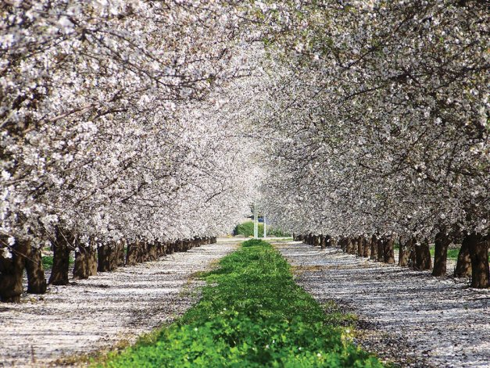
Fungicides
70 million pounds- USDA
Almond Bloom
1.6 million colonies
Fungicides
Chlorothalonil
Iprodione
Boscalid
Notes:
There are over 650,000 acres of almonds in California, which supply almost 80% of world’s requirements
Over a million honey bee hives are needed to pollinate the almond crop

Slide 13
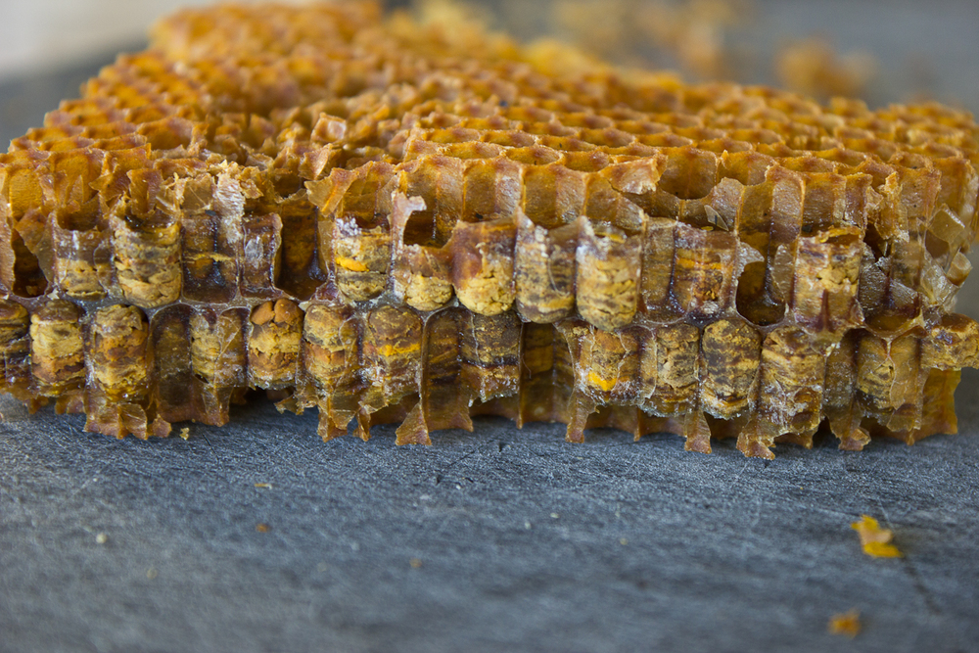

Slide 14
Are honey bee associated fungi sensitive to fungicides used in pollination dependent crops?

Slide 15
Experimental Background
In vitro: In glass
In vivo: In a living organism
Growth media
Media amendment

Slide 16
Methods
Chlorothalonil 700 ppb
Iprodione 13,900 ppb
Iprodione 5, 840 ppb
Boscalid 4,600 ppb
Control (no amendments)

Slide 17
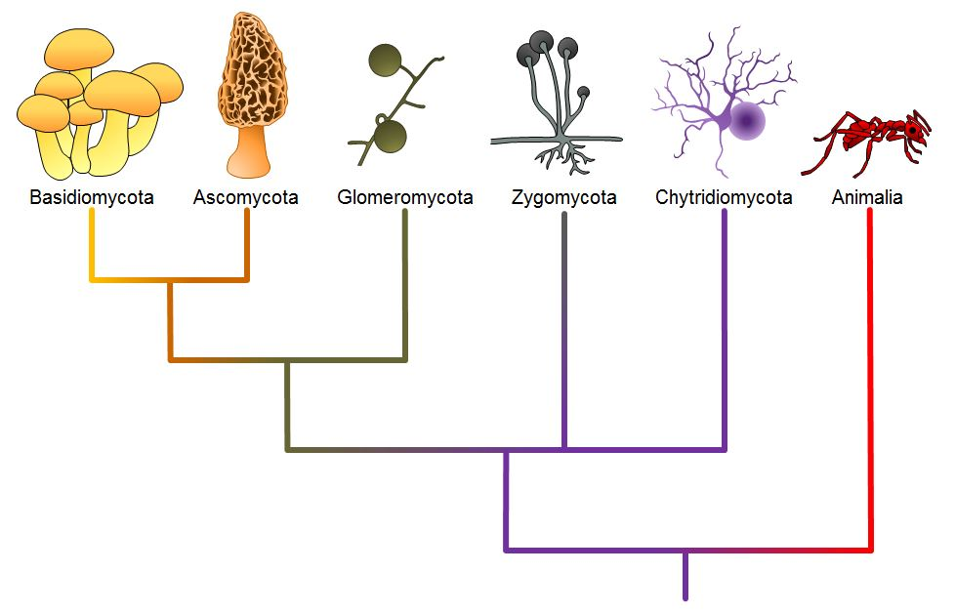
Fungal Phylogeny

Slide 20
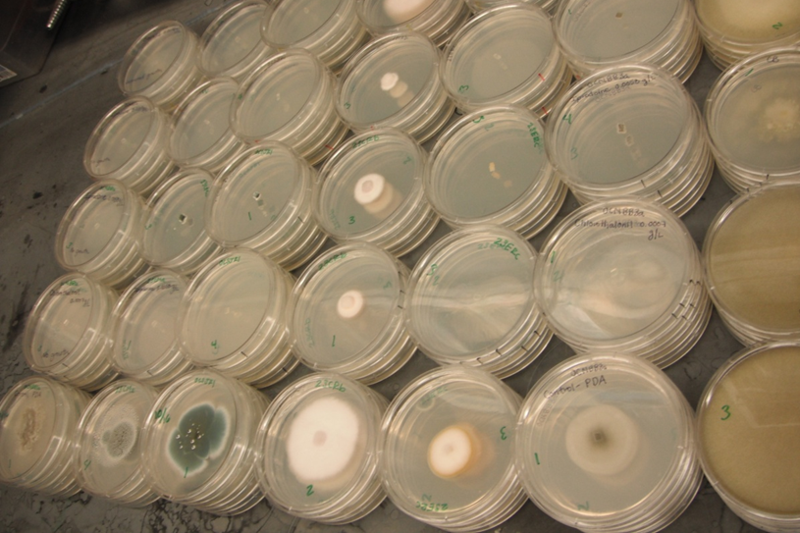

Slide 21
Discussion
Exact role of fungi in hive unknown
Fungicides do inhibit growth of fungi in the honey bee hive
Long term effects unknown
Provided incentive to understand role of fungi in hive

Slide 22
Part III
Tylosin & Fumagillin –
Impacts on honey bee midgut bacterial symbionts

Slide 23
Importance of Microbiome
Human Microbiome
Immunity
Metabolism & Obesity (Greer et al 2013)
Digestive illnesses
Honey Bee Microbiome
More diverse microbiome = healthier hive (Mattila et al 2012)
Microbes needed for honey production
Pathogen competition (Evans & Armstrong 2006)

Slide 24
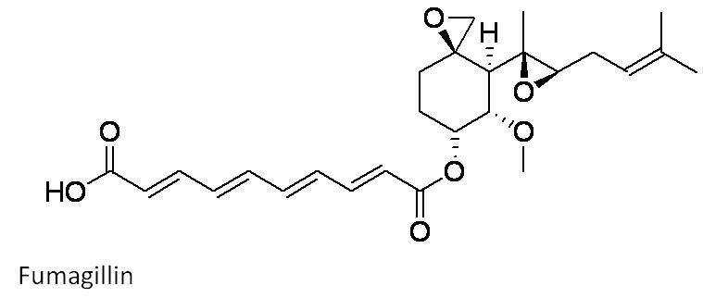
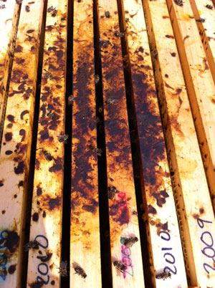
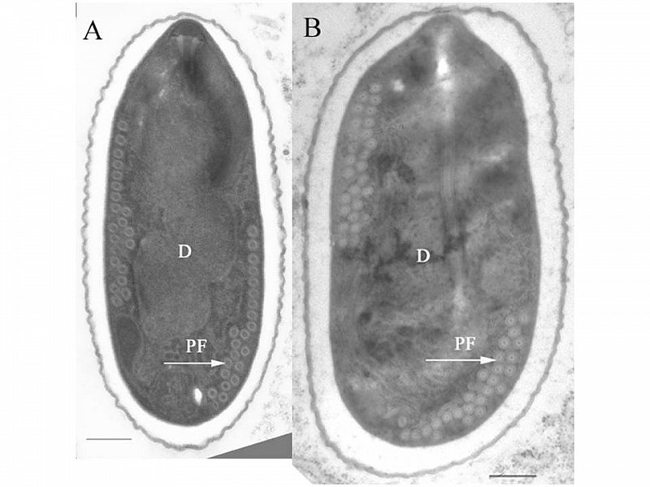
Nosema

Slide 25
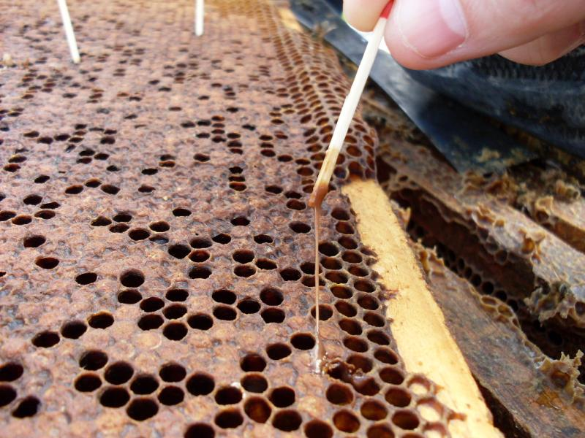
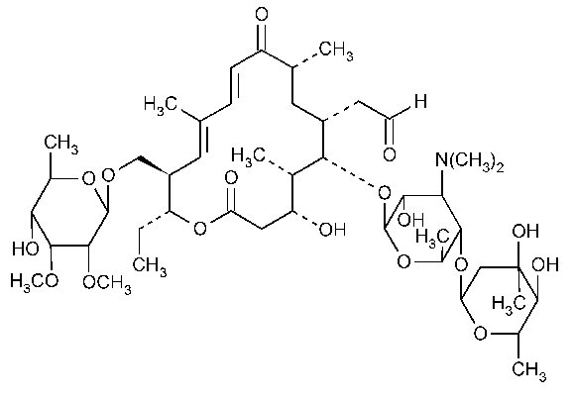
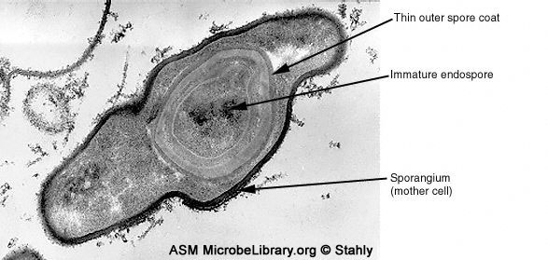
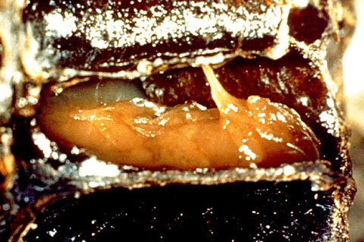
American Foulbrood
Notes:
Growth reduction of Penicillium, Trichoderma, Fusarium, and Camarosporium

Slide 26
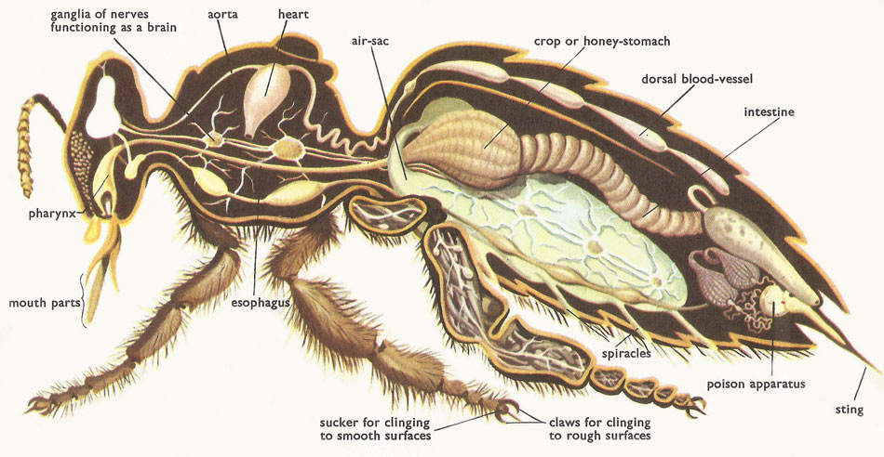
Midgut
www.daviddarling.info

Slide 27
Do fumagillin and tylosin treatments effect the honey bee midgut microbiome?

Slide 28
Preliminary in vitro Test
Tylosin
Control
Fumagillin & Tylosin

Slide 29
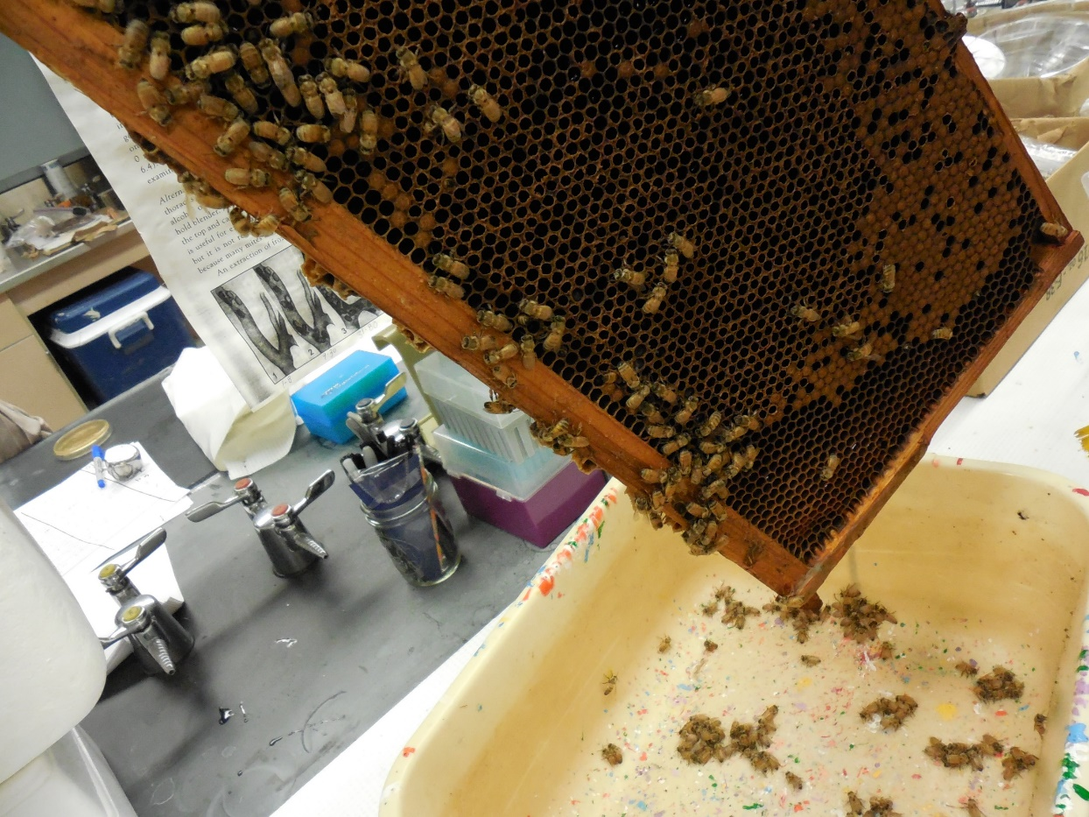
In vivo Methods
Notes:
More reflective of the field setting as the microbes and chemicals are introduced to each other in the complex system of which they would be introduced to each other in reality but still some variables of field setting are lost.

Slide 30
Photo by Stephen Ward

Slide 31
Treatment Groups
1) Control
2) Tylosin
3) Fumagillin
4) Tylosin and Fumagillin
Each treatment was replicated 4 times
Each cage contained ~100 individual bees
Concentrations of chemical application was equivalent to those beekeepers use

Slide 32
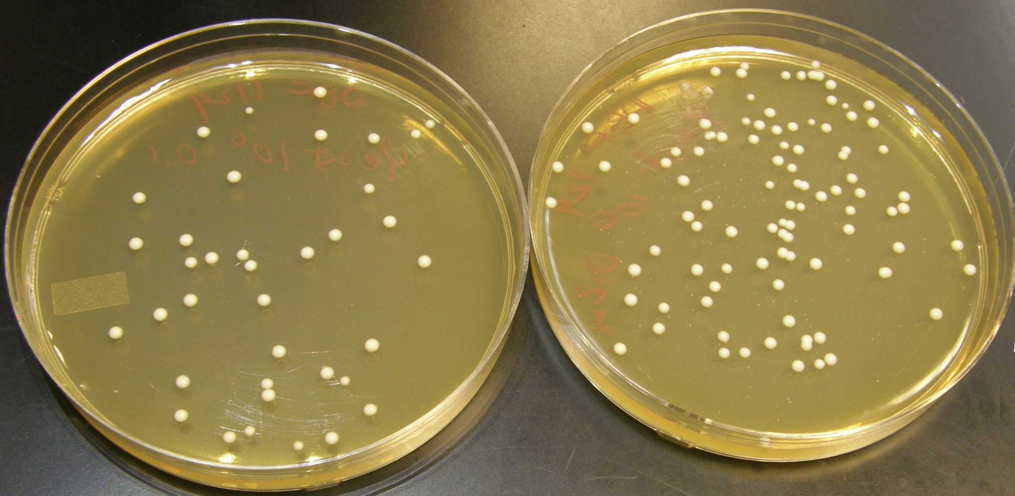

Slide 33
Proportion of high Colony Formation Units samples between treatment groups at time points
Results

Slide 37
Treatment | p value | Χ²
Control | 0.208 | 5.882
Fumagillin* | 0.026 | 11.01
Tylosin* | <0.001 | 24.67
Fumagillin & Tylosin* | <0.001 | 23.44
Before proportions of all treatments | 0.204 | 8.492

Slide 38
Discussion
Agricultural chemicals do have an effect on honey bee associated microbes
Chemical safety could be better assessed by studying chemical synergy and indirect effects
Further studies can help create more effective, lower impact, pesticide application procedures

Slide 39
Limitations
Laboratory cage based experiment
Fairly short term observations
CFU data

Slide 40
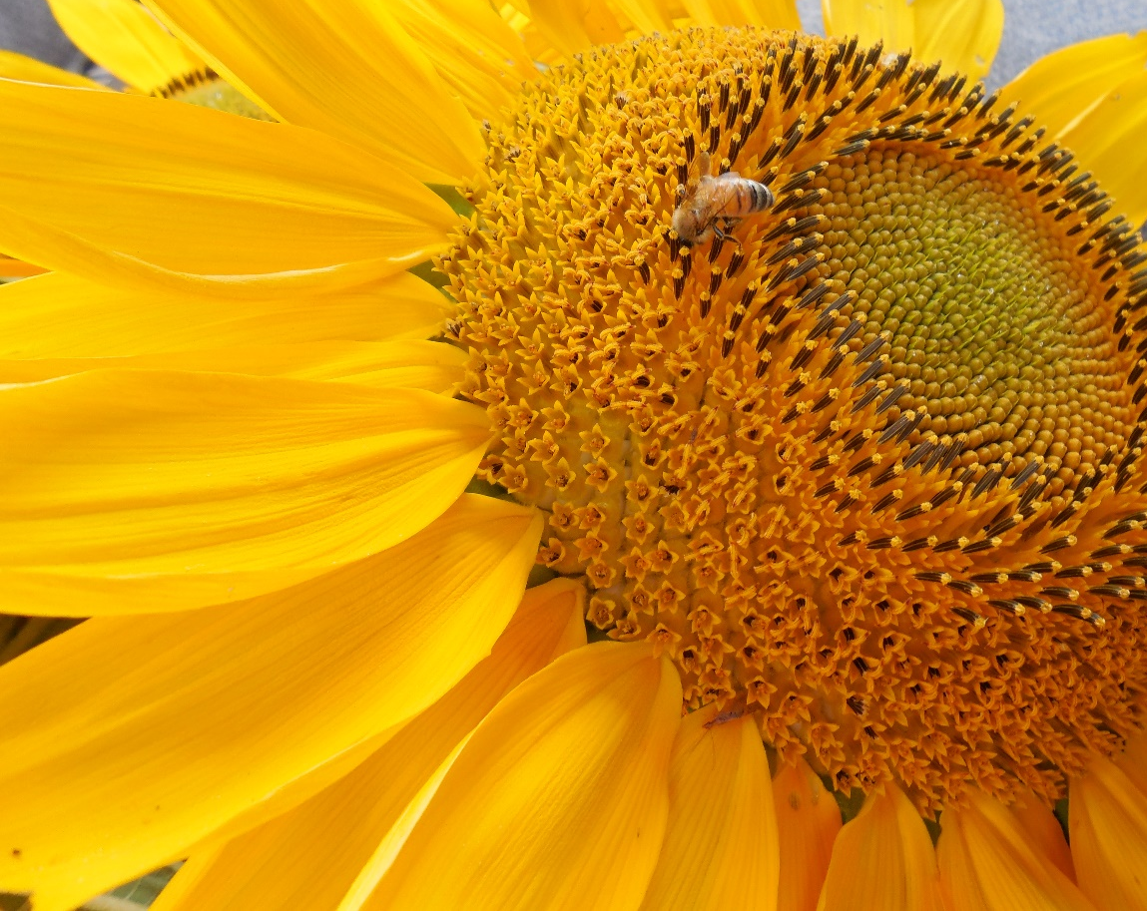
Future Directions
Functional Roles of Microbes
Indirect effects to honey bees from microbiome change
Long term health impacts

Slide 41
Photo References
Land use map from - http://phys.org/news/2013-11-global-insights.html
World Population Map from http://www.infinitearttournament.com/2014/02/a-users-guide-to-forty-maps-that-will_17.html
Overwintering loses – from Bee Informed at http://beeinformed.org/2014/05/colony-loss-2013-2014/
Bee Bread from - http://nordicfoodlab.org/blog/2013/5/the-whole-hive
Almond Bloom - http://www.sactownmag.com/February-March-2009/Almond-Joy/
Fungal Phylogeny trees- http://cnx.org/contents/b95751e9-54aa-43b7-9bb0-406671635905@7/Kingdom_Fungi & http://scienceblogs.com/evolgen/2006/11/03/phylogeny-friday-20-october-20/
Nosema - mainebeekeepers.org
Nosema spores- http://www.zoologie.uni-halle.de/allgemeine_zoologie/research/host-parasite/
American Foulbrood- kiwimana.co.nz & www.mol-ecol.uni-halle.de
http://www.michiganbees.org/2012/fungus-fights-deadly-bee-mites-in-a-two-pronged-attack/ Picture ofvarroa mite
Colony forming units example- http://biology.clc.uc.edu/fankhauser/Labs/Microbiology/Yeast_Plate_Count/Yeast_Plate_Count.htm

Slide 42
Literature References
Calderone, N.W. (2012) Insect Pollinated Crops, Insect Pollinators and US Agriculture: Trend Analysis of Aggregate Data for the Period 1992–2009. PLoS One DOI: 10.1371/journal.pone.0037235
Cain, M., Bowman, W., Hacker, S.D. (2014) Ecology, Third Edition. Sinauer Associates, Inc.
Hein, L., (2009) The Economic Value of the Pollination Service, a Review Across Scales. The Open Ecology Journal 2, 74-82 1874-2130/09
Greer, R.L., Morgun, A., Shulzhenko, N. (2013) Bridging immunity and lipid metabolism by gut microbiota. Clinical reviews in allergy and immunology 132 (2) 253-262
Evans, J., Armstrong T. (2006) Antagonistic interactions between honey bee symbionts and implications for disease BMC Ecology 6 (4)
Mattila, H., Rios, D., Walker-Sperling, V., Roeselers, G., Newton I. (2012) Characterization of the Active Microbiotas Associated with Honey Bees Reveals Healthier and Broader communities when Colonies are Genetically Diverse. PLoS ONE 7 (3) e32962

Slide 43
Acknowledgments
Undergraduate Research, Innovation, Science, Creativity (URISC)
Louisa Hooven
Carolyn Breece
Ashrafun Nessa
Ken Johnson
Todd Temple
Ellen Toptizhofer
Cameron Jack
Wanda Crannell
Nick Fleury

Slide 44
Questions?

