Slide 1
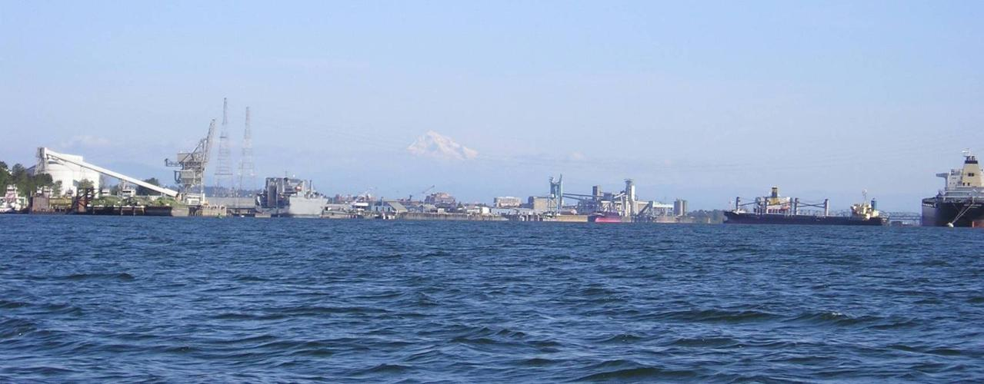
Reconnaissance Investigation of Emerging Contaminants in Wastewater-Treatment-Plant Effluent and Stormwater Runoff in the Columbia River Basin
Jennifer Morace, USGS Oregon Water Science Center

Slide 2
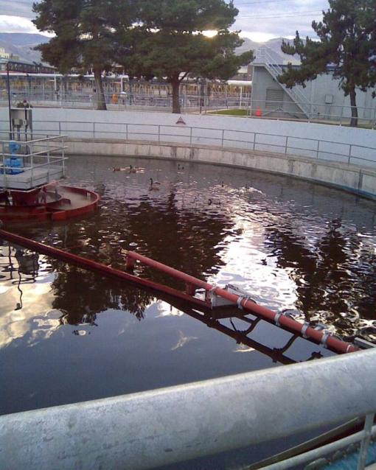
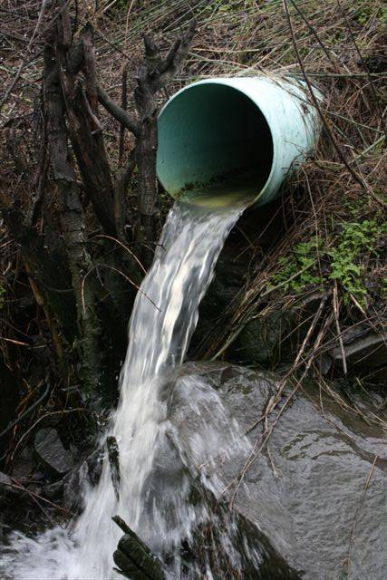
Columbia River Inputs Study
Characterize pathways contributing directly to the Columbia River
WWTP effluent
Stormwater runoff
Notes:
Note these are pathways, not sources.

Slide 3
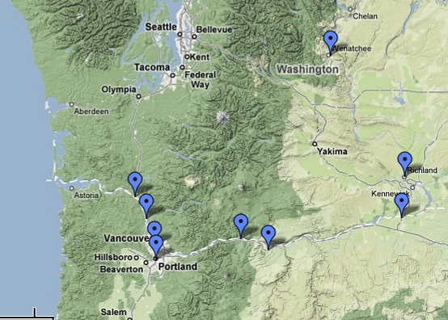
Wenatchee
Richland
Longview
Hood River
St Helens
Vancouver
Umatilla
Portland
The Dalles
Notes:
The Columbia River is a 1,200-mile river that starts up in Canada and drains an area of 259,000 square miles on its way to the Pacific Ocean. This drainage is roughly the size of France and covers area from 7 US states and a Canadian province. It is the fourth largest river in the United States by volume and the largest river flowing into the Pacific Ocean. The Columbia River Basin is home to approximately 8 million people.
The cities included in this study were chosen to provide diversity in location – between Oregon and Washington, the drier eastside versus wetter westside characteristics, and differences in population densities, from the larger cities of Portland and Vancouver to the smaller cities of Umatilla and St Helens.

Slide 4
City and WWTP characteristics
City | Annual precip, inches | Population | Columbia River Mile | Design flow, mgd | Plant Description
Wenatchee | 9 | 27,856 | 466.6 | 7.1 | Activated sludge; secondary treatment; ultraviolet (UV) disinfection
Richland | 7 | 38,708 | 337.1 | 11.4 | Activated sludge; secondary clarification; chlorine disinfection
Umatilla | 8 | 4,978 | 289 | 0.92 | Oxidation ditch; UV disinfection
The Dalles | 14 | 12,156 | 189.5 | 4.15 | Activated sludge; UV disinfection
Hood River | 32 | 5,831 | 165 | 2 | Activated sludge; UV disinfection
Portland | 37 | 529,121 | 105.5 | 72 | Activated sludge; secondary clarification; chlorine disinfection
Vancouver | 42 | 143,560 | 105 | 28 | Industrial pretreatment lagoon; secondary activated sludge; UV disinfection
St Helens | 46 | 10,019 | 86.9 | 45 | Combined municipal and kraft mill aerated stabilization basin
Longview | 48 | 34,660 | 67.5 | 26 | Activated sludge; secondary clarification; chlorine disinfection

Slide 5
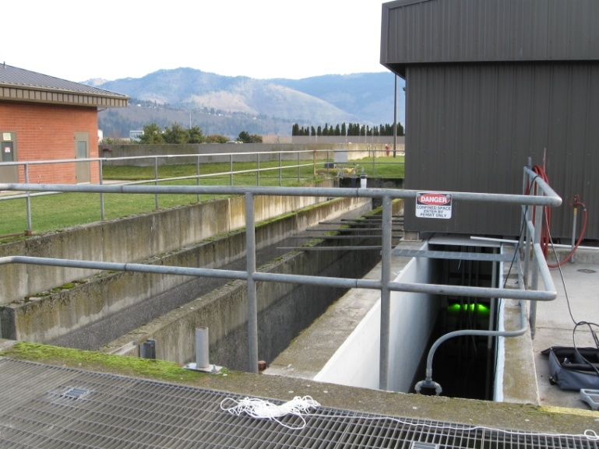
Contaminants analyzed in WWTP effluent
Pharmaceuticals
Anthropogenic-indicator compounds
PCBs
PBDEs
PAHs
Currently used pesticides
Mercury
Estrogenicity
Hood River Wastewater Treatment Plant
Notes:
Pharmaceuticals – both prescription and over-the-counter – SPE extract, HPLC/MS
Anthropogenic indicators – GC/MS ~70 compounds
– plasticizers, personal care products, detergent metabolites, other industrial use compounds
Halogenated compounds – GC/MS
PCBs – 18 congeners
– were used as insulators and cooling compounds in electrical equipment like transformers, capacitors, and fluorescent-light bulb ballasts
– persistent, bioaccumulative, carcinogenic
PBDEs – brominated flame retardants
– 10 PBDEs and 3 others
– used in plastics, cushions, and clothing
– similar to PCBS – bioaccumulative and persistent
– of concern because of their neurotoxicity and ability to disrupt hormone functions
PAHs
- exist in petroleum products or are created through incomplete combustion of carbon-containing materials like wood, coal, fat, tabacco
- used in manufacture of dyes, insecticides, and solvents
- widespread and persistent
- anthracene, fluoranthene, naphthalene
Currently used pesticides – 83 fungicides, herbicides, insecticides, other, and degradates – GC/MS
Mercury and methylmercury – 0.4 ng/L
- mercury - Oxidation, Purge and Trap, and Cold Vapor Atomic Fluorescence Spectrometry
- methylmercury - Aqueous Phase Ethylation, Followed by Gas Chromatographic Separation with Cold Vapor Atomic Fluorescence Detection
Estrogenicity – YES assay

Slide 6
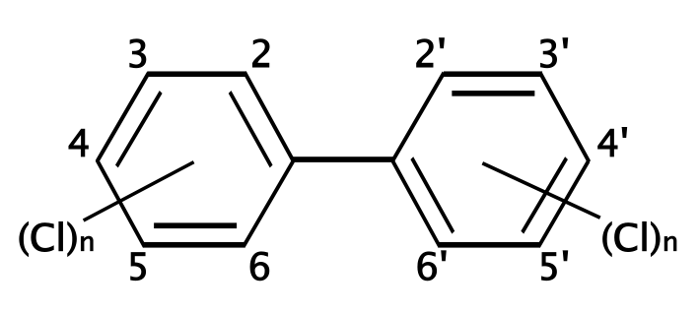
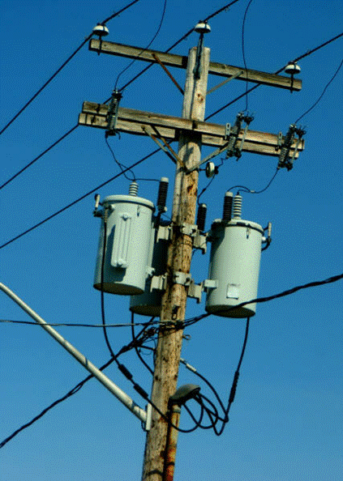
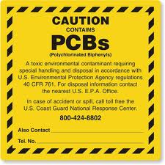
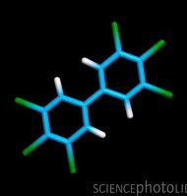
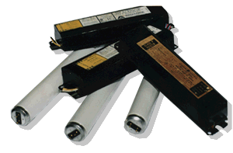
PCBs—Polychlorinated Biphenyls
In general, the more chlorines, the more toxic
Transformers and capacitors, other electrical equipment, oil and lubricants, fluorescent light ballasts, insulation material, oil-based paints, inks, caulking, plastics, adhesives
Manufacture banned in 1979
Persistent and bioaccumulative —found in soils, sediments, and biota
Potential carcinogenic and non-carcinogenic effects in people and animals
Notes:
Two-ringed structures, 209 congeners based on how many chlorines and the resulting position and structure
Mixtures of these congeners were marketed as Aroclors
Used as insulators and cooling compounds in electrical equipment such as transformers, capacitors, and ballasts
Incorporated into lubricants, paints, varnishes, inks, pesticides, carbonless copy paper, and other consumer products
Persistent and hydrophobic—do not degrade readily or dissolve in water
Bioaccumulate in body fat and biomagnify up the food chain
Effects on the immune system, reproductive system, nervous system, endocrine system, …
Banned because of environmental and human health risk
Still can be used in closed electrical equipment

Slide 7
PBDEs—Polybrominated diphenyl ethers
Similar to PCBs, except Br instead of Cl
Accumulate in soil, sediment, and biota
Synthetic flame retardants, computers, TVs, furniture, cars, clothing, carpet, …
Concentrations in the environment, animals, and humans are increasing dramatically
Notes:
Synthetic flame retardants, account for ~25 % of flame retardants produced worldwide.
Plastic components of computers, televisions, and circuit boards; in seat cushions and other furniture; and in clothing.
Bioaccumulate in both freshwater and marine fish.
Toxicity info not complete yet. Believed to be similar to PCBs—neurotoxicity to hormone disruption.
Values in osprey eggs from Willamette River basin among highest recorded for fish-eating birds

Slide 8
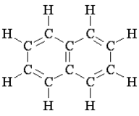
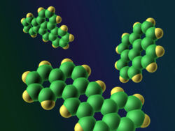
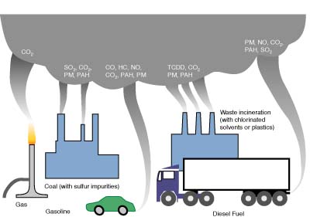
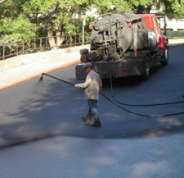
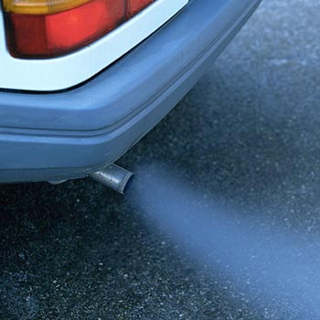
PAHs—Polycyclic aromatic hydrocarbons
Originate from combustion and weathered petroleum products
Commonly attach to particles
Metabolized by salmon
Suspected carcinogens
Anthracene, benzo[a]pyrene, chrysene, fluoranthene, naphthalene, phenanthrene, …
Notes:
Fused aromatic rings
Typically come from weathered petroleum products, like gasoline or diesel fuel.
Enter streams through storm water runoff from urban areas.
High molecular weight PAHs have four or more rings and originate from combustion.
Common sources are vehicle exhaust fumes, coal tar, and municipal or industrial activities that involve combustion.
Many are suspected carcinogens.
PAHs most commonly attach to soil and sediment, but they also can be found on particles suspended in the air or water.
Some are water soluble (naphthalenes), while others are lipophilic.

Slide 9
Contaminants measured in WWTP effluents
4/4
4/4
7/8
50/59
12/15
8/9
14/17
14/17
9/18
27/104
149/255
Notes:
This graph reports data collected from wastewater-treatment-plant effluents and stormwater runoff throughout the Columbia River Basin. Overall, almost 60 percent of the compounds analyzed for (200+ compounds) were detected in these samples.

Slide 10
Percent of detection at each WWTP sampled
 | Total # analyzed | Wenatchee | Richland | Umatilla | The Dalles | Hood River | Vancouver | Portland (am) | Portland (noon) | Portland (pm) | St. Helens | Longview
plasticizers | 4 | 100 | 25 | 50 | 50 | 25 | 50 | 25 | 75 | 50 | 100 | 100
steroids | 4 | 100 | 75 | 100 | 75 | 75 | 75 | 75 | 75 | 75 | 100 | 100
detergent metabolites | 8 | 50 | 0 | 38 | 50 | 50 | 38 | 63 | 63 | 63 | 63 | 63
pharmaceuticals | 59 | 53 | 41 | 34 | 54 | 47 | 47 | 46 | 47 | 47 | 42 | 59
personal care products | 15 | 60 | 47 | 33 | 47 | 53 | 40 | 47 | 53 | 47 | 53 | 80
PAHs | 9 | 0 | 0 | 11 | 11 | 0 | 0 | 11 | 11 | 11 | 22 | 44
flame retardants | 17 | 82 | 76 | 76 | 82 | 82 | 82 | 82 | 82 | 82 | 82 | 65
miscellaneous | 17 | 47 | 29 | 24 | 35 | 24 | 24 | 35 | 35 | 47 | 35 | 53
PCBs | 18 | 44 | 0 | 0 | 0 | 0 | 0 | 0 | 0 | 0 | 6 | 11
pesticides | 104 | 12 | 18 | 12 | 15 | 13 | 16 | 9 | 13 | 9 | 13 | 15
overall | 255 | 37 | 28 | 25 | 33 | 29 | 30 | 29 | 32 | 30 | 33 | 40

Slide 11
Compounds found at all WWTPs maximum concentrations shown in micrograms per liter
Tri(2-chloroethyl)phosphate – 0.65
Tri(dichloroisopropyl)phosphate – 0.69
Benzophenone – 0.28
1,4-Dichlorobenzene – 0.88
HHCB – 2.5
Cholesterol – E 6.3
3-beta-Coprostanol – E 5.8
beta-Sitosterol – E 3.2
PBDE congeners (47, 66, 85, 99, 100, 153, 154)
trans-Chlordane – 0.00019
E = estimated
Notes:
2 phosphate-based flame retardants, both suspected endocrine disruptors
3 personal care products
Benzophenone – suspected endocrine disrupter, found in perfumes, soaps, sunscreens
1,4-Dichlorobenzene – suspected endocrine disrupter, moth repellant, fumigant, deodorant
HHCB – musk, widely used
3 fecal indicators, expected to be in wastewater
7 PBDE congeners found everywhere with highest concentration of any one at 0.012 ug/L level
Trans-Chlordane - An organochlorine insecticide

Slide 12
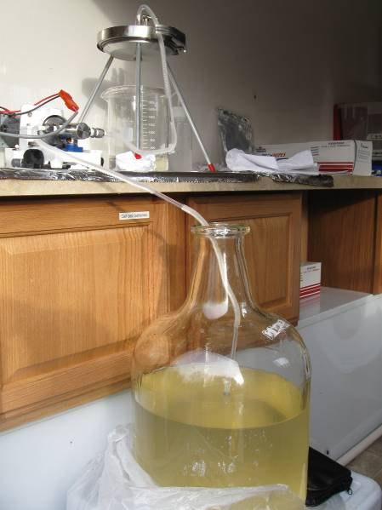
WWTP effluent – PCBS, PBDEs, DDTs
PBDEs detected at all cities
9 congeners analyzed
PBDE-47, PBDE-99, PBDE-100 at highest concentrations
Richland and Portland highest
Higher later in the day (2 to 4 x morning concentrations)
PCBs primarily at Wenatchee
No DDTs detected
Notes:
1.6–12 µg/L for PBDE-47, 1.2–4.8 µg/L for PBDE-99, and 0.29–1.6 µg/L for PBDE-100
typical pattern observed in environmental data because these congeners are the most stable
This pattern of lower concentrations in the morning and higher concentrations later in the day was observed in the other halogenated compounds measured as well. Interestingly the suspended-sediment concentrations remained fairly low and constant throughout the day. So the amount of suspended sediment does not account for these differences, but rather the amount of contaminants associated with these solids.
What about BIOSOLIDS? Kinney and others (2006) performed a survey of biosolids destined for land application from 9 cities across the United States and found 25 AOCs present. All of these compounds, except fluoxetine which was not measured in this study, were also found in this study, indicating that biosolids may be an important source of contamination for study in the future in the Columbia River Basin.

Slide 13
Pharmaceuticals found at all WWTPs maximum concentrations shown in micrograms per liter
Iminostilbene – 0.4
Citalopram (Celexa, Cipramil) – 0.5
Diltiazem – 0.4
Lidocaine – 0.4
Methocarbamol (Robaxin)– 13
Phenobarbital – 0.2
Tramadol (Ultram) – 0.4
Carbamazepine – 0.12
Phenytoin (Dilantin) – 0.6
Diphenhydramine (Benadryl, Motrin PM, …) – 0.11
Any use of trade, product, or firm names is for descriptive purposes only and does not imply endorsement by the U.S. Government.
Notes:
Might expect Portland or Vancouver to have highest concentrations because of population base
Portland over 500,000 people and Vancouver nearly 150,000
Instead Highest concentrations at Wenatchee for the first 6 compounds listed here
-- 7.1 mgd, 30,000 people, large retirement community, 2 hospitals and many elder care facilities
Iminostilbene – anticonvulsant
Citalopram (Celexa, Cipramil) – antidepressant, seretonin reuptake inhibitor
Diltiazem – heart medicine
Lidocaine – local anesthetic
Methocarbamol (Robaxin) muscle relaxant
Phenobarbital – barbituate, prevent seizures, sleep disorders, and anxiety
Longview – 26 mgd, 35,000 people
Tramadol (Ultram) – pain medicine
Umatillla – smallest plant measured, <1 mgd, 5000 people
Carbamazepine – anticonvulsant, common in WWTP effluent, passes right through
Phenytoin (Dilantin) – antiepileptic, anticonvulsant
The Dalles – 4 mgd, 12,000 people
Diphenhydramine (Benadryl, Motrin PM, …) – common in over-the-counter medicines, let’s look at this further

Slide 14
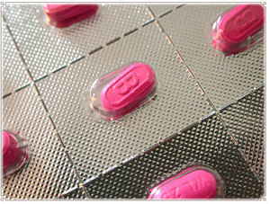
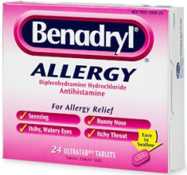
Diphenhydramine
Antihistamine
Uses
Relieves allergy and cold symptoms
Prevents and treats motion sickness
Treats insomnia
Controls abnormal movements in people with early Parkinson’s syndrome
Products
89 different brand names
Another 112 brand names for combination medications
Any use of trade, product, or firm names is for descriptive purposes only and does not imply endorsement by the U.S. Government.
Notes:
From PubMed Health (http://www.ncbi.nlm.nih.gov/pubmedhealth/PMH0000704#a682539-brandNames)
The brand names are from RxNorm, a standardized nomenclature for clinical drugs produced by the National Library of Medicine, for diphenhydramine.

Slide 15
Diphenhydramine
Present

Slide 16
Loadings to the Columbia
Diphenhydramine in Portland
49 mgd from WWTP
Average concentration of 0.5 µg/L
93 g/day of diphenhydramine
1 tablet = 25 mg
3,710 tablets/day (155 boxes)
Could lead to Columbia concentration of 0.0005 µg/L
Detection limit is 0.018 µg/L
Notes:
Portland’s design flow is 72 mgd (50,000 gallons per minute)
Daily flow on day of sampling was 49 mgd
Discharges to Columbia River at 7Q10 flow of 79,436 cfs
7Q10 statistic is the annual 7-day minimum flow with a 10-year recurrence interval (nonexceedance probability of 10 percent).
Vancouver discharge comes in within 0.5 mile – another 7.6 g/day, ~300 tablets, another 13 boxes
Portland concentrations were 0.5, 0.6, 0.4 ug/L
Vancouver concentration was 0.2 ug/L

Slide 17
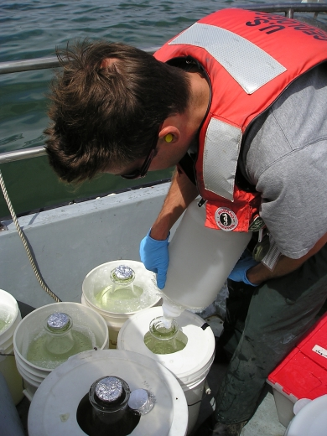
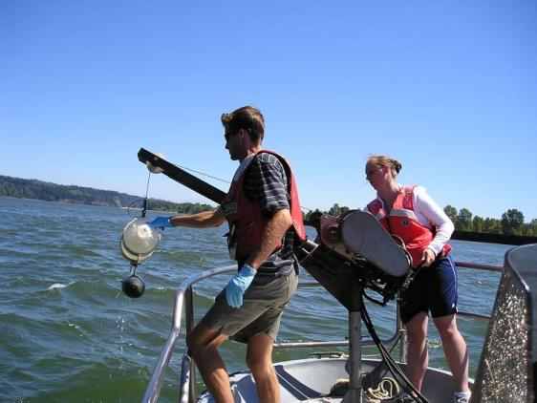
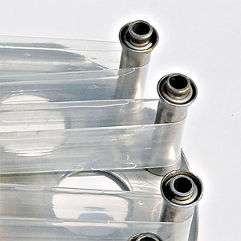
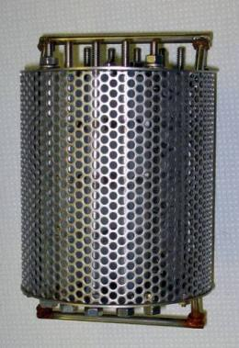
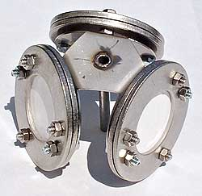
Implications for sampling
Most compounds would not be quantifiable in the main stem using conventional methods (0.01 µg/L)
Emphasizes the utility of passive sampling
Concentrates compounds, therefore lower detection limits
Time-integrated sample

Slide 18
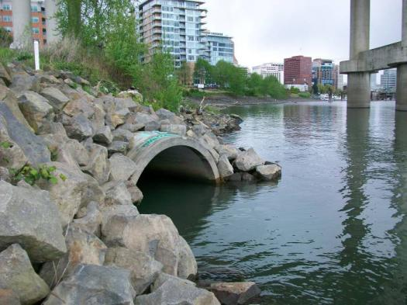
Contaminants analyzed in Stormwater Runoff
Currently used pesticides
PCBs
PBDEs
PAHs
Mercury
Metals and trace elements
Oil and grease
Willamette River in Portland at Marquam Bridge

Slide 19
Contaminants measured in stormwater runoff
10/10
12/13
17/18
34/56
3/5
38/93
114/195
Notes:
Interesting to note that the overall percentage is nearly the same as for WWTP, nearly 60 percent
Biased by a few samples with many detections

Slide 20
A few interesting findings…
One location on the Willamette
Highest number of detected compounds, highest concentrations
Umatilla sample
high solids, 834 mg/L suspended sediment
Flame retardants
Many matrix issues
PBDE-99 and PBDE-47 were highest concentrations
PBDE-153 had the most detections
PCBs
Primarily Willamette sample (sum 0.44 µg/L)
Pesticides
Chlorpyrifos (0.024 µg/L), trifluralin (0.006), dacthal (0.032), carbaryl (0.4)
p,p’-DDT showed up at Willamette site at 0.017 µg/L
PAHs
Many, many present, but at low concentrations
Hood River and St. Helens had no PAHs
Notes:
One location on the Willamette
Highest number of detected compounds
Highest concentrations of these compounds
Umatilla sample
First rain event after summer of dry weather
Flame retardants
Many matrix issues
PBDE-99 and PBDE-47 were highest cons.
PBDE-153 had most detections
PCBs
Primarily Willamette sample (sum of 18 congeners 0.44 ug/L)
PCB-180 found at 11 of 15 sites (Present – 0.014 ug/L)
Pesticides
no one compound was found at all stormwater locations
herbicides and insecticides were the compounds detected most often
highest numbers of detections were found in the Portland/Willamette area
DDT
Usually find degradate, DDE
Pipe drains area that was historically used by a pesticide manufacturer
Suggests that remnants of contaminants from historic land uses may still be contributing to the receiving waters periodically via stormwater runoff
PAHs
Many, many present, but at low concentrations
Hood River and St. Helens had no PAHs

Slide 21
Trace elements in stormwater runoff
Compound | Unfiltered water |  | Filtered Water
 | Minimum | Maximum | Minimum | Maximum
Arsenic | E 0.13 | 2.6 | 0.13 | 2.3
Cadmium | E 0.02 | 0.77 | E 0.01 | 0.6
Chromium | Present | 33 | Present | 2.1
Copper | 2.2 | 42 | E 0.68 | 11
Lead | 0.19 | 53 | 0.03 | 12
Mercury | E 0.007 | 0.18 | 0.01 | 0.01
Nickel | 0.23 | 22 | 0.23 | 3.2
Selenium | E 0.05 | 0.74 | E 0.03 | 0.61
Silver | E 0.010 | 0.25 | E 0.006 | 0.02
Zinc | 7.5 | 250 | E 4.5 | 100
Concentrations shown in micrograms per liter
Notes:
Although trace elements are naturally occurring, they can also be introduced through industrial uses and motor vehicles. For instance, copper and zinc are contributed to roads and other impervious services from brake pads, tires, and vehicle exhaust and then stormwater runoff transports these deposits to its receiving waters.
Can really see the effects of higher solids delivered by stormwater flushing, not all from one sample
Concern about sublethal effects from some of these dissolved metals
Copper has been shown to cause sublethal effects on salmon at concentrations as low as 2 µg/L and all unfiltered-water results were greater than this.
Chromium and zinc were found to cause reproductive issues in rainbow trout at levels as low as 0.005 and 20 µg/L, respectively.
Chromium concentrations in unfiltered stormwater-runoff samples were all greater than 0.3 µg/L.
Most zinc concentrations in filtered samples were greater than 20 µg/L
Smaller, intermittent inputs, but add up how many throughout the basin.

Slide 22
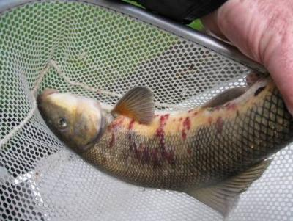
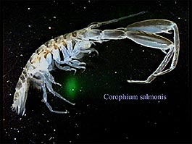
Unknowns
Lack of criteria for “newer” contaminants makes regulation and reporting difficult
Implications for fish and wildlife using the area are not characterized
Impact of mixing zones on the ecosystem is unknown
Foodweb implications
Steve Warnstaff

Slide 23
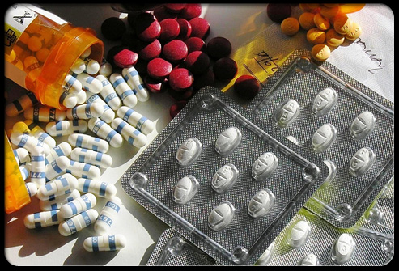
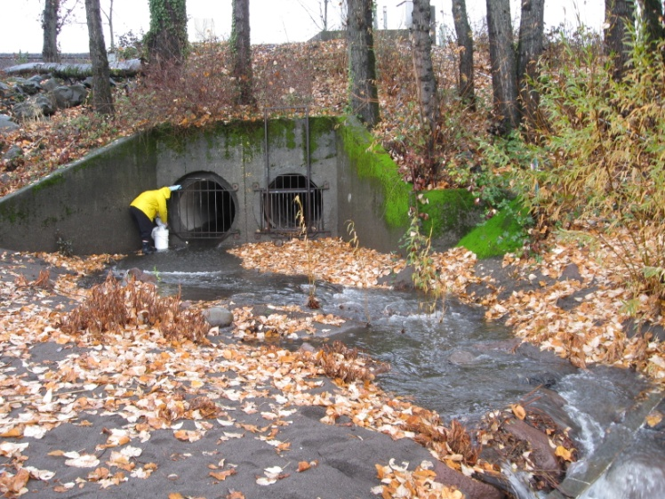
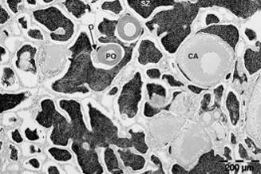
Future steps…
Toxicity studies
What do these contaminant levels mean to fish, wildlife, and human health
Synergistic effects
Bioaccumulation
Other contributors – industry, NPDES permit holders
Variability – seasonal, spatial, …
Further characterization
Notes:
The pathways targeted in this study, WWTP effluent and stormwater runoff, integrate human activities at the landscape level and offer an area where management actions and policy decisions could be made to lessen contaminant impacts on the environment.
We really hope the information gained from this study will be stimulus for future work.

Slide 24
Questions?
Jack Ohman, The Oregonian, May 2007
Jennifer Morace jlmorace@usgs.gov
503.251.3229

