Slide 1
Does Consumption of Xanthohumol Alter the Microbiota Composition of the Gut?
Kareem Raslan
Gombart lab

Slide 2
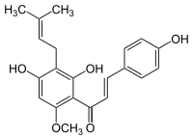
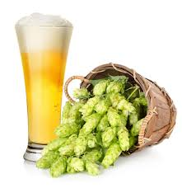
What is Xanthohumol?
A polyphenol found in beer hops
Observed characteristics
Antioxidant
Anti-inflammatory
Antimicrobial
Cancer chemopreventitive agent
Immune system modulator
Notes:
Xanthohumol is a polyphenol compound that is commonly found in beer hops. Hops are the flower or seed bearing portion of the hops plant called hulus lupulus. They are used to give beer a variety of flavor. So they are pretty popular with brrewries.
Besides giving flavor to beer, xanthohumol has been know to have some health benefits that com along with consuming it. Some of hich include..
These traits are making brewries consider taking the left over hops and using them to make xanthohumol suppliments to sell to the public
Talk about structure if time allows
CUT down on this a lot

Slide 3
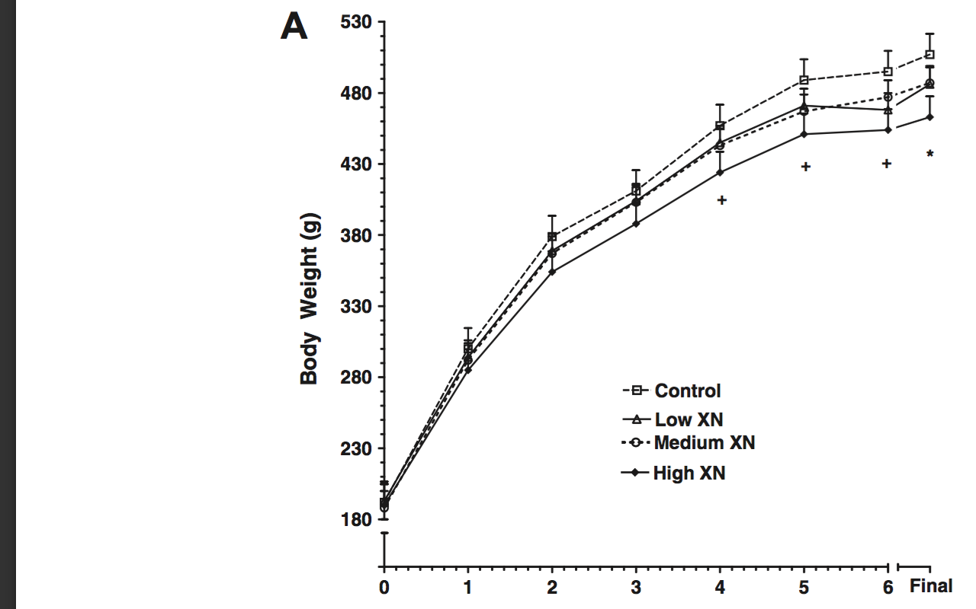
Effects of Xanthohumol
The Stevens lab has shown that:
Of mice fed a high fat diet, those that were fed a high fat diet + xanthohumol gained 15- 20% less weight than those without
Notes:
Fred stevens an oregonstate researcher, has shown that mice which are fed a high fat diet and those that were fed the diet and xanthohumol gained 15-20% less weight.
The amount of food the mice ate in these experiments was controlled, so the difference in weights is not due to a difference .
Maier, stevens and gombart labs have evidence that
xanthohumol binds FXR… binding allows FXR to form a heterodimer with RXR retinoid x receptor, this dimer can now bind the VDREs which are located withine the promoter of the catheleicidin antimicrobial gene, FXR is acting like a trancriptional regulator that will interm determine the amount of CAMP that is produced

Slide 4
Effects of Xanthohumol
Maier, Stevens and Gombart have evidence that:
Xanthohumol binds to the Farnesoid X receptor (FXR)
FXR appears to bind to the Vitamin D response element in the promoter of the cathelicidin antimicrobial peptide (CAMP) gene
FXR regulates CAMP gene expression

Slide 5
Antimicrobial peptides (AMPs) are expressed in tissues exposed to environmental microbes
  Skin, oral mucosa, tongue and colon
  salivary & sweat glands
  various white blood cell populations
Notes:
A little more about anti microbial peptides in general
CAMP is a calass of AMP
Some of the places AMPS are expresed include…..
These site ar all ones that are exposed to the outside enviornment
Now that we have discussed what tissues express AMPS we can get a bitt more specific and discuss CAMP and the cells that express it

Slide 6
CAMP is important for innate immunity
Found in
Epithelial cells
Macrophages
Neutrophils
Protects against
G+ and G- bacteria
Enveloped viruses
CAMP knockout mice showed an increase in:
Skin and urinary tract infections
Eye infections
The severity of inflammation in gut epithelia
Notes:
6
CAMP is commonly found in epithelial, macros, and neutros. Macs and neuts are comon cells used in innate immunity, which is one of your bodies 1st lines of defense agains potentially harmful microbes. CAMP protects/ is effective agains G+ G- bac and enveloped viruses
In mice, that had the CAMP gene knocked out and therefore could produce CAMP, they showed increased signs of skin and urinary tract infections. The gut was overcolonized by the bacteria present, which increases the probability of infection, and by new and potentially pathogenic bacterium that were introduced . Instances of eyey infections also occurred.
Belox is the structure of the CAMP protein, which is produced and a proprotein, a preotein that tis inactive, this is very beneficial for the cell because having the protein active can lead to detrimental effects. One example of this is when CAMP is made in the neutrophil it is madeas the propotein and stored in its secondary granules. Where as the enzyme use to cleave it will be stored in a primary granule. Lets say a neutrophil takes up a phage. The primary vesicles will first fuse then the econdary onse leading to activation of CMAP.
The proprotein is cleaved by proteinase, or kallkriens 5 and 7 to mature and activate.
Produced in the cell as a propreotein- inactive …. Activated by enzyme clevage
LL37 is CAMP
Enzymes cleave CAMP to activate it
importance is mainly for safe storage within the cell
neutrophils store these in 2ndary granules .. Enzyme is in primary granule…. Come together in the phagosome, to activate.....

Slide 7
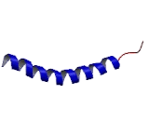
CAMP protein structure
Proteinase 3
Kallikreins 5 & 7
SP
Cathelin prosequence
Mature AMP
Z
C
C
C
C
s
s
s
s
Conserved
Variable
Cathelin-derived precursor
stored in neutrophil specific
granules
Amphipathic α-helix

Slide 8
AMPs disrupt integrity of bacterial membrane
Oren et al., Biochem J. 1999; 341: 501–513
Notes:
Amphoteric peptide
positively charged domain in attracted to the negative charge of the membrane
lays on /covers the membrane
disrupts the membranes

Slide 9
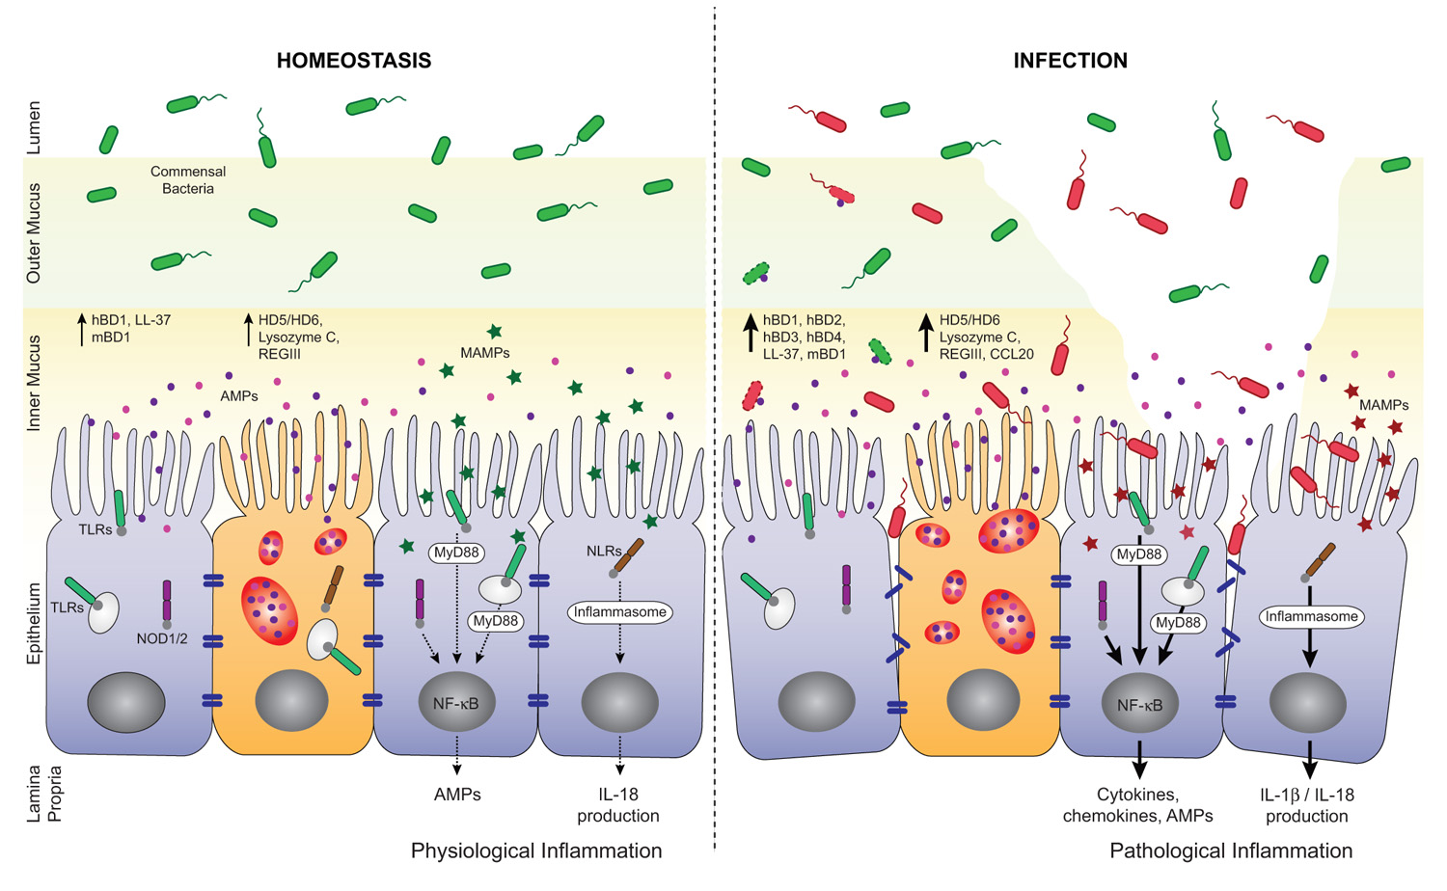
AMPs are important for gut health
Composition of the Gut
Notes:
CAMP and other AMPs are present in the inner mucus layer
Help keep the flora of the gut at bay
But that leads you to think, what if camp does more than just keep the flora at bay, what if it plays a role in shaping what bacteria make up that flora. An what if that CAMP altered flora lead to a phenotype that was different to one in which CAMP is not present.
bacteria aid in digestion- allowing us to harvest energy from sourced we would not able to normally (EX?)
certain bacteria allow for more nutrient uptake than others… leads to fat

Slide 10
Hypothesis
Consumption of Xanthohumol induces CAMP gene expression in the gut which alters the bacterial composition.
The question I addressed this quarter
When compared to mice eating only a high-fat diet, do mice fed a high fat diet and xanthomhumol show changes in their gut microbiota?

Slide 11
Experiment Setup
12 control mice- fed a high fat diet
12 test mice – fed a high fat diet + xanthohumol
  Xanthohumol dosage was 30mg/kg
Euthanized at 14 weeks
  Tissue and feces samples were collected
Notes:
Amount of xanthohumol in the food changed as the mice gained weight
Mice with XN didn’t have as high of blood glucose, and decreased their blood glucose much quicker than mice without XN

Slide 12
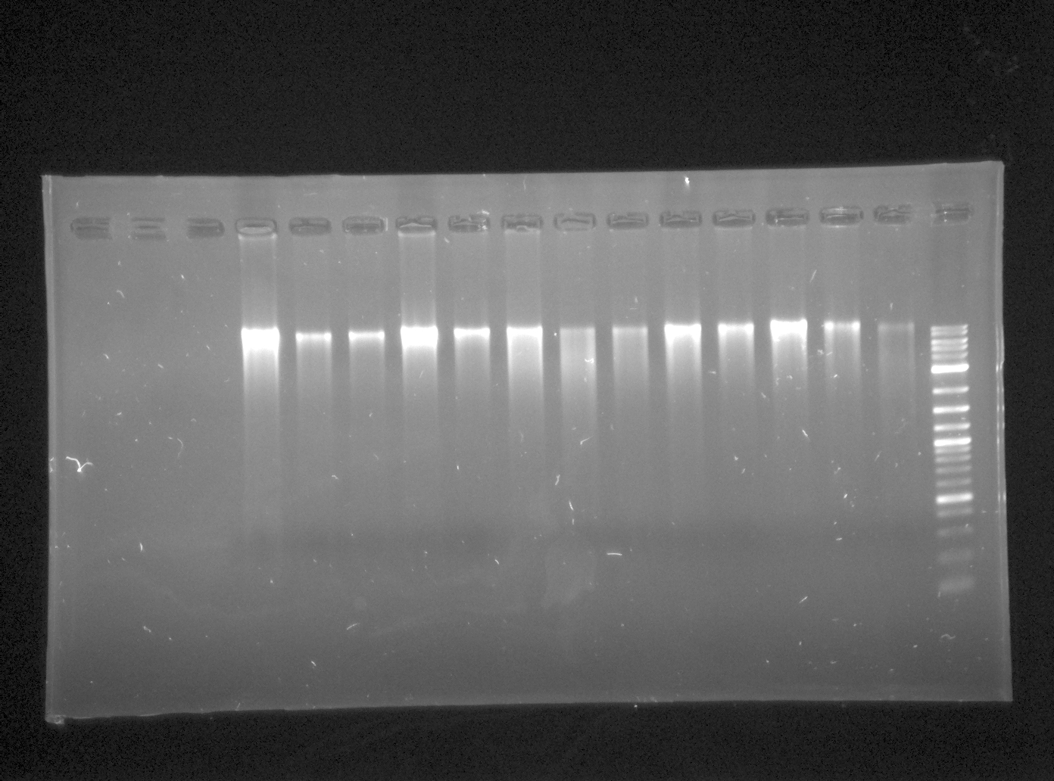
16s rRNA Sequencing
gDNA isolation use MO BIO Kit
Quantification of gDNA
Gel electrophoresis
Notes:
Should let us be able to identify different phyla of bacteria
16s rRNA is a conserved sequence within the 30s small ribosomal subunit
Within this conserved sequence there are areas a variability that arise from muts/ horzozntal gene transfer
This allows us to sequence this area to determine what phyla of bacteria are present
Graphicall representation

Slide 13
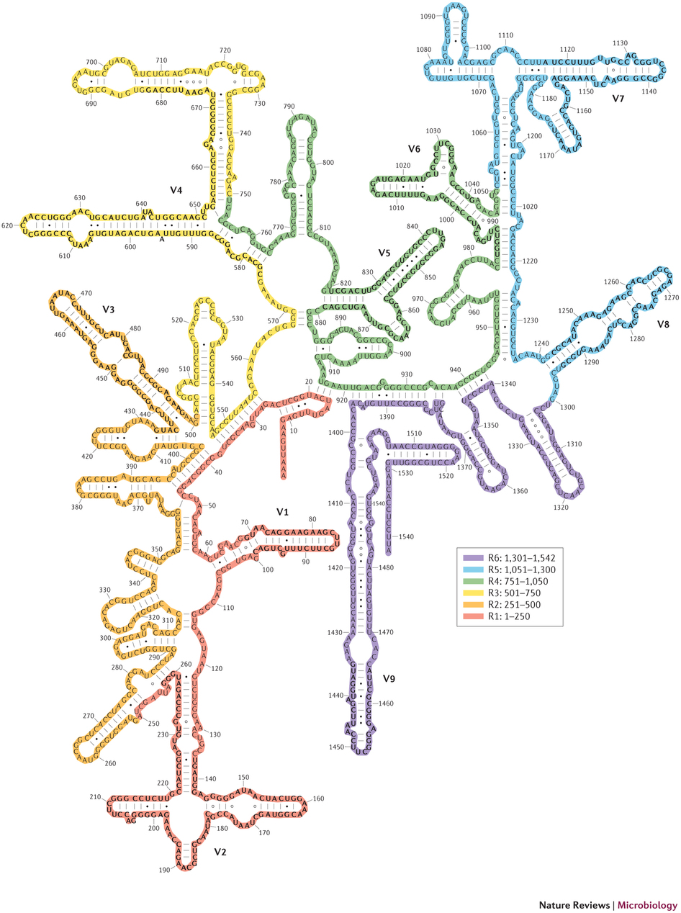

16s rRNA Sequencing
PCR of the 16s rRNA gene
  Amplification of the V3 and V4 hypervariable regions
Illumina Miseq
Analysis of sequencing

Slide 14
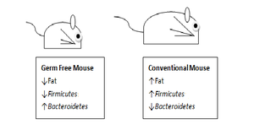
Predictions
Consumption of Xanthohumol will alter the bacterial composition of the gut
The bacterial composition may favor a lean phenotype
For example:
Fewer Firmicutes
More Bacteroidetes
Turnbaugh, et al. 2009. A core gut microbiome in obese and lean twins. Nature 457:480– 484
Notes:
Metagenomic analysis
allows us to determine which bacteria are present in lean vs obese phenotypes
Metabolomic analysis
which metabolites are present.. Can determine which metabollic processes play a role in weight gain

Slide 15
Future plans
Metagenomics
Metabolomics

Slide 16
Thank You
Dr. Gombart
Miles Thompson

