Slide 1
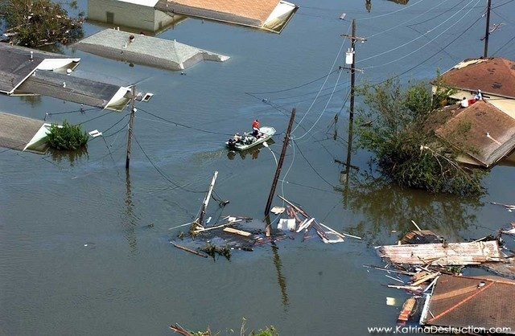
A novel physically-based framework for the intelligent control of river flooding
Arturo Leon
Assistant Professor of Water Resources Engineering
School of Civil and Construction Engineering
Oregon State University

Slide 2
Acknowledgements:
Financial support:
NSF and NSF-EPSCoR Idaho.
Contributors/Collaborators:
Ph.D. Student Tseganeh Zekiewos (OSU)
M.S. Student Akemi Kanashiro (BSU)
Dr. Juan Gonzales-Castro
Notes:
Let me present you the outline of my talk
First I am going to present an overview of real time control. Here I also will talk about the difference between simulation and optimization modeling.
Second I will show two cases of simulation an optimization control, in which I was involved.
Finally I will give some conclusions and I will talk about the future work.

Slide 3
Presentation outline
Brief overview of flood control and current limitations
State-of the-art technology for reservoir operation including flood control
Overview of proposed framework
    Application of proposed framework to the Boise River system, Idaho
Conclusions and near-future work
3
Notes:
3
Let me present you the outline of my talk
First I am going to present an overview of real time control. Here I also will talk about the difference between simulation and optimization modeling.
Second I will show two cases of simulation an optimization control, in which I was involved.
Finally I will give some conclusions and I will talk about the future work.

Slide 4
Overview of flooding: Need of real-time control and need of accounting for system flow dynamics
Dam “C”
Medium risk
Low risk
Reach 4
High risk
Dam “B”
Large inflows
Dam “A”
Reach 3
Q
Available storage
Reach 1
t
Reach 2
Medium risk
Notes:
Let me present you the outline of my talk
First I am going to present an overview of real time control. Here I also will talk about the difference between simulation and optimization modeling.
Second I will show two cases of simulation an optimization control, in which I was involved.
Finally I will give some conclusions and I will talk about the future work.

Slide 5
Why does current frameworks neglect system flow dynamics?
Lack of robustness: Unsteady models typically have convergence and stability problems.
Computational burden: A framework that combines simulation and optimization may require hundreds or even thousands of simulations for each operational decision.
Notes:
Current frameworks combining simulation and optimization simply perform mass balance in the reservoirs.
Neglecting system flow dynamics due to a lack of robustness and computational burden of current unsteady flow models.
Because of lack of robustness is present especially in some one-dimensional models, that are highly robust for a wide range of conditions but not necessarily for all.
And because of computational burden is due to the implementation of a Real-time strategy that combines simulation and optimization may require hundreds or even thousands of simulations for each operational decision.
To address the complexity of river flooding and to overcome the limitations of current frameworks for flood control, the proposed framework couples a simulation and an optimization component that accounts for system flow dynamics and that makes possible the intelligent control of river flooding.
This framework is robust and very fast that will allow its application to actual complex river systems.
Maximizing the in-line storage of the entire river system and associated reservoirs, and allowing control flooding only after the capacity of the entire system has been exceeded.
5

Slide 6
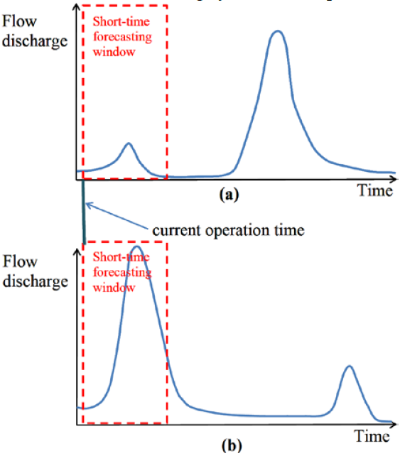
Need of accounting for short- and long-term forecasting
May result in Flooding
May lead to an unnecessary release of a large volume of water. Conflict with long-term objectives
Notes:
Let me present you the outline of my talk
First I am going to present an overview of real time control. Here I also will talk about the difference between simulation and optimization modeling.
Second I will show two cases of simulation an optimization control, in which I was involved.
Finally I will give some conclusions and I will talk about the future work.

Slide 7
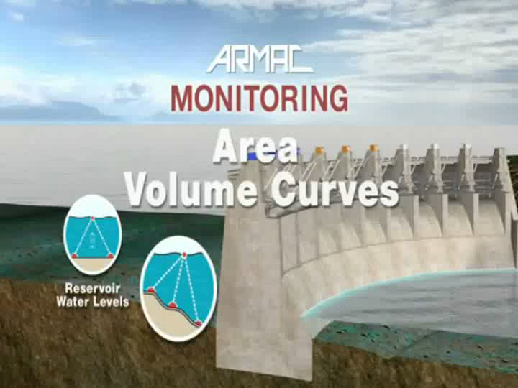
State-of-the-art operation of reservoir systems (Video)
Source: ARMAC
Notes:
Let me present you the outline of my talk
First I am going to present an overview of real time control. Here I also will talk about the difference between simulation and optimization modeling.
Second I will show two cases of simulation an optimization control, in which I was involved.
Finally I will give some conclusions and I will talk about the future work.

Slide 8
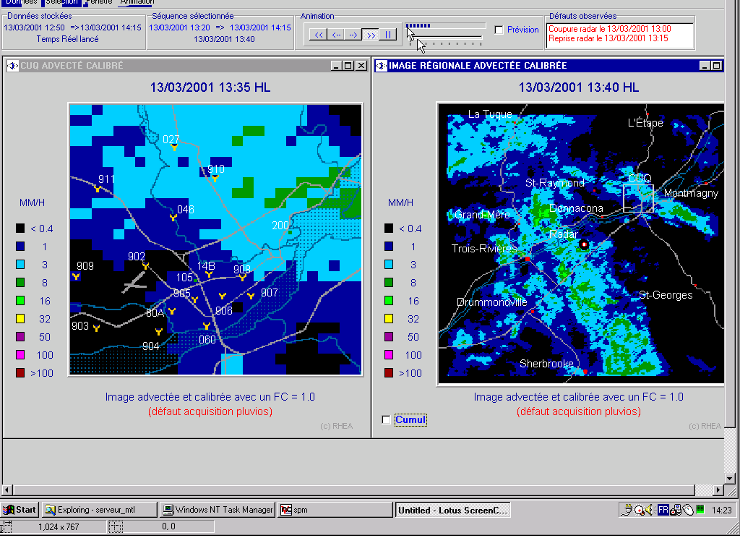
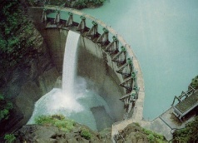
An ideal real-time control strategy
Real-time Forecasting:
high-risk
medium-risk
low-risk
Simulation model accounting for system flow dynamics
Optimization (stochastic for long-term and deterministic for short-term )
Flow hydrograph at boundaries
Choose best operational decision
Feed new BCs and Initial conditions
Water levels and flow discharges in reaches
Remote gate and lock modulation
operator action
(Automation)
Notes:
A real time control in hydraulic systems has various components.
First, Real-time forecasting ---- to compute flow variables at boundaries of system
Second, State of hydraulic system (initial conditions, water levels, initial opening of gates, etc.
Set of objectives: maximize storage, minimize overflows. Run the model for a set of conditions specified by the user in order to fulfill the set of objectives.
The best set of conditions is chosen as the decision sequence
Control points in the ground

Slide 9
Proposed Framework (OSU Rivers?)
The proposed framework couples a robust and numerically efficient hydraulic routing technique (simulation model) with a state-of-the-art Optimization technique (Genetic Algorithm) (will add stochastic optimization for long-term and deterministic for short-term)
Provides a system analysis and a system control in real-time conditions.
Accounts for short and long-term forecasting
9
Notes:
9

Slide 10
Proposed Framework (Cont.)
Two different sets of objectives: Short-term and long-term
Long term: Maximize storage for Hydropower production, irrigation, etc (making sure that there is no flooding due to wrong operation of locks and gates)
Short-term: Avoid flooding or in the worst case allow controlled flooding
10
Notes:
10

Slide 11
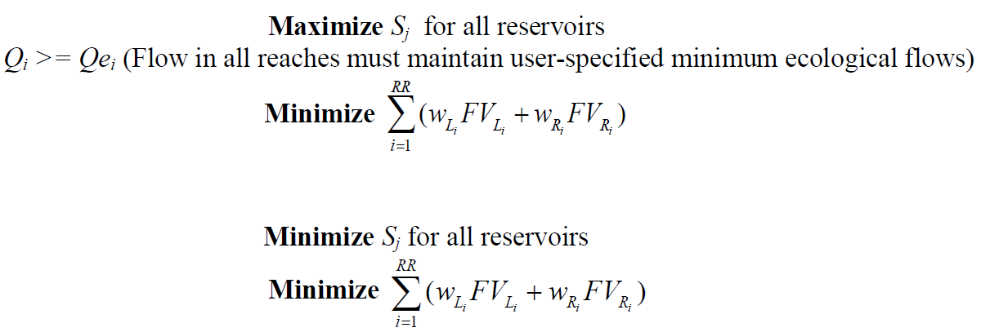
Optimization objectives
Long-term objectives
Short-term objectives

Slide 12
Proposed Framework (Cont.)
When capacity of river system is exceeded, the proposed framework allows controlled flooding based on a hierarchy of risk areas (Urban areas have highest risk)
12
Notes:
12

Slide 13
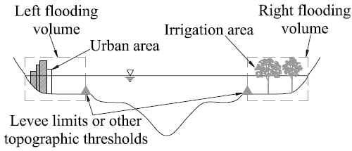
Controlled flooding
Notes:
Recurrent disasters associated with river flooding suggest that current strategies for river flood control need to be reevaluated looking for most appropriate frameworks. Climate change studies suggest that rain-storms will be more recurrent and have higher peak flows.
A review of common structural measures used for flood control reveals most of these measures are passive, with dams being the most important structural measure for flood control. Most dams built for flood control have gates that are operated based on rule curves.
Rule curves do not take into account the flow conditions in the entire river system, which makes this approach a ``slow-response'' method for flood control. This is particularly true in complex river systems when parts of the river system have enough in-line storage capacity, while other portions of the system are overflowing.
Fig. 1, shows that reach 1 upstream of Dam “A'' is about to flood in a high risk area.
While reaches 2, 3 (medium and low risk area) have enough capacity for storage.
Under these conditions, the rule curve approach would open the gates of dam “A'' but not those of dams B and C.
Gates of dam C would open only after reach 3 is almost full, and the gates of dam B would open after reach 2 is almost full. This near-passive approach is far from being the most optimal flood control method.

Slide 14
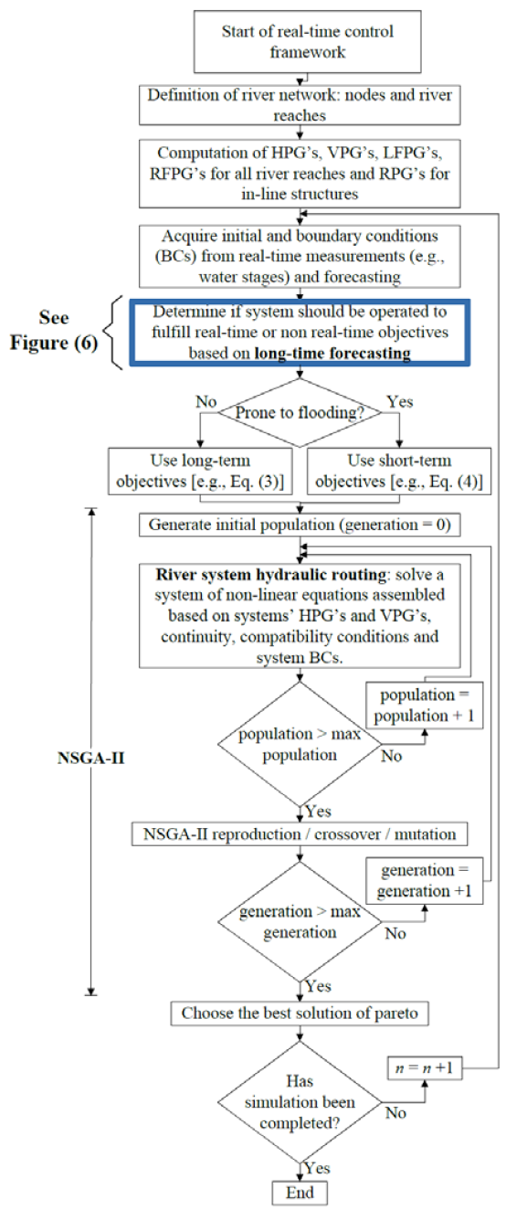
Flow chart of Proposed Framework
Hydraulic routing for each reach (Pre-computed)
Does system should be operated to fulfill short-term or long-term objectives?
Coupling of NSGA-II Genetic Algorithm (and stochastic optimization) with river system hydraulic routing
14
Notes:
14

Slide 15
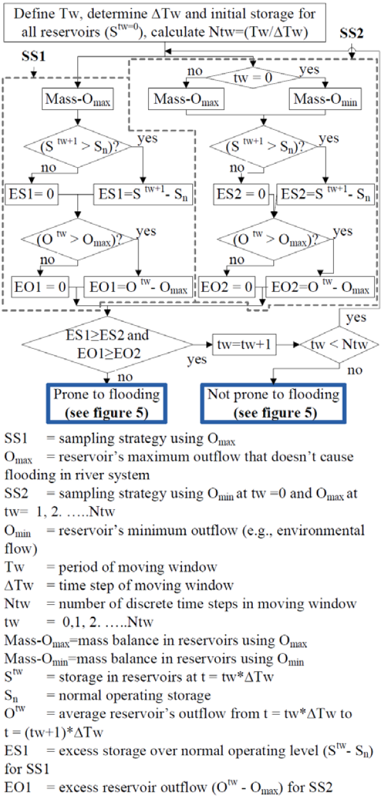
Flow chart of Proposed Framework (Cont.)
15
Notes:
15

Slide 16

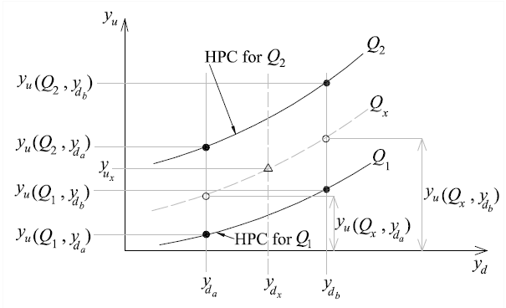
River system hydraulic routing
River network consisting of N reaches
3N unknowns (Qu, Qd, yd of each reach)
yu is known, estimated using HPG, yd and spatially averaged discharge
(1)
Schematic of interpolation
Notes:
This module assembles and solves a non-linear system of equations to perform the hydraulic routing of the river system. These equations are assembled based on information summarized in the systems’ HPG’s, VPG’s and RPG’s, the reach-wise equation of conservation of mass, continuity, compatibility conditions at the union of reaches (nodes), and the system boundary conditions.
In general for a river network consisting of N reaches, there is a total of 3N unknowns, namely the flow discharge at the upstream and downstream end of each reach and the water depth at the downstream end of each reach, and hence 3N equations are required.
The water depth at the upstream end of each reach is not an unknown because it can be estimated from the reach HPG using the water depth at its downstream end and the spatially averaged flow discharge as input values.
This can be represented as eq 3

Slide 17
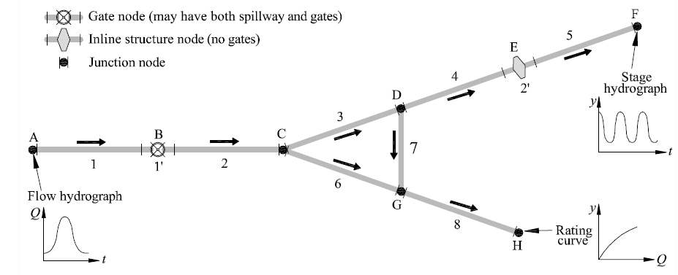
System routing
RR=8 -> 24 unknowns
Schematic of a simple network system
Conservation of mass -> 8 equations
Continuity equations -> 5 equations
External boundary conditions -> 3 equations
Compatibility conditions -> 6 equations
RPG’s -> 2 equations
Notes:
For illustration purposes without loosing generality, these equations are formulated for the simple network system depicted in Fig.16.
has eight reaches and therefore has twenty four unknowns (3x8).
The water storage at any time in a river reach is determined from the reach VPG using its downstream water depth and the spatially averaged flow discharge as input values, the application of VPG’s requires an interpolation process similar to that of the HPG.
Junction nodes: if a node is connected to k river reaches, k-1 compatibility conditions are available.
Compatibility conditions enforce the same elevation for the water stages immediately upstream and downstream of the junction node.
The last two equations are obtained from uncontrolled and controlled in-line structures BC’s (RPG’s)

Slide 18
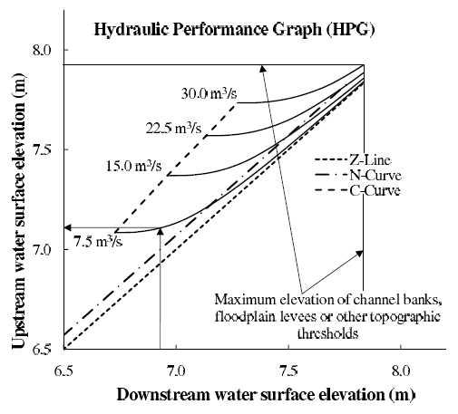
Components of the proposed framework: Simulation component - River system flow routing
HPGs/VPGS (in general flooding performance graphs) neglect local but takes into account backwater effects and convective acceleration terms
Hydraulic Performance Graph (HPG)
Notes:
The hydraulic component of the proposed framework consists in dividing the river system into reaches and pre-computing the hydraulics for each of these reaches independently using any gradually varied flow model (one-, two- or three-dimensional model).
The pre-computed hydraulics for each reach is stored in matrices and is accessed as look up tables.
The HPG of a channel reach graphically summarizes the dynamic relation between the flow through and the stages at the ends of the reach under gradually varied flow (GVF) conditions, while the VPG summarizes the corresponding storage.
18

Slide 19
Optimization component: The Non-dominated Sorting Genetic Algorithm-II (NSGA-II) – To be combined with stochastic optimization for long-term
One of the most efficient algorithms for multi-objective optimization.
Find the optimum set of solutions for a multi-objective optimization.
Handle constraints without the use of penalty functions
Notes:
The proposed framework will link two components: river system routing (simulation) and optimization.
This algorithm has been demonstrated as one of the most efficient algorithms for multi-objective optimization on a number of benchmark problems, including water resources engineering problems.
NSGA-II algorithm is used to find the optimum set of solutions for a multi-objective optimization and has the ability to handle constraints without the use of penalty functions.
19

Slide 20
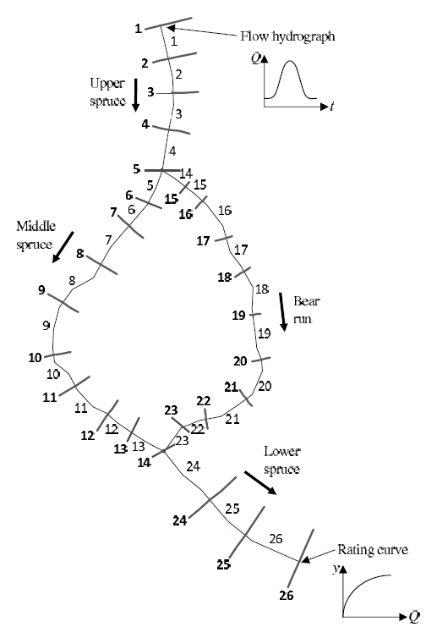
Comparison of hydraulic component of the proposed framework for unsteady flow routing with the Unsteady HEC-RAS model
Looped river system adapted from an example in the Applications Guide of the HEC-RAS model (Hydrologic Engineering Center, 2010).
Plan view of HEC-RAS looped river system.
Notes:
For illustrating the use of the proposed model in unsteady flow routing, this model has been applied to a looped river system adapted from an example in the Applications Guide of the HEC-RAS model (Hydrologic Engineering Center (2010a)).
20

Slide 21
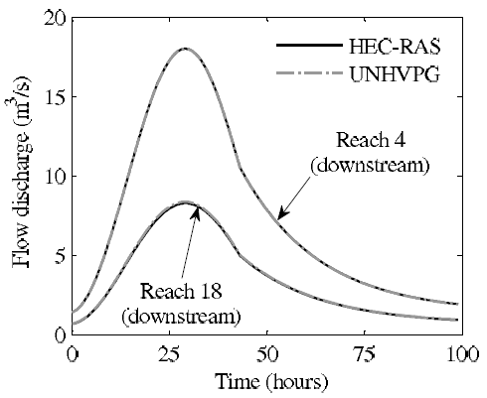
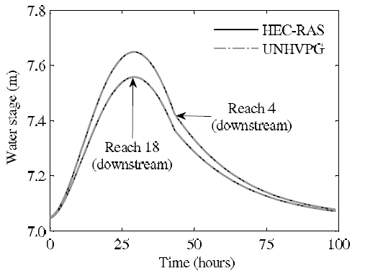
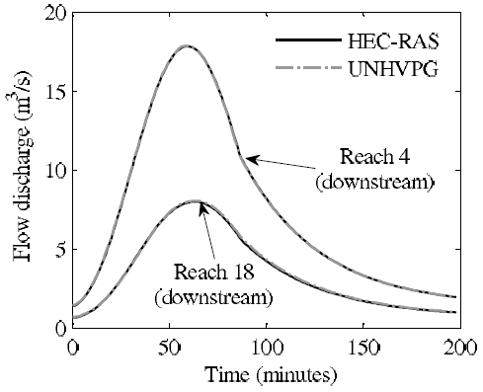
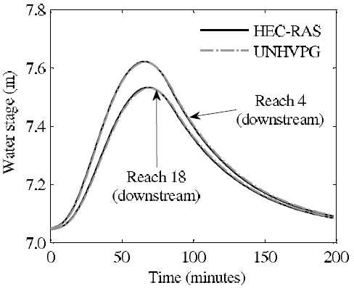
Slow flood wave
Fast flood wave
Notes:
Results show that agreement between proposed and HEC-RAS models is very good for slow and fast flood-wave conditions.
21

Slide 22
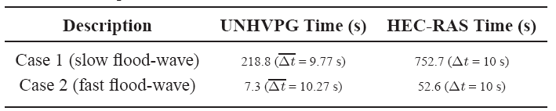
CPU Times
The results obtained with the UNHVPG model (proposed framework) are about 300% and 700% faster than those of the HEC-RAS model for the slow and fast flood-wave cases, respectively.
Robustness: Proposed Framework is more robust because it involves mostly interpolation steps.
Notes:
Proposed model 300% and 700% faster than those of the HEC-RAS model for the slow and fast flood-waves, respectively.
Results show that agreement between UNHVPG and HEC-RAS models is very good for slow and fast flood-wave conditions, with better agreement for
slow flood-wave conditions.
22

Slide 23
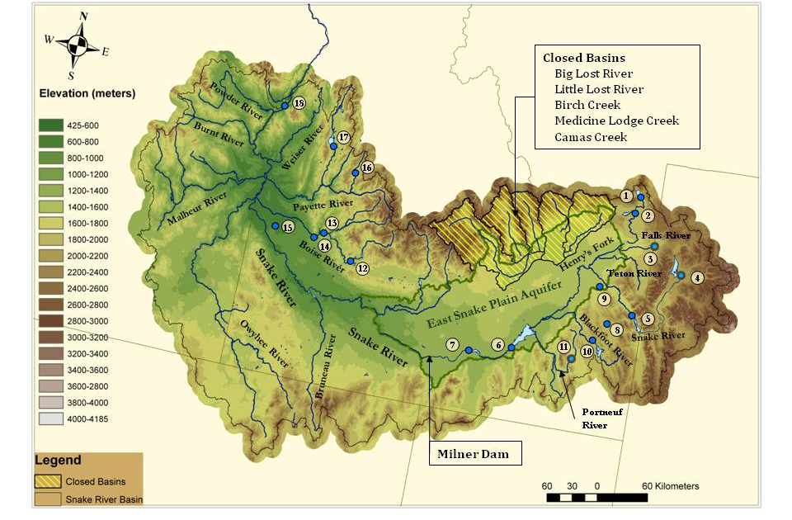
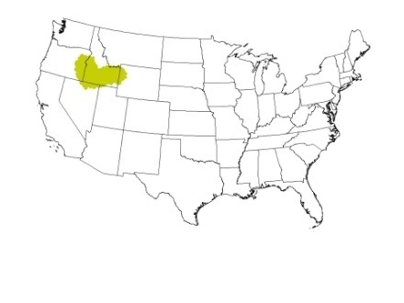
Application of proposed framework to the Boise River System (Idaho)
Boise River

Slide 24
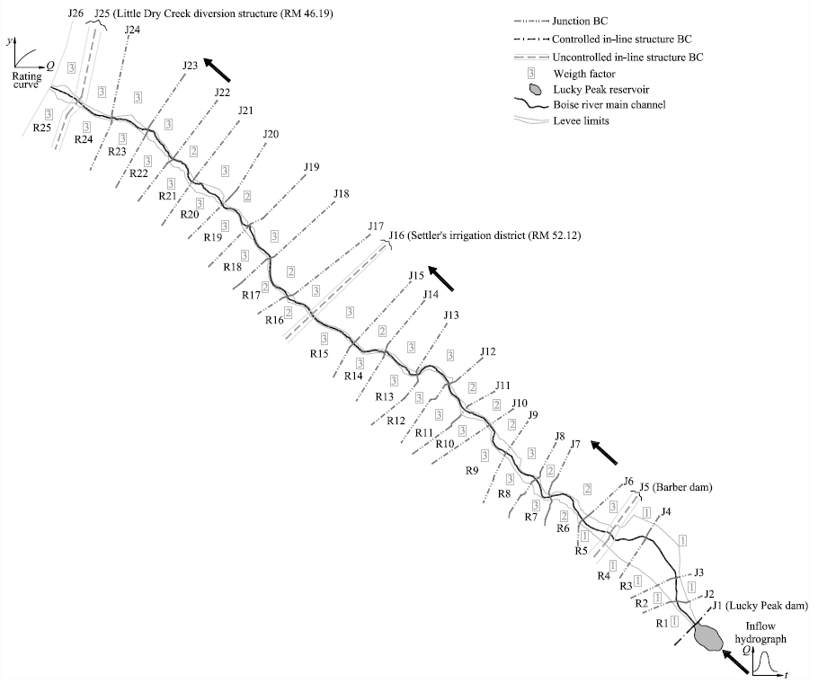
Boise River System Plan View
Notes:
The Boise River system was divided into twenty five river reaches, three uncontrolled in-line structure BC’s, and one controlled in-line structure
BC (that is automatically operated to meet the objectives of the optimization).
The controlled in-line structure BC consist of six sluice gates.
The upstream end of the reach R1 is located right downstream of Boise River Diversion Dam and the downstream end of reach 25 is
located approximately 2600 m downstream near Glenwood bridge.
24

Slide 25
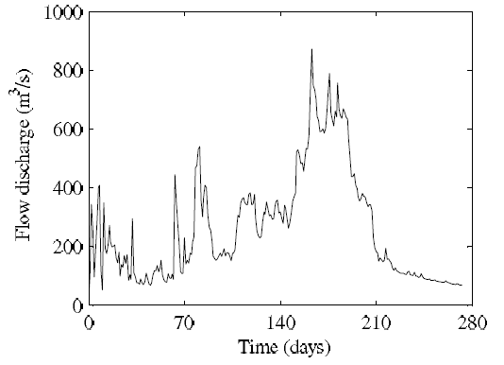
Inflow hydrographs
Original inflow hydrograph -50 years (from 01/01/2010 to 12/19/2059)-SWAT (Courtesy Prof. Sridhar, BSU)
Simulation period of nine months (11/30/2041 to 8/30/2042) 274 days - maximum volume of inflow.
Original inflow hydrograph represents natural flows at the location of Lucky Peak reservoir
Inflow hydrograph (SWAT)
(11/30/2041 to 8/30/2042)
Notes:
The original inflow hydrograph was obtained using Soil and Water Assessment Tool (SWAT) for a climate change simulation.
This inflow hydrograph consist of average daily flows for a fifty years period (from 01/01/2010 to 12/19/2059).
Is important to notice that this inflow hydrograph represents natural flows at the location of Lucky Peak reservoir assuming that there is not storage facilities.

Slide 26
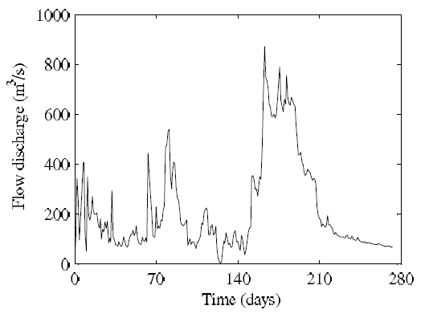
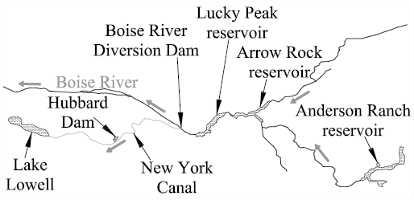
Modified inflow hydrograph
Anderson Ranch reservoir (509.6 MCM) - 90 m3/s 03/07/2042 to 05/11/2042 to fill the reservoir.
Arrow Rock reservoir (335.8 MCM) - 84 m3/s
03/25/2042 to 05/10/2042 to fill the reservoir.
Lake Lowell (196.6 MCM) - 51.5 m3/s
03/18/2042 to 04/30/2042 to fill the lake.
Hubbard Dam (4.9MCM) - 10 m3/s
05/05/2042 to 05/09/2042 to fill the reservoir.
Inflow hydrograph subtracting active storage capacity of Anderson Ranch, Arrow Rock, Hubbard reservoirs and Lake Lowell.
Plan view of major storage reservoirs in the Boise river basin.
Figure 8: Inflow hydrographs
Notes:
In order to consider storage in our application, the active storage capacity of Anderson Ranch reservoir (509.6 MCM) and Arrow Rock reservoir (335.8 MCM),
both located upstream of Lucky Peak reservoir.
A constant flow discharge of 90 m3/s was subtracted from the inflow hydrograph for dates 03/07/2042 to 05/11/2042 to fill Anderson Ranch reservoir.
A constant flow discharge of 84 m3/s was subtracted from the inflow hydrograph for dates 03/25/2042 to 05/10/2042 to fill Arrow Rock reservoir.
The Boise River Diversion Dam, is an inline structure located downstream of Lucky Peak reservoir and upstream of river reach R1, diverts water into the New York Canal.
The New York Canal feeds Lake Lowell (196.6 MCM) and Hubbard Dam (4.9MCM).
In order to consider the active storage capacity of Lake Lowell and Hubbard Dam
A constant flow discharge of 51.5 m3/s was subtracted from the inflow hydrograph for dates 03/18/2042 to 04/30/2042 to fill Lake Lowell
A constant flow discharge of 10 m3/s was subtracted from the inflow hydrograph for dates 05/05/2042 to 05/09/2042 to fill Hubbard Dam.
A composite flow hydrograph resulting from reducing the storage in Anderson Ranch reservoir, Arrow Rock reservoir, Lake Lowell and Hubbard dam was used in the present application

Slide 27
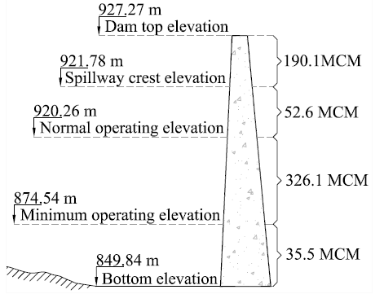
Stage-storage relationship of Lucky Peak reservoir
Notes:
Due to a lack of river geometry between Lucky Peak reservoir and Boise Diversion Dam (node J1 in Fig), it was assumed that Lucky Peak reservoir is immediately upstream of node J1.
In other words, the outflow of Lucky Peak reservoir discharges directly to river reach R1.
The stage-storage curve for the Lucky Peak reservoir is presented in Fig. 3.7. Is important to mention that this relationship was adjusted for elevations due to Lucky Peak reservoir was move from its original elevation to immediately upstream of node J1.

Slide 28


Optimization objectives (short-term)
(1)
(2)
Notes:
The first optimization objective is minimize objective function 1 and 2.
The second objective was minimize storage in Lucky Peak reservoir.
The storage in the reservoir can be found using a stage-storage curve.
The outflow discharge at Lucky Peak dam was constrained to a maximum flow discharge of 184.06 m3/s, which is the maximum flow that the Boise River can convey without producing flooding.

Slide 29
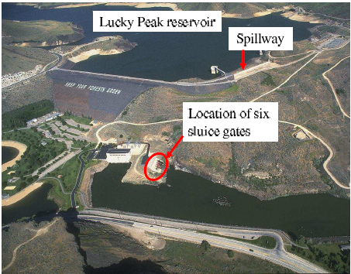
Outlet structure of Lucky Peak
- 6.71 m diameter steel-lined pressure tunnel (upstream end)
- Six sluice gates (downstream end)
Gates conveyance (hydraulic capacity) was smaller than that of tunnel
View of Lucky peak reservoir and associated structures.
Notes:
The outlet structure of Lucky Peak reservoir consists of a 6.706 m diameter steel-lined pressure tunnel at upstream end of the outlet structure
six sluice gates at the downstream end of the outlet.
The configuration of these gates is presented. The hydraulic capacity of the upstream and downstream ends of the outlet structure were compared. The gate conveyance was smaller than that of the tunnel and hence controls the flow discharge through the outlet structure.
The gates are assumed to be operated identically (i.e., all open or closed). The RPG’s were built assuming that all gates are operated (opened or closed) using the same discrete levels. In this application 32 discrete positions for the gates have been considered. The plan view of Lucky Peak reservoir and associated structures is presented in Fig. 23.

Slide 30
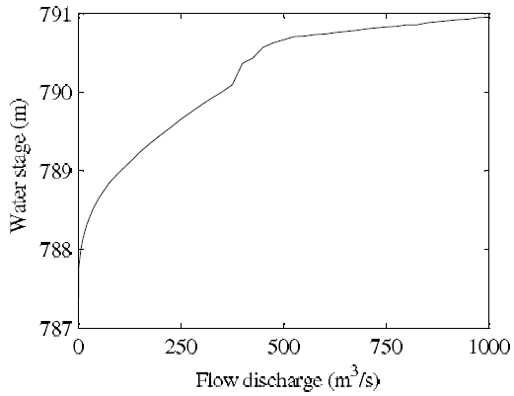
External Boundary conditions
Inflow hydrograph at upstream end of Lucky Peak reservoir.
2) Flow-stage relation at node J26 (most downstream end of river system)
Notes:
In this application we have two external boundary conditions (EBCs), the first BC is an inflow hydrograph at the upstream end of Lucky Peak reservoir, presented in Fig. 24 and the second BC is a flow-stage relation at the downstream end of reach 25, presented in Fig. 25, this flow-stage relation was build using critical conditions.
The initial flow discharge in the system of 166.7 m3/s (steady state)
Water stage in Lucky Peak reservoir of 879.84 m.

Slide 31
Simulated scenarios
Without gate operation (i.e. the gates are closed)
2) Assuming that Lucky Peak reservoir doesn’t exist
3) With gate operation according to proposed framework.
Notes:
Three scenarios were simulated:
1) Without gate operation, i.e. the gates are closed.
2) With Lucky Peak reservoir remove.
3) Accordance to the proposed framework.

Slide 32
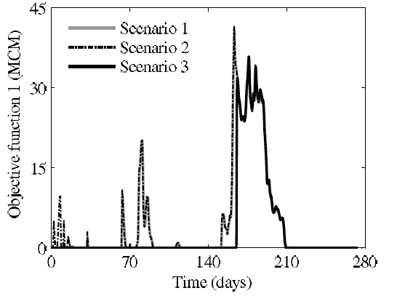
Results
When flooding starts to occur?
Scenario 1 -> day 16
Scenario 2 -> day 2
Scenario 3 -> day 165
Objective function 1: Flooding volume for simulated scenarios.
Notes:
Results of flooding volume and objective function 1 shows that the river start to flood at day 16 for the first scenario , at day
2 for the second scenario and at day 165 for the third scenario.
The maximum flooding volumes for scenarios 3 and 1 are 86.97% and 98.71% the maximum flooding volumes for scenario 2.
Total flooding volume for scenarios 3 and 1 are 71.48% and 96.86% the total flooding volumes for scenario 2.
Scenario 1: simply reduces flooding at the beginning of the simulation.
Because, the reservoir is rapidly filled, and the filled reservoir does not help much for attenuating the peak flow discharge.
32

Slide 33
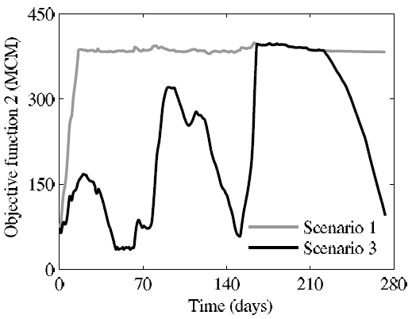
Results (cont.)
Flooding
Storage at reservoir spillway elevation
Objective function 2 (Storage) for scenarios 1 and 3
Boise river would flood for all scenarios. Proposed framework (scenario 3) attenuates and delays the flood but does not avoid flooding due to lack of storage capacity. Boise river was flooding few days ago.
Notes:
For scenario 3, reservoir is not full until day 165.
When a solution does not violate the constraints, the reservoir release stored water from the reservoir due to objective function 2 (Eq. 3.2).
It is important to notice that for the assumed inflow hydrograph, the Boise river would flood for all scenarios.
The operation of gates according with proposed framework attenuates and delays the flood but does not avoid flooding problem for this assumed inflow hydrograph due to lack of storage capacity.
33

Slide 34
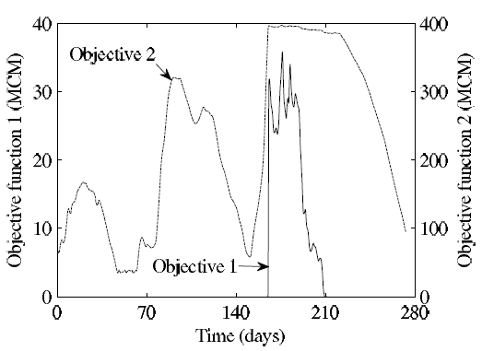
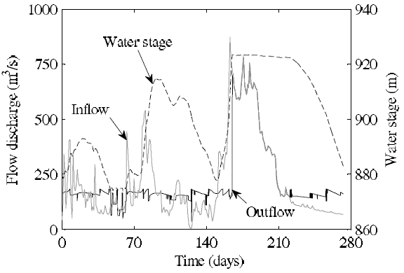
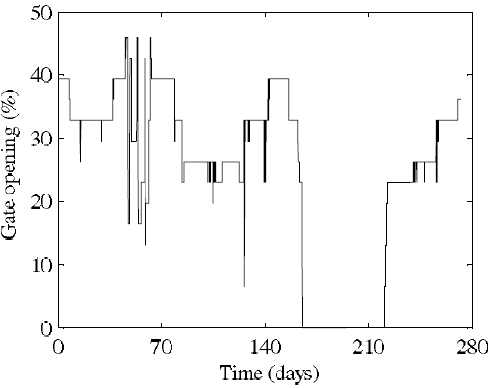
Results (cont.)
A flow discharge less than maximum flow discharge without flooding (184 m3/s) is released most of the time.
Results of objective functions for scenario 3 (proposed framework)
Inflow, outflow and water stage hydrographs at Lucky Peak reservoir.
Gate operation (six gates) at Lucky Peak reservoir.
Notes:
For the third scenario, operated gates releasing a flow discharge lower than the maximum flow discharge without flooding (184.06 m3/s) most of the time.
However, when the reservoir has been filled the flow discharge increase rapidly and the flow hydrograph has a similar shape to that of scenario 2. Scenario 3 retarded and better controlled flooding, however flooding it is not entirely avoided due to storage limitations.
34

Slide 35
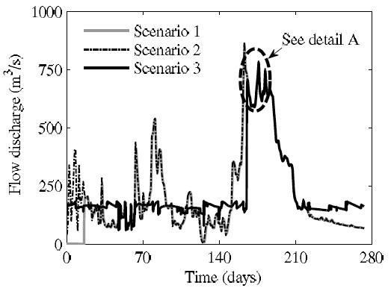
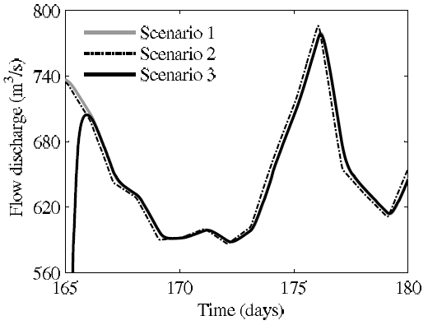
Results (cont.)
Filled reservoir
Flow hydrographs at downstream end of reach R10 for simulated scenarios.
Detail A
-Scenario 1: Reservoir is rapidly filled and overflow occurs there after.
-Scenario 3: Flooding is better controlled, however it is not entirely avoided due to storage limitations.
Notes:
Detail A show the flood attenuation and propagation due to the reservoir.
The peak flow for scenario 3 arrives two hours later than in scenario 2.
It is important to notice that the peak flow for scenario 3 is 7.76 m3/s smaller than that for scenario 2 (1% of the peak flow for scenario 3).
As expected, the reservoir causes the attenuation of flow discharge and water stage for scenarios 1 and 3.
We also see that flow hydrograph of scenario 3 has a similar shape to that of scenario 1 after the reservoir was filled.

Slide 36
CONCLUSIONS
Results show that Boise River would flood for all simulated scenarios. The operation of gates according with the proposed framework attenuates and delays the flood but does not avoid flooding due to lack of storage capacity.
The use of performance graphs for unsteady flow routing in a river system as proposed herein results in a robust and numerically efficient model.

Slide 37
Near-future work
A stochastic optimization for long-term and a deterministic one for short-term will be implemented
A physical laboratory model of a hypothetical complex regulated river system will be built in the wave lab for testing the advantages of the proposed framework for a wide array of flow conditions.
The proposed framework could also be used as a flood warning tool. A flood warning module will be implemented.
A Graphical User Interface (GUI) of the model will be implemented.
Notes:
37

Slide 38
Many thanks for your kind attention!
Contact: Arturo Leon (arturo.leon@oregonstate.edu)
Notes:
38

