Slide 1
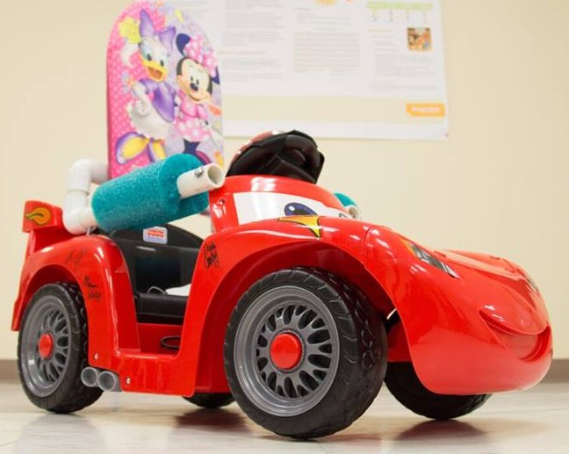
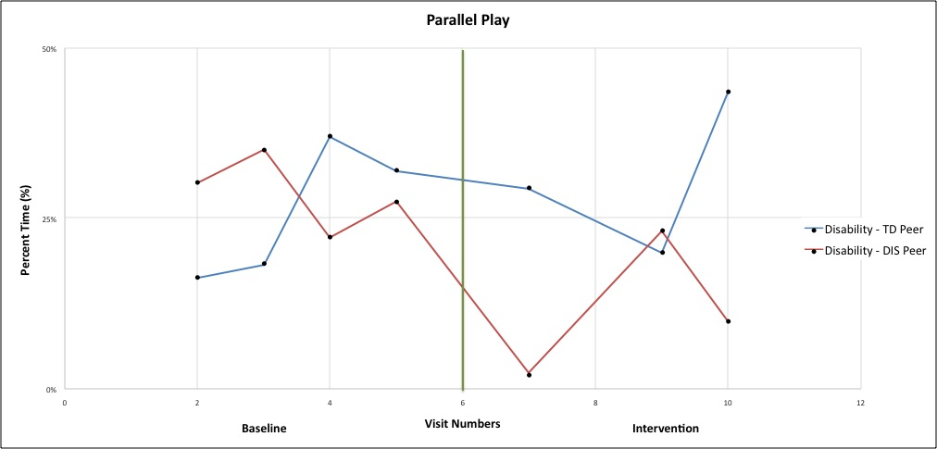
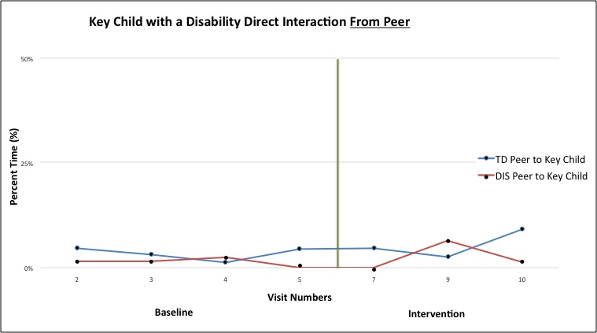
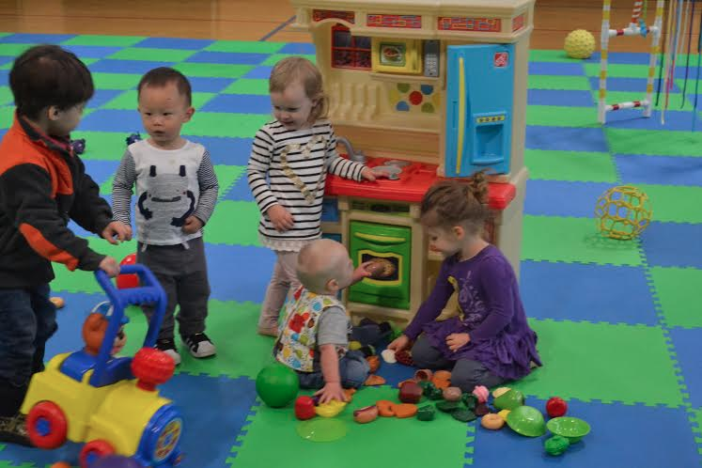
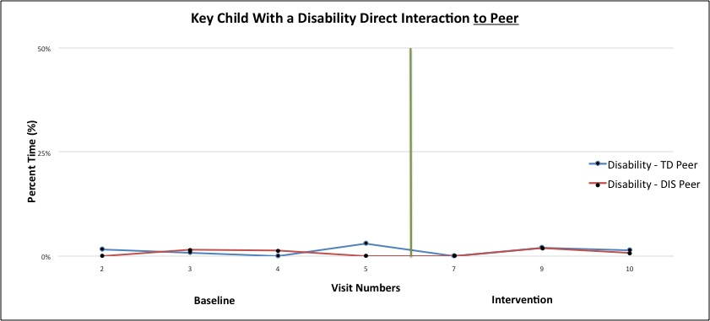
COLLEGE OF PUBLIC HEALTH AND HUMAN SCIENCES
The Effects of an Inclusive Playgroup on Social Interaction Between Children With and Without Disabilities
Kelsey Inskeep; Samantha Ross, M.S.; Erica Twardzik, M.S.; Michele Catena, DPT;
Apoorva Ayyagari; Erika Cook; Haylee Winden; Jeremiah Fine; Jessica Magnani, Samuel W. Logan, PhD
College of Public Health and Human Sciences, Kinesiology, Adapted Physical Activity, Oregon State University
Background
Being present in an area of play can create a dynamic experience of exploration, movement, and interaction with objects and peers. These are required to foster positive development across cognitive, social, and physical domains (1).
Children with disabilities may experience limitations in mobility impacting their early exploration, socialization, and play (2).
Playgroups that are inclusive of children with and without disabilities have been shown to further support positive developmental and behavioral outcomes (3).
There is a substantial gap in peer interaction and play behaviors between typically developing children and children with disabilities (2).
What remains unclear is how peer interaction and play behaviors change over time or change in response to an enriched inclusive playgroup setting.
Purpose Statement
The purpose of the present study is to document the effect on an enriched environment intervention on social interactions between peers with and without disabilities.
Results
Conclusion
Figure 3 suggests that over the length of the study children with disabilities were in parallel play with typically developing peers more often than with other children with disabilities.
During the intervention phase, children with disabilities increased their time spent in parallel play with typically developing peers at about week 10 (Figure 3).
There was no difference of direct interaction from a typically developing peer to a child with a disability throughout the study (Figure 4).
Take Home
Preliminary findings suggest an enriched playgroup may increase parallel play between children with and without disabilities.
There are a remaining 7 weeks of data from the intervention period that is still under analysis.
We hypothesize that the trend for increased parallel play for children with disabilities will continue, as well as an increase in peer interaction.
An inclusive, enriched playgroup setting has potential to reduce the disparity and enhance social play experiences of all children.
Study Limitations
Interrater reliability may have been affected from the amount of coders used.
Attendance for the participants varied each week.
References
Lobo, M. A., Harbourne, R. T., Dusing, S. C., & Mccoy, S. W. (2013). Grounding Early Intervention: Physical Therapy Cannot Just Be About Motor Skills Anymore. Physical Therapy, 93(1), 94-103.
Logan, S. W., PhD, Schreiber, M., MS, Lobo, M., PT, PhD, Pritchard, B., BS, George, L., BS, & Galloway, J. C., PT, PhD. (2015). Real-World Performance: Physical Activity, Play, and Object-Related Behaviors of Toddlers With and Without Disabilities. 433-441.
Odom, S. L., Vitztum, J., Wolery, R., Lieber, J., Sandall, S., Hanson, M. J., ... & Horn, E. (2004). Preschool inclusion in the United States: A review of research from an ecological systems perspective. Journal of Research in Special Educational Needs, 4(1), 17-49.
Acknowledgements
A special thank you to the following:
OSU Undergraduate Research/Arts Fellow Transcript Notation
Figure 2: An example of a ride-on car used in the study for the intervention phase
Methods
Study Design
Single-subject repeated measures study design
17 weeks (preliminary 10 weeks presented here)
Weekly 30 minute inclusive playgroup
Baseline: Weeks 1 - 6
Intervention: Week 7 Enriched environment including the provision of a modified ride-on car (Figure 2) to each child with a disability
Participants
12 total participants 1 to 4 years of age
5 participants with a disability
7 participants with out a disability
Independent Variables
Each child served as their own control
Baseline vs. intervention social behaviors were compared
Dependent Variables
Social behaviors coded using momentary time sampling– 10 second observation/5 second record
SOCIAL BEHAVIORS:
Solitary Play: key child further than 3 feet away from a peer or adult
Parallel Play: key child within 3 feet of a peer (typically developing child or child with a disability) or an adult
PEER to key child Interaction: peer directs a verbal and/or physical interaction to the key child
KEY CHILD to peer Interaction: key child directs a verbal and/or physical interaction to a peer
Data Analysis
Calculated % time child was observed in social behaviors
Visual analysis for comparison of children with and without disabilities’ play behaviors across time points
Meth
Figure 3: Percentage of time spent in parallel play over the entire 10 week study
Figure 4: Percentage of time spent in direct interaction FROM a peer to the key child with a disability.
Figure 1: Social interaction between four typically developing children and one child with a disability (sitting in middle) during an inclusive playgroup.
Figure 5: Percentage of time spent in direct interaction from the key child with a disability TO a peer.

