Slide 1
The Good, The Muddle & The Predatory
Open access journals in marine & aquatic sciences
40th IAMSLIC Conference
New Caledonia, September 2014

Slide 2
Notes:
This is to acknowledge my co-author, Barb Butler, who could not be here, but helped me puzzle through the complexity of OA journals.
Barb is from the University of Oregon’s Oregon Institute of Marine Biology
I’m Janet Webster from Oregon State University’s Hatfield Marine Science Center
We have collaborated for years on a variety of projects. Every two years, we update a section of Magazines for Libraries on marine and ocean science and technology.
Every time we do it, we try to find a new angle rather than just reviewing our recommended title, their coverage, audience and pricing. This year, we decided to look more closely at open access options.
This talk builds on that work. We started thinking that this conversation would fall into The Good, The Bad and The Predatory. Just as with Clint Eastwood movies, things are more complex than appears at first glance. So, I changed the title and the groupings of journals into the The Good, The Muddle and The Predatory. Even that challenges my thinking on what kind of advice to give all of you as well as authors we work with.

Slide 3
Describe types of Open Access. Look at journal policies. Suggest how to talk to authors.
Notes:
To start this conversation, I thought we should review what is meant by open access or what is generally agreed upon.
Then I’m going to look more closely at some of field’s more popular journals and see what their policies say.
And I’ll finish with how I’m approaching my message to authors. In part, this talk is practice for one I’ll give when I get back to Oregon and give something similar to my scientists and students.

Slide 4
Definition
Digital
Online
Free of charge
Free of most copyright and licensing restrictions
Peter Suber. 2004. http://legacy.earlham.edu/~peters/fos/overview.htm
Notes:
This is what we typically think of as open access – free to view/read by anyone with internet access.
There are flavors of open access.

Slide 5
Green vs Gold OA
Self-archive
Author’s web page
Institution’s archive
Subject archive
Pre-print
Post-print
Version of record
Direct
Whole journal is accessible w/o limitations
Delayed
Embargo period before all content is accessible
Hybrid
Some articles are accessible, but not all
Notes:
This seems simple, but it’s not when you start asking what different pieces mean.
Staring with Green, this is the option where an author can archive his or her article. That can happen in a variety of spaces and may be limited by the journal.
What can be archived is also defined by the publisher. A pre-print is the manuscript prior to review and editing – can be quite raw. A post-print has gone through the review process but is not the published version. The Version of Record would be the published article – the publisher’s pdf. Not everyone agrees on what is a postprint, though. You need to check the publisher’s policies. InterResearch describes it clearly –” the author-generated version of the manuscript accepted for publication and sent to the publisher for production (i.e. includes the corrections made during peer review, but excludes corrections and enhancements made by the publisher's sub-editors, copy-editors, graphic designers, and web-services”
Gold comes in several shades as well. Direct are the journals that are completely open from start to finish. Society and Ecology is an example. Delayed access mean that subscribers get access to the most recent and then access is open after a certain period. Marine Ecology Progress Series is an example. Finally hybrid oa journal are selectively open – meaning some articles are accessible because the authors paid a surcharge or the editors decided that an article needed to be accessible given its subject and reader demand.
Bjork et al in 2009. found that 20.4% of scholarly journals were open and 8.%5 were gold and 11.9% were green.
In 2013, Khabsa and Giles estimated that 24% of scholarly journals were open. Some disciplines were higher than others.

Slide 6
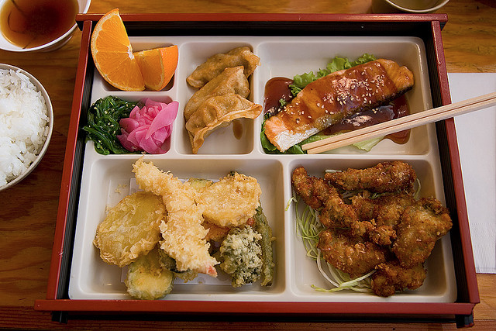
Notes:
So, access is growing. As is the spam we get to publish in a variety of journals we have never heard of. I get questions about who to respond to the inquiries , where can people publish where it will meet our university mandate to be open, what will it cost? In other, words, what is going on and who is paying? There is not such thing as a free lunch.

Slide 7
Examples of the Muddle
Botanica Marina
Canadian Journal of Fisheries & Aquatic Science
Biological Bulletin
Notes:
I’m going to use examples from the core list of journals Barb and I developed and discussed at the Argentina conference.
Botanica Marine allows archving of the post-print after 12 months.
Canadian Journal of Fisheries & Aquatic Science allows posting of the pre-print after submitted or accepted. For $3000 USD, an author can purchase immediate open access through NRC’s OpenArticle program.
Biological Bulletin is an example of delayed OA with a dash of goodness. It doesn’t charge authors, but does charge libraries( $525) and individuals for subscriptions. It makes the June Symposium issue open to all, and embargoes everything else for year. After 12 months, all content is open. It does not allow posting to a repository. They self-identify as Open Access in Ulrichs.

Slide 8
More examples of the Muddle
Deep Sea Research I & II – Elsevier
ICES Journal of Marine Science - Oxford
Limnology & Oceanography - ASLO
Marine Biology - Springer
Notes:
Deep Sea Research is published by Elsevier. An article can be open for a fee - $2500. An author can archive a pre or post print, but not the publisher’s pdf.
ICES Journal of Marine Science is published by Oxford. An article can be open for a fee - $2800 ($1400 or nothing for authors from developing countries). An author can archive a pre-print anytime and an post print 12 months after publication, but not the publisher’s pdf.
Limnology & Oceanography, published by ASLO, has page charges. Author may pay $350 for immediate open access. Sherpa-Romeo says that ASLO allows archiving of the post-print and publisher’s pdf, but I cannot find that one the journals web page.
Marine Biology is published by Springer. AN author may pay the $3000 OpenChoice fee for immediate open access. Pre and post prints may be deposted 12 months after publication.

Slide 9
Marine Ecology Progress Series
Notes:
MEPS is greenish goldish. It’s confusing, but they are trying to be fair.
Everything is open after five years.
Authors can pay one of two fees to make an article immediately open.
(1) Free Access. Articles are freely accessible to all readers; IR retains the copyright.
(2) Open Access under the Creative Commons by Attribution Licence (CC-BY).
Publication fees for open access depend on article length.
Free Access: €800 to €1300; Open Access: €1000 to €1500.

Slide 10
Predator or Just the New Animal on the Block?
Identify theft
High author charges
False claims
No quality control
Photo by Richard Ling

Slide 11
Be aware of fake (OpenAccess) Journals and Publishers! Do not reply to their emails!
Do not send them any manuscripts!
If in doubt, ask a librarian :-)
Jökull
journal of Earth Sciences
Published by the Iceland Glaciological Society and Geoscience Society of Iceland
Original journal URL: http://jokulljournal.is/
Fake journal URL: http://jokulljournal.com/
Notes:
Here’s an example of identity theft.
Courtesy of Marcel Branneman from the Alfred Wegner Institute in Bremerhaven Germany.

Slide 12
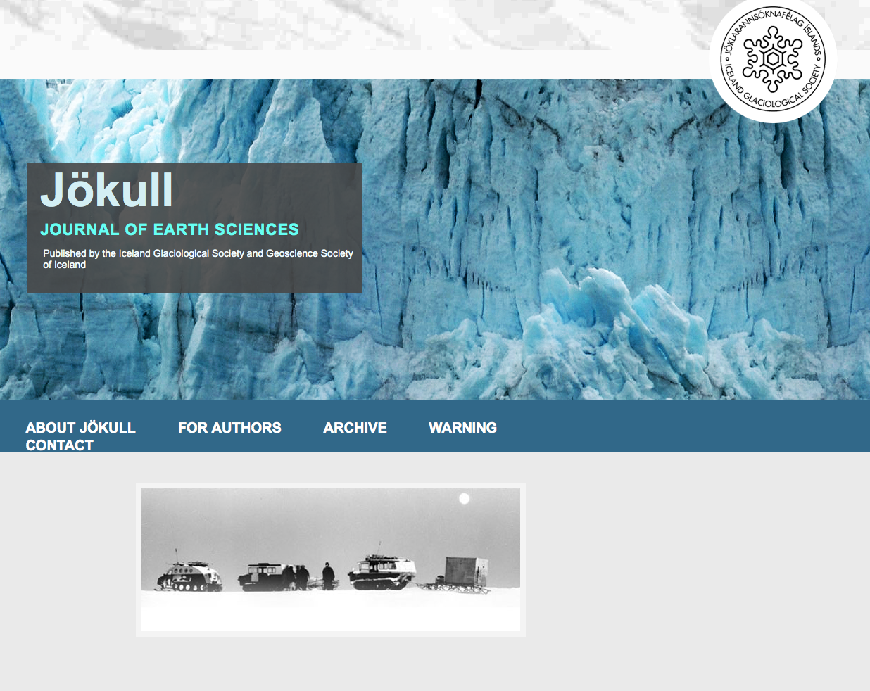
Notes:
Here’s the real journal The Glaciological Society of Iceland that has been around since 1950.
Notice the warning on it front page!

Slide 13
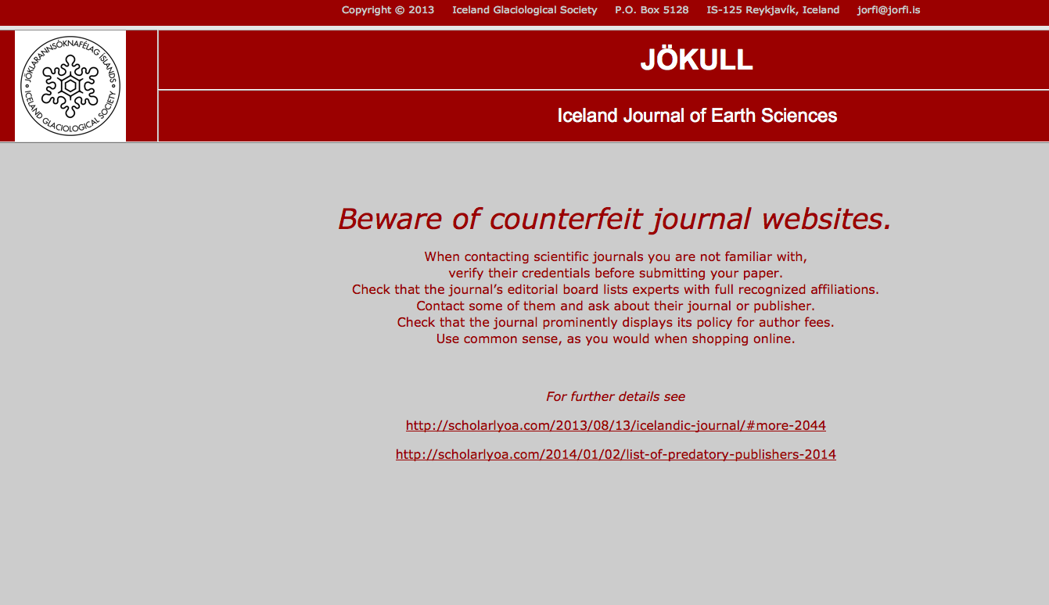
Notes:
The advice on this page is sound:
Check the editorial board.
Contact some of them if you are unfamiliar.
Look for the fee policy.
USE COMMON SENSE.

Slide 14
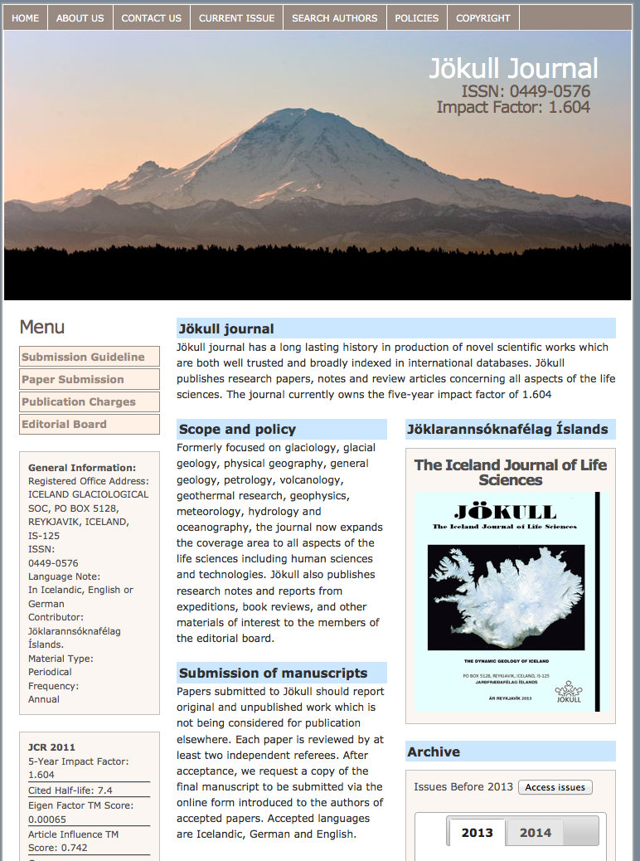
Notes:
Here’s the fake journal. It doesn’t charge for papers in glaciology but does for other field. Why would someone publish papers on other topics? It has an editorial review staff and a turnaround of 4 weeks. Might be tempting to someone wanting to get something out fast without a lot a trouble.

Slide 15
Dear Dr. Barbara A. Butler,
Greetings for the day!!
In view of your eminent contributions in the field of Annals of Marine Biology and Research, I would kindly invite you to join as an Editorial Board Member of the Journal, Annals of Marine Biology and Research
For more details on the Journal, kindly visit: http://www.jscimedcentral.com/MarineBiology/
If you are interested, please send your CV along with keywords of your research interest. We will be pleased to consider your eminent services as an Editor.
We will be looking forward for your positive response.
Notes:
We love Barb, but is she really an eminent contributor marine biology – marine science libraries yes, science no.
We have all received these notices as have our scientists.
How can you figure out what real and what’s predatory?
This type of message from someone you do not know or recognize is a clue.

Slide 16
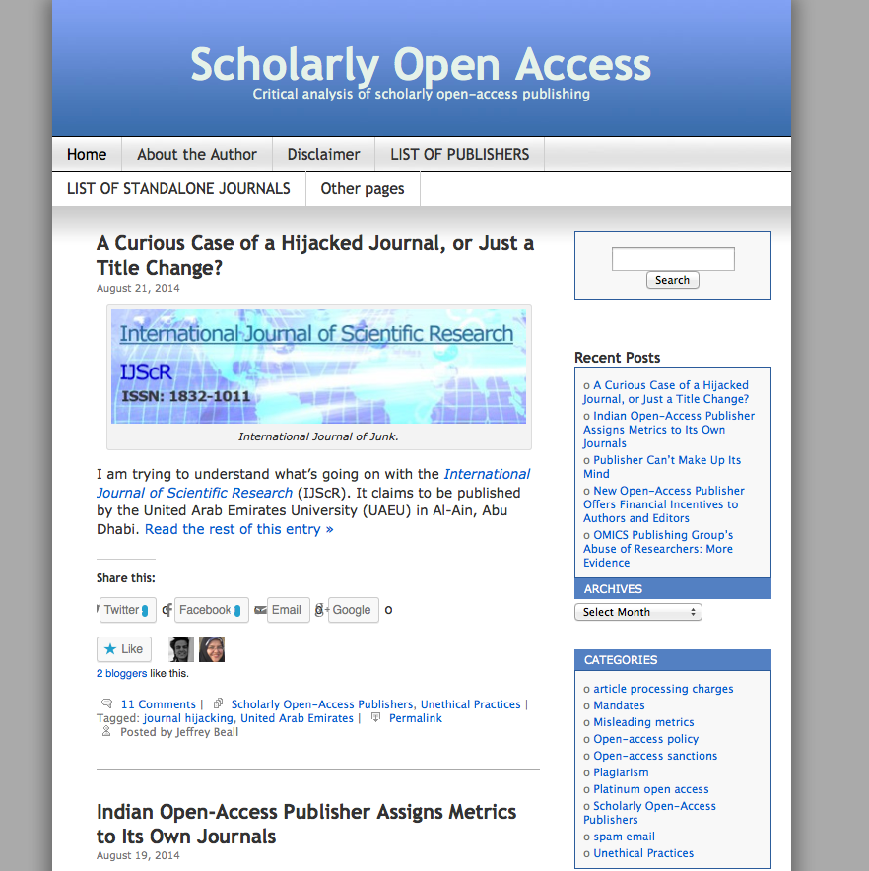
Notes:
Beall’s List
http://scholarlyoa.com/publishers/
Jeffrey Beall is a scholarly communication librarian at the University of Colorado Denver. He has taken it upon himself to keep a list of predatory publishers. Even he will concede that it’s not always easy to tell.
Beall’s advice
Complete an analysis of the publisher’s content, practices, and websites according to ethical standards established by membership organizations.
Complete an analysis of the publisher’s content, practices, and websites:
contact the publisher if necessary,
read statements from the publisher’s authors about their experiences with the publisher, and
determine whether the publisher commits any of the following practices (below) that are known to be committed by predatory publishers.
Editor and staff –
Is there an editor?
Is it the same as the publisher?
If more than one title, are the editorial boards the same or have lots of overlap?
Any copyediting?
Are they publishing exactly what is submited?
Publisher-
Is information available – is it transparent or hard to decipher if it can be found?
Do they a digital preservation policy?
Is the only source of income author fees?
Do they publish a suite of journals that seems excessive or strange?
Integrity
Does the journal title reflect the content?
Does the title reflect the geographic location is appropriate?
Does the site make false claims – eg impact factors, indexing
Is there a sense of scientific quality?
How do they recruit reviewers and editors?

Slide 17
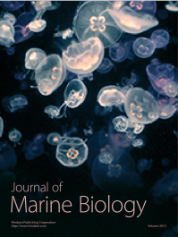
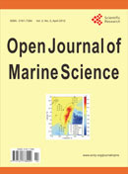
Notes:
Journal of Marine Biology is published by Hindawi. This month, it isn’t charging authors. It’s large and very profitable. But it could be considered questionable.
http://scholarlyoa.com/2013/04/04/hindawis-profits-are-larger-than-elseviers/#more-1514
International Journal of Marine Biology. Sophia Publishing Group http://sophiapublisher.comis the Canadian publisher based British Columbia of Canada, who publishes nearly 100 peer-reviewed online journals and 100 new books annually in print and online. It doesn’t have an editorial board but relies on a network of reviewers. Authors pays $1100. Payment logo is prominent. Questionable but not on Beall’s list.
Open Journal of Marine Science is on Beall’s list as predatory. $800/10 pages + $50 per page after that . Those not reviewed – 10 days after submission. Those reviewed (single reviewer) – 4 weeks. You could argue either way by working through the web site. http://www.scirp.org/Journal/ojms/
Frontier in Marine Science is a new one.

Slide 18
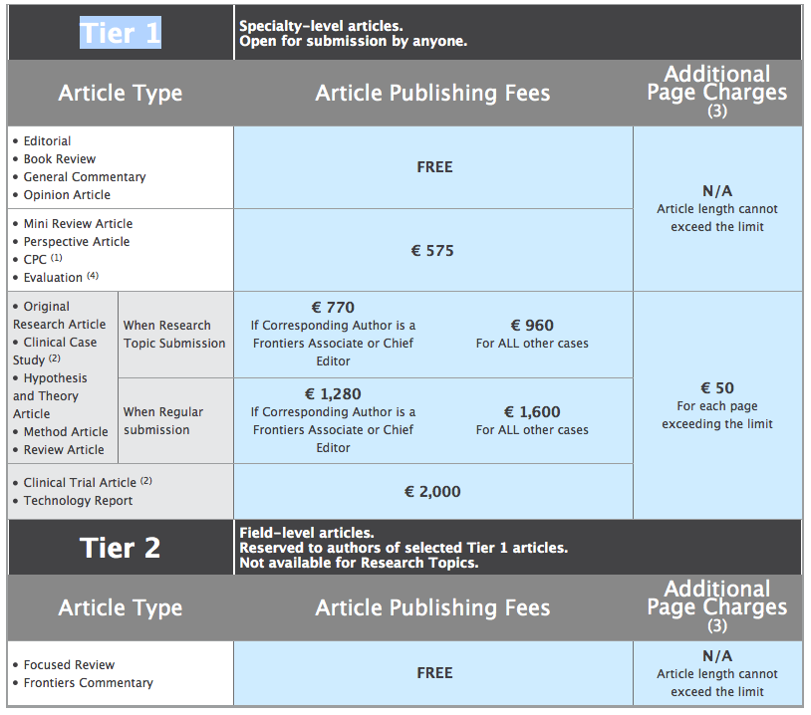
Notes:
Borderline?
Frontiers does not meet the criteria for inclusion as a predatory publisher, but Beall regularly receive complaints about its spamming and editorial practices.
Frontiers was launched as a grassroots initiative in 2007 by scientists from the Swiss Federal Institute of Technology in Lausanne, Switzerland
over 20,000 high-quality, peer-reviewed articles have been published in 45 community-driven journals across more than 300 specialty niches in science, medicine and technology, and more than 40,000 high-impact researchers serve on the editorial boards and over 6 million monthly page views.
Nature Publishing Group has a stake in the 38 journals in this suite of OA journals.

Slide 19
What is “Good”
Scientific quality
Timeliness
Permanence
Audience
Access
© Roger Villanueva
Notes:
This is a quandary.
Just because a journal is not directly open access, are they bad?
I think we go back to our standards.
Scientific quality
Timeliness
Permanence
Audience
Access

Slide 20
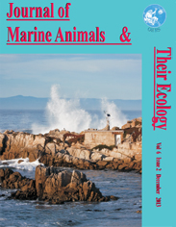
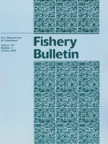
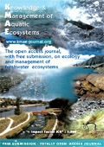
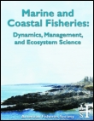
Notes:
Scientia Marina use the Open Journal System. All content is accessible including thee forthcoming.
It is supported by the Institut Ciencies del Mar in Barcelona.
It’s been in publication since 1955, it’s indexed, is peer-reviewed.
Knowledge and Marine of Aquatic Ecosystems published by EDP is freely available to readers and does not charge authors. How? Like Scientia Marina, it has a sponsor - The French National Agency for Water and Aquatic Environments. It also has a ’good’ copyright transfer agreement.
Journal of Marine Animal & Their Ecology is open with no charges. It’s reviewed. Perhaps not so timely – two issues a year. And it’s very focused. It’s a labor of volunteerism with a little bit of self-serving. Not broad of prestigious, but contributing to science by covering a small piece of the realm - “preservation of the marine environment, protection, conservation, rescue and rehabilitation of marine life.”
Fishery Bulletin is US government publication. As such it is in the public domain – nothing is copyrighted. It’s open and free to page charges. US Government scientists do the editing as part of their job.
Marine and Coastal Fisheries from American Fisheries Society is a straight forward ‘author pays’ journals. $1000/5000 words,$900 if you review for the journal, $500 if you are an AFS member, no charge if you from a low-income country. Bit when I tried to get to the journal from the AFS web site last month, it didn’t work. It is linked correctly through DOAJ.

Slide 21
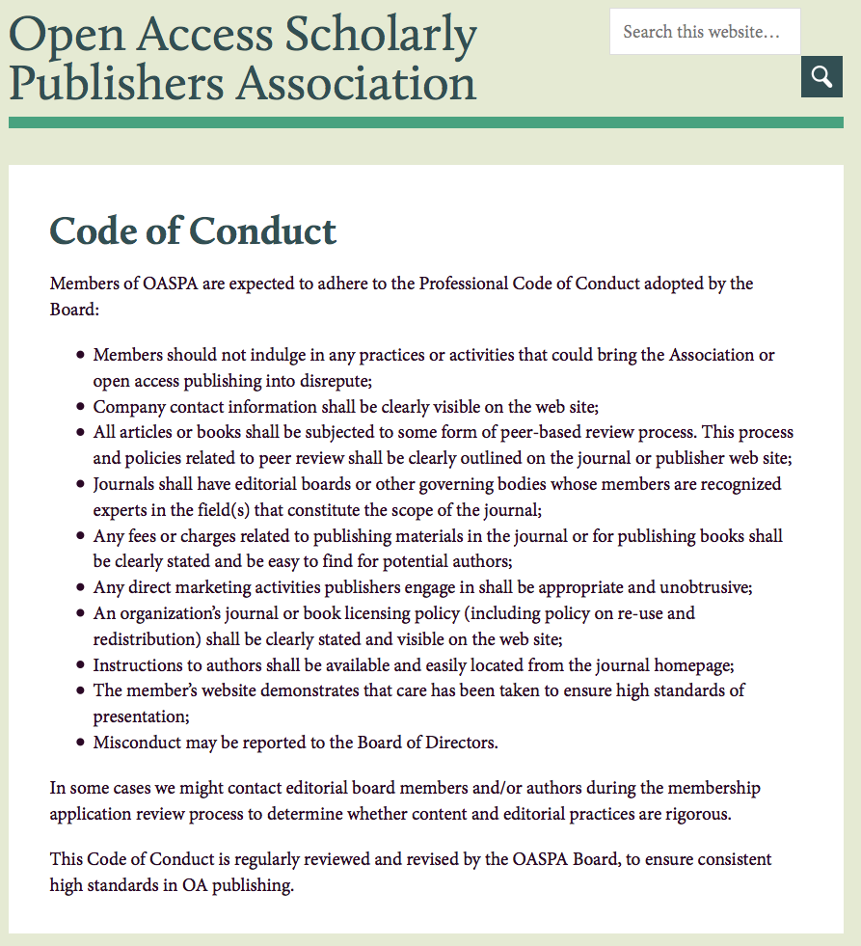
Notes:
Contact information is clearly visible.
There must be some kind of peer-review process
Editorial boards should have experts in the field
Fees and page charges must be clearly stated and easy to understand.
Direct marketing should be appropriate and unobtrusive
Licensing should be clearly stated and visible.
Instructions to authors should be available.
The website should demonstrate a level of professionalism.

Slide 22
Advice to authors?
Know your audience.
Publish with an ethical publisher.
Review process
Timeliness
Fees & subscriptions
Copyright transfer
Follow policies.
Notes:
As you can see, it’s confusing. Even those that are predatory are getting more sophisticated in how they present them selves.
Beall recommends “that scholars read the available reviews, assessments and descriptions provided here, and then decide for themselves whether they want to submit articles, serve as editors or on editorial boards.” But it’s not always clear by the information provided. Young authors are probably the most vulnerable as they are eager to get their work out and perhaps don’t have a mentor at hand to help them make decisions.
What advice can I give?
I go back to who is the audience and what’s the best outlet to reach that audience.
Look for people you recognize from the literature that you read. If you don’t know anyone, ask those you trust.
Expediency can be a trap. They promise to get something out fast without a lot of revision. It might be fast, but it might be expensive with hidden author charges or poor quality.
Those without author charges probably get their operating funds elsewhere – libraries for instance. What’s cheap for the author may be expensive for her library or institution.
Copyright Transfer Agreement
Did you read it or just sign it?
You probably have multiple authors. Did you sign for them or did they sign for you?
Institutional & Funders Policies
University policy
Government regulation
Funder requirement

Slide 23
OA is growing.
It’s messy.
It’s evolving.
It’s beneficial.
Painting: Philip Gouvedare
Notes:
Chen in his 2014 article “Open Access in 2013: Reaching the 50% Milestone” makes the case through his research that we are reaching the 50% point of science journal articles are open. As we have seem today, open can mean a lot of things. But, it is a significant change in how accessible science information is to the world.
But it’s messy. There are people trying to make money from the hard work of others. There are scientists who want quick recognition for perhaps not very sound work.
There are new models being tested.
PlosOne gives discounts to authors if their institutions have a membership – a split pay model. Any scientific discipline.
PeerJ has an author membership model where you pay a fee and can publish one to unlimited publications depending on your level of membership. $99 to $299 Biological and Medical Sciences focus. PeerJ is one to watch. OSULibraries has a deposit account with them so any OSU author who has a manuscript accepted, we pay the fee.
eLife is an example of funding organizations offering a platform for publishing. They are currently covering the costs but may add an authors pays layer. They want to encourage early career scientists. Howard Hughes Medical, Wellcome Trust, Max Planck Society Life sciences and biomedicine. Their 2013 financials state that it costs them $14,000 to publish an article. http://scholarlykitchen.sspnet.org/2014/08/18/how-much-does-it-cost-elife-to-publish-an-article/
These three are general science and not marine or aquatic specific. Of them, PeerJ may be the most useful for our fields although PlosOne has quite a bit of marine/aquatic material.
In 2010, the Study of Open Access Publishing undertook a large scale survey of international scientists to learn about their attitudes and experiences with OA publishing. 89% of the published scientists considered OA publishing beneficial to their discipline. While the vast majority see the good, few actually publish in OA journals – although that is slowly changing. When queried further in the most important criteria for choosing to publish in OA journals, those scientists said:
Freely available content
Quality or prestige of the journal
Impact factor
No fees
They complain that of the lack of quality and they also don’t want to pay.

Slide 24
What can librarians do?
Janet Webster
Oregon State University
Barbara Butler
University of Oregon
1904 Haeckel
Notes:
As librarians, we need to be comfortable talking about the different types of Open Access
Green – depositing into a repository and usually a pre or post print, not the Version of Record – the publisher’s copy.
Gold – open through the publisher – truly open, author-pays/institutions pays, delayed
We can keep track of what titles are emerging and be ready to offer advice on how to assess new journals.
We can be honest that someone pays so we can use information.
We can help promote the ‘good’ journals.
We can consider if we should start a journal. Barbara suggests that IAMSLIC could have a general interest marine/aquatic journal by tapping into our membership and our network.
We need to remember why we share information: science is built on the work of those who came before.
OA is one way to share information. It is not perfect and we need to help our scientists and students develop their approaches to sharing their work with colleagues and beyond. Open is not necessarily good. It can be a muddle and it can be predatory.. Learning to define the nuances of good is our challenge.

