Slide 1
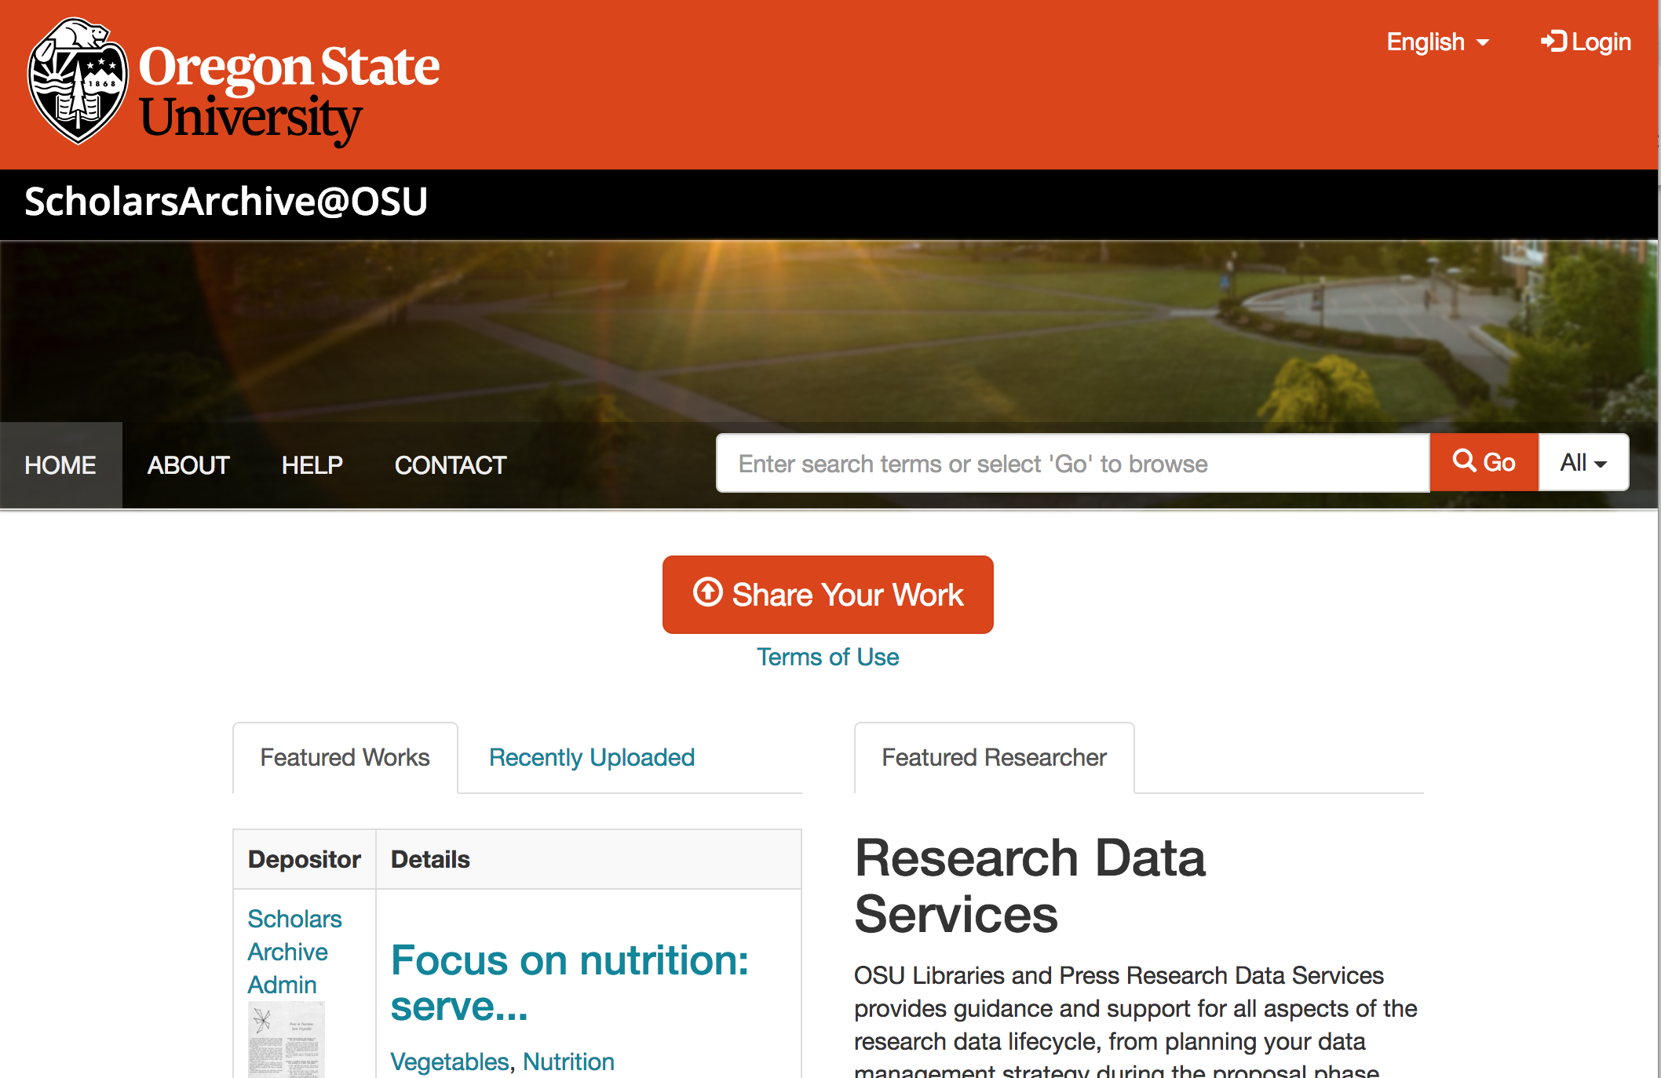
SCHOLARSARCHIVE@OSU as a data repository
Notes:
Must be in Slide Master mode to swap out photos.

Slide 2
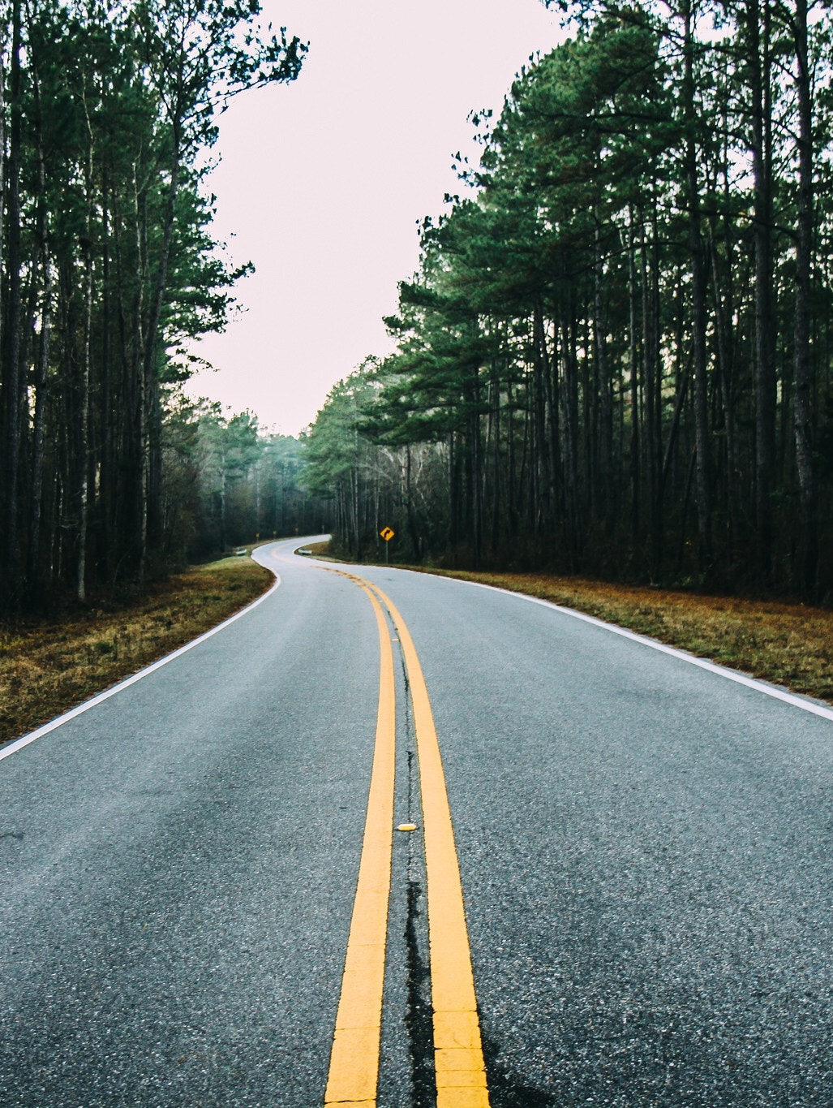
1. What we’ll cover today
Data repositories
What is a data repository
How to select a data repository
Characteristics of a good data repository
Alternatives to data repositories
ScholarsArchive@OSU
Know ScholarsArchive@OSU
Deposit process
Prepare datasets for submission
Notes:
Image credit: Photo by Teddy Kelley on Unsplash

Slide 3
What is a data repository?
A place where to store data
A place to make data publicly available - findable
A place to preserve your data
Notes:
Image credit: By Roche DG, Lanfear R, Binning SA, Haff TM, Schwanz LE, et al. (2014) [CC BY 4.0 (https://creativecommons.org/licenses/by/4.0)], via Wikimedia Commons

Slide 4
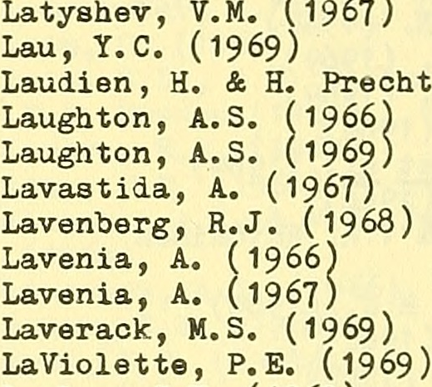
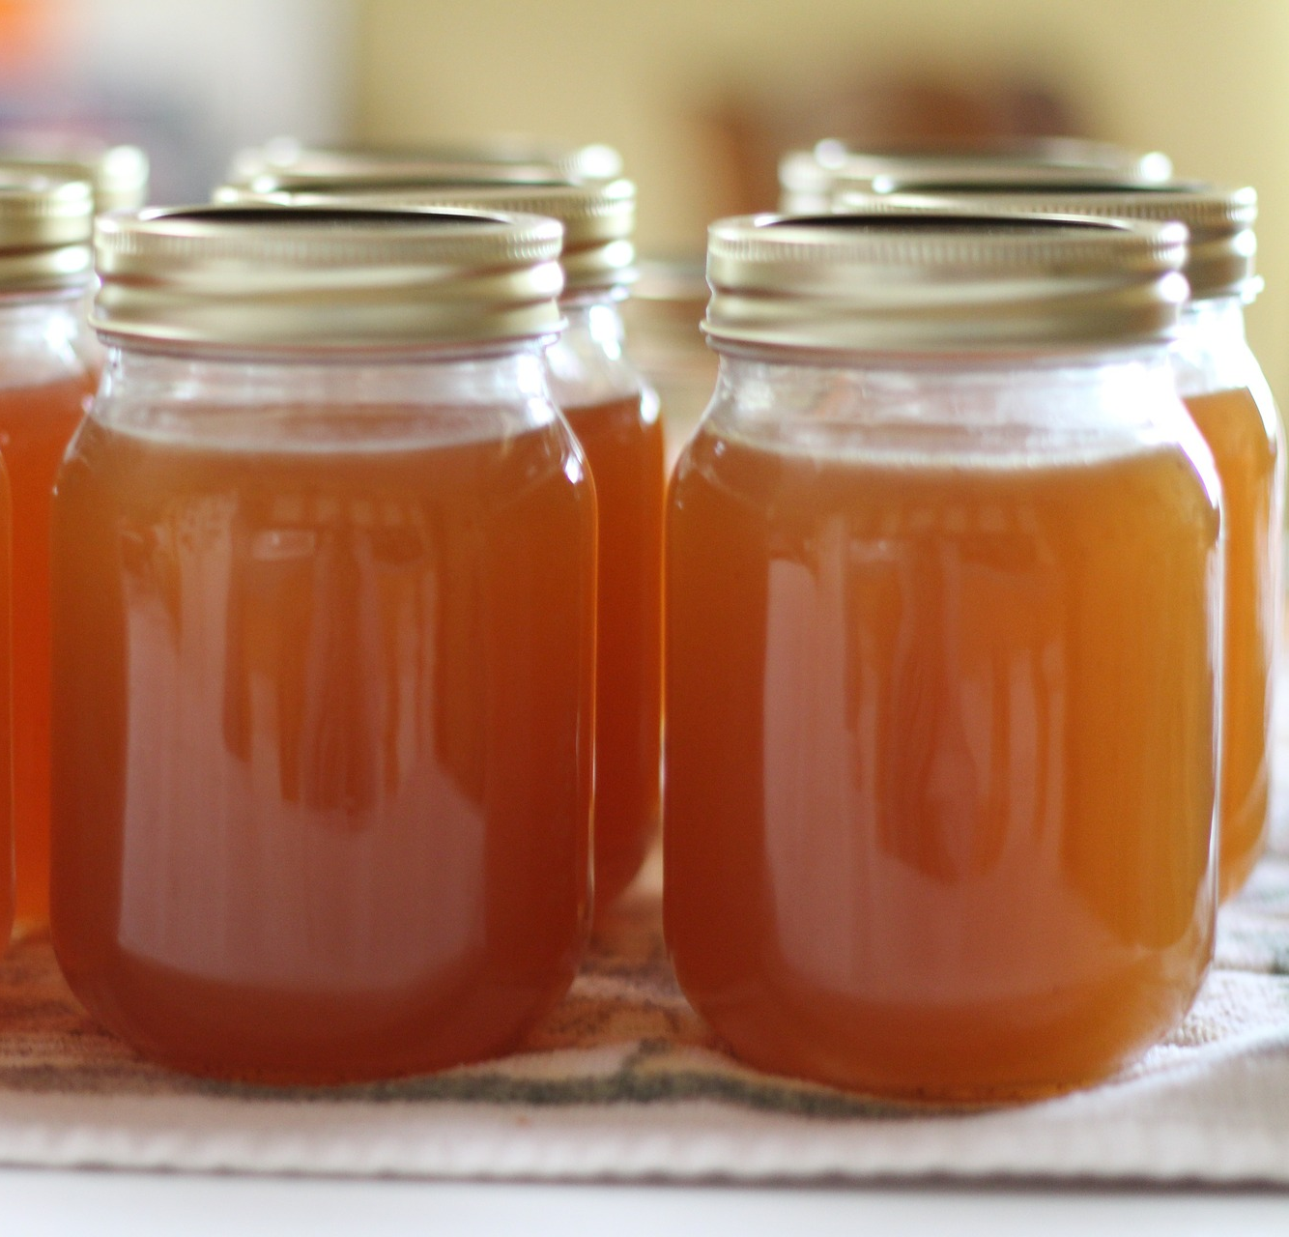
Why use a data repository?
Comply with your Data Management Plan
Give credit to data creators
Share your data: open science
Preserve your data
Notes:
Image credits
Plan: by Nick Youngson CC BY-SA 3.0 Alpha Stock Images http://creative-commons-images.com/handwriting/p/plan.html
Bibliography” by Food and Agriculture Organization of the United Nations. Fishery Resources and Exploitation Division. Biological Data Section; Food and Agriculture Organization of the United Nations. Fisheries Division. Biology Branch No known copyright restrictions. https://www.flickr.com/photos/internetarchivebookimages/20804980132/in/photostream/
Preserve: by HomeMaker in pixabay.com Published on the Public Domain.
Umbrella: by 지우 황 in flickr. Published as CC-BY https://www.flickr.com/photos/100477638@N03/10204741904

Slide 5
How to select a data repository
external data archive or repository already established for your research domain; recognized standards in your discipline.
institutional research data repository, or your research group’s established data management facilities.
cost-free data repository such as Zenodo, Figshare, Dryad.
Search for other data repositories here: re3data.org.
Notes:
Source: https://www.openaire.eu/opendatapilot-repository

Slide 6
How to identify a good repository for your data?
Gives your submitted dataset a persistent and unique identifier.
Provides a landing page for each dataset, with metadata.
makes your research more visible.
stimulates reuse of the data.
Helps you to track how the data has been used by providing access and download statistics.
Explicit ambition to keep the data available in the long term.
Matches your particular data needs (formats, sustainability, access…)
Meets legal requirements and allow reuse without unnecessary licensing conditions.
Guidance on how to cite data.
Guidance and review on how to prepare data for deposit.
Notes:
Source: https://www.openaire.eu/opendatapilot-repository

Slide 7
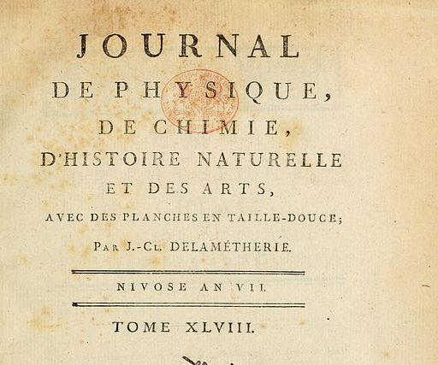
Alternatives to data repositories for data sharing
Website (department, project, personal)
Pros: functionality tailored to your data collection
Cons: less likely to sustain long-term access to your data collection
Cloud (third party)
Pros: Easy to use
Cons: long-term reliability, unpredictable costs
Journal supplementary material service
Pros: comply with publisher’s requirements
Cons: may be costly, unlikely to offer a data repository’s functionality or long-term solution
Notes:
Image credits:
Computer by JuralMin in pixabay.com. Licensed in the public domain.
Cloud: by rawpixel in pixabay.com. Licensed in the public domain.
Journal: See page for author [Public domain], via Wikimedia Commons https://commons.wikimedia.org/wiki/File:Journal_Delam%C3%A9therie.JPG
Source: http://www.dcc.ac.uk/resources/how-guides-checklists/where-keep-research-data/where-keep-research-data

Slide 8
ScholarsArchive@OSU
https://ir.library.oregonstate.edu/
Who is it for?
What can you store in it?
How to get help?
Notes:
Source: https://ir.library.oregonstate.edu/
Navigate to the about page. Talk about the types of materials that can be submitted (research, scholarship, and historical records); talk about who can submit items (OSU community); talk about benefits of submitting materials at SA@OSU; Talk about access
Navigate to the Help page: talk about the user guide and the contact form.

Slide 9
ScholarsArchive@OSU as a user
Notes:
Image credit:
Magnifying glass: by coyot in pixabay.com. Published in the public domain.
Search engines: logos of Google, DuckDuckGo and Bing

Slide 10
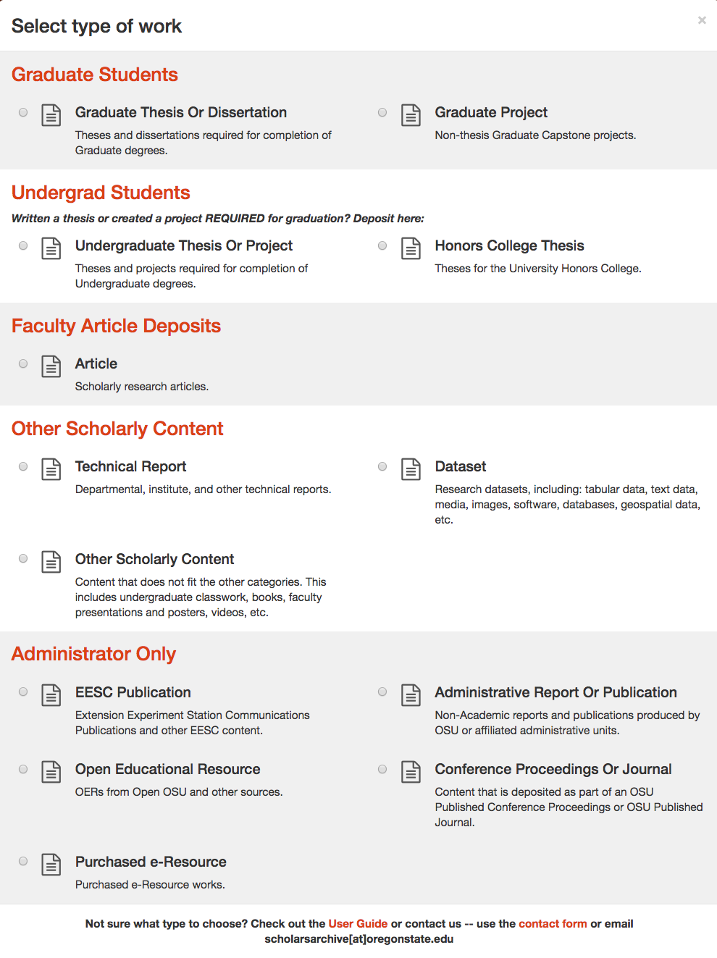
ScholarsArchive@OSU as an author

Slide 11
ScholarsArchive@OSU as an author
Notes:
Image credit: by Kurious in pixabay.com. Published in the public domain.
Before pushing the button, stop. Data submissions need some work first.

Slide 12
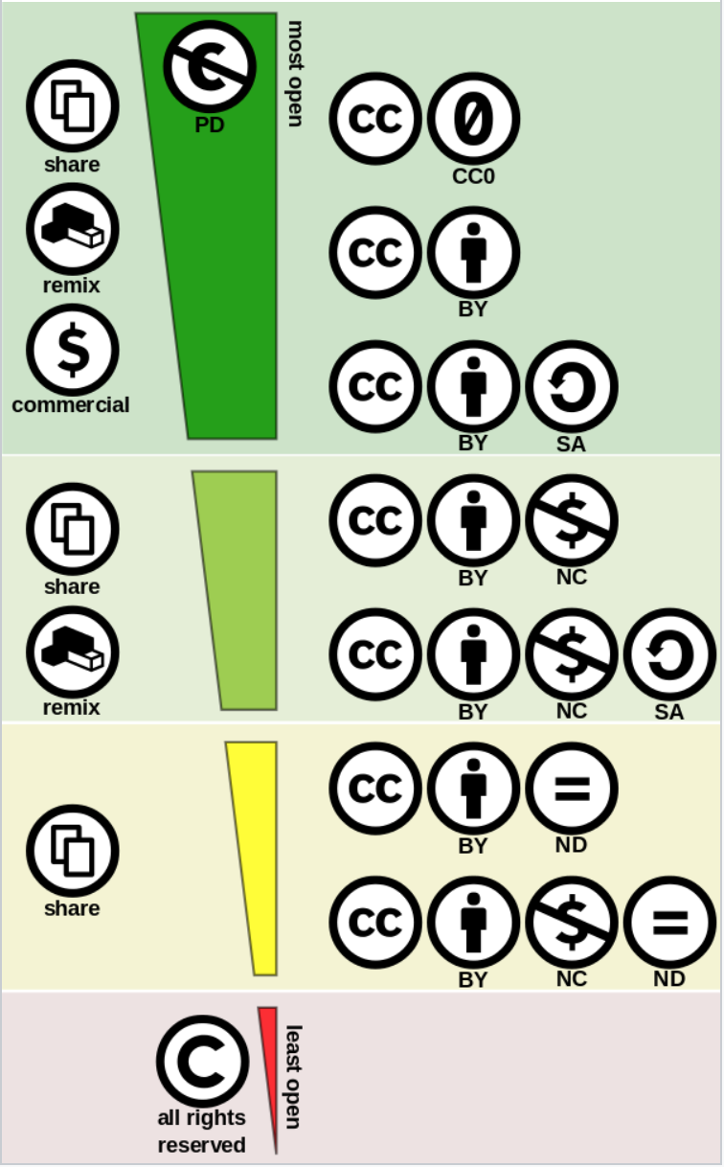
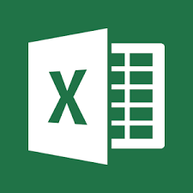
Prepare your dataset
Choose a license
Tidy data
Open format, text based if possible
Documentation
Readme.txt
Notes:
Image credits:
Logos from Microsoft excel, Microsoft Word, Microsoft Access
Creative Commons Licenses: By Shaddim; original CC license symbols by Creative Commons - https://creativecommons.org/about/downloads/https://creativecommons.org/policies/Original CC license icons licensed under CC BY 4.0, CC BY 4.0, https://commons.wikimedia.org/w/index.php?curid=47247325

Slide 13
Prepare other documents to share
Make sure that you are the copyright owner.
Make sure that the document is in good shape: spell check, author names, credit to other sources…
Have handy all the information you will need to post as metadata.
Choose a license.
Choose a visibility option.
Make sure you agree with the deposit agreement.
In the case of articles, you will need a post-review, pre-typeset version.

Slide 14
License for data
Allow derivative works?
Attribution requirements.
Allow commercial use?
Recommended for data: CC0 and CC-BY
Do you have software? Copyrightable kinds of data? Special situations? Ask us.
Notes:
Creative Commons Licenses: By Shaddim; original CC license symbols by Creative Commons - https://creativecommons.org/about/downloads/https://creativecommons.org/policies/Original CC license icons licensed under CC BY 4.0, CC BY 4.0, https://commons.wikimedia.org/w/index.php?curid=47247325

Slide 15
ScholarsArchive@OSU as a user
Deposit agreement:
https://ir.library.oregonstate.edu/agreement
Notes:
Navigate the deposit agreement https://ir.library.oregonstate.edu/agreement
Talk about the different visibililty levels and how that can help you to protect your data. For example, you could have private data, with the metadata being the only thing available, and have good instructions about how people should ask about the dataset.

Slide 16
The process
User: Prepare work
User: Describe your work
User: Add files
User: Check deposit agreement
SA@OSU: Check metadata for consistency
SA@OSU: Review (datasets)
User: Make required changes
SA@OSU Generate DOI (datasets)
SA@OSU Approval

Slide 17
Let’s share!
Notes:
Image credit: by aamiraimer in pixabay.com, published under the Public Domain.

Slide 18
Clara Llebot Lorente | Data Management Specialist
clara.llebot@oregonstate.edu
ResearchDataServices@oregonstate.edu
http://bit.ly/OSUData
This presentation is licensed under a CC0 license.

