Slide 1
Collaborations between Tribal and Non-Tribal Organizations: Sharing Expertise, Knowledge, and Cultural Resources
A Research Study
Elizabeth Joffrion and Natalia Fernández
ATALM September 2015 Session #111
Washington D.C.
Notes:
SLIDE 1: Title (BETH)
We are so pleased to present our research on collaborations with native communities at this forum---ATALM.
Collaborations between tribal and non-tribal organizations bring diverse communities together, often for the first time, to educate and learn, to address misinterpretations of the past, and to share cultural resources and knowledge. By examining data obtained through a nationally distributed survey, our research explores how successful partnerships between tribal and nontribal institutions are initiated, developed, and maintained; and reveals the “lessons learned” across a wide range of collaborative projects and partnerships. Our overview of collaborative models is intended to offer recommended best practices for both tribal and nontribal organizations interested in sharing useful skills, knowledge, and resources through partnerships built on mutual understanding and respect.

Slide 2
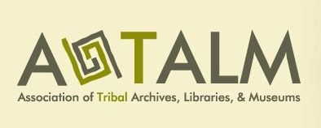
Project Background and Context
Notes:
SLIDE 2: Project Background and Context (BETH)
Our research was grounded in a number of important initiatives over the last decade that served to reassert the rights of Indigenous peoples over their cultural heritage, including, the establishment of the Association of Tribal Archives, Libraries, and Museums, the UN Declaration on the Rights of Indigenous Peoples, and the Protocols for Native American Archival Materials.

Slide 3
Sovereignty, self-determination, and self-governance are primary goals of Indigenous nations worldwide—and they take important steps toward those goals by renewing control over their stories, documents and artifacts. In the U.S. the last 30 years have been a remarkable period of reasserted and reaffirmed authority over such cultural patrimony through the creation of tribal archives, libraries and museums.
Miriam Jorgensen, Sustaining Indigenous Culture: The Structure, Activities and Needs of Tribal Archives, ATALM 2012
Notes:
SLIDE 3: Jorgensen Quote (BETH)
This momentum toward sovereignty, self-determination, and self-governance provided a framework for the establishment of tribal cultural organizations with the objective of locating, acquiring, and providing context for native historical documentation housed in non-Native institutions--an effort that is central to the cultural sovereignty of indigenous communities. This in turn, fostered a need for many tribes to collaborate with non-tribal organizations holding native cultural resources.
In 2012, the Association of Tribal Archives, Libraries, and Museums (ATALM) published a groundbreaking report entitled Sustaining Indigenous Culture that assessed the status and needs of American Indian, Alaska Native, and Native Hawaiian cultural heritage organizations. Its recommendations encouraged collaboration between tribal and non-tribal institutions and led to new grant opportunities from a number of federal funding agencies, including NEH, and especially IMLS.
In my former role as a program officer with NEH, I worked with a number of collaborative projects between tribal and non-tribal organizations. These projects typically involved sharing documentation and expertise through the digitization of collections, arrangement and description, and education and training. At times, these projects were not successful in the review process because the expected documentation was not in place, including MOU’s, letters of commitment, and other evidence of institutional or tribal support for the collaborative effort. In partnership with Natalia, we’ve sought to explore this issue with the goal establishing best practices for building successful and sustainable relationships across communities.

Slide 4
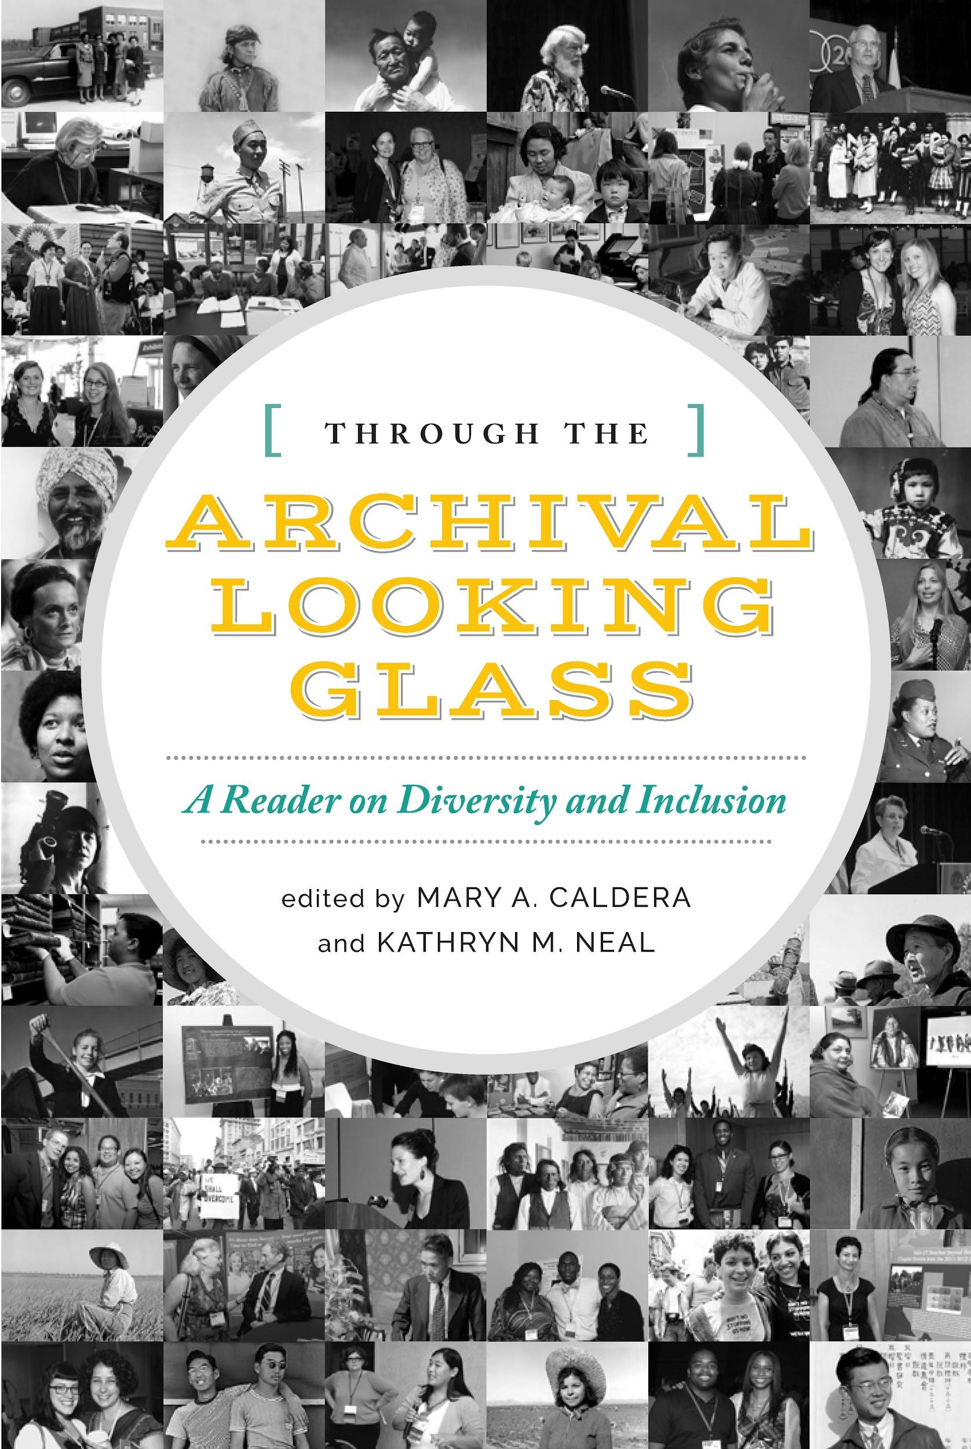
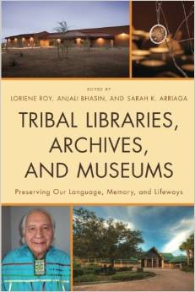
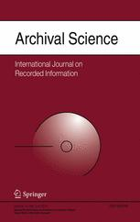
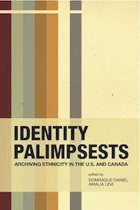
Addressing a Gap in the Literature
Notes:
SLIDE 4: Addressing Gaps in the Literature (NATALIA)
There were several projects and publications that influenced our research agenda. These include Kim Christen’s development of the Plateau People’s Portal, Kim Mathiesen’s research on Native American rights, and several books and articles that examined theoretical approaches and practical strategies for cultivating relationships with historically marginalized groups, including indigenous cultures.
Collectively, these works provided excellent individual case studies documenting unique partnerships between tribal and nontribal organizations. However, when we began our research, no comprehensive study on a national scale had been undertaken that addressed collaborative projects across multiple institutions, and there was no significant analysis of how collaborative processes developed between Native and non-Native institutions. Our work aims to address this gap in the literature.

Slide 5
Research Questions
How are successful collaborations between tribal and nontribal institutions initiated, developed, and maintained?
How were the project goals and agreements negotiated and to what degree were the Protocols for Native American Archival Materials used or referenced in developing policies and procedures for partnerships involving Indigenous cultural heritage materials?
What were the challenges or “lessons learned” across a diverse range of collaborative projects and partnerships?
Notes:
SLIDE 5: Our work centered on three basic Research Questions (NATALIA)
How are successful collaborations between tribal and nontribal institutions initiated, developed, and maintained?
How were the project goals and agreements negotiated-- and to what degree were the Protocols for Native American Archival Materials used or referenced in developing policies and procedures for partnerships involving Indigenous cultural heritage materials?
What were the challenges or “lessons learned” across a diverse range of collaborative projects and partnerships?

Slide 6
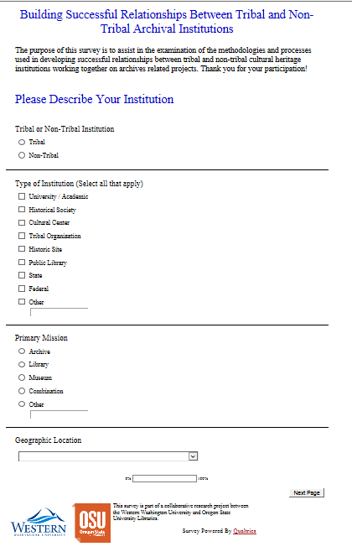
The Research Project: Methodology
A mixed methods research design (both
qualitative and quantitative) that entailed
two phases:
1) In-Depth Online Survey
2) Interviews
Notes:
SLIDE 6: Research Methodology utilized a mixed methods approach (NATALIA)
In-Depth Online Survey
Interviews

Slide 7
In-Depth Online Survey
1) Demographic and institutional information
2) Nature of the collaborative project (goals, partnerships, funding/institutional support)
3) Practices supporting relationship building and the collaborative process
4) Policies and procedures for the collaborative management of Indigenous cultural heritage materials
5) Lessons learned and recommendations for best practice guidelines
Notes:
SLIDE 7: In Depth Online Survey (NATALIA)
The survey consisted of 30 questions covering 5 broad areas of investigation:
Demographic and institutional information
Nature of the collaborative project (goals, partnerships, funding/institutional support)
Practices supporting relationship building and the collaborative process
Policies and procedures for the collaborative management of Indigenous cultural heritage materials
Lessons learned and recommendations for best practice guidelines

Slide 8
The Interviews
Questions expanded on the survey by exploring:
Origins of the project
Methods for building trusting relationships
Mechanisms for formalizing collaborative agreements
Exploration of project policies and procedures
Incorporation/influence of the Protocols for Native American Archival Materials
We interviewed tribal and non tribal representatives from a range of organizational types
Notes:
SLIDE 8: The Interviews (NATALIA)
We devised follow-up interviews to expand and qualify the survey results through in-depth discussions with representatives from self-identified successful projects selected during the survey process. The 9 interviewees were selected from a pool of 12 survey respondents who agreed to be contacted for an interview. When possible we conducted interviews with both tribal and nontribal partners, and several instances, we were able to engage in subsequent interviews with all collaborative partners. In this way, we were able to include the perspective of both tribal and nontribal participants for many of the representative projects. Of the initial interviewees, 4 represented tribal organizations, and 5 were nontribal representatives selected from organizations across the United States, including museums, libraries, academic institutions, tribal cultural heritage centers, and one graduate program in library and information science.
The interview questions focused on the origins of the project; The methods for building trusting relationships; The mechanisms for formalizing collaborative agreements; Detailed exploration of policies and protocols. And, we were especially interested in whether the collaboration incorporated the Protocols for Native American Materials, including: Consultation with tribal communities and government; Methods for special treatment of culturally sensitive materials; Mechanisms for determining appropriate levels of access for sensitive materials; Engagement of tribal communities in the identification of sensitive materials, Management of privacy and intellectual and/or cultural property rights; The copying, sharing, and/or repatriation of certain materials; Reciprocal or shared education and training activities.

Slide 9
The Survey Data and Interview Results
1) Demographic and Institutional Information
2) Nature of the Collaborative Projects
3) Practices Supporting Relationship Building and the Collaborative Process
4) Collaborative Management of Indigenous Cultural Heritage Materials: Policies and Protocols
5) Lessons Learned
Notes:
SLIDE 9: The RESULTS: We will cover the following (BETH)

Slide 10
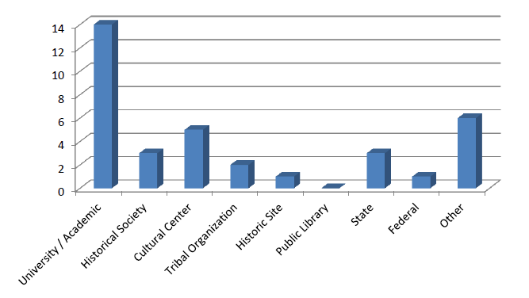
Demographic and Institutional Information
The types of responding institutions fell into 9 categories:
Notes:
SLIDE 10: Demographic Information/ Institutional Type (BETH)
The first series of survey questions was designed to gain information about the nature of the responding institutions and their missions. Of the 31 respondents, 8 were tribal and 23 were nontribal. (NOTE: elimination of incomplete surveys)
The majority of our 23 nontribal respondents (45%) were drawn from academic institutions partnering with tribal organizations. Historical societies, historic sites, and governmental organizations were also substantially represented. The 6 respondents (19%) that chose “other” included museums, a historical center, a partner of the National Park Service, a Native arts publication, and an organization involved in teaching Native languages.

Slide 11
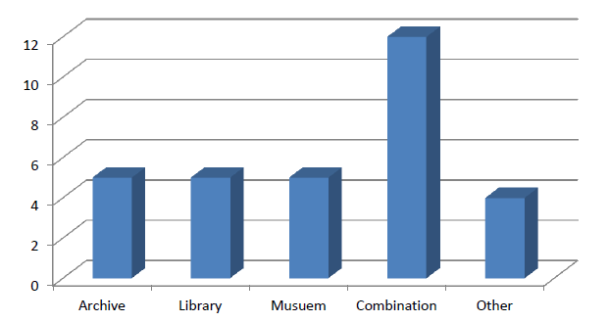
Demographic and Institutional Information
Respondents’ institutional missions represented 5 categories:
Notes:
SLIDE 11: Demographic Information/Mission (BETH)
The 8 tribal organizations were affiliated with tribal cultural centers or tribal governance or a combination of both. Nearly half of tribal respondents identified their primary mission as a combination of archival, library, and museum affiliations. Four institutions identified their mission as “other.” These included education and training programs.

Slide 12
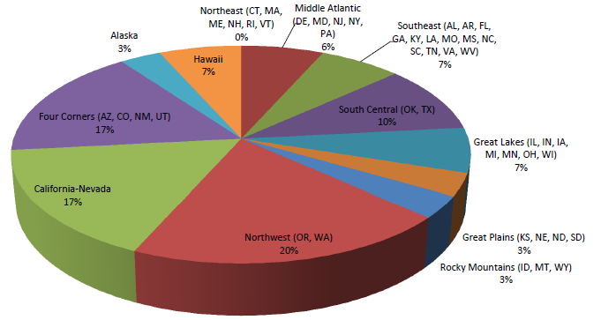
Demographic and Institutional Information
Geographic Location: Respondents were located around the United States
Notes:
SLIDE 12: Demographic Information/Geographic Location (BETH)
The responding institutions were geographically dispersed across the United States, including Alaska and Hawaii. Most were from the Northwest, California, Oklahoma/Texas, and the Four Corners region. This demographic range corresponds to the states with the highest populations of Native American residents.

Slide 13
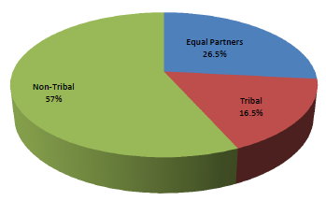
Nature of the Collaborative Projects
The Partnerships
Project Goals
Funding and Institutional Support
Project Leadership
Notes:
SLIDE 13: A second series of questions focused on the Nature of the Collaborative Relationships (BETH)
The Partnerships: Nontribal organizations served as project lead in 57% of the collaborations, with the remainder led by tribal organizations, or a combination of both (see chart). The 31 projects had between 2 and 11 partnering institutions with a median of 20 individuals engaged in each project.
The interviews indicated that the lead organization was often determined through established memorandums of understanding or grant contracts, with several mentioning IMLS program requirements stipulating that the lead organization must be tribal.
Project Goals: The collaborative projects addressed a wide range of activities with overlapping primary and secondary goals. The majority of the projects focused on a combination of language revitalization, education and training, digitization and collection sharing, archival processing, and exhibit curation. Other projects involved genealogy, oral history, preservation, library automation, and the construction of a collaborative museum and cultural center.
Funding and Institutional Support: Funding for the collaborative projects ranged from under $1,000 to over $100,000, with 32% receiving more than $100,000 in financial support. These included 2 highly funded projects led by tribal organizations. The interviewees were also asked if the availability of funding influenced their projects and whether funding was a barrier to future collaboration. Most agreed that their projects would not have been possible without outside funding. In most cases, this involved a combination of tribal funds and grants.

Slide 14
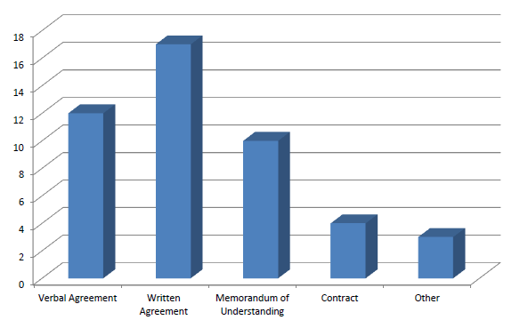
Practices Supporting Relationship Building and the Collaborative Process
Mechanisms for formalizing respondents’ collaborations took several forms:
Notes:
SLIDE 14: Practices Supporting Relationship Building and the Collaborative Process (BETH)
The third series of survey questions explored the methods for initiating and building successful relationships, including the instruments used to establish and formalize collaborative agreements.
43% of the collaborative projects were launched through face-to-face meetings. Other common methods of contact included email or phone calls. In most instances, the partnerships relied heavily on all 3 methods to maintain and build relationships throughout the project phase, with 90% reporting that they held regular face to- face meetings with their partners. Almost a quarter of the survey respondents were involved in their first collaboration, while 39% had engaged in 4 or more collaborations, often with the same organizational partners. Tribal council members were actively involved in 44% of the projects providing guidance and defining project objectives. In several instances, the nontribal partner initiated contact by attending a tribal council meeting to introduce project goals and to negotiate approval from tribal governance. Most survey respondents agreed that development of mutual agreements, memorandums of understanding, and other means of formalizing the collaborative process proved central to building successful relationships (see graph). The majority of the collaborative agreements were somewhat informal, with 61% involving a written agreement by letter or email. Other instruments included verbal agreements (43%), memorandums of understanding (36%), and formal contracts (14%). Several respondents acknowledged that their grant applications outlined the nature of the collaboration and provided guidance in the project phase. Many projects included a combination of all of these methods at various stages in the collaborative process.

Slide 15
Collaborative Management of Indigenous Cultural Heritage Materials: Policies and Protocols
The Protocols emerged as a critical managing document for many of the projects surveyed.
The data indicate that 44% of the institutions surveyed actively use or refer to the Protocols in their daily work, and 38% directly used the Protocols in the development of project policy, procedures, and contracts for their collaborative projects.
Notes:
SLIDE 15: Collaborative Management of Indigenous Cultural Materials (BETH)
50% of the collaborative projects included collections and resources held by both tribal and nontribal organizations, with a smaller subset that dealt with materials exclusively in the possession of the tribal organization (27%) or the nontribal partner (23%).
Since most of the projects involved the sharing of cultural resources, we were interested in learning whether either partnering institution had existing policies for the use of culturally sensitive materials. The data indicate that 19% of the survey respondents have a written policy in place, while 1/3 operate with an unwritten policy, and another 1/3 had not developed a policy at the time of the survey. 15% had a written policy in progress. In some cases, new policies were initiated in response to needs that emerged through the collaborative effort.
We were also interested in determining the degree to which the partners referenced or actively used The Protocols for Native American Archival Materials in the development of project goals and procedures. The Protocols offer a set of best practices and procedures for the “culturally responsive care and use of American Indian archival material held by nontribal organizations.” The Protocols also provide guiding principles for entering partnerships, handling culturally sensitive materials, engaging in reciprocal training, and the inclusion of Indigenous perspectives in the interpretation and description of Native American materials. Although not officially endorsed by many professional organizations, the Protocols emerged as a critical managing document for many of the projects surveyed. The data indicate that 44% of the institutions surveyed actively use or refer to the Protocols in their daily work, and 38% directly used the Protocols in the development of project policy, procedures, and contracts for their collaborative projects.

Slide 16
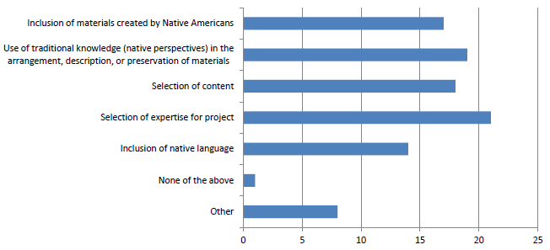
Collaborative Management of Indigenous Cultural Heritage Materials: Policies and Protocols
The survey data indicate that most of the project participants, both tribal and nontribal, actively sought to include Native perspectives and knowledge:
Notes:
SLIDE 16: Protocols continued (BETH)
To gain a better understanding of how the Protocols directly or indirectly informed these projects, we asked detailed questions related to their central recommendations. The survey data indicate that most of the project participants, both tribal and nontribal, actively sought the perspective of tribal communities, including the selection of content, the identification of staff expertise, the incorporation of tribal knowledge in the arrangement, description, and preservation of materials, and the inclusion of Native language (see graph). Respondents who answered “other” emphasized the importance of community involvement and coordinating roles for tribal members with specialized expertise, including NAGPRA liaisons.

Slide 17
Lessons Learned
1) Get started early, be flexible, and build trust slowly.
2) Challenge your motivations and be authentic.
3) Respectful communication is fundamental. Strive to understand tribal perspectives and express a willingness to learn from and work within tribal culture.
4) Establish and communicate clear, realistic project goals and time-lines while respecting cultural differences.
5) Be flexible when formalizing collaborative agreements.
6) Successful collaboration requires committed and equitable institutional support from both partners, as well as outside funding.
Notes:
SLIDES 17: Lessons Learned (NATALIA)
The survey respondents were also asked to share any successes, challenges, and “lessons learned” in their efforts to build trusting relationships and to develop successful collaborative projects. We investigated these questions further in the interview phase. Several themes emerged that are best described through the eloquent words of those who participated in the study—both the online survey respondents and the interviewees—who brought valuable insights and first-hand experience. These voices represent a blend of Native and non-Native perspectives working both within and outside of their respective cultures.
Get started early, be flexible, and build trust slowly.
Challenge your motivations and be authentic.
Respectful communication is fundamental. Strive to understand tribal perspectives and express a willingness to learn from and work within tribal culture.
Establish and communicate clear, realistic project goals and time-lines while respecting cultural differences.
Be flexible when formalizing collaborative agreements.
Successful collaboration requires committed and equitable institutional support from both partners, as well as outside funding.
In a series of open-ended questions, we also asked our survey respondents if they would consider future collaborations. Without exception, all respondents indicated that they would be interested in collaborating with their partners or other organizations on similar projects in the future.

Slide 18
Toward a Set of Best Practices for Collaboration between Tribal and Nontribal Organizations
Initiating the Project
Cultivating Relationships
Developing Policies and Procedures
Sustaining Project Outcomes
Notes:
SLIDE 18: Toward a set of Best Practices (BETH)
Given this substantial body of research data concerning the development of cross-cultural relationships, what characteristics do these successful collaborative partnerships have in common? The survey data, compiled across multiple institutions, indicate that the project partners share several commonalities. Collectively, these themes form a set of strategies and best practices that can assist tribal and nontribal organizations in building trusting, reciprocal relationships and successful collaborative projects. Our recommendations are intended as a starting point for those interested in sharing useful skills, knowledge, and resources through collaboration.

Slide 19
Toward a Set of Best Practices for Collaboration between Tribal and Nontribal Organizations
Initiating the Project
Institutional Support
Consult with Tribes
Involve leadership
Articulate Need
Strategic Partnerships
Clear objectives
Funding
Get Permission
Impact is greater than project goals
Notes:
SLIDE 19: Initiating the Project (PANELISTS)
Cultivate strong institutional support when developing project objectives. Align the project with organizational mission and strategic goals.
Consult with tribal communities and tribal governance early in the planning phase, and gain approval for the project goals, policies, and procedures.
Involve leadership at the highest levels to engender a sustainable culture of trust and respect. Ensure that leadership in partnering institutions understands the unique nature of collaborations with tribal organizations.
Articulate a pressing social, cultural, or economic reason to collaborate and publicize to relevant communities.
Focus on existing cultural, historical, or geographic alignments to identify partners, while also recognizing the historical tensions across cultural groups.
Establish clear project objectives that are mutually beneficial to all parties. Engage in extensive preliminary planning to set clear goals, responsibilities, planned outcomes, and time-lines.
Seek funding from both internal and external sources, and use the grant writing process as a mechanism to formalize the collaborative relationship.
Ask permission, listen, be patient, and always keep the well-being of the tribal community in mind.
Realize the collaboration is greater than the initial project goals. Interact with the community at all levels, attend cultural events, extend invitations, share equally in establishing the relationship.

Slide 20
Toward a Set of Best Practices for Collaboration between Tribal and Nontribal Organizations
Cultivating Relationships
Respectful communication and inclusivity
Written Agreements
Project Coordinator with tribal history and perspective
Sensitive to difference perceptions of work and time management
Meet frequently
Equal partnerships
Reciprocal education and training
Notes:
SLIDE 20: Cultivating Relationships (PANELISTS)
Develop a culture of respectful communication and inclusivity that learns from and works within tribal culture.
Develop written agreements, including memorandums of understanding or contractual agreements that guide institutional commitments, workflow, and staff roles. Gain support through a tribal resolution whenever possible.
Engage a project coordinator familiar with tribal history and cultural perspectives.
Be sensitive to different understandings of work culture and time management.
Meet frequently in both tribal and nontribal venues, and build trust through regular face-to-face meetings hosted by each collaborative partner.
Engage in equal partnerships, and ensure that partners have an equal voice. Develop an advisory board representative of all partners.
Engage in reciprocal training and education. Share critical skill sets, such as tribal knowledge, knowledge of archival best practices, and grant writing.

Slide 21
Toward a Set of Best Practices for Collaboration between Tribal and Nontribal Organizations
Developing Policies and Procedures
Include tribal expertise and traditional knowledge
Tribal approval for content
Identification and management of sensitive materials
Contractual agreements
Adequate Infrastructure
Notes:
SLIDE 21: Developing Policies and Procedures (PANELISTS)
Develop policies and procedures for the inclusion of tribal expertise, traditional cultural expressions, and traditional knowledge in the selection, interpretation and management of content.
Ensure that the process for approving content selection and interpretation is determined by the tribal entity.
Respect tribal expertise in the identification and handling of culturally sensitive materials, including clearance from tribal communities, restriction or removal of sensitive materials, and agreements on mechanisms for limiting access or use.
Utilize contractual agreements, including grant reports to provide structure, accountability, and resources required to support projects.
Ensure the project is of a manageable size and scale, and that the technical infrastructure is sound.

Slide 22
Toward a Set of Best Practices for Collaboration between Tribal and Nontribal Organizations
Sustaining Project Outcomes
Maintain and share documentation
Tribal approval for publicity
Institutional support
Maintain alliances
Publicize impact
Notes:
SLIDE 22: Sustaining Project Outcomes (PANELISTS)
Maintain ongoing documentation and share this information widely.
Develop mechanisms for tribal approval of any information planned for public dissemination.
Gain institutional support for long-term and sustainable management of project outcomes.
Continue to maintain community goodwill and relationships after the project ceases. Follow up regularly and engage in subsequent partnerships that build alliances over time.
Publicize impact and share successes with others.

Slide 23
Every society needs educated people, but the primary responsibility of educated people is to bring wisdom back into the community and make it available to others so that the lives they are leading make sense.
—Vine Deloria Jr., 1997
Notes:
SLIDE 23: Conclusion (BETH and NATALIA)
Our research focused on the promotion of ethical and successful relationships between tribal and nontribal cultural institutions. In the course of our investigation, we have discovered that relationship building is difficult to document. Every partnership is unique, and in the case of tribal and nontribal collaborations, each participant must adapt to the circumstances and cultural history surrounding the project. Although there is no “one-size-fits-all” approach to the development of sustainable collaborative partnerships, we have identified several fundamental elements essential to building ethical and trusting relationships. These include respect for and an openness to learn from differing cultural perspectives, recognition of historical differences in power and privilege, establishment of reciprocal partnerships where knowledge and expertise is equally valued and shared, and acknowledgment that relationship building is an ongoing process and the responsibility of all partnering communities.
Our research has focused on a small but representative set of highly effective collaborative projects identified as “successful” by the partnering institutions during the survey process. Additional research is needed to test these recommendations among a larger population of collaborative efforts. Another critical area of research might involve an analysis of unsuccessful collaborative projects to better understand the complexities of relationship building and strategies to overcome project barriers. In particular, further examination of the challenges and difficulties associated with developing trusting relationships, exclusively from the tribal perspective, would enhance our research findings significantly.
Our research also highlights the degree to which those involved in collaborative projects are adopting the guidelines set forth in the Protocols for Native American Archival Materials. The survey data clearly indicate that tribal and nontribal archivists regard the Protocols as critical guiding documentation for navigating the sensitive issues surrounding shared or appropriated cultural heritage. Central to future inquiry is the recognition that cultural heritage institutions are increasingly referencing and incorporating the Protocols into the structures and agreements sustaining their projects
In combination with the Protocols, our findings, lessons learned, and recommended best practices offer insight and foundational information for those interested in developing the cultural competencies necessary for sustainable partnerships with Indigenous and other communities. Through the cultivation of equitable and trusting relationships, tribal and nontribal archivists can discover new and alternate professional frameworks that integrate traditional knowledge and sensitive approaches to shared stewardship of Native American history and culture. Through these reciprocal relationships, we can begin to address injustices inherent in the misappropriation and misuse of Indigenous cultural patrimony and historical documentation housed in many non-Native institutions.
To develop the recommendations and best practices set forth in this article, our research has focused on a small but representative set of highly effective collaborative projects identified as “successful” by the participating partners during the survey process. We hope that this initial overview of successful models of collaboration will offer a set of strategies for those interested in sharing expertise, knowledge, and cultural resources across communities, and encourage the exchange of information and documentation of great interest to Indigenous peoples and fundamental to their cultural sovereignty. These best practices provide a roadmap for relationship building, the development of mutual agreements, memorandums of understanding, and other means of formalizing the collaborative process, as well as the importance of funding and institutional support for these efforts.
Our research also highlights the degree to which those involved in collaborative projects are adopting the guidelines set forth in the Protocols for Native American Archival Materials. Based on the research data, most of the surveyed institutions are aware of the Protocols, and this awareness extends beyond the archival field. There continues to be a great deal of potential for original research on the use of the Protocols, especially in relation to collaborative projects involving museums (where NAGPRA obligations are quite familiar, but where only now are its recommendations being extended to archival collections and exhibition practices). Additional research is also needed to develop a broader set of recommendations that more fully addresses the complex issues associated with ownership and shared stewardship of Native cultural materials that extends beyond the collaborative processes described in this work.
The projects selected for this study share several commonalities associated with building effective collaborative relationships, but represent only a small sample of the ongoing or planned collaborations between tribal and nontribal organizations. Additional research is needed to test these recommendations and best practices among a larger population of collaborative efforts. Another critical area of research might involve an analysis of unsuccessful collaborative projects to better understand the complexities of relationship building and the development of strategies to overcome project barriers. In particular, further examination of the challenges and difficulties associated with developing trusting relationships, particularly from the tribal perspective, would enhance and complement our research findings significantly.
Nevertheless, the research set forth in this article comprises the first comprehensive national study of a variety of collaborative projects undertaken by multiple Native and non-Native institutions. We believe our findings address a serious gap in archival literature, and we anticipate that they will stimulate further study of cross-cultural collaboration with historically marginalized groups, especially Indigenous peoples. Central to future inquiry is the recognition that cultural heritage institutions are increasingly referencing and incorporating the Protocols for Native American Archival Materials into the structures and agreements sustaining their projects. When the Protocols were released in 2006, many archivists considered them controversial, perhaps even radical, and argued against endorsing the recommendations as professional practice. However, the survey data clearly indicate that tribal and nontribal archivists regard the Protocols as critical guiding documentation for navigating the sensitive issues surrounding shared or appropriated cultural heritage. In combination with the Protocols, our findings, lessons learned, and recommended best practices offer insight and foundational information for students and experienced archivists interested in developing the cultural competencies necessary for sustainable partnerships with Indigenous and other communities. Through the cultivation of equitable and trusting relationships, tribal and nontribal archivists can discover new and alternate professional frameworks that integrate traditional knowledge and sensitive approaches to shared stewardship of Native American history and culture. Through these reciprocal relationships, we can begin to address past injustices inherent in the misappropriation and misuse of Indigenous cultural patrimony and historical documentation housed in non-Native institutions.

Slide 24
Learn More!
“Collaborations between Tribal and Nontribal Organizations: Suggested Best Practices for Sharing Expertise, Cultural Resources, and Knowledge”
The American Archivist Vol. 78, No. 1 Spring/Summer 2015

