Slide 1
Final Undergraduate Research Report
Anthony Dulaney
The Role of Phenolics in Anode Fouling During Electrolysis of Aqueous Alkali Byproduct Streams from Food and Agricultural Processing

Slide 2
Agenda
Part 1:
Introductory
Background Information
Initial Findings
Part 2:
Wheat Straw Alkali Extract
Gas Produced
Electrode Fouling
Part 3:
Measuring Phenolics
Removing Phenolics

Slide 3
Conceptual Biorefinery
Different varieties
Wheat straw
Different agronomic practices
Alkali pretreatment
H₂ (gas)
Cellulose products
Solids
(cellulose & other)
Liquid
(hemicelluloses, lignin & other)
Enzyme saccharification
Caustic recovery
S.C.
Ethanol
Glucose
O.Y.
Liquid
(hemicelluloses & other)
Solid
(lignin)
Lipid
S.C.
Chemical/Physical Modification
Enzyme saccharification
X.I.
Xylulose
Xylose liquor
Polymer products
Low/high molecular weight products
O.Y.
H₂/hydrogenation
Lipid
Xylitol
S.C. = Saccharomyces cerevisiae, O.Y. = Olegenous yeast, X.I. = Xylose isomerase

Slide 4
The Big Picture
In the context of the Penner lab’s biorefinery-oriented research, the primary goal of ongoing electrochemical studies is to generate knowledge pertaining to the chemistry of anode fouling during electrolysis of lignocellulose-derived caustic liquors and, thus, to contribute to implementation of membrane-assisted-electrolysis for alkali recycling during bio-material processing.

Slide 5
Reltaively Long-Term Research Goals
Fabricate laboratory-scale continuous flow membrane-assisted electrolysis (MAE) apparatuses for electrochemical studies
Generate fundamental knowledge of electrochemical processes dictating the efficiency of MAE applications with lignocellulose-dervied caustic liquors

Slide 6
Relatively Short-Term Research Objectives
To understand, at a rudimentary level, the basics of simple electrolytic systems
To characterize the extent of anode fouling during electrolysis of wheat straw alakli extracts
Lay groundwork for future research in alkali recovery

Slide 7
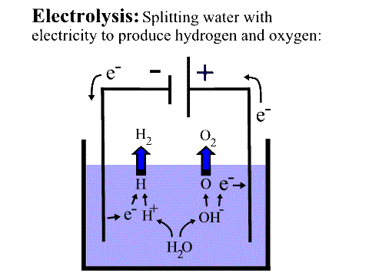
Electrolysis
Image from New Mexico Solar Energy Association

Slide 8
Hydroxide depleted (neutralized) alkali processing liquor
Hydroxide enriched (caustic)
process water
Ion selective membrane
O₂(g)
+
2H₂O
H₂(g)
+
2OH⁻
anode
(+)
Cathode
(-)
Na⁺
Na⁺
4OH⁻
2H₂O
raw alkali processing liquor
process water
Schematic diagram of two-compartment electrochemical cell for membrane-assisted electrolysis (adapted from Hobbs et al, 1999)

Slide 9
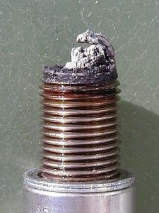
What is Anodic Fouling?
Fouling is the degredation in efficency of an electrode
  Generally through deposition of material on electode

Slide 10
How do we approach a research problem?
Identify end goals
Engineer a path from from what we want to know to what we currently know with special consideration of where our competencies lie
Gradually increase the difficulty of the experiments
  “Science Fair Experiment”
  Intermediate Step-Alkali electrolysis
  Meeting goals-MAE

Slide 11
Special Considerations for “Science Fair Experiment”
Understanding why certain reactions are taking place at the electrodes (competing reactions)
How to use gas capture as an analytical tool (hydrogen and oxygen production and efficiency)
Basic electrical theories (efficiency)

Slide 12
Special Considerations for WSAE Electrolysis
WSAE is a complex system (competing anodic reactions)
Alkali lignin adsorption (anode fouling)
Amount of hydrogen produced (hydrogen production and efficiency)
Studies say very little oxygen is produced in Weak Black Liquor which is very similar to our WSAE (oxygen production and efficiency)

Slide 13
Agenda
Part 1:
Introductory
Background Information
Initial Findings
Part 2:
Wheat Straw Alkali Extract
Gas Produced
Electrode Fouling
Part 3:
Measuring Phenolics
Removing Phenolics

Slide 14
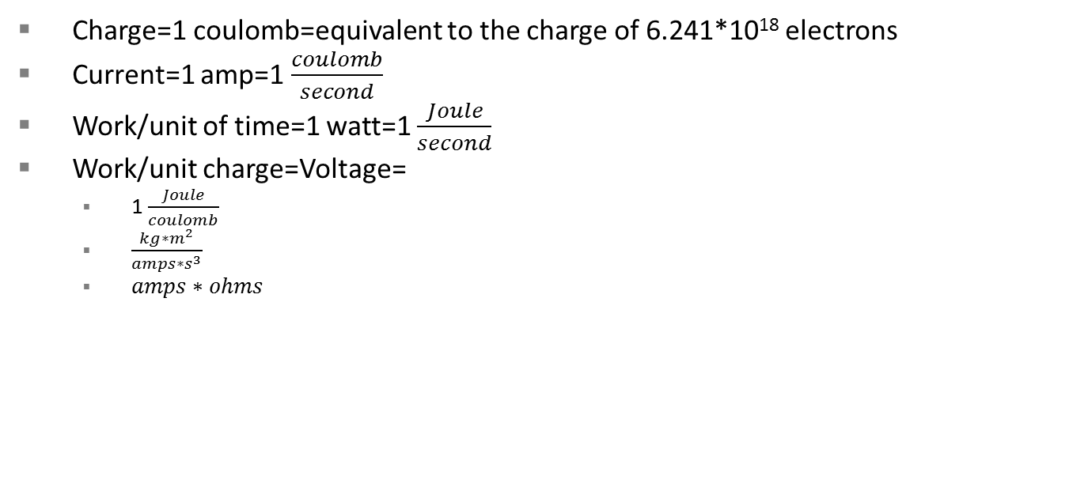
Electrical Terms
Charge=1 coulomb=equivalent to the charge of 6.241*10¹⁸ electrons
Current=1 amp=1 $\frac{coulomb}{second}$
Work/unit of time=1 watt=1 $\frac{Joule}{second}$
Work/unit charge=Voltage=
  1 $\frac{Joule}{coulomb}$
  $\frac{kg∗m^{2}}{amps∗s^{3}}$
  $amps∗ohms$

Slide 15
Understanding Reduction Potential
Represented as a reduction half-reaction followed by an E/V value
  M⁺+e-->M⁰ (example half-reaction)
E/V Value is the ease of a half-reaction to take place measured in volts (CRC)
  Cathode is a reduction site thus the highest reduction potential happens first
  Anode is actually an oxidation site so the lowest reduction potential happens first (highest oxidation potential)

Slide 16
Cathodic Reactions in Water
2H⁺+2e⁻ ->H₂ E/V=0.000
2H₂O+2e⁻ -> 2OH⁻+H₂ E/V=-0.8277
Reactions are based on two things:
  E/V
  Concentration

Slide 17
Anodic Reactions in Water
Anode reaction is actually an oxidation
4OH⁻->O₂+2H₂O+4e⁻ E/V=-0.401
2H₂O->O₂+4H⁺+4e⁻ E/V=-1.229
Anodic reactions represented as:
O₂+2H₂O+4e⁻ -> 4OH⁻ E/V=0.401
O₂+4H⁺+4e⁻ -> 2H₂O E/V=1.229
Reactions are based on two things:
  E/V
  Concentration

Slide 18
Autoionization of Water
K_{w}=[H⁺][OH⁻]=1.0*10⁻¹⁴
[H⁺]=1.0*10⁻⁷
[OH⁻]=1.0*10⁻⁷
Very low concentration of ions
Ions are cruical for an aqueous electrolysis system

Slide 19
Electrolysis of H₂O
The water ions (H⁺, OH⁻) react readily with the electrodes
  Very low concentrations (10⁻⁷M)
The water molecules (H₂O) react more slowly with the electrodes
  Very high concentrations (55M)
When H₂O reacts with electrodes, it leaves ions around the electrodes.
  Anions around cathodes, cations around anodes
  Becomes more and more energetically unfavorable to continue moving electrons to a charged area

Slide 20
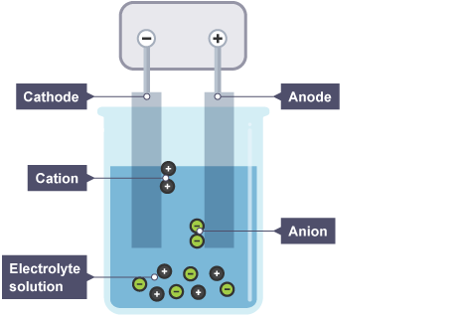
Why Do Electrolytes Help?
Electrolytes are attracted to the electrodes causing a much higher concentration than throughout the water
  Cations move toward the cathode
  Anions move toward the anode
Image from British Broadcasting Corporation

Slide 21
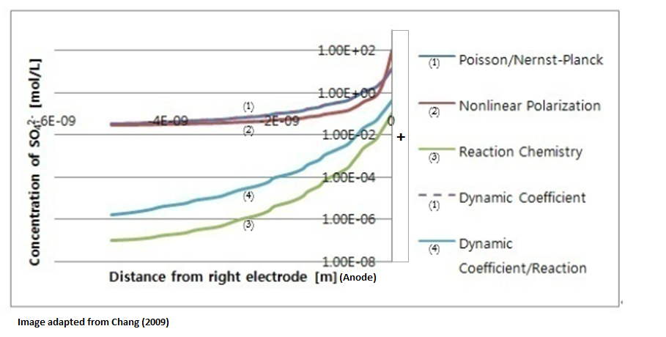

Slide 22
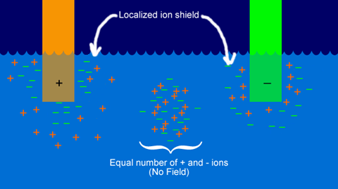
Why Do Electrolytes Help?
Electrolytes “buffer the charge” to reduce the back potential
  Reduce the required voltage
  Some electrolytes react with electrodes
    E/V
    Concentration
Image adapted from National Supercomputing Center for Energy and the Environment

Slide 23
Agenda
Part 1:
Introductory
Background Information
Initial Findings
Part 2:
Wheat Straw Alkali Extract
Gas Produced
Electrode Fouling
Part 3:
Measuring Phenolics
Removing Phenolics

Slide 24
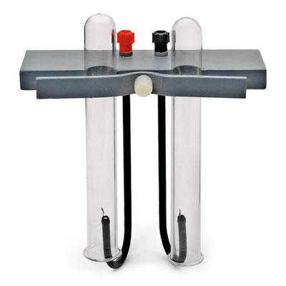
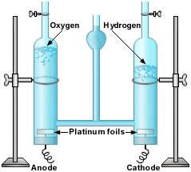
Learning the Fundamentals
Ideation:
  Electrolysis of Water Experiment (Education.com)
  Hoffaman Apparatus
  Brownlee Apparatus
Execution:
  Power Supply
  Electrodes
  Inverted graduated cylinders
  Solution reservoir

Slide 25
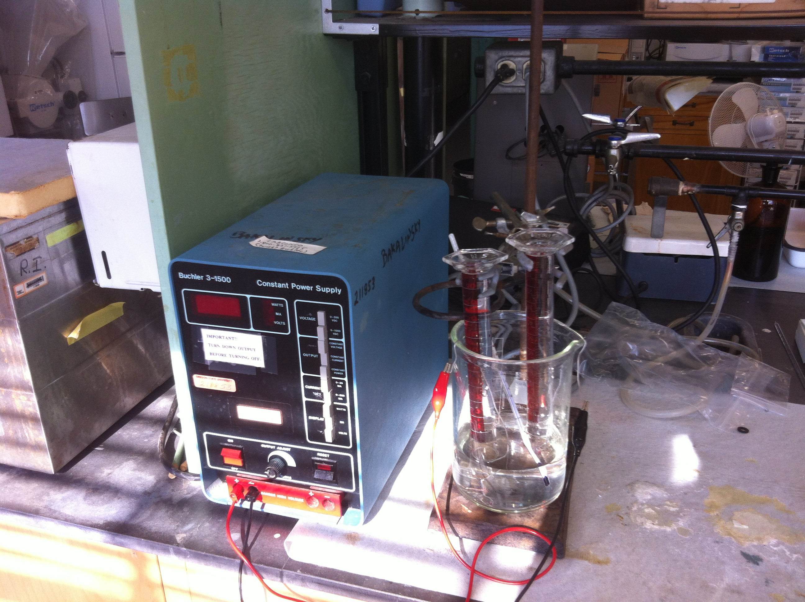

Slide 26
Ideal and Assumptions?
Ideal
All electrons are going into hydrogen production
Assumptions
All cathodic reactions are producing H₂
Cathodic reactions are operating at 100% efficiency
H₂:O₂ ratio ~2

Slide 27
Initial Findings

Slide 28
Agenda
Part 1:
Introductory
Background Information
Initial Findings
Part 2:
Wheat Straw Alkali Extract
Gas Produced
Electrode Fouling
Part 3:
Measuring Phenolics
Removing Phenolics

Slide 29
What is Wheat Straw Alkali Extract?
-- Alkali processing of plant cell wall materials --
Lignin
Hemicellulose
Processing
Cellulose
Intact cell wall
Treated cell wall
Adapted from Mosier et al. 2005. Features of promising technologies for pretreatment of lignocellulosic biomass. Bioresource Technology, 96, 673-686.
Notes:
I would like you to have a clear picture after separation of these two phases
Next slide remove soluble insoluble along with hemi and lignin
Some lignins are broken down become small fractions soluble in alkali, hemicellulose is hydrolyze b
บอกด้วยว่า ลิกนิน กะ เฮ เหลือ เซล อยู่ในของแบ็ง ทีนี้จะบอกว่า อะไรบ้างที่ไปใน solution Structural glucan or cellulose is more resistant to alkali because its low reactivity to alkali and high crystallinity of cellulose
What alkali do with lignin?
Lignin showed outer line after pretreatment it is broken down into small fractions, cell wall is open up
General concept of pretreatment is to open up cell wall structure by solubilize hemicellulose and lignin
to make cellulose more accessible to the enzymes
The goal is to break the lignin seal and disrupt the crystalline structure of cellulose

Slide 30
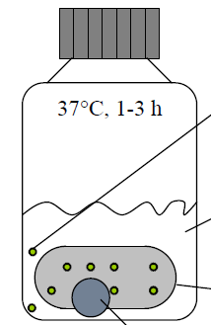
What is Wheat Straw Alkali Extract?
-- Alkali processing of plant cell wall materials --
Separation
Solid phase
Treated cell wall
Liquid phase
Adapted from Mosier et al. 2005. Features of promising technologies for pretreatment of lignocellulosic biomass. Bioresource Technology, 96, 673-686.
Notes:
My research studies are focused on lignin recovered from alkali solution. So let’s see what components are in this solution?
Add Next slide reomve soluble insoluble aling with hemi and lignin
บอกด้วยว่า ลิกนิน กะ เฮ เหลือ เซล อยู่ในของแบ็ง ทีนี้จะบอกว่า อะไรบ้างที่ไปใน solution
My research has emphasis on
During separation process, when the solid phase was extracted it had cellulose but also residue lignin and hemicellulose
The liquid phase only has lignin and hemicellulose

Slide 31
Agenda
Part 1:
Introductory
Background Information
Initial Findings
Part 2:
Wheat Straw Alkali Extract
Gas Produced
Electrode Fouling
Part 3:
Measuring Phenolics
Removing Phenolics

Slide 32
Using a Hoffaman Apparatus
Ideation:
  Building on initial experiment
    More precise
  Hoffaman Apparatus
Execution:
  Power Supply
  Electrodes
  Hoffaman Apparatus
  Voltmeter

Slide 33
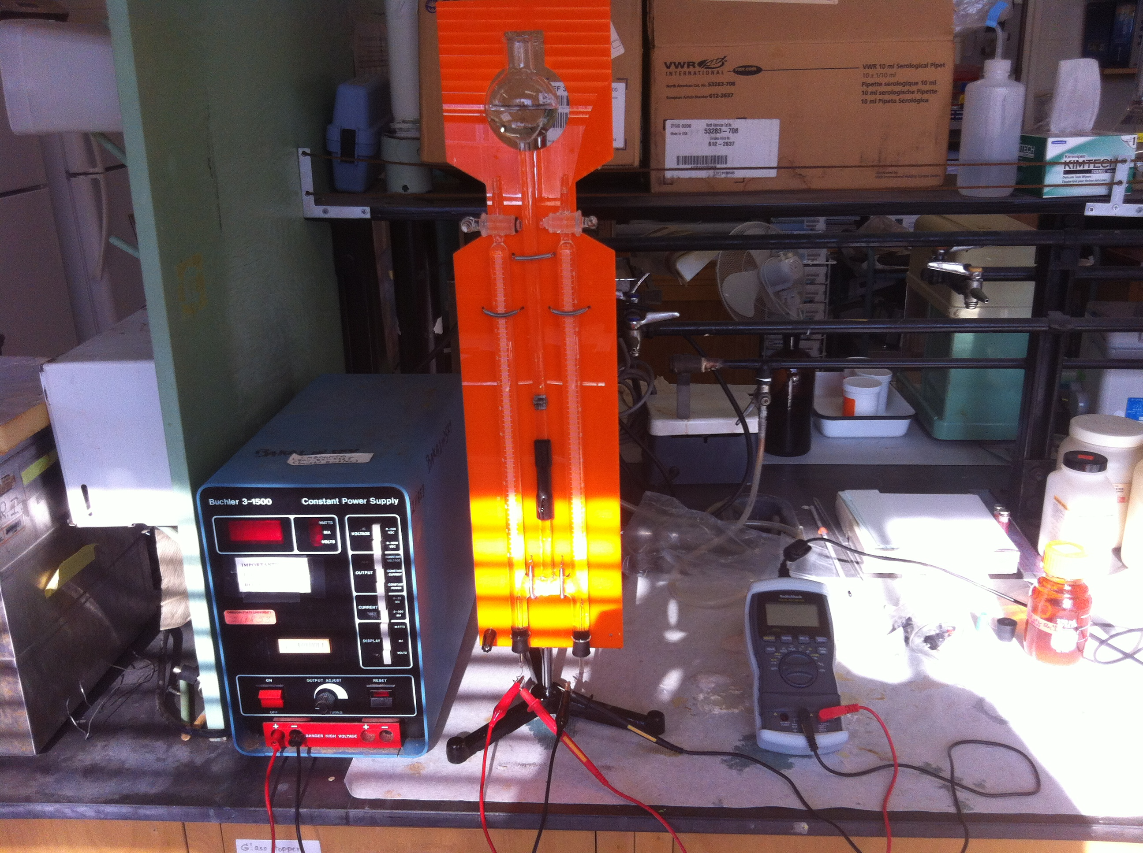

Slide 38
Conclusions from Gas Production Experiments
WSAE had significant non-O2 producing reactions occurring at the anode
Are the non-O2 producing reactions at the anode correlated with anodic fouling?

Slide 39
Agenda
Part 1:
Introductory
Background Information
Initial Findings
Part 2:
Wheat Straw Alkali Extract
Gas Produced
Electrode Fouling
Part 3:
Measuring Phenolics
Removing Phenolics

Slide 44
Conclusions from Fouling Experiments
WSAE showed signs of fouling in two phases
  First phase takes place in the first 3 minutes with a dramatic jump in voltage
  Second phase shows a slow fouling over time
What components of WSAE are responsible for electrode fouling?

Slide 45
Agenda
Part 1:
Introductory
Background Information
Initial Findings
Part 2:
Wheat Straw Alkali Extract
Gas Produced
Electrode Fouling
Part 3:
Measuring Phenolics
Removing Phenolics

Slide 46
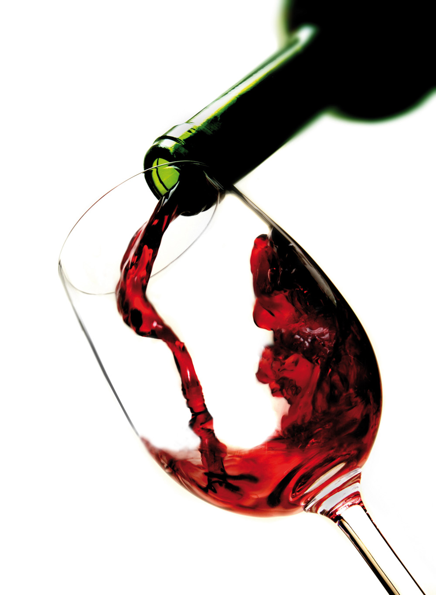
The Role of Phenolics in Foods
Natural antioxidant
  Primary antioxidant found in foods
Mouthfeel and texture
  In wines, phenolics influence the intensity and type of astringency
Flavor
  Raspberry Ketone is responsible for raspberry flavor
Alkali lignin is a component of WSAE composed of a range of phenolic compounds
  E/V~0.015-0.60 (Steenken and others, 1982)

Slide 47
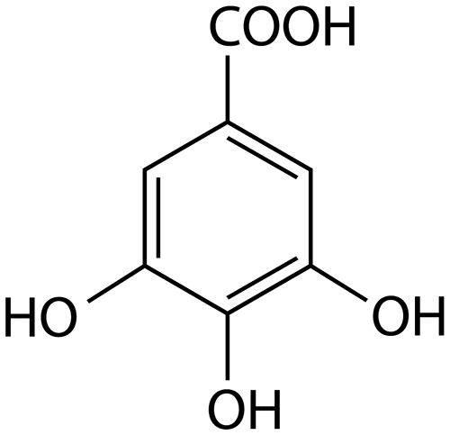
Measuring Phenolics
Use Folin-Ciocalteu Reagent to assess the phenolic content
  Commonly accepted measurement of total phenolics
Use gallic acid equivalent (mg GAE/L)
  Relatively easy to solublize
  Medium absorptivity (Singleton, 1999)
  Common measurement of phenolics

Slide 49
Phenolic Content of Common Foods
Red Wine~2000 mg/L (Caccetta and others, 2000)
White Wine~400 mg/L (Sato and others, 1996)
Blueberries~4,100 mg/g (Zheng and others, 2003)
Cranberries~3,100 mg/g (Zheng and others, 2003)
WSAE~850 mg/L

Slide 50
Agenda
Part 1:
Introductory
Background Information
Initial Findings
Part 2:
Wheat Straw Alkali Extract
Gas Produced
Electrode Fouling
Part 3:
Measuring Phenolics
Removing Phenolics

Slide 51
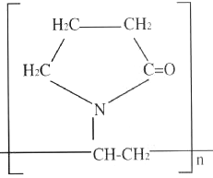
Phenolic Treatments
PVPP is a common fining agent in wines
Why PVPP?
  Relatively cheap
  Does not affect pH
  Insoluble

Slide 52
Hypothetical PVPP-Polyphenolic Associations
PVPP appears to form strong non-covalent associations with selected polyphenolics. The structure depicted above is the hypothetical association between PVPP and the flavonoid catechin.
from: Gopal, C. and Marti, J. (1999) “The use of polyclar (pvpp) for preventive and remedial treatment of wine.” The Australian Grapegrower & Winemaker 426a: 141–145

Slide 53
66%
67%

Slide 54
*

Slide 55
78%
76%
35%

Slide 56
Conclusions from Phenolic Stripping Experiments
A combination of pH and PVPP treatments can be used to remove many phenolics
How does the removal of phenolics affect anodic fouling?

Slide 57
Areas for continuing research
What is the fouling behavior of WSAE electrolysis after phenolics have been stripped? Hydrogen production?
Regeneration of electrodes ($40 each pair)
The efficiency of other fining agents such as activated carbon and gelatin
Deadsorbing lignin molecules from PVPP
What are some non-oxygen producing competing reactions? Is there a place to commercialize this?
Improvements in the experimental system

Slide 58
Relatively Short-Term Research Objectives
To understand, at a rudimentary level, the basics of simple electrolytic systems
To characterize the extent of anode fouling during electrolysis of wheat straw alakli extracts
Lay groundwork for future research in alkali recovery

Slide 59
Questions?

Slide 60
Works Cited (Scholarly Articles)
Beaudry EG, Caro RF. Electrolysis of Weak Black Liquor and Bleach Effluent. 1996 Engineering Conference; September 16-19 1996; Chicago IL.
Caccetta RA, Croft KD, Beilin LJ, Puddey IB. 2000. Ingestion of Red Wine Significantly Increases Plasma Phenolic Acid Concentrations but Does Not Acutely Affect Ex Vivo Lipoprotein Oxidizability. Am J Clin Nutr 71:67-74.
Cloutier JN, Azarniouch MK, Callender D. 1993. Electrolysis of Weak Black Liquor. Part 1: Laboratory Study. J Pulp Paper Sci 19:J244-8.
Chang JH. 2009. Modeling of an Electrochemical Cell. [MSc Thesis]. Toronto, Canada: University of Toronto. 117 p. Available from: https://tspace.library.utoronto.ca/bitstream/1807/18247/6/Chang_JinHyun_200911_MASc_Thesis.pdf
Ghatak HR. 2006. Electrolysis of Black Liquor for Hydrogen Production: Some Initial Findings. Intern J Hydrogen Energy 31:934-8.
Ghatak HR. 2008. Spectroscopic Comparison of Lignin Separated by Electrolysis and Acid Precipitation of Wheat Straw Soda Black Liquor. Intern J Hydrogen Energy 28:206-12.
Naber MR. 1980. Analysis of Experimental Variables for the Kolbe Electrolysis of Organic Acids to Hydrocarbons. [BS Thesis]. Cambridge, MA: Massachusetts Institute of Technology. 62 p. Available from: http://dspace.mit.edu/bitstream/handle/1721.1/68297/32114654.pdf?sequence=1
Sato M, Ramarathnam N, Suzuki Y, Ohkubo T, Takeuchi M, Ochi H. 1996. Varietal Differences in the Phenolic Content and Superoxide Racial Scavenging Potential of Wines from Different Sources. J Agric Food Chem 44:37-41.
Steenken S, Neta P. 1982. One-Electron Redox Potentials of Phenols. Hydroxy- and Related Compounds of Biological Interest. J Phys Chem 86:3661-7.
Ulleberg O. 2003. Modeling of Advanced Alkaline Electrolyzers: A System Simulation Approach. Intern J Hydrogen Energy 28:21-33.
Zheng W, Wang SY. 2003. Oxygen Radical Absorbing Capacity of Phenolics in Blueberries, Cranberries, Chokeberries and Lingonberries. J Agric Food Chem 51:502-9.

Slide 61
Works Cited (Websites)
Electrolysis: Obtaining hydrogen from water: The Basis for a Solar-Hydrogen Economy. (n.d.). Retrieved from New Mexico Solar Energy Association website: http://www.nmsea.org/Curriculum/7_12/electrolysis/electrolysis.htm
Electrolysis of sodium hydroxide and sulfuric acid. (n.d.). Retrieved from British Broadcasting Corporation website: http://www.bbc.co.uk/schools/gcsebitesize/science/triple_ocr_gateway/chemistry_out_there/electrolysis/revision/2/
Electrolysis of Water Experiment. (n.d.). Retrieved from Education.com website: http://www.education.com/science-fair/article/water-electrolysis/
Have You Got the Power? (n.d.). Retrieved from National Supercomputing Center for Energy and the Environment website: http://emandpplabs.nscee.edu/cool/temporary/doors/toolbox/batteries.htm

