Slide 1
Going for Good not Gold
Using Alma Digital for Electronic Course Reserves
Sagan Wallace
Sagan.Wallace@oregonstate.edu
Notes:
Hi, my name is Sagan Wallace and I’m from Oregon State University, where I work as the Library Experience & Access Department’s Evening Supervisor. Thank you for coming to my presentation Going for Good, Not Gold: Using Alma Digital for Electronic Course Reserves

Slide 2
Land Acknowledgement
I stand on the traditional land of the Cowlitz, Multnomah, Kathlamet, Clackamas, Tualatin, Kalapuya, and many others.
Historically, indigenous folks have been told to forget their identities, through forced displacement, suppression of languages, violence and genocide
How will you center Indigenous knowledge today and going forward?
Image credit David Mark, Pixabay.com
Notes:
Before I begin, I want to give a brief land acknowledgment. I hope this has been part of the conference as a whole, but I specifically want to reflect on the fact that I personally am presenting from the traditional land of the Cowlitz, Multnomah, Kathlamet, Clackamas, Tualatin, Kalapuya, and many others.
Historically, indigenous folks have been told to forget their identities, through forced displacement, suppression of languages, violence and genocide. This is a call that as you think about what you design, that you center Indigenous knowledge and autonomy today and going forward.

Slide 3
Agenda
How we manage e-reserves at OSU
Design principles I followed
Takeaways & other unsolicited advice
Stick around for Q&A!
Notes:
Today I’m going to be talking to you very briefly about the context in which our e-reserves program came to be. I’ll give you a quick overview about what Alma Digital looks like and the design constraints I had to work with in order to modify it into an e-reserves program. However, the meat of this presentation is going to be some takeaways. I want this to be as platform-neutral as possible. This isn’t a how-to guide for Alma Digital – but if you’re interested in that aspect of it, my documentation and contact information is available at the end of the presentation, and I’d be thrilled to tell you more.

Slide 4
Where’d we come from?
Pre-COVID
COVID hits
Now (and beyond?)
Print collection only
3- or 6-hour checkouts
Instructor-initiated
Students needing more than “drop-in” support sent to student center
“All students are HSRC students”
Student-initiated requests
Digital copies only
…risky copyright
Constantly re-iterating and improving
Controlled Digital Lending principles
Alma Digital
Notes:
OK I’d like the context to be more interesting than this, maybe something involving space lasers, but the answer is unfortunately COVID. Prior to the pandemic, OSU Libraries offered short-term course reserves for in-person, print use only. We only accepted requests from instructors – so if an instructor didn’t put it on reserves, we wouldn’t be able to support the student. We had next to no support in our department for our Ecampus students. If students needed long-term support, such as having a textbook available for the whole term, we would send them to the Human Services Review Center (or the HSRC), a student support center on campus. We helped them get a lending program set up, but otherwise were separate entities.
Like most libraries we had to switch with almost no warning to a 100% remote environment. For us, that doomsday came during finals week of winter term. Suddenly we had requests flying in, both from students worried about having access to the print texts they had planned on studying with for exams, instructors trying to triage where their students would be able to physically take their tests, and campus administrators trying to identify what supports were available throughout the campus. It was awful.
We kept coming back to the phrase, “All students are HSRC students.” Pre-pandemic we were careful to only offer term-long support to students in need, so that we could stretch limited resources to their fullest. But with the pandemic everyone was in a situation where they would need additional support, whether that was financial, medical, food, or even mental health concerns. We live in a communally traumatic time.
The piece of the puzzle that my team - and when I say ‘my team’ I want to be clear that this is a team I am part of, not a team that I am leading – the piece that we were trying to solve was that of course reserves. Even if we packaged up and mailed out all of our textbooks, we knew that we’d only be helping the smallest percentage of people in need – and maybe not even then, as people were needing to move home out of the country, or lived in areas where the mail services were down. This is why we immediately moved to offering electronic reserves. After a lot of iterations, we settled on a process where students could submit a request form for their course materials. Wherever possible, we would license an ebook. Unfortunately for many texts, ebook licenses were not an option.

Slide 5
Controlled Digital Lending
1
Only digitize books that can’t be licensed elsewhere
2
Only digitize books we physically own
Principles taken from “A White Paper on Controlled Digital Lending of Library Books” by David R. Hansen & Kyle K. Courtney
3
Only allow one viewer at a time (“DRM”)
Notes:
In this case, we used the principles of Controlled Digital Lending, or CDL, to digitize print books we owned and make the scans available through Alma Digital. We worked with legal counsel to ensure we were adhering to copyright law, meaning we had to follow some basic rules:
Only digitize books that were not available to be licensed by libraries at any price. We couldn’t do CDL to get around an expensive license.
Only digitize books we physically owned – we frequently had to purchase the print copy
Only allow one viewer at a time, and don’t allow them to download a copy. In essence, I needed some sort of software that allowed me to control the DRM.
We ended up using Alma Digital, a digital services program hosted by Ex Libris, to host our course reserves. Financially, this was the best option for us because it was already part of our software service through our consortium. Unfortunately, it was distinctly not set up as a course reserves platform, which meant we had to do make a lot of changes and do quite a bit of handwaving in order to make it work.

Slide 6
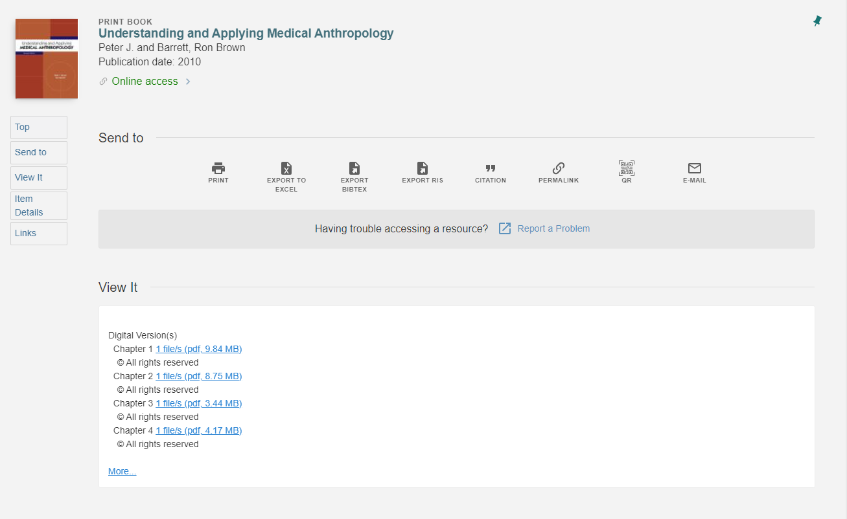
Logged in – Catalog
Notes:
Before I go further, I want to give you a quick tour of what Alma Digital looks like to our patrons. Our first priority was that students could theoretically find the materials themselves without any librarian intervention. So these links were in a variety of places – we maintained a list of digitized titles they could log in and view, they were findable in our catalog and connected with our course reserves system so they could look them up that way, and we contacted instructors when we finished digitizing a text used in their class so they could share it out further.
This image is what patrons see in when they are logged into our catalog. All the metadata about the book is at the top, and there are links to each chapter in the View It section below.

Slide 7
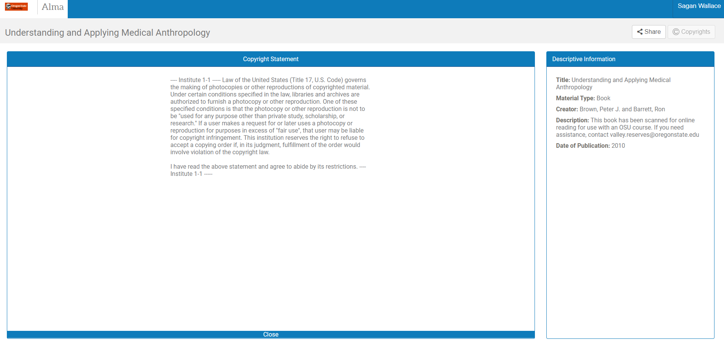
Logged in – Alma Digital Landing Page
Notes:
Clicking the PDF link sends the patron to this page. They are shown a copyright page which I have absolute faith that all students read in its entirety and take to heart. This copyright text is customizable, I just haven’t yet.

Slide 8
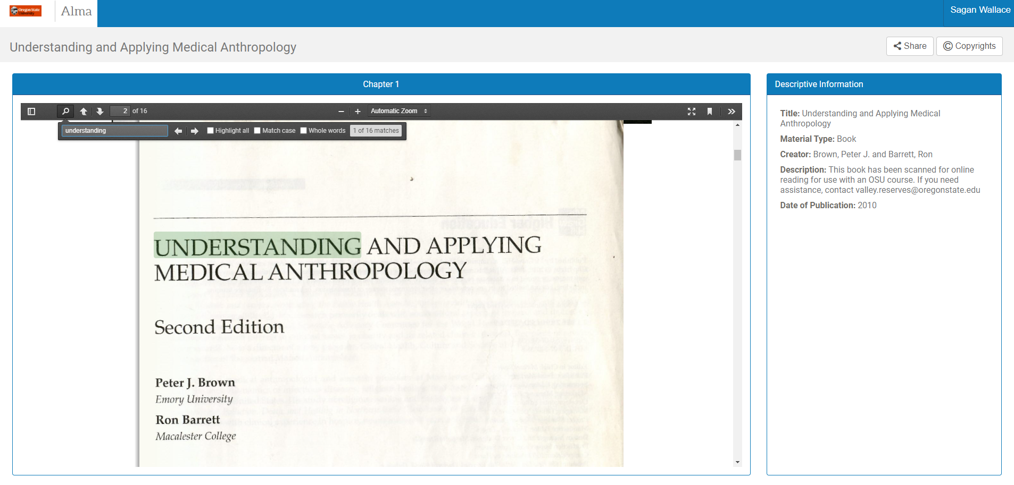
Logged in – PDF viewer open
Notes:
Once they close the copyright warning, they are able to view their PDF. The PDFs have all been OCR’d and are searchable and should work with a screenreader. You can zoom in and move around and such. However, they are not able to download a copy from this page.
That’s where we’ve ended up. Now I want to talk about the thought processes going on behind it.

Slide 9
Concept credit Abby Covert
Image credit https://medium.com/uxblog/step-8-structure-ia-751cd98761cf
Notes:
Abby Covert is an information architect leader who developed the following principles of design:
Findable: We made the links findable in as many places as possible
Accessible – are there barriers to use anywhere?
Clear – how is your wording? Is the site super busy or is it clean?
Communicative – Do the links go where you expect?
Useful – Finally! A heuristic we can automatically check off the list since this is course reserves!
Credible – This is more applicable for web design – are you sending your users off to download viruses from your website?
Controllable – this usually means the user is able to control their experience in some way So for example, by being given the choice to sign up for a notification or organizing a dashboard
Valuable – do your users cherish this service?
Learnable: Do your users have to go through a steep learning curve before they can actually use the texts?
Delightful: Is it actually enjoyable to use the service?
I love these principles because they are short and sweet and they’re great summaries of some really key things to frame design in your mind when you’re working on something. They are incredibly aspirational and may not fit well, especially at the beginning of a project. Which leads me to, “Sagan’s Three Laws of Starting a New Program During a Pandemic”

Slide 10
Sagan’s Three Laws of Starting a New Program During a Pandemic
1.
Understand your constraints
2.
Design for universal accessibility
3.
Give yourself a break

Slide 11
Boundaries
1
What are your limits?
Maintain copyright compliance
Students can be self-reliant
Inexpensive or free
….But what are the structural limits?
Notes:
We had several boundaries in mind when we tried to come up with Alma Digital:
Copyright compliant
Students can find the resources themselves
Inexpensive or free
Because we had these in mind as we were going into planning, we were able to very quickly discard ideas that to be honest, I’d really like to revisit someday when we’re able. For example, there are other services that offer the type of DRM for copyright compliance, but that don’t offer any sort of automation so students aren’t able to be self-reliant.
But it’s also about knowing the structural limits of the software you’re using. For this example, I’m going to show you a change we made to the out of the box version of Alma Digital.

Slide 12
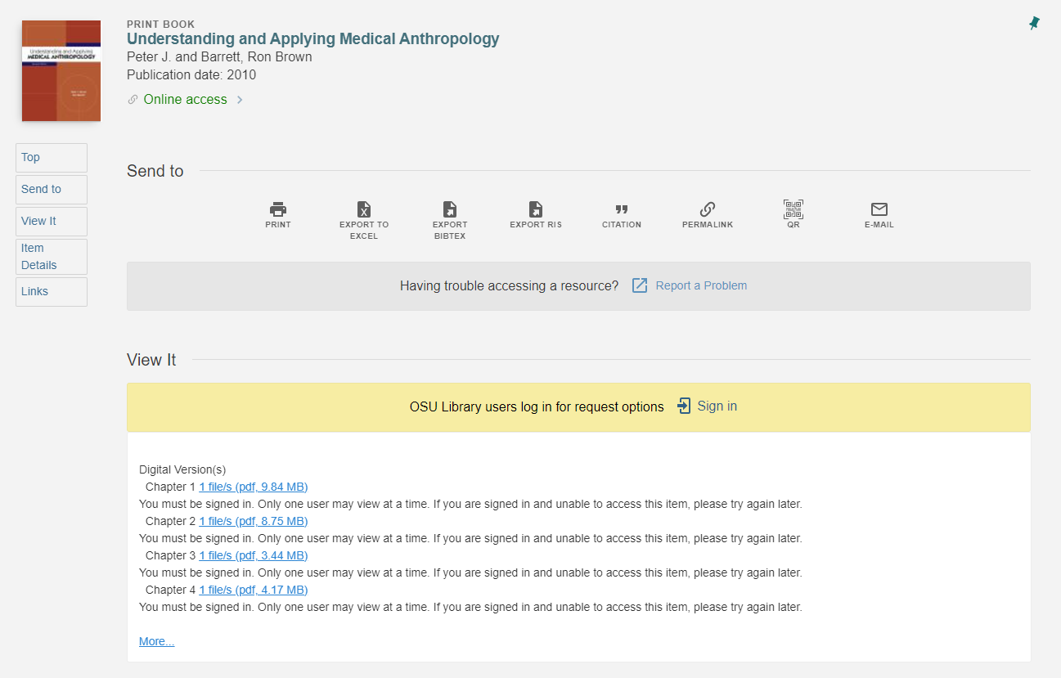
Patron is not signed in
Notes:
Going back to the patron interface, you’ll see a slightly different view if the patron is NOT signed in. Ideally, they will sign in from this screen, which will then grant them access to the PDF and they’ll go on their way. However, if they don’t sign in here and click the PDF link anyway, they’ll be directed to this screen instead:

Slide 13
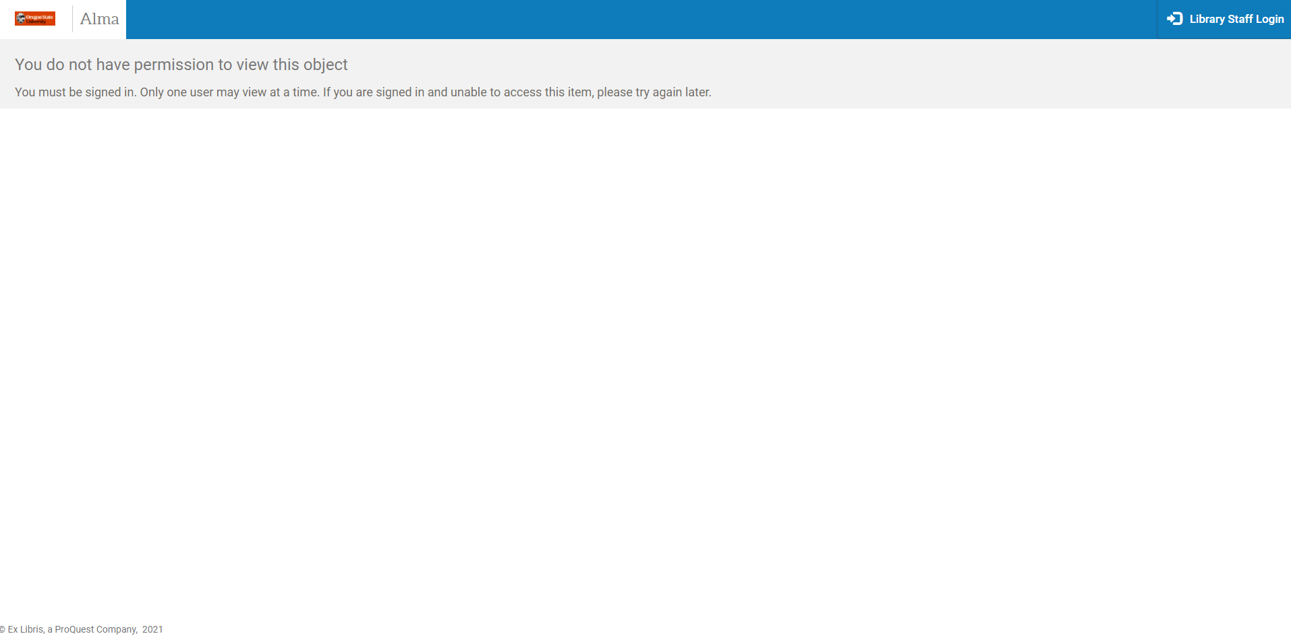
1.
Notes:
It’s a pretty boring screen that says across the top, “You do not have permission to view this object. You must be signed in. Only one user may view at a time. If you are signed in and unable to access this item, please try again later.”

Slide 14
1.
2.
Notes:
But see in the upper corner how it says “Library Staff Login”? The out of the box version simply said “Sign In.” That was problematic for us. This sign in button is not associated with our patron authentication service. If the patron clicks it, it leads them to

Slide 15
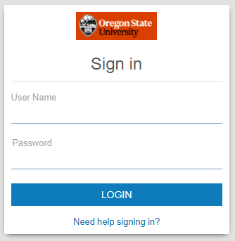
1.
2.
3.
Notes:
THIS sign in button, which is not associated with our patron authentication service. It looks similar to ours, but is actually sending you to Alma, our staff interface. In addition, if you tried and failed to log in, then clicked on “need help signing in?” you’d get this awful screen.

Slide 16
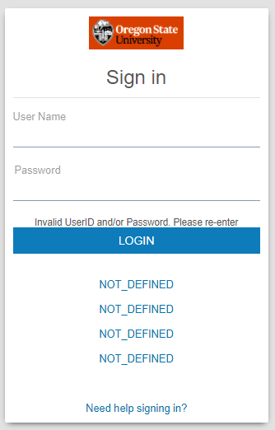
1.
2.
4.
3.
Notes:
Getting that login fixed wasn’t an option. For a lot of us, we are using what’s called Software As Service. We don’t have a team of designers creating a new interface, we are licensing software from an outside company and hoping that their vision matches our vision. In this particular case, Ex Libris isn’t going to change what login button goes there because the purpose of Alma Digital is an institutional repository that allows your users to sign up and upload their own papers directly into the catalog.
As a side note, there’s a financial element to this which could have some social justice ramifications. Occasionally you’ll see baked-in quote features because the vendor wants you to upgrade. I had to work with this with OCLC and Tipasa, where the patron interface on our ILL screens led you to a search page within their proprietary version of WorldCat, which we did not subscribe to. Our patrons had a more confusing, less appropriately designed experience with a system that was branded as “our library” because we couldn’t afford to license the whole package.
Things like this are why knowing your boundaries are so important. I could have spent so much time with Ex Libris support, asking them to change this, submitting enhancement requests, training patrons…or I could accept that was a current boundary, and I could do some handwaving and edit the button to something else. One foundational aspect of working on a user interface is managing expectations. If someone clicks on Sign In, they expect to sign in. But what if I could change this so they would expect a different result? Let’s see…if the patron clicks the button and inputs their credentials, they are blocked because they’re using patron credentials on a staff interface…Ah ha! Let’s relabel it so it actually tells them what’s happening. This is a library staff login.
Relabeling it as Library Staff Login means that an error message is the expected result for the patron. Even if they go all the way through and run into trouble, the phrasing they read and the result they get will match up.
OK my second principle.

Slide 17
Design for Universal Accessibility
“Curb Cut effect”
OCR your PDFs!
Look at accessibility from all angles
What barriers affect your patrons?
What barriers do your staff face?
Notes:
Design for universal accessibility.
This means our PDFs are OCR’d so they are immediately usable with a screenreader, no need to ask for special accommodations. Universal accessibility always improves life for others, not just the person with the accessibility need. You’re probably familiar with the curb cut affect – curb cuts are there for people in wheelchairs, but they also help people with baby strollers. In this case, an OCR’d PDF means it’s searchable, which is helpful for everyone reading it.
However, universal accessibility also means keeping in mind your staff’s needs. My presentation was originally going to be titled Damn it Jim, I’m a Librarian, Not an IT Specialist! When creating this program, I had to make sure that everyone could work on it with as small a learning curve as possible. This mostly looked like chunking the tasks into as small as steps as possible. So, instead of asking someone “please digitize this and get it into Alma Digital”, it was broken down so that if necessary, one person would scan the book, another person would create the initial record in Alma, yet another person would edit the MARC record to make it look better, still another person would add it to a course reserves module. We certainly have some superstars who can do all those steps for each book, but I value the folks who do each chunk individually.

Slide 18
Give Yourself Grace
“AKA Sagan goes woo-woo”
Trauma symptoms include things like irritability, anxiety, inability to concentrate, memory difficulty – sound familiar?
Notes:
And this leads to my third principle – and I’m sorry, we’re going to get a little woo woo here.
Give yourself grace.
We are living in a communally traumatic time, and as someone with a complex PTSD diagnosis, I don’t use the “trauma” word lightly. The pandemic, the news, the “gestures at everything”, are traumatic in so many ways.
I was never able to heal from my trauma until I got out of the situation that was traumatizing me. I spent years “stuck”, because growth doesn’t happen well when you are continually fighting. That’s not an experience I would wish on anyone, but it’s a situation that with extremely rare exception, we are all in now.
So are you faced with starting a new program during a pandemic? Go you. No matter what it looks like.
One of those design principles above is “Delightful”, which generally means something is aesthetically pleasing or enjoyable to use. I hope that you turn that on its head. I hope that whatever gnarled, crappy program you are able to pull up right now is delightful to you because the very act of creation during a global disaster is something to delight in.

Slide 19
It still works!
“Librarians are life savers. You guys are absolutely essential workers.”
~*~
“It really makes a difference for students.”
~*~
Thank you all for your heroic efforts!!!
~*~
“At least 10 people enrolled shared that they would have skipped assignments without the access that was provided. It's been very appreciated by students (and me!)”
~*~
“I appreciate how quickly you are working to make these resources available–I know our switch to online must have you guys swamped! And these are some wonderful resources that I think our students will get a lot of use out of.”
567
Books digitized
25k
Total views
55
Average number of views per book

Slide 20
Recommended Reading
100 Things Every Designer Needs to Know about People by Susan M Weinschenk – comprehensive, bite-sized, science-based
Accessibility Toolkit by the Orbis Cascade Alliance: https://beav.es/JQf - continually updated
“A White Paper on Controlled Digital Lending of Library Books” by David R. Hansen & Kyle K. Courtney (https://controlleddigitallending.org/whitepaper)
Information Architecture: for the Web and Beyond by Louis Rosenfeld and Peter Morville – tangible examples, not too in-depth, great introduction
Medium’s UX Blog (great resources, but specifically Step 8 about Structure): https://medium.com/uxblog
“E-Reserves Using Alma Digital” by Sagan Wallace (see slides for link)
Image from Goodreads.com
Notes:
Accessibility Toolkit: https://docs.google.com/document/d/1ee9pqsSXezzEKWDgnoRkAy0X6HWNEO_B94lnj8ttYy0/edit?usp=sharing
E-Reserves Using Alma Digital: https://docs.google.com/document/d/1cWmiDPTfzuM-OTaMYzjRYxS08hLxHJtJOSN6lOmAJQk/edit

Slide 21
Going for Good not Gold
Using Alma Digital for Electronic Course Reserves
Sagan Wallace
Sagan.Wallace@oregonstate.edu
THANK YOU!!!
Please stick around for Q&A
Notes:
Hi, my name is Sagan Wallace and I’m from Oregon State University, where I work as the Library Experience & Access Department’s Evening Supervisor. Thank you for coming to my presentation Going for Good, Not Gold: E-Reserves Using Alma Digital.

