Slide 1
Creating Isogenic Cell Cultures for Functional Studies of DNA Mismatch Repair
Kimberly Sarver
Dept. Bioresource Research
Dr. Andrew Buermeyer - Mentor
Dept. Environmental and Molecular Toxicology
Thesis Seminar 2015
Sarver 4/30/15

Slide 2
3rd Most Commonly Diagnosed Cancer (USA)
Common in People over 50
136,000
New Cases and 50,000 Fatalities in USA during 2014
3rd Leading Cause of Cancer Death
(USA)
1 in 20
Sarver 4/30/15
Notes:
Note: US rates going down, worldwide going up (western diet, industrialization increasing)

Slide 3
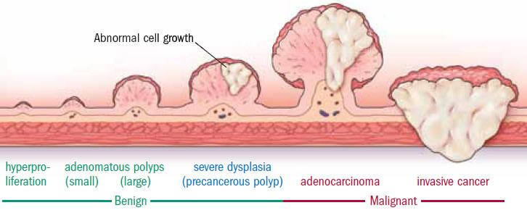
Adenomas
Sarver 4/30/15
Notes:
Adenocarcinomas
Stats on development into cancer

Slide 4
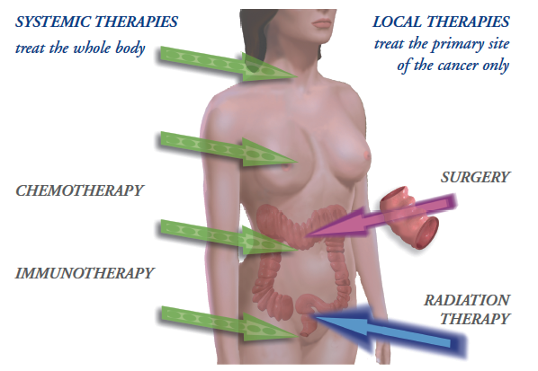
Treatment
Sarver 4/30/15
Notes:
Surgery
Chemotherapy
EGFR & VEGF Inhibitors

Slide 5
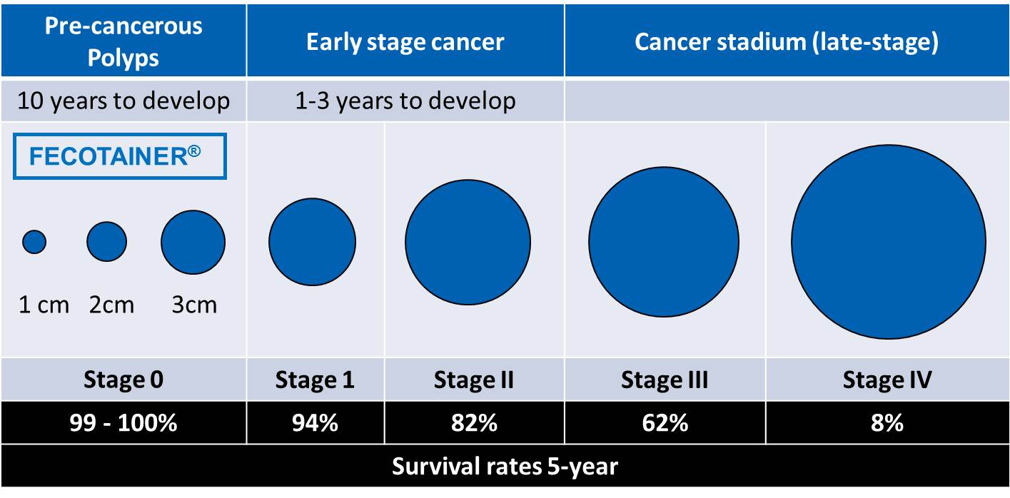
Prevention
Sarver 4/30/15
Notes:
Colonoscopy
Stats on not getting screened
Importance of catching early

Slide 6
Prevention
PAHs
Sarver 4/30/15
Notes:
PAH’s, sources, etc

Slide 7
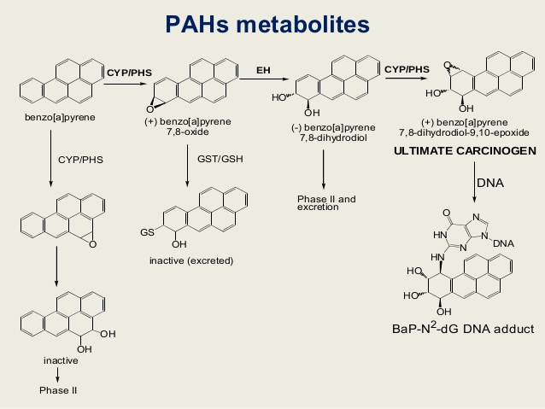
Sarver 4/30/15
Notes:
Complete carcinogens
Initiators/tumor promotion
Metabolism of pahs for excretion or into diol epoxides

Slide 8
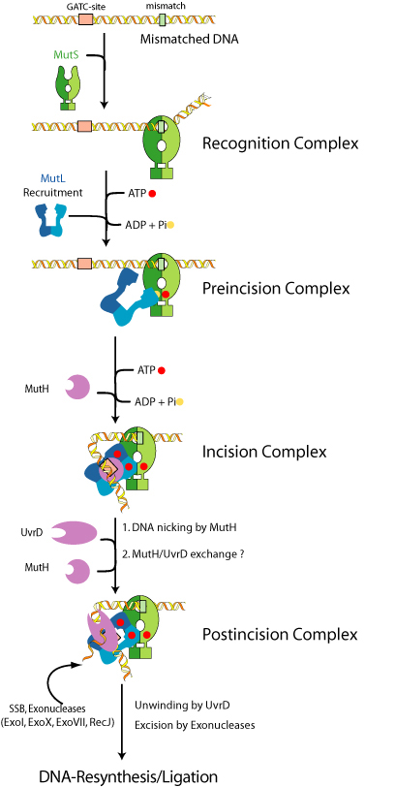
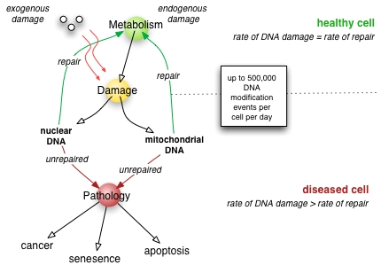
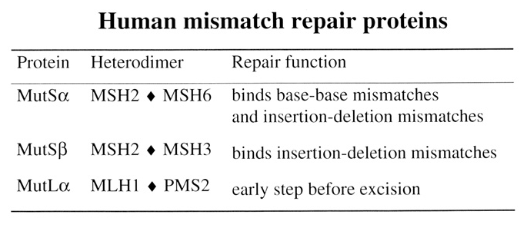
Prevention
Sarver 4/30/15
Notes:
How body repairs damage... Intro to MMR... Overview of MMR

Slide 9
Genetic Factors
Familial Adenomatous Polyposis (FAP)
Hereditary Non-Polyposis Colorectal Cancer (HNPCC/Lynch Syndrome)
Mutation in ACP
Chromosome 5q21
Mutation type- varies
Tumor location –varies
Retinal, desmoid, mandibular
Hundreds – thousands of colorectal adenomas
20’s and 30’s
Mutations in MMR genes
MSH2 60%
MLH1 30%
PMS1 5%
PMS2 5%
Cannot detect/correct DNA mismatches
Indicator – Microsatellite Instability
90% of patients exibit inactivating mutations in RII (Tumor growth factor β)
Tumor suppressor gene in colon cells
Sarver 4/30/15
Notes:
Colonoscopy
Stats on not getting screened
Importance of catching early

Slide 10
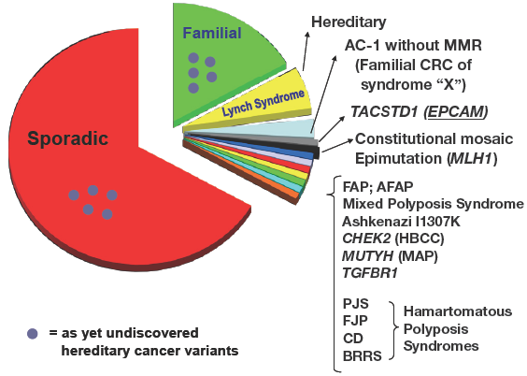
Sporadic
Sarver 4/30/15
Notes:
Sporadic – does increase in individuals with family history
No obvious pattern of inheritance could be attributed
Some from hypermethylation of MLH1

Slide 11
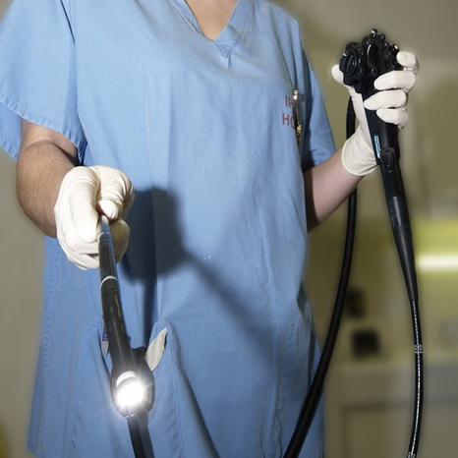
Cancer Risk
Everyone is Different
Identification of High-Risk Individuals
Environmental Exposures + Individual Genetics
How body responds to exposures
Biological pathways
Variation in pathways
How this changes exposures
Sarver 4/30/15
Notes:
Identification of high-risk individuals for early testing/lifestyle choices, etc.

Slide 12
Question
What is the extent to which environmental carcinogens, such as PAHs, interact with specific MMR deficiencies to increase the accumulation of mutations, and therefore the risk of cancer?
Sarver 4/30/15

Slide 13
Past Methods
Cellular response to methylating agents
Spontaneous Mutation Rate of HPRT
Microsatellite Instability
Used MMR-Deficient Cells → inherently cancerous → high spontaneous mutation rate → variable changes
Sarver 4/30/15

Slide 14
Objective
Used MMR-Deficient Cells → inherently cancerous → high spontaneous mutation rate → variable changes
Used MMR-Proficient Cells → alter to disrupt MMR→ low spontaneous mutation rate → measurable changes
Notes:
Problems with past studies... How mine is different

Slide 15
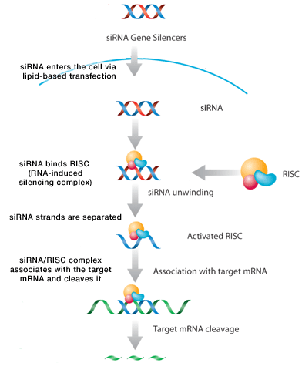
siRNA
21-23 nt
Lipid based-transfection
Selective silencing of genes
Sarver 4/30/15

Slide 16
Overall Hypothesis
By starting with MMR-proficient cells and transfection the cells with siRNA, I could limit the expression of specific MMR proteins resulting in a disruption of MMR activity.
Sarver 4/30/15

Slide 17
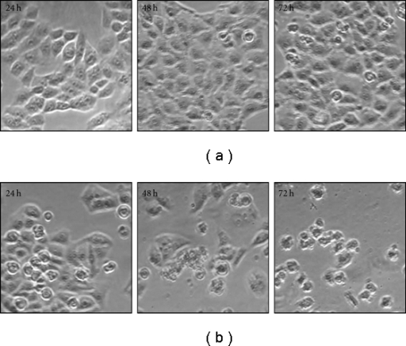
Step 1: Plating Density
Image adapted from: http://www.google.com/imgres?imgurl=http://openi.nlm.nih.gov/imgs/512/314/3159392/3159392_ECAM2011-427031.004.png&imgrefurl=http://openi.nlm.nih.gov/detailedresult.php?img%3D3159392_ECAM2011-427031.004%26req%3D4&h=437&w=512&tbnid=Vs4GpdgXa9zioM:&zoom=1&docid=7tuVOoh11cEnVM&ei=IjJAVfalHYXwoASQsYG4AQ&tbm=isch&ved=0CCcQMygJMAk
Sarver 4/30/15
Notes:
Plating density importance for siRNA.... Examples of confluency

Slide 18
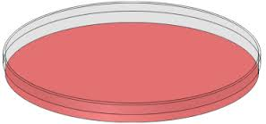
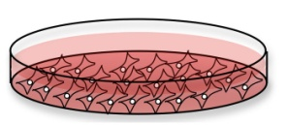
Step 1: Plating Density
Plated Cells
100,000 cells
150,000 cells
200,000 cells
250,000 cells
Observe for 1 Week
Low density
Confluent at approximately 2 days
Over-confluent at 2 days
Over-confluent at 1 day
Conclusions
Sarver 4/30/15
Notes:
Plating density experiment... Methods and results/conclusions

Slide 19
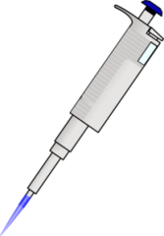
Step 2: siRNA Transfection
Plated Cells
(150,000)
24 hr Recovery
siRNA transfection
Anti-MLH1
Anti-MSH2
Allstars Negative
Untransfected
Growth
Harvest
Flow Cytometry
Whole Cell Lysates
Immunoblotting
Sarver 4/30/15

Slide 20
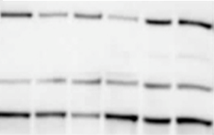
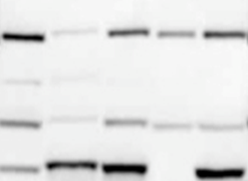
A
24 Hrs
48 Hrs
Controls
MW
(kDa)
MW Marker
U
N
M1
M2
U
N
M1
M2
H
HK
H3
150
100
75
MSH6
MSH2
MLH1
1 2 3 4 5 6
7 8 9 10 11
B
C
Sarver 4/30/15

Slide 21
A
24 Hrs
48 Hrs
72 Hrs
96 Hrs
Controls
MW
(kDa)
MW Marker
150
100
75
M2
N
U
M2
N
U
M2
N
U
M2
N
U
H
HK
H3
MSH6
MSH2
MLH1
1 2 3
4 5 6
7 8 9
10 11 12
13 14 15
B
C
Sarver 4/30/15

Slide 22
Step 4: MMR-Dependent Cytotoxic Response
siRNA Transfection
Anti-MSH2 siRNA
Allstars Negative siRNA
Untransfected
Plated Cells
(500 cells)
(Overnight
Recovery)
24h
48h
72h
96h
24h
48h
72h
96h
24h
48h
72h
96h
0 nM
0 nM
0 nM
6-TG Dose
0.1 nM
0.1 nM
0.1 nM
0.3 nM
0.3 nM
0.3 nM
1.0 nM
1.0 nM
1.0 nM
3.0 nM
3.0 nM
3.0 nM
Growth (12-14 Days)
Fix, Stain, Count
Sarver 4/30/15

Slide 23
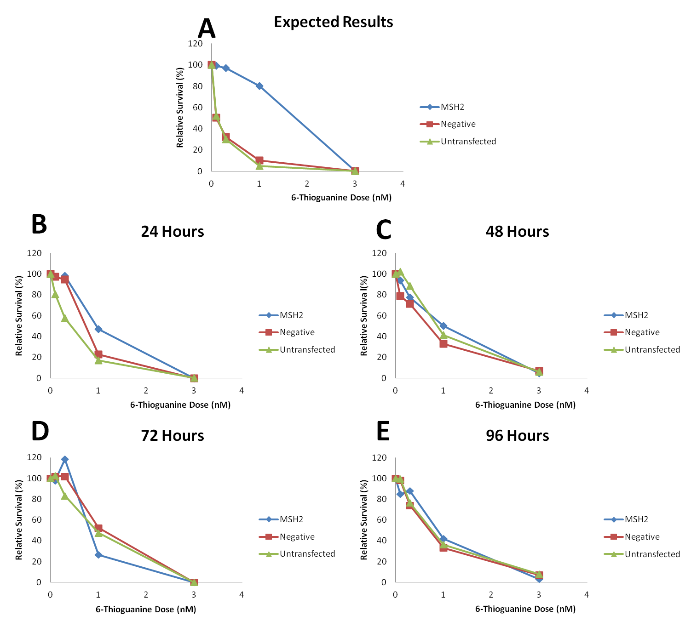
Sarver 4/30/15

Slide 24
Summary
Original Hypothesis – Partially Supported
siRNA effective for reducing levels of MSH2, MSH6 and MLH1
Hypothesize the MMR activity IS reduced, issues with assay
Future Plans...
Optimize transfection to increase protein inhibition
Refine functional assays to measure MMR activity

Slide 25
Acknowledgements
Family and Friends
Dr. Andrew Buermeyer
Dr. Kate Field
Dr. Dave Stone
Dr. Kevin Ahern and Howard Hughes Medical Institute
Wanda Crannell

Slide 26
Image Sources
http://www.ccalliance.org/colorectal_cancer/statistics.html
http://www.google.com/imgres?imgurl=http://visualizing.org/sites/default/files/imagecache/embedded_vis_medium/images/cancer-facts-the-killer-654x1024.jpg&imgrefurl=
http://visualizing.org/visualizations/cancer-facts-%25E2%2580%2593-killer&h=600&w=944&tbnid=duPC-uyk3liH5M:&zoom=1&docid=v-D2Ur0rEEfl3M&ei=qaA-VZTcCYfzoASDu4CQDw&tbm=isch&ved=0CCkQMygMMAw
https://www.ndhealthfacts.org/wiki/images/4/44/Colon_cancer.jpg
http://adkblog.s3.amazonaws.com/wp-content/uploads/2014/02/Progression-of-colon-polyp.jpg
http://www.google.com/imgres?imgurl=http://beasurvivor-colorectal.com/wp-content/uploads/2013/01/TREATMENT-CHOICES.png&imgrefurl=http://beasurvivor-colorectal.com/treatment-options-for-colorectal-cancer/&h=413&w=598&tbnid=Hn9lnBTux-ap6M:&zoom=1&docid=dDF33a0P_wZQ5M&ei=P6o-VbXwEcbGogTb84G4BQ&tbm=isch&ved=0CCYQMygKMAo
http://www.screeningforlife.ca/colorectalcancer
http://www.fecotainer.eu/Static/Images/UserUpload/ColonCancerScreening.jpg
http://beerandwinejournal.com/wp-content/uploads/2014/03/800px-Benzo-a-pyrene.svg_.png
http://thumbs.dreamstime.com/x/gravel-road-farmland-montana-usa-21070643.jpg
http://www.google.com/imgres?imgurl=http://www.cityam.com/sites/default/files/main/articles/Pictures-Of-Smokers.jpg&imgrefurl=http://www.cityam.com/1412186869/stoptober-five-ways-kick-your-smoking-habit&h=729&w=1100&tbnid=Ro6TQqkjlILpbM:&zoom=1&docid=I7GvzlpzaPW_-M&ei=H60-VaSZJJHToAToyoGQDQ&tbm=isch&ved=0CB4QMygCMAI
http://www.google.com/imgres?imgurl=http://www.ratingdietplans.com/wp-content/uploads/2013/11/grilled-food.jpg&imgrefurl=http://pixshark.com/grilled-food-recipes.htm&h=310&w=413&tbnid=-elh2mNImjpgQM:&zoom=1&docid=c5corpucNC71iM&ei=GK0-VZzaK4O7ogSZ4oDwDQ&tbm=isch&ved=0CDgQMygHMAc
http://static1.businessinsider.com/image/53b84baa6bb3f7021aa6ba2c-480/coal-roller.jpg
http://image.slidesharecdn.com/xenobioticsandcytp450bydrrajender-150224103837-conversion-gate01/95/xenobiotics-and-cyt-p450-by-dr-rajender-59-638.jpg?cb=1424796361
http://upload.wikimedia.org/wikipedia/commons/0/09/Dnarepair1.png
http://www.mm2m.eu/general/perspective1a.jpg
http://www.google.com/imgres?imgurl=http://cmgm.stanford.edu/biochem201/Slides/DNA%252520Repair/25%252520Human%252520mismatch%252520repair%252520pr.JPG&imgrefurl=http://cmgm.stanford.edu/biochem201/Slides/DNA%2520Repair/&h=507&w=763&tbnid=ouiMhJK_KgGX0M:&zoom=1&docid=T_bjKGsanfdbMM&ei=wNs-VaCeM4-oogStpICYDQ&tbm=isch&ved=0CCIQMygGMAY
http://www.google.com/imgres?imgurl=http://www.thecco.net/article/viewFile/1747/3043/8376&imgrefurl=http://www.thecco.net/article/view/1747/3043&h=402&w=564&tbnid=w7MSpSdG6BYfRM:&zoom=1&docid=aJAhr2UZUpZ_sM&ei=1eA-VeGVIpe3ogTBvIAw&tbm=isch&ved=0CCAQMygBMAE
http://www.google.com/imgres?imgurl=https://edc2.healthtap.com/ht-staging/user_answer/reference_image/15760/large/Carcinogen.jpeg%253F1386669661&imgrefurl=https://www.healthtap.com/topics/ethidium-bromide-carcinogen&h=402&w=600&tbnid=RAw80fdZ9SB7pM:&zoom=1&docid=o4suWb3ZYuhT4M&ei=fuI-Vc_KHYHaoATYmYC4BQ&tbm=isch&ved=0CIMBEDMoSjBK
http://geneticsawareness.org/documents/iStock_000002163295Medium.jpg
http://www.google.com/imgres?imgurl=http://kochealth.com/images/PatientComplaintHandlingSoftware1.jpg&imgrefurl=http://kochealth.com/e.php?e%3D30_patient-information&h=2427&w=3650&tbnid=YfVorABDMKs4sM:&zoom=1&docid=56CvzXceXEliOM&ei=7eI-VauKEYKtogTCh4CADw&tbm=isch&ved=0CFAQMygXMBc
http://socialportal.ballywhointeractive.com/images/uploads/Female%20patient%20doctor%285%29.jpg
http://www.thehealthage.com/site/wp-content/uploads/2011/02/woman-eating-red-meat.gif
http://www.pulsetoday.co.uk/Pictures/web/q/a/y/endoscopy_screening_investigation_bowel_cancer__PPL.jpg
http://www.clker.com/cliparts/7/d/x/J/L/9/red-petri-dish.svg
http://www.google.com/imgres?imgurl=http://www.clker.com/cliparts/A/5/U/g/i/U/pipette-with-tip-md.png&imgrefurl=http://www.clker.com/clipart-pipette-with-tip.html&h=297&w=207&tbnid=iieWb0UD9C2sZM:&zoom=1&docid=z6plTMdj3yqzrM&ei=LC5AVZTzHI6zogSEqICQDg&tbm=isch&ved=0CDEQMygAMAA
http://www.google.com/imgres?imgurl=http://www.nature.com/scitable/content/ne0000/ne0000/ne0000/ne0000/14264811/chow_fig1_1_2.jpg&imgrefurl=http://www.nature.com/scitable/content/cells-growing-in-a-tissue-culture-14264811&h=306&w=700&tbnid=GZnOhXI-jtkq-M:&zoom=1&docid=3-ITlmwNXWH8GM&ei=ny5AVZviIIerogTW0YHwCg&tbm=isch&ved=0CCkQMygAMAA
http://www.google.com/imgres?imgurl=http://openi.nlm.nih.gov/imgs/512/314/3159392/3159392_ECAM2011-427031.004.png&imgrefurl=http://openi.nlm.nih.gov/detailedresult.php?img%3D3159392_ECAM2011-427031.004%26req%3D4&h=437&w=512&tbnid=Vs4GpdgXa9zioM:&zoom=1&docid=7tuVOoh11cEnVM&ei=IjJAVfalHYXwoASQsYG4AQ&tbm=isch&ved=0CCcQMygJMAk
Sarver 4/30/15

Slide 27
References
Baird, William M., Louisa A. Hooven, and Brinda Mahadevan. 2005. “Carcinogenic Polycyclic Aromatic Hydrocarbon-DNA Adducts and Mechanism of Action.” Environmental and Molecular Mutagenesis 45 (2-3): 106–14. doi:10.1002/em.20095.
Bishehsari, Faraz. 2014. “Epidemiological Transition of Colorectal Cancer in Developing Countries: Environmental Factors, Molecular Pathways, and Opportunities for Prevention.” World Journal of Gastroenterology 20 (20): 6055. doi:10.3748/wjg.v20.i20.6055.
Gabrieli, Jacopo, Paul Vallelonga, Giulio Cozzi, Paolo Gabrielli, Andrea Gambaro, Michael Sigl, Fabio Decet, et al. 2010. “Post 17th-Century Changes of European PAH Emissions Recorded in High-Altitude Alpine Snow and Ice.” Environmental Science & Technology 44 (9): 3260–66.
Hernandez-Pigeon, Hélène, Guy Laurent, Odile Humbert, Bernard Salles, and Dominique Lautier. 2004. “Degadration of Mismatch Repair hMutSα Heterodimer by the Ubiquitin-Proteasome Pathway.” FEBS Letters 562 (1-3): 40–44. doi:10.1016/S0014-5793(04)00181-4.
Jasperson, Kory W., Thérèse M. Tuohy, Deborah W. Neklason, and Randall W. Burt. 2010. “Hereditary and Familial Colon Cancer.” Gastroenterology 138 (6): 2044–58. doi:10.1053/j.gastro.2010.01.054.
Jiricny, Josef. 2006. “The Multifaceted Mismatch-Repair System.” Nature Reviews Molecular Cell Biology 7 (5): 335–46. doi:10.1038/nrm1907.
Kinzler, Kenneth W., and Bert Vogelstein. 1996. “Lessons from Hereditary Colorectal Cancer.” Cell 87 (2): 159–70.
López-Abente, Gonzalo, Javier García-Pérez, Pablo Fernández-Navarro, Elena Boldo, and Rebeca Ramis. 2012. “Colorectal Cancer Mortality and Industrial Pollution in Spain.” BMC Public Health 12 (1): 589.
Mathews, Lesley A., Stephanie M. Cabarcas, and Elaine M. Hurt. 2012. “DNA Repair of Cancer Stem Cells.” In DNA Repair of Cancer Stem Cells, 25–26. Dordrecht : Springer.
Midgley, R, and D Kerr. 1999. “Colorectal Cancer.” The Lancet 353 (9150): 391–99.
Phillips, David H. 1999. “Polycyclic Aromatic Hydrocarbons in the Diet.” Genetic Toxicology and Environmental Mutagenesis, Mutation Research, 443 (February): 139–47.
Rasmussen, Lene Juel, Christopher D. Heinen, Brigette Pokora-Royer, Mark Drost, Sean Tavtigian, Robert M.W. Hofstra, and Niels de Wind. 2012. “Pathological Assessment of Mismatch Repair Gene Variants in Lynch Syndrome: Past, Present, and Future.” Human Mutation 33 (12): 1617–25.
Schütze, N. 2004. “siRNA Technology.” Molecular and Cellular Endocrinology 213 (2): 115–19. doi:10.1016/j.mce.2003.10.078.
Shimada, Tsutomu. 2006. “Xenobiotic-Metabolizing Enzymes Involved in Activation and Detoxification of Carcinogenic Polycyclic Aromatic Hydrocarbons.” Drug Metabolism and Pharmacokinetics 21 (4): 257–76.
Siegel, Rebecca, and Ahmedin Jemal. 2014. “Facts & Figures 2014-2016.” http://yourhealthmatters.org/resources/Health%20Care%20Providers/ACS%20Colorectal%20Cancer%20Facts%26Figures%202014-2016.pdf.
Sinha, R. 2005. “Dietary Benzo[a]Pyrene Intake and Risk of Colorectal Adenoma.” Cancer Epidemiology Biomarkers & Prevention 14 (8): 2030–34. doi:10.1158/1055-9965.EPI-04-0854.
Whitehead, Kathryn A., Robert Langer, and Daniel G. Anderson. 2009. “Knocking down Barriers: Advances in siRNA Delivery.” Nature Reviews Drug Discovery 8 (2): 129–38. doi:10.1038/nrd2742.
Sarver 4/30/15

Slide 28
Questions?
Thanks for Watching!
Sarver 4/30/15

